Slide 1
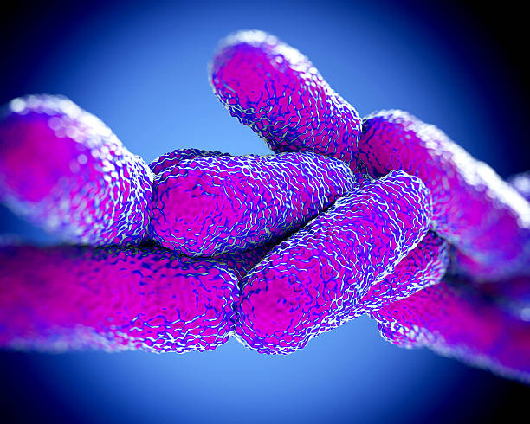
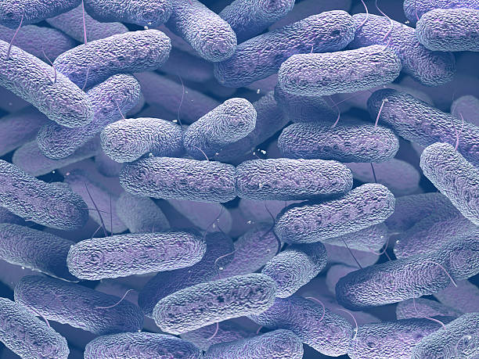
BactiVision
R-8-23-2
Amit Shitrit 205725385
Cyrine Salame 319009064
Supervisor: Zeev Frenkel
Notes:
Hello my name is *** my partner is *** Today we will present our project A CNN-Powered method to help in parasite bacterial identification so lets begin ☺

Slide 2
About Us
01.
Problem Definition Introduction
Table of
Contents
Background
02.
Microbiology
Back & Front
03.
U-Net Architecture GUI Diagrams
04.
Thanks
Questions
Thanks
Notes:
As you can see we are going to talk about the problem, the solution,
a general scientific background and a general background on the U-Net architecture.
In addition to that we will show a short video of the gui, we will leave time for questions and that's it

Slide 3

01.
About us
Problem Definition && Introduction

Slide 4
Problem Definition
-Over 10K Different Type Of Bacteria
-Many Methods to identify The Bacteria
-Limited Workforce
-Process Takes Lot Of Time
Notes:
Today there are thousands of types of bacteria, and the identification process is
becoming more difficult from moment to moment, in addition to
this the professional and medical workforce is not able to cope with the work pressure,
therefore, a fast and efficient system is needed to help meet these needs.

Slide 5
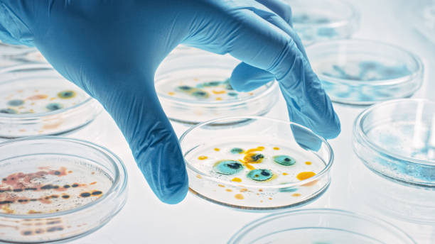
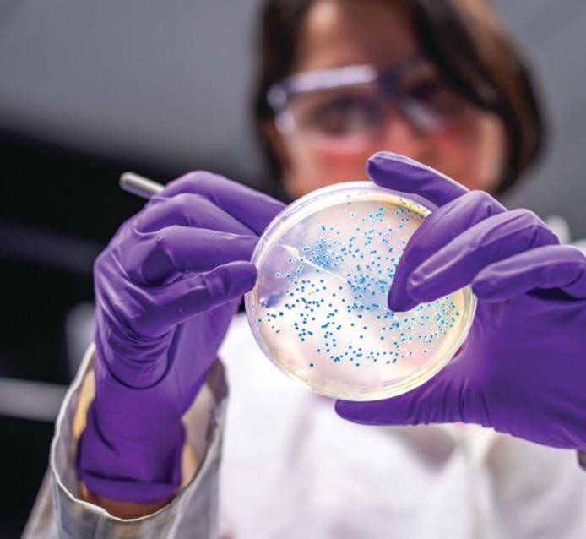
Mission
Vision
Prototype with 70% Correct Prediction
Complete Software
Notes:
Our vision is a system that will know how to classify all bacteria known to humans in over 95 percent.

Slide 6
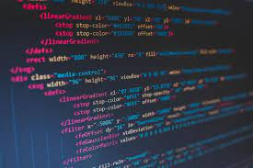
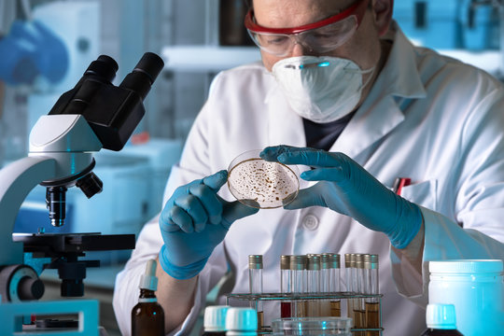
The Idea
What we do?
-A Machine Learning Based System
-Use U-Net Architecture
-Optimal Prediction Ability
Notes:
Our idea is a machine learning based system that uses the U-net architecture which is known for its ability to handle images with tiny objects
In addition to this, the system will include an easy-to-use gui that includes a registration/login interface with privacy protection,
fortheremore, the user will have the option to read articles about new bacteria that have recently been discovered and a variety of other actions
Our request is to get a microscope picture and basically say what type of bacteria it is, what family it comes from and what are the ways to treat it.

Slide 7
Development Process
Literature Review
Microbiology, Bacterial, Gram Stain, Identify Methods
Data Collection
DataSet Of Bacterial Samples
Data Pre-processing
Resizable, Tag, Organize, Normalizing
Software Development
Front & Back include U-Net Architecture
Software Testing
We Will Test it on Pre-processed Dataset
Notes:
We will first study the subject in depth , fields like ..
The second step is to collect the data set images of Bacterial Samples
Next step is Pre-processing we will Organize the images with labels
In this step we will implements the front and back software include the U-net architecture
In last step we will test the software on the data set that’s we collect in second step.

Slide 8
02.
Background
Microbiology && Mathematical

Slide 9
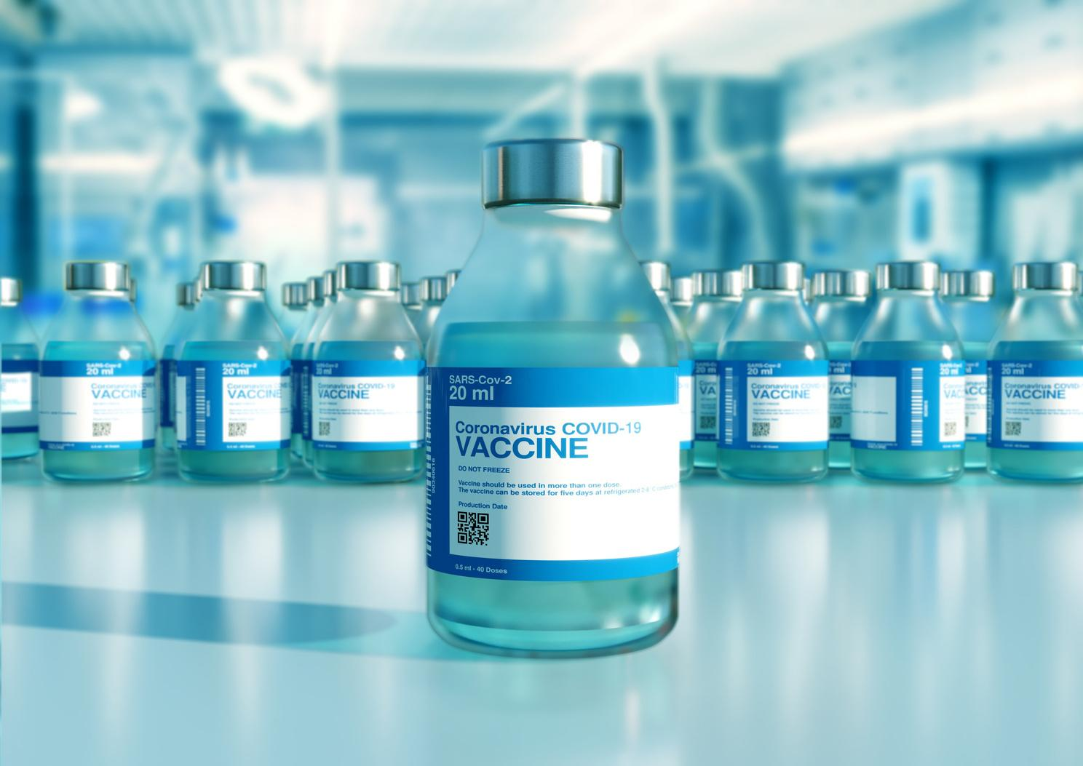
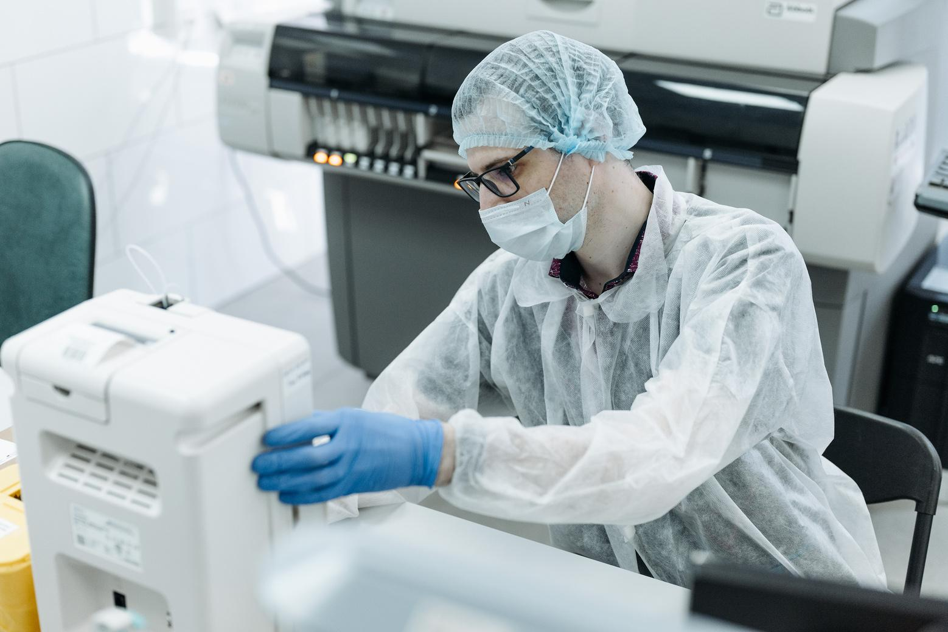
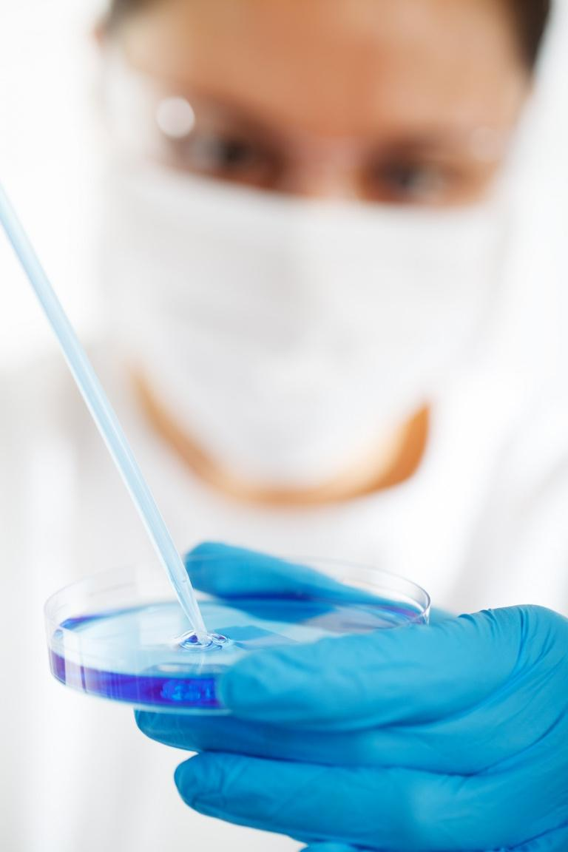
Bacterial
They are Single-celled microorganisms. They are characterized by their prokaryotic cellular structure.
Bacterial are among the first creatures to appear on Earth
Notes:
Read from the presentation

Slide 10
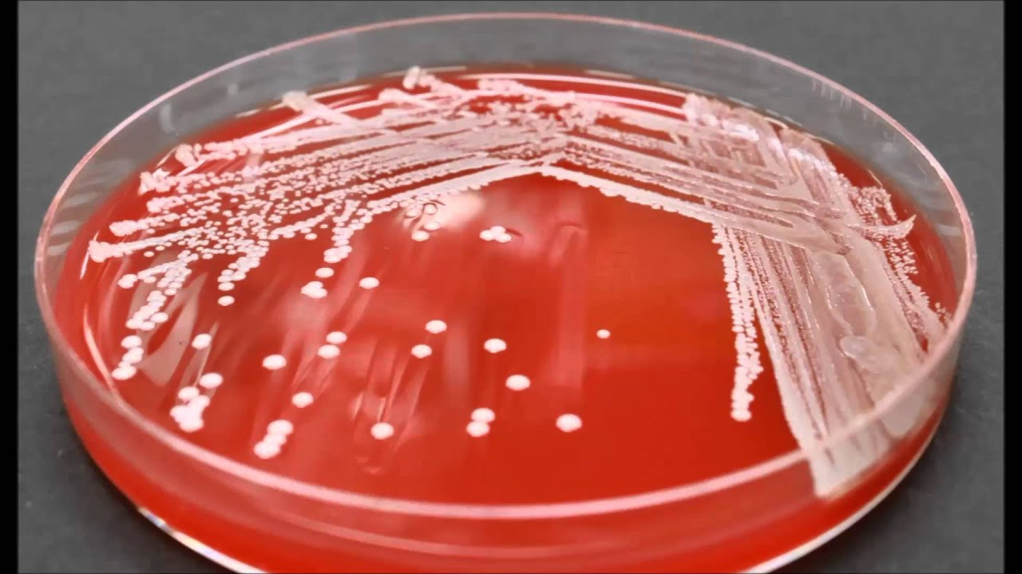
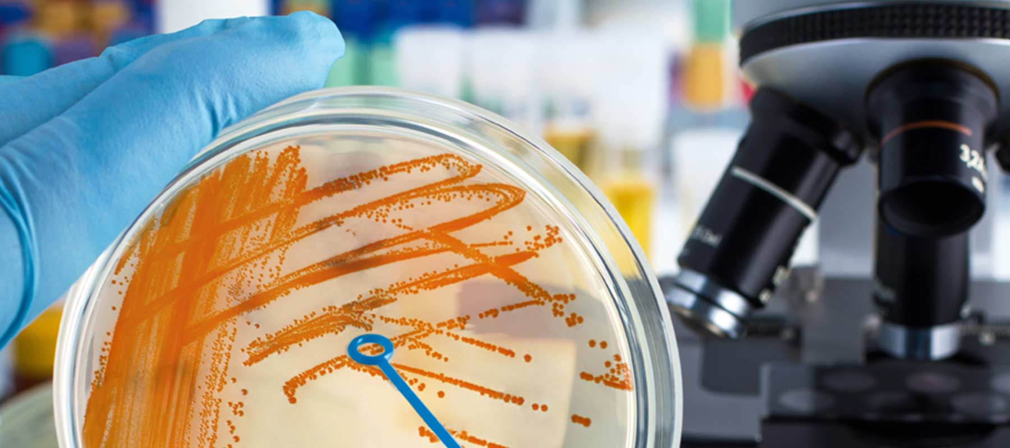
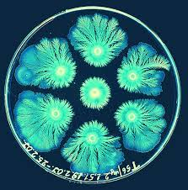
Colony Of Bacterial
Allows researchers to study their growth characteristics, such as colony size,
shape, and color.
provides a macroscopic view of bacterial growth patterns.
By counting the density of the colony, it is possible to estimate the size of the sample we will have to select to optimize the accuracy percentages.
Notes:
Now we talk about the Advantages of colony of bacterial in identification Read from the presentation

Slide 11
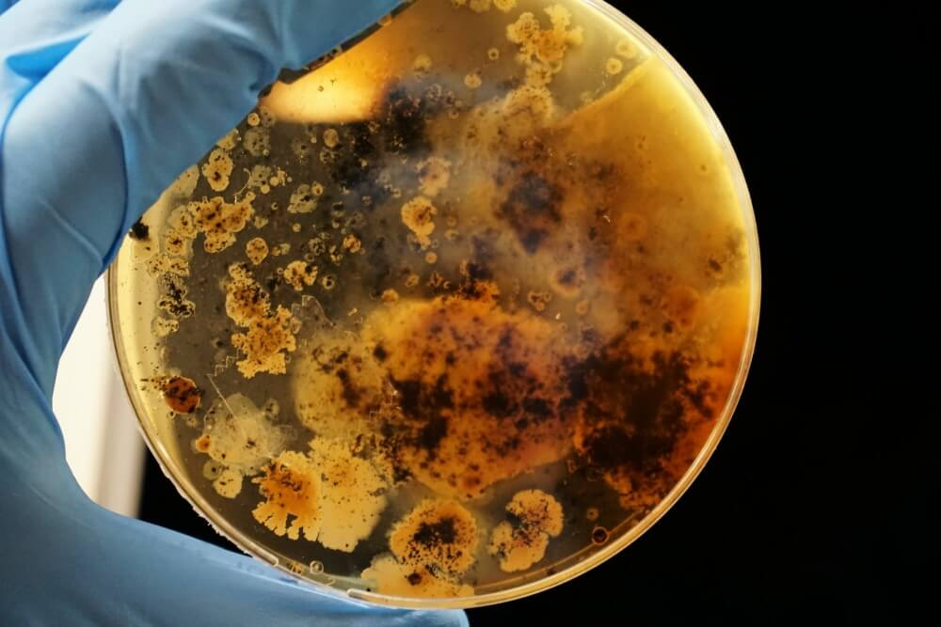
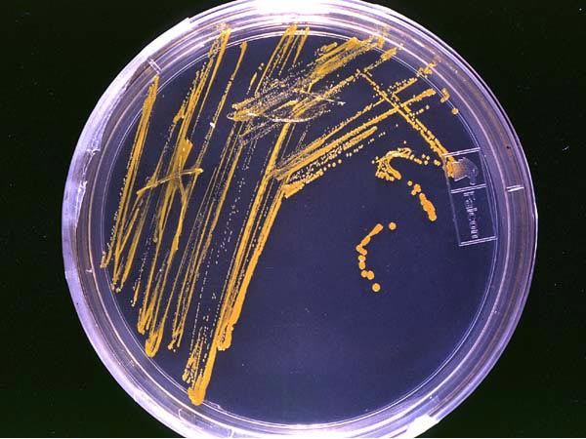
a colony of bacteria
a picture is worth a thousand words

Slide 12
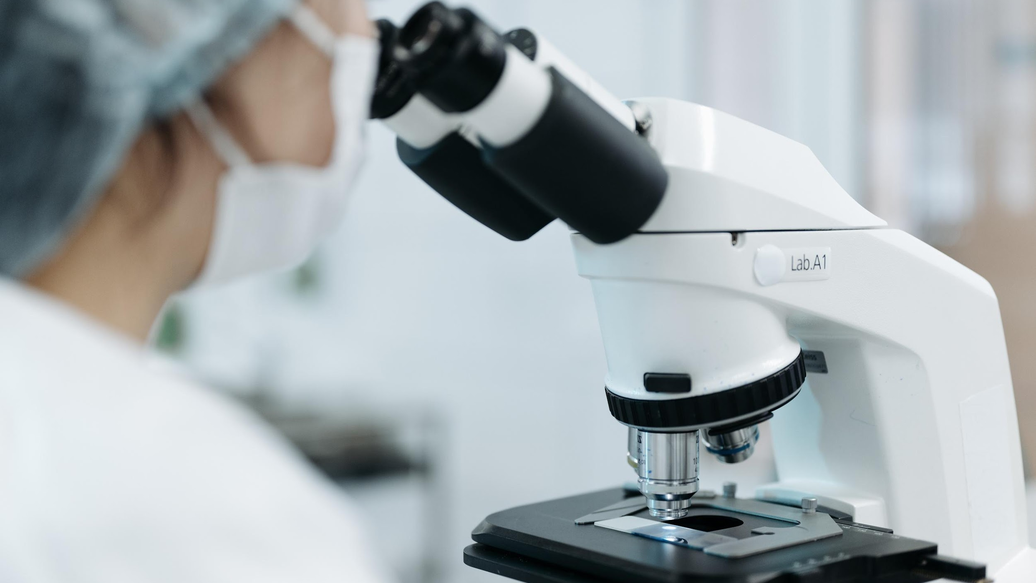
Identify Methods
Observing the physical and biochemical characteristics of bacterial cells.
Phenotypic Method
Use antibodies to identify specific bacterial antigens.
Immunological Method
use DNA or RNA Sequencing to identify bacteria at the genetic level.
Molecular methods
Notes:
The phenotypic method is an approach in biological research that focuses on observing and measuring the observable physical and
biochemical characteristics of organisms. It helps researchers understand how traits are inherited,
identify genes associated with traits or diseases and study the interaction between genes and the environment. The immunological method is a scientific approach used to study and analyze the immune system and its response to foreign substances. It involves techniques and assays that detect and measure immune responses, such as the production of antibodies or activation of immune cells. The immunological method helps researchers understand how the immune system functions, identify and characterize specific immune molecules, and develop diagnostic tests and treatments for diseases related to immune dysfunction. Molecular methods refer to a collection of techniques used in biological and medical research to study and manipulate molecules, such as DNA, RNA, proteins, and other cellular components. These methods involve the analysis, manipulation, and detection of molecules at the molecular level

Slide 13
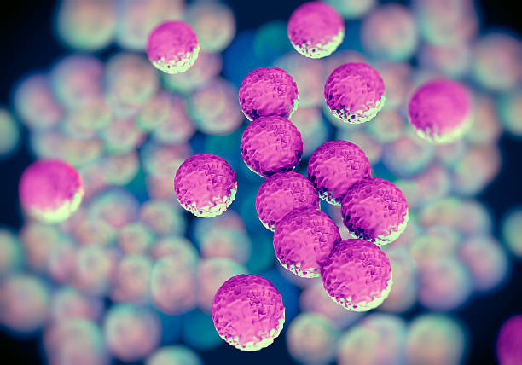
Differences between the methods
Predict | Cost | Time
70%-90% | 5$-50$ | Several days to weeks | Phenotypic Methods
80%-96% | 50$-150$ | Few hours to Day | Immunological Methods
95%-99.9% | 50$-250$ | Few hours to Day | Molecular methods
Notes:
Our software will only accept the image after gram staining, the cheap and simple part of this method,
and then it will go through our software,
which will result in a considerable cost reduction and time saving.
All the methods of Phenotypic in a Gram stain (the cheapest part ) ,they extract a microscope image then our software will receive it as input

Slide 14
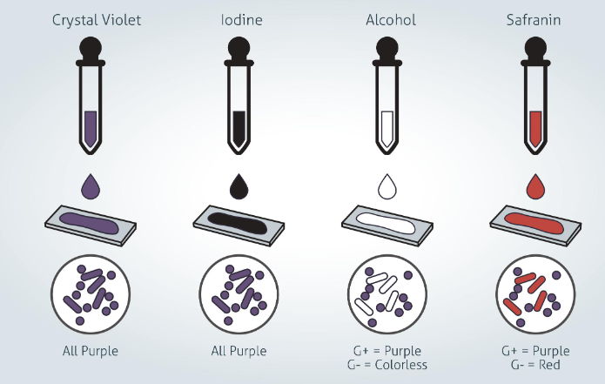
Gram Stain
Staining bacterial cells with crystal violet and iodine
Gram Staining
-Thick peptidoglycan in cell wall
-Crystal Violate color after staining
Gram Positive
-Thinner peptidoglycan in cell wall
-Pink or Red Color After staining
Gram Negative
Notes:
Gram staining is a phenotypic method that involves staining bacterial cells with crystal violet and iodine,
followed by decolorization with alcohol and counterstaining with safranin.
This method is used to distinguish between Gram-positive and Gram-negative bacteria based on differences in the composition of their cell walls.
Gram-positive bacteria retain the crystal violet stain, appearing purple, while Gram-negative bacteria lose the stain and appear pink/red with the counterstain.
It can be concluded from this that if the color of the bacteria after staining is purple then it is positive and is more resistant to drug treatment. And if after coloring the color is red or pink, it will be possible to treat it with milder medication.

Slide 15
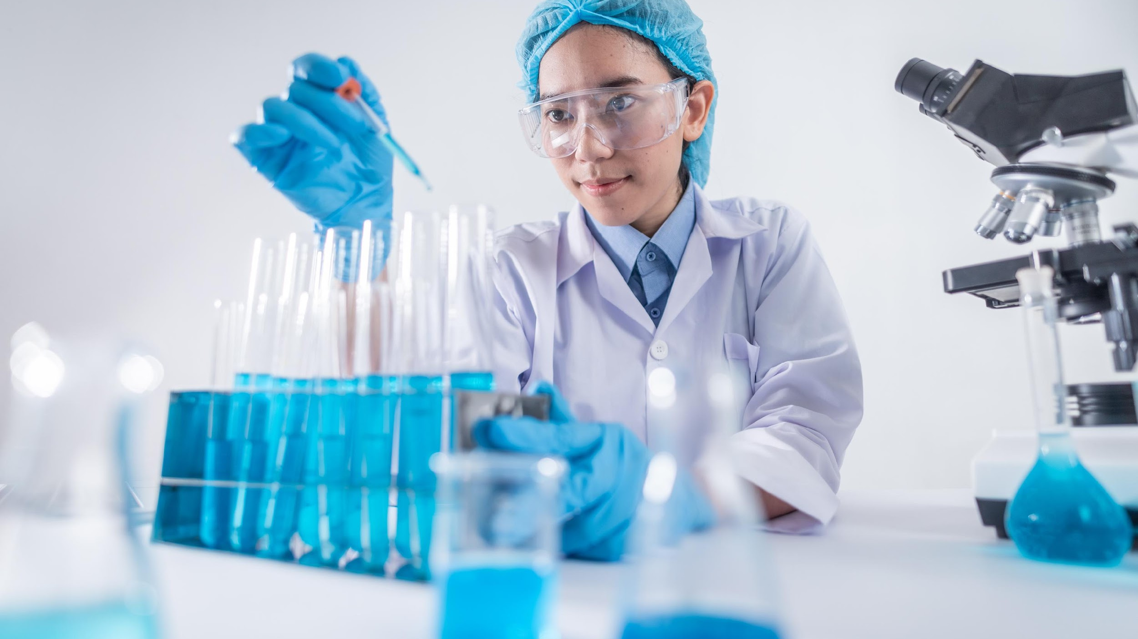
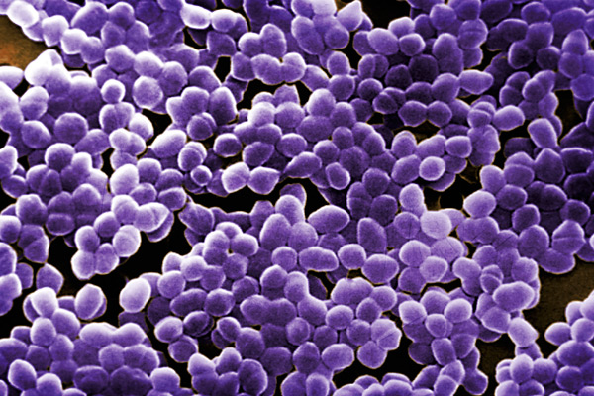
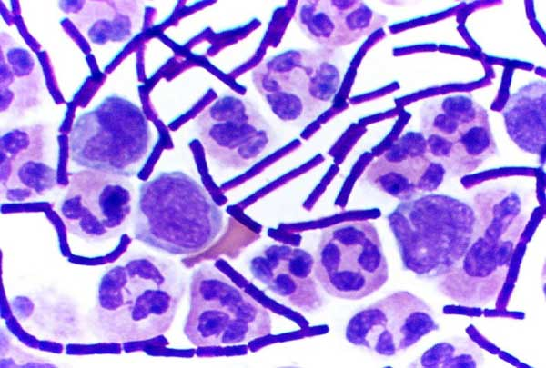
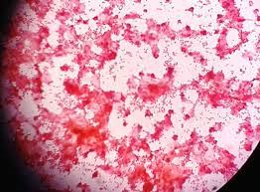
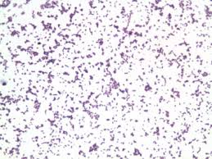
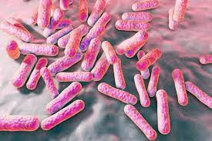
Gram Positive Vs
Gram Negative

Slide 16
5 Main Shapes
Cocci-
These are spherical bacteria that can exist singly or in clusters.
Bacilli-
These are rod-shaped bacteria that can be found singly or in chains.
These are spiral-shaped bacteria that can be found singly or in chains.
Spirilla-
Vibrio’s-
These are comma-shaped bacteria that are typically found singly.
Spirochetes-
These are corkscrew-shaped bacteria that can be found singly
Notes:
Read from the here

Slide 17
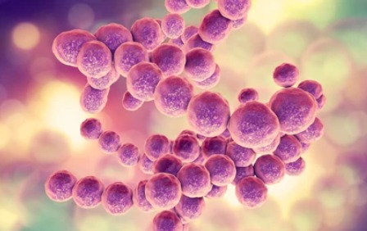
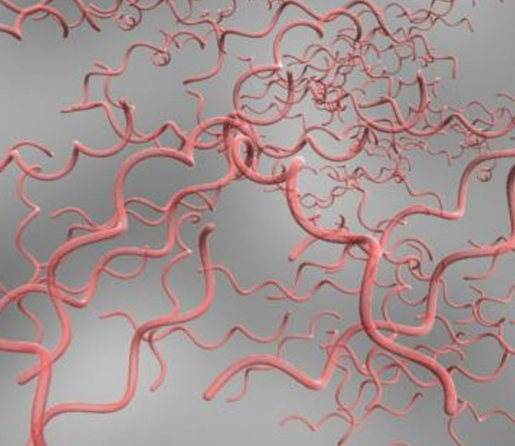
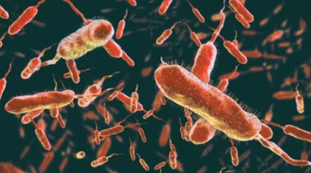
Bacteria Shapes

Slide 18

03.
Software Architecture
Background && U-Net Architecture

Slide 19
Artificial Intelligence
Artificial Intelligence
Is a popular branch of computer science that concerns with building “intelligent” machine capable of performing a human task
Main subjects: machine learning , deep learning NLP, computer vision etc..
Notes:
The main subjects in AI is: Machine Learning, and we talk about it later Deep learning is a subset of machine learning that specifically deals with neural networks consisting of multiple layers.
Natural Language Processing (NLP): NLP involves the interaction between computers and human language.
It encompasses tasks such as language understanding, sentiment analysis, machine translation, and chatbots.
Computer Vision: Computer vision focuses on enabling computers to understand and interpret visual information from images or videos. Of course, there are other methods for example GANs and Reinforcement Learning

Slide 20
Machine Learning
Is a subset of artificial Intelligence that involves training machines to learn from data and improve their performance on specific task without being explicitly programed.

Slide 21
Convolutional Neural Networks (CNNs)
Model commonly used for image and visual data analysis. It is designed to automatically extract and learn relevant features from input images or text through a series of convolutional layers

Slide 22


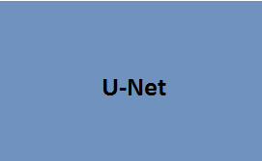
U-Net Input & Output
Learning Segmentation
Input
Output Segmentation map
Notes:
U-Net is a deep learning architecture that is commonly used for image segmentation tasks.
That alogrithem work better with medical image,bacterial images etc..
It was introduced by Olaf Ronneberger, Philipp Fischer, and Thomas Brox in 2015.

Slide 23
4 Stages Of U-Net
Encoder | Bottleneck | Decoder | Output
1 | 2 | 3 | 4
This stage is responsible for capturing context and extracting features from the input image. It consists of several convolutional layers with progressively decreasing spatial dimensions | The bottleneck serves as a bridge between the contracting path and the expanding path. | The expanding path gradually upsamples the learned features to the original input image resolution. | The final stage of the U-Net algorithm is the output layer, which produces the segmentation map or mask segmentation.

Slide 24
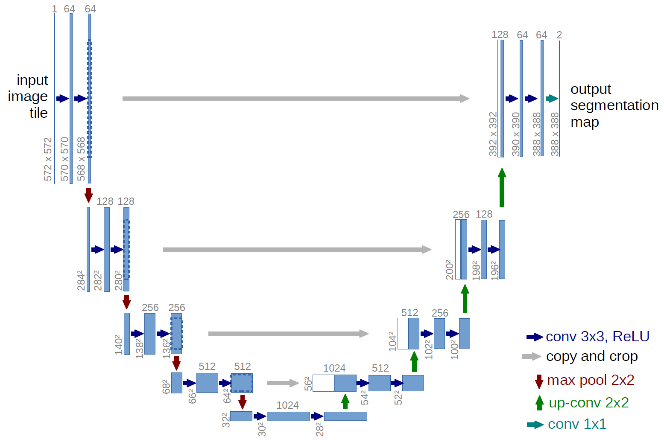
U-Net Architecture Input & Output
Encoder Section
- Increases field of view
Notes:
As we can see here in the first stage of unet we have the number 64
that mean this layer will compute 64 different map features.
The first block on encoder extract low level features for example corners, texture, gradients next step is max pool function in the second blocks we have input of 284*284 and we use 128 filters
And this filters calss high level feture for example roughness, smoothness The number of times of block varies from implementation to implementation

Slide 25
U-Net Architecture Input & Output
Decoder Section
Create High Resolution
Mapping
Notes:
The decoder stage uses the outputs of each block from the same stage in the encoder in
order to recover critical information.
the combination of the encoder input and decoder input improve the accuracy of the output
2 segmentation map results are obtained where each pixel is assigned to one of two classes for example the
background and foreground or in my case bacterial and background.

Slide 26
U-Net Architecture Input & Output
Concatenate with high-resolution feature maps from the Contraction Phase
Notes:
These connections involve concatenating the feature maps from the encoder stage and decoder stage
And we capture both low-level and high-level information. the U-Net model returns a higher quality output because we keep information that could be lost

Slide 27
Video
Of The
GUI

Slide 28
Question?? What is the meaning of life? Will AI take over the world?? Do you feel self-sufficient?
What would you change in your life?

Slide 29
Thank you!

