Slide 1
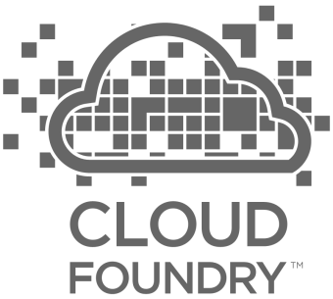
Cloud Foundry Hour of Power
Final Interview Presentation - Pivotal
Amit Gandotra
Notes:
You should never give this presentation to folks who have not seen a basic CF demo. You want to use the push of an app, with a service binding (i.e. spring-music) as the backstory for this deck.
The story line for this deck is:
you’ve seen us deploy and scale and app; we want to show you how it’s done.
This deck is intended to instill confidence in our customers, that they can trust their application to our platform. Cloud foundry is implemented with well understood patterns for distributed, web-based computing that result in extreme scalability and resilience. We know cloud and distributed systems.
We have two main layers:
The part that runs your apps (the elastic runtime)
And a whole ‘nother, kickass system, BOSH, that manages the elastic runtime and services
Let’s see how the elastic runtime deploys your app, supports service bindings and scales your app.
Let’s then see how BOSH deploys clusters, such as the elastic runtime, and services.
BUT that’s not all! Now show that the platform does SO much more than just deploy apps or clusters. → The four levels of HA.
Point out similarity of patterns between the ERS and BOSH. These are some of the patterns for distributed systems. This instills confidence.

Slide 2
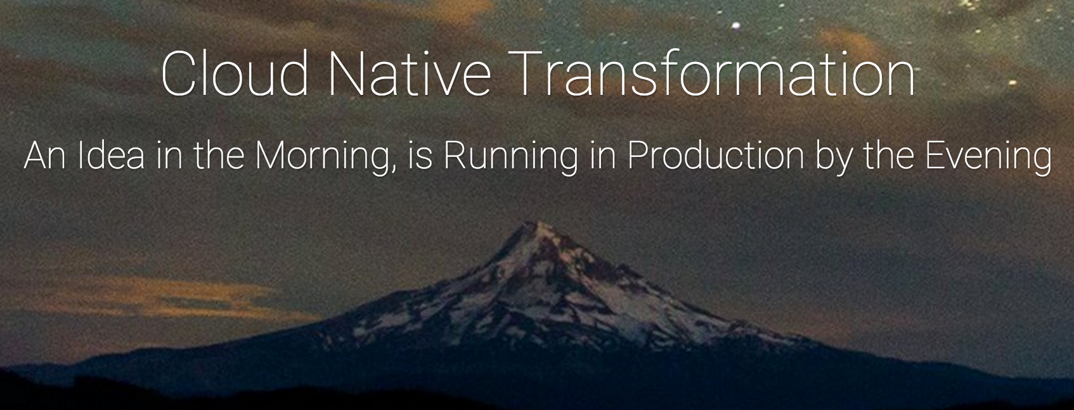
WHY?

Slide 3
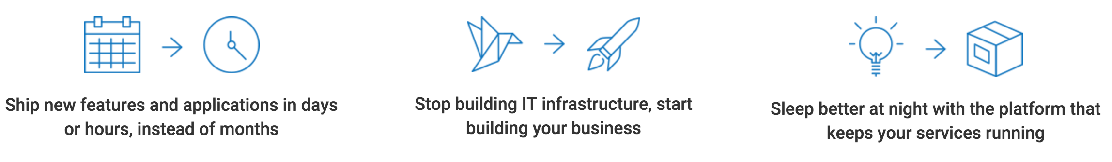
HOW?

Slide 4
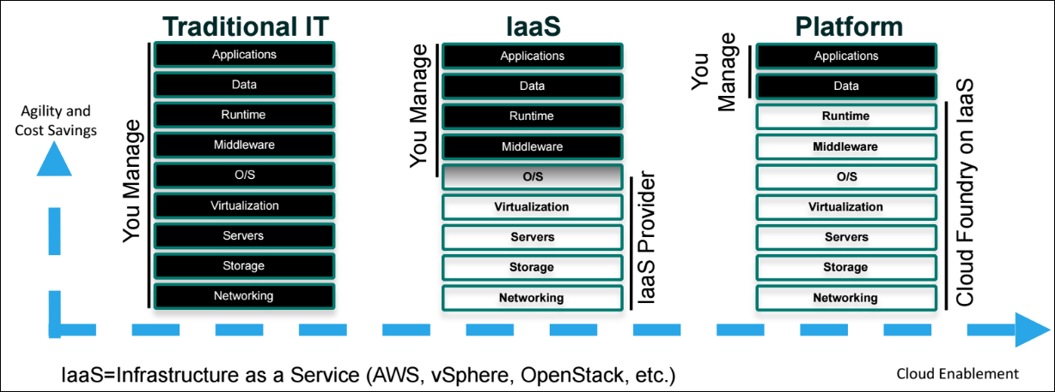
Cloud Foundry on IaaS

Slide 5
CF Platform Runtime

Slide 6
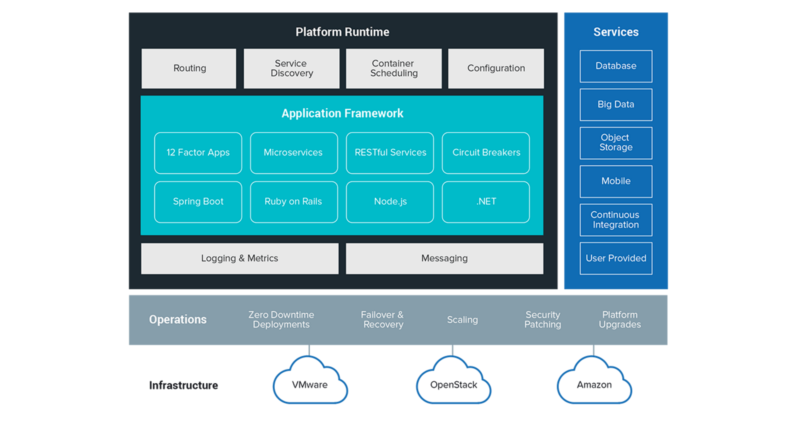
WHAT?

Slide 7
Orgs, Spaces, Roles, and Permissions

Slide 8
An org is a development account that an individual or multiple collaborators can own and use.
A user account represents an individual person within the context of a PCF installation. A user can have different roles in different spaces within an org
Every application and service is scoped to a space. Each org contains at least one space. A space provides users with access to a shared location for application development, deployment, and maintenance
A user can have one or more roles. The combination of these roles defines the user’s overall permissions in the org and within specific spaces in that org.
Notes:
Admin - has permissions on all orgs and spaces
Admin Read-Only - has read-only access to all Cloud Controller API resources.
Global Auditor - has read-only access to all Cloud Controller API resources except for secrets such as environment variables.
Org Managers - are managers who need to administer the org.
Org Auditors - view but cannot edit user information and org quota usage information.
Space Managers - are managers who administer a space within an org.
Space Developers - are application developers who manage applications and services in a space.
Space Auditors - view but cannot edit the space.

Slide 9
MICROSERVICES

Slide 10
Microservices describes a modular approach to building software in which complex applications are composed of several small, independent processes communicating with each other through explicitly defined boundaries using language-agnostic APIs.
These smaller services focus on doing a single task very well.
They are highly decoupled and can scale independently.

Slide 11
12 Factor App
These 12 factors were used as guidelines to help steer development of new applications, as well as to create a scorecard with which to measure existing applications and their suitability for the cloud:
Codebase: One codebase tracked in revision control, many deploys
Dependencies: Explicitly declare and isolate dependencies
Configuration: Store configuration in the environment
Backing Services: Treat backing services as attached resources
Build, release, run: Strictly separate build and run stages
Processes: Execute the app as one or more stateless processes
Port binding: Export services via port binding
Concurrency: Scale out via the process model
Disposability: Maximize robustness with fast startup and graceful shutdown
Dev/prod parity: Keep development, staging, and production as similar as possible
Logs: Treat logs as event streams
Admin processes: Run admin/management tasks as one-off processes

Slide 12
ELASTIC
RUNTIME

Slide 13
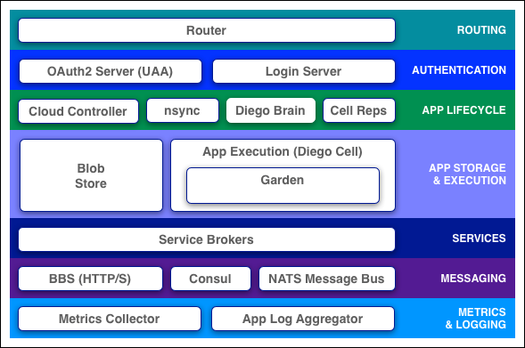
Notes:
The router routes incoming traffic to the appropriate component, either a Cloud Controller component or a hosted application running on a Diego Cell.
The OAuth2 server (the UAA) and Login Server work together to provide identity management.
The Cloud Controller (CC) directs the deployment of applications. To push an app to Cloud Foundry, you target the Cloud Controller. The Cloud Controller then directs the Diego Brain through the CC-Bridge to coordinate individual Diego cells to stage and run applications.
nsync receives a message from the Cloud Controller when the user scales an app. It writes the number of instances into a DesiredLRP structure in the Diego BBS database.
BBS uses its convergence process to monitor the DesiredLRP and ActualLRP values. It launches or kills application instances as appropriate to ensure the ActualLRP count matches the DesiredLRP count.
Cell Rep monitors the containers and provides the ActualLRP value.
The blobstore is a repository for large binary files, which Github cannot easily manage because Github is designed for code. Blobstore binaries include:
Application code packages
Buildpacks
Droplets
Diego Cell
Each application VM has a Diego Cell that executes application start and stop actions locally, manages the VM’s containers, and reports app status and other data to the BBS and Loggregator.
Service Brokers
Applications typically depend on services such as databases or third-party SaaS providers. When a developer provisions and binds a service to an application, the service broker for that service is responsible for providing the service instance.
Messaging
Consul and BBS
A Consul server stores longer-lived control data, such as component IP addresses and distributed locks that prevent components from duplicating actions.
Diego’s Bulletin Board System (BBS) stores more frequently updated and disposable data such as cell and application status, unallocated work, and heartbeat messages. The BBS stores data in MySQL
Metrics and Logging
Loggregator
The Loggregator (log aggregator) system streams application logs to developers.

Slide 14
BUILDPACKS

Slide 15
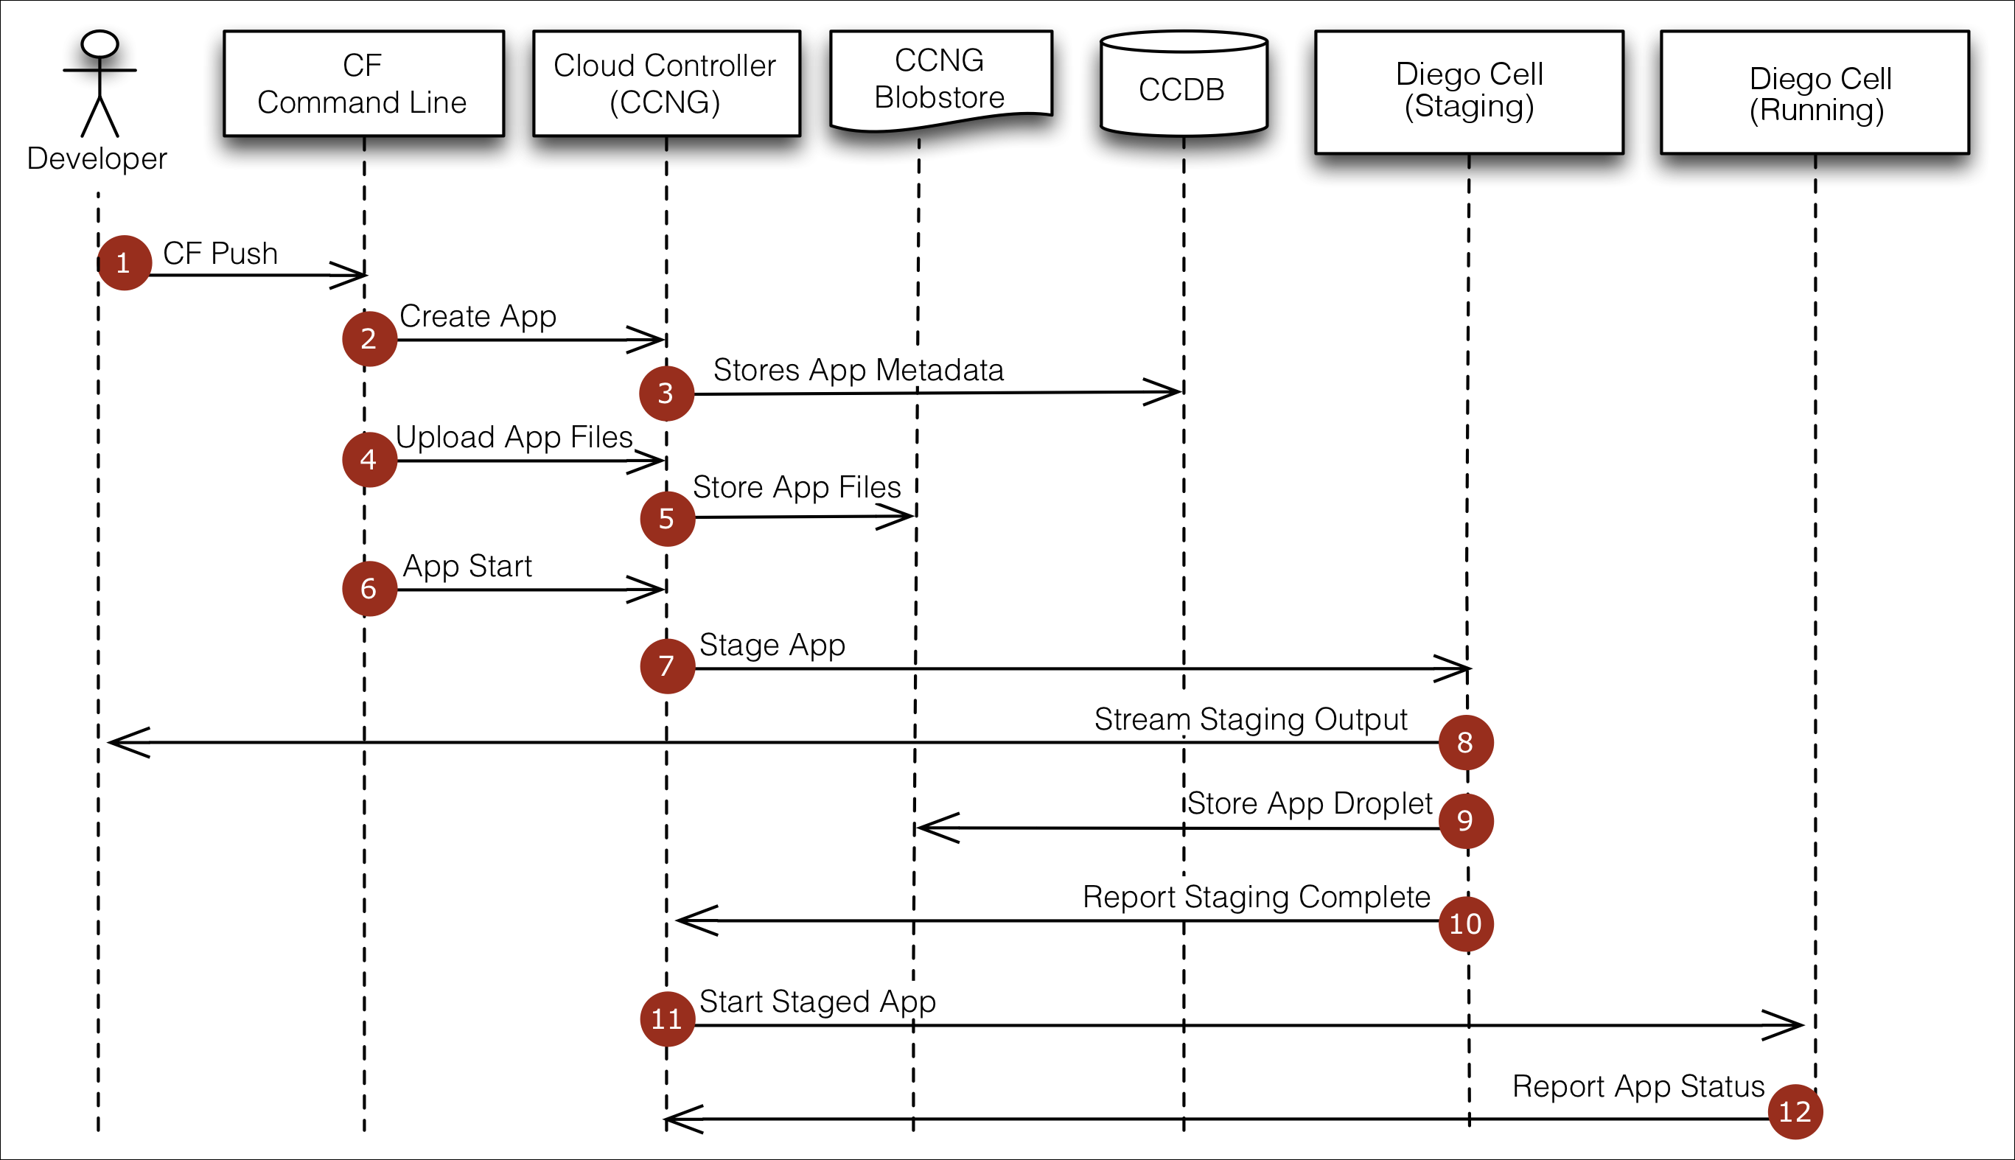
Notes:
At the command line, the developer enters the directory containing her application and uses the Cloud Foundry Command Line Interface (cf CLI) to issue a push command.
The cf CLI tells the Cloud Controller to create a record for the application.
The Cloud Controller stores the application metadata. Application metadata can include the app name, number of instances the user specified, and the buildpack, and other information about the application.
Before uploading all the application files, the cf CLI issues a resource match request to the Cloud Controller to determine if any of the application files already exist in the resource cache. When the application files are uploaded, the cf CLI omits files that exist in the resource cache by supplying the result of the resource match request. The uploaded application files are combined with the files from the resource cache to create the application package.
The Cloud Controller stores the application package in the blobstore.
The cf CLI issues an app start command.
The Cloud Controller issues a staging request to Diego, which then schedules a Cell to run the staging Task. The Task downloads buildpacks and if present, the app’s buildpack cache. It then uses the buildpack that is detected automatically or specified with the -b flag to build the droplet. The Task uses the instructions in the buildpack to stage the application.
The Diego Cell streams the output of the staging process so the developer can troubleshoot application staging problems.
The Task packages the resulting staged application into a tarball called a “droplet” and the Diego Cell stores it in the blobstore. The Task also uploads the buildpack cache to the blobstore for use the next time the application is staged.
The Diego Bulletin Board System reports to the Cloud Controller that staging is complete. Staging must complete within 15 minutes or the staging is considered failed. Apps are given a minimum of 1GB memory to stage, even if the requested running memory is smaller.
Diego schedules the application as a Long Running Process on one or more Diego Cells.
The Diego Cells report the status of the application to the Cloud Controller.

Slide 16
Buildpacks provide framework and runtime support for your applications.
Buildpacks typically examine user-provided artifacts to determine what dependencies to download and how to configure applications to communicate with bound services.
The Cloud Controller issues a staging request to Diego, which then schedules a Cell to run the staging Task. The Task downloads buildpacks and if present, the app’s buildpack cache. It then uses the buildpack that is detected automatically to build the droplet. The Task uses the instructions in the buildpack to stage the application.
Droplet = (Application + Buildpack)
Buildpack= (Appserver + Libraries + Runtime)

Slide 17
BOSH

Slide 18
BOSH
Cloud Foundry is designed to be configured, deployed, managed, scaled, and upgraded on any cloud IaaS provider. Cloud Foundry achieves this by leveraging BOSH, an open source tool for release engineering, deployment, lifecycle management, and distributed systems monitoring.
At a high level, the steps are the same regardless of IaaS:
Set up all external dependencies, such as IaaS account, external load balancers, DNS records, and any additional components.
Create a manifest to deploy a BOSH Director.
Deploy the BOSH Director.
Create a manifest to deploy Cloud Foundry.
Deploy Cloud Foundry.

Slide 19
BOSH
BOSH unifies release engineering, deployment, and lifecycle management of small and large-scale cloud software.
BOSH can provision and deploy software over hundreds of VMs.
BOSH performs monitoring, failure recovery, and software updates with zero-to-minimal downtime.
BOSH allows individual developers and teams to easily version, package and deploy software in a reproducible manner.

Slide 20
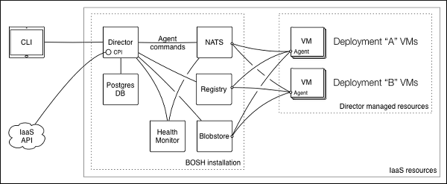
BOSH Architecture
Notes:
The Command Line Interface (CLI) is the primary operator interface to BOSH
Director
The Director is the core orchestrating component in BOSH. The Director controls VM creation and deployment, as well as other software and service lifecycle events.
The Director creates actionable tasks:
By translating commands sent by an operator through the CLI
From scheduled processes like backups or snapshots
If needed to reconcile the expected state with the actual state of a VM
Once created, the Director adds these tasks to the Task Queue. Worker processes take tasks from the Task Queue and act on them.
Task Queue
An asynchronous queue used by the Director and Workers to manage tasks. The Task Queue resides in the Database.
Workers
Director workers take tasks from the Task Queue and act on them.
Cloud Provider Interface (CPI)
A Cloud Provider Interface (CPI) is an API that the Director uses to interact with an IaaS to create and manage stemcells, VMs, and disks. A CPI abstracts infrastructure differences from the rest of BOSH.
Health Monitor
The Health Monitor uses status and lifecycle events received from Agents to monitor the health of VMs. If the Health Monitor detects a problem with a VM, it can send an alert through notification plugins, or trigger the Resurrector.
Resurrector
If enabled, the Resurrector plugin automatically recreates VMs identified by the Health Monitor as missing or unresponsive. It uses same Director API that CLI uses.
DNS Server
BOSH uses PowerDNS to provide DNS resolution between the VMs in a deployment.
Components used to store Director’s persistent data
Database
The Director uses a Postgres database to store information about the desired state of a deployment. This includes information about stemcells, releases, and deployments.
Blobstore
The Blobstore stores the source forms of releases and the compiled images of releases. An operator uploads a release using the CLI, and the Director inserts the release into the Blobstore. When you deploy a release, BOSH orchestrates the compilation of packages and stores the result in the Blobstore.
Agent
BOSH includes an Agent on every VM that it deploys. The Agent listens for instructions from the Director and carries out those instructions. The Agent receives job specifications from the Director and uses them to assign a role, or Job, to the VM.
Components used for cross-component communication
Message Bus (NATS)
The Director and the Agents communicate through a lightweight publish-subscribe messaging system called NATS. These messages have two purposes: to perform provisioning instructions on the VMs, and to inform the Health Monitor about changes in the health of monitored processes.
Registry
When the Director creates or updates a VM, it stores configuration information for the VM in the Registry so that it can be used during bootstrapping stage of the VM.

Slide 21
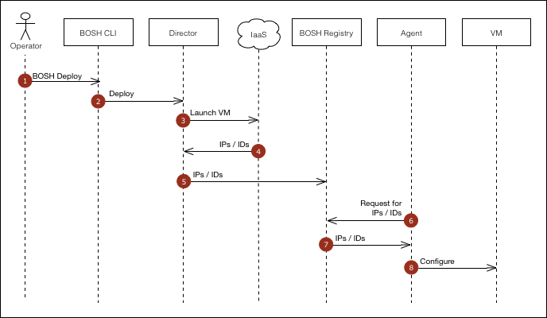
Creating a new VM
Notes:
1.Through the CLI, the operator takes an action (e.g. deploy for the first time, scaling up deployment) which requires creating a new VM.
2.The CLI passes the instruction to the Director.
3.The Director uses the CPI to tell the IaaS to launch a VM.
4.The IaaS provides the Director with information (IP addresses and IDs) the Agent on the VM needs to configure the VM.
5.The Director updates the Registry with the configuration information for the VM.
6.The Agent running on the VM requests the configuration information for the VM from the Registry.
7.The Registry responds with the IP addresses and IDs.
8.The Agent uses the IP addresses and IDs to configure the VM.

Slide 22
HIGH AVAILABILITY

Slide 23
Four Layers of HA
Application instances are evenly distributed across availability zones. Application stays up despite loosing an AZ.
Bosh Managed Processes (Elastic runtime processes are monitored and automatically restarted) . Failed Cloud Controller processes are restarted by ‘Monit’
Monit-> Bosh Agent-> Message Bus -> Health Monitor (Pager/Email/Ressurector)
Ressurector determines missing VMs and informs Bosh director to recreate VM/job
Failed VMs will be restarted automatically. Bosh Agent continuously reports health of the VM/job
Self Healing Application Instances
Cells (Rep + Executer) -> BBS -> Brain (Auctioneer+ Converger)

Slide 24
WHY NOT?

