Slide 1
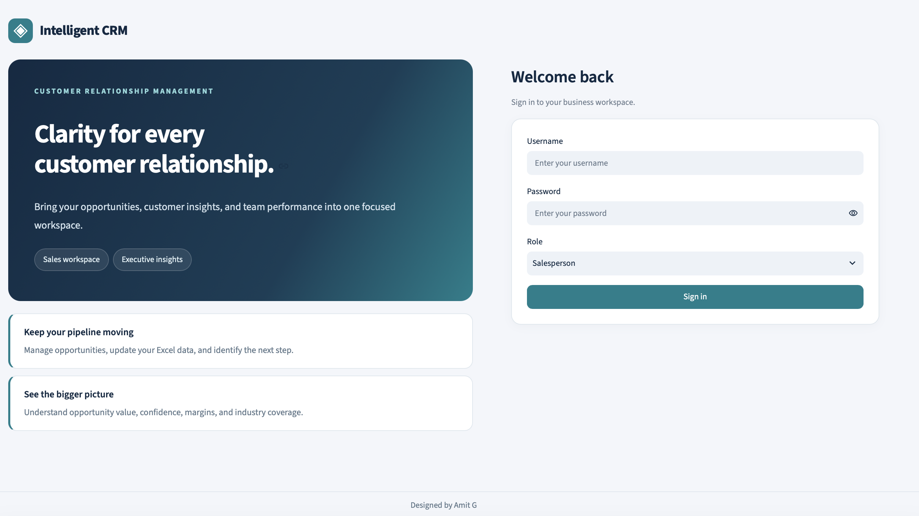
Intelligent CRM
PROJECT GOAL
Create a centralized CRM that gathers sales intelligence and visualizes the pipeline to support informed decisions.
Three roles supporting one shared view of sales activity
Company administrator
Salesperson
Executive dashboard
Manage users, assign roles, and administer passwords.
Upload pipeline data and manage opportunities.
View pipeline and performance through dashboards.
Designed by Amit Gandre

Slide 2
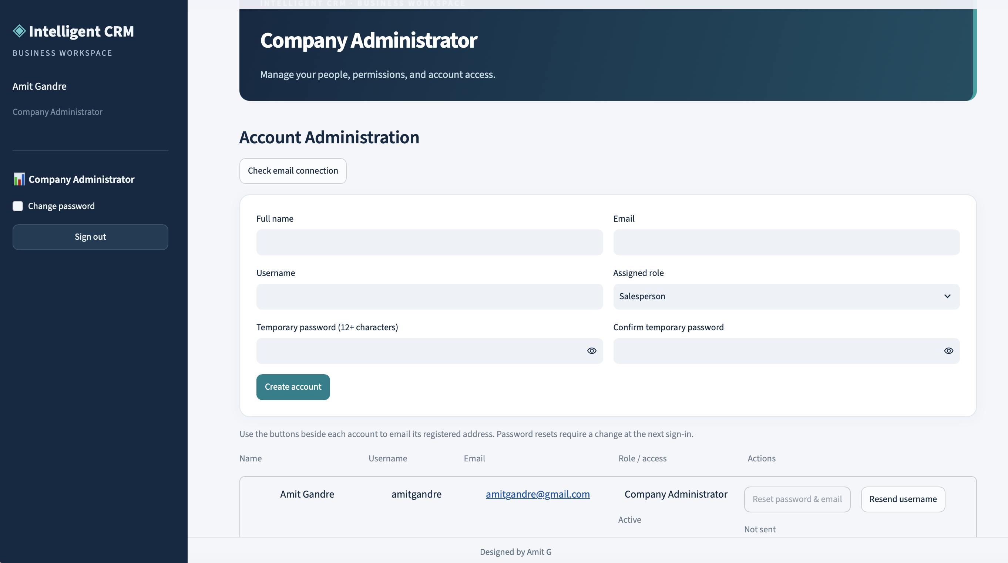
Company dashboard
Account Administration
01
Create account
02
Reset password
03
Send username
04
Change role
05
Disable user
06
Delete user / archive data
Designed by Amit Gandre

Slide 3
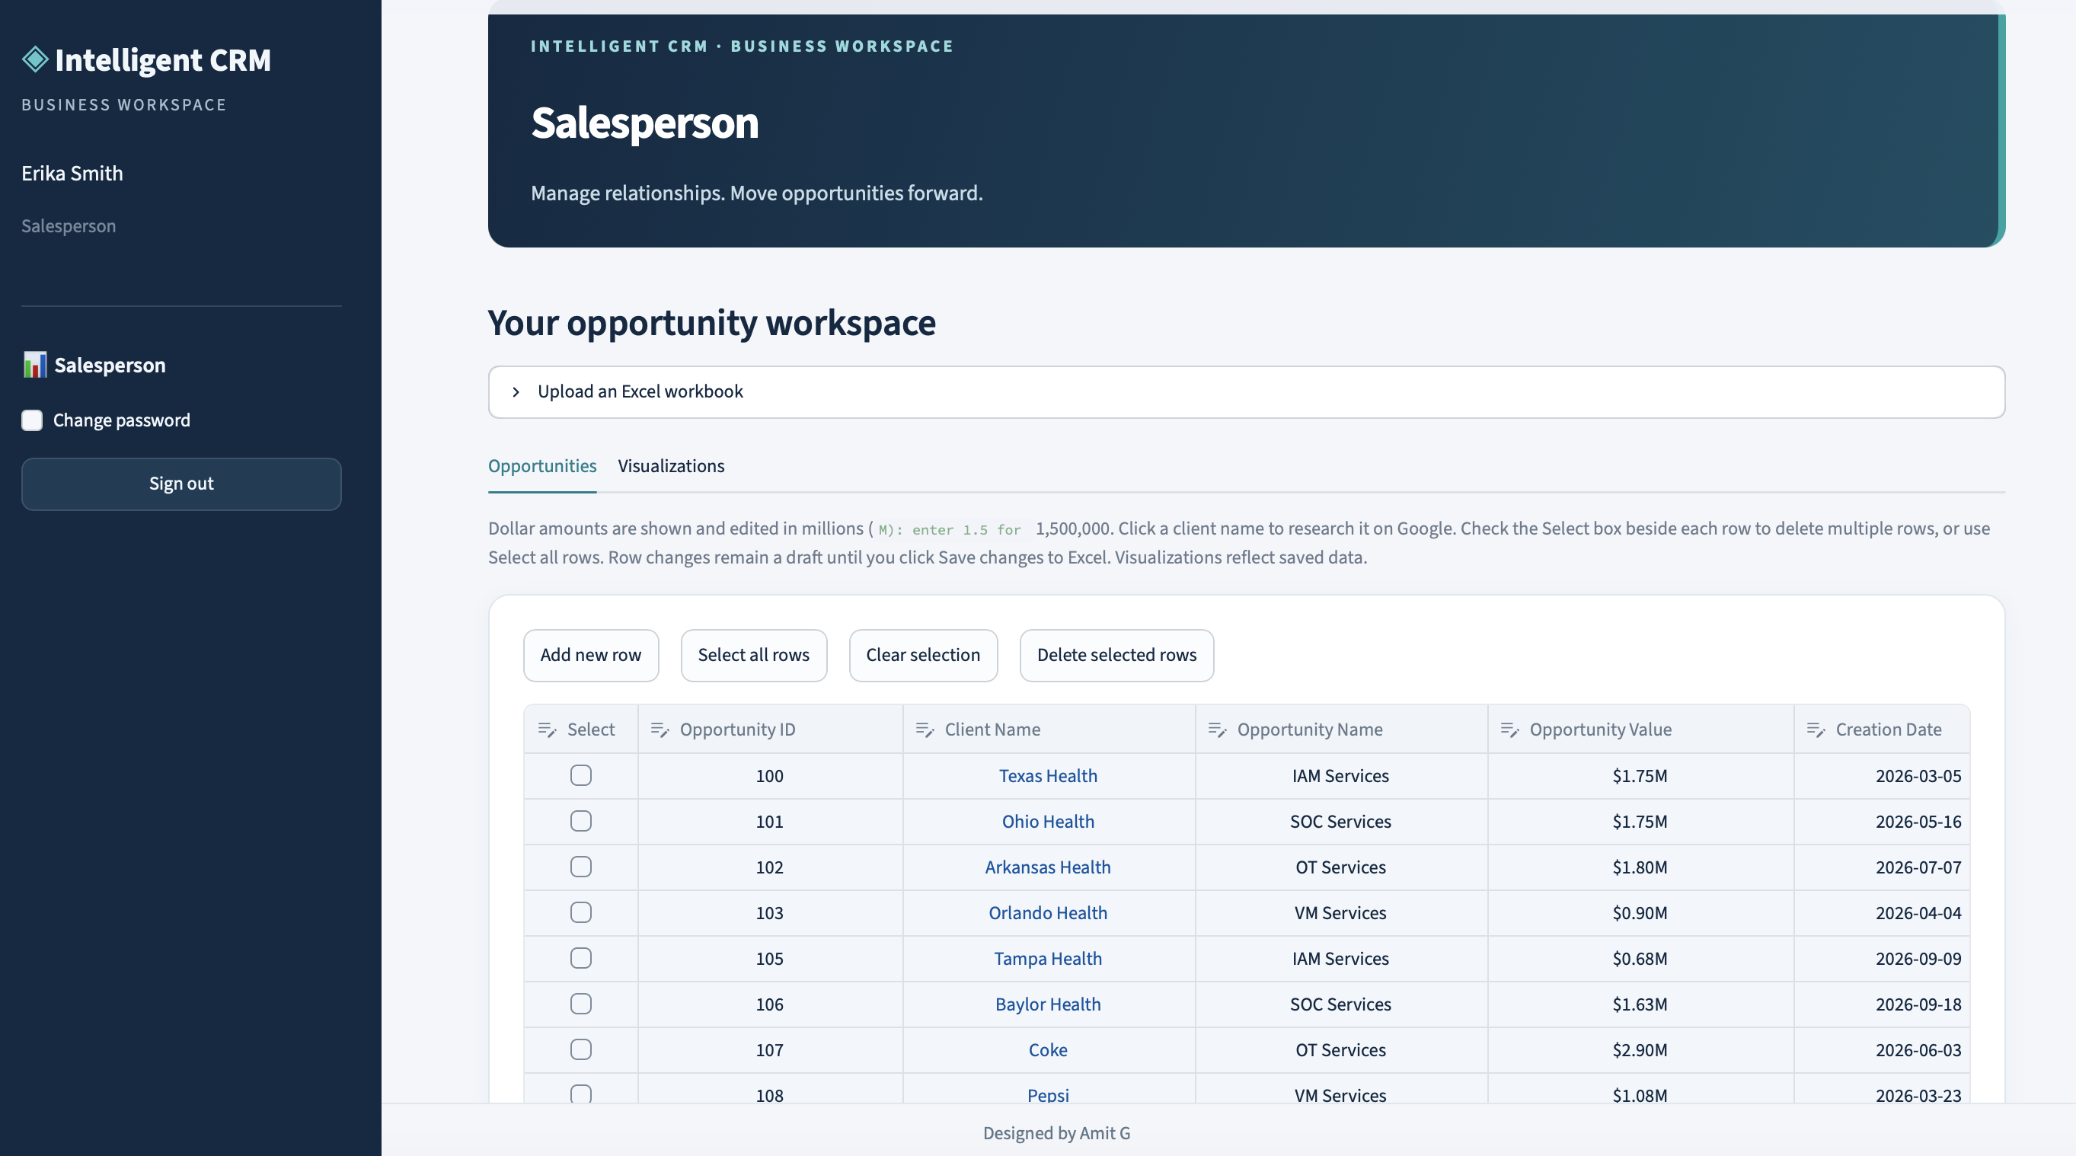
Salesperson
Pipeline management and visualization
01
View pipeline
02
Update pipeline
03
Download pipeline
04
Reload workbook
05
Visualization
Designed by Amit Gandre

Slide 4
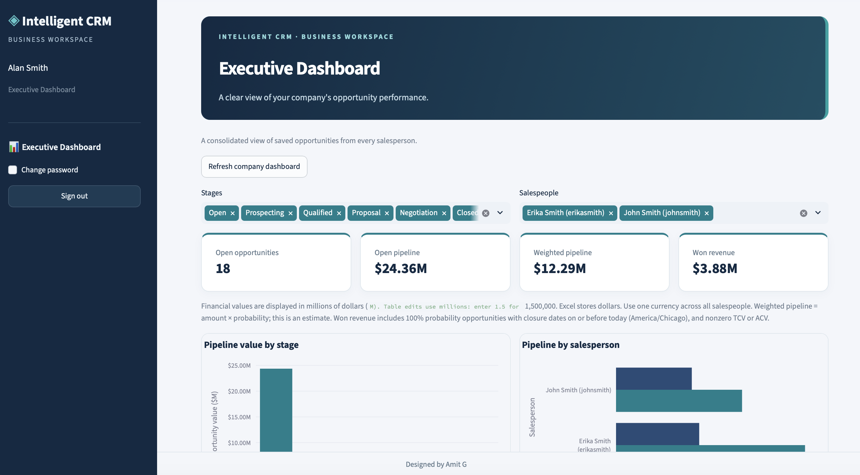
Executive Dashboard
Company Financials
01
Overall summary
02
Visualization by:
Sales stage
Salesperson
Customers
Industry
03
Opportunity intelligence
Designed by Amit Gandre

Slide 5
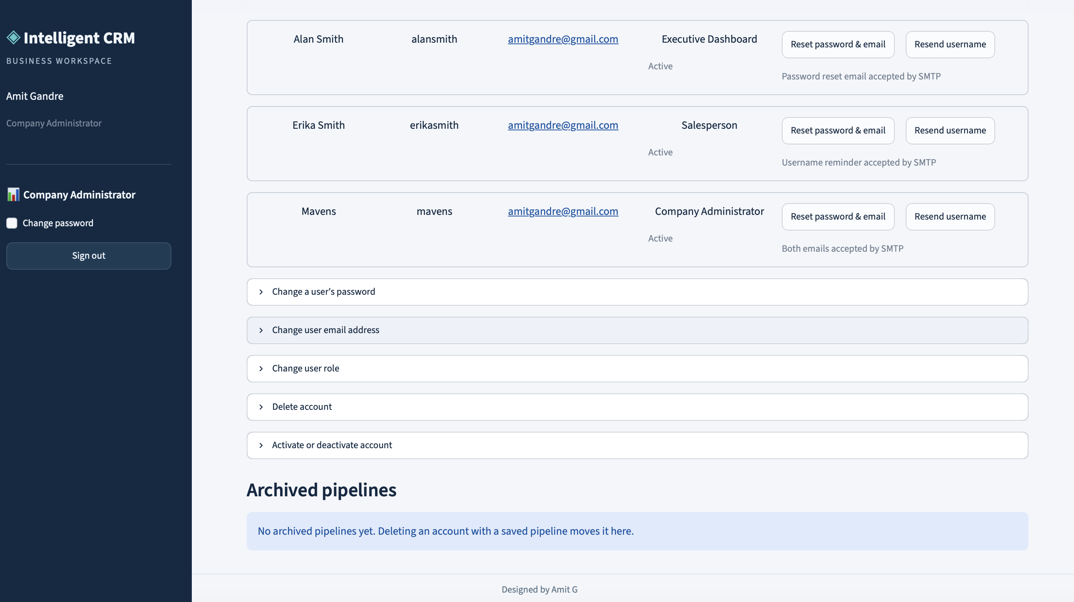
Security features
Strong passwords
Require strong passwords for user accounts.
Session inactivity
End user sessions after 15 minutes of inactivity.
New account credentials
Generate and send the username and password in two separate emails.
Password changes
Allow users to change their passwords.
Account controls
Allow administrators to disable accounts.
Designed by Amit Gandre

Slide 6
How to use
Setup the SMTP env variables by updating the file .env.smtp
Use Mavens login with password abcd12345678 to login as a Company Administrator
You can create Salesperson, Executive, Company Administrator users
Use the Salesperson user that you created to upload your pipeline data. Recommend creating two users with the Salesperson role. Login using this user and try out the features.
Use the Executive user that you created to visualize pipeline from the two Salesperson users that you created.
Test out the security features. Login as the Company Administrator and try out the options.
Designed by Amit Gandre

Slide 7
Q&A
Thank You

