Slide 1
MAVENS / WEEK 3 PROJECT
4 AGENTS
1 ORCHESTRATOR
REUSABLE MEMORY
Public-source IT &
Cybersecurity Research
Project goals, agents, architecture and a practical walkthrough
Amit Gandre
October 25, 2026
GOALS → DELIVERY
Notes:
Project overview of the implemented local n8n system. This deck is distinct from the Target research presentation. Screenshots show actual local workflow canvases captured October 25, 2026.

Slide 2
MAVENS / WEEK 3 PROJECT
Project goals
Turn a company name into a repeatable, source-linked research briefing.
01 Identify comparable companies
02 Surface recent signals
Find up to five revenue peers using supported financial evidence and sector checks.
Review three calendar months of IT, cybersecurity, technology and leadership news.
03 Add professional context
04 Deliver and remember
Research CEO, CISO, CTO and CIO candidates, public career history and LinkedIn links.
Create an editable PowerPoint and retain dated research for comparison and recall.
Amit Gandre • October 25, 2026 • Public-source research automation
2
Notes:
Five peers is a target, not a guarantee. Final run 196 selected one eligible peer and reports a shortfall of four. Unsupported target revenue blocks research. An eligible-peer shortfall stays explicit. Search excerpts remain preliminary evidence.

Slide 3
MAVENS / WEEK 3 PROJECT
Architecture: from company input to retained briefing
Explicit workflow routing connects search, local inference, validation and reporting.
COMPANY FORM
→
AGENT 1
→
AGENTS 2 → 3
→
AGENT 4
Name • website • sector
Revenue peers + checks
Search → extract signals
Leadership + background
ORCHESTRATOR → EDITABLE POWERPOINT + RESEARCH JSON
Append-only Data Table memory • Prior-run comparison • Download and recall
Runtime: local n8n + Ollama/Gemma | External evidence: native Google/SerpApi nodes
Amit Gandre • October 25, 2026 • Public-source research automation
3
Notes:
Actual routing: Agent 1 inside Research Orchestrator; Agent 2 calls Agent 3 internally. Orchestrator recalls leadership memory and calls Agent 4 for missing/stale profiles; the current cache is 168 hours (seven days). It recalls previous research, compiles PPTX and appends a snapshot. No HTTP Request nodes in current production workflows.

Slide 4
MAVENS / WEEK 3 PROJECT
All agents and their responsibilities
The orchestrator coordinates the four research stages and owns final output.
Agent 1
Revenue peers
Company + financial evidence
Up to five eligible peers; evidence gaps
Agent 2
Public web and news
Target + selected peers + date window
Dated headlines, links and evidence package
Agent 3
IT / cyber signal analysis
Supplied public evidence
Validated, attributed signals and citations
Agent 4
Leadership background
Company + saved profile context
Role candidates, career/education claims, links
Orchestrator
Coordinate, compile, retain
Peer decisions + signals + profiles
PPTX + research JSON + persistent snapshot
Amit Gandre • October 25, 2026 • Public-source research automation
4
Notes:
Agents are bounded workflows with defined inputs/outputs and local model extraction, not unrestricted autonomous browsers. Agent 1 resides in the main orchestrator. Test workflows are separate from production.

Slide 5
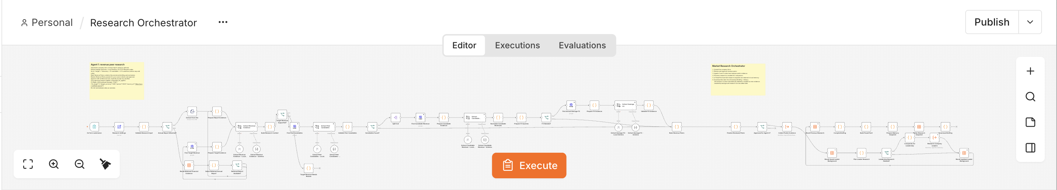
MAVENS / WEEK 3 PROJECT
Agent 1: build the revenue peer set
Research Orchestrator canvas; Agent 1 runs in the opening financial stages.
INPUT
CHECKS
OUTPUT
Company identity, annual report or retained revenue evidence.
Quoted amount, year, currency, company attribution and range.
Ranked eligible peers and explicit evidence gaps.
Amit Gandre • October 25, 2026 • Public-source research automation
5
Notes:
Screenshot: actual local Research Orchestrator. Financial flow includes report upload/retained-report fallback, peer discovery, revenue extraction, normalization and FX validation. Current user-authorized automatic selection sets sources_verified=false. The node name Finalize Reviewed Peers is retained, but there is no interactive pre-approval form in the current production graph.

Slide 6
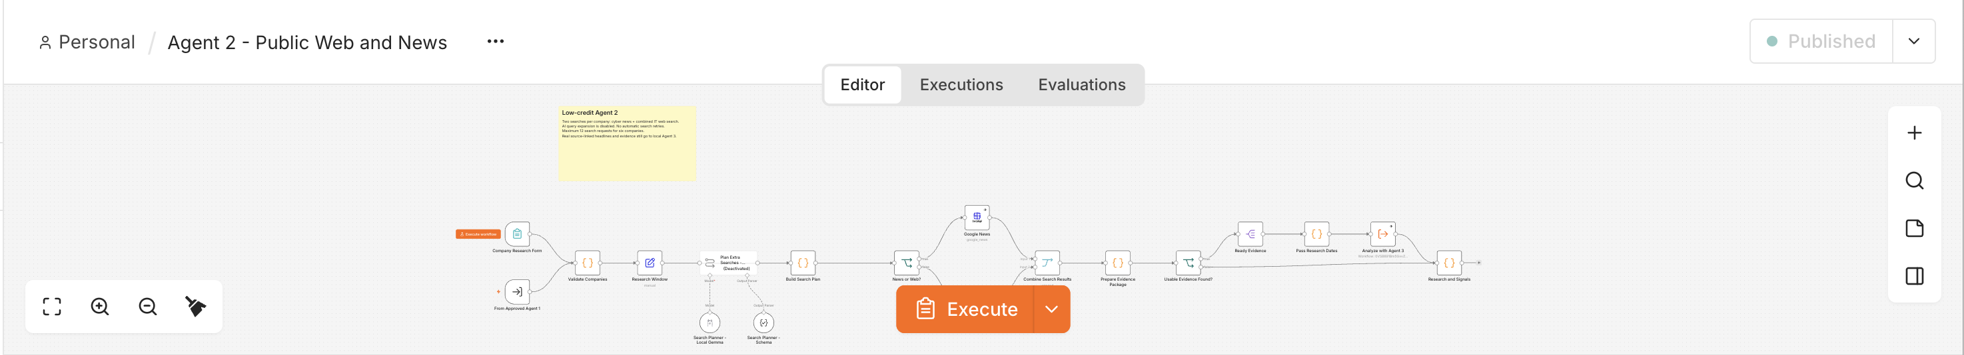
MAVENS / WEEK 3 PROJECT
Agent 2: collect public web and news
Native Google News + Google Web return evidence with source URLs.
SEARCH
FILTER
HANDOFF
Current low-credit mode uses two core searches per company.
Apply research dates, company matching, URL cleanup and deduplication.
Package source evidence and send it to Agent 3.
Amit Gandre • October 25, 2026 • Public-source research automation
6
Notes:
Actual Agent 2 canvas. Current low-credit settings disable the extra local AI query planner and automatic search retries. Six companies require up to 12 base Agent 2 search requests; financial discovery and leadership searches are additional. Unknown dates and weak matches remain review candidates.

Slide 7
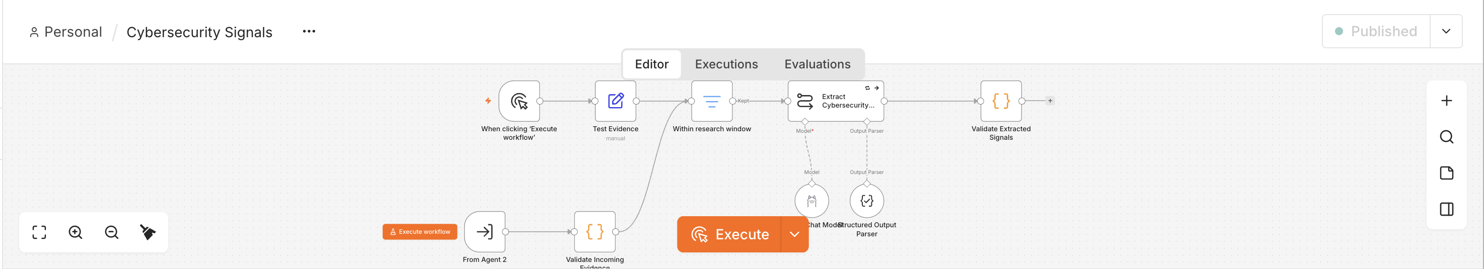
MAVENS / WEEK 3 PROJECT
Agent 3: extract supported IT / cyber signals
Local Gemma extracts structured claims; deterministic checks narrow what is retained.
EXTRACT
VALIDATE
LABEL
Leadership, contracts, cyber news and technology signals.
Check company attribution, source quotes and date window.
Separate hiring, planned activity and announced deployment.
Amit Gandre • October 25, 2026 • Public-source research automation
7
Notes:
Actual Cybersecurity Signals canvas, called by Agent 2. Local Ollama gemma4:12b with structured output. Guards reject unsupported company claims, generic advice and contract-value inferences. Job advertisements are hiring evidence, not proof of installed technology.

Slide 8
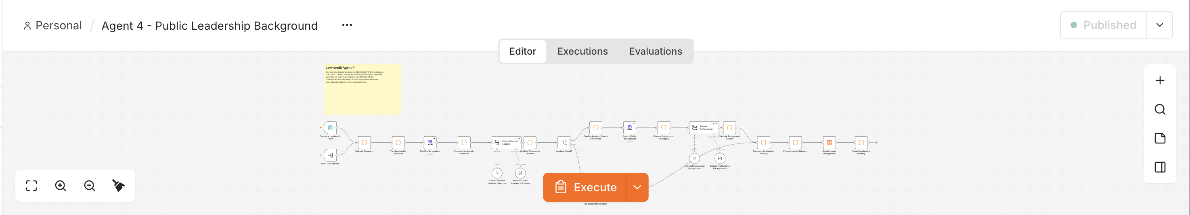
MAVENS / WEEK 3 PROJECT
Agent 4: research public leadership background
Discover CEO / CISO / CTO / CIO candidates and preserve uncertainty.
DISCOVER
ENRICH
RETAIN
Two combined leadership searches, then validate candidates.
One public LinkedIn search per distinct leader; up to four people.
Append profiles with dates, source links and missing/conflicting roles.
Amit Gandre • October 25, 2026 • Public-source research automation
8
Notes:
Actual low-credit Agent 4 canvas. At most six initial searches per company: two discovery plus up to four leader background searches; no automatic retries. Extract Deloitte/KPMG/EY employment and SEC-school education only when supported. The reduced search plan may leave these fields missing. Public LinkedIn snippets are not full-profile retrieval. Orchestrator reuses complete/partial profiles for up to seven days.

Slide 9
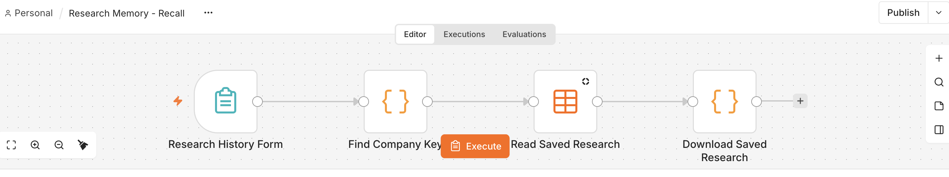
MAVENS / WEEK 3 PROJECT
Research memory: retain, compare and recall
Actual recall workflow; production research is retained in the native n8n Data Table.
APPEND
COMPARE
RECALL
Keep research snapshots, leadership profiles and PowerPoint bytes.
Mark prior evidence and newly observed sources across runs.
Search by company; use a run ID to retrieve an older saved version.
Amit Gandre • October 25, 2026 • Public-source research automation
9
Notes:
Actual Research Memory - Recall canvas: form → company key → read saved records → downloadable JSON/PPTX. Preview and test record types remain separate. The UI returns 20 matches at a time. Workflow JSON exports do not include the memory database; preserve the n8n data volume and local memory export.

Slide 10
MAVENS / WEEK 3 PROJECT
How to run: use the existing local installation
Use Research Orchestrator at localhost:5678; the tested fixes are now published.
1
Start services
Keep Docker/n8n and local Ollama running; confirm gemma4:12b is available.
2
Open the workflow
Open Research Orchestrator, refresh the editor, click Execute workflow and open its form.
3
Submit the company
Enter real company name, official website, sector and geography. Attach an annual report when available.
4
Let the stages complete
Peer checks → public search → signal extraction → leadership recall/research → presentation and memory.
5
Download your briefing
Open Download Briefing → Binary → presentation. Use Research Memory - Recall for saved versions.
Amit Gandre • October 25, 2026 • Public-source research automation
10
Notes:
Final tested automatic peer decision is user-authorized and continues with explicit gaps; it does not mean original financial sources have been independently verified. Leadership retrieval uses seven-day cached matching profiles. Unsupported target revenue stops the pipeline and produces a review diagnostic. Executing native searches uses SerpApi allowance.

Slide 11
MAVENS / WEEK 3 PROJECT
Example input: reproduce the Target walkthrough
The main form supplies the company identity and financial-comparison context.
FORM VALUES
OPTIONAL CONTROLS
Company Name: Target
Official Website: https://corporate.target.com
Industry Sector: Retail
Geography: United States
Annual Report: upload if available
Annual Report URL
Minimum / Maximum Revenue Ratio
FX Rates JSON when supported conversion is needed
News window: three calendar months
Expected output: a dated briefing, explicit coverage gaps, source links and a retained research snapshot.
Amit Gandre • October 25, 2026 • Public-source research automation
11
Notes:
These labels match the current orchestrator form. Uploaded or retained financial evidence still requires original-source verification. A new run may return different eligible peers, source counts, leadership candidates or findings; the archived Target production run is not a promised result for future runs.

Slide 12
MAVENS / WEEK 3 PROJECT
How to set up from GitHub
Import portable workflows, configure local dependencies and reconnect credentials.
01 GET THE PROJECT
02 CONNECT SERVICES
03 INITIALIZE & TEST
Clone amitgandre/Mavens-Week3-AmitG.
Use n8n/saved-workflows/all-workflows.json or import individual production workflows.
Run n8n with persistent storage.
Install Ollama + gemma4:12b. Configure Ollama and SerpApi credentials; native search nodes must be available.
Inspect Research Memory - Setup and create/map the native Data Table.
Publish internal-call workflows, remap references if needed, then run the local model check.
Portable imports are inactive and contain no credential references. Memory and generated files remain local.
Amit Gandre • October 25, 2026 • Public-source research automation
12
Notes:
Repository: https://github.com/amitgandre/Mavens-Week3-AmitG. For n8n in Docker on Mac, the Ollama credential endpoint is http://host.docker.internal:11434. Internal call workflows are Agent2PublicResearch, Cybersecurity Signals and Agent4LeadershipBackground. Native Data Table IDs and workflow references may require remapping on another instance. Test/cached workflows are optional. Root .env.example and research.py are historical prototypes, not current setup entry points. Preserve the existing database/volume to migrate research history.

Slide 13
MAVENS / WEEK 3 PROJECT
Deliverables: a usable research system
Outputs support both presentation and further evidence review.
EDITABLE POWERPOINT
COMPLETE RESEARCH
Target-final-briefing.pptx
Peer comparison, selected signals, leadership and linked sources.
Target-final-briefing.json
Full evidence, quotations, source registry, dates and gaps.
REUSABLE WORKFLOWS
PERSISTENT HISTORY
22 portable production/test workflow exports, agent source, checks and documentation.
Native memory retains dated research and deck bytes; recall retrieves saved versions.
Amit Gandre • October 25, 2026 • Public-source research automation
13
Notes:
PDF is a shareable export of the presentation. Full local backup contains 28 workflows, including six temporary Target production/recovery/compilation workflows. Portable set contains 22 reusable workflows. Raw backups, memory exports and generated output artifacts are excluded from GitHub. This project overview is the second requested deck.

Slide 14
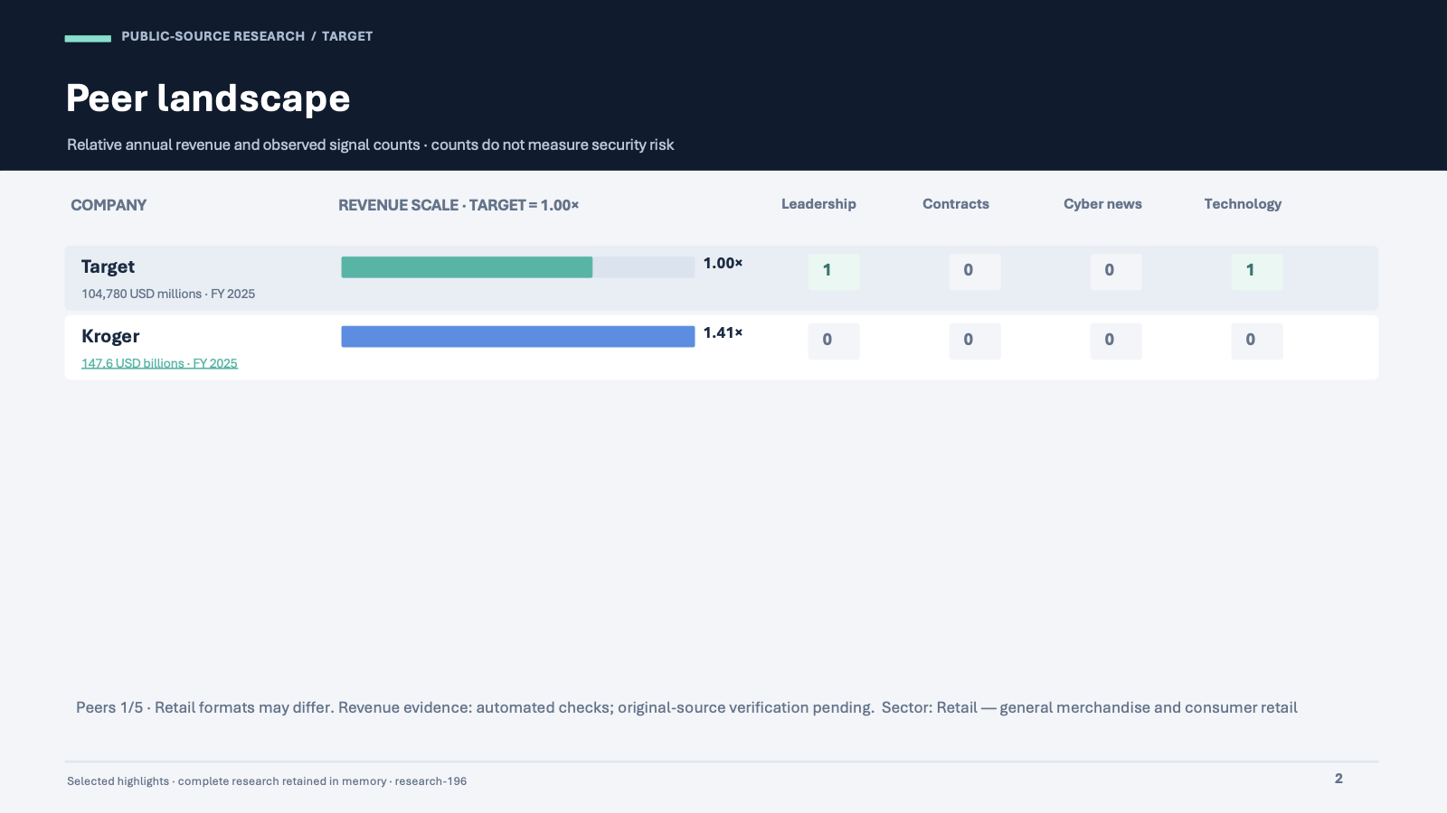
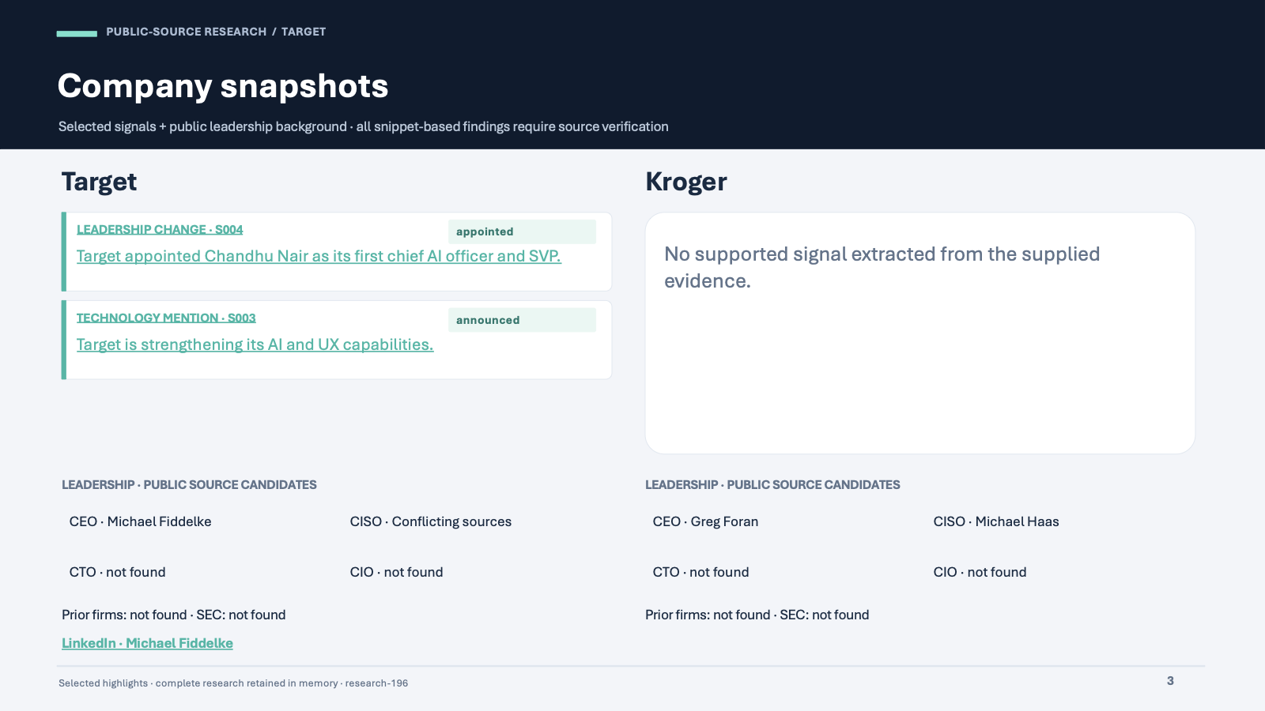
MAVENS / WEEK 3 PROJECT
Example delivery: the Target research briefing
Actual generated presentation pages, retained separately from this project walkthrough.
2
2
39
3
Companies
Extracted signals
Source records
Leaders researched
Amit Gandre • October 25, 2026 • Public-source research automation
14
Notes:
Current saved run: research-196. Counts on this slide are read from that run. Images are actual exported Target deck pages: peer revenue/signal comparison and company snapshots. Companies and counts follow the current saved Target run. Metrics are read from the current saved research JSON. The research deck has a dedicated cover; slide count depends on the current evidence and source appendix. Source records include public search evidence and background records, not fully reviewed articles.

Slide 15
MAVENS / WEEK 3 PROJECT
Validation and operating limits
All four agents executed in final run 196; the five-peer coverage target remains unmet.
CHECKED IN THIS PROJECT
WHAT THE READER MUST KNOW
Company attribution and quoted evidence
Structured extraction and date handling
Peer eligibility and unsupported-revenue stops
Append-only memory and prior-run recall
PowerPoint opens, exports and fits slide bounds
Search snippets need original-source review.
Role candidates may be stale or disputed.
Hiring is not evidence of deployment.
Signal counts are not security-risk scores.
Low-credit search limits coverage; missing means insufficient evidence.
Final run 196: all four agents completed; 1/5 peers qualified. Tested changes are published.
Amit Gandre • October 25, 2026 • Public-source research automation
15
Notes:
Recorded tests live under each agent directory and n8n/orchestrator. Deterministic checks and selected live/cached regressions were completed; this is not a claim of exhaustive correctness or independently verified current corporate facts. Financial, search and leadership stages all use quota beyond the Agent 2 base query count. Public-source retrieval does not require LinkedIn login, and no full-profile scraping occurs.

Slide 16
MAVENS / WEEK 3 PROJECT
Handoff: code, workflow entry points and files
Published workflow, source code and deliverables from the tested implementation.
GITHUB REPOSITORY
TWO PRESENTATIONS
github.com/amitgandre/Mavens-Week3-AmitG
Start: README.md
Import: n8n/saved-workflows/README.md
Run / recall: Research Orchestrator; Research Memory - Recall
Presentation source: n8n/project-overview/build_presentation.py
1 Target research briefing
Business research results
2 Project overview
Goals, agents, architecture, screenshots, operation and deliverables
Open the repository →
Amit Gandre • October 25, 2026 • Public-source research automation
16
Notes:
Generated PowerPoint/PDF deliverables remain local and are linked in the chat. Rebuild this deck with python3 n8n/project-overview/build_presentation.py after capturing screenshots in n8n/output/project-screenshots. Screenshots are real n8n workflow canvases; editable architecture and process summaries are explanatory diagrams, not screenshots.

