Slide 1

Intro By Amit Ganvir
Notes:
Provided by Mr. Amit Ganvir
amitganvir6@gmail.com

Slide 2
What is version control?
How version control helps high performing development and DevOps teams prosper

Slide 3
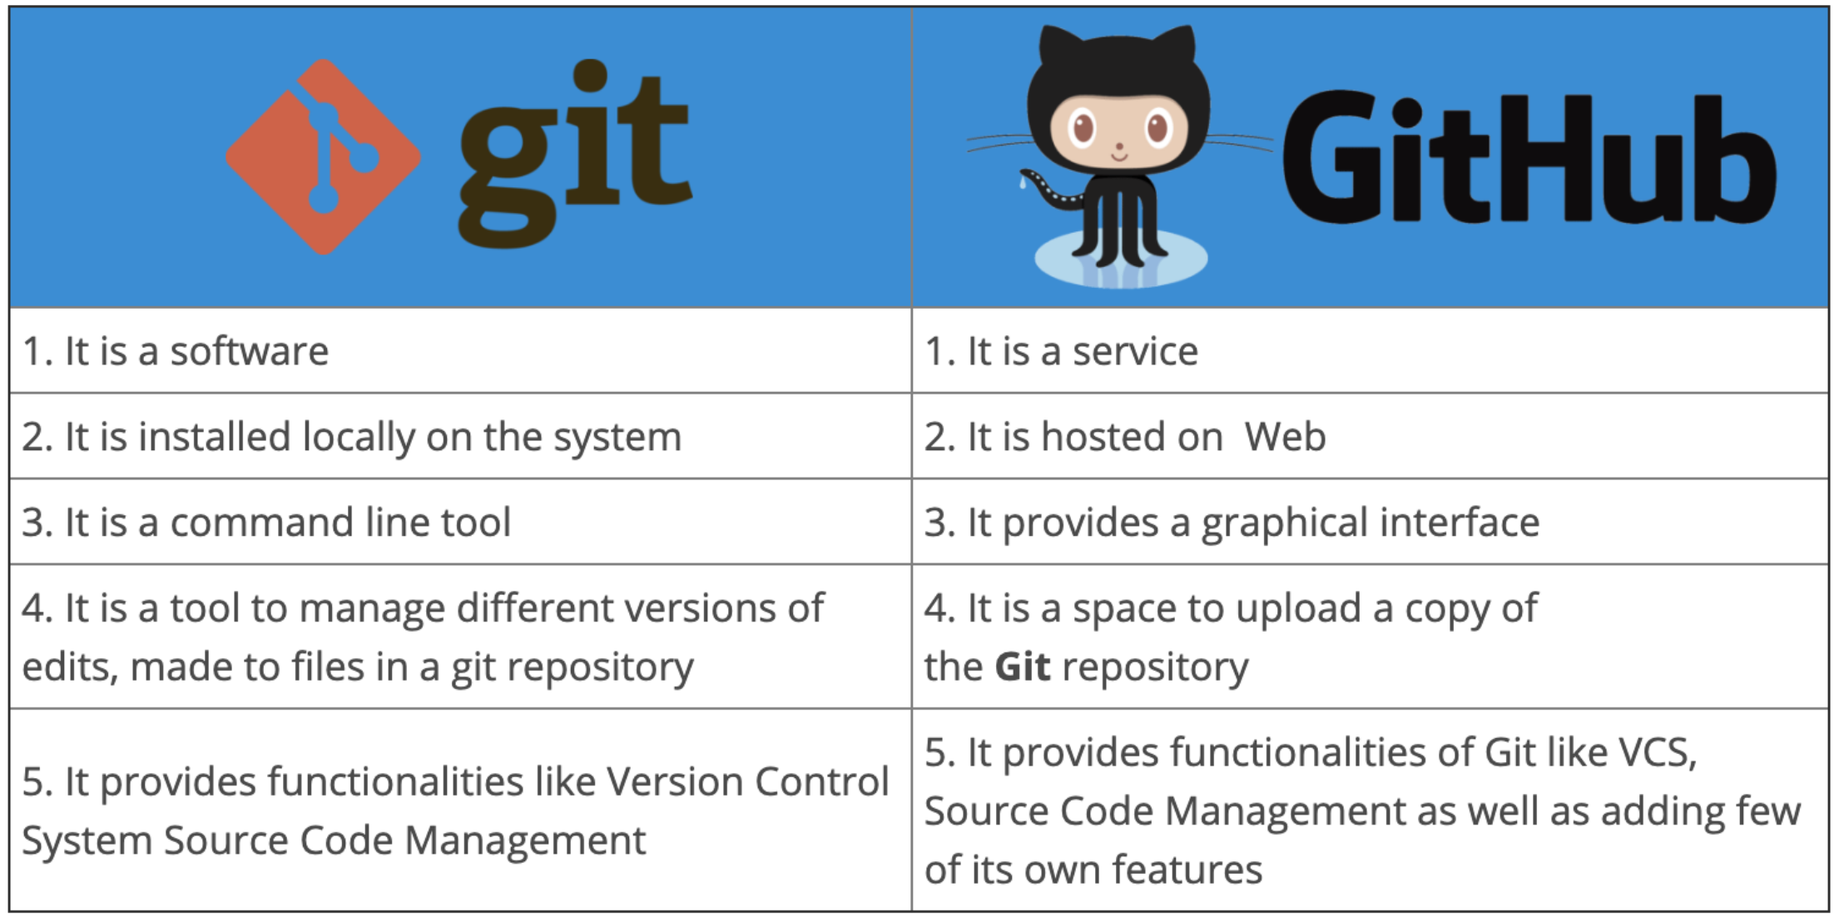
GIT vs GitHub
Notes:
Provided by Mr. Amit Ganvir
amitganvir6@gmail.com

Slide 4
How to store files on GitHub
Git clone
$sudo apt-get update $sudo apt-get install git
git clone https://github.com/amitganvir23/project-xyz.git
cd project-xyz
git status git add file1.txt (git add .) (git add -–all ) git status git branch git commit -am "my first commit for testing" git push origin master

Slide 5
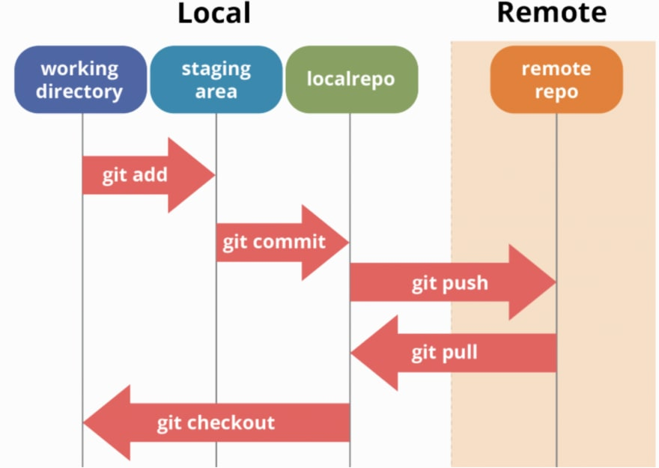
How it Works?

Slide 6

Notes:
Provided by Mr. Amit Ganvir
amitganvir6@gmail.com

Slide 7
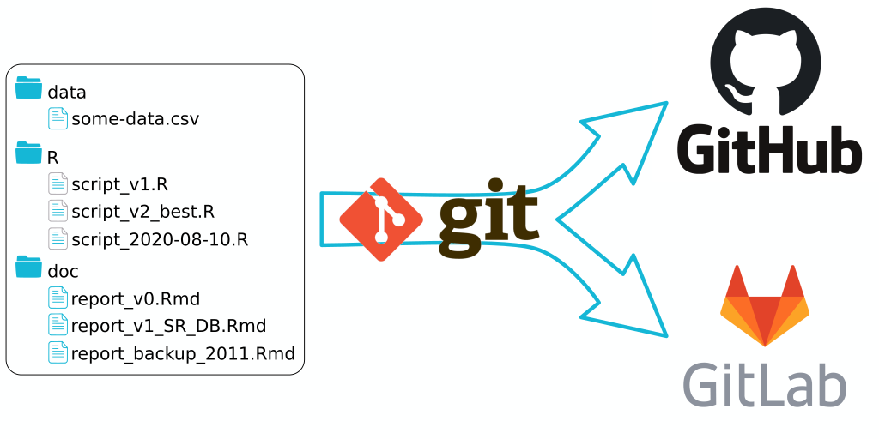

Notes:
Provided by Mr. Amit Ganvir
amitganvir6@gmail.com

Slide 8
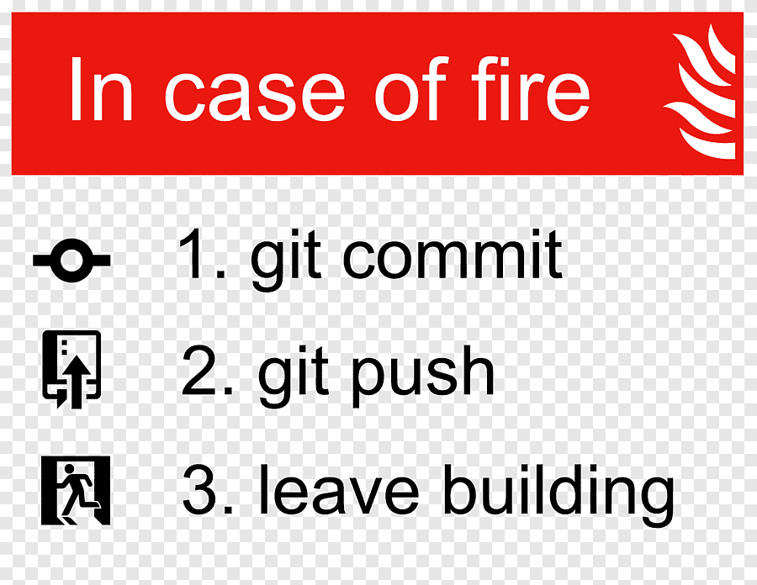

Slide 9

Notes:
Provided by Mr. Amit Ganvir
amitganvir6@gmail.com

