Slide 1

Introduction to GITHUB and GIT
Notes:
Today I am going to talk about Github – a web based Software version control system. It makes collaboration easy whether you are running an open source project or managing project for fortune 500 company.
Github is based on GIT which is a distribued Version control system and Github is RIA for git.

Slide 2





Why use github ?
How to use github?
Important features of GIT
Notes:
This is the pattern my presentation will follow.
I am going to talk about different features about Github and how they simplify developing software in collaborative way.
Next there will be a short demo about using git with github. We will see how to fork a repository, clone a repository , make changes and commit them. Then how to make a pull request and how to merge them.
Lastly I will talk about GIT and its features and compare it with SVN

Slide 3
3.4 M people
12.5 M Repositories
99.69 % uptime
Notes:
Looks like it’s the most popular code hosting site on the planet. It does have competitors like bit-bucket, beanstalk(paid private repository)
For Public code hosting is free and for private code its as little as $7 per month.
I think why sites like GITHUB are becoming popular is because it saves you time and leaves you free to build great applications. GITHUB takes care of managing the repository, taking backups and security.
Most importantly it makes collaboration easier. People from any part of the world can contribute to your project.
Git was originally built to develop to handle the development of Linux Kernel
You can use command line git client or graphical application. There are many available.

Slide 4








Homebrew
Notes:
Some of the open source projects on Github front end framework built at twitter.

Slide 5




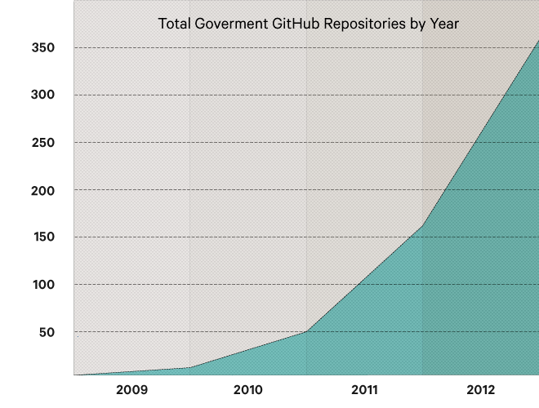
Notes:
GitHub also sells an enterprise product that lets companies run your own version of GitHub behind the corporate firewall. That starts at $5,000 per year, but can cost hundreds of thousands annually for companies with hundreds of coders.
They install Github on a VM and then you just plug that into your network.
Not just enterprise but Government also use github.
While researching this topic I came across a some creative uses of Github. Why not put legal documents or bills on github which is a public medium. What if anyone could write ammendments to existing laws and propose them to congress using pull request.

Slide 6
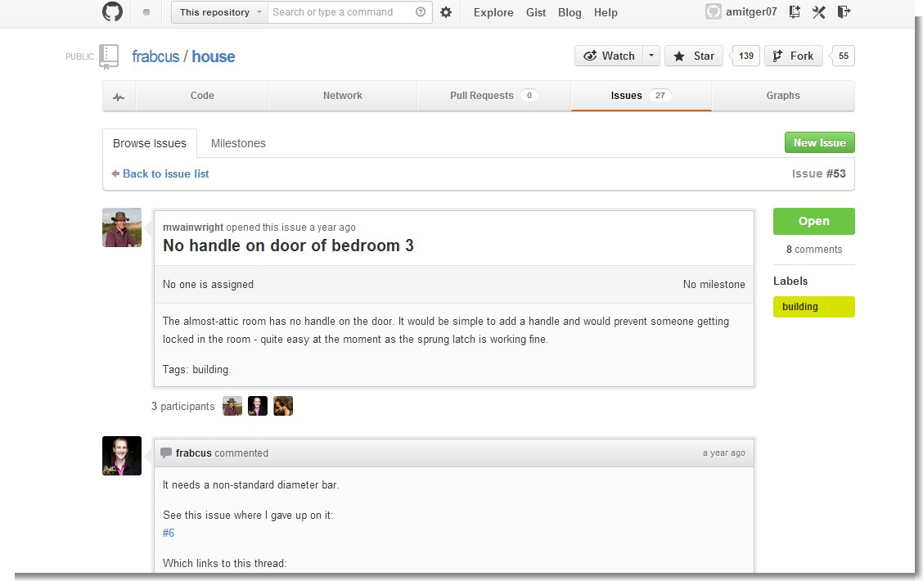
Notes:
Not just code hosting!. This person got locked in his attic room that he was renting. He opened up an issue on github
In the year he’s been fixing up his house via github he and other folks have opened up 82 issues relating to the house and 46 out of those have been dealt with.

Slide 7
Notes:
Not everyone is Linus Torwalds, and not every company is Google. For the 99 percent Git’s command line interface is notoriously difficult to use.
That’s where Github comes in. It simplifies Git.

Slide 8





Using GITHUB is easy
Signup for an Github account
Install and set up git
Create a repository
Fork a Repository
Be Social
Notes:
You can replace step2 by installing Github for your system
Create a repository means just creating a container for a new project
Fork a repository means creates a copy of someone else’s repository for you. Contributing to a project
Be Social means following other people and their activity or watching other projects or making a pull requests

Slide 9
Notes:
Lets take a little tour of Github and see some of the features before the demo
Explore repositories. Talk about best practices and find reusable code
Signup create a new user
Search Users, Project
Gists – They are snippets of code.
Graphs - activity
Star -
Watch
Organizations
Use topger06@gmail.com to sign up on github

Slide 10
Introduction to GIT

Slide 11
GIT is small and fast
Operation |  | GIT | SVN
Commit Files | Add, commit and push 113 modified files | 0.64 | 2.60 | 4x
Commit images | Add, commit and push 1000 1k images | 1.53 | 24.70 | 16x
Diff Current | Diff 187 changed files against last commit | 0.25 | 1.09 | 4x
Diff Recent | Diff against 4 commits back | 0.25 | 3.99 | 16x
Diff Tags | Diff two tags against each other (v1.9.1.0/v1.9.3.0 ) | 1.17 | 83.57 | 71x
Clone Size (M) |  | 107.5 181.0 | 14.0 132.0
Notes:
Git is fast because almost all the operations are performed locally.
Two Amazon Webservices instances were set up. Git and SVN were installed on both machines
They copied Ruby respository to both Git and SVN servers and common operation were performed.
One place where Git is slower is in the initial clone operation
Git is downloading the entire history not just the latest version
Distributed, Multiple backups

Slide 12
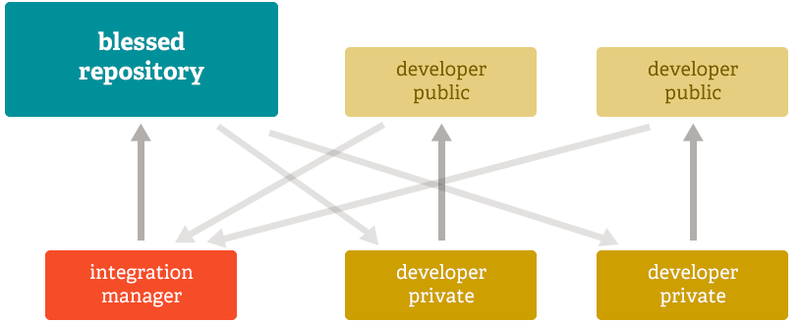
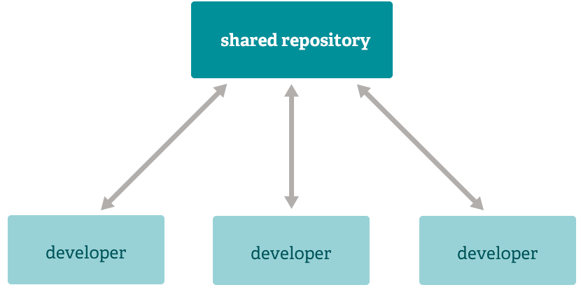
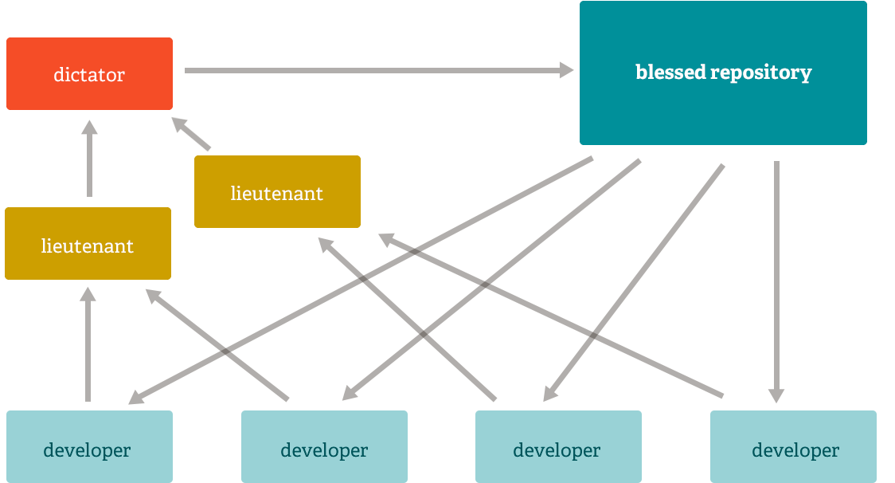
Distributed
Notes:
Git is distributed
This means instead of doing a checkout you do clone of entire repository
Due to its distributed nature and superb branching system an almost endless number of workflows can be implemented
Subversion Style workflow
Integration Manager Workflow
Dictator and Lieutenants Workflow

Slide 13
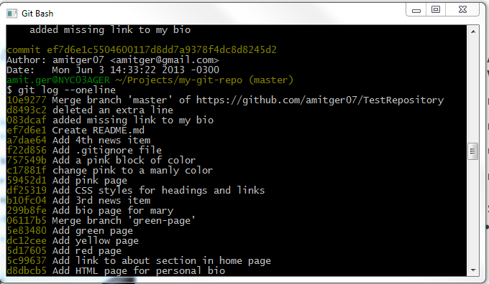
Data Assurance
Notes:
The data model that Git uses ensures the cryptographic integrity of every bit of your project. Every file and commit is checksummed and retrieved by its checksum when checked back out. It's impossible to get anything out of Git other than the exact bits you put in.

Slide 14
Resources
http://git-scm.com/docs
http://git-scm.com/videos
http://rypress.com/tutorials/git/index.html
https://help.github.com

