Slide 1
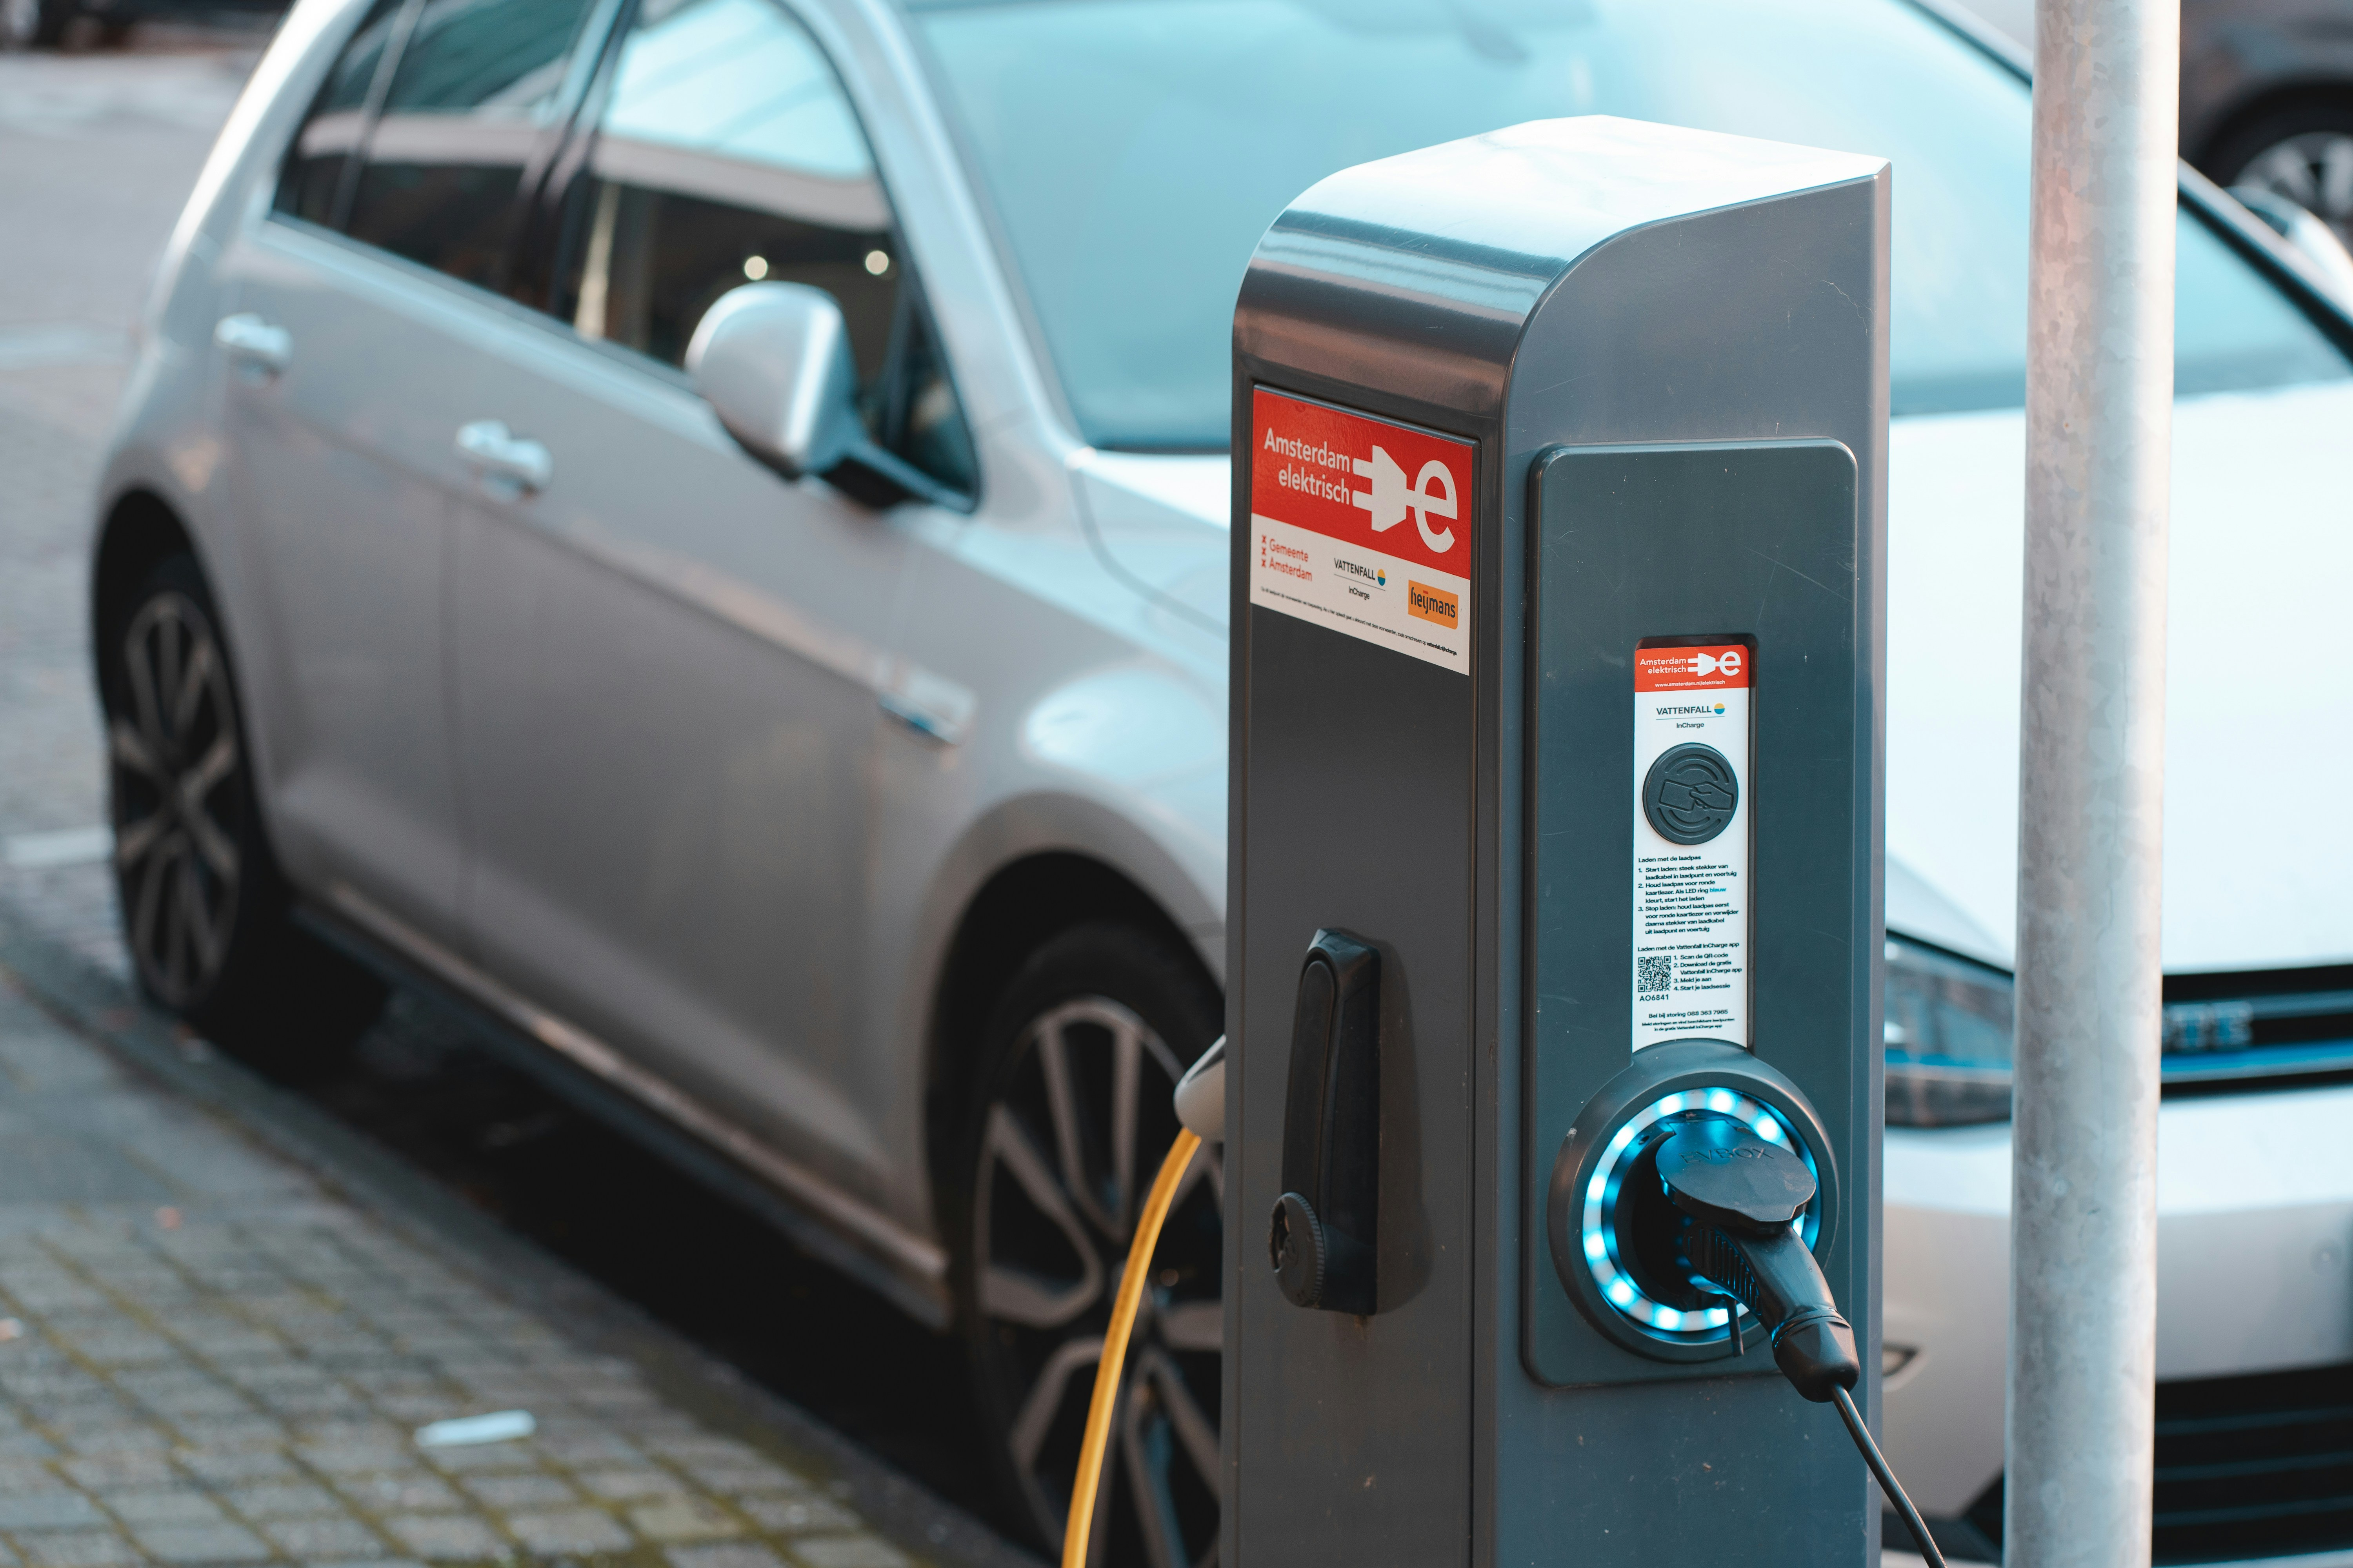
Delaware EV Charging : Powering the Future of Sustainable Mobility
by Amit Ghosh

Slide 2
Creating a PowerPoint presentation based on your Power BI project about Delaware EV Charging can be structured effectively by focusing on key insights, visualizations, and recommendations. Here's an outline and content guide for each slide:

Slide 3
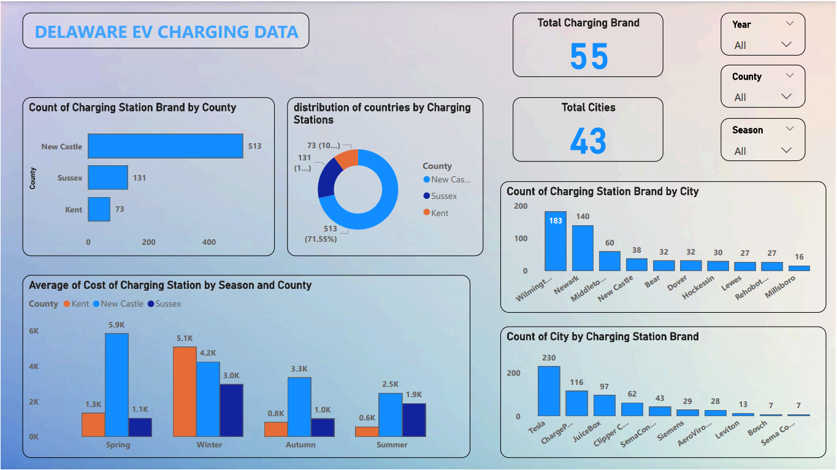

Slide 4
Introduction :
Objective:-
Provide an overview of the project objectives and goals.
Key Points:-
Analyze the distribution and cost of EV charging stations across Delaware.
Identify trends and patterns in the data.
Provide actionable insights for stakeholders.

Slide 5
Data Overview
Description:-
Summarize the data sources used in the project.
Delaware EV charging stations data.
Rebates and cost data.
Visuals:-
Bullet points summarizing the data.

Slide 6
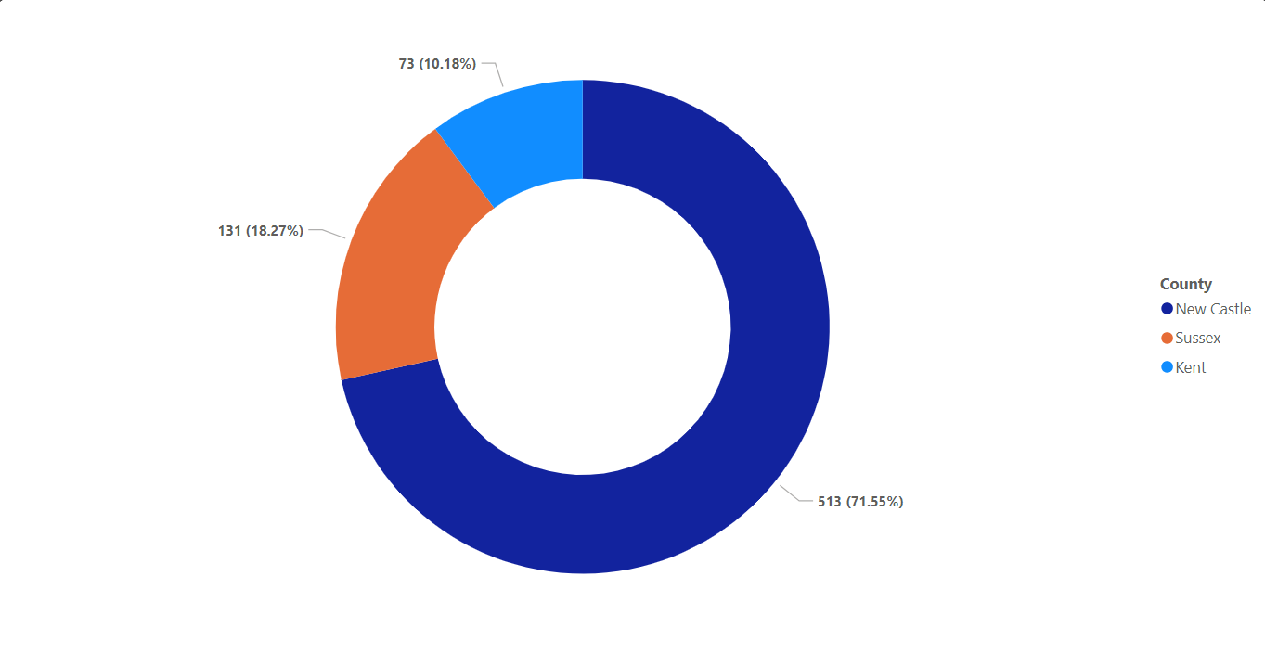
Charging Stations Distribution by County
Description:-
Present the distribution of charging stations across different counties.
Visuals:-
Bar chart from the Power BI showing the count of charging stations in New Castle, Sussex, and Kent.
New Castle: 513 stations (71.55%)
Sussex: 131 stations (18.28%)
Kent: 73 stations (10.17%)

Slide 7
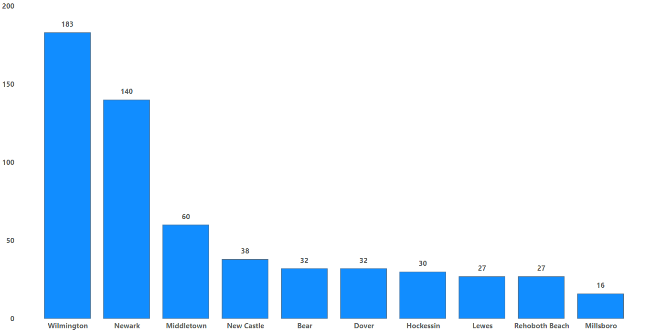
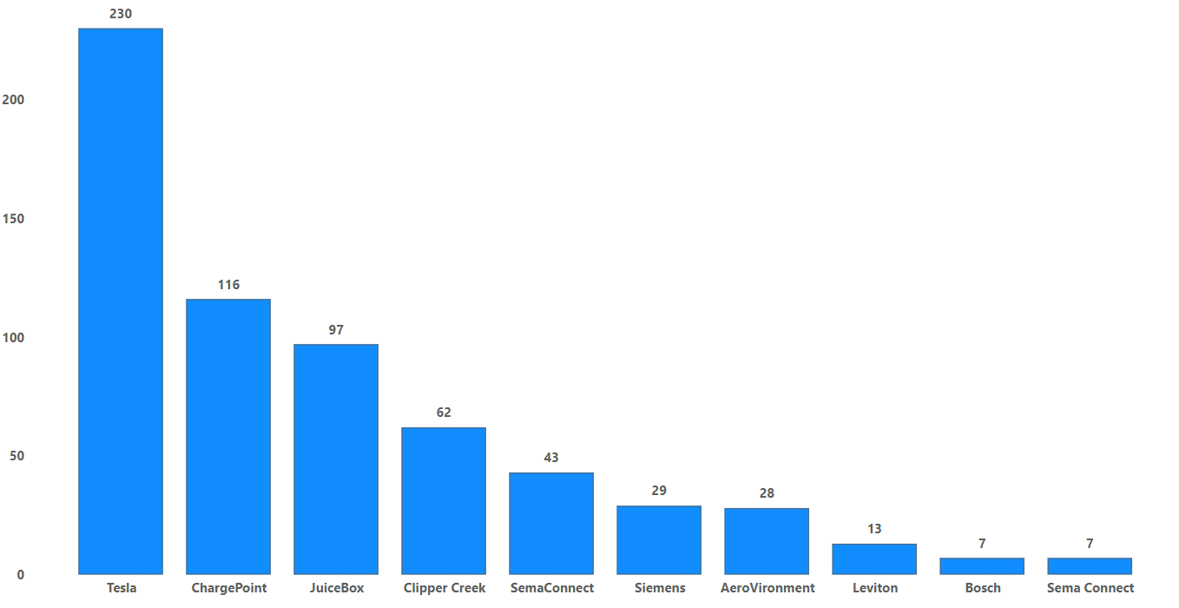
Charging Stations by Brand and City
Description:-
Breakdown of charging station brands and their distribution in various cities.
Visuals:-
Bar chart showing the count of charging stations by brand (Tesla, ChargePoint, etc.)
Bar chart showing the count of charging stations by city (Wilmington, Newark, etc.)
Count of Charging Station Brand by City
Count of City by Charging Station Brand

Slide 8
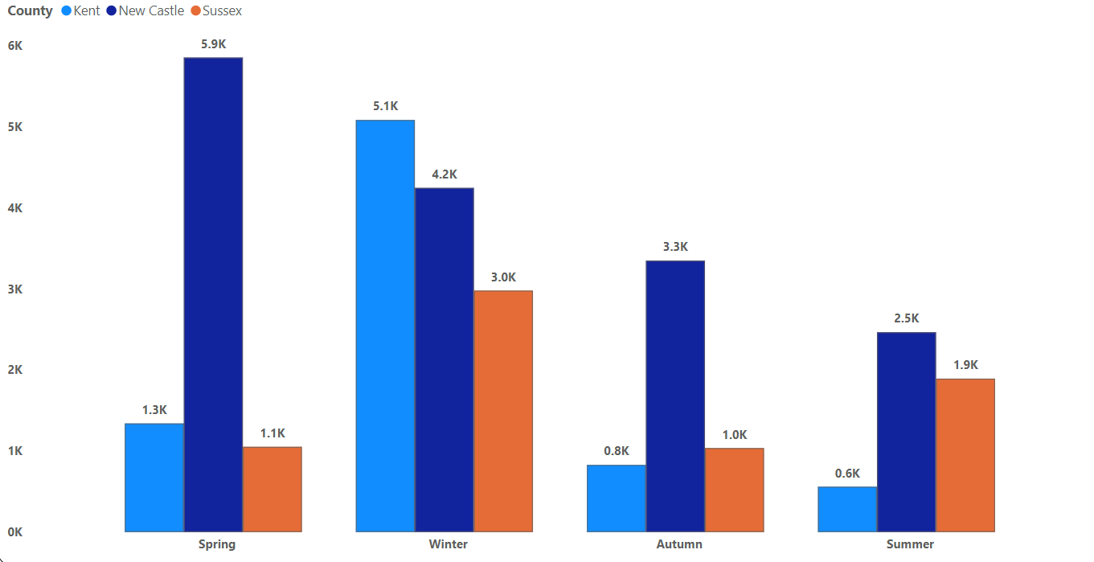
Cost of Charging Stations by Season and County
Description:-
Analyze the average cost of charging stations across different seasons and counties.
Visuals:-
Line or bar chart showing average costs in Spring, Summer, Autumn, and Winter across Kent, New Castle, and Sussex.
Notable points:-
Highest average cost in Winter for New Castle: 5.9K
Lowest average cost in Summer for Sussex: 0.6K

Slide 9
Key Insights
Description:-
Summarize the key findings from the data analysis.
New Castle has the highest number of charging stations.
Tesla is the most common charging station brand.
Seasonal variations in the cost of charging stations, with winter being the most expensive in New Castle.

Slide 10
Recommendations
Description:-
Provide actionable recommendations based on the analysis.
Increase the number of charging stations in Sussex and Kent to promote EV adoption.
Consider cost-effective strategies for installing charging stations in the winter.
Promote a mix of charging station brands to cater to different EV users.

Slide 11
Conclusion
Description:-
Wrap up the presentation with a summary of the project's importance and potential impact.
Emphasize the significance of enhancing EV infrastructure.
Highlight future steps or further analysis that could be undertaken.

