Slide 1
DevSecOps

Slide 2
DevSecOps
Application code or OS change
Build application container or OS image
Update cloud and infrastructure configuration
Deploy cloud configuration or application to environment
Infrastructure code change
The high-level steps are as follows:
The user makes a change to the application code or OS configuration for a service.
Once the change is committed to source, a build is kicked off resulting in an AMI or a container image.
The infrastructure as code is updated with the new AMI or container image to use.
Changes to cloud configuration or infrastructure as code may have also been committed.
A deployment to the environment ensues applying the changes

Slide 3
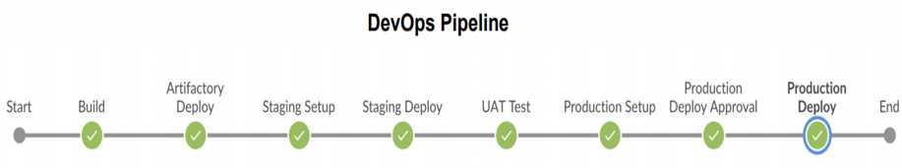
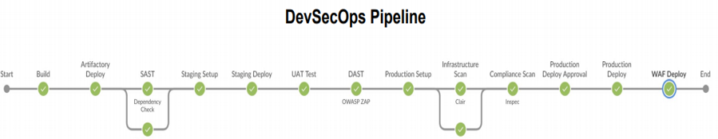
DevSecOps – Build Security in the CI/CD Pipeline

Slide 4
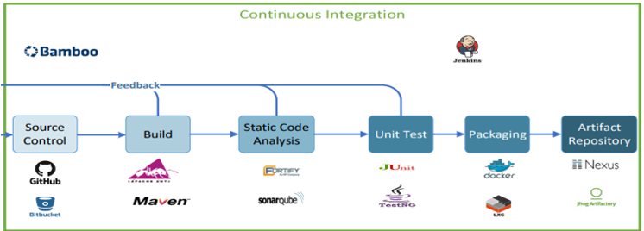
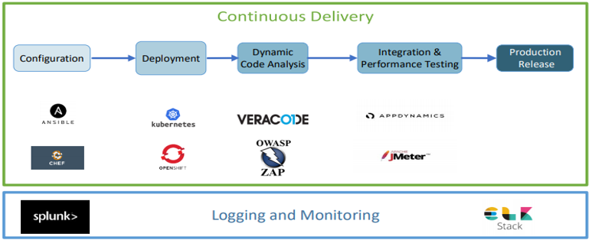
Tools – DevSecOps Pipeline

