Slide 1
DevSecOps

Slide 2
DevSecOps
Post Deployment Compliance Scanning
Application code or OS change
Build application container or OS image
Update cloud and infrastructure configuration
Deploy cloud configuration or application to environment
Infrastructure code change
The high-level steps are as follows:
The user makes a change to the application code or OS configuration for a service.
Once the change is committed to source, a build is kicked off resulting in an AMI or a container image.
The infrastructure as code is updated with the new AMI or container image to use.
Changes to cloud configuration or infrastructure as code may have also been committed.
A deployment to the environment ensues applying the changes

Slide 3
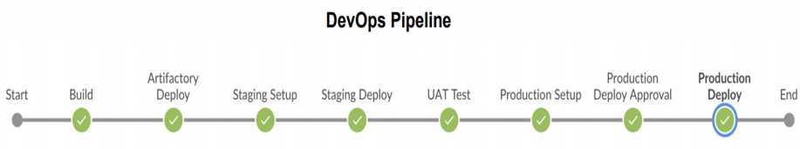
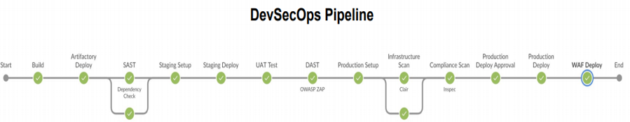
DevSecOps – Build Security in the CI/CD Pipeline

Slide 4
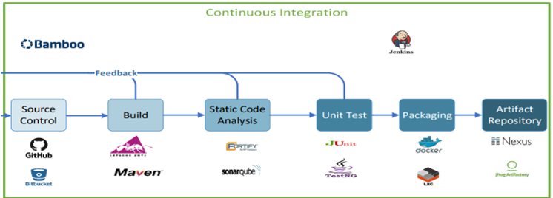
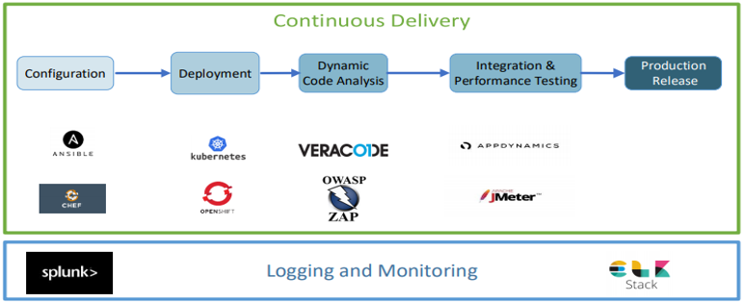
Tools – DevSecOps Pipeline
Post Deployment Compliance Scanning

