Slide 1

What Makes A Great Manager

Slide 2
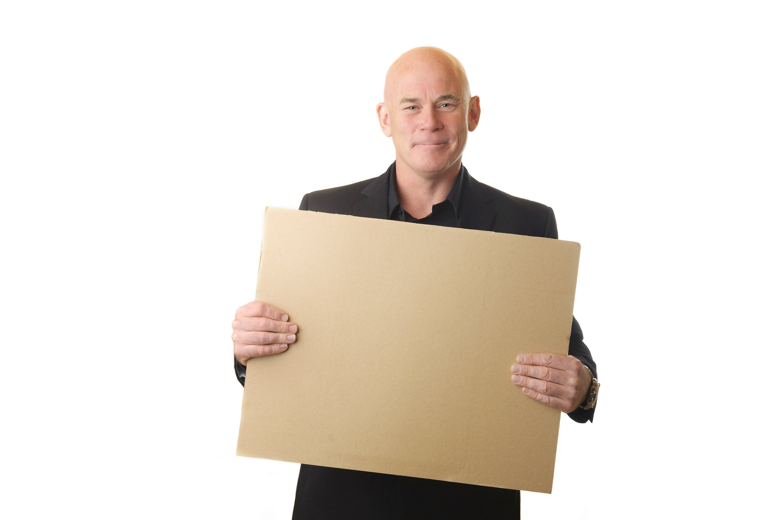
What Makes A Great Manager?
THE AIM OF THIS MODULE:
To give you an insight into some of the different elements that will help make you effective as a manager.
Let’s explore the 11 things that make a great manager!

Slide 3
#1 - CONFIDENCE
Confidence comes with time. Be aware that confidence increases with every difficult situation you encounter.
Every time you come across a challenging management situation at work, say to yourself:
“This is only going to make me stronger.”
There is a fine line between confidence and arrogance. Don’t be afraid to make mistakes – you will never be the perfect manager, and that’s a good thing, because it means you are willing to keep learning and developing.

Slide 4
#2 – LEARNING & DEVELOPMENT
Managers who are open to learning and developing will always improve and grow.
There are lots of ways you can continue to learn and develop as a manager:
Training courses (external and internal.)
Reading books (check out my recommended list of books to read.)
Learning from other people (both managers and even your team!)

Slide 5
#3 – STANDARDS
My very first manager in the Fire Service told me this:
“As a manager or leader, it is always best to set the standards high from the get go. If you set them low, it will be a challenge to bring them back up again.”
It’s far easier to lower standards if needed, than to raise them!

Slide 6
#4 – Manage Your Relationships With Staff
Consider your relationships with members of your team. My advice is to keep a distance, as you may need to manage underperformance later on down the line.
If you’re overly friendly or close to a member of your team and you need to discipline them at some stage, it will prove extremely difficult.
If you have relationships with staff outside of work, this can then lead to blurred lines of authority and other members of the team feeling left out or undervalued.

Slide 7
#5 – Be On The Side Of The Senior Managers/CEO/Company Directors
As a manager, you are constantly working towards the goals and objectives of your employer.
There will be times when you disagree with the decisions being made, but don’t let your emotions get the better of you.
If you disagree with something, that’s fine… but know when to move on and commit to the long term objectives of the business.
Never be disrespectful of senior management or the company owners in front of your team!

Slide 8
#6 – Find Out What Motivates Individual Team Members
I have personally found this to be a great way to keep team members motivated.
Everybody has different motivators and drivers in life:
Promotion and advancement.
To do a great job and to feel appreciated.
Provide for their family and go home at the end of the working day without any stresses or pressures.
Want to be left alone to get on with their work.
Use the Performance Review / Appraisal process to find out what makes people tick!
Information is knowledge, and knowledge is power!

Slide 9
#7 – Support Your Staff But Don’t Unnecessarily Micro Manage
Give your staff the space to work and achieve.
Empower them to be brilliant at what they do. This can be achieved by considering what training courses they may need to develop their skills in the workplace.
Some manager’s like to keep a close eye on their staff, especially if the member of the team is new, inexperienced or if they have had performance-related issues previously.
Give your staff a brief on what they need to achieve and by when, and then let them get on with it!

Slide 10
#8 – Be Approachable, But Set Boundaries
I would always encourage people to come and speak to me if they needed help, support or advice.
“If you need help with any aspect of your work, or if there are any issues or problems you need to speak to me about, don’t be afraid to come and see me.”

Slide 11
#9 – Communicate Clearly & Concisely
One of the greatest strengths I possessed as a manager was my ability to communicate with absolute clarity.
If people know what to do, to what standard, and by when, they will do it!
Communicating with clarity and purpose enables you to benchmark and hold people accountable.

Slide 12
#10 – Empathy (When Needed)
I would never advise people on what I thought they should do to resolve any personal issues at home. Instead, I would be there as someone to listen and provide support to help them get back to full working capacity as soon as possible.
I wanted to be a manager whom people feel they can come and talk to me about anything, including personal problems.
If I understand what problems a member of my team is experiencing, this empowers me to make long term decisions in the best interests of the team and the organization.

Slide 13
#11 – Training & Development
A member of my team in the Fire Service had great potential. I recognized this and I encouraged him to develop. He eventually became my senior manager!
I did this because the long-term success of the organization was more important than my own career goals.

Slide 14
There are, of course, many other facets to being a great manager and I will talk about these more as I progress through the course.

Slide 15
LET’S MOVE ON TO THE NEXT MODULE!

