Slide 1



Concealed Carry Legislation
Amit Gottipati
23 November 2020
Notes:
Amit

Slide 2
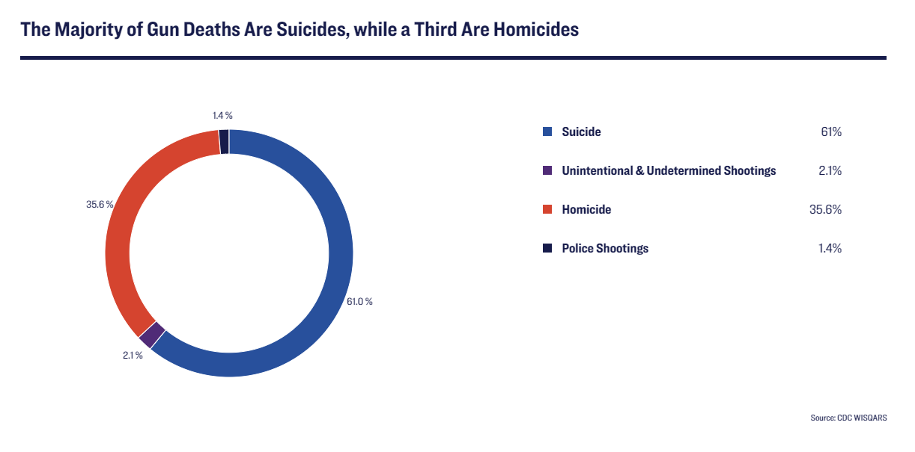
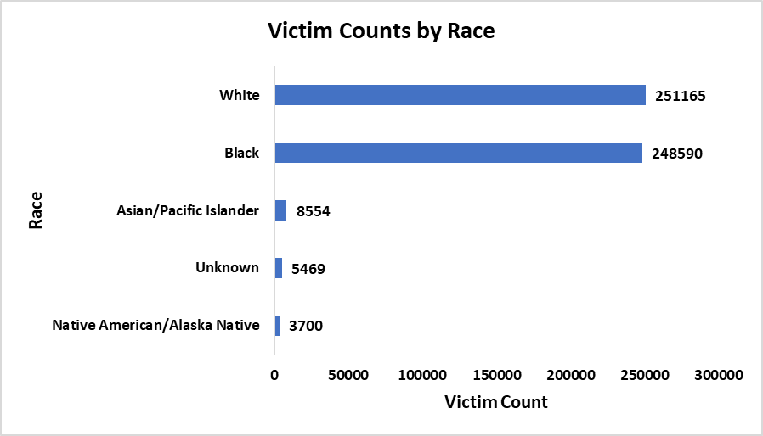

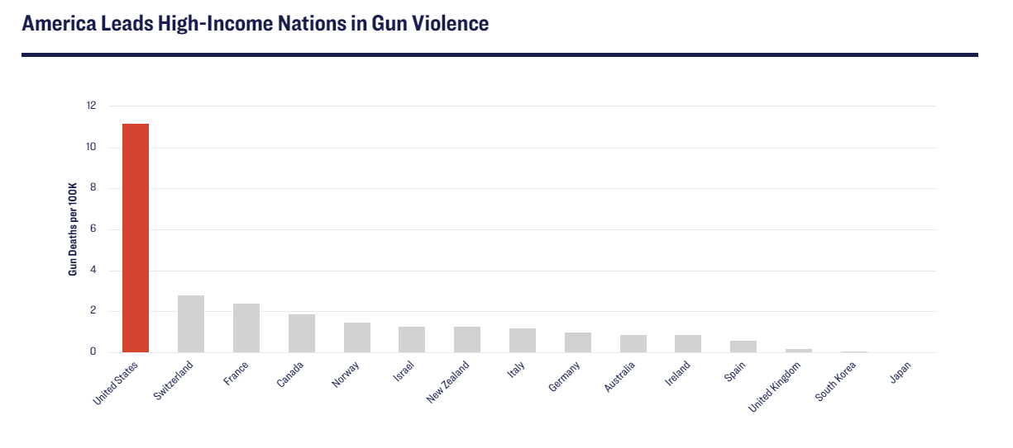
Facts
Gun violence takes many forms such as suicides, homicides, police shootings, etc. One third of Gun deaths are homicides.
Black / African American population in the US is just around 13% yet they are affected disproportionately.
America leads in gun violence among high income nations.
Notes:
Reana

Slide 3
Concealed Carry
National Controversy and Second Amendment Rights
Debate Surrounding Gun Control
Look at Concealed Carry Legislation
Explore effect on Homicides
Notes:
Amit

Slide 4
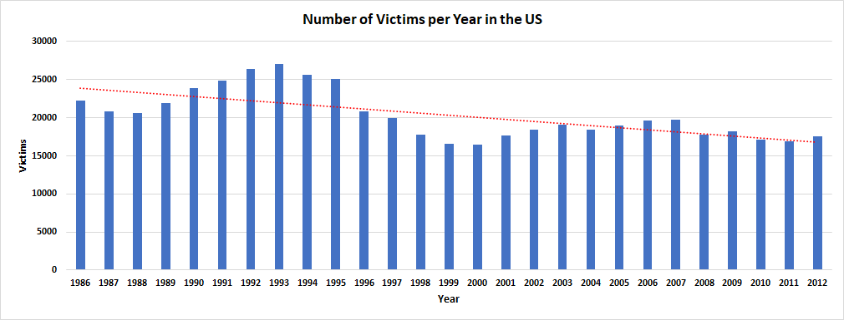
History
Notes:
Reana

Slide 5

What effect does change in concealed carry legislation have on the number of victims seen due to gun violence?
Notes:
Amit

Slide 6
The
Data
Sourced from the Murder Accountability Project
Contains Homicide Data from all 50 States
Each Record - 1 Homicide Incident
Focusing on Texas, Illinois, North Carolina
Focusing on Victim Count
Key Terms:
Shall Issue: If all requirements set by state law are met, concealed carry permit will be issued
No Issue: No issuance of concealed carry permits regardless of qualifications
Notes:
Reana

Slide 7



Post-processed
Data
Date Range: 1990/2000
Texas vs. Illinois Data
3,427 Total Homicides
Texas: 2,495
Change in Legislation in 1995
Illinois: 932
North Carolina vs. Illinois Data
1,736 Total Homicides
N. Carolina: 804
Change in Legislation in 1995
Illinois: 932
Notes:
Reana

Slide 8
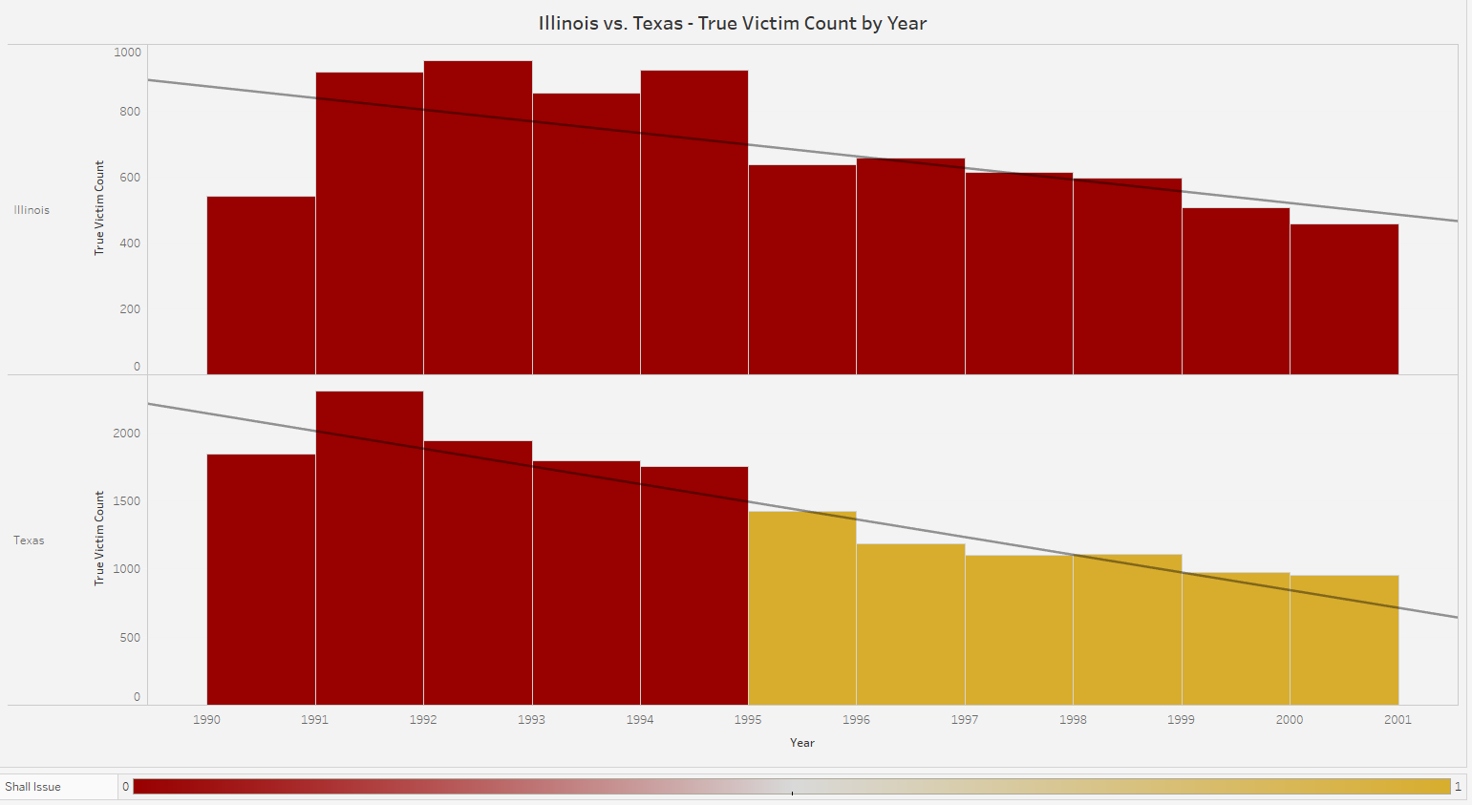
Parallel Trends- DiD Model 1
Parallel Trends in Illinois and Texas before change in gun law
Notes:
Aman

Slide 9
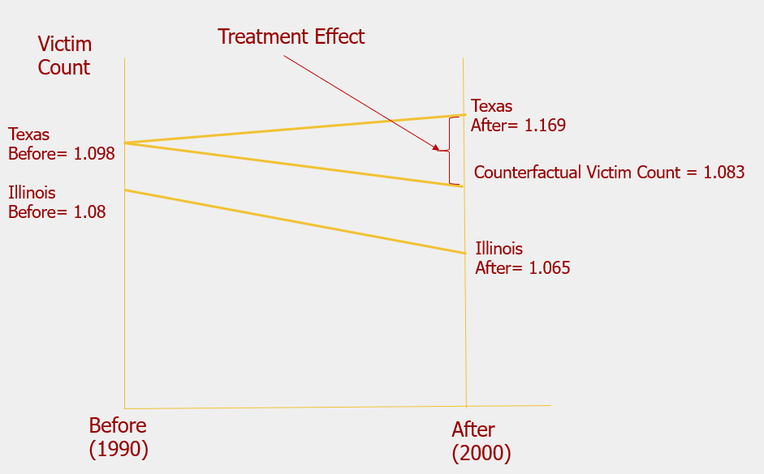
TX vs. IL Model
Victim_Count = β₀+δ₀ y20 + β₁Texas + δ₁y20*Texas +µ
Control Group: Illinois
Before: 1.08
After: 1.065
Treatment Group: Texas
Before: 1.098
After: 1.169
Legislation Change in 1995
Notes:
Aman

Slide 10
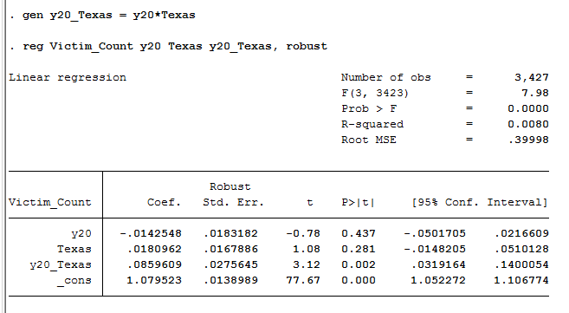
Model 1
Results
Based on the results above, the isolated effect of change in legislation from no issue to shall issue is an increase in average victim count of 0.08596 individuals per homicide.
Notes:
Mariam: While looking at our interaction variable here we see the isolated effect in gun legislation is 0.08596.

Slide 11
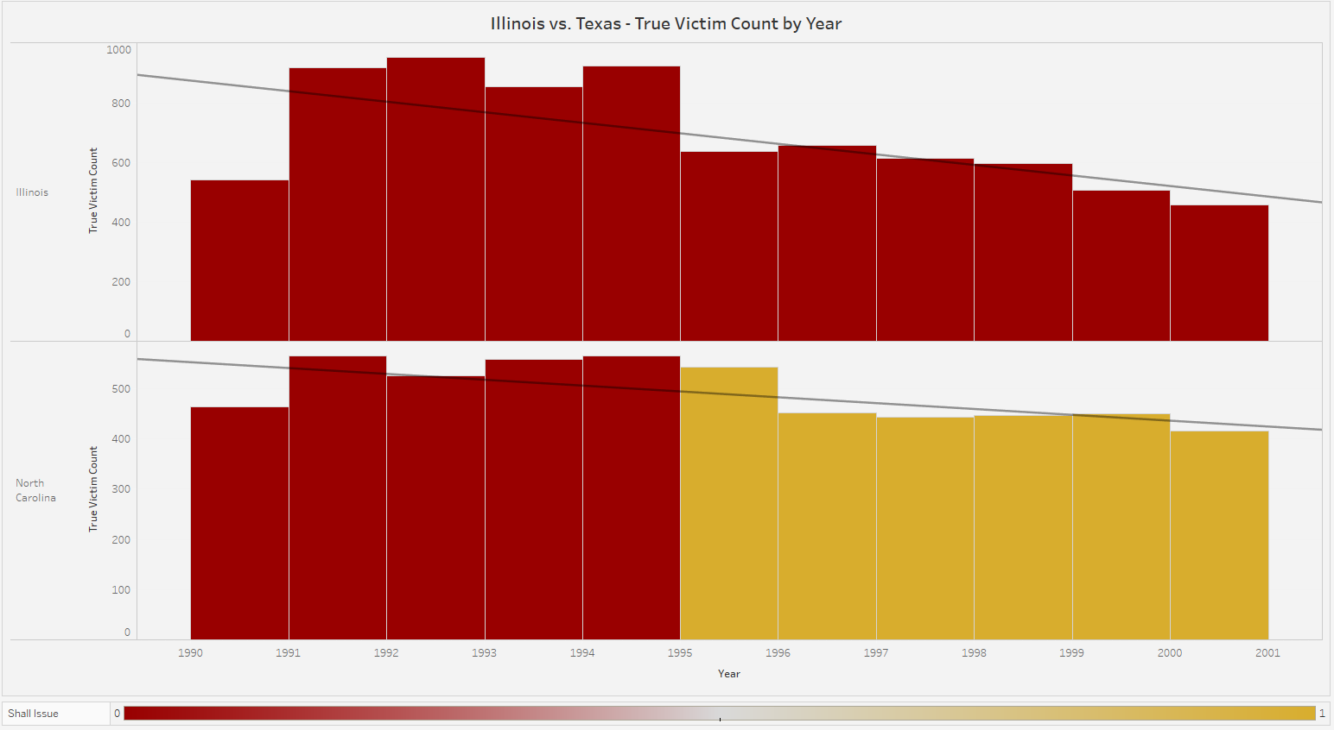
Parallel Trends - DiD Model 2
Parallel Trends in Illinois and North Carolina before change in gun law
Notes:
Aman

Slide 12
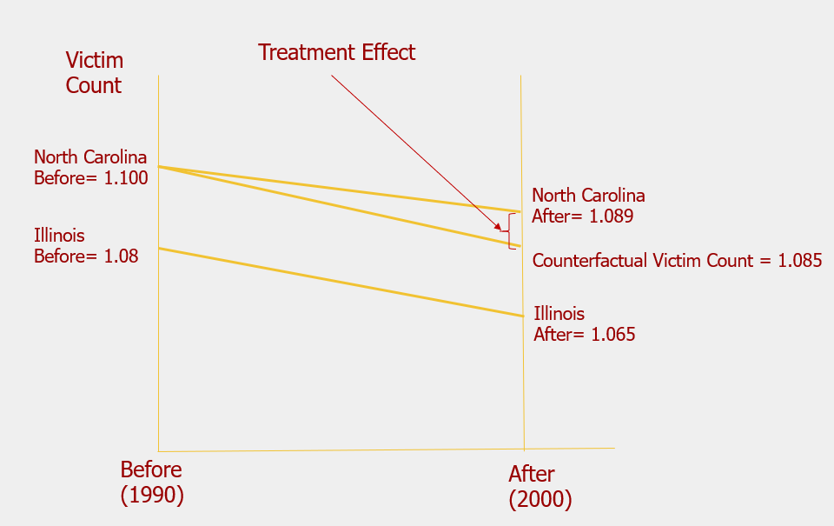
NC vs. IL Model
Victim_Count = β₀+δ₀ y20 + β₁NC + δ₁y20*NC+µ
Control Group: Illinois
Before: 1.08
After: 1.065
Treatment Group: North Carolina
Before: 1.100
After: 1.089
Legislation Change in 1995
Notes:
Aman

Slide 13
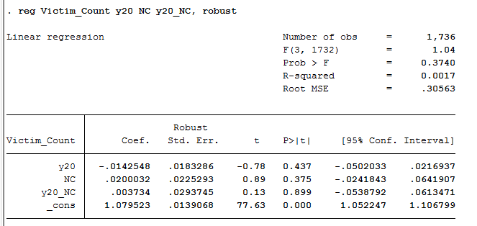
Model 2
Results
Based on the results above, the isolated effect of change in legislation from no issue to shall issue is an increase in average victim count of
0.003734 individuals per homicide.
Notes:
Brandon, once again here, the r squared value was very low, but can still interpret the coefficients, results are similar to prior model in which we saw a slight increase in victim count due to legislation change. Based off our two models , the hypothesis that easier gun access will lead to more victims is supported.

Slide 14
Thank You
Notes:
Amit

