Slide 1

COUPON REDEMPTION PREDICTION AND ANALYSIS
Amit Gottipati

Slide 2

Company background
XYZ credit card company regularly helps its merchants understand their data better and take key business decisions accurately by providing machine learning and analytics consulting.
ABC is an established brick & mortar retailer that frequently conducts marketing campaigns for its diverse product range.
As a merchant of XYZ, they have sought XYZ to assist them in their discount marketing process using the power of machine learning.
ABC promotions are shared across various channels including email, notifications etc.
A number of these campaigns include coupon discounts that are offered for a specific product/range of products.
The retailer would like the ability to predict whether customers redeem the coupons received across channels, which will enable the retailer’s marketing team to accurately design coupon construct and develop more precise and targeted marketing strategies.

Slide 3
Objective
Based on previous transaction & performance data from the last 18 campaigns, predict the probability for the next 10 campaigns in the test set for each coupon and customer combination, whether the customer will redeem the coupon or not?

Slide 4
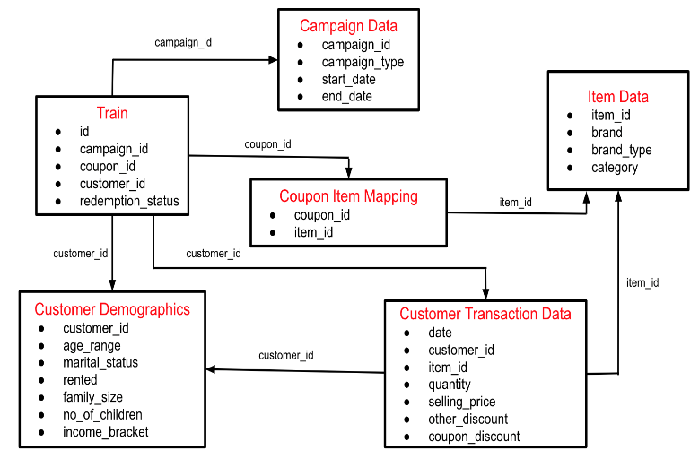
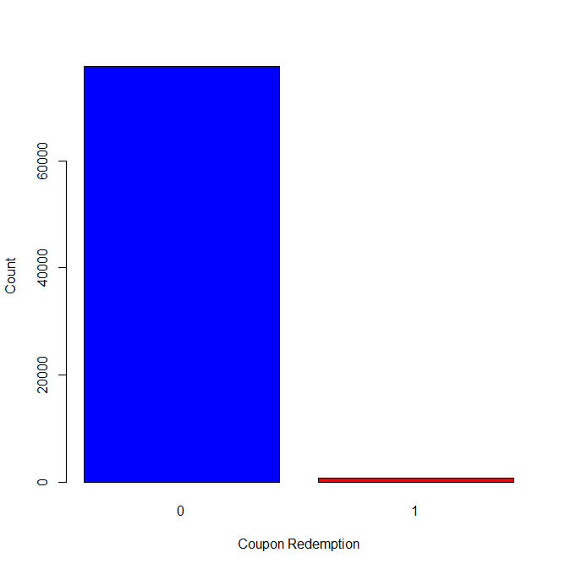
Data and Description
The data available in this problem contains the following information, including the details of a sample of campaigns and coupons used in previous campaigns
User Demographic Details
Campaign and coupon Details
Product details
Previous transactions
Our data was available in the following schema. The merged and aggregated version of the data was used for predicting customer’s coupon redemption.
We looked at our target variable redemption_status and found it to be imbalanced as only ~1% of coupons were redeemed by customers.
We then normalized our independent variables by subtraction by mean and dividing by standard deviation to fit and train our model better.

Slide 5
Data and Description
TRANSACTIONS AND CUSTOMER ID’s:
Data covers the transactions between 1/2/2012 to 3/22/2013 – There are 445 days in total.
Total number of transactions in 445 days is 1.048.575.
There are 1582 different customer ID’s.
The maximum count of transaction is 3920, which is done by customer ID 1555.
The minimum count of transaction is 12, which is done by customer ID 796.
PRODUCTS AND ASSOCIATED REVENUE:
There were 66.449 different kinds of items considered.
85055 is the highest quantity of items sold in one transaction.
Total revenue generated in 445 days 142.060.287.051,94
The two different discount in data - coupon discount and other discount.
17.810 is the price of the most expensive item, 0.36 the cheapest item.

Slide 6
Data and Description
COUPONS REDEEMPTION & DISCOUNTS BASED ON TRANSACTIONS:
In 16.403 transactions, customers used coupon.
In 533.572 transactions, item was discounted by other discounts.
In 509.045 transactions, item was sold without any discount.
In 529.085 transactions, item was discounted by other or coupon discounts.
In 10.445 transactions, both coupon and other discounts were used.
In 5.958 transactions, ONLY coupon discount was used.
In 523.127 transactions, ONLY other discounts applied.
OVERALL REVENUE GENERATED:
220.022.165,01 is the total amount of revenue that came from full price sales.
913.150,86 revenue came from both coupon & other discounts applied.
1.078.408,10 revenue came when customer used ONLY coupon discount.

Slide 7
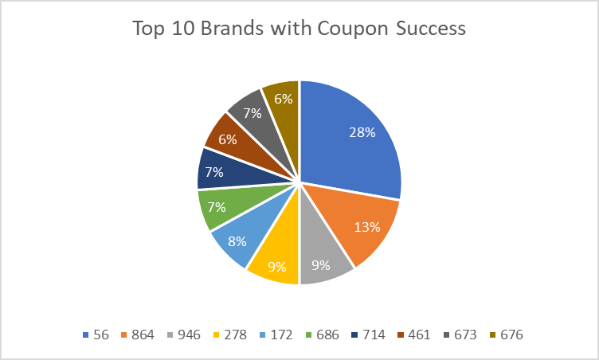
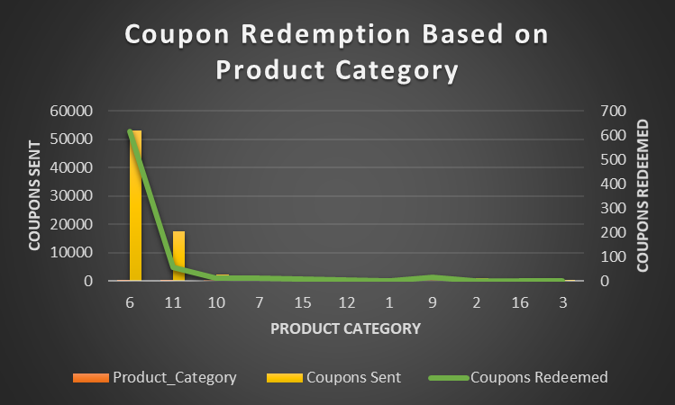
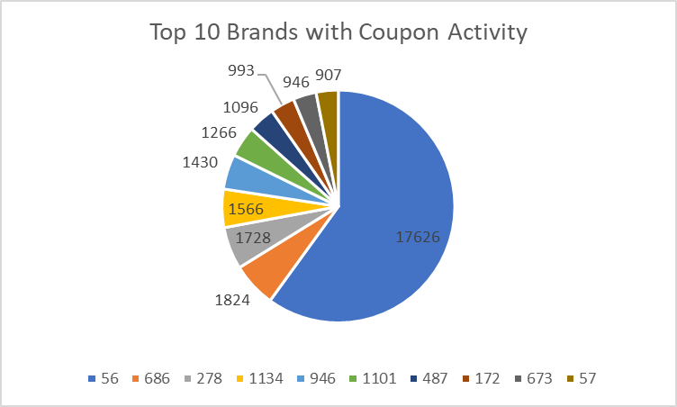
Exploratory Analysis
Campaign duration was between 32 - 63 Days for training data
Most coupons were sent for Product Category 6 and 11
Coupons were sent for 289 brands, out of those only 124 brands had their coupons redeemed.
Brand 56 sent the most coupons and got most success
Brands sending more coupons were not always successful.

Slide 8
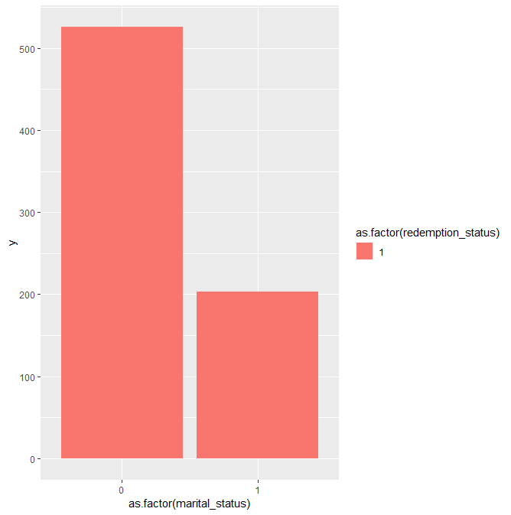
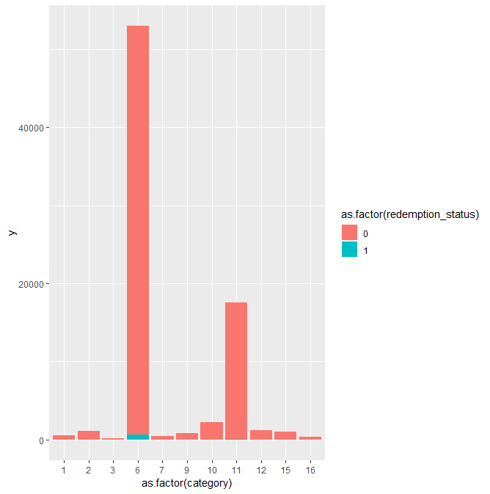
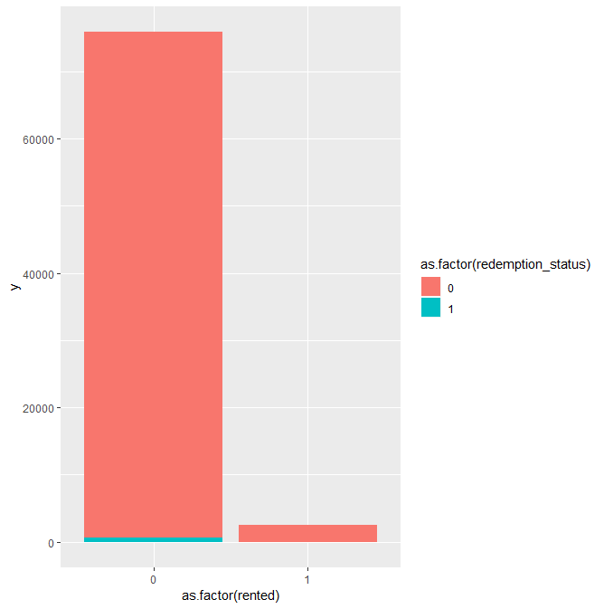
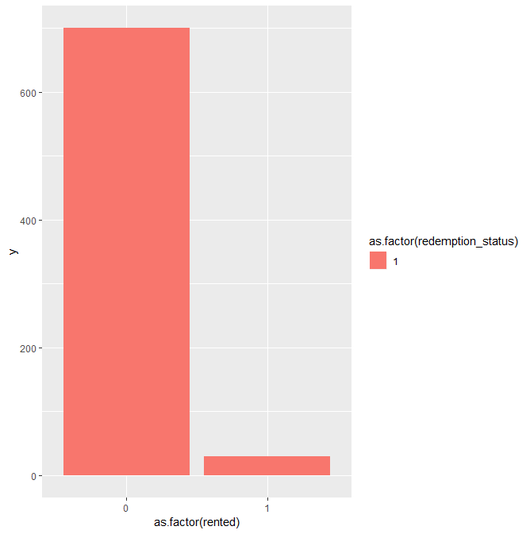
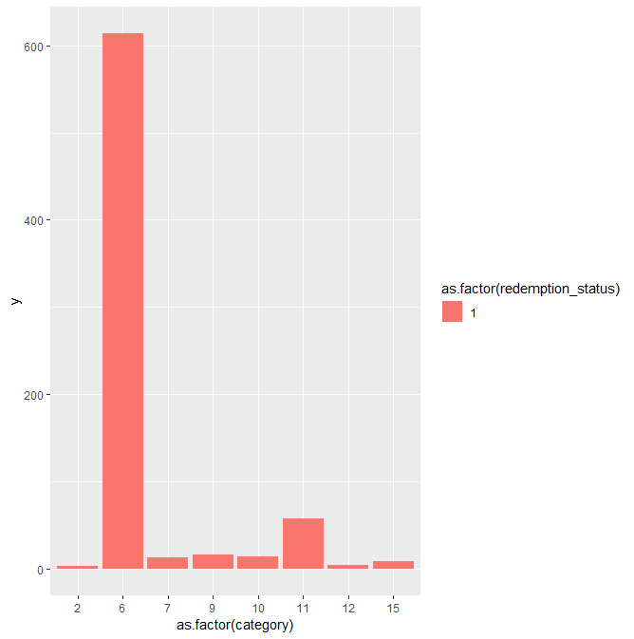
Exploratory Analysis
Product Category 6 and 11 were more targeted. Product 6 most success as a result.
Single People redeemed the coupon more times.
Coupons who rented were sent very less coupons as a result less coupons

Slide 9
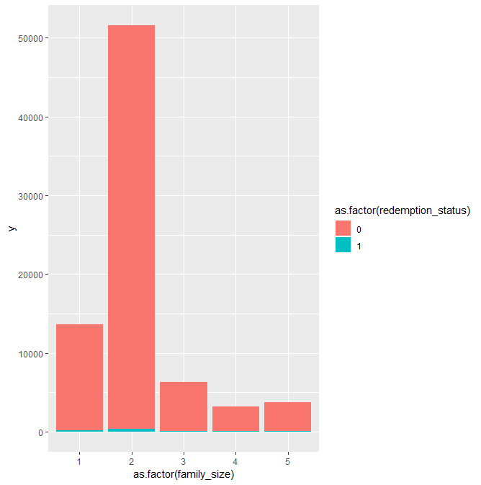
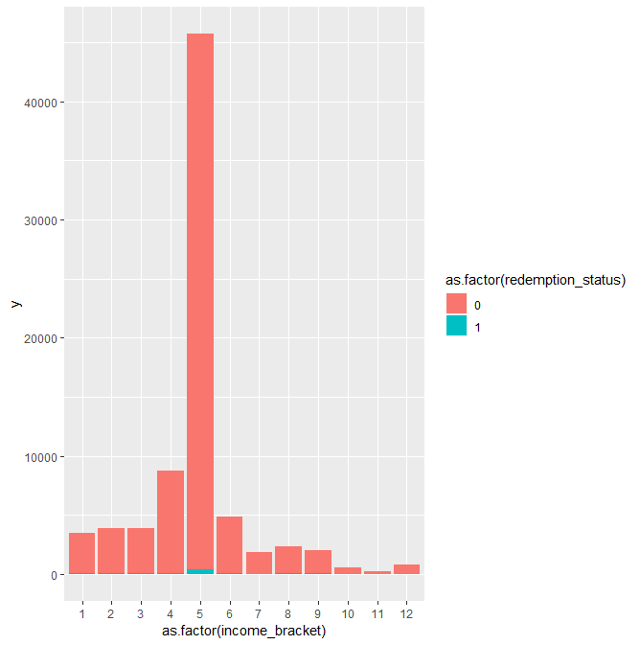
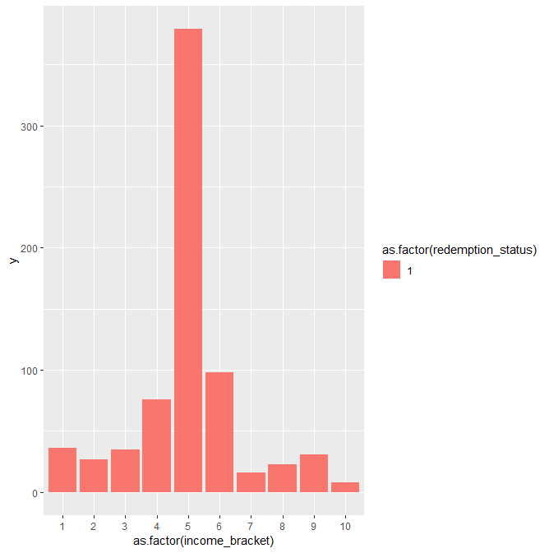
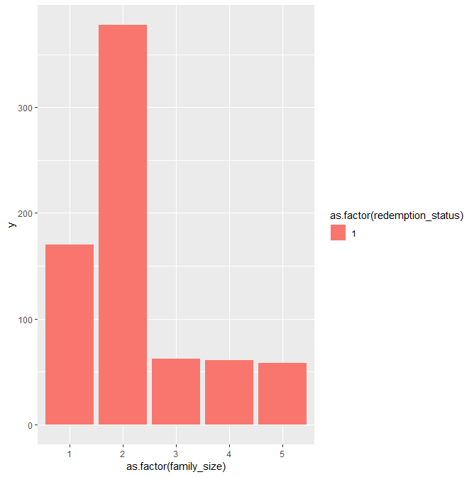
Exploratory Analysis
Income bracket of 4,5,6 were sent most coupons. Middle class people were prioritized.
Income bracket 5 redeemed the most coupons and income bracket 6 had used more coupons than 4 despite being sent less coupons. The people are price sensitive.
Family size of 2 and 1 were sent the most coupons

Slide 10
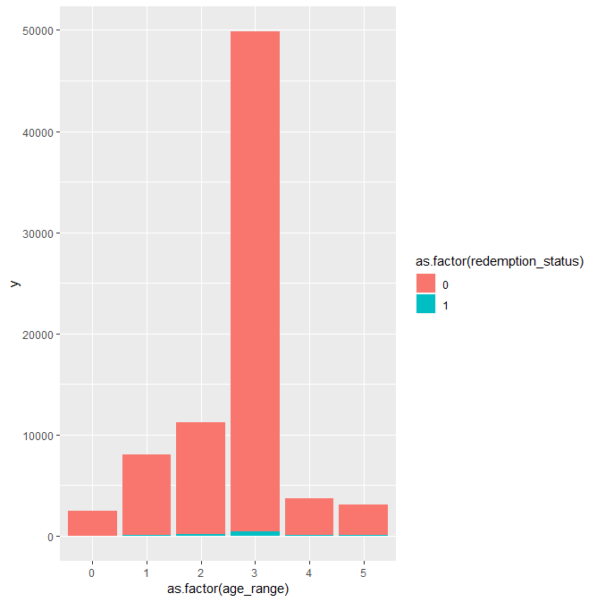
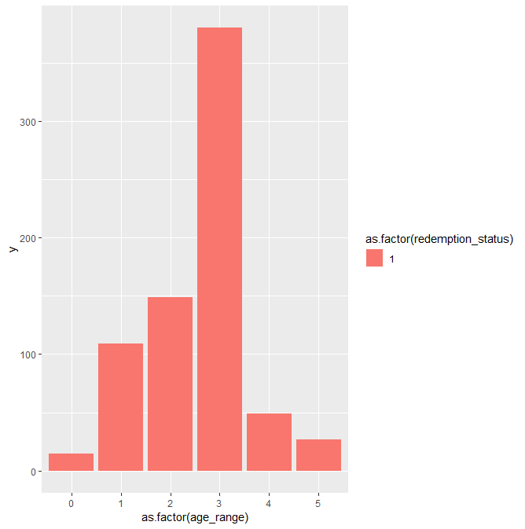
Exploratory Analysis
Age Range 3 was most preferred for sending coupons but age range 1 and 2 are also using coupons. Younger generation is using more coupons

Slide 11
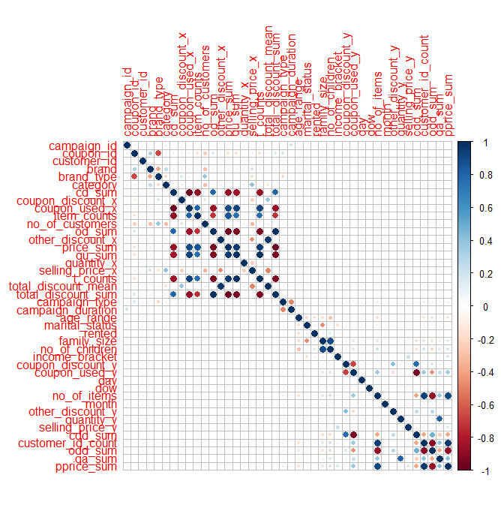
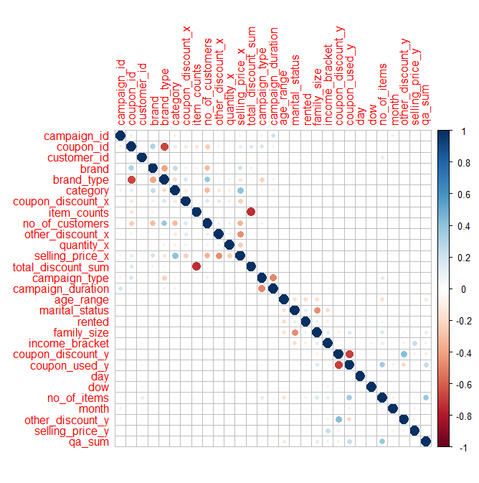
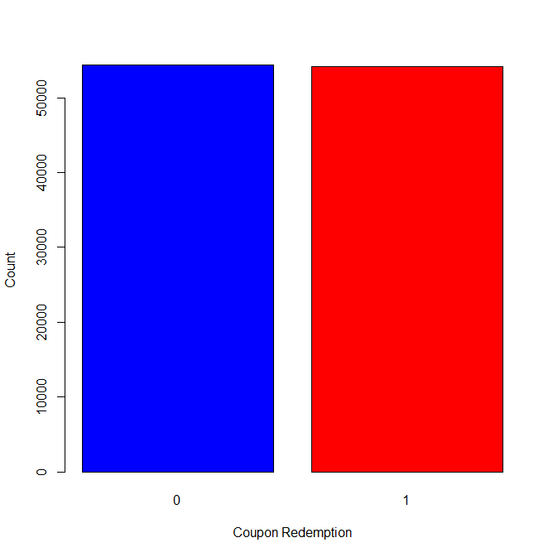
Data Transformation
Next, we checked for correlations in our dataset and removed variables which were highly correlated (>=0.75). Some variables which caused high correlation were no of children which was highly correlated to family size, price_sum, total_discount_mean, coupon_discount_sum, etc. These were removed from our data.
After this, the dataset was split into training and validation dataset with 70:30 ratio and then Synthetic Minority Oversampling Technique (SMOTE) was applied only on the training dataset to increase number of observations in which coupon was redeemed. This was done because we only had 1% coupons redeemed and 99% coupons unredeemed. Applying this technique gave better performance on validation dataset by 20%

Slide 12
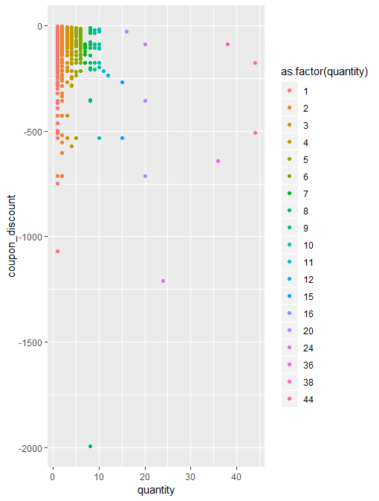
Customer transaction data
We looked at the quantity purchased when coupon discount was used. We see that purchase quantity is limited to 10 even when discount is increased.
With very high discounts (250-500 $) the quantity is limited 1,2,3 suggesting higher price of items.

Slide 13
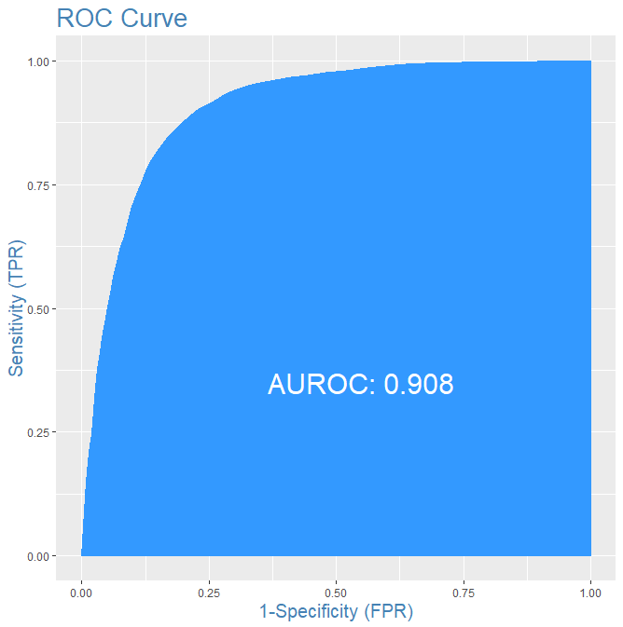
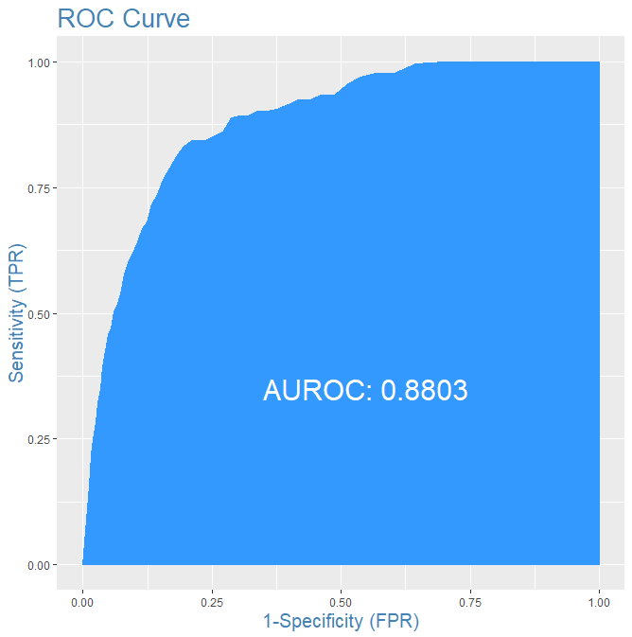
Results
A logistic regression model was trained on 70% of data to predict which coupon will be redeemed.
After creating the model we checked for VIF>5 for multicollinearity and found none.
Precision and Accuracy were considered important metrics for our model as precision is number of correctly predicted positives out of actual positives = TP/(FP + TP) and we want to minimize the number of False Positives as we are using resources to send coupons of our brands through different channels.
This model was run on remaining 30% validation dataset and it performed well.
For our next 10 campaigns this will be used to predict the customer redemptions on the test set.
This model was chosen as it had the lowest AIC score which represents the best model.

Slide 14
Limitations and Recommendations
Due to low % of coupon redemptions (~1%), It is very difficult to explore much differences across different groups, brands in terms of coupons redeemed and not redeemed . We cannot use the oversampled data to do exploratory analysis.
The transaction data is from last 18 campaigns. We are using it to predict our next 10 campaigns. We should update our model with latest transactions every passing campaign to make our model gather more variations from the data and be more accurate. Not doing so can result in poor performance for latter campaigns.
In our data many of the labels like income_bracket, brand etc. are level encoded so it is very difficult to analyze the reasons and patterns shown by them.
The data is aggregated for all brands and product categories. The models can more accurate if we only take individual brands or product categories.
Having location of customers/products sold would help us see the effect of coupons based on geographical location.

Slide 15

The End!

