Slide 1
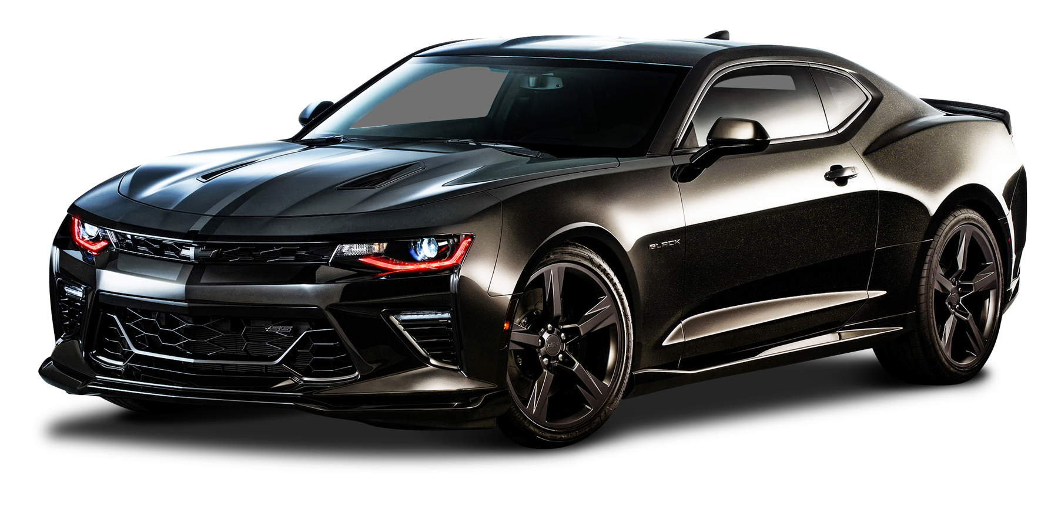
FLEET SALES PRICING AT FJORD MOTOR
Amit Gottipati

Slide 2

Coronet Elizabeth Fleet Sales background
Popular for fleet purchases (>10 units) by corporations and police departments
Fleet sales are negotiated separately by regional sales teams
Price is negotiated via a bidding process
4,000 bids each quarter, with a 70% win rate
Cost per unit is $15,000 and MSRP is $25,000

Slide 3

Opportunities to Optimize Fleet Sales Pricing with a universal price
There is money left on the table to be made
Data of the last 4,000 bids are gathered
No unified strategies for pricing
No specifications of competitors and their offers for each bid
No specifications on customers type for each bid
A universal price model can be applied to maximize Margin

Slide 4
Universal pricing model can increase Total Contribution by 40% and change Net Margin from 12% to 28% without customer specification
Without customer specification, we suggest the following model for Fjord:
Margin = (Price – Cost)* Current # cars sold/ (1+e^{-7.756+9.164*Price/MSRP})
Suggested price to optimize Contribution Margin: $20,818.5
The new price, given to all customer bids, can improve the current contribution by $69M, or 40% increase.
Net Margin improves from 12% to 18%.
However, revenue will be offset by $600M (-41%) due to lower demand.
This model can be applied to abide by Fjord’s objective of profit maximization.
 | Current | Optimized
Total Contribution | $ 171,829,002 | $ 241,072,096
Revenue | $ 1,463,168,035 | $ 862,544,013
Net Margin | 12% | 28%

Slide 5
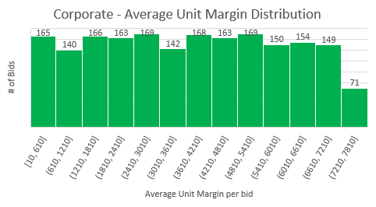
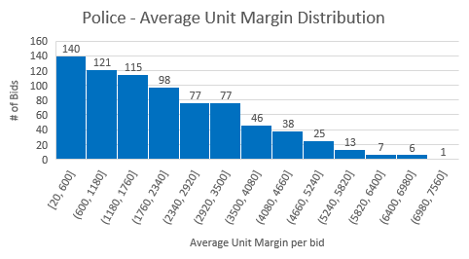
With customer identification, we observe that Corporate customers bring significantly more business and profits …
Fjord historically wins 98% of Corporate bids but only 38% of Police bids (with similar # of units sold per bid).
On average, Corporate businesses are 78% more profitable than Police.
The majority of Police customers are concentrated on the low end of profitability per unit, while Corporate customers are more flexible, even in the higher end of pricing.
Customer | Total Contribution | Units sold | Average Unit Margin | Bids Won | Average cars # /bid won
Police | $ 30,054,865 | 14,386 | $ 2,089 | 38% | 18.80
Corporate | $ 141,774,137 | 38,144 | $ 3,717 | 98% | 19.40

Slide 6
With customers identification, we can apply our Optimization model for Police and Corporate separately
Applying the same profit optimization model, we recommend the following:
M_{P} = (P_{P}-C)*Market size_{P}/(1+ e^{-14.224 + 20.01*P}_{P} ^{/MSRP}) at P_{Police} = $17,638.5
M_{C} = (P_{C}-C)*Market size_{C} /(1+ e^{-27.875 + 28.812*P}_{C} ^{/MSRP}) at P_{Corp} = $22,431.2
Segmented Optimization incurs $67M (28%) increase in Total Contribution and $269M (31%) increase in Total Revenue compared to Universal Optimization.
Segmented Optimization incurs $136M (80%) increase in Total Contribution with a $331M (-22%) decrease in Total Revenue compared to current price.
Segmented Optimization, in general, maintains the profit margin while reducing the adverse effect on Revenue in the case of Profit optimization.
 | Current | Universal Optimization | Segmented Optimization
Total Revenue | $ 1,463,168,035 | $ 862,544,013 | $ 1,131,880,007
Total Contribution | $ 171,829,002 | $ 241,072,096 | $ 308,684,997
Margin | 12% | 28% | 27%

Slide 7
Exploring models in which fleet size creates an impact on Optimal price
With fleet size being a consideration for an optimal price, we recommend the following models for Winning probablity
Police sales: P_{P} = 1 / (1+e^{-14.97+20.23*Pp+0.029*S})
Corporate : P_{C} = 1 / (1+e^{-28.88+29.31*Pc+0.029*S})
Suggested bid pricings are included in the adjacent table
There is a slight positive proportion between fleet size and discount rate compared to the Segmented Optimal Price.
Optimal Price |  |  | Segmented Optimized Price
 | 20 cars | 40 cars
Police | $17,620 | $17,258 | $17,638
Corporation | $22,394 | $21,946 | $22,431
Average Discount | 0.13% | 2.16% | -
The adjacent table displays respective log likelihood of pricing models differentiating Police vs Corporate with a combined model.
Segmented models have lower log likelihood => Recommended.
Models | Log Likelihood
Police | -905.86
Corporate | -124.34
Both | -1021.15

Slide 8
The Unit cost for Police Cars has increased to $16,000 …
Optimal Price |  |  | Original Optimized Price
 | 20 cars | 40 cars
Police | $18,143 | $17,862 | $17,638
Increment | $505 | $224
The new cost of Police cars increase the recommended price per bids.
Recommended prices for a sales of 20 cars are slightly higher than 40 cars.

Slide 9
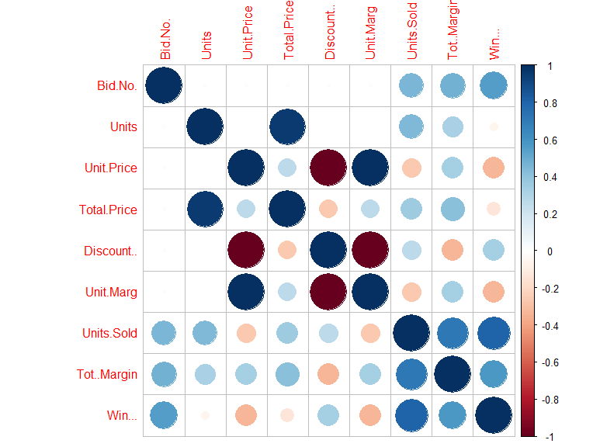
Ways to improve the models
We recommend collecting and monitoring the following factors to improve the model in the future:
Numbers of days from receiving RFQ to sending bids.
Employee ID# to monitor each salesperson’s performance.
Non-price factors such as proposal quality, relationships with the customers and technical fit of the proposal to customer’s need.
Dates of bids sent and accepted to find trends and seasonality.
Location and industry of customers.
Variations in products per customer preferences.
Many of the variables in the data are highly correlated such as Units - Total Price, Unit Price - Discount - Unit Margin, Units Sold - Total Margin -Win. We need to use significant uncorrelated variables for better prediction of winning a bid.

Slide 10
Restrictions on Fjord’s pricing
Poor economic factors such as GDP slow down, drop in global trade of the automotive industry might restrict Fjord in implementing its optimal pricing strategy.
Stricter regulations and increased trade tariffs can raise the crucial manufacturing cost of an automaker.
The models do not consider increasingly competitions in the market.
The models do not consider the vehicle usage as high usage can lead to better profit in the service sector.

Slide 11
Incentives for Fjord fleet staffs
Customer satisfaction should be considered for incentives.
Sales staff should be allowed to price outside optimal prices in certain circumstances, such as to incur repeated customers or to incentivize a large sale.
In case, if a buyer wanted to buy large number of vehicles and get it delivered in 2 days or so – the sales staff can charge a price higher than its optimal price for its customized service offerings. In the above scenario, delivery time is a significant factor that may affect the product price.
Sales staff should not be measured based solely on Revenues, but rather a robust set of metrics including revenues, profits, how close they can get to the optimal price and customer satisfaction.

Slide 12

The End!

