Slide 1
Comparing Clustering Algorithms
Partitioning Algorithms
  K-Means
  DBSCAN Using KD Trees
Hierarchical Algorithms
  Agglomerative Clustering
  CURE

Slide 2
K-Means Partitional clustering
Prototype based Clustering
O(I * K * m * n) Space Complexity
Using KD Trees the overall Time Complexity reduces to O(m * logm)‏
Select K initial centroids
Repeat
  For each point, find its closes centroid and assign that point to the centroid. This results in the formation of K clusters
  Recompute centroid for each cluster
  until the centroids do not change

Slide 3
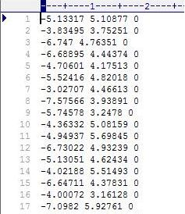
K-Means (Contd.)‏
Datasets
- SPAETH2 2D dataset of 3360 points

Slide 4
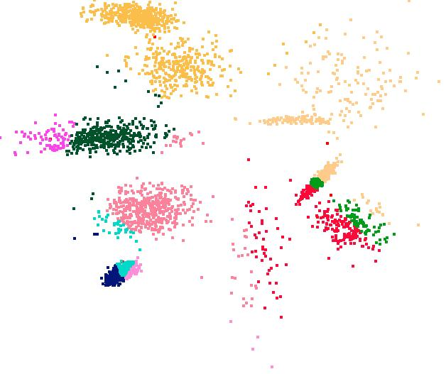

Slide 5
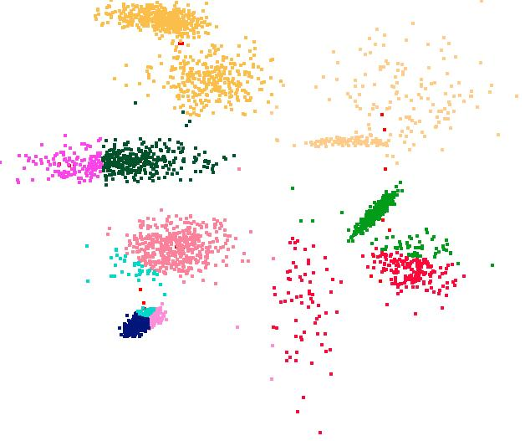

Slide 6
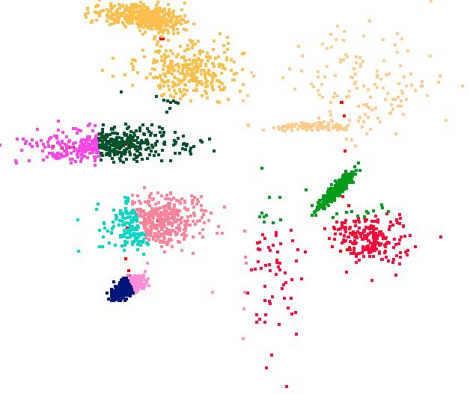

Slide 7


Slide 8
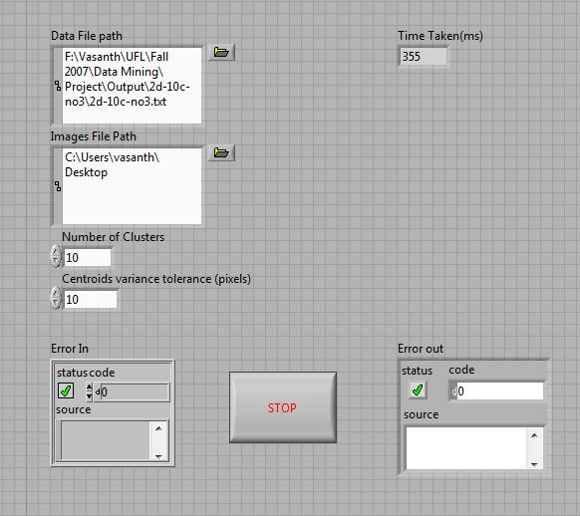

Slide 9
K-Means (Contd.)‏
Performance Measurements
Compiler Used
  LabVIEW 8.2.1
Hardware Used
  Intel® Core(TM)2 IV 1.73 Ghz
  1 GB RAM
Current Status
  Done
Time Taken
  355 ms / 3360 points

Slide 10
K-Means (Contd.)‏
Pros
Simple
Fast for low dimensional data
It can find pure sub clusters if large number of clusters is specified
Cons
K-Means cannot handle non-globular data of different sizes and densities
K-Means will not identify outliers
K-Means is restricted to data which has the notion of a center (centroid)

Slide 11
Agglomerative Hierarchical Clustering
Starting with one point (singleton) clusters and recursively merging two or more most similar clusters to one "parent" cluster until the termination criterion is reached
Algorithms:
  MIN (Single Link)
  MAX (Complete Link)
  Group Average (GA)
MIN: susceptible to noise/outliers
MAX/GA: may not work well with non-globular clusters
CURE tries to handle both problems

Slide 12
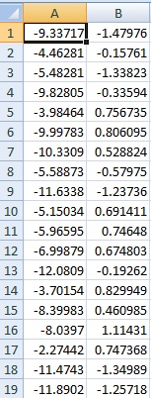
Data Set
2-D data set used
  The SPAETH2 dataset is a related collection of data for cluster analysis. (Around 1500 data points)

Slide 13
Algorithm optimization
It involved the implementation of Minimum Spanning Tree using Kruskal’s algorithm
Union By Rank method is used to speed-up the algorithm
Environment:
  Implemented using MATLAB
Other Tools:
  Gnuplot
Present Status
  Single Link and Complete Link– Done
  Group Average – in progress

Slide 14
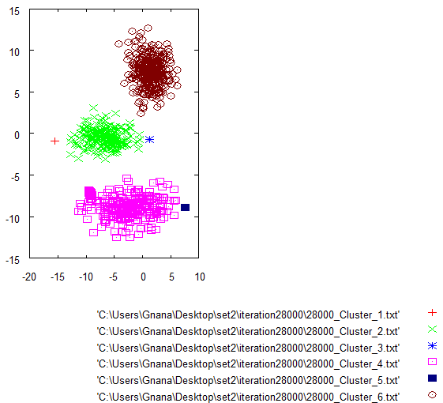
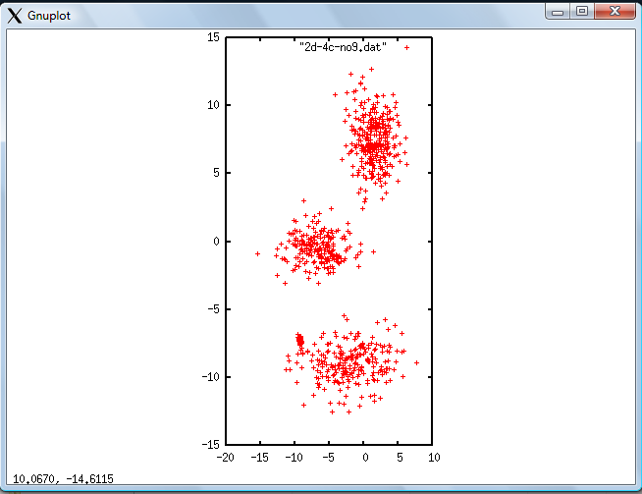
Single Link/CURE Globular Clusters

Slide 15
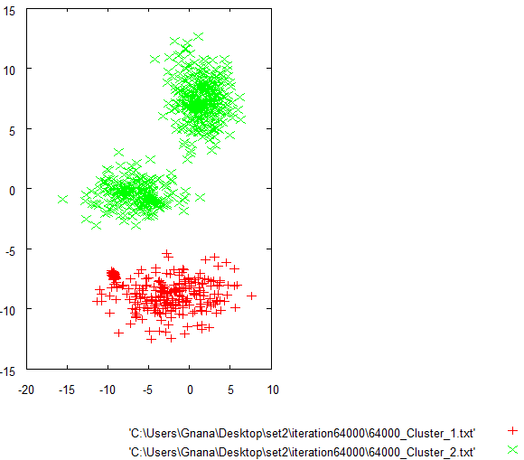
After 64000 iterations

Slide 16
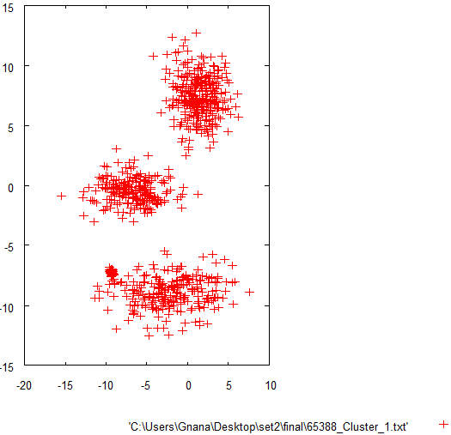
Final Cluster

Slide 17
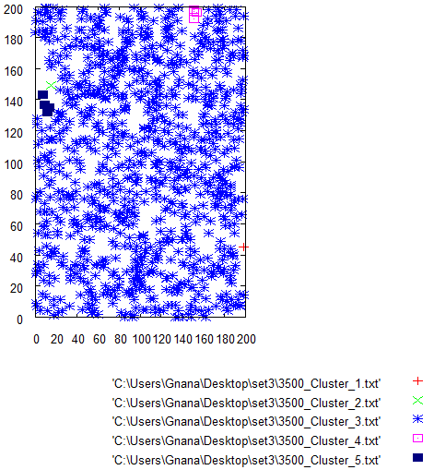
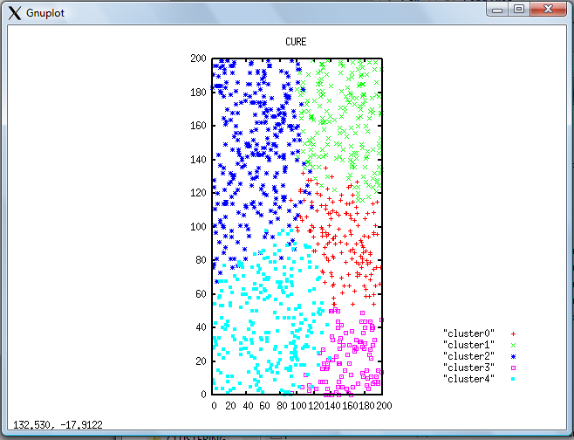
Single Link / CURE Non globular

Slide 18
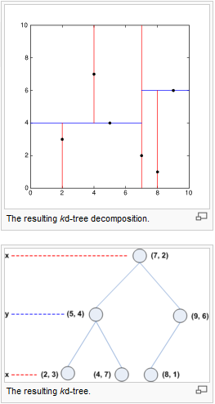
KD Trees
K Dimensional Trees
Space Partitioning Data Structure
Splitting planes perpendicular to Coordinate Axes
Useful in Nearest Neighbor Search
Reduces the Overall Time Complexity to O(log n)‏
Has been used in many clustering algorithms and other domains

Slide 19
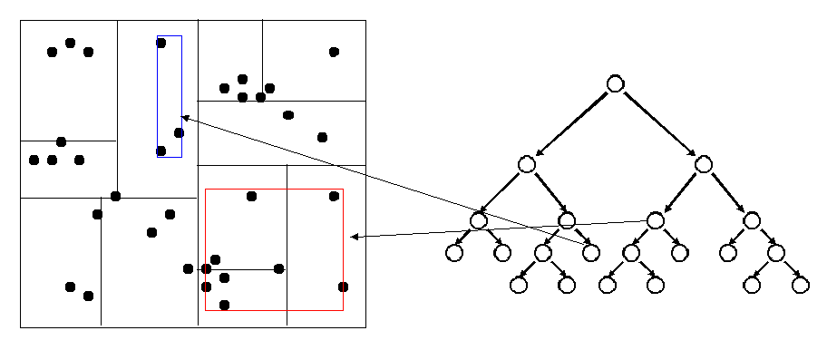
Clustering Algorithms use KD Trees extensively for improving their Time Complexity Requirements
Eg. Fast K-Means, Fast DBSCAN etc
We considered 2 popular Clustering Algorithms which use KD Tree Approach to speed up clustering and minimize search time.
We used Open Source Implementation of KD Trees (available under GNU GPL)‏

Slide 20
DBSCAN (Using KD Trees)‏
Density based Clustering (Maximal Set of Density Connected Points)‏
O(m) Space Complexity
Using KD Trees the overall Time Complexity reduces to O(m * logm) from O(m^2)‏
Pros
Fast for low dimensional data
Can discover clusters of arbitrary shapes
Robust towards Outlier Detection (Noise)‏

Slide 21
DBSCAN - Issues
DBSCAN is very sensitive to clustering parameters MinPoints (Min Neighborhood Points) and EPS (Images Next)‏
The Algorithm is not partitionable for multi-processor systems.
DBSCAN fails to identify clusters if density varies and if the data set is too sparse. (Images Next)‏
Sampling Affects Density Measures

Slide 22
DBSCAN (Contd.)‏
Performance Measurements
Compiler Used - Java 1.6
Hardware Used Intel Pentium IV 1.8 Ghz (Duo Core)‏ 1 GB RAM
No. of Points 1572 3568 7502 10256
Clustering Time (sec) 3.5 10.9 39.5 78.4

Slide 23
CURE – Hierarchical Clustering
Involves Two Pass clustering
Uses Efficient Sampling Algorithms
Scalable for Large Datasets
First pass of Algorithm is partitionable so that it can run concurrently on multiple processors (Higher number of partitions help keeping execution time linear as size of dataset increase)‏

Slide 24
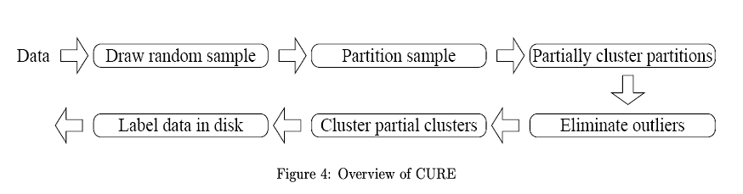
Source - CURE: An Efficient Clustering Algorithm for Large Databases. S. Guha, R. Rastogi and K. Shim, 1998.
Each STEP is Important in Achieving Scalability and Efficiency as well as Improving concurrency.
Data Structures
KD-Tree to store the data/representative points : O(log n) searching time for nearest neighbors
Min Heap to Store the Clusters : O(1) searching time to compute next cluster to be processed
Cure hence has a O(n) Space Complexity

Slide 25
CURE (Contd.)‏
Outperforms Basic Hierarchical Clustering by reducing the Time Complexity to O(n^2) from O(n^2*logn)‏
Two Steps of Outlier Elimination
  After Pre-clustering
  Assigning label to data which was not part of Sample
Captures the shape of clusters by selecting the notion of representative points (well scattered points which determine the boundary of cluster)‏

Slide 26
CURE - Benefits against Popular Algorithms
K-Means (& Centroid based Algorithms) : Unsuitable for non-spherical and size differing clusters.
CLARANS : Needs multiple data scan (R* Trees were proposed later on). CURE uses KD Trees inherently to store the dataset and use it across passes.
BIRCH : Suffers from identifying only convex or spherical clusters of uniform size
DBSCAN : No parallelism, High Sensitivity, Sampling of data may affect density measures.

Slide 27
CURE (Contd.)‏
Observations towards Sensitivity to Parameters
  Random Sample Size : It should be ensured that the sample represents all existing cluster. Algorithm uses Chernoff Bounds to calculate the size
  Shrink Factor of Representative Points
  Representative Points ⬆ Computation Time ⬆
  Number of Partitions : Very high number of partitions (>50) would not give suitable results as some partitions may not have sufficient points to cluster.

Slide 28
CURE - Performance
Compiler : Java 1.6 Hardware Used : Intel Pentium IV 1.8 Ghz (Duo Core)‏ 1 GB RAM
    No. of Points 1572 3568 7502 10256
    Clustering Time (sec)‏
    Partition P = 2 6.4 7.8 29.4 75.7
    Partition P = 3 6.5 7.6 21.6 43.6
    Partition P = 5 6.1 7.3 12.2 21.2

Slide 29
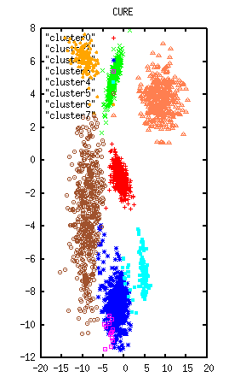
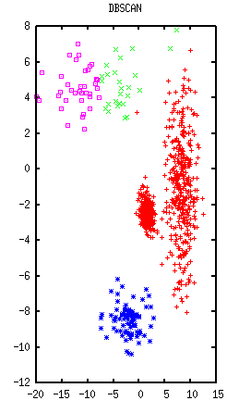
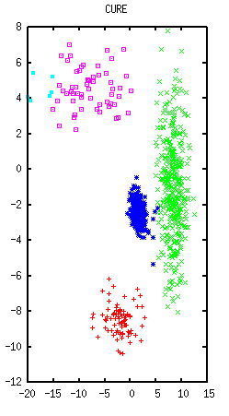
Data Sets and Results
SPAETH - http://people.scs.fsu.edu/~burkardt/f_src/spaeth/spaeth.html
Synthetic Data - http://dbkgroup.org/handl/generators/

Slide 30
References
An Efficient k-Means Clustering Algorithm: Analysis and Implementation - Tapas Kanungo, Nathan S. Netanyahu, Christine D. Piatko, Ruth Silverman, Angela Y. Wu.
A Density-Based Algorithm for Discovering Clusters in Large Spatial Databases with Noise - Martin Ester, Hans-Peter Kriegel, Jörg Sander, Xiaowei Xu, KDD '96
CURE : An Efficient Clustering Algorithm for Large Databases – S. Guha, R. Rastogi and K. Shim, 1998.
Introduction to Clustering Techniques – by Leo Wanner
A comprehensive overview of Basic Clustering Algorithms – Glenn Fung
Introduction to Data Mining – Tan/Steinbach/Kumar

Slide 31
Thanks!
Presenters
  Vasanth Prabhu Sundararaj
  Gnana Sundar Rajendiran
  Joyesh Mishra
Source www.cise.ufl.edu/~jmishra/clustering
Tools Used
JDK 1.6, Eclipse, MATLAB, LABView, GnuPlot
This slide was made using Open Office 2.2.1

