Slide 1


















SALES PROCESS TIMELINE
Prospect Identification
Prospect Qualification
Offer Presentation
Negotiation
Closing
Negotiate terms and adjust based on feedback from product testing.
Finalize the deal and launch the product with an integrated marketing strategy.
Find and identify prospects that match your target market.
Validate prospects before moving forward with product prototyping.
Present the product and identify issues for improvement.
Step 01
Step 02
Step 03
Step 04
Step 05

Slide 2














PRODUCT DEVELOPMENT TIMELINE
Ideation
Market Research
Ideation
Identify market needs and initial concepts for a new product.
Analyze trends and customer needs to validate the product idea.
Iterate based on feedback from product testing results.
02
04
06
01
03
05
Product Design
Testing & Prototyping
Launch
Develop the main design and features of the product before prototyping.
The product is launched to the market with an integrated marketing strategy.
Test the initial product to identify issues and improvements.

Slide 3



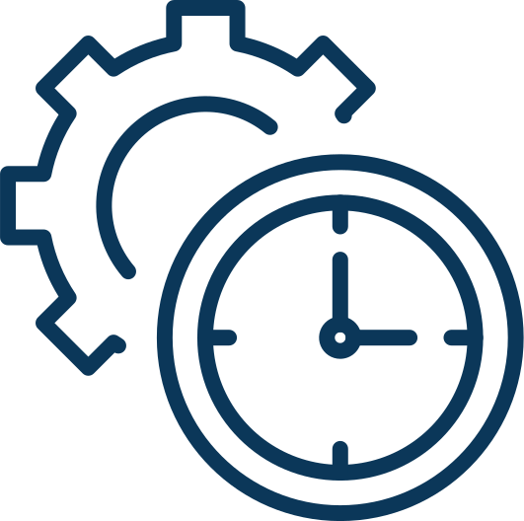








PROJECT MANAGEMENT TIMELINE
Project Planning
Team Allocation
Execution
Monitoring
Completion
Define the goals, budget, and project schedule before starting.
Allocate resources and the team that will work on the project.
Execute the project according to the plan and monitor progress.
Regularly track project progress to ensure goals are met.
Complete all deliverables and conduct project evaluation.
01
02
03
04
05

Slide 4












MARKETING STRATEGY TIMELINE
Audience Targeting
Campaign Execution
02
04
Market Research
Identify key audience segments for a more effective marketing campaign.
Campaign Development
Launch the campaign through the most relevant marketing channels.
Performance Analysis
01
03
05
Collect data to understand the target market and consumer preferences.
Design a marketing strategy based on research insights.
Evaluate the campaign to measure success and make adjustments.

Slide 5















Idea Validation
Identify market needs and initial concepts for a new product.
Funding Search
Identify market needs and initial concepts for a new product.
Product Development
STARTUP GROWTH TIMELINE
Identify market needs and initial concepts for a new product.
Launch & Scaling
Identify market needs and initial concepts for a new product.

Slide 6









IT IMPLEMENTATION TIMELINE
01
02
03
04
Planning & Approval
System Development
Testing
Go-Live
Identify market needs and initial concepts for a new product.
Identify market needs and initial concepts for a new product.
Identify market needs and initial concepts for a new product.
Identify market needs and initial concepts for a new product.

Slide 7











HR ONBOARDING TIMELINE
Planning & Approval
Planning & Approval
Planning & Approval
Identify market needs and initial concepts for a new product.
Identify market needs and initial concepts for a new product.
Identify market needs and initial concepts for a new product.
Planning & Approval
Planning & Approval
Planning & Approval
Identify market needs and initial concepts for a new product.
Identify market needs and initial concepts for a new product.
Identify market needs and initial concepts for a new product.

Slide 8











BUSINESS EXPANSION TIMELINE
01
03
02
04
Market Research
New Market Launch
Evaluate potential markets before expanding the business.
Execute the launch strategy to enter new markets.
Product Adjustment
Evaluation & Scaling
Adapt products or services to fit the new market's needs.
Review expansion results and plan continued growth.

Slide 9




Research & Design
Testing & Feedback
Design the product based on market research.
Test the product and gather feedback from early users.
Product Refinement
Marketing Strategy
Adjust the product based on feedback and testing results.
Develop a strong marketing strategy to support the launch.
Official Launch
PRODUCT LAUNCH TIMELINE
Launch the product to the market with a coordinated campaign.

Slide 10








CONTENT STRATEGY TIMELINE
Research & Audience Targeting
Distribution & Promotion
Identify the target audience for a tailored content strategy.
Distribute content through the most effective channels.
Content Creation
Analytics & Feedback
Create relevant content that meets audience needs and preferences.
Monitor content performance and gather audience feedback.
Step 01
Step 02
Step 03
Step 04

