Slide 1
Most probable path
A* Heuristic Search
Group 21
Members –
Rishi Raj Yadav 19ucs045
Tanay Makharia 19ucs122
Amit Gupta 19ucs011
Vipul Aggarwal 19ucs042
Vaibhav Gupta 19ucs115

Slide 2
Overview
The inadequacies of “Dijkstra's shortest path algorithm” search.
What is A* heuristic search ?
A* algorithm
A* heuristics
When to use A* over Dijkstra's algorithm
Is A* Guaranteed to Find the Optimal Path ?
Admissible Heuristic
Our findings

Slide 3
inadequacies of Dijkstra algorithm
Dijkstra’s is an uninformed algorithm. This means it doesn’t need to know about the target node beforehand. And for this feature, it can be used where you do not have any prior knowledge of the graph and you can’t estimate the distance between each node and the target.
Since Dijkstra picks edges with the smallest cost at each step it usually covers a large area of the graph which can be costly in terms of time and memory in big graphs.
So dijkstra algorithm is not the best choice if the graph is very big like google maps (2-D path).

Slide 4
What is A* heuristic search ?
The A* algorithm is based on heuristics for navigating the search, but unlike many similar algorithms with this base (for example Best Search Algorithm), it is both complete and (under certain conditions – if graph is pre-known) optimal:
A complete algorithm is an algorithm that guarantees a correct answer for any correct input, if that answer exists
An optimal algorithm is an algorithm that returns an answer for the shortest possible amount of time.

Slide 5
A* algorithm
1. Initialize the open list
2. Initialize the closed list put the starting node on the open list (you can leave its f at zero)
3. While the open list is not empty
a) find the node with the least f on the open list, call it "q"
b) pop q off the open list
c) generate q's 8 successors and set their parents to q
d) for each successor
i) if successor is the goal, stop search successor.g = q.g + distance between successor and q successor.h = distance from goal to successor (This can be done using many ways, we will discuss three heuristics- Manhattan, Diagonal and Euclidean Heuristics) successor.f = successor.g + successor.h
ii) if a node with the same position as successor is in the OPEN list which has a lower f than successor, skip this successor
iii) if a node with the same position as successor is in the CLOSED list which has a lower f than successor, skip this successor otherwise, add the node to the open list end (for loop)
push q on the closed list
end (while loop)

Slide 6
A* heuristics
The optimality of A* algorithm is heavily dependent on the quality of its function of evaluation.
For the A* algorithm, the evaluation function has a specific form:
f(n)=g(n)+h(n)
g(n) is distance of current node from source node
h(n) is approximate distance of goal node from current node

Slide 7
When to use A* search over Dijkstra's algorithm
When graph is pre-known.
When graph is very big
When run time is an important factor

Slide 8
A* search vs Dijkstra search
Dijkstra search
A* search

Slide 9
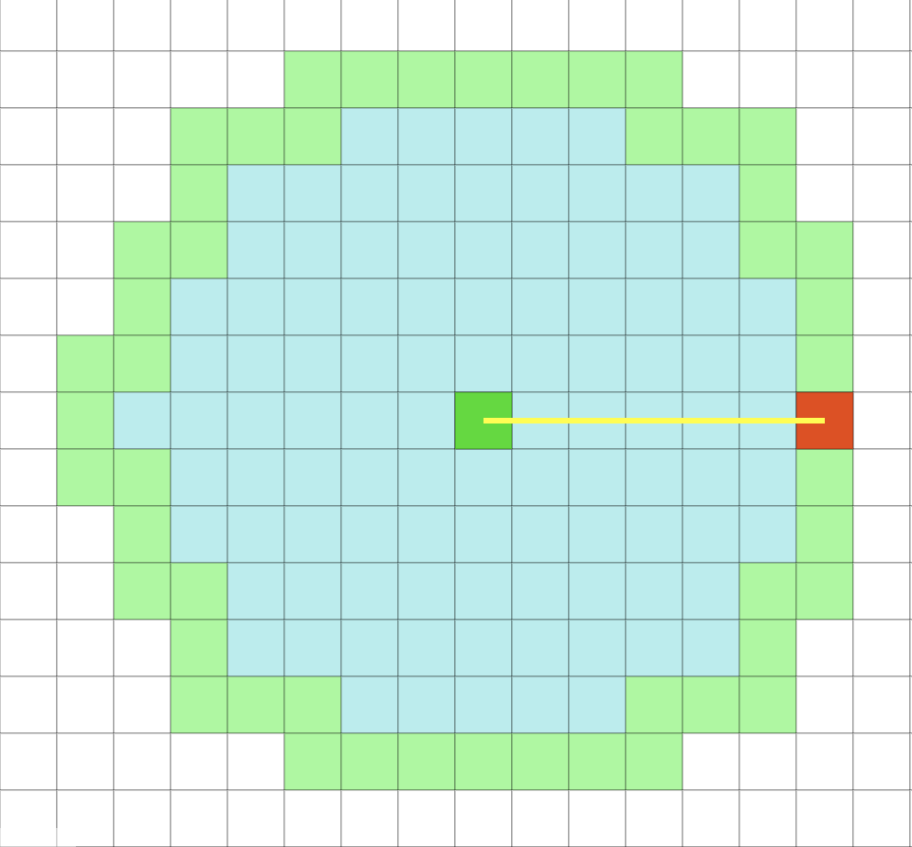
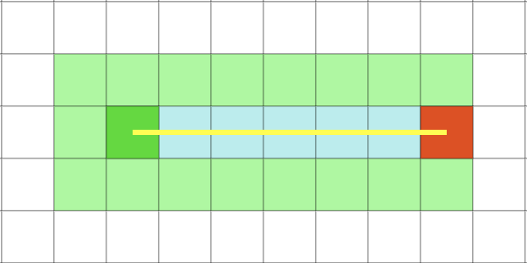
A* heuristic search
Dijkstra's shortest path algorithm
Number of visited nodes in both searches

Slide 10
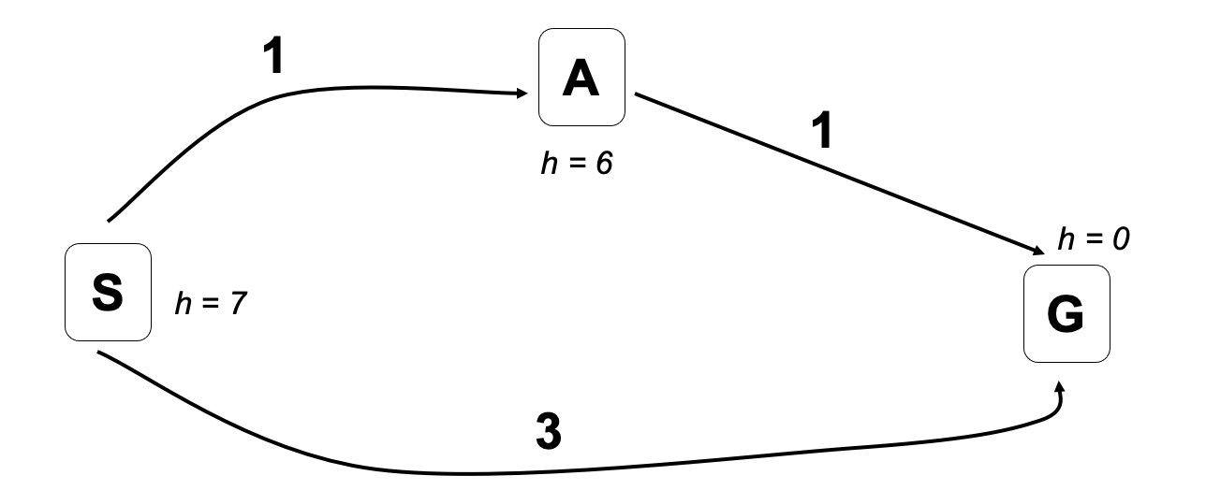
Is A* Guaranteed to Find the Optimal Path ?
No. And this example shows why not.

Slide 11
Admissible Heuristic
Write h*(n) = the true minimal cost to goal from n.
A heuristic h is admissible if
h(n) <= h*(n) for all states n.
An admissible heuristic is guaranteed never to overestimate cost to goal.
A* with Admissible Heuristic Guarantees Optimal Path

Slide 12
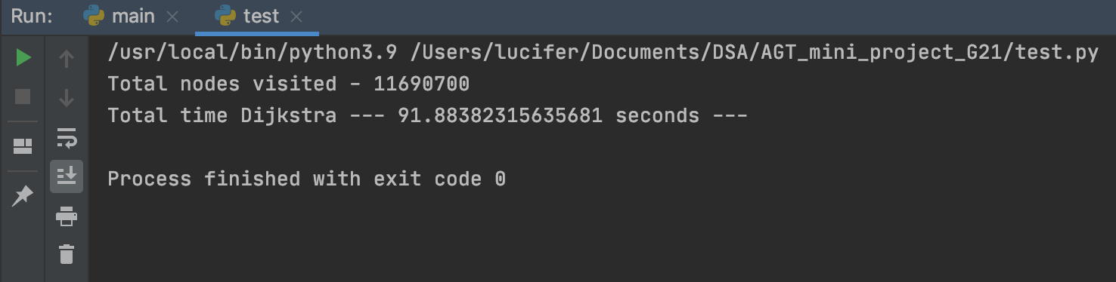
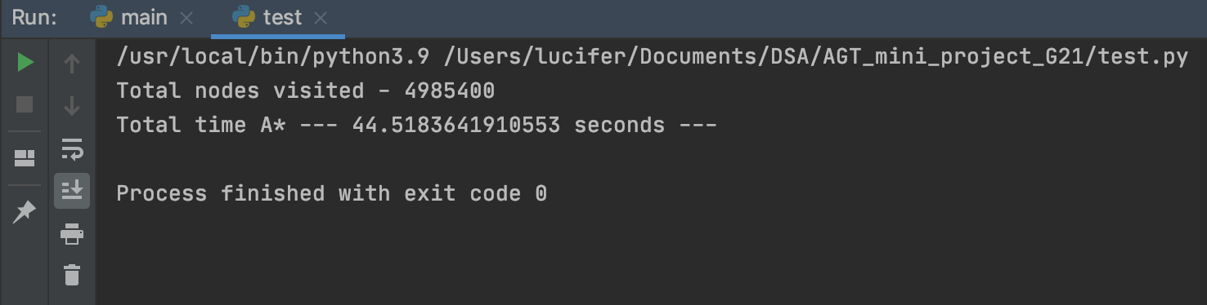
Our findings
Same input were given to both algorithm for testing.
A* algorithm have better complexity both memory wise and time wise compared to Dijkstra algorithm.

Slide 13
THANK YOU

