Slide 2

SENTIMENT ANALYSIS OF TWITTER DATASET
WittyWicky Inc.
CONQUEROR

Slide 3





PROCESS
EDA
Feature
Model
Evaluate
1
2
3
4
EDA & PREPROCESS
FEATURE SELECTION
Build Model
Evaluate ML Model
Text_preprocessing and cleaning
Extracting feature from clean Tweets
Build model and find accuracy
Model accuracy
and Conclusion

Slide 4
Problem Statement
01
To build business through twitter Sentiment as it helps in giving the brand a voice and a personality.
02
Identifying the sentiments about the product/brand through tweets can help the business take better actions.
03
To evaluate tweets about multiple brands.
04
To understand the sentiments of tweets from audience to predict Future on past Sentiments

Slide 5
EDA & Preprossing

Slide 6

Train Data Sentiment Layout
32%
sentiment == 2
sentiment= 2 row are 2382
59%
1%
sentiment == 3
sentiment= 3 row are 125
32%
6%
sentiment == 0
sentiment= 0 row are 456
59%
sentiment == 1
sentiment= 1 row are 4311
6%
1%

Slide 7
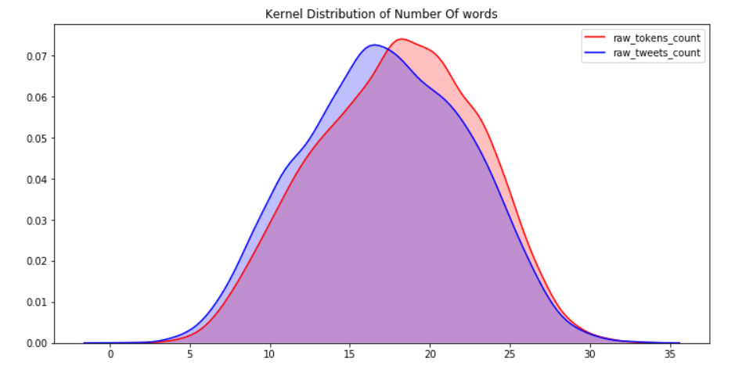
The number of words plot is really interesting the tweets having number of words greater than 30 are very less and thus the number of words distribution plot is normally distributed
INSERT THE TITLE
OF YOUR PRESENTATION HERE

Slide 8
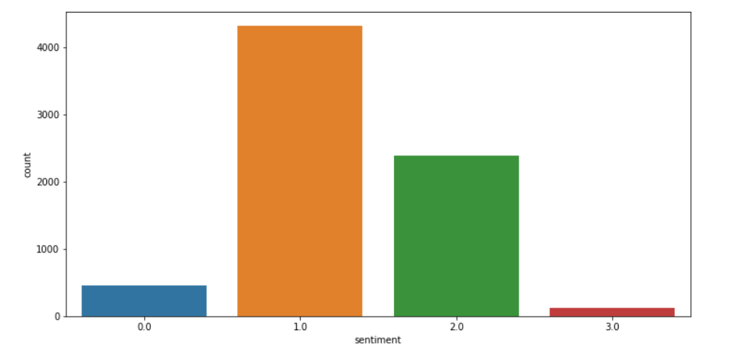
Overall Sentiment Distribution
0-negative
1-neutral
2-positive
3-can’t tell
Point Presentation that best suit your needs.

Slide 9
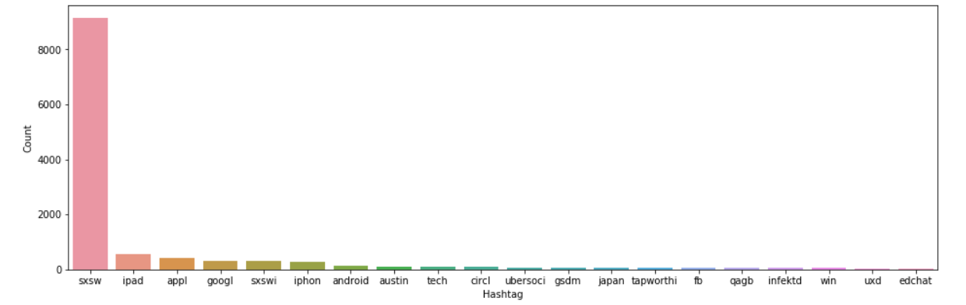
Most Used Hashtags in Overall Tweets Data

Slide 10
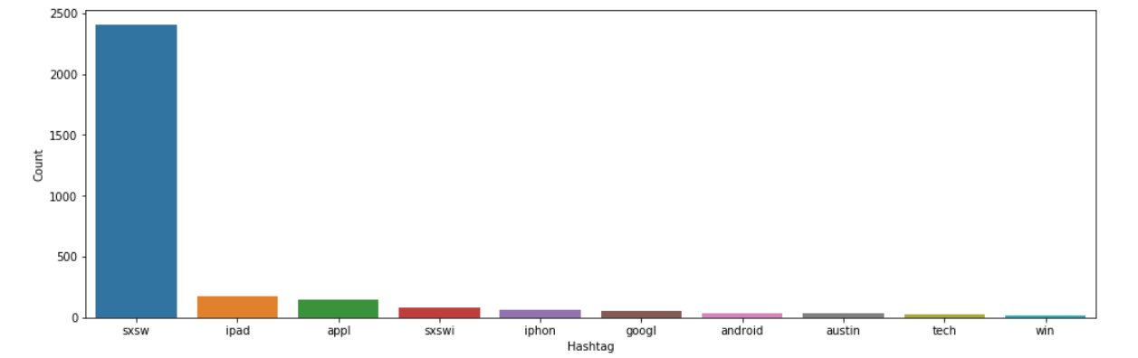
Positive Tweets
INSERT THE TITLE
OF YOUR PRESENTATION HERE

Slide 11
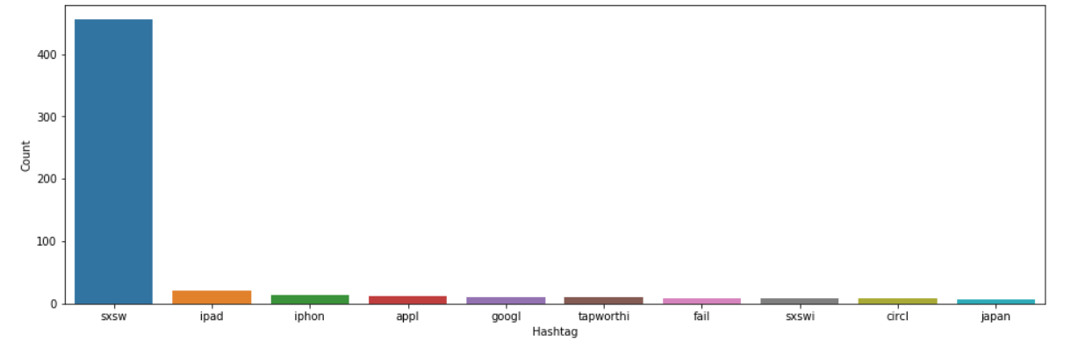
Negative Tweets
INSERT THE TITLE
OF YOUR PRESENTATION HERE

Slide 12
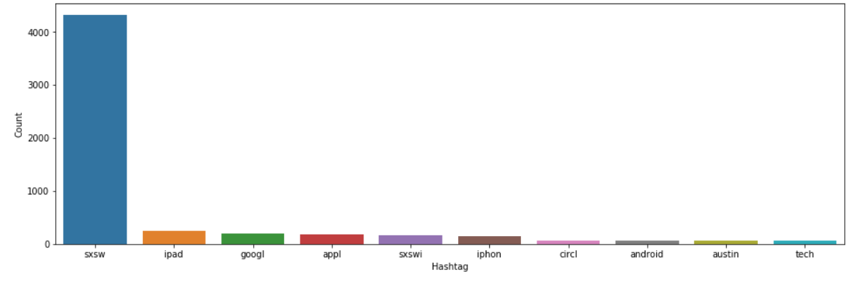
Neutral Tweets
INSERT THE TITLE
OF YOUR PRESENTATION HERE

Slide 13
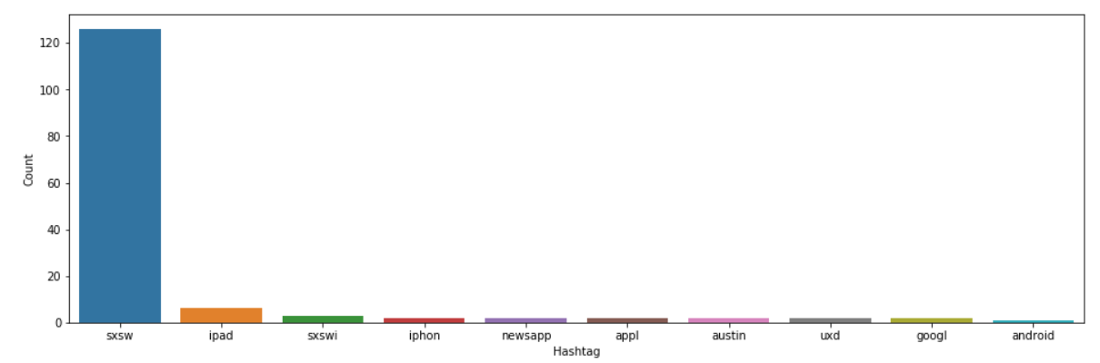
Can’t Tell Tweets
INSERT THE TITLE
OF YOUR PRESENTATION HERE

Slide 14
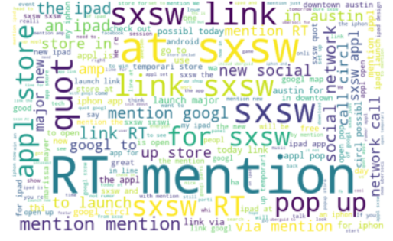
All Words IN Data
WordCLoud

Slide 15
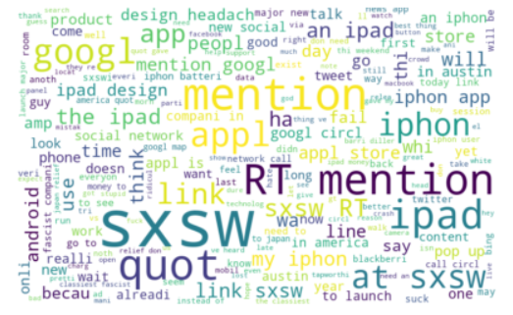
Negative Sentiment Word Cloud

Slide 16
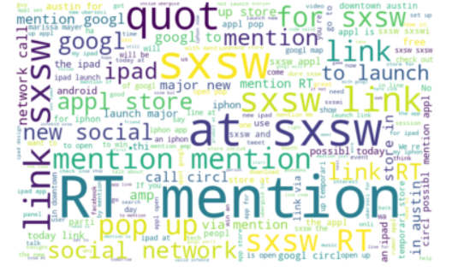
Neutral Sentiment Word Cloud

Slide 17
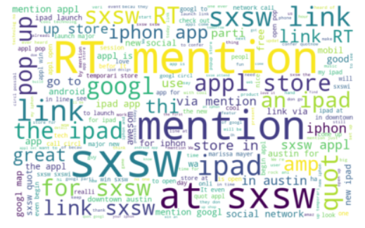
Positive Sentiment Word Cloud

Slide 18
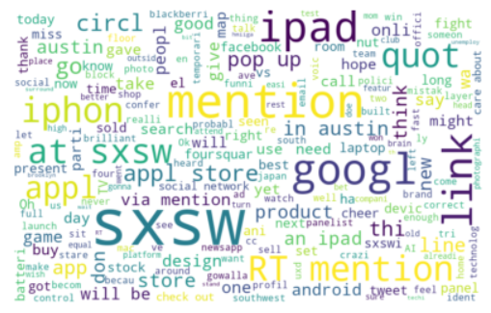
Can’t Tell Sentiment Word Cloud

Slide 19
Data Preprocessing
123….
$%>:)8-)
mention
Numbers
Non ascii Values
all number in text is removed from
Train/test Data
special characters are removed
from whole dataset
Handheld @ by removing it from word
@apple -> apple
Train/test Data
#
?/;,
Word
Punctuation
Text Normalization
Handheld # tage by keeping word witch was with tag #apple -> apple
Train/test Data
Removed Punctuation frome
Train/test Data
lower case
stop word
stamming
Tokenizing

Slide 20
Extracting Features From Tweets
Bag-of-wd-Features
TF-IDF Features
Word2Vec Embeddings
Doc2Vec Embedding
Bag-of-words
Tf-IDF
Word2Vec
Doc2Vec
max_features=1000
max_features=1000
max_features=200
max_features=200
(9062, 1000)
(9062, 1000)
(9062, 200)
(9062, 200)

Slide 21
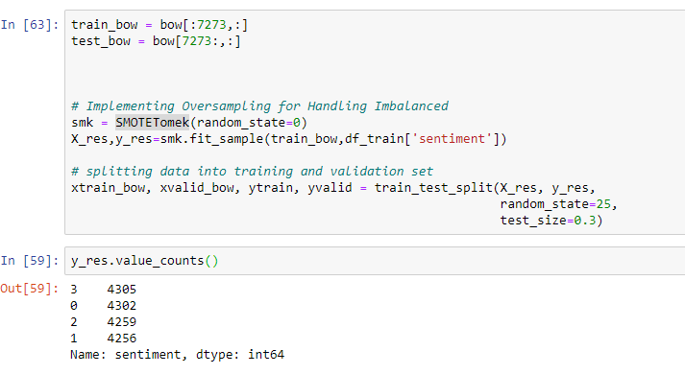
Model Tuning
Handling Imbalance Data
By
Using
SmoteTomek

Slide 22
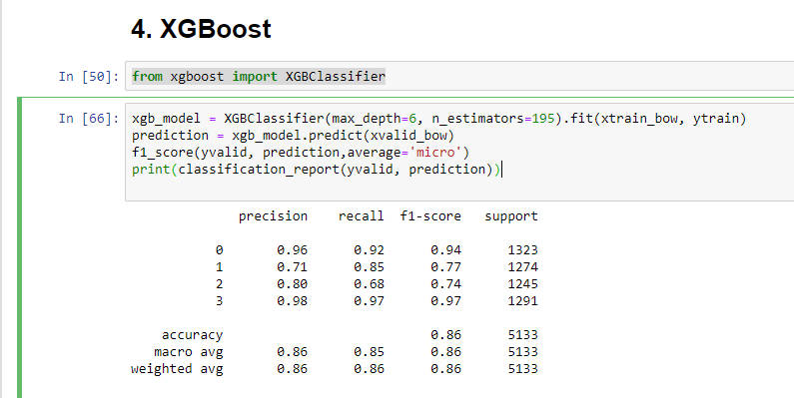
Accuracy On Balance Data

Slide 23
Table Layout
F1
BAG OF Words
0.573
0.593
0.654
0.860
0.680
TF IDF
0.590
0.596
0.550
0.62
0.690
Word2Vect
0.595
0.595
0.564
NA
NA
Doc2Vect
0.593
0.597
0.590
NA
NA
Logistic Regression
Support vector
Rendom Forest
Xgboot
voting classifier

Slide 24
EXECUTIVE SUMMARY
1. Upselling opportunities
Happy customers are more likely to be receptive to upselling, it helps us recognise customers who might be receptive to spending more, as well as avoiding upsetting customers with any negative sentiments.
2. Healthy customer service :
Quick response to people having negative sentiments, Just to be clear what exactly are the issue and solve it asap.
3. Identifying key emotional triggers :
We can identify what messages and conversations act as emotive triggers that change customer mood. Understanding what messages trigger certain emotions in your customers can help you give better service, and is also useful for creating effective marketing materials.

Slide 25
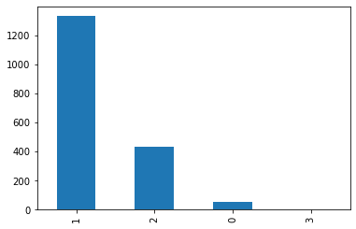
Test Data
Analysis
sentiment -
0: Negative,
1: Neutral,
2: Positive,
3: Can't Tell

Slide 26
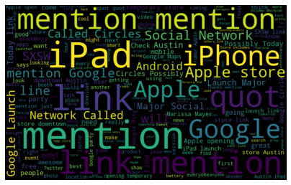
All Words IN Test Data
Word CLoud

Slide 27
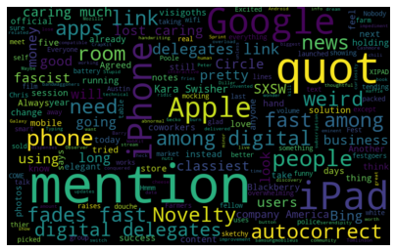
Negative Sentiment
Word Cloud

Slide 28
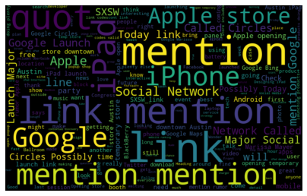
Neutral Sentiment Word Cloud

Slide 29
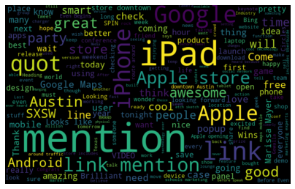
Positive Sentiment Word Cloud

Slide 30
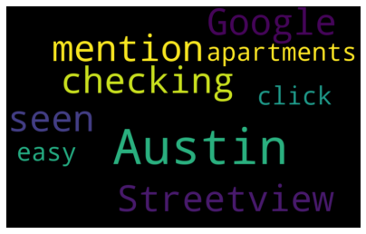
Can’t Tell Sentiment Word Cloud

Slide 31


