Slide 1
Pandemic Insights
Analysing lockdowns, mask usages, student enrollments and more.

Slide 2
01
INTRODUCTION

Slide 3


THE PANDEMIC
The COVID-19 pandemic has affected multiple sectors worldwide, including:
Healthcare
Economy
Education
Travel and Tourism

Slide 4
SECTORS
LOCKDOWN PREDICTION
MASK EFFECTIVENESS
INTERNATIONAL STUDENTS
TRENDS

Slide 5
QUESTIONS
How did the pandemic affect the international student enrollment?
When is a lockdown most likely to happen
How does the frequency of mask usage in different communities correlate with the incidence and severity of COVID-19 cases and deaths?

Slide 6
How have COVID-19 cases and deaths evolved over time in different counties and states across the United States?

Slide 7
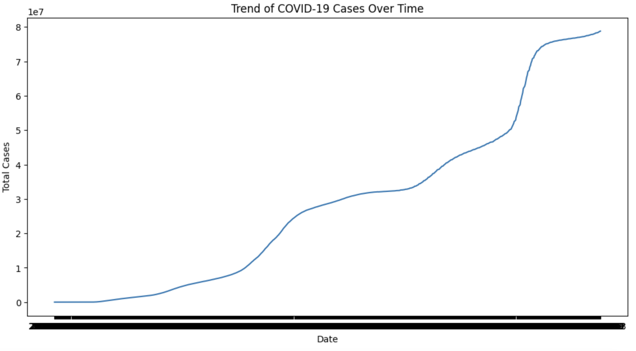
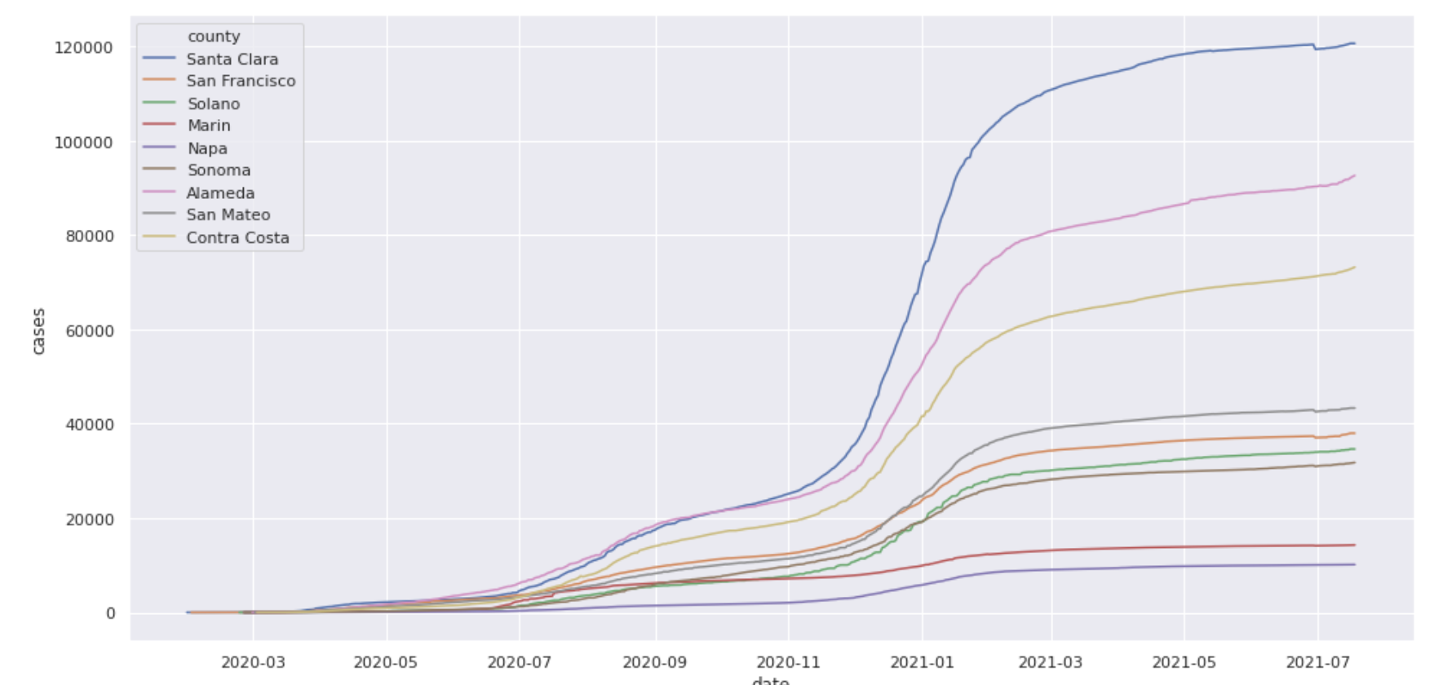
Temporal Analysis
Trend of Covid -19 Cases over time
Total Cases by County

Slide 8
How does the frequency of mask usage in different communities correlate with the incidence and severity of COVID-19 cases and deaths?

Slide 9
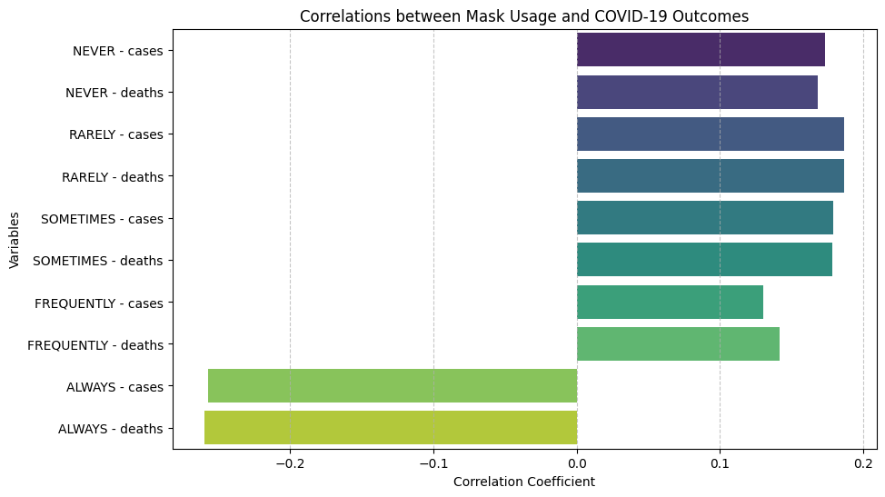
Positive correlations suggest that higher mask usage may be associated with lower COVID-19 incidence and mortality rates, while negative correlations indicate the opposite.

Slide 10
How did the pandemic affect the international student enrollment?

Slide 11
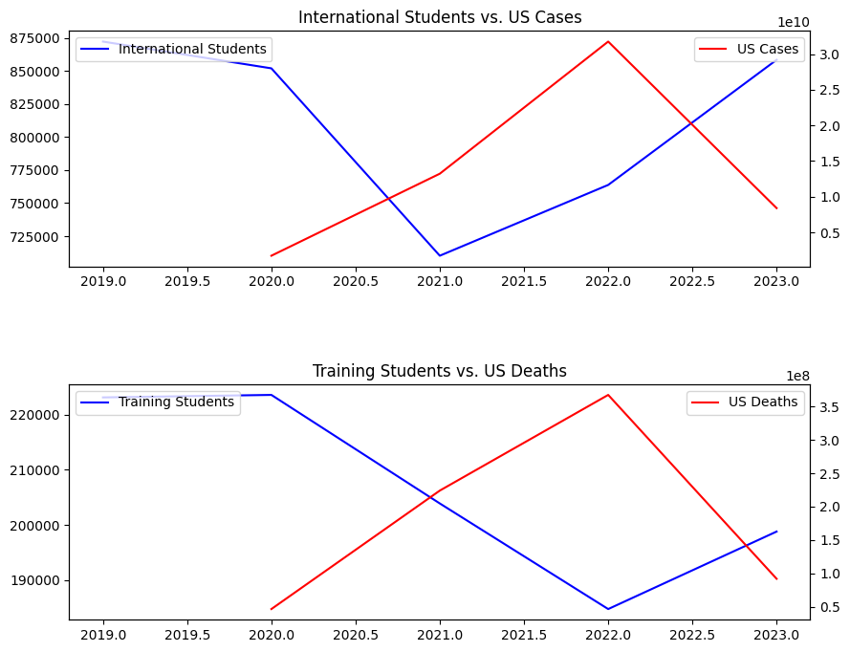
International Student Enrollment

Slide 12
Bonus Question
When is a lockdown most likely to happen and in which county and state

Slide 13
Bonus Question
Question : When is a lockdown most likely to happen and in which county and state
- The analysis identified counties with significant increases in COVID-19 cases and deaths, suggesting potential areas of concern for public health interventions.
- Predictive modeling based on peak periods in the data indicated hypothetical lockdown periods for specific counties, offering insights into potential periods of heightened restrictions to mitigate the spread of the virus.

Slide 14
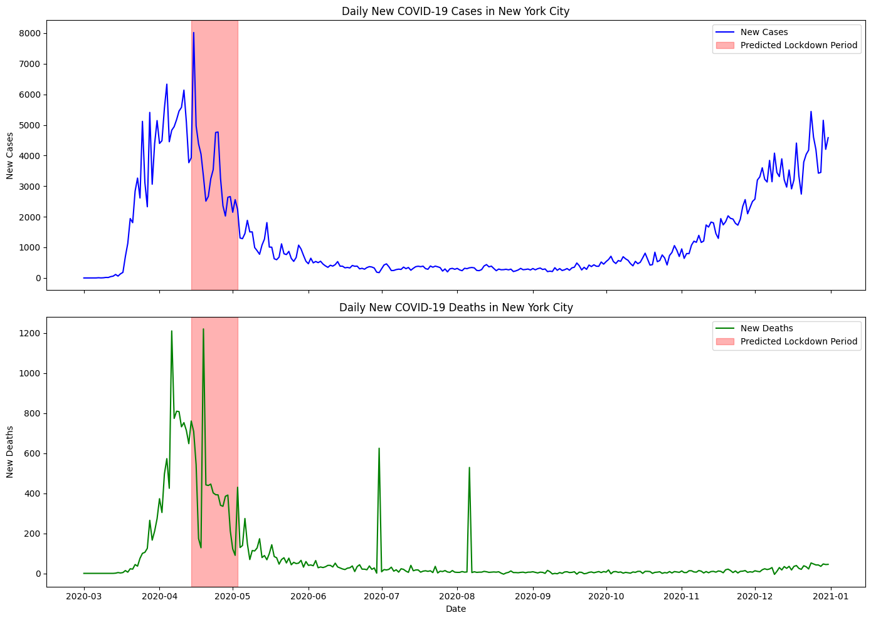
Bonus Question

Slide 15
THANKS
External Data Sources:
https://www.higheredimmigrationportal.org/national/national-data/#:~:text=Immigrant%2Dorigin%20students%20accounted%20in,education%20are%20people%20of%20color.
https://www.nafsa.org/policy-and-advocacy/policy-resources/nafsa-international-student-economic-value-tool-v2

