Slide 1
EGFR* as a Treatment Target in NSCLC
*Epidermal Growth Factor Receptor
Ligand
EGF
EGFR
EGFR Tyrosine kinase domain (exons 18-21)
Permanently activated intracellular signaling
Cellular proliferation
Cell Nucleus
Survival (anti-apoptosis)
Resistance to chemotherapy and radiotherapy
Metastasis
Angiogenesis
Ref: Astra Zeneca
Notes:
EGFR or epidermal growth factor receptor is a transmembrane signalling protein
Deregulation of the EGFR pathway is central to tumour pathogenesis in NSCLC. Mutations occur mainly in the tyrosine kinase domain (exons 18-21) which permanently activates a number of cell proliferation pathways.
1

Slide 2
EGFR Can Gain Resistance to TKIs
Ligand
EGF
EGFR
T790M resistance mutation confers resistance to TKIs
EGFR TK
Osimertinib
(3rd generation TKI)
TKI agents compete with ATP for binding tyrosine kinase domain
Inhibition of cell signaling
Permanently activated intracellular signaling
Inhibition of EGFR-dependent proliferation
Cell Nucleus
Cell proliferation processes
Ref: Astra Zeneca
Notes:
85% - Reversibly compete with ATP binding
These were generally women, ‘never smokers’, East Asians (Japanese) and in patients with adenocarcinomas
Target for the drugs (1st etc)
Work by AZ has found that EGFR positive patients have a median progression free survival of ~24 months
~85% of patients with EGFR mutations respond to treatment with tyrosine kinase inhibitors
Target for the drugs:
Gefitinib (1st line),
Afatinib (2nd line)
Osimertinib (3rd line)
Progression free survival
median of ~24 months
Talking Points
IRESSA competes with ATP for binding in the ATP pocket of the intracellular domain of EGFR, thereby blocking signal transduction
This inhibition of EGFR signaling leads to inhibition of tumor cell proliferation, angiogenesis, and tumor invasion
Reference
Bronte G, Rolfo C, Giovannetti E, et al. Are erlotinib and gefitinib interchangeable, opposite or complementary for non-small cell lung cancer treatment? Biological, pharmacological and clinical aspects. Crit Rev Hematol Oncol. 2014;89(2):300-313.
2

Slide 3
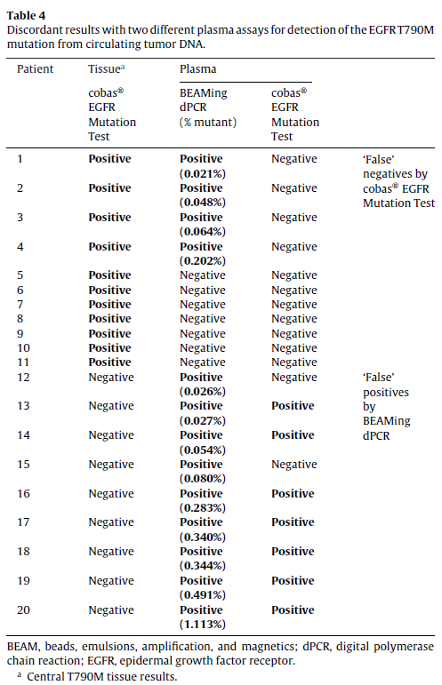
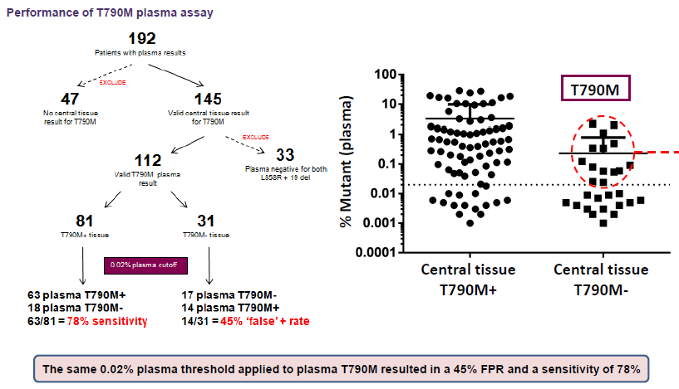
Sensitivity and Specificity 2
Discordant results reflect tumour heterogeneity rather than technical failures
Thress et al 2015. Lung cancer 90, 509

Slide 4


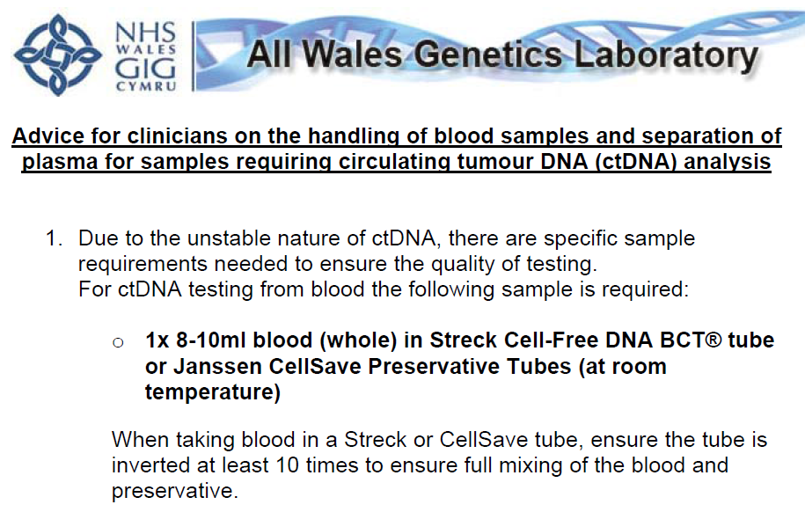
Education
Attendance at MDTs
Seminars
Website
Regularly updated
literature
All Wales Genetics Laboratory Protocol 2017

Slide 5
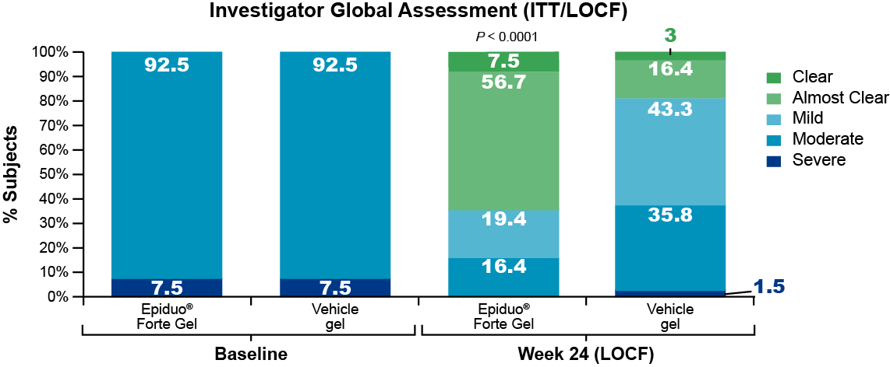
64.2% of Subjects Were Clear/Almost Clear With Epiduo® Forte Gel at Week 24
IGA assessments were significantly better with Epiduo® Forte Gel at all post-baseline study visits
Clinical Study RD.03.SPR.105061. Galderma R&D.

Slide 6
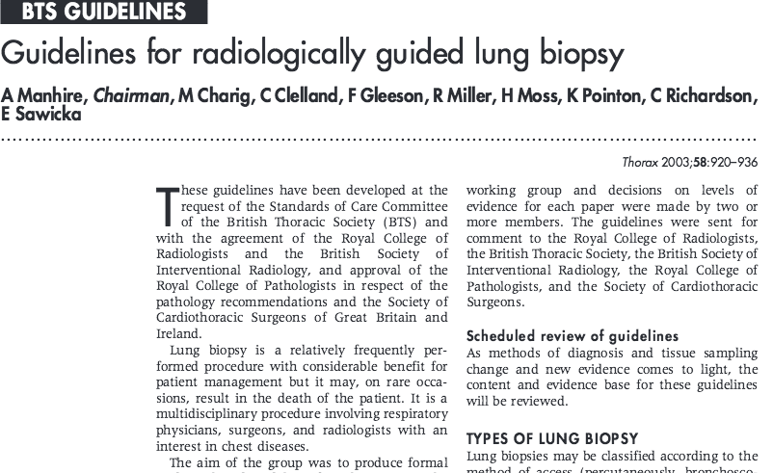
What is the morbidity of lung biopsy?
“The most common complication is pneumothorax which occurs in 0–61% of lung biopsies. Between 3.3% and 15% of all patients will require a chest drain”
Manhire, A et al. (2003). Thorax 58;11:920-936

Slide 7
Referral
Lung function
Book bed
Biopsy
Inpatient bed 4-6 hours
CXR @ 4-6 hours
No PTx
Significant PTx
Admit for underwater seal drain for 24-48 hours
CXR = Check Xray
PTx = PNEUMOTHORAX
Discharge
Notes:
Bed requirement -> delay/cancellations; low throughput
Fears of pneumothorax in frail patients -> delay/biopsy not performed
Low lung function often seen as contraindication to biopsy (most patients have emphysema…)
Inpatient stay -> disruptive for patients; hospital acquired problems
Cost of equipment and beds (~£400/day)
Delays in diagnosis & treatment

Slide 8
Referral
DELAY IN DIAGNOSIS
Lung function
Book bed
Biopsy
Inpatient bed 4-6 hours
CXR @ 4-6 hours
PATIENT INCONVENIENCE
No PTx
Significant PTx
Admit for underwater seal drain for 24-48 hours
Discharge
Notes:
Bed requirement -> delay/cancellations; low throughput
Fears of pneumothorax in frail patients -> delay/biopsy not performed
Low lung function often seen as contraindication to biopsy (most patients have emphysema…)
Inpatient stay -> disruptive for patients; hospital acquired problems
Cost of equipment and beds (~£400/day)
Delays in diagnosis & treatment

Slide 9
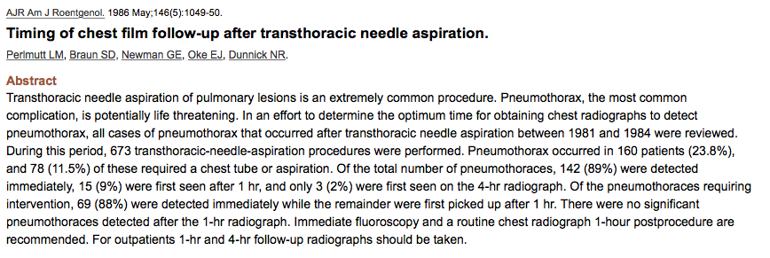
Post-biopsy CXR – when?
Of the 160 (23.8%) pneumothoraces requiring intervention (78/160; 11.6%), 69 (88%) were detected immediately (<30 mins) while the rest were identified on the 1-hour radiograph
“There were no significant pneumothoraces detected after the 1-hr CXR”
Perlmutt, LM et al. (1986). AJR Am J Roentgenol. 146;5:1049-50.

Slide 10
GOLD 2017: treatment goals and pharmacological treatment algorithm by GOLD grade¹
Goals for treatment
of stable COPD¹
Group C
Group D
Exacerbation history
>2 or >1 leading to hospital admission
LAMA + LABA
LABA + ICS
Consider roflumilast ▼ if FEV₁ <50% pred. and patient has chronic bronchitis
Consider macrolide (in former smokers)
Relieve symptoms
Improve exercise tolerance
Further exacerbations(s)
Further exacerbations(s)
Persistent symptoms/further exacerbations(s)
REDUCE SYMPTOMS
LAMA + LABA + ICS
Improve health
status
Further exacerbations(s)
LAMA
LAMA
LAMA + LABA
LABA + ICS
Prevent disease progression
Group A
Group B
Exacerbation history
0 or 1 (not leading to hospital admission)
Prevent and treat exacerbations
REDUCE RISK
Continue, stop or try alternative class of bronchodilator
LAMA + LABA
Reduce mortality
Persistent symptoms
Symptoms
mMRC 0-1 CAT < 10
Evaluate effect
Symptoms
mMRC > 2 CAT < 10
A long-acting bronchodilator
(LAMA or LABA)
A bronchodilator
Preferred treatment pathway
1. Global Strategy for the Diagnosis, Management and Prevention of COPD, Global Initiative for Chronic Obstructive Lung Disease (GOLD) 2017.
Adapted from GOLD 2017 Strategy Document

