Slide 1
Byzantine Chain Replication
Amith Gopal
Manish Shambu

Slide 2
Contents
Introduction
Motivation and challenges
Key takeaways from Shuttle
Why 2f +1 replicas
Improvements
Implementation
Evaluation

Slide 3

Byzantine faults and chain replication
A technique based on state replication that mask arbitrary failures including crashes malicious attacks and software errors.
A server can consistently appear both failed and functioning to a failure detection system presenting different symptoms to different observers.

Slide 4
Motivation and challenges
Traditional BSMR requires 3f+1 replicas in order to tolerate f faults. Whereas primary backup replication protocols require only f + 1 replicas.
1
The protocols may require expensive cryptographic operations and significant network bandwidth, further increasing cost
2
Protocols are complex. Even basic Paxos replication is difficult to implement and debug.
3
Very few implementations of Shuttle protocol present till date.
4

Slide 5
Key takeaways from Shuttle
Pipelining and high throughput due to chain replication.
Lesser bandwidth consumption to replicate data.
Cheaper cryptographic primitives.
Lesser replicas.
Stronger assumption on adversaries – Only arbitrary failures and no hackers.
No rollbacks and checkpointing.

Slide 6

Comparison with shuttle
Bchain 3 –
https://github.com/bft-smart
Requires 3f +1 replicas and expensive cryptographic functions.
Shuttle
https://github.com/manishshambu/ByzantineChainReplication
Requires 2f +1 replicas and cheaper cryptographic functions.

Slide 7
Why 2f + 1 replicas?
Separating agreement from execution.
Centralized server to issue commands in order. (FIFO queue)
Earlier protocols used to issue requests randomly in an unordered fashion.
f+1 replicas and f witnesses.
Witnesses do not hold application state nor perform application operations.
Relies on external configuration service for liveness and safety.
The replicas keep a copy of Histp, while the witnesses only keep the length of the most recent history.
[Separating Agreement from Execution for Byzantine Fault Tolerant Services]

Slide 8
Detecting Failures
Unprovable vs Provable failures.
Trigger FDS service on replicas.
Provable failures – proved from order proofs in the history.
Corrupted messages - a message carrying a malformed order proof and verified to have been sent by the leader indicates that the leader has failed.
Lost messages - A member expects some particular messages in each step of the protocol. When the member times out on waiting for a message, it raises a suspicion.

Slide 9
Implementation
Distalgo - Very high-level language for programming distributed algorithms.
Distributed processes and sending messages.
Control flows and receiving messages.
High-level queries of message histories.
Configurations.

Slide 10
Case Study
Bank Account class
Multiple replicas considered as branches.
Update at 1 branch should reflect at the other.
Supported operations:
Add account
Deposit money
Withdraw money
Check Balance

Slide 11
Testing for Failure free case
Created a file with 5000, 10000 and 15000 bank transactions.
Eg Deposit, Withdrawal, Check Balance, Create Account.
Initialized multiple clients and made them query the BFT application with these transaction values.
Record time.

Slide 12
Testing for crash failures
Add sleeps randomly to imitate a crash failure.
When the client issues a command and if it has not heard back, it queries the Olympus to issue a new configuration.
Olympus issues a new configuration installation.

Slide 13
Testing for Byzantine faults
For a replica to be Byzantine, it should execute a wrong operation.
Ex: Executing withdrawal while deposit command is issued.
Manually made a replica Byzantine. After few iterations of transactions, 1 replica starts executing wrong operations.
The client will still be able to read the correct values.
Make another process Byzantine (3 replicas). In this case the client wont be able to infer correct calues.

Slide 14
Handling order proof mismatches
Issue operations Deposit, Withdraw and Check Balance in order.
A Byzantine replica executes :
Deposit, Deposit and Check Balance
The correct operations as told by the client in a different order.
The next replica verifies the order proof, triggers a suspicion in a FDS event.
Commands the Olympus to install a new configuration.

Slide 15
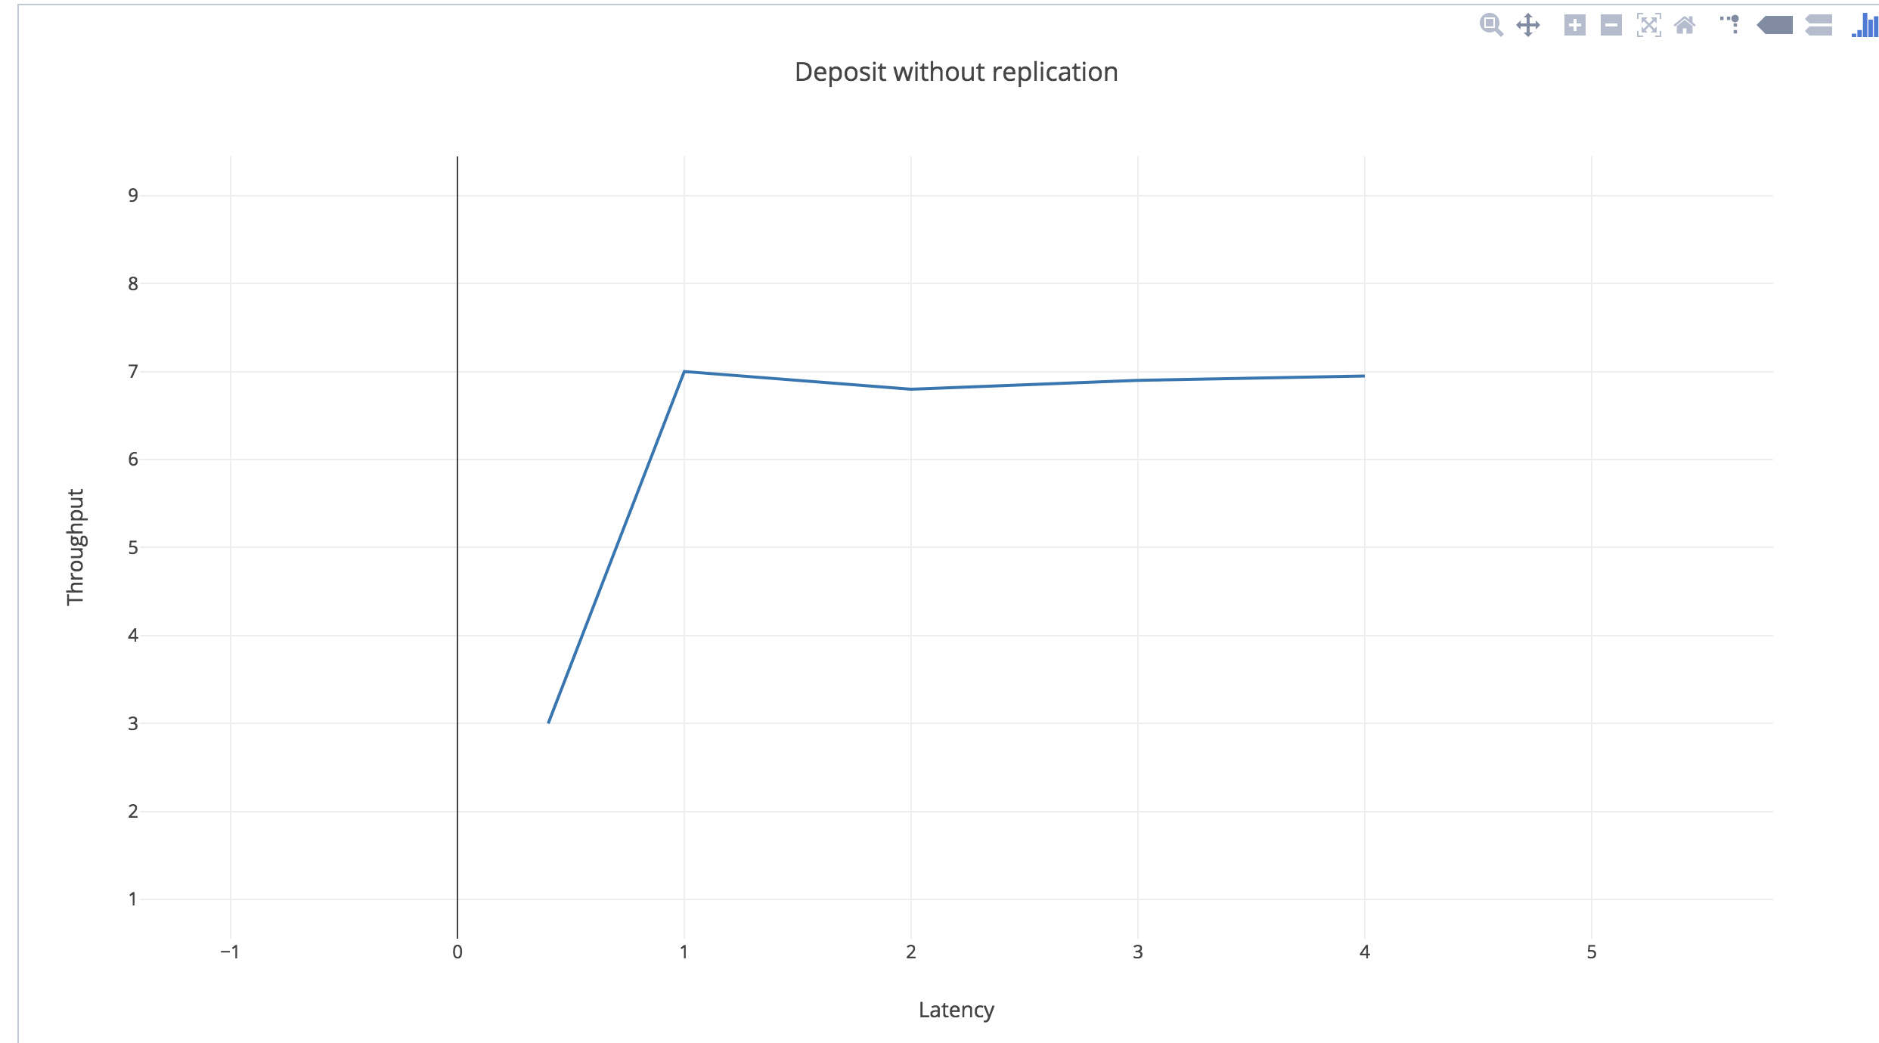
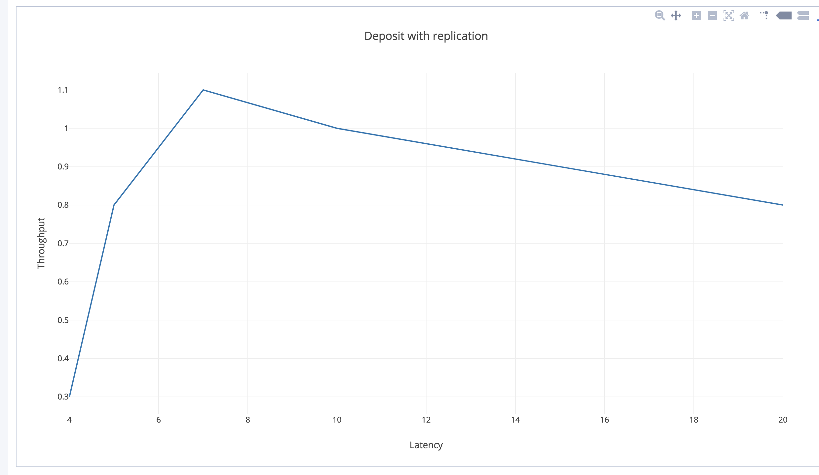
Latency vs Throughput

Slide 16
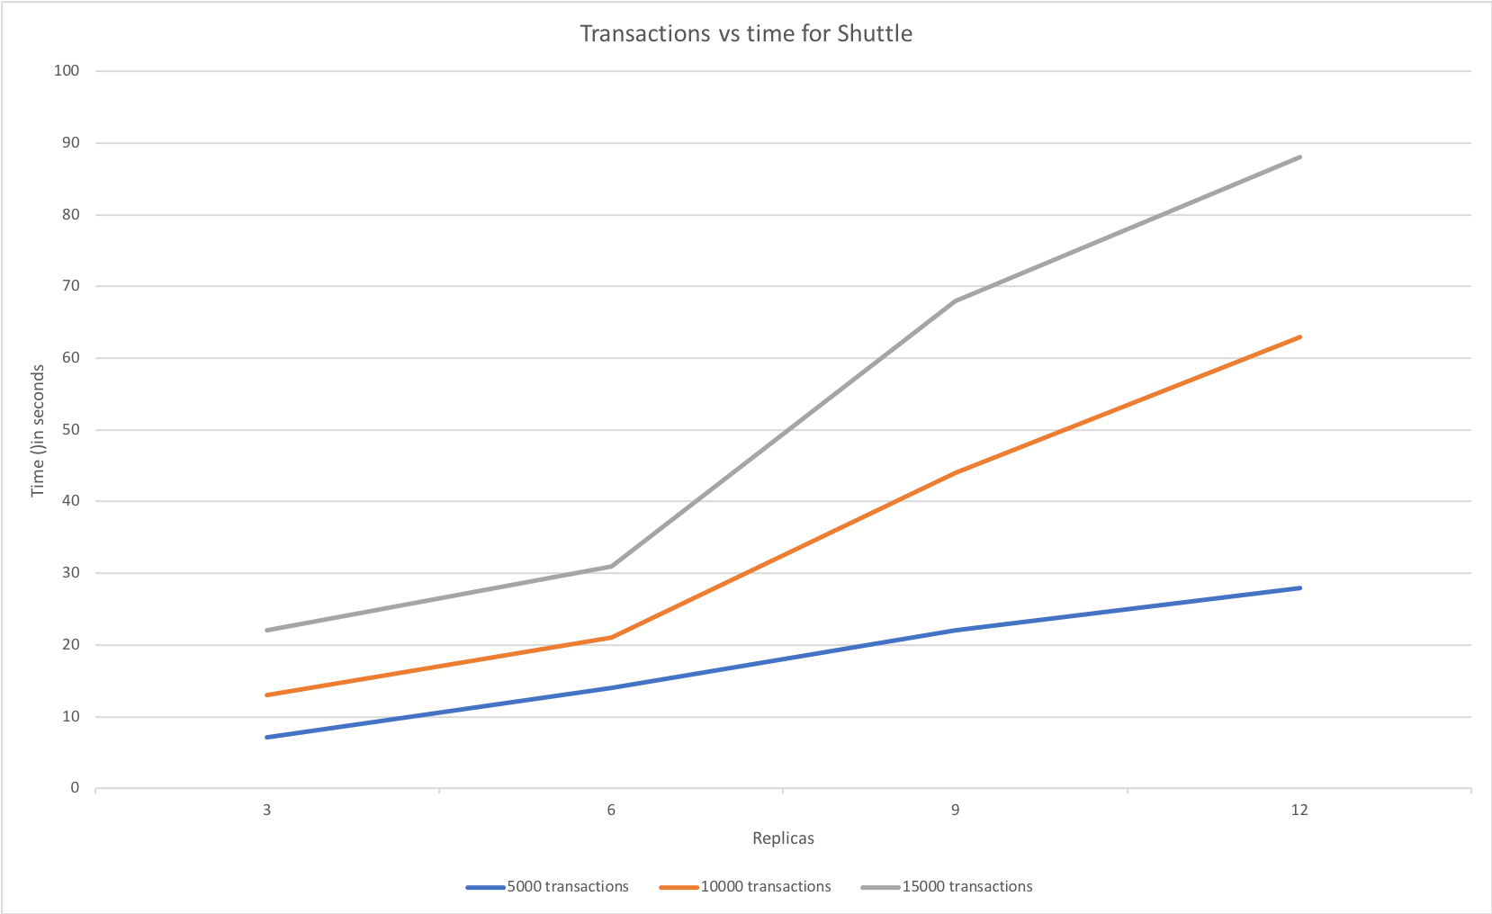
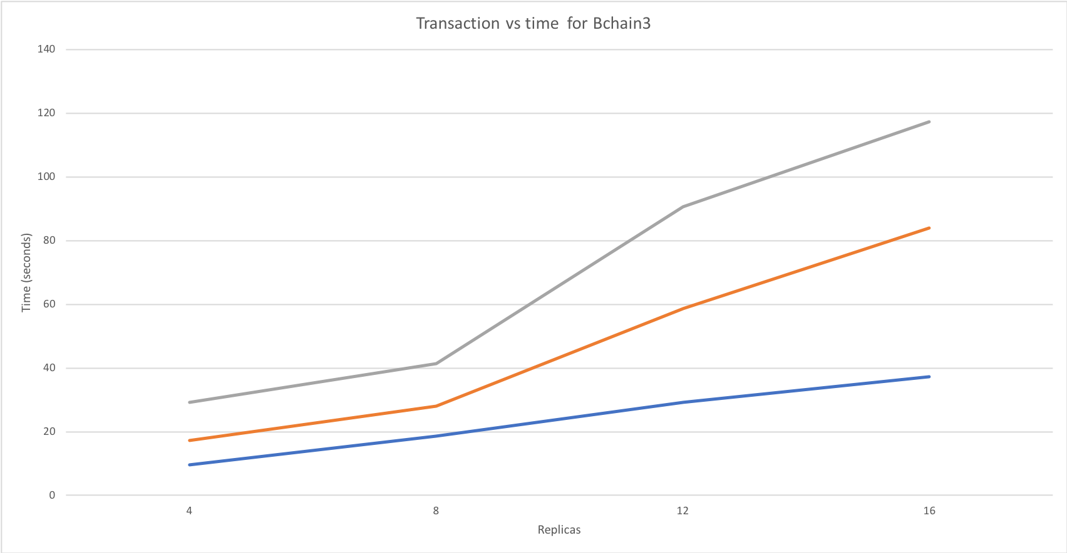
Shuttle vs Bchain3

Slide 17
Improvements made to Shuttle
In shuttle, when the client timeouts happen for a request, the request is broadcasted to all the replicas. Every replica contacts the head directly and waits for it to respond. The way we have implemented is that only instead of head replying directly to each replica. It propagates the result through the chain and as a result cancels the timers of replicas waiting for the result much before it should.
During the reconfiguration, in shuttle, new configurations are formed by creating new instances. We have optimized this by making the replicas in the existing configuration to catch up with the longest history and making these replicas part of the new configuration as well. This saves utilizing new servers.

