Slide 1
MOSAIC PHOTO GENERATION
- SNEHA RAO GR (01FB16EEE085)
- SHARATH HS (01FB16EEE077)

Slide 2
What is a Photomosaic ?
A photomosaic is an image split into a grid of rectangles, with each replaced by another image that matches the target (the image you ultimately want to appear in the photomosaic)

Slide 3
Photomosaics:
If you look at a photomosaic from a distance, you see the target image
But if you come closer, you will see that the image actually consists of many smaller images. That is, when viewed at low magnifications, the individual pixels appear as the primary image, while close examination reveals that the image is in fact made up of many hundreds or thousands of smaller images.
This works because of how the human eye works !!

Slide 4
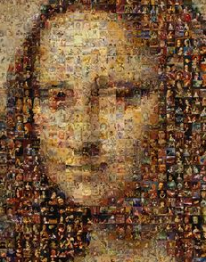
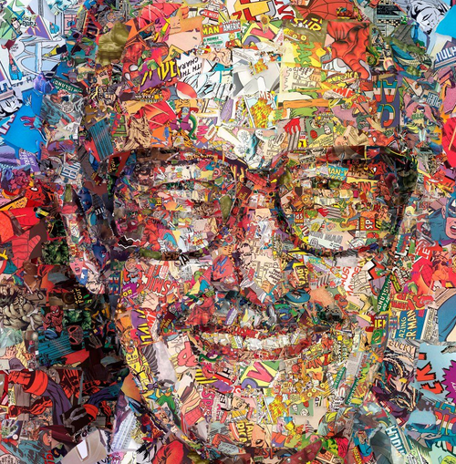
Creating something like this :)

Slide 5
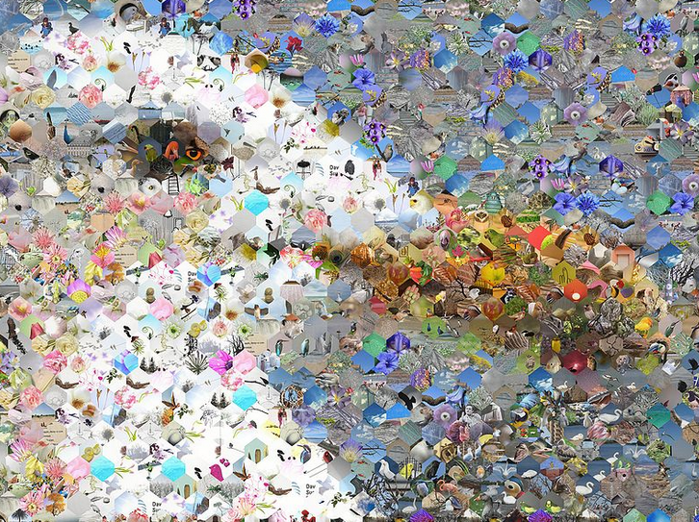
Classification
Based on :
- Shape of each tile
- How matching is done

Slide 6
Implementation 1:
Each part of the target image is averaged down to a single color.
Each of the library images is also reduced to a single color.
Each part of the target image is then replaced with one from the library where these colors are as similar as possible.
In effect, the target image is reduced in resolution (by downsampling), and then each of the resulting pixels is replaced with an image whose average color matches that pixel.

Slide 7
Implementation 2:
In the more advanced kind of photographic mosaic, the target image is not downsampled
Also, the matching is done by comparing each pixel in the rectangle to the corresponding pixel from each library image.
The rectangle in the target is then replaced with the library image that minimizes the total difference.
This requires much more computation than the simple kind, but the results can be much better since the pixel-by-pixel matching can preserve the resolution of the target image.

Slide 8
Video mosaic
The term "video mosaic" also describes a large still image made from adjacent frames of video, such as those from video shots of geographic features like roads or cities.
A mosaic of the video's relevant frames replaces the full video, saving time and bandwidth, since the stills are much smaller.

Slide 9
How to create Photomosaics ?
1) Read the tile images, which will replace the tiles in the original image.
2) Read the target image and split it into an M×N grid of tiles.
3) For each tile, find the best match from the input images.
4) Create the fnal mosaic by arranging the selected input images in an M×N grid.

Slide 10
Splitting the image into tiles:
Calculating the coordinates for a single tile from this grid :
The tile with index (i, j) has a top-left corner coordinate of (i*w, i*j) and a bottom-right corner coordinate of ((i+1)*w, (j+1)*h), where w and h stand for the width and height of a tile, respectively. These can be used with the PIL to crop and create a tile from this image.

Slide 11

Averaging colour values :
Every pixel is represented by RGB values.
In this case, you are using 8-bit images, so each of these components has an 8-bit value in the range [0, 255]
Given an image with a total of N pixels, the average RGB is calculated as :

Slide 12
Matching images :
Techniques available :
1) Mean square error distance method
2) Colour distance based on perception (By CIELab Colour space research)
3) Dominant colour approach

Slide 13
1) Mean square Error Distance Method : (MSE)
For each tile in the target image, you need to find a matching image from the images in the input folder specified by the user.
To determine whether two images match, use the average RGB values. The closest match is the image with the closest average RGB value.

Slide 14

The simplest way to do this is to calculate the distance between the RGB values in a pixel to fnd the best match among the input images. We can use the following distance calculation for 3D points from geometry:

Slide 15
2) Colour Perception method
Motivation : “colour perception is non-linear and not exactly orthogonal. ”
We don’t have perceptually uniform colour space, ie distance measure is not highly correlated with how close we feel 2 colours are.
Solution : Weighted Euclidean distance functions

Slide 16
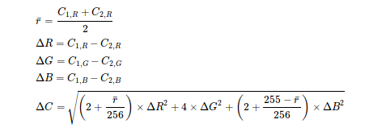
Low cost approximation :
First calculate the mean level of "red" and then weights the ΔR′ and ΔB′ signals as a function of the mean red level. The distance between colours C1 and C2 (where each of the red, green and blue channels has a range of 0-255) is:

Slide 17
3) Dominant Colour Approach
We consider most frequent colour shade for each tile.
Range of colours => colour shade
We use k-means to get the center for each shade

Slide 18

4) Structural similarity approach:
Here, the structural similarity of 2 images is given more importance rather than colour.
So, generated mosaic will have high attention to structure of target image.
We use Structural Similarity Index (SSIM) here

Slide 19
Lets see what we got !
Any Questions ?

Slide 20
THANK YOU !!

