Slide 1
Enabling Dynamic Voltage and Frequency Scaling in Multicore Architecture
Amithash Prasad

Slide 2
Thesis Statement
This work proposes a method of conserving energy without sacrificing performance on a multi-core architecture by the use of performance directed scheduling and delta constrained mutation.

Slide 3
Problem Statement
Current DVFS mechanisms utilized to conserve power act on the utilization of a processor regardless of clock speed requirements of the application.
Schedulers currently implemented in modern architecture are not aware of asymmetric capabilities of processors enabled by DVFS.

Slide 4
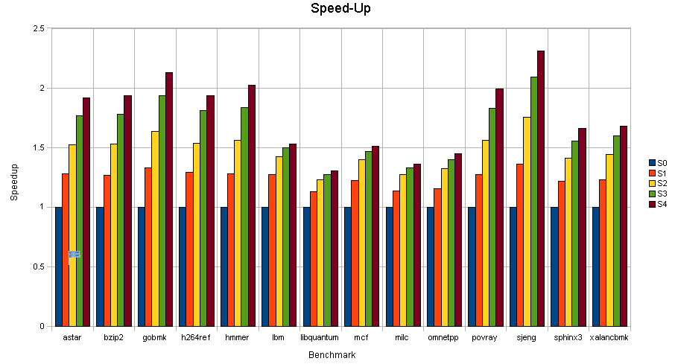
Motivation

Slide 5
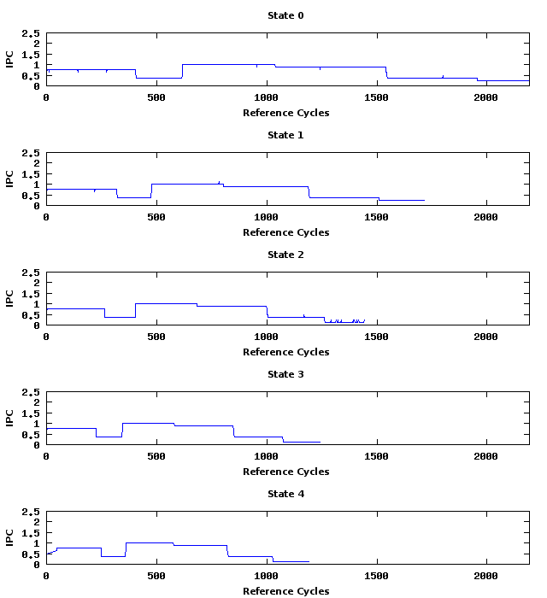
Time-line (astar)

Slide 6
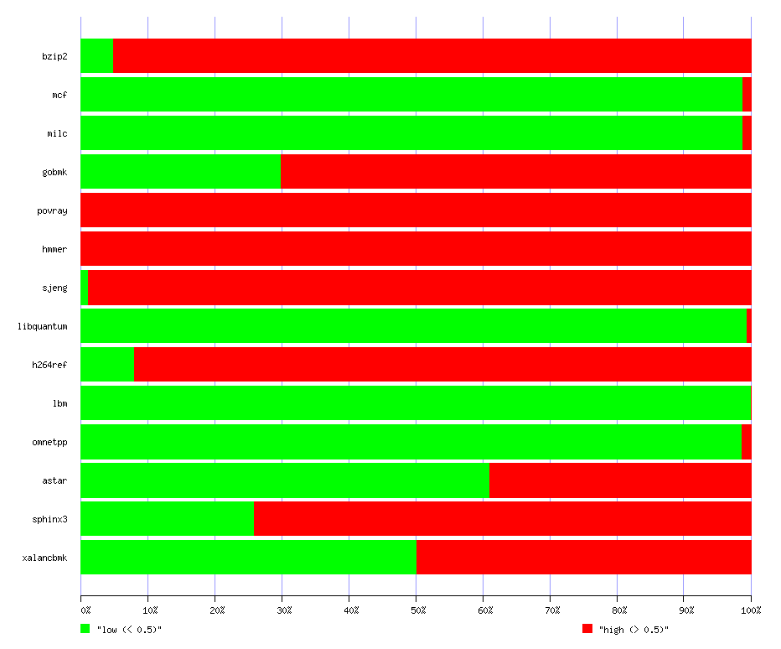
Benchmark Classification

Slide 7
Benchmark Classification
Group | Benchmarks
Low (90% executes below and equal to IPC=0.75) | mcf | milc | libquantum | lbm | omnetpp
High (90% executes above IPC=0.75) | bzip2 | povray | hmmer | sjeng | h264ref
PLow (>50% executes above IPC=0.75) | gobmk | sphinx3
PHigh (>50% executes below and equal to IPC=0.75) | astar | xalancbmk

Slide 8
Benchmark Groups
Group | Benchmark 1 | Benchmark 2 | Benchmark 3 | Benchmark 4
Low | milc | libquantum | lbm | omnetpp
High | bzip2 | povray | hmmer | sjeng
Low-High | bzip2 | povray | milc | omnetpp
PHigh-PLow | gobmk | sphinx3 | astar | xalancbmk
PLow-High | astar | xalancbmk | povray | hmmer
PLow-Low | astar | xalancbmk | milc | omnetpp

Slide 9
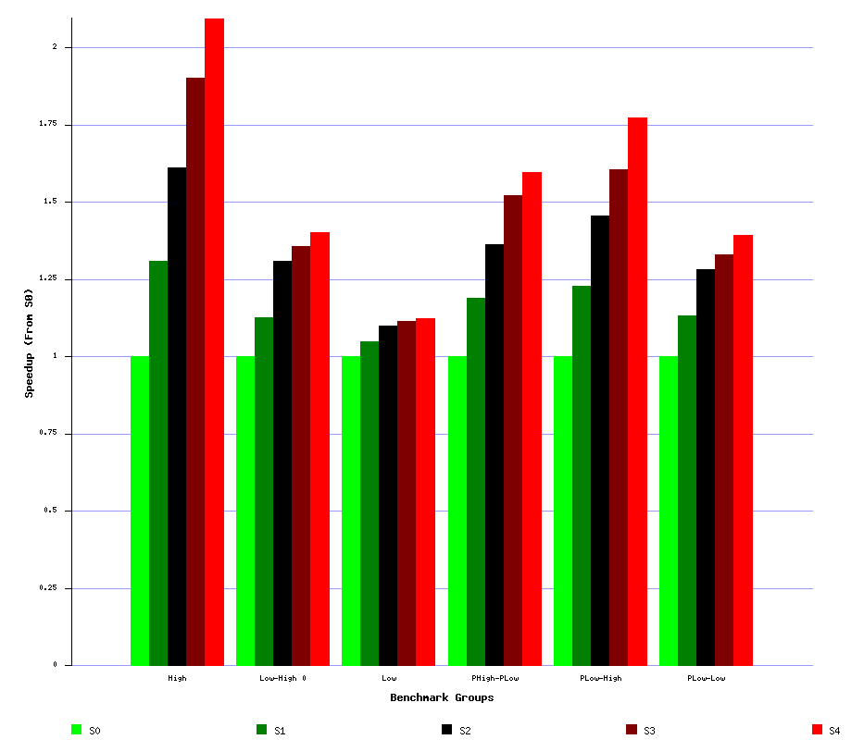
Benchmark Groups

Slide 10
AMD Opteron Capabilities
Performance State | Clock Speed (MHz) | Power (W) *
0 | 1100 | 64.6
1 | 1400 | 75.6
2 | 1700 | 88.8
3 | 2000 | 108.2
4 | 2200 | 115
* - From AMD Opteron Power and Thermal Data Sheet

Slide 11
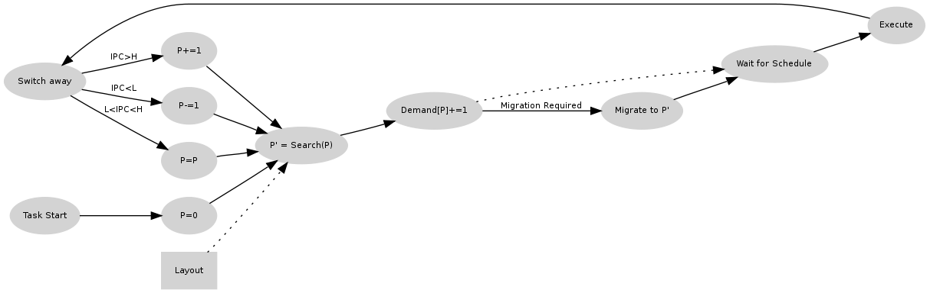
Performance Directed Scheduling on Asymmetric Multiprocessors
H = 0.875
L = 0.625
Implemented using kprobes as a kernel module for the 2.6.28.9 kernel

Slide 12
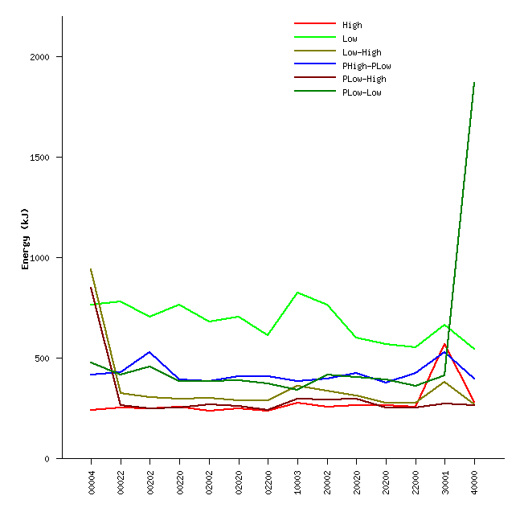
Results

Slide 13
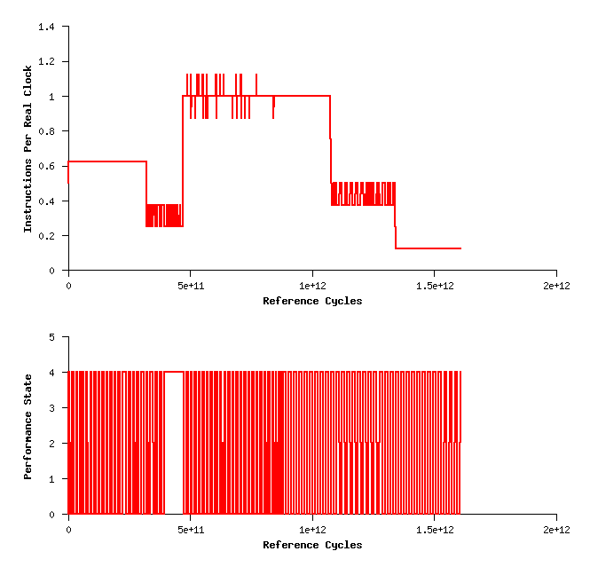
Time-Line [30001] – astar

Slide 14
Mutation Strategies?
      Demand based mutation: Performance directed Scheduler does the mutation based on demand.
          Latency of frequency/voltage transition
          Current instabilities
      Mutation on intervals
          Care must be taken to not perform too many transitions

Slide 15
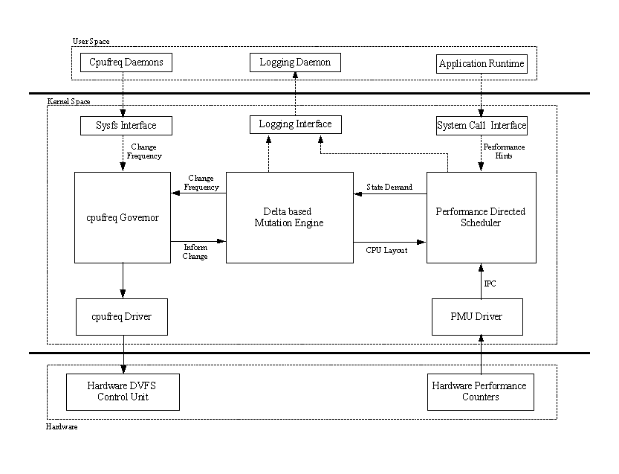
Seeker

Slide 16
Definitions
Performance States: Each DVFS configuration is given a performance state number with 0 being the one with the lowest clock-speed. This is usually denoted as P_{n} .
T – The total number of performance states supported by the system
N – The total processors on line.
C_{i} – The i'th processor.
P_{i} – The i'th performance state. P₀ is the one with the lowest clock speed and power consumption, and P_{T-1} is the one with the highest clock speed and power consumption. Note that this is the exact opposite when compared to P-State provided in processor manuals.

Slide 17
Definitions
Delta: The total changes in Performance states on a global basis.
Mutation: The act of changing the performance states of the CPUs in the system.
Mutation Interval: The interval between two consecutive mutations.
Scheduling Quanta: Interval on which scheduling decisions are made. Usually every 1-10ms per processor and depends on the OS configuration.
Demand: Number of requests from the previous mutation for each state in the system. Represented as D = [D₀,D₁,D₂,…].

Slide 18
Layout

Slide 19
Delta Constrained Mutation
Start
Compute Transition Direction
Compute State Matrix
Compute state weight
Pick Winning State
Choose Processor
Mark Processor as assigned
Adjust Delta
Delta > 0
End

Slide 20
Transition Direction
All elements in
Poison Matrix,
X (N x T)
Is set to false.

Slide 21
State Matrix M, Direction High

Slide 22
State Matrix M, Direction Low

Slide 23
State Matrix M, Balance

Slide 24
State Weight
The state with the max W value wins.
The winning state chooses the max value in the state matrix whose position in the poison matrix X, is false.
Sets the position in the poison matrix X to true.
Set clock speed of the winning processor to the required state if required.
Adjust delta based on the transition.
Reduce the processor demand d of the winning state.
Continue till delta = 0 or a max of load iterations have been performed.

Slide 25
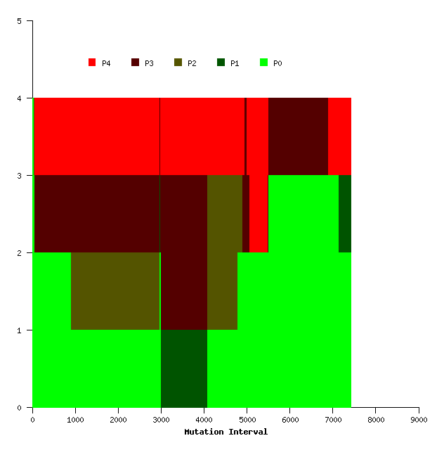
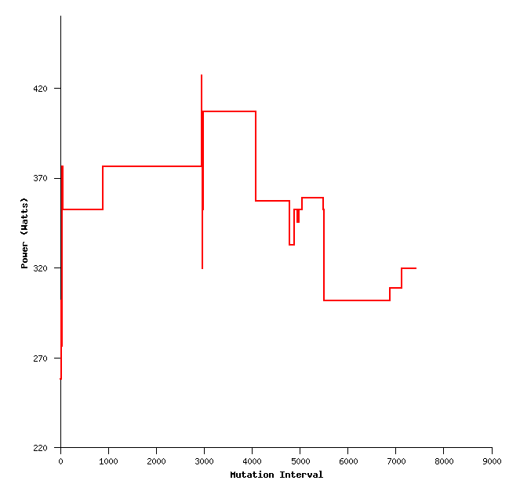
Mutation: Delta = 2, PHigh-PLow

Slide 26
More Visualizations
In the process.
Data is a plenty, rigorously writing text and scripts

