Slide 1

Customer Response Analysis
This presentation dives into a detailed analysis of customer data, examining response rates correlated with household size, average spending habits, and wine purchase patterns. We’ll explore key findings, model performance, and suggest data-driven recommendations for optimized marketing campaigns.

Slide 2
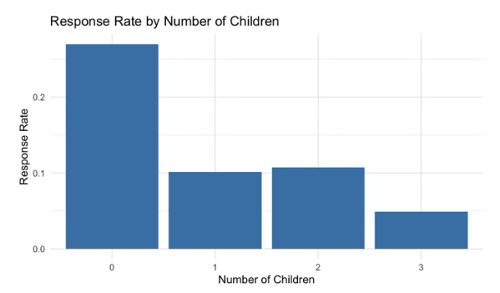
Response Rate by Number of Children
Insight
Recommendation
Child-free households have the highest response rate (~27%).
Focus marketing campaigns on child-free households.
Response rates drop significantly as the number of children increases.
Offer personalized promotions for families with children.
Families with 3 children have the lowest response rate (~4.9%).

Slide 3
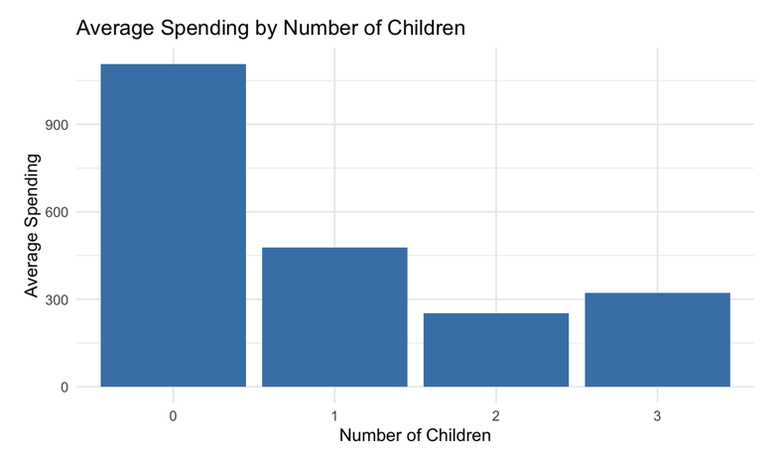
Average Spending by Number of Children
Insight
Recommendation
Child-free households spend the most (~$1,107 on average)
Market premium products to child-free households.
Spending drops significantly for families with children.
Offer budget-friendly options for families with children.

Slide 4
Wine Purchase Correlations
Insight
Recommendation
Wine purchases correlate highest with meat purchases (0.56).
Apply bundle marketing strategies (e.g., discounts for wine + meat).
Sweet products, fish, and gold products also have moderate correlations.
Target high-value customers with exclusive promotions.

Slide 5

Key Findings & Recommendations
Wine Purchases
Child-free Households
Strong correlation with meat and other luxury products.
Higher response rates and higher spending.

Slide 6
Model Performance Metrics
Model
Accuracy
AUC
Sensitivity
Specificity
Precision
F1_Score
Logistic Regression
0.9050279
0.7150978
0.4651163
0.9296636
0.6451613
0.5405405
Random Forest
0.8910615
0.5866740
0.1860465
0.8988439
0.6666667
0.2909091
XGBoost
0.8994413
0.6516796
0.3255814
0.9139466
0.6666667
0.4375000
Lasso Regression
0.9189944
0.7330749
0.4883721
0.9333333
0.7500000
0.5915493

Slide 7
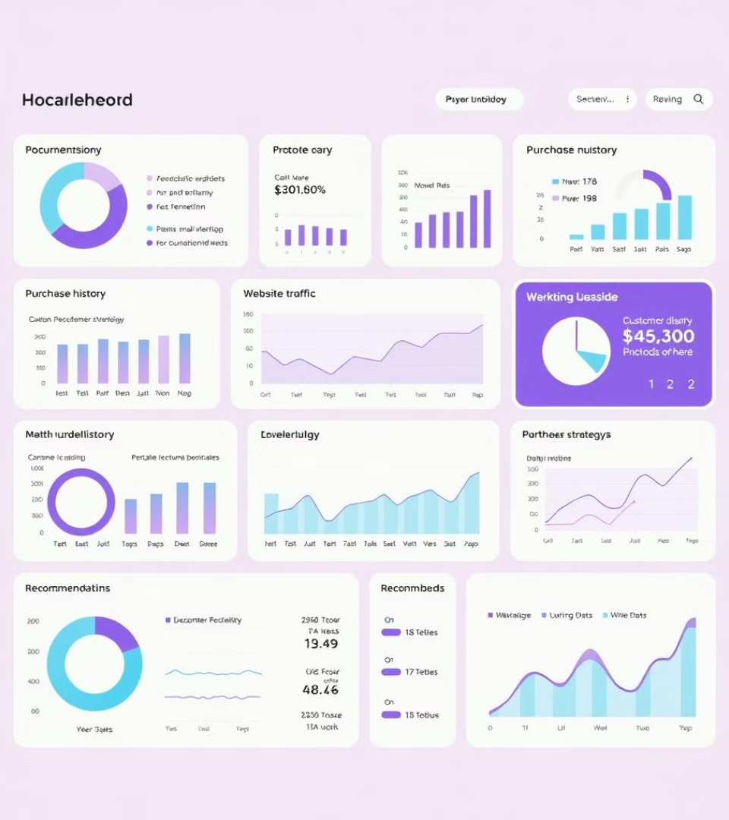
Best Model: Lasso Regression
Highest Accuracy
Lasso Regression achieved the highest accuracy (91.52%).
Predictive Capabilities
Predict customer response probability for future campaigns.
Identify high-value customers.

Slide 8

Lasso Regression: Inner Workings
1
Feature Selection
Forces some coefficients to be zero, selecting only relevant features.
2
Regularization
Shrinks coefficients, preventing overfitting and making the model simpler.
3
Optimization
Minimizes the sum of squared errors while applying an L1 penalty to coefficients.

Slide 9
Evaluation Metrics
Accuracy
1
Measures the proportion of correct predictions (91.52%).
AUC
2
Measures the area under the ROC curve (0.7129).
Precision
3
Measures how many predicted positives were actually positive (69.69%).
Recall
4
Measures how many actual positives were correctly identified (45.09%).
F1-Score
5
Balances precision and recall (54.76%).

Slide 10
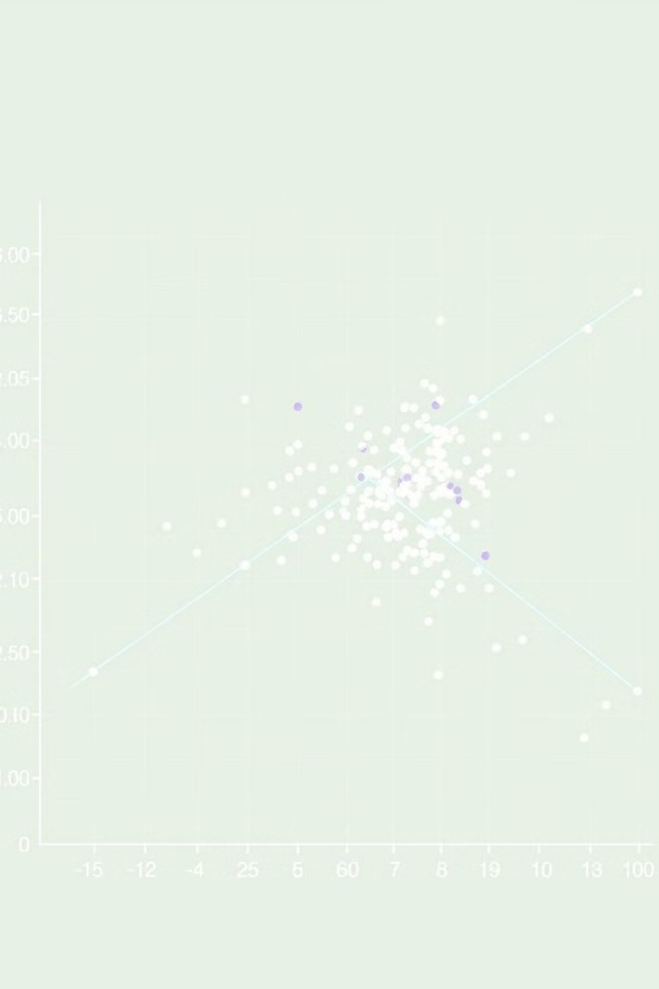
Generalization Approach
1
Cross-validation
2
Feature Selection
Selects the best penalty term (λ) to balance bias and variance.
Reduces noise by eliminating irrelevant predictors.
3
Normalization
4
Train-test Split
Maintains consistent weight distribution for numerical features.
Prevents overfitting and measures real-world performance.

