Slide 1
MEMBERS 01–10
ATOMIC STRUCTURE
From Thomson's Plum Pudding Model
to Modern Quantum Theory
First-year undergraduate lecture • Group of 10 • [Team Name TBD] • [College Name TBD]
• Ten students teach one story: how the electron was found, how Thomson built a model, how Rutherford broke it, and why even Rutherford had to be replaced.
• Driving question for the whole hour: atoms contain charged parts, so what holds them together — and why do atoms not collapse?
• Every slide shows real dates, numbers, and equations you can verify — plus the member number responsible for teaching it.
• Team: Members 01–10 (names TBD). College: [College Name TBD]. Read each slide's points aloud, point at the diagram, then hand over.
Schematic — crisp rings are HISTORICAL orbits (see Slide 38)
ATOMIC STRUCTURE — THOMSON TO QUANTUM
ALL MEMBERS 01–10
01 / 45
Notes:
MEMBERS 01–10 — ATOMIC STRUCTURE — From Thomson's Plum Pudding Model to Modern Quantum Theory. Notes (ALL, Member 01 leads): Welcome the class and state the driving question. Point at the orbit rings and warn they are HISTORICAL Bohr orbits — Slide 38 will replace them with quantum clouds. Stress terms: plum pudding, nucleus, quantised. HANDOFF: Member 01 stays on for the journey map.

Slide 2
ATOMIC STRUCTURE • FROM THOMSON TO QUANTUM
Our Learning Journey — Five Models, One Method
ALL MEMBERS • M01
• 1808 Dalton: solid ball explains combining ratios — Member 1 shows what it explained and why it was believed.
• 1897–1904 Thomson: electron found, pudding built — Members 2–4 cover discovery, model, and its failures.
• 1909–1911 Rutherford, Geiger, Marsden: nucleus found — Members 5–7 rebuild the atom from scattering evidence.
• 1913 Bohr to quantum orbitals: stability and spectra fixed — Members 9–10 close the arc after Member 8 compares models.
• Method to carry all hour: each model kept what worked and was broken by a new experiment with numbers.
1808
1897
1911
1913
1926
Dalton
Thomson
Rutherford
Bohr
Quantum
ball
electron
nucleus
orbits
orbitals
Members 01–10 own the numbered stops — follow the pills.
ATOMIC STRUCTURE — THOMSON TO QUANTUM
ALL MEMBERS — OPENS: MEMBER 01
02 / 45
Notes:
ALL MEMBERS • M01 — Our Learning Journey — Five Models, One Method. Notes (ALL/Member 01): Walk the five timeline nodes left to right. Tell the class to listen for break-dates and counts (e/m, 1 in 8000). Stress terms: scattering, stationary, orbital. HANDOFF: Member 01 continues with what atom meant.

Slide 3
ATOMIC STRUCTURE • FROM THOMSON TO QUANTUM
What Is an Atom? From Atomos to Dalton's Theory (1808)
PRESENTER 01
• The word atom comes from Greek atomos, meaning indivisible — first a philosophical idea, not an experiment.
• In 1808 John Dalton turned philosophy into testable chemistry: matter is made of tiny particles called atoms.
• Dalton's rules: atoms of one element are identical, and atoms combine in fixed ratios to form compounds.
• Example the class can weigh: carbon and oxygen always combine in fixed mass ratios, never arbitrary amounts.
• In Dalton's picture the atom was a tiny solid ball that could never be broken — a claim later experiments destroyed.
atomos — uncuttable spheres, one kind per element
C : O 12:16
C : O₂ 12:32
Custom schematic — fixed ratios you can weigh.
ATOMIC STRUCTURE — THOMSON TO QUANTUM
MEMBER 01 — FOUNDATIONS
03 / 45
Notes:
PRESENTER 01 — What Is an Atom? From Atomos to Dalton's Theory (1808). Notes (Member 01): Pronounce atomos; date Dalton 1808. Explain fixed ratios with a weighing example. Diagram: five solid spheres plus ratio bars. Stress terms: atomos, fixed ratios. HANDOFF: Staying with Member 01 — what the ball explained.

Slide 4
ATOMIC STRUCTURE • FROM THOMSON TO QUANTUM
Dalton's Solid Ball — What It Explained and Why It Was Accepted
PRESENTER 01
• The solid ball explained why elements combine in fixed, predictable ratios instead of melting together arbitrarily.
• It gave chemistry measurable atoms: each element had a characteristic combining mass chemists could weigh in the lab.
• With no evidence of inner parts for nearly a century, an indivisible sphere was the simplest picture that worked.
• Acceptance came from usefulness: the model predicted combining behaviour correctly even though its hardness was assumed.
• Its weakness was structural silence: a solid ball cannot emit electrons, conduct in discharge tubes, or give line spectra.
Useful: predicts combining masses • Silent: no inner parts
Kept for ~90 years because it WORKED, not because it was proven
ATOMIC STRUCTURE — THOMSON TO QUANTUM
MEMBER 01 — FOUNDATIONS
04 / 45
Notes:
PRESENTER 01 — Dalton's Solid Ball — What It Explained and Why It Was Accepted. Notes (Member 01): Emphasise usefulness vs truth — Dalton was kept because it worked, not because indivisibility was proven. Bars show fixed ratios visually. Stress terms: combining mass. HANDOFF: Staying with Member 01 — the evidence that broke it.

Slide 5
ATOMIC STRUCTURE • FROM THOMSON TO QUANTUM
Atoms Are Divisible — Electricity Reveals Parts Inside
PRESENTER 01
• Electrolysis splits compounds with electric current — neutral matter responds to charge, so charge must live inside atoms.
• Electric discharge through low-pressure gases glows and conducts — again, atoms and electricity are connected.
• Both experiments force one conclusion: atoms contain smaller charged parts, so atoms are divisible after all.
• This raises the question every atomic model tries to answer: how are the inner charged particles arranged?
• Atomic models are scientists' arranged-furniture plans for these parts — Member 2 opens the first drawer: the electron.
sealed ball
opened: charged parts
Electrolysis + discharge glow → electricity lives inside atoms
Custom schematic — the logical crowbar that opens the ball.
ATOMIC STRUCTURE — THOMSON TO QUANTUM
MEMBER 01 — FOUNDATIONS
05 / 45
Notes:
PRESENTER 01 — Atoms Are Divisible — Electricity Reveals Parts Inside. Notes (Member 01): Name both experiments slowly; they are the logical crowbar that opens Dalton's ball. Diagram contrasts sealed ball with opened ball showing dots. Stress terms: electrolysis, divisible. HANDOFF: Over to Member 02 for the electron discovery.

Slide 6
ATOMIC STRUCTURE • FROM THOMSON TO QUANTUM
The Three Subatomic Particles — Electron, Proton, Neutron
PRESENTER 01
• The electron carries −1.6 × 10⁻¹⁹ C with a tiny mass of ~9.1 × 10⁻³¹ kg — the lightest part, first proof atoms break open.
• The proton carries the same charge but positive (+1.6 × 10⁻¹⁹ C) and is ~1836 times heavier than the electron.
• The neutron, found later by Chadwick in 1932, has no charge and a mass almost equal to the proton.
• Neutrality rule: total positive charge equals total negative charge, so the whole atom is electrically neutral.
• TABLE (right): read each row's charge, mass, and discoverer — the rest of this talk only rearranges these three parts.
Particle | Charge | Mass | Found
electron | −1.6×10⁻¹⁹ C | 9.1×10⁻³¹ kg | Thomson 1897
proton | +1.6×10⁻¹⁹ C | ~1836 × e⁻ | —
neutron | 0 | ≈ proton | Chadwick 1932
Neutrality: total + equals total −
ATOMIC STRUCTURE — THOMSON TO QUANTUM
MEMBER 01 — FOUNDATIONS
06 / 45
Notes:
PRESENTER 01 — The Three Subatomic Particles — Electron, Proton, Neutron. Notes (Member 01): Read the native table row by row; stress 1836× and Chadwick 1932 as later than our main story. Terms: coulomb, neutral. HANDOFF: Over to Member 02 — where the electron was found.

Slide 7
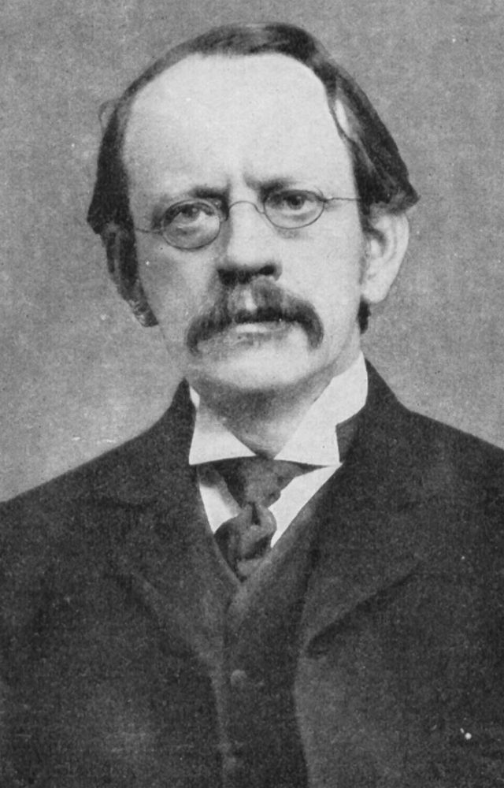
ATOMIC STRUCTURE • FROM THOMSON TO QUANTUM
Discovery of the Electron (1897) — Building the Cathode-Ray Tube
PRESENTER 02
• J. J. Thomson discovered the electron in 1897 while studying cathode rays — the project starts with his glass tube.
• The tube is sealed glass holding a gas at very low pressure, so the beam flies without scattering off air molecules.
• Two electrodes sit inside: the cathode (−) and the anode (+), wired to a high-voltage supply across the tube.
• When voltage is applied, rays stream from cathode to anode — these streams are the cathode rays under test.
• Portrait: J. J. Thomson (photo, public domain) — the glow alone proved nothing; his deflection measurements proved everything.
Sealed tube • very low pressure • high voltage
CATHODE −
ANODE +
Straight beam = baseline for the field tests.
J. J. Thomson (PD)
Custom schematic + Thomson portrait (PD).
ATOMIC STRUCTURE — THOMSON TO QUANTUM
MEMBER 02 — ELECTRON
07 / 45
Notes:
PRESENTER 02 — Discovery of the Electron (1897) — Building the Cathode-Ray Tube. Notes (Member 02): Trace each labelled part: tube, cathode, anode, supply, screen. Explain why low pressure matters. Terms: cathode, anode, vacuum. HANDOFF: Same speaker — what the rays do.

Slide 8
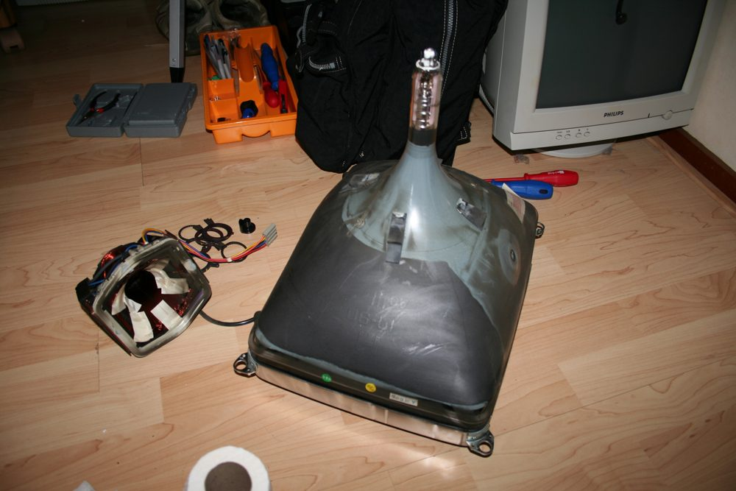
ATOMIC STRUCTURE • FROM THOMSON TO QUANTUM
Cathode Rays at Work — Straight Lines, Shadows, Motion, Glow
PRESENTER 02
• The rays travel in straight lines — slide any object into the beam and it casts a sharp shadow on the glass.
• Straightness plus shadow proves directed travel from cathode to anode, establishing the baseline undeflected path.
• A tiny paddle wheel placed in the beam rotates — the rays carry energy and momentum, so they are physical, not illusion.
• Where rays strike, glass or a fluorescent screen glows — each impact point becomes visible as a bright spot.
• So far we know the path and the punch, but not the charge — the field tests on the next slide decide that.
Glowing beam in a real tube (modern photo, illustrative — not Thomson's original)
straight + shadow
paddle spins
screen glows
ATOMIC STRUCTURE — THOMSON TO QUANTUM
MEMBER 02 — ELECTRON
08 / 45
Notes:
PRESENTER 02 — Cathode Rays at Work — Straight Lines, Shadows, Motion, Glow. Notes (Member 02): Present four observations as courtroom exhibits; the photo shows a real glowing tube (illustrative modern tube, captioned). Terms: fluorescence, momentum. HANDOFF: Same speaker — the deflection verdict.

Slide 9
ATOMIC STRUCTURE • FROM THOMSON TO QUANTUM
Negative Charge Proved — Bending in Electric and Magnetic Fields
PRESENTER 02
• In an electric field the rays bend toward the positively charged plate — only a negative charge is pulled that way.
• Magnetic fields deflect them likewise, confirming the beam responds as moving charge, not as light waves.
• The undeflected straight path versus the bent path is the whole argument: the difference is caused by charge.
• Light would ignore both fields; these rays obey both — so they are streams of charged particles.
• Charge is now settled; the next measurement asks how light each particle is — the famous ratio.
POSITIVE PLATE (+)
NEGATIVE PLATE (−)
Bends toward + plate, so the beam is NEGATIVE. Magnetic deflection agrees.
Custom schematic — bend direction is the evidence.
ATOMIC STRUCTURE — THOMSON TO QUANTUM
MEMBER 02 — ELECTRON
09 / 45
Notes:
PRESENTER 02 — Negative Charge Proved — Bending in Electric and Magnetic Fields. Notes (Member 02): Point at the straight baseline versus the bent cyan path; name the + and − plates. Terms: deflection, polarity. HANDOFF: Same speaker — measuring e/m.

Slide 10
ATOMIC STRUCTURE • FROM THOMSON TO QUANTUM
How Light Is the Electron? e/m = 1.76 × 10¹¹ C/kg
PRESENTER 02
• Thomson balanced electric against magnetic deflection until the two bends cancelled — then computed e/m = 1.76 × 10¹¹ C/kg.
• Here e is the particle's charge in coulombs and m its mass in kilograms, so the ratio reads coulombs per kilogram.
• The value is ~1800 times larger than for a hydrogen ion — for equal charge the mass must be ~1800 times smaller.
• The same ratio appeared with every gas and every cathode metal — so electrons are a common part of every atom.
• Later Millikan's oil-drop experiment fixed the charge e separately; combined with e/m this gives the electron mass. The atom is divisible.
e/m = 1.76 × 10¹¹ C/kg
E-field bends down
balanced → cancel → measure
B-field bends up
e = charge (C) • m = mass (kg) • ~1800× hydrogen ion → extremely light
Same ratio, every gas and cathode metal → electrons live in ALL atoms
Millikan oil-drop fixed e separately → mass follows from e/m
ATOMIC STRUCTURE — THOMSON TO QUANTUM
MEMBER 02 — ELECTRON
10 / 45
Notes:
PRESENTER 02 — How Light Is the Electron? e/m = 1.76 × 10¹¹ C/kg. Notes (Member 02): Read the equation as words: charge over mass. Do the 1800× logic live: bigger ratio means lighter particle. Terms: charge-to-mass ratio, universal. HANDOFF: Over to Member 03 — the model Thomson built.

Slide 11
ATOMIC STRUCTURE • FROM THOMSON TO QUANTUM
Thomson Asks the Next Question — Where Is the Positive Charge? (1904)
PRESENTER 03
• Electrons are negative, yet whole atoms are neutral — so an equal positive charge must exist somewhere inside.
• In 1904 Thomson proposed his answer: the atom is a sphere of diffuse positive charge filling the whole atom.
• The sphere's radius is ~10⁻¹⁰ metre — this size becomes the target Rutherford's experiment will test.
• Crucially, there is no nucleus in this picture: positive charge is spread smoothly everywhere, not concentrated.
e⁻ negative + atom neutral = missing + charge … where?
R ≈ 10⁻¹⁰ m
1904 answer: uniform + sphere, NO nucleus
ATOMIC STRUCTURE — THOMSON TO QUANTUM
MEMBER 03 — THOMSON MODEL
11 / 45
Notes:
PRESENTER 03 — Thomson Asks the Next Question — Where Is the Positive Charge? (1904). Notes (Member 03): Pose the puzzle before the answer; let the class feel the gap. Diagram shows uniform fill with no centre dot. Terms: diffuse, neutral. HANDOFF: Same speaker — the pudding analogy.

Slide 12
ATOMIC STRUCTURE • FROM THOMSON TO QUANTUM
Plum Pudding — Positive Pudding, Electron Plums, Neutral Whole
PRESENTER 03
• The pudding is the uniform positive charge; the plums are electrons embedded throughout it like fruit in dessert.
• Twin analogy from the source: watermelon red pulp is the positive charge and the seeds are the electrons.
• Embedding matters: electrons sit inside the positive sphere, held wherever the surrounding charge balances them.
• Neutrality is automatic: total positive charge equals total negative charge, so the atom has no net charge.
• Point at the diagram: amber fill everywhere versus navy dots — fill and dots together make neutrality visible.
Pudding = uniform + • Plums = electrons • total + = total −
Custom schematic — watermelon twin: pulp = +, seeds = electrons.
ATOMIC STRUCTURE — THOMSON TO QUANTUM
MEMBER 03 — THOMSON MODEL
12 / 45
Notes:
PRESENTER 03 — Plum Pudding — Positive Pudding, Electron Plums, Neutral Whole. Notes (Member 03): Tell both analogies; ask the class which image sticks. Emphasise embedded, not orbiting. Terms: embedded, neutrality. HANDOFF: Same speaker — assumptions and light.

Slide 13
ATOMIC STRUCTURE • FROM THOMSON TO QUANTUM
Assumptions Inside the Pudding — And What It Could Explain
PRESENTER 03
• Assumption one: positive charge is spread uniformly through the entire atomic volume, with no dense centre.
• Assumption two: electrons sit or vibrate gently about fixed positions inside that uniform charge.
• Thomson used these vibrations to try to explain light emission — shaking charges should radiate light.
• What the model genuinely explained: electrical neutrality and the fact that electrons can be pulled out of atoms.
• What it never earned: exact spectral lines, a nucleus, or stability proof — Member 4 prosecutes each gap.
uniform + everywhere
no dense centre
electrons vibrate
tried to explain light
neutral + removable e⁻
what it got right
ATOMIC STRUCTURE — THOMSON TO QUANTUM
MEMBER 03 — THOMSON MODEL
13 / 45
Notes:
PRESENTER 03 — Assumptions Inside the Pudding — And What It Could Explain. Notes (Member 03): Be fair: credit neutrality and removable electrons before attacking. Terms: uniform, vibrate. HANDOFF: Over to Member 04 — why the pudding failed.

Slide 14
ATOMIC STRUCTURE • FROM THOMSON TO QUANTUM
Failure One — Large-Angle Scattering Is Impossible in Pudding
PRESENTER 04
• Spread-out positive charge makes only a weak electric field inside the atom, so a passing alpha feels a slight push.
• The model therefore predicts every alpha particle suffers only a tiny deflection — a small wiggle, never a rebound.
• Worse, electrons cannot rescue the prediction: an alpha is ~7300 times heavier than an electron.
• Source analogy: a bus hitting ping-pong balls — the bus never bounces back, no matter how many balls it meets.
• Experiments showed violent large-angle rebounds instead — the first direct clash between pudding and reality.
THOMSON PREDICTS: only tiny nudges
BUS (alpha)
alpha ≈ 7300× electron — ping-pong balls can't stop a bus
ATOMIC STRUCTURE — THOMSON TO QUANTUM
MEMBER 04 — THOMSON LIMITS
14 / 45
Notes:
PRESENTER 04 — Failure One — Large-Angle Scattering Is Impossible in Pudding. Notes (Member 04): Act out the bus analogy; write 7300× large. Diagram contrasts predicted wiggle with observed rebound. Terms: electric field, deflection. HANDOFF: Same speaker — three more failures.

Slide 15
ATOMIC STRUCTURE • FROM THOMSON TO QUANTUM
Failures Two to Four — No Nucleus, No Lines, No Stability
PRESENTER 04
• No nucleus: the model assumes positive charge fills the atom, leaving no dense centre that could hurl an alpha back.
• No line spectra: real atoms emit light only at exact wavelengths, but vibrating electrons give no such sharp lines.
• Observe-vs-model discipline: exact wavelengths are measured facts; Thomson's smooth vibrations are the failed explanation.
• No stability: a set of motionless charges cannot sit in stable balance under electrostatic forces alone.
• Three independent failures plus scattering make four — the model is cornered on every side except neutrality.
1 no nucleus
spread +, no dense centre
2 no exact lines
vibrations ≠ sharp spectra
3 no stability
static charges can't balance
4 wrong scattering
tiny bends predicted, rebounds seen
ATOMIC STRUCTURE — THOMSON TO QUANTUM
MEMBER 04 — THOMSON LIMITS
15 / 45
Notes:
PRESENTER 04 — Failures Two to Four — No Nucleus, No Lines, No Stability. Notes (Member 04): Count failures on fingers: scattering, nucleus, spectra, stability. Terms: line spectra, electrostatic balance. HANDOFF: Same speaker — verdict and transition.

Slide 16
ATOMIC STRUCTURE • FROM THOMSON TO QUANTUM
Verdict on Thomson — And the Experiment That Will Test It
PRESENTER 04
• Kept: electrons exist inside atoms, and neutrality balances equal positive against negative charge.
• Lost: large-angle scattering, nuclear structure, exact line spectra, and guaranteed stability.
• The honest scientific move is a direct test: fire fast heavy particles at atoms and watch the deflections.
• If pudding is right, almost every particle sails through with a tiny nudge — Rutherford's team ran exactly this trial.
• Transition question for the class: what apparatus could count single particles at every angle? Member 5 answers.
KEPT: electrons inside atoms • neutrality balances
LOST: scattering • nucleus • line spectra • stability
Next: fire fast particles at atoms and count the bends
ATOMIC STRUCTURE — THOMSON TO QUANTUM
MEMBER 04 — THOMSON LIMITS
16 / 45
Notes:
PRESENTER 04 — Verdict on Thomson — And the Experiment That Will Test It. Notes (Member 04): Summarise kept-vs-lost in two breaths; end on the apparatus question. Terms: direct test. HANDOFF: Over to Member 05 — the gold-foil setup.

Slide 17
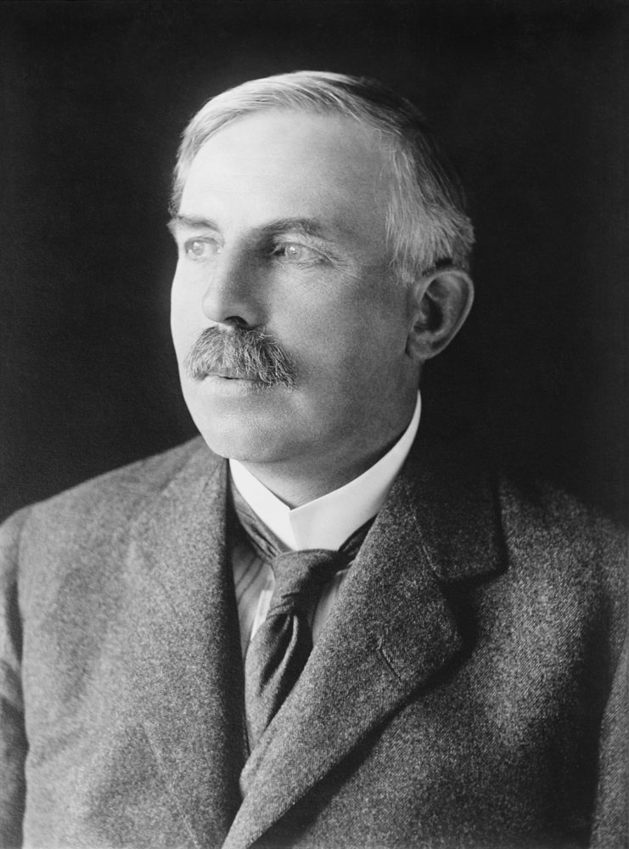
ATOMIC STRUCTURE • FROM THOMSON TO QUANTUM
Testing Thomson — Rutherford, Geiger and Marsden (Manchester, ~1909)
PRESENTER 05
• Experimenters: Ernest Rutherford with Hans Geiger and Ernest Marsden, working at Manchester around 1909.
• Their aim was explicit: test Thomson's model by firing fast particles at atoms and watching how they deflect.
• Strategy: use a heavy, fast, charged probe so any concentrated charge inside the atom reveals itself by repulsion.
• Everything that follows — source, beam, foil, screen — serves that single aim: count deflections angle by angle.
• Portrait: Rutherford (photo, public domain) — Geiger and Marsden ran the bench; Rutherford read the meaning.
Rutherford • Geiger • Marsden — Manchester, ~1909
Bench: Geiger and Marsden. Meaning: Rutherford.
AIM: test Thomson — fire fast particles, watch deflections
Every part below serves that aim — source, beam, foil, screen.
Portrait: Bain News Service via LoC (PD-US), restoration Bammesk, via Commons.
ATOMIC STRUCTURE — THOMSON TO QUANTUM
MEMBER 05 — GOLD-FOIL SETUP
17 / 45
Notes:
PRESENTER 05 — Testing Thomson — Rutherford, Geiger and Marsden (Manchester, ~1909). Notes (Member 05): Name all three; stress aim-before-apparatus so each part has a purpose. Terms: probe, deflection survey. HANDOFF: Same speaker — the source and beam.

Slide 18
ATOMIC STRUCTURE • FROM THOMSON TO QUANTUM
The Probe — Alpha Particles in a Lead Collimator
PRESENTER 05
• The source is a radioactive material such as radium or polonium, steadily emitting alpha particles.
• Alpha particles are helium nuclei — two protons plus two neutrons — carrying charge +2e.
• They leave the source at ~10⁷ metres per second: heavy and fast, ideal hammers for testing atomic structure.
• The source sits in a lead block with a narrow hole; lead absorbs every stray particle except the thin emerging beam.
• Result: a narrow, aimed, single-direction beam — without collimation the angle counts would be meaningless.
Pb block + hole
alpha = helium nucleus (2p + 2n) • +2e • ~10⁷ m/s
radium / polonium source • lead absorbs the rest → thin aimed beam
ATOMIC STRUCTURE — THOMSON TO QUANTUM
MEMBER 05 — GOLD-FOIL SETUP
18 / 45
Notes:
PRESENTER 05 — The Probe — Alpha Particles in a Lead Collimator. Notes (Member 05): Define each number: +2e charge, 10⁷ m/s speed, helium-nucleus identity. Diagram shows block, hole, beam. Terms: collimator, absorb. HANDOFF: Same speaker — target and detector.

Slide 19
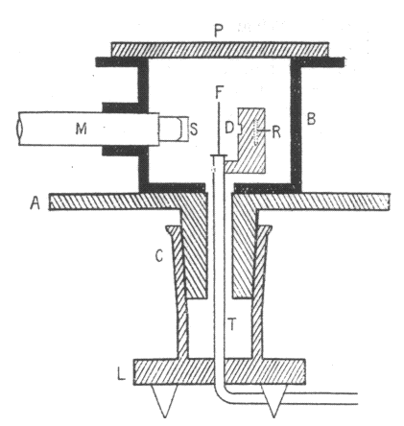
ATOMIC STRUCTURE • FROM THOMSON TO QUANTUM
Target and Detector — Gold Foil, Vacuum, Flashes Counted One by One
PRESENTER 05
• The beam strikes a gold foil only a few hundred atoms thick — nearly two-dimensional, so each alpha meets few atoms.
• Gold was chosen for two reasons: it hammers into extremely thin sheets, and its heavy nucleus (charge +79) repels strongly.
• Around the foil stands a zinc-sulphide screen: every alpha impact flashes as a tiny scintillation of light.
• A microscope counts these flashes angle by angle — single-particle detection, position by position, in the dark.
• The whole apparatus sits in vacuum so alphas never scatter off air; Thomson's expectation was almost-all-through with tiny bends.
ZnS flash
Au foil (Z=79)
few-hundred atoms thick • malleable • vacuum • microscope counts
Custom top-view schematic + historic Geiger–Marsden fig. thumbnail (PD, 1913).
ATOMIC STRUCTURE — THOMSON TO QUANTUM
MEMBER 05 — GOLD-FOIL SETUP
19 / 45
Notes:
PRESENTER 05 — Target and Detector — Gold Foil, Vacuum, Flashes Counted One by One. Notes (Member 05): Walk the full path: source, hole, foil, flash, microscope. Historic Geiger–Marsden figure shown as thumbnail beside the redrawn schematic. Terms: scintillation, vacuum. HANDOFF: Over to Member 06 — what actually happened.

Slide 20
ATOMIC STRUCTURE • FROM THOMSON TO QUANTUM
Observation 1 — Almost Everything Goes Straight Through
PRESENTER 06
• What happened: the overwhelming majority of alpha particles crossed the foil with zero measurable deflection.
• This is a seen count, not an inference — flash after flash appeared at the straight-ahead position.
• Conclusion, and only this: most of the atom offers nothing solid enough to disturb a fast heavy particle.
• In the source's words: the atom is mostly empty space — the beam usually meets no charge worth noticing.
• Keep observation and conclusion apart: straight flashes were seen; emptiness is what they mean. Two more results follow.
SEEN: flash dead ahead, again and again
MEANT: mostly empty space
Custom schematic — left column is SEEN, right column is MEANT.
ATOMIC STRUCTURE — THOMSON TO QUANTUM
MEMBER 06 — OBSERVATIONS
20 / 45
Notes:
PRESENTER 06 — Observation 1 — Almost Everything Goes Straight Through. Notes (Member 06): Point at the straight cyan path; repeat the discipline aloud: seen versus meant. Terms: undeflected. HANDOFF: Same speaker — the small bends.

Slide 21
ATOMIC STRUCTURE • FROM THOMSON TO QUANTUM
Observation 2 — A Few Particles Bend by Small Angles
PRESENTER 06
• What happened: a small fraction of alphas left the foil travelling a few degrees off the straight path.
• Source figure: about 0.14% of particles deflected by more than 1 degree — rare, but far too many to ignore.
• Conclusion: positive charge really exists inside the atom, and it repelled the positively charged alphas.
• Like charges repel: the bend direction and size fingerprint a positive interior acting at a distance.
• These are near misses past buried charge — the next result shows what a direct hit looks like.
SEEN: ~0.14% bend past 1°
MEANT: positive charge inside repels + alphas
Custom schematic — left column is SEEN, right column is MEANT.
ATOMIC STRUCTURE — THOMSON TO QUANTUM
MEMBER 06 — OBSERVATIONS
21 / 45
Notes:
PRESENTER 06 — Observation 2 — A Few Particles Bend by Small Angles. Notes (Member 06): Read 0.14% slowly and write it large; it is the middle tier between common and ultra-rare. Diagram shows the bent cyan path. Terms: repulsion, 0.14%. HANDOFF: Same speaker — the violent rebounds.

Slide 22
ATOMIC STRUCTURE • FROM THOMSON TO QUANTUM
Observation 3 — About 1 in 8000 Bounces Back
PRESENTER 06
• What happened: very few alphas — about 1 in 8000 — scattered through more than 90 degrees, some straight back at 180°.
• Conclusion: almost all the atom's mass and all its positive charge sit in a tiny, dense nucleus.
• Reasoning: only a head-on collision with concentrated charge can reverse a fast, heavy alpha particle.
• Rutherford's image: like firing a huge shell at tissue paper and watching it come back — utterly unexpected.
• This single result kills spread charge: pudding predicts zero rebounds, yet rebounds were counted flash by flash.
SEEN: ~1 in 8000 past 90°, some 180° back
MEANT: tiny dense nucleus holds + and mass
Custom schematic — left column is SEEN, right column is MEANT.
ATOMIC STRUCTURE — THOMSON TO QUANTUM
MEMBER 06 — OBSERVATIONS
22 / 45
Notes:
PRESENTER 06 — Observation 3 — About 1 in 8000 Bounces Back. Notes (Member 06): Land the 1-in-8000 figure; deliver the shell-vs-tissue quote verbatim. Red path shows the 180° return. Terms: dense, head-on. HANDOFF: Same speaker — why aim decides fate.

Slide 23
ATOMIC STRUCTURE • FROM THOMSON TO QUANTUM
Impact Parameter — Why the Same Beam Gives Three Fates
PRESENTER 06
• Definition: the impact parameter b is the perpendicular distance between the alpha's original path and the nucleus centre.
• In plain words, b measures how off-centre the aim is — a wide miss has large b, a near hit has small b.
• Large b: the alpha passes far away, feels only weak distant repulsion, and sails on nearly straight — the common fate.
• Small b: the alpha dives through the strong near-nucleus field and swings through a large angle — the rare 0.14% tail.
• Diagram: trace both paths from the same incoming direction; the nucleus sits at the bend centre of each.
large b → tiny bend
b
nucleus
small b → large bend
Custom schematic — b is measured from the original path to the centre.
ATOMIC STRUCTURE — THOMSON TO QUANTUM
MEMBER 06 — IMPACT PARAMETER
23 / 45
Notes:
PRESENTER 06 — Impact Parameter — Why the Same Beam Gives Three Fates. Notes (Member 06): Point at the b-bracket between original path and nucleus. Connect rarity tiers to b sizes. Terms: impact parameter, perpendicular. HANDOFF: Same speaker — the zero case.

Slide 24
ATOMIC STRUCTURE • FROM THOMSON TO QUANTUM
Head-On Collision — When b = 0 the Particle Comes Back
PRESENTER 06
• Zero impact parameter means perfectly head-on aim: the alpha charges straight at the nucleus centre.
• It climbs the repulsion head-on, stops, turns around, and exits back along its entry line at 180 degrees.
• This is the ultra-rare ~1-in-8000 fate — direct hits are rare because nuclei are vanishingly small targets.
• One-line rule to memorize: smaller impact parameter means closer approach means larger deflection.
• From this data Rutherford built a new model — Member 7 assembles it from exactly these three fates.
b = 0: dead centre — in, stopped, turned, 180° out
RULE: smaller b → closer → larger deflection
Custom schematic — the ultra-rare ~1-in-8000 fate.
ATOMIC STRUCTURE — THOMSON TO QUANTUM
MEMBER 06 — IMPACT PARAMETER
24 / 45
Notes:
PRESENTER 06 — Head-On Collision — When b = 0 the Particle Comes Back. Notes (Member 06): Trace the red in-and-out path; chant the rule with the class. Terms: head-on, 180°. HANDOFF: Over to Member 07 — the nuclear model.

Slide 25
ATOMIC STRUCTURE • FROM THOMSON TO QUANTUM
Rutherford's Nuclear Model (1911) — A Dense Centre in Vast Emptiness
PRESENTER 07
• In 1911 Rutherford proposed: a small, dense, positively charged nucleus sits at the atom's centre.
• Most of the atom's mass lives in that nucleus — the light electrons contribute almost nothing to the weight.
• Electrons revolve around the nucleus in circular orbits, and the rest of the atom is empty space.
• Because electrons circle like planets around the Sun, this is also called the planetary model.
• Historical label: the orbit picture below explains scattering beautifully — but it is the old model, not today's quantum atom.
nucleus (+, heavy)
HISTORICAL orbit picture — kept for scattering, replaced for stability
ATOMIC STRUCTURE — THOMSON TO QUANTUM
MEMBER 07 — NUCLEAR MODEL
25 / 45
Notes:
PRESENTER 07 — Rutherford's Nuclear Model (1911) — A Dense Centre in Vast Emptiness. Notes (Member 07): Point at nucleus, rings, and emptiness in turn. Warn the class the rings are historical. Terms: nucleus, planetary. HANDOFF: Same speaker — what holds the orbits.

Slide 26
ATOMIC STRUCTURE • FROM THOMSON TO QUANTUM
What Holds Electrons Up? Coulomb Attraction as Centripetal Force
PRESENTER 07
• Without something pulling inward, orbiting electrons would fly off in straight lines — circular motion needs a centre pull.
• That pull is electrostatic attraction between the positive nucleus and each negative electron.
• Just as gravity holds planets, charge holds electrons — with attraction playing gravity's role in the analogy.
• Historical relation: F(Coulomb) = m·v²/r — the inward electric force supplies the required circular-motion force.
• Term by term: F is the Coulomb attraction in newtons, m the electron mass, v its orbital speed, r the orbit radius.
F(Coulomb) = m·v²/r
e⁻
+ nucleus
F attraction (N) • m electron mass • v speed • r radius
Custom schematic — red arrow is the inward pull; gravity plays this role for planets.
ATOMIC STRUCTURE — THOMSON TO QUANTUM
MEMBER 07 — NUCLEAR MODEL
26 / 45
Notes:
PRESENTER 07 — What Holds Electrons Up? Coulomb Attraction as Centripetal Force. Notes (Member 07): Read the equation as a sentence: attraction provides the turning force. Diagram draws inward arrows on the orbiting dot. Terms: centripetal, coulomb. HANDOFF: Same speaker — how small is small.

Slide 27
ATOMIC STRUCTURE • FROM THOMSON TO QUANTUM
How Small Is the Nucleus? The Stadium-and-Seed Scale
PRESENTER 07
• Source sizes: the nucleus radius is ~10⁻¹⁵ to 10⁻¹⁴ m, while the whole atom's radius is ~10⁻¹⁰ m.
• So the atom is roughly 10,000 to 100,000 times wider than its nucleus — emptiness dominates by four to five orders.
• Source analogy: if the atom were a football stadium, the nucleus would be a tiny seed at the centre spot.
• The log bar (right) is honest about drawing: both sizes cannot share one linear scale, so the dot is magnified.
• Memorize both powers of ten — the teacher's favourite trap is asking which belongs to nucleus and which to atom.
LOG SCALE — each step is 10× smaller
atom radius ≈ 10⁻¹⁰ m
nucleus ≈ 10⁻¹⁵–10⁻¹⁴ m (dot magnified)
stadium = atom • seed at centre = nucleus
ATOMIC STRUCTURE — THOMSON TO QUANTUM
MEMBER 07 — NUCLEAR MODEL
27 / 45
Notes:
PRESENTER 07 — How Small Is the Nucleus? The Stadium-and-Seed Scale. Notes (Member 07): State both radii with units; admit the drawing compromise explicitly. Terms: order of magnitude, log scale. HANDOFF: Same speaker — what the model wins and still owes.

Slide 28
ATOMIC STRUCTURE • FROM THOMSON TO QUANTUM
What the Nuclear Model Wins — And What It Still Owes
PRESENTER 07
• It explains straight-through flight: most alphas never approach any nucleus, so most flashes sit dead ahead.
• It explains small bends: distant passes feel weak repulsion — the common 0.14% tier falls out naturally.
• It explains rebounds: the nucleus packs strong field into a tiny volume, so rare direct hits bounce back.
• One concentrated centre replaces pudding's smear — every observation tier now has a matching mechanism.
• What it still owes: why orbiting electrons neither radiate nor spiral in, and why spectra are sharp lines — Member 9 collects.
straight flight
most alphas never near a nucleus
small bends
distant passes feel weak push
rare rebounds
direct hits meet dense + core
Still owed: silent stable orbits + sharp spectral lines
One concentrated centre explains all three tiers.
ATOMIC STRUCTURE — THOMSON TO QUANTUM
MEMBER 07 — NUCLEAR MODEL
28 / 45
Notes:
PRESENTER 07 — What the Nuclear Model Wins — And What It Still Owes. Notes (Member 07): Map each fate to its mechanism; end owing stability and spectra honestly. Terms: mechanism, tier. HANDOFF: Over to Member 08 — head-to-head comparison.

Slide 29
ATOMIC STRUCTURE • FROM THOMSON TO QUANTUM
Thomson vs Rutherford — Same Electrons, Opposite Architecture
PRESENTER 08
• One-line contrast: Thomson imagined a uniform FILLED atom; Rutherford proved a mostly EMPTY atom with a tiny dense centre.
• TABLE (right): positive charge spread through the atom versus concentrated in the nucleus — the whole difference.
• Electrons embedded in the sphere versus revolving around the nucleus; no nucleus versus a dense massive one present.
• Alpha scattering: Thomson predicts only tiny bends and fails, while Rutherford predicts all three tiers and succeeds.
• Bridge warning: both pictures are still classical — and classical orbits carry the fatal flaw Member 9 now exposes.
Feature | Thomson | Rutherford
Positive charge | Spread through atom | In tiny nucleus
Electrons | Embedded in sphere | Revolve in orbits
Nucleus | None | Dense, massive
Alpha scattering | Fails: tiny bends only | Explains all 3 tiers
Both classical — the orbit flaw falls next.
ATOMIC STRUCTURE — THOMSON TO QUANTUM
MEMBER 08 — COMPARISON
29 / 45
Notes:
PRESENTER 08 — Thomson vs Rutherford — Same Electrons, Opposite Architecture. Notes (Member 08): Read the native table row by row; point at both cartoons. Terms: architecture, concentrated. HANDOFF: Same speaker — the five-model panorama.

Slide 30
ATOMIC STRUCTURE • FROM THOMSON TO QUANTUM
Five Models in One View — Structure, Evidence, and What Broke Each
PRESENTER 08
• Dalton's ball: solid and indivisible — explained combining ratios until discharge tubes proved inner charge.
• Thomson's pudding: electrons in uniform positive — explained neutrality until large-angle scattering broke it.
• Rutherford's nucleus: dense centre with orbiting electrons — explained scattering until collapse and spectra broke it.
• Bohr's orbits: quantised rings giving hydrogen lines — explained spectra until heavier atoms overflowed it.
• Quantum clouds: probability orbitals as the current model — every step kept what worked and fixed what failed.
Model | Structure | Explained | Broken by
Dalton 1808 | Solid ball | Combining ratios | Discharge charge
Thomson 1904 | e⁻ in uniform + | Neutrality | Big scattering
Rutherford 1911 | Nucleus + orbits | Scattering tiers | Collapse + lines
Bohr 1913 | Quantised rings | H line spectrum | Heavier atoms
Quantum 1926 | Probability clouds | Stability + spectra | Current model
ATOMIC STRUCTURE — THOMSON TO QUANTUM
MEMBER 08 — COMPARISON
30 / 45
Notes:
PRESENTER 08 — Five Models in One View — Structure, Evidence, and What Broke Each. Notes (Member 08): Walk the wide table column by column: structure, electrons, evidence, explained, breaker. Credit Thomson (electrons inside) and Rutherford (nucleus). Terms: evidence-driven. HANDOFF: Over to Member 09 — why classical orbits die.

Slide 31
ATOMIC STRUCTURE • FROM THOMSON TO QUANTUM
Why Classical Orbits Collapse — The ~10⁻¹¹ s Death Sentence
PRESENTER 09
• Circular motion constantly changes direction, and changing direction is acceleration — orbiting means accelerating.
• Classical electrodynamics (Maxwell) says an accelerated charge radiates electromagnetic waves and loses energy.
• Losing energy shrinks the orbit, which speeds the spiral: the electron should crash into the nucleus.
• The source's timescale is ~10⁻¹¹ seconds — clearly labelled a CLASSICAL PREDICTION, never a measurement.
• Reality check: real atoms are stable indefinitely — so the prediction refutes the classical orbit, not the atom.
turning = accelerating → radiates → loses energy → spirals in
collapse in ~10⁻¹¹ s — a PREDICTION, never measured
ATOMIC STRUCTURE — THOMSON TO QUANTUM
MEMBER 09 — CLASSICAL LIMITS
31 / 45
Notes:
PRESENTER 09 — Why Classical Orbits Collapse — The ~10⁻¹¹ s Death Sentence. Notes (Member 09): Stress accelerated-equals-turning; label 10⁻¹¹ s as prediction in red. Diagram shows circle decaying to crash with radiation squiggles. Terms: radiate, spiral. HANDOFF: Same speaker — the second verdict from light.

Slide 32

ATOMIC STRUCTURE • FROM THOMSON TO QUANTUM
Continuous Glow Predicted — Sharp Lines Observed
PRESENTER 09
• A spiralling electron's circling frequency would change smoothly, so classical physics predicts a smooth rainbow continuum.
• Continuous means every wavelength present — a smeared band with no gaps, the signature of unquantised motion.
• Real hydrogen instead shows sharp isolated lines — the visible Balmer series in red, cyan-blue, and violet (photo, CC0).
• Those line positions follow the Rydberg pattern [SUPPL: 1/λ = R(1/n₁² − 1/n₂²), R ≈ 1.097×10⁷ m⁻¹] — exact integers in, exact lines out.
• A spiral can never print integers: Rutherford's model is silent where hydrogen speaks most precisely.
PREDICTED: smooth continuum
MEASURED: sharp Balmer lines
(photo: hydrogen discharge, Umop503, CC0)
Rydberg pattern [SUPPL]: 1/λ = R(1/n₁² − 1/n₂²), R ≈ 1.097×10⁷ m⁻¹
Integers in, exact lines out — spirals cannot print integers.
ATOMIC STRUCTURE — THOMSON TO QUANTUM
MEMBER 09 — SPECTRA
32 / 45
Notes:
PRESENTER 09 — Continuous Glow Predicted — Sharp Lines Observed. Notes (Member 09): Contrast the drawn continuum band with the photographed lines. Flag Rydberg as textbook context. Terms: Balmer, continuum. HANDOFF: Same speaker — prediction versus measurement.

Slide 33
ATOMIC STRUCTURE • FROM THOMSON TO QUANTUM
Prediction vs Measurement — How Physics Judges a Theory
PRESENTER 09
• Classical PREDICTIONS: atomic collapse in ~10⁻¹¹ s and a continuous spectrum — what the old theory demands.
• Experimental MEASUREMENTS: atoms are stable and spectra are sharp lines — what nature actually shows.
• Physics keeps measurements and discards the theory: classical laws fail at the atomic scale, however grand elsewhere.
• This is not a draw — two independent failures (stability, spectra) convict the classical orbit twice over.
• A replacement must quantise something — Member 10 shows Bohr's first working fix.
PREDICTS
MEASURES
collapse ~10⁻¹¹ s
atoms stable
continuous spectrum
sharp line spectra
theory demands
nature shows
Physics keeps measurements. Classical law fails at atomic scale.
ATOMIC STRUCTURE — THOMSON TO QUANTUM
MEMBER 09 — CLASSICAL LIMITS
33 / 45
Notes:
PRESENTER 09 — Prediction vs Measurement — How Physics Judges a Theory. Notes (Member 09): Point left for predictions, right for measurements; end on the need for quantisation. Terms: verdict, quantise. HANDOFF: Over to Member 10 — Bohr's fix.

Slide 34
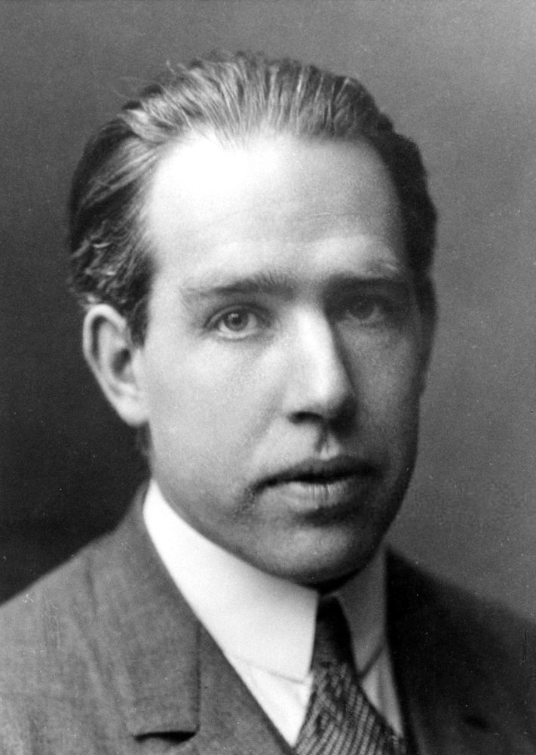
ATOMIC STRUCTURE • FROM THOMSON TO QUANTUM
Bohr's Fix, Idea 1 (1913) — Stationary Orbits That Do Not Radiate
PRESENTER 10
• In 1913 Niels Bohr repaired the collapse by decree: electrons may occupy certain stationary orbits.
• Inside a stationary orbit the electron radiates no energy at all — stability is imposed as a rule, not derived.
• This directly cancels the Maxwell death sentence: no radiation means no energy loss and no spiral.
• The price is honesty: Bohr cannot yet say WHY these orbits are silent — he postulates it and checks the payoff.
• Open question left hanging: which orbits qualify? Idea 2 answers with whole numbers.
stationary ring: silent cruise, no radiation
Bohr c.1922 (PD, Nobel year) — stability postulated, then tested
ATOMIC STRUCTURE — THOMSON TO QUANTUM
MEMBER 10 — BOHR & QUANTUM
34 / 45
Notes:
PRESENTER 10 — Bohr's Fix, Idea 1 (1913) — Stationary Orbits That Do Not Radiate. Notes (Member 10): Stress postulated, not proven — Bohr bets stability and wins. Portrait: Bohr c.1922 (public domain, Nobel year). Terms: stationary, postulate. HANDOFF: Same speaker — idea 2.

Slide 35
ATOMIC STRUCTURE • FROM THOMSON TO QUANTUM
Bohr's Fix, Idea 2 — Only Whole-Number Orbits Are Allowed
PRESENTER 10
• Allowed orbits satisfy L = n·h/2π, with n = 1, 2, 3, and so on — no fractions, no in-betweens.
• Term by term: L is the electron's angular momentum, n the orbit number, h Planck's constant [SUPPL: h = 6.626×10⁻³⁴ J·s].
• Physically this says circling motion comes in whole steps — orbits are quantised like rungs, not a ramp.
• Forbidden zones follow: an electron can sit on rung 1 or 2, but never hover halfway between them.
• With silent rungs fixed, one rule remains: how does light ever get in or out? Idea 3 answers.
L = n·h/2π n = 1, 2, 3, …
rung n = 1 allowed
rung n = 2 allowed
rung n = 3 allowed
L angular momentum • h Planck constant [SUPPL] • between rungs: forbidden
ATOMIC STRUCTURE — THOMSON TO QUANTUM
MEMBER 10 — BOHR & QUANTUM
35 / 45
Notes:
PRESENTER 10 — Bohr's Fix, Idea 2 — Only Whole-Number Orbits Are Allowed. Notes (Member 10): Tap each rung as you count n = 1, 2, 3. Flag h as textbook context. Terms: angular momentum, quantised. HANDOFF: Same speaker — idea 3.

Slide 36
ATOMIC STRUCTURE • FROM THOMSON TO QUANTUM
Bohr's Fix, Idea 3 — Light Only in Quantum Jumps
PRESENTER 10
• An electron emits or absorbs light ONLY when jumping between allowed orbits — never while cruising inside one.
• Each jump's photon carries exactly the level difference: ΔE = h·ν, with ν the light's frequency.
• Bigger jump means bluer, more energetic light; smaller jump means redder light — colour encodes the gap.
• Fixed gaps give fixed photon energies, hence fixed spectral lines — hydrogen's spectrum is explained at last.
• The ladder and its arithmetic come next: numbers in, wavelengths out.
ABSORB: photon in, climb
EMIT: fall, photon out
ΔE = h·ν — photon carries the exact gap
ATOMIC STRUCTURE — THOMSON TO QUANTUM
MEMBER 10 — BOHR & QUANTUM
36 / 45
Notes:
PRESENTER 10 — Bohr's Fix, Idea 3 — Light Only in Quantum Jumps. Notes (Member 10): Mime a jump between rungs; bigger leap, bluer flash. Terms: photon, jump. HANDOFF: Same speaker — the energy ladder.

Slide 37
ATOMIC STRUCTURE • FROM THOMSON TO QUANTUM
Hydrogen's Energy Ladder — E(n) = −13.6/n² eV, Worked Live
PRESENTER 10
• Source formula, hydrogen only: E(n) = −13.6/n² eV — n = 1 gives −13.6, n = 2 gives −3.4, n = 3 gives −1.51, n = 4 gives −0.85.
• UP arrow means absorption: a photon lifts the electron to a higher rung; DOWN arrow means emission as it falls.
• Worked fall 2→1: −3.4 minus −13.6 releases 10.2 eV — an ultraviolet photon of the Lyman series.
• Worked fall 3→2: −1.51 minus −3.4 releases 1.89 eV — about 656 nm red light, Balmer-α [SUPPL: hc ≈ 1240 eV·nm].
• Scope warning from the source: Bohr fits hydrogen-like atoms only — heavier atoms need the full quantum machinery.
E(n) = −13.6/n² eV (hydrogen only)
n=4 −0.85 eV
n=3 −1.51 eV
n=2 −3.40 eV
n=1 −13.6 eV
2→1: 10.2 eV UV • 3→2: 1.89 eV ≈ 656 nm red [SUPPL hc]
ATOMIC STRUCTURE — THOMSON TO QUANTUM
MEMBER 10 — BOHR & QUANTUM
37 / 45
Notes:
PRESENTER 10 — Hydrogen's Energy Ladder — E(n) = −13.6/n² eV, Worked Live. Notes (Member 10): Compute −13.6/4 = −3.4 live; subtract for 10.2 and 1.89. Flag hc as textbook arithmetic on the source formula. Terms: electron-volt, Lyman, Balmer. HANDOFF: Same speaker — orbits to orbitals.

Slide 38
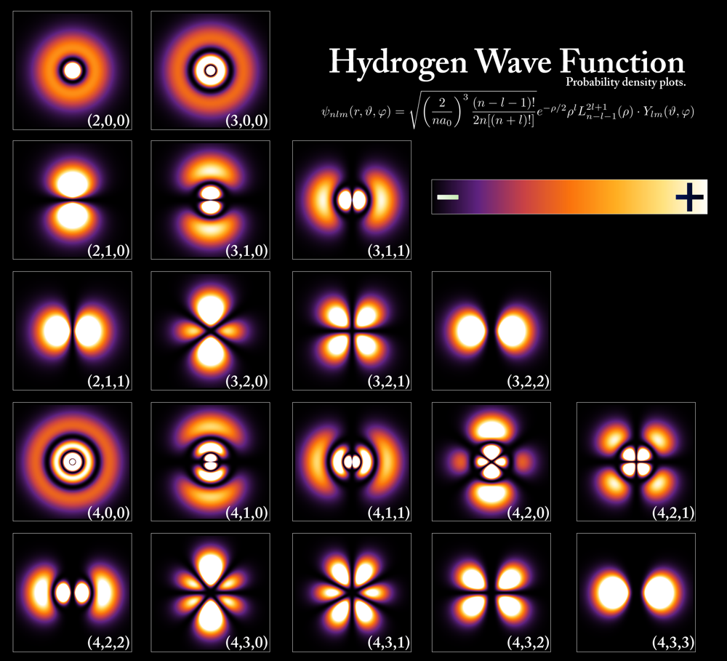
ATOMIC STRUCTURE • FROM THOMSON TO QUANTUM
Beyond Bohr — Probability Clouds Replace Fixed Paths
PRESENTER 10
• Heavier atoms overflow Bohr's single-electron arithmetic, so physics rebuilt the foundation as wave mechanics.
• Heisenberg's uncertainty principle [SUPPL, 1927]: an electron's exact path and speed cannot be known together.
• Schrödinger's wave equation [SUPPL, 1926] replaces paths with wavefunctions, where |ψ|² is the probability per region.
• An orbital is such a region — the 1s cloud is densest at the centre (image: brighter means likelier; public domain).
• Exam trap, say it twice: a Bohr ORBIT is a fixed ring, a quantum ORBITAL is a probable cloud — never swap the words.
• Orbitals carry quantum numbers n, l, m, s — the address system behind the periodic table you already use.
ORBIT: fixed ring (Bohr)
ORBITAL: probable cloud (now)
|ψ|² = probability
brighter = likelier (PoorLeno, PD)
numbers n, l, m, s
ATOMIC STRUCTURE — THOMSON TO QUANTUM
MEMBER 10 — BOHR & QUANTUM
38 / 45
Notes:
PRESENTER 10 — Beyond Bohr — Probability Clouds Replace Fixed Paths. Notes (Member 10): Point at bright-vs-dim zones; drill orbit/orbital until the class repeats it. Flag years as context. Terms: wavefunction, probability density. HANDOFF: Same speaker — the full timeline.

Slide 39
ATOMIC STRUCTURE • FROM THOMSON TO QUANTUM
Evolution Timeline — Dalton to Quantum in Five Breaks
PRESENTER 10
• 1808 Dalton's ball explained ratios — broken by discharge tubes proving inner charge.
• 1897–1904 Thomson's electron and pudding explained neutrality — broken by 1-in-8000 rebounds.
• 1909–1911 Rutherford's nucleus explained scattering — broken by predicted collapse and continuum.
• 1913 Bohr's quantised orbits explained hydrogen's lines — limited to hydrogen-like atoms.
• 1926 quantum orbitals hold today: each model kept what worked, and every break came with numbers, not opinions.
1808
1897/04
1909/11
1913
1926
DALTON
THOMSON
RUTHERFORD
BOHR
QUANTUM
ball
e⁻+pudding
nucleus
orbits
orbitals
Each break came with numbers — experiment corrects theory.
ATOMIC STRUCTURE — THOMSON TO QUANTUM
MEMBER 10 — SYNTHESIS
39 / 45
Notes:
PRESENTER 10 — Evolution Timeline — Dalton to Quantum in Five Breaks. Notes (Member 10): Walk nodes naming each breaker experiment; end on method over memory. Terms: synthesis. HANDOFF: All members — revision round.

Slide 40
ATOMIC STRUCTURE • FROM THOMSON TO QUANTUM
Quick Revision A — Electron, Thomson, Gold Foil, Nucleus
ALL MEMBERS
• Electron? Thomson, 1897, cathode rays, e/m = 1.76×10¹¹ C/kg — same ratio for every gas and cathode metal.
• Thomson model? Positive sphere ~10⁻¹⁰ m, embedded electrons, neutral overall, NO nucleus — pudding or watermelon.
• Gold foil? 1909, +2e alphas at ~10⁷ m/s onto thin gold (Z = 79), flashes on ZnS counted in vacuum.
• Three results? Most straight (empty space), ~0.14% small bends (positive charge), ~1 in 8000 back (tiny dense nucleus).
1
1897 + e/m?
2
pudding = ?
3
gold foil = ?
4
3 results?
Answers are the slide-left points — one breath each.
ATOMIC STRUCTURE — THOMSON TO QUANTUM
ALL MEMBERS — REVISION
40 / 45
Notes:
ALL MEMBERS — Quick Revision A — Electron, Thomson, Gold Foil, Nucleus. Notes (ALL): Rapid-fire, one breath per answer; any member takes one. Terms: rapid recall. HANDOFF: Same round — part B.

Slide 41
ATOMIC STRUCTURE • FROM THOMSON TO QUANTUM
Quick Revision B — Collapse, Spectra, Bohr, Numbers Drill
ALL MEMBERS
• Collapse? Orbiting charge should radiate and spiral in ~10⁻¹¹ s (PREDICTION) — yet atoms are stable.
• Spectra? Classical predicts continuum; hydrogen shows Balmer lines following the Rydberg pattern.
• Bohr? Stationary orbits, L = n·h/2π, jumps with ΔE = hν, hydrogen levels −13.6/n² eV — orbitals replace orbits today.
• Numbers drill: atom 10⁻¹⁰ m, nucleus 10⁻¹⁵–10⁻¹⁴ m, alpha 7300× electron, proton 1836× electron, stadium holds a seed.
1
collapse?
2
spectra?
3
Bohr?
4
drill numbers?
Answers are the slide-left points — one breath each.
ATOMIC STRUCTURE — THOMSON TO QUANTUM
ALL MEMBERS — REVISION
41 / 45
Notes:
ALL MEMBERS — Quick Revision B — Collapse, Spectra, Bohr, Numbers Drill. Notes (ALL): End with the class chanting both sizes and both mass ratios. Terms: drill. HANDOFF: Topic owners stand for cross-questions.

Slide 42
ATOMIC STRUCTURE • FROM THOMSON TO QUANTUM
Teacher Cross-Questions 1–5 — Answered by the Topic Owner
MEMBERS — SEE TAGS
• Q1 [MEMBER 01]: What is an atom? The smallest particle of an element in chemical reactions — once called indivisible, now known to hold electrons, protons, neutrons.
• Q2 [MEMBER 03]: Why plum pudding? Electrons embedded in a positive sphere, like plums in pudding — or seeds in watermelon pulp.
• Q3 [MEMBER 02]: What are cathode rays? Streams of negative particles, electrons, flying cathode to anode in a low-pressure tube, bent by fields.
• Q4 [MEMBER 04]: Why did Thomson fail? No nucleus, no large-angle scattering, no exact line spectra, no guaranteed stability.
• Q5 [MEMBER 05]: What are alpha particles? Helium nuclei — two protons plus two neutrons — charge +2e, ~10⁷ m/s, from radium or polonium.
Rule: the tagged owner stands, answers in two sentences, sits.
M01
answers Q1
M03
answers Q2
M02
answers Q3
M04
answers Q4
M05
answers Q5
Full Q + A pairs are on the slide left.
ATOMIC STRUCTURE — THOMSON TO QUANTUM
Q&A — TOPIC OWNERS (SEE TAGS)
42 / 45
Notes:
MEMBERS — SEE TAGS — Teacher Cross-Questions 1–5 — Answered by the Topic Owner. Notes: Each tagged owner stands, answers in two sentences, sits. Point at the tag chips. HANDOFF: Five more — same rule.

Slide 43
ATOMIC STRUCTURE • FROM THOMSON TO QUANTUM
Teacher Cross-Questions 6–10 — Answered by the Topic Owner
MEMBERS — SEE TAGS
• Q6 [MEMBER 06]: Why did most alphas pass straight? The atom is mostly empty space — most never came near any nucleus.
• Q7 [MEMBER 06]: Why were a few greatly deflected? They passed very close to the tiny dense positive nucleus; small b means large bend, b = 0 means 180° back.
• Q8 [MEMBER 07]: What is the nuclear model? A small dense positive nucleus holds most mass, electrons circle it, rest is empty space.
• Q9 [MEMBER 07]: Why planetary? Electrons circle the nucleus like planets circle the Sun, with charge attraction replacing gravity.
• Q10 [MEMBER 09]: Classical limits? Orbits should radiate, collapse in ~10⁻¹¹ s, and glow continuously — real atoms are stable with sharp lines.
Rule: the tagged owner stands, answers in two sentences, sits.
M06
answers Q6
M06
answers Q7
M07
answers Q8
M07
answers Q9
M09
answers Q10
Full Q + A pairs are on the slide left.
ATOMIC STRUCTURE — THOMSON TO QUANTUM
Q&A — TOPIC OWNERS (SEE TAGS)
43 / 45
Notes:
MEMBERS — SEE TAGS — Teacher Cross-Questions 6–10 — Answered by the Topic Owner. Notes: Member 09 closes on the double failure. HANDOFF: All together for the conclusion.

Slide 44
ATOMIC STRUCTURE • FROM THOMSON TO QUANTUM
Conclusion — From Solid Ball to Probability Cloud
MEMBERS 01–10
• Dalton (1808) gave us atoms as solid balls — broken open by electricity into electrons, protons, neutrons.
• Thomson (1897/1904) gave us the electron and the first inner model — neutral but nucleus-free, broken by scattering.
• Rutherford (1909–1911) gave us the nucleus and the planetary picture — vast emptiness around a dense seed.
• Bohr (1913) quantised the orbits and saved hydrogen's lines; quantum theory replaced orbits with orbitals.
• Respected teacher and friends, thank you for listening to our presentation. We are ready for questions.
BALL → PUDDING → NUCLEUS → ORBITS → CLOUDS
Experiment breaks theory.
Numbers decide.
You are ready for questions.
“Respected teacher and friends, thank you for listening. We are ready for questions.”
ATOMIC STRUCTURE — THOMSON TO QUANTUM
ALL MEMBERS 01–10
44 / 45
Notes:
MEMBERS 01–10 — Conclusion — From Solid Ball to Probability Cloud. Notes (ALL, Member 10 leads): Recap the arc slowly, then deliver the source's closing line verbatim. Invite questions. HANDOFF: none — open floor.

Slide 45
ATOMIC STRUCTURE • FROM THOMSON TO QUANTUM
References, Sources and Image Credits — Trace Every Claim
ALL MEMBERS 01–10
• Teaching source (primary): the 8-page Detailed Teach-the-Teacher Script — all dates, numbers, equations, and Q&A above come from it.
• Supplementary textbook context, flagged in notes: Rydberg R, Planck h, Heisenberg 1927 / Schrödinger 1926 framing, hc — verify against your course text.
• Images (Wikimedia Commons, accessed 2026-10-15): Thomson pre-1915 photo (PD); Rutherford, Bain News Service via LoC (PD-US); Bohr c.1922 (PD); Geiger–Marsden 1913 diagram (PD); H spectrum, Umop503 (CC0); orbital densities, PoorLeno (PD); CRT photo, Hebels (PD, illustrative).
• Diagrams labelled custom schematic were drawn natively in PowerPoint for accuracy — not to scale unless stated; orbit rings are always historical-model labelled.
• Full per-asset record: image_asset_manifest.csv (filename, slide, source URL, creator, licence, attribution, caption, date). Placeholders [TBD] must be replaced before delivery.
– PRIMARY: 8-page Teach-the-Teacher Script — all dates, numbers, Q&A.
– SUPPL: Rydberg R, Planck h, 1926–27 framing, hc — check textbook.
– IMAGES: Commons PD/CC0 — Thomson / Rutherford (LoC) / Bohr / Geiger–Marsden / Umop503 / PoorLeno / Hebels.
– DIAGRAMS: custom PPT schematics — not to scale unless stated.
– MANIFEST: image_asset_manifest.csv (also in dist) • Accessed 2026-10-15.
ATOMIC STRUCTURE — THOMSON TO QUANTUM
ALL MEMBERS 01–10
45 / 45
Notes:
ALL MEMBERS 01–10 — References, Sources and Image Credits — Trace Every Claim. Notes (ALL): Point at the manifest path; state plainly which images are illustrative or low-res thumbnails. HANDOFF: end of deck.

