Slide 1
Life Insurance Sales Project
Capstone Presentation
Author:
Amit Jain
January Batch-C-2022
Date: 15-January-2023

Slide 2
Index
Business Problem Understanding
Business Problem
Modelling Approach Used & Why
Data Preparation
Define Models
Insights from Analysis
Data Insights
Important EDA Insights
Constraints
Objective
Model Comparison
Model Insights
RMSE Comparisons
MAPE Comparisons
Recommendations
Business benefits
Improvement Area

Slide 3

Business Problem Understanding
Business Problem:
A leading life insurance company wants to predict the bonus for its agents so that it may design appropriate engagement activity for their high performing agents and upskill programs for low performing agents are most important.
Insurance Company has given data for 4520 Old Customers, their personal details, like Education, Job, Family background, Sum Insured and Agent Bonus given for those Customers.
Encourage good performing Agents with giving them bonus without partiality.
Identify good performing Sales -Person to deal with tough Customers and tough Market place.
Identify low performing Agents and upscale them with trainings or take necessary actions.
Business Object
Constraints:
Data has anomalies in it. There are Multiple fields , which has same categories but slight different names, Eg: Exe and Executive are same Job Title, Fe Male and Female are same Gender, Large and Laarge are same, UG and Under graduate are same Education etc.
NULL values and Outliers
Many unwanted fields, not required for model building, like CustID, Complaints, LastMonth_calls, CustCareScore etc
Data don’t have Agent ID, so that we can identify actual good performing Agents or low performing Agents. We can only predict Bonus amount for Random Agents based on limited fields of dataDivide data into Train and Test data set.

Slide 4
Modelling Approach Used & Why
Understand Data
Define dependent variable, which is Agent Bonus
Data
Cleansing
NULL value treatment
Merged Identical Categories of any Column
Impute
data
Remove not needed Columns eg: CustID, Complaints, LastMonth_calls, CustCareScore etc
Describe data, check NULLs, Duplicates and Outliers
Add new fields : AgentBonus_per_policy and SumAssured_per_policy
Data Preparation
Encode the Categorical fields into Numeric : Channel, Occupation, EducationField, Gender, Designation, MaritalStatus, Zone and PaymentMathod
Divide data into Train and Test data set.

Slide 5
Modelling Approach Used Continue ..
MAE ( Mean Absolute error)
MSE (Mean squared error)
MAPE (mean absolute percentage error)
EVS (Explained variance)
RMSE (Root Mean Square Error)
Decision Tree
Random Forest
Hyper Param Tuning for Random forest
Linear Regression
Hyper Param Tuning for Dtree
Stats Model
Bagging with Random Forest
Remove Fields with High VIF and High P-Value in Stats Model
Gather Performance Evaluation parameters

Slide 6
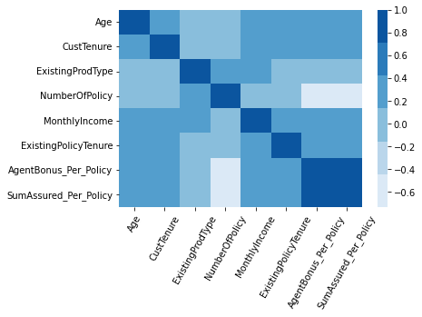
Insights from Analysis
Data Insights:
Source data have 4520 Rows and 20 columns. Column names are:
'CustID', 'AgentBonus', 'Age', 'CustTenure', 'Channel', 'Occupation’, 'EducationField', 'Gender', 'ExistingProdType', 'Designation’, 'NumberOfPolicy', 'MaritalStatus', 'MonthlyIncome', 'Complaint’, 'ExistingPolicyTenure', 'SumAssured', 'Zone', 'PaymentMethod’, 'LastMonthCalls', 'CustCareScore', 'AgentBonus_Per_Policy’, 'SumAssured_Per_Policy’
Dependent Column is : 'AgentBonus_Per_Policy
Important EDA Insights:
Customers prefer to buy policies from Agents, rather than Online.
Maximum Policy Holders are Salaried , very less are business people.
MBA Educated customers are least, and Graduate Customers are maximum
in numbers.
Company have very less number of Customers in South region.
Data is not normally distributed and its Slight Right Skewed
Customer like to pay half yearly/yearly EMI payments
rather Monthly/Quarterly.
7. Clear co-relation of SumAssured on AgentBonus
8. Slight positive co-relation ExistingPolicytenure and NumberOfPolicy as well
On AgentBonus.

Slide 7
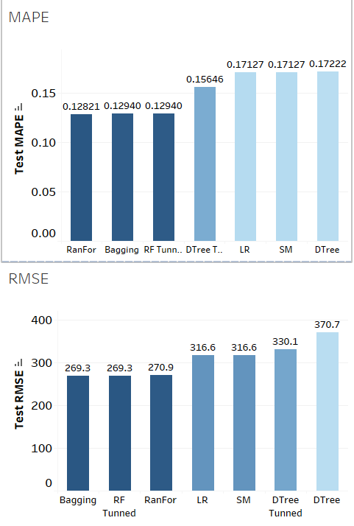
Insights from Analysis Continue ..
Full Stats Table
Model Insights:
Model_name | Train RMSE | Test RMSE | Train MAPE | Test MAPE
Decision Tree | 0 | 370.651998 | 0 | 0.172221
Random Forest | 101.955542 | 270.907949 | 0.047686 | 0.128212
Random Forest Bagging Model | 157.545892 | 269.293587 | 0.076903 | 0.129404
Random Forest Tunned Param | 157.545892 | 269.293587 | 0.076903 | 0.129404
Linear Regression | 317.48346 | 316.634998 | 0.170724 | 0.171265
Stats Model 1 | 317.48346 | 316.634998 | 0.170724 | 0.171265
decission_tree tunned param | 331.648706 | 330.099188 | 0.147677 | 0.156464
Stats Model 2 | 354.543968 | 353.56278 | 0.175574 | 0.179678
Stats Model 3 | 354.547229 | 353.556869 | 0.175633 | 0.179681
Stats Model 4 | 354.574087 | 353.35723 | 0.175619 | 0.17965
Stats Model 5 | 354.625969 | 353.2078 | 0.175782 | 0.179249
Stats Model 6 | 354.684807 | 353.017498 | 0.17576 | 0.179242
Stats Model 7 | 354.763634 | 352.875795 | 0.175744 | 0.179435
Stats Model 8 | 354.881641 | 352.685785 | 0.175876 | 0.179265
Stats Model 9 | 355.067564 | 352.602124 | 0.175543 | 0.178756
ANN Model | 5082.681797 | 5093.46129 | 5.255689 | 5.291988

Slide 8
Model Comparison:
Comparisons done on Lowest RMSE values and Lower MAPE values, RMSE gives Error in the model and MAPE gives good result in percentage wise.
RMSE Comparisons:
Least RMSE for Random forest Model with Bagging regressor and Random Forest with Tunned Hyper Parameters, But this seems overfitting model.
4th Lowest RMSE Model is the best one, which is “Linear Regression” Model.
MAPE Comparisons:
Random forest related all 3 models have lowest MAPE model. But again, those seems over fitting the model.
Decision tree with tunned hyper parameters , Linear Regression and Stats Model seems best model among all, which are giving similar results for both train and test data set.
I would recommend Linear Regression is the best model with about same results for train and test data for both RMSE and MAPE values.

Slide 9
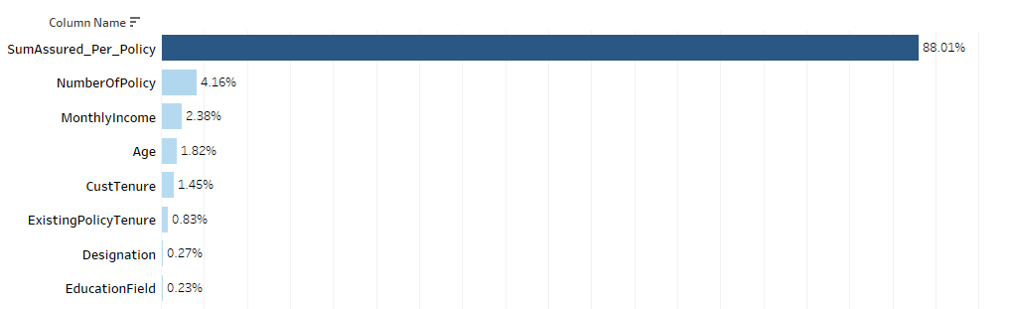
Model Comparison
Formula for Linear regression Model is:
AgentBonus_per_policy = 671.7150861205953 + Age * 4.789430368850247 + CustTenure * 4.759701081772676 + Channel * -8.882960541752864 + Occupation * 7.510211001225475 + EducationField * -5.507 046975671935 + Gender * 2.1343057926728486 + ExistingProdType * -15.273396744099568 + Designation * 4.737994566790387 + NumberOfPolicy * -159.7092491616902 + MaritalStatus * 14.788341883378328 + MonthlyIncome * 0.008683193446440198 + ExistingPolicyTenure * 2.6087386706276594 + Zone * -5.627466691687209 + PaymentMethod * 1.6127186348940015 + SumAssured_Per_Policy * 0.004765571407328226
The intercept for the model is 671.7150861205953. Intercept is the point on Y Axis , when all values of X are Zero. basically, when we say, what should be the value of Y when all parameters are Zero.
Feature Importance in approx. all Models , this is snippet from Decision tree:

Slide 10
Recommendations
Business benefits:
Company would know strength of their own employees.
They can easily segregate good Salesperson and low performing Agents.
Company can give clear criteria, by informing Salesperson, how they can achieve good incentives.
It will remove partiality and bad judgements of the top-level managements
It will create good environment among all employees for fare justifications of the Bonus amounts.
Company can encourage good performing Sales-persons
Company can also provide Trainings or build any special program to assist bad Agents.
Additional steps can be taken by Company by accompanying good Agent with low performing Agents, so that they can learn from good resources.
Improvement Area:
South Zone have least number of Customers, so good salesperson should deploy to tough market
There can be some discount offer or Less policy premium campaign can be run in South and East regions, where policy Holders are very less.
There is good opportunity to attract more Large business holders, they have deep pockets and Company can make good money from them.

Slide 11
Questions ?

