Slide 1
Solving Travelling Salesman Problem using Particle Swarm Optimization (PSO)
By
Amit Kumar Mondal (08/IT/18)
Prithwish Kumar Samanta (08/IT/29)
Arvind Yadav (08/IT/64)
Subhadeep Das (07/IT/42)
Under Supervision of Asst. Prof. Nanda Dulal Jana
National Institute of Technology, Durgapur

Slide 2
Particle Swarm Optimization
Particle Swarm Optimization (PSO) applies to concept of social interaction to problem solving.
It was developed in 1995 by James Kennedy and Russ Eberhart
It has been applied successfully to a wide variety of search and optimization problems.
In PSO, a swarm of n individuals communicate either directly or indirectly with one another search directions (gradients).
PSO is a simple but powerful search technique.

Slide 3
Classical PSO
Swarm is better than personal

Slide 4
Particle Swarm Optimization: Swarm Topology
In PSO, there have been two basic topologies used in the literature
Ring Topology (neighborhood of 3)
Star Topology (global neighborhood)
I₀
I₀
I₁
I₁
I₄
I₄
I₃
I₂
I₃
I₂

Slide 5
Particle Swarm Optimization: The Anatomy of a Particle
A particle (individual) is composed of:
Three vectors:
The x-vector records the current position (location) of the particle in the search space,
The p-vector records the location of the best solution found so far by the particle, and
The v-vector contains a gradient (direction) for which particle will travel in if undisturbed.
Two fitness values:
The x-fitness records the fitness of the x-vector, and
The p-fitness records the fitness of the p-vector.
I_{k}
X = <x_{k0},x_{k1},…,x_{kn-1}>
P = <p_{k0},p_{k1},…,p_{kn-1}>
V = <v_{k0},v_{k1},…,v_{kn-1}>
x_fitness = ?
p_fitness = ?

Slide 6
Particle Swarm Optimization: Swarm Search
In PSO, particles never die!
Particles can be seen as simple agents that fly through the search space and record (and possibly communicate) the best solution that they have discovered.
So the question now is, “How does a particle move from one location in the search space to another?”
This is done by simply adding the v-vector to the x-vector to get another x-vector (X_{i} = X_{i} + V_{i}).
Once the particle computes the new Xi it then evaluates its new location. If x-fitness is better than p-fitness, then P_{i} = X_{i} and p-fitness = x-fitness.

Slide 7
Particle Swarm Optimization: Swarm Search
Initially the values of the velocity vectors are randomly generated with the range [-Vmax, Vmax] where Vmax is the maximum value that can be assigned to any v_{id}.

Slide 8
Particle Swarm Optimization: Swarm Search
Actually, we must adjust the v-vector before adding it to the x-vector as follows:
v_{id} = v_{id} + ϕ1*rnd()*(p_{id}-x_{id}) + ϕ2*rnd()*(p_{gd}-x_{id});
x_{id} = x_{id} + v_{id};
Where i is the particle,
ϕ1,ϕ2 are learning rates governing the cognition and social components
Where g represents the index of the particle with the best p-fitness, and
Where d is the d^{th} dimension.

Slide 9
Classical PSO
Main idea: - Exploitation (Local Search) - Exploration (Global Search)
Exploit the current best position
Pbest
Gbest
Explore the unkown space

Slide 10
Classical PSO
Implementation

Slide 11
Particle Swarm Optimization: Swarm Types
Kennedy identifies 3 types of PSO based on ϕ1 and ϕ2 .
Given: v_{id} = v_{id} + ϕ1*rnd()*(p_{id}-x_{id}) + ϕ2*rnd()*(p_{gd}-x_{id});
x_{id} = x_{id} + v_{id};
Full Model (ϕ1, ϕ2 > 0)
Cognition Only (ϕ1 > 0 and ϕ2 = 0),
Social Only (ϕ1 = 0 and ϕ2 > 0)

Slide 12
Particle Swarm Optimization: Related Issues
There are a number of related issues concerning PSO:
Controlling velocities (determining the best value for Vmax),
Swarm Size,
Neighborhood Size,
Updating X and Velocity Vectors,
Robust Settings for (ϕ1 and ϕ2),
An Off-The-Shelf PSO

Slide 13
Particle Swarm: Controlling Velocities
When using PSO, it is possible for the magnitude of the velocities to become very large.
Performance can suffer if Vmax is inappropriately set.
Two methods were developed for controlling the growth of velocities:
A dynamically adjusted inertia factor, and
A constriction coefficient.

Slide 14
Particle Swarm Optimization: The Inertia Factor
When the inertia factor is used, the equation for updating velocities is changed to:
v_{id} = ω*v_{id} + ϕ1*rnd()*(p_{id}-x_{id}) + ϕ2*rnd()*(p_{gd}-x_{id});
Where ω is initialized to 1.0 and is gradually reduced over time (measured by cycles through the algorithm).

Slide 15
Particle Swarm Optimization: The Constriction Coefficient
In 1999, Maurice Clerc developed a constriction Coefficient for PSO.
v_{id} = K[v_{id} + ϕ1*rnd()*(p_{id}-x_{id}) + ϕ2*rnd()*(p_{gd}-x_{id})];
Where K = 2/|2 - ϕ - sqrt(ϕ² - 4ϕ)|,
ϕ = ϕ1 + ϕ2, and
4.0 <ϕ <4.1

Slide 16
Particle Swarm Optimization: Swarm and Neighborhood Size
Concerning the swarm size for PSO, as with other ECs there is a trade-off between solution quality and cost (in terms of function evaluations).
Global neighborhoods seem to be better in terms of computational costs. The performance is similar to the ring topology.
There has been little research on the effects of swarm topology on the search behavior of PSO.

Slide 17
Particle Swarm Optimization: Particle Update Methods
There are two ways that particles can be updated:
Synchronously
Asynchronously
Asynchronous update allows for newly discovered solutions to be used more quickly
I₀
I₁
I₄
I₃
I₂

Slide 18
Visual Representation
max
y
min
fitness
x
search space

Slide 19
Visual Representation
max
y
min
fitness
x
search space

Slide 20
Visual Representation
max
y
min
fitness
x
search space

Slide 21
Visual Representation
max
y
min
fitness
x
search space

Slide 22
Visual Representation
max
y
min
fitness
x
search space

Slide 23
Visual Representation
max
y
min
fitness
x
search space

Slide 24
Visual Representation
max
y
min
fitness
x
search space

Slide 25
Visual Representation
max
y
min
fitness
x
search space

Slide 26
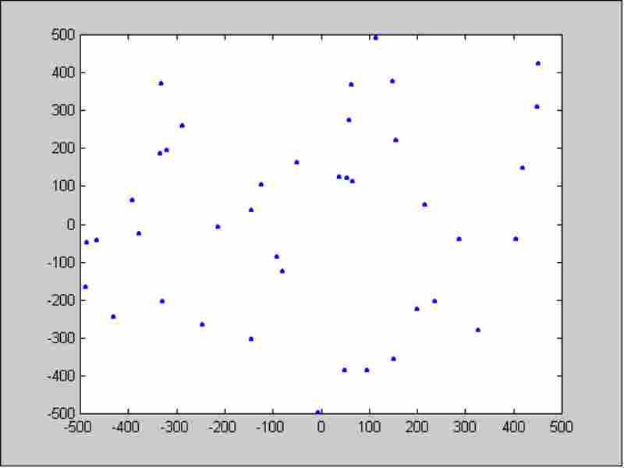
Evolution－Initialization

Slide 27
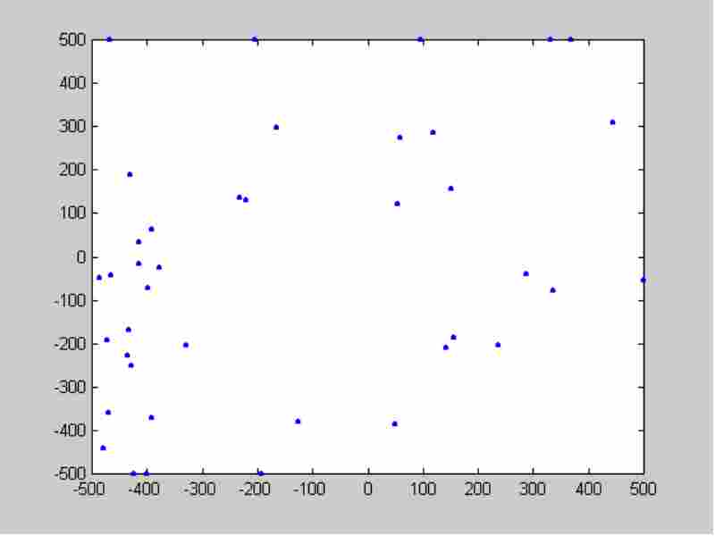
Evolution－5 iteration

Slide 28
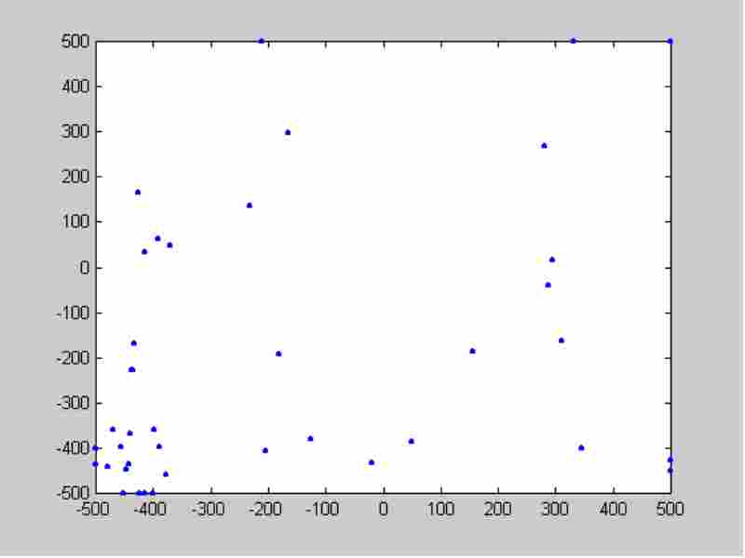
Evolution－10 iteration

Slide 29
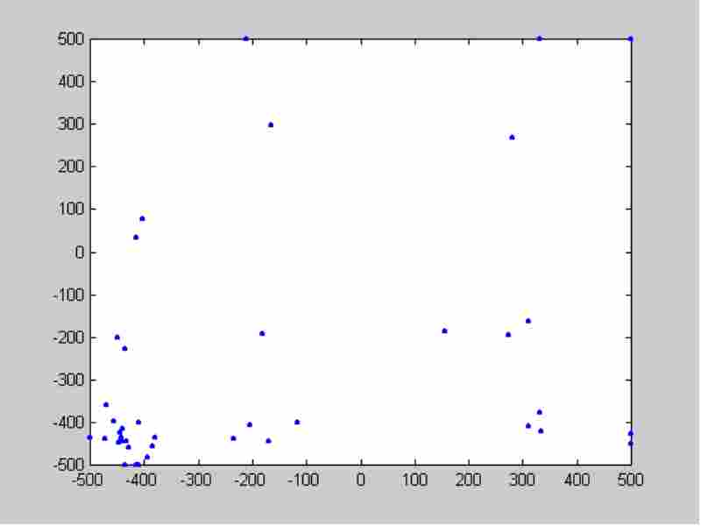
Evolution－15 iteration

Slide 30
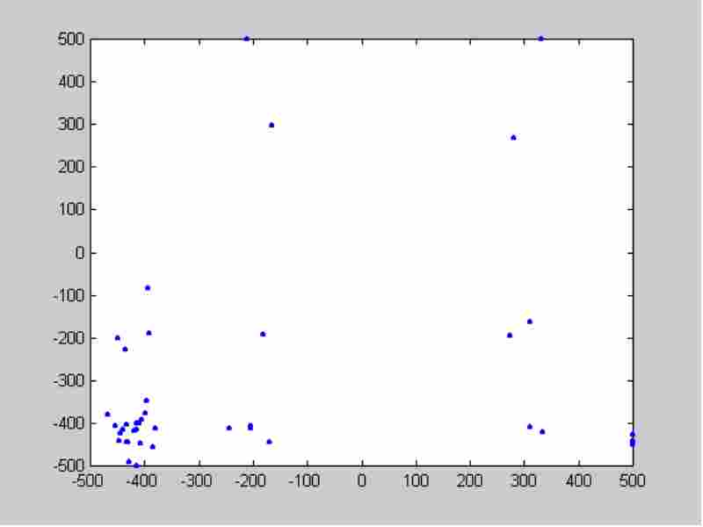
Evolution－20 iteration

Slide 31
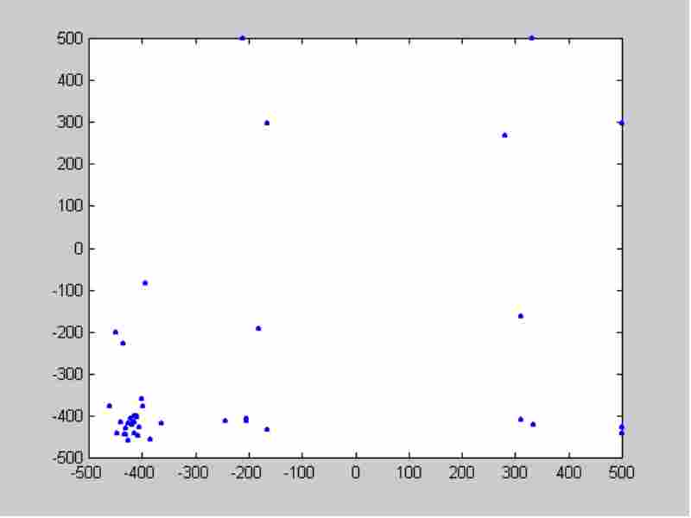
Evolution－25 iteration

Slide 32
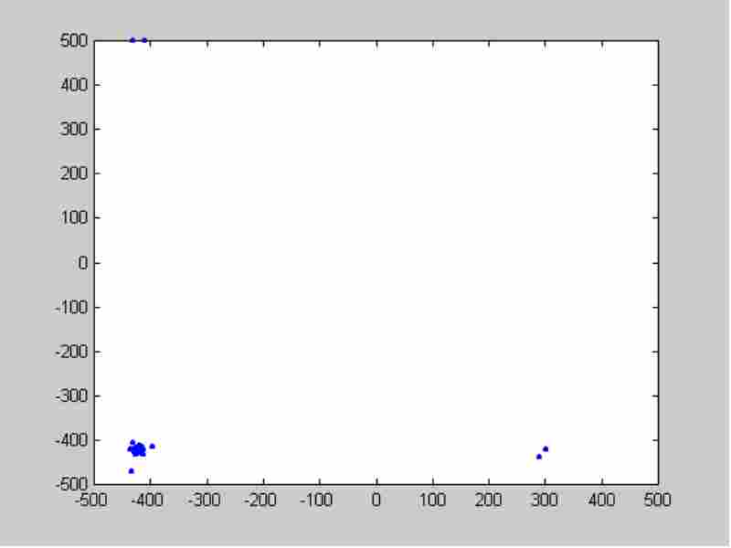
Evolution－100 iteration

Slide 33
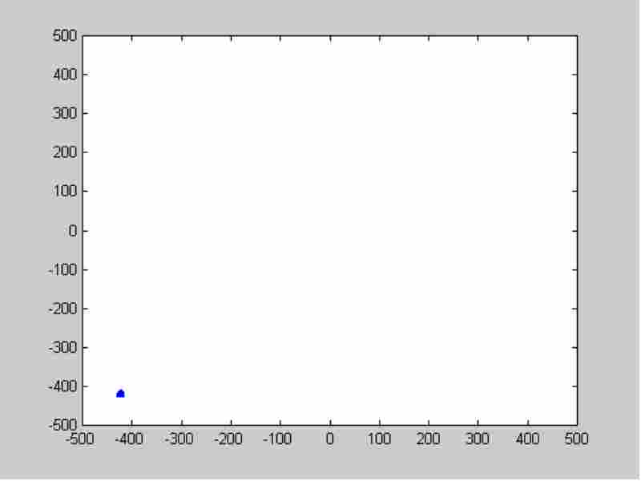
Evolution－500 iteration

Slide 34
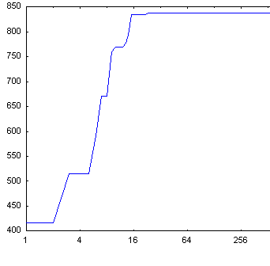
Search result
Iteration | Swarm best
0 | 416.245599
5 | 515.748796
10 | 759.404006
15 | 793.732019
20 | 834.813763
100 | 837.911535
5000 | 837.965771
Global | 837.9658

Slide 35
Sub-Swarm Generations

Slide 36
Variants of PSO
Cellular Particle Swarm Optimization (CPSO)
Advanced and Retreat Particle Swarm Optimization (AR-CPSO)
Modified Particle Swarm Optimization(MPSO)
Fireworks Particle Swarm Optimization (FPSO)

Slide 37
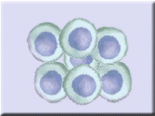
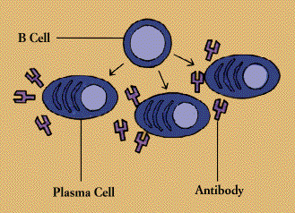
Variants of PSO
CPSO
The General framework of cellular
Particle Swarm Optimization
Initialize swarm size and PSO parameter
Initialize particles position and velocities
LOOP
Identify every particle’s state
Implement cellular automata mechanism
Update velocities
Update positions
Exit loop if criterion is met
END LOOP

Slide 38
Variants of PSO
MPSO A modified algorithm which makes the most optimal particle of every time of iteration evolving continuously and assign the worst particle with a new value to increase its disturbance. By testing of some classic testing functions, we can say that the modified PSO algorithm has better performance of convergence and global searching than the original PSO.

Slide 39
Variants of PSO
AR-CPSO We Advance and Retreat PSO method to find the local optimal to validate the quality of last flight and restricts the particle in near by of the local optimal.

Slide 40
Variants of PSO
FPSO
The Fireworks PSO is totally based on the probability of finding out the trajectory of burst bomb particle.

Slide 41
Applications of PSO
Forecast of Driving Load of Hybrid Electric Vehicles
Immunity-Clonal Mechanism to Spam Detection
Biomedical applications
Bioinformatics
Optimizing any type of problem

Slide 42
Traveling Salesman Problem
The TSP involves finding the minimum traveling cost for visiting a fixed set of customers.
The salesman must visit each customer exactly once and return to its point of origin also called depot.
The objective function is the total cost of the tour.

Slide 43
Traveling Salesman Problem
3
2
4
3
2
2
3
2
1
4
1
4
3
5
5
The total number of solutions is (n-1)! /2 if the distances are symmetric.
For example, if there are 50 customers to visit, the total number of solutions is 49!/2=3.04x10⁶².

Slide 44
Traveling Salesman Problem
Solution
3
2
4
3
2
2
3
2
1
4
1
4
3
5
5
If the depot is located at node 1, then the optimal tour is 1-5-2-3-4-1 with total cost equal to 11.

Slide 45
Adjacency Matrix Representation of Nodes in TSP
 | 1 | 2 | 3 | 4 | 5
1 | - | 2 | 3 | 2 | 3
2 | 2 | - | 3 | 4 | 1
3 | 3 | 3 | - | 2 | 4
4 | 2 | 4 | 2 | - | 5
5 | 3 | 1 | 4 | 5 | -

Slide 46
Implementation for TSP using generic PSO
Functions required:
getRandNumber(int,int) : Returns an integer within the range in arguments
globalSolution(arr[][]) : Returns the nodes as particles with random velocities
X_location(int) : returns the current location of a particle
local_best(int,int) : returns the local best (pbest) between the two numbers specified in the parameter
calculate_v(int) : calculates the velocity to return the new location of any particle
global_best(int) : specifies an end criterion to stop the algorithm (gbest)
debug() : finalizes output after it meets end criterion The question is “How will we calculate New location for each particle?”

Slide 47
Calculating pbest
The random velocities generated for each particle
1 | 3 | 4 | 2 | 5
For 2nd iteration, in determining next X location after imposing V vector
3 | 2 | 5 | 1 | 4
We need to sum up the index values of two arrays
4 | 5 | 9 | 3 | 9

Slide 48
Continued.
4 | 5 | 9 | 3 | 9
In this case, the generated array is obsolete as 9 must not be
calculated for determining the new x location
So we need to implement some kinds of rules.
Rule 1: If the final array is generated with values in the range of
1-5 without repeating any value then consider that array
Rule 2: If the final array is generated with values in the range of
1-5 and some not in the range of 1-5 with repetition of
values then we need to calculate
value mod N
N – array index no value – array value -- If value mod N equals to zero, then N = N+1 -- If value mod N not equals to zero, then N will be as usual. Rule 3 : Iterate the whole step with previous rules until it finds an array with unique values.

Slide 49
Continued.
Rule 4: If the final array is not unique and it comprises repetitive values it needs to set flags in those indices which comprise those repetition of values. - Now it needs to check the other values (unique). - Only one value needs to changed. - Check for the missing value. - The higher order index which holds the repetition of value will get changed

Slide 50
Continued.
Here for the previous scenerio, the array will be as follows.
4 | 5 | 1 | 3 | 4
4 | 5 | 1 | 3 | 2
Now we can determine the pbest easily after comparing this array
and the previous array.
The previous array was as follows.
1 | 3 | 4 | 2 | 5
Now the pbest will be as follows.
1 | 3 | 4 | 2 | 5

Slide 51
Continued.
Because the total path cost in 4-5-1-3-2 is 14 whereas in 1-3
-4-2-5, it is 10. (From Adjacency Matrix). So we are going to consider the next array.
So now we need to process the Generic formula for getting Vid(t+1) and thereafter we need to iterate the whole step until
the end condition gets satisfied. END CONDITION: max iteration no = no of elements in the array.

Slide 52
Traveling Salesman Problem Solution
Problem
3
2
4
3
2
2
3
2
1
4
2
4
3
5
0

Slide 53
Traveling Salesman Problem Solution
Solution
3
2
4
3
2
2
3
2
1
4
2
4
3
5
0
Here the bolded lines show the optimized path
4-1-2-0-3-4 (Cost – 12)

Slide 54
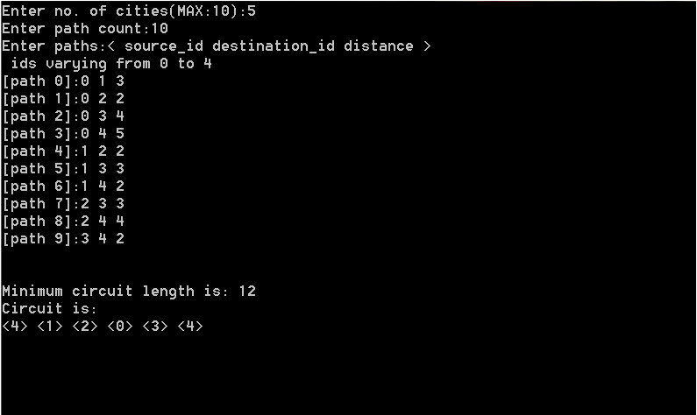
Traveling Salesman Problem Solution Output

Slide 55
Disadvantage of PSO
Firstly, in nature, there are many internal differences among birds (or fish), such as ages, catching skills, flying experiences, and muscles' stretching, etc. Furthermore, the lying positions also provide an important influence on individuals.

Slide 56
References
Kennedy, J. and Eberhart, R. (1995). “Particle Swarm Optimization”, Proceedings of the 1995 IEEE International Conference on Neural Networks, pp. 1942-1948, IEEE Press.
Carlisle, A. and Dozier, G. (2001). “An Off-The-Shelf PSO”, Proceedings of the 2001 Workshop on Particle Swarm Optimization, pp. 1-6, Indianapolis, IN.
Clerc, M. (1999) The swarm and the queen: towards a deterministic and adaptive particle swarm optimization Proceedings, 1999 ICEC, Washington, DC, pp 1951-1957
Kennedy, J. (1998). The Behavior of Particles, 7th Annual Conference on Evolutionary Programming, San Diego, USA
Kang-Ping Wang, L-Huang, Chun-Guang Zhou, Wei Pang (2003) “Particle Swarm optimization for Travelling Salesman Problem”
Arvind Mohais, Rui Mendes, Christopher Ward and Christian Posthoff “Neighborhood Re-Structuring in Particle Swarm Optimization”
Jason Tilett, T.M.Rao, Feret Sahin and Raghuveer Rao “Darwinian Particle Swarm optimization”
Cai, Cui, Jeng and Tan “Individual Parameter Selection Strategy for PSO”
Elizabeth Goldberg, Marco C Goldberg and R de Souza “Particle Swarm Optimization for Travelling Salesman Problem”
Shi, Liang, Lee and Wang (2007) “Particle Swarm Optimization-based algorithms for TSP and generalized TSP”

Slide 57
Thank You

