Slide 1
Operating System Overview
Chapter 2

Slide 2
Operating System
A program that controls the execution of application programs
An interface between applications and hardware

Slide 3
Operating System Objectives
Convenience
  Makes the computer more convenient to use
Efficiency
  Allows computer system resources to be used in an efficient manner
Ability to evolve
  Permit effective development, testing, and introduction of new system functions without interfering with service

Slide 4
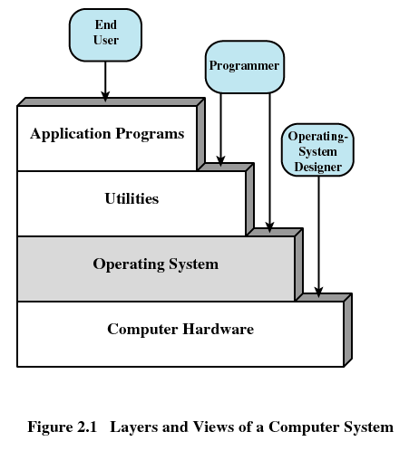
Layers of Computer System

Slide 5
Services Provided by the Operating System
Program development
  Editors and debuggers
Program execution
Access to I/O devices
Controlled access to files
System access

Slide 6
Services Provided by the Operating System
Error detection and response
  Internal and external hardware errors
    Memory error
    Device failure
  Software errors
    Arithmetic overflow
    Access forbidden memory locations
  Operating system cannot grant request of application

Slide 7
Services Provided by the Operating System
Accounting
  Collect usage statistics
  Monitor performance
  Used to anticipate future enhancements
  Used for billing purposes

Slide 8
Operating System
Responsible for managing resources
Functions same way as ordinary computer software
  It is program that is executed
Operating system relinquishes control of the processor

Slide 9
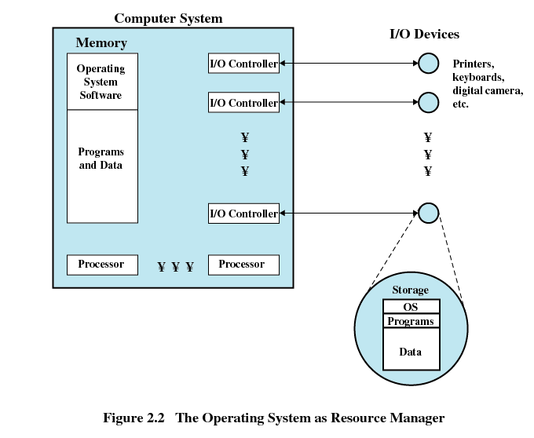

Slide 10
Kernel
Portion of operating system that is in main memory
Contains most frequently used functions
Also called the nucleus

Slide 11
Evolution of an Operating System
Hardware upgrades plus new types of hardware
New services
Fixes

Slide 12
Evolution of Operating Systems
Serial Processing
  No operating system
  Machines run from a console with display lights, toggle switches, input device, and printer
  Schedule time
  Setup included loading the compiler, source program, saving compiled program, and loading and linking

Slide 13
Evolution of Operating Systems
Simple Batch Systems
  Monitors
    Software that controls the sequence of events
    Batch jobs together
    Program branches back to monitor when finished

Slide 14
Job Control Language (JCL)
Special type of programming language
Provides instruction to the monitor
  What compiler to use
  What data to use

Slide 15
Hardware Features
Memory protection
  Do not allow the memory area containing the monitor to be altered
Timer
  Prevents a job from monopolizing the system

Slide 16
Hardware Features
Privileged instructions
  Certain machine level instructions can only be executed by the monitor
Interrupts
  Early computer models did not have this capability

Slide 17
Memory Protection
User program executes in user mode
  Certain instructions may not be executed
Monitor executes in system mode
  Kernel mode
  Privileged instructions are executed
  Protected areas of memory may be accessed

Slide 18
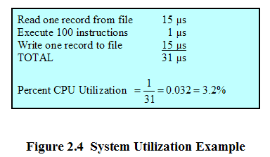
I/O Devices Slow

Slide 19
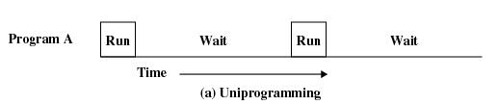
Uniprogramming
Processor must wait for I/O instruction to complete before preceding

Slide 20
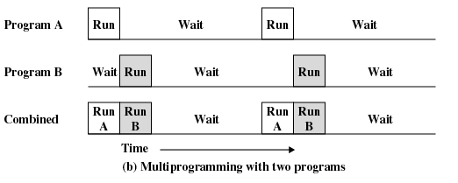
Multiprogramming
When one job needs to wait for I/O, the processor can switch to the other job

Slide 21
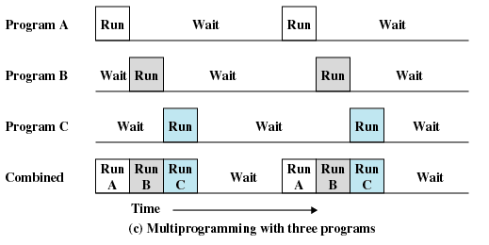
Multiprogramming

Slide 22
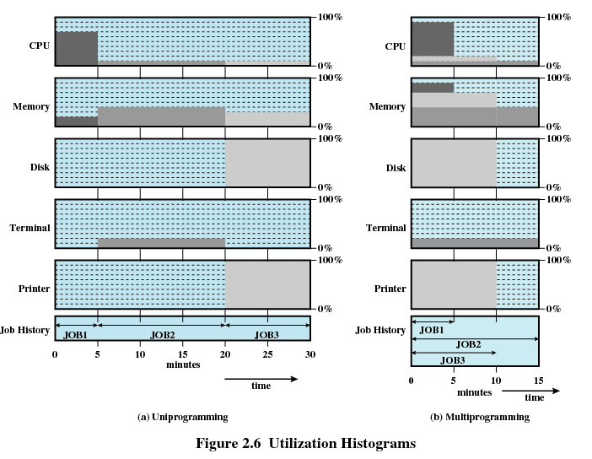
Utilization Histograms

Slide 23
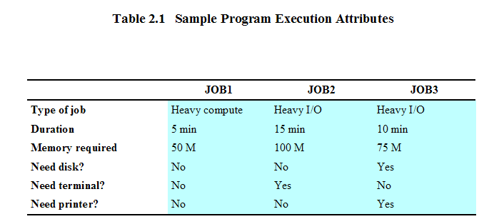
Example

Slide 24
Time Sharing
Using multiprogramming to handle multiple interactive jobs
Processor’s time is shared among multiple users
Multiple users simultaneously access the system through terminals

Slide 25
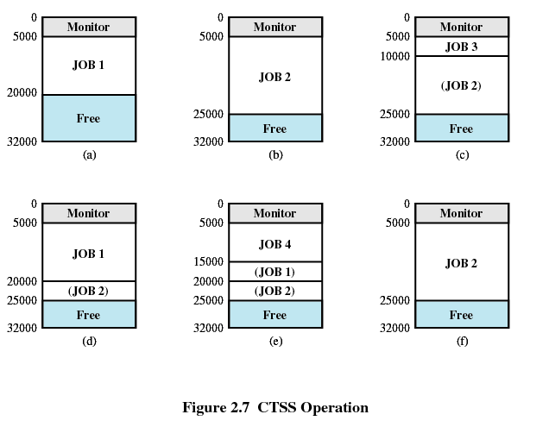
Compatible Time-Sharing System (CTSS)
First time-sharing system developed at MIT

Slide 26
Major Achievements
Processes
Memory Management
Information protection and security
Scheduling and resource management
System structure

Slide 27
Processes
A program in execution
An instance of a program running on a computer
The entity that can be assigned to and executed on a processor
A unit of activity characterized by a single sequential thread of execution, a current state, and an associated set of system resources

Slide 28
Difficulties with Designing
System Software
Improper synchronization
  Ensure a process waiting for an I/O device receives the signal
Failed mutual exclusion
Nondeterminate program operation
  Program should only depend on input to it, not on the activities of other programs
Deadlocks

Slide 29
Process
Consists of three components
  An executable program
  Associated data needed by the program
  Execution context of the program
    All information the operating system needs to manage the process

Slide 30
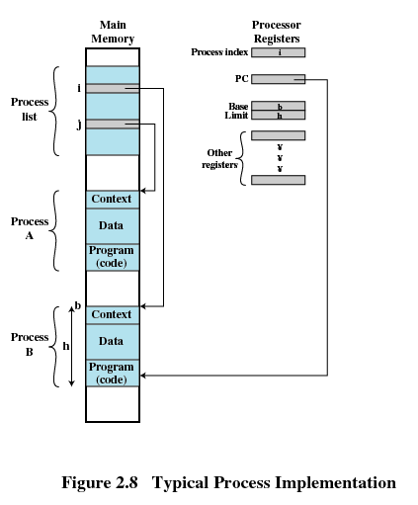
Process

Slide 31
Memory Management
Process isolation
Automatic allocation and management
Support of modular programming
Protection and access control
Long-term storage

Slide 32
Virtual Memory
Allows programmers to address memory from a logical point of view
No hiatus between the execution of successive processes while one process was written out to secondary store and the successor proceess was read in

Slide 33
Virtual Memory and File System
Implements long-term store
Information stored in named objects called files

Slide 34
Paging
Allows process to be comprised of a number of fixed-size blocks, called pages
Virtual address is a page number and an offset within the page
Each page may be located any where in main memory
Real address or physical address in main memory

Slide 35
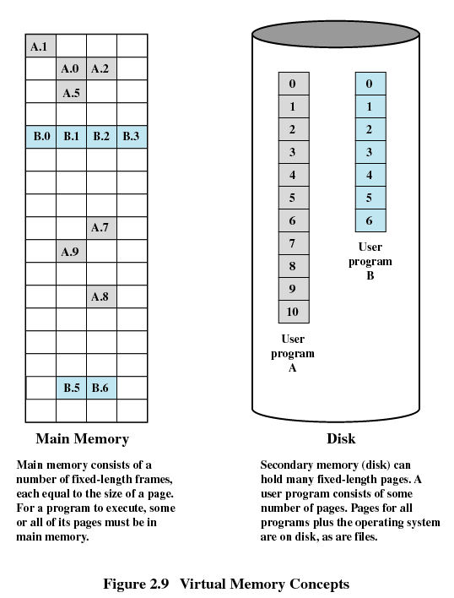
Virtual Memory

Slide 36
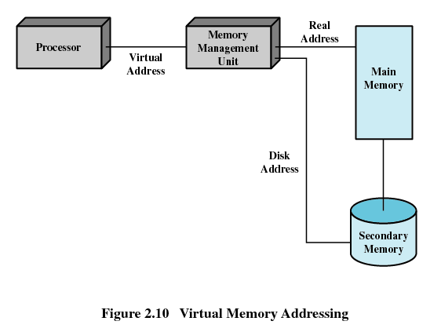
Virtual Memory Addressing

Slide 37
Information Protection and Security
Availability
  Concerned with protecting the system against interruption
Confidentiality
  Assuring that users cannot read data for which access is unauthorized

Slide 38
Information Protection and Security
Data integrity
  Protection of data from unauthorized modification
Authenticity
  Concerned with the proper verification of the identity of users and the validity of messages or data

Slide 39
Scheduling and Resource Management
Fairness
  Give equal and fair access to resources
Differential responsiveness
  Discriminate among different classes of jobs
Efficiency
  Maximize throughput, minimize response time, and accommodate as many uses as possible

Slide 40
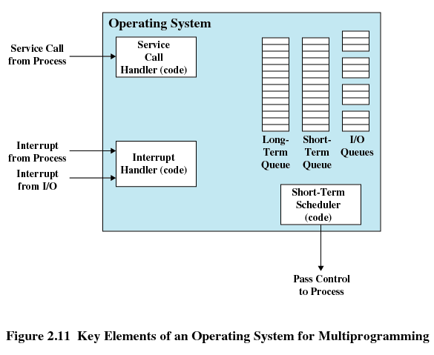
Key Elements of
Operating System

Slide 41
System Structure
View the system as a series of levels
Each level performs a related subset of functions
Each level relies on the next lower level to perform more primitive functions
This decomposes a problem into a number of more manageable subproblems

Slide 42
Process Hardware Levels
Level 1
  Electronic circuits
  Objects are registers, memory cells, and logic gates
  Operations are clearing a register or reading a memory location
Level 2
  Processor’s instruction set
  Operations such as add, subtract, load, and store

Slide 43
Process Hardware Levels
Level 3
  Adds the concept of a procedure or subroutine, plus call/return operations
Level 4
  Interrupts

Slide 44
Concepts with Multiprogramming
Level 5
  Process as a program in execution
  Suspend and resume processes
Level 6
  Secondary storage devices
  Transfer of blocks of data
Level 7
  Creates logical address space for processes
  Organizes virtual address space into blocks

Slide 45
Deal with External Objects
Level 8
  Communication of information and messages between processes
Level 9
  Supports long-term storage of named files
Level 10
  Provides access to external devices using standardized interfaces

Slide 46
Deal with External Objects
Level 11
  Responsible for maintaining the association between the external and internal identifiers
Level 12
  Provides full-featured facility for the support of processes
Level 13
  Provides an interface to the operating system for the user

Slide 47
Modern Operating Systems
Microkernel architecture
  Assigns only a few essential functions to the kernel
    Address spaces
    Interprocess communication (IPC)
    Basic scheduling

Slide 48
Modern Operating Systems
Multithreading
  Process is divided into threads that can run concurrently
    Thread
      Dispatchable unit of work
      executes sequentially and is interruptable
    Process is a collection of one or more threads

Slide 49
Modern Operating Systems
Symmetric multiprocessing (SMP)
  There are multiple processors
  These processors share same main memory and I/O facilities
  All processors can perform the same functions

Slide 50
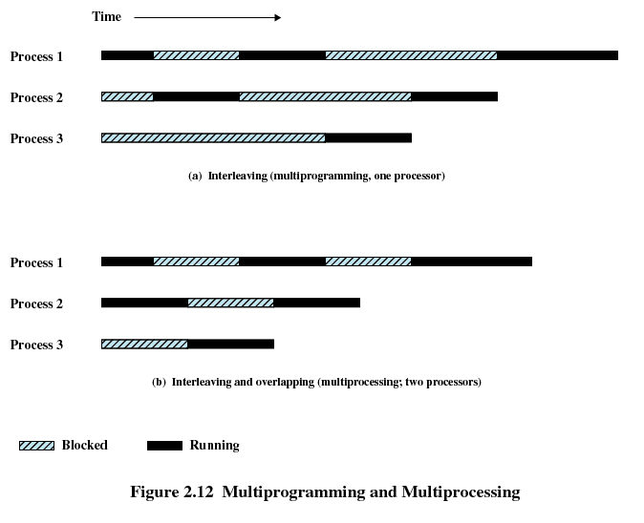
Multiprogramming and Multiprocessing

Slide 51
Modern Operating Systems
Distributed operating systems
  Provides the illusion of a single main memory space and single secondary memory space

Slide 52
Modern Operating Systems
Object-oriented design
  Used for adding modular extensions to a small kernel
  Enables programmers to customize an operating system without disrupting system integrity

Slide 53
Windows Architecture
Modular structure for flexibility
Executes on a variety of hardware platforms
Supports application written for other operating system

Slide 54
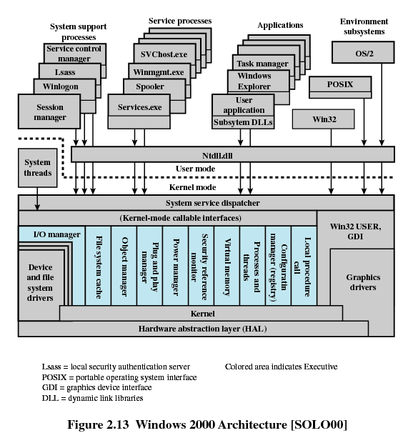

Slide 55
Operating System Organization
Modified microkernel architecture
  Not a pure microkernel
  Many system functions outside of the microkernel run in kernel mode
Any module can be removed, upgraded, or replaced without rewriting the entire system

Slide 56
Kernel-Mode Components
Executive
  Contains base operating system services
    Memory management
    Process and thread management
    Security
    I/O
    Interprocess communication
Kernel
  Consists of the most used components

Slide 57
Kernel-Mode Components
Hardware abstraction layer (HAL)
  Isolates the operating system from platform-specific hardware differences
Device drivers
  Translate user I/O function calls into specific hardware device I/O requests
Windowing and graphics systems
  Implements the graphical user interface (GUI)

Slide 58
Windows Executive
I/O manager
Cache manager
Object manager
Plug and play manager
Power manager
Security reference monitor
Virtual memory manager
Process/thread manager
Configuration manager
Local procedure call (LPC) facility

Slide 59
User-Mode Processes
Special system support processes
  Ex: logon process and the session manager
Service processes
Environment subsystems
User applications

Slide 60
Client/Server Model
Simplifies the Executive
  Possible to construct a variety of APIs
Improves reliability
  Each service runs on a separate process with its own partition of memory
  Clients cannot not directly access hardware
Provides a uniform means for applications to communicate via LPC
Provides base for distributed computing

Slide 61
Threads and SMP
Operating system routines can run on any available processor
Different routines can execute simultaneously on different processors
Multiple threads of execution within a single process may execute on different processors simultaneously
Server processes may use multiple threads
Share data and resources between process

Slide 62
Windows Objects
Encapsulation
  Object consists of one or more data items and one or more procedures
Object class or instance
  Create specified instances of an object
Inheritance
  Support to some extent in the Executive
Polymorphism

Slide 63
UNIX
Hardware is surrounded by the operating system software
Operating system is called the system kernel
Comes with a number of user services and interfaces
  Shell
  Components of the C compiler

Slide 64
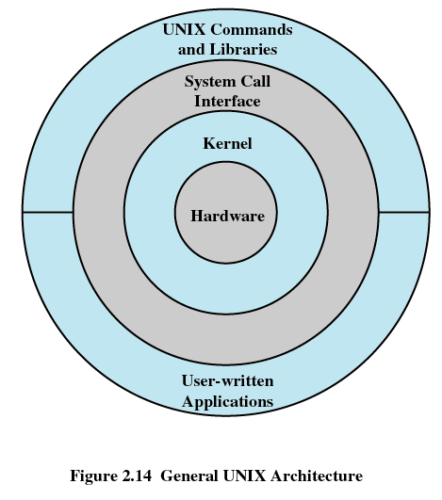
UNIX

Slide 65
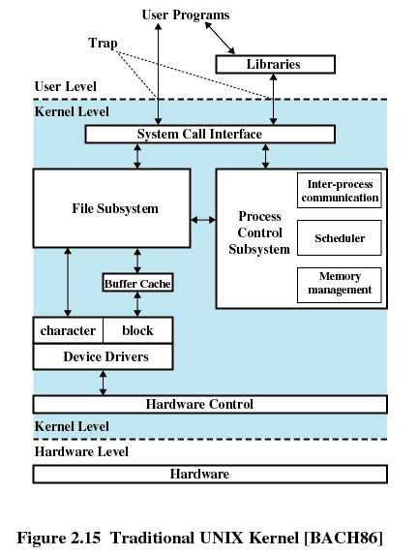
UNIX Kernel

Slide 66
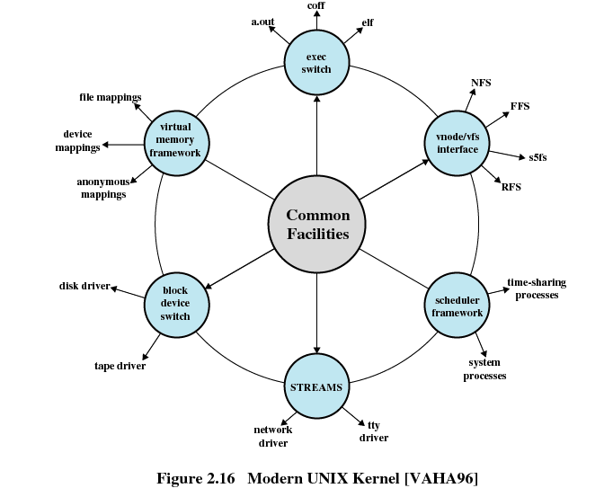
Modern UNIX Kernel

Slide 67
Modern UNIX Systems
System V Release 4 (SVR4)
Solaris 9
4.4BSD
Linux

