Slide 1

What Is an E-Product?

Slide 2
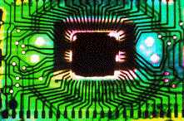
What is an electronic product?
A product containing an integrated circuit or IC -- a small electronic device made out of a semiconductor material

Slide 3
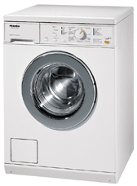

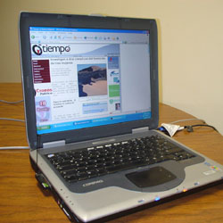
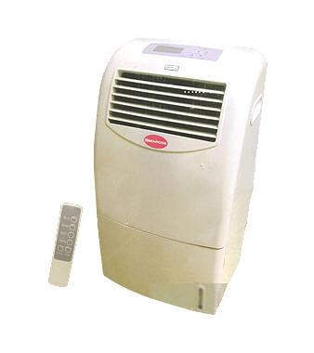

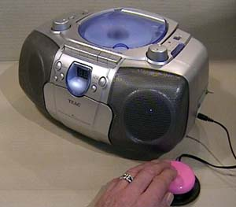
What is an electronic product?
“Brown goods” are appliances that are intensively electronic in composition
“White goods” are not considered an electronic product

Slide 4
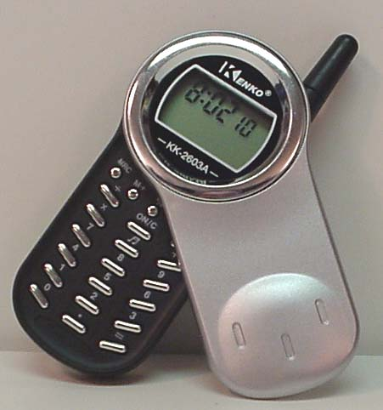
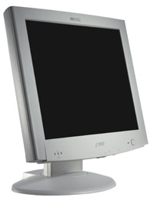
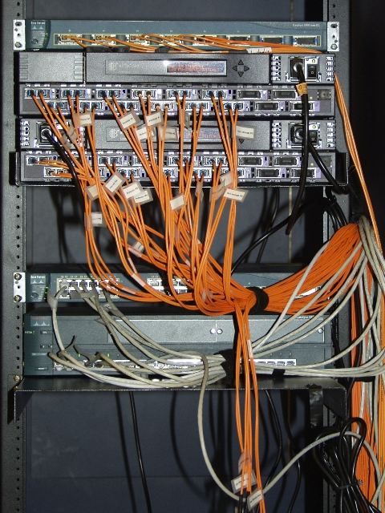
What is an electronic product?
All parts and components that form part of the consumer electronics are also considered as electronic products

Slide 5
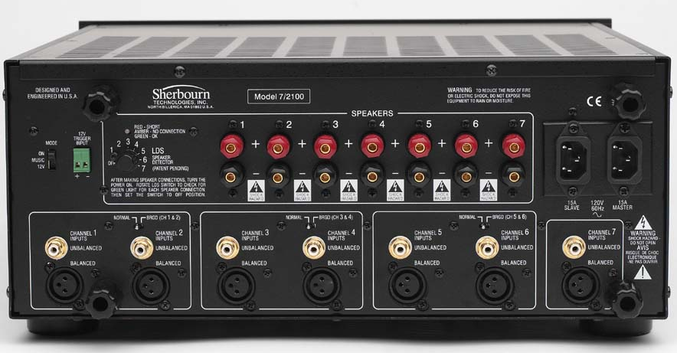
Classification of Electronic Products
1. Components and devices (semiconductors)
2. Electronic data processing
3. Office equipment
4. Consumer electronics
5. Telecommunication
6. Communication and radar
7. Control and instrumentation
8. Medical /industrial instrumentation
9. Automotive electronics

Slide 6
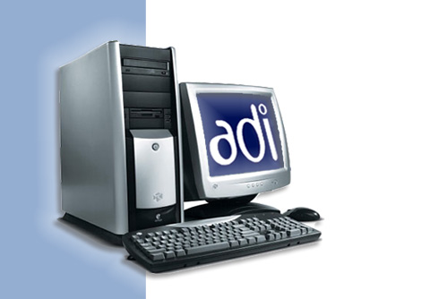
Classification of Electronic Products
1. Components and devices (semiconductors)
2. Electronic data processing
3. Office equipment
4. Consumer electronics
5. Telecommunication
6. Communication and radar
7. Control and instrumentation
8. Medical /industrial instrumentation
9. Automotive electronics

Slide 7
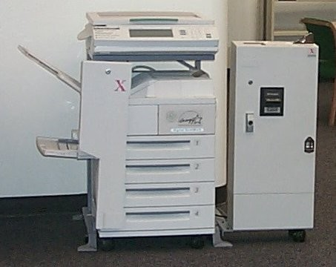
Classification of Electronic Products
1. Components and devices (semiconductors)
2. Electronic data processing
3. Office equipment
4. Consumer electronics
5. Telecommunication
6. Communication and radar
7. Control and instrumentation
8. Medical /industrial instrumentation
9. Automotive electronics

Slide 8
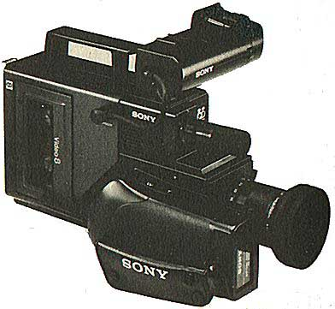
Classification of Electronic Products
1. Components and devices (semiconductors)
2. Electronic data processing
3. Office equipment
4. Consumer electronics
5. Telecommunication
6. Communication and radar
7. Control and instrumentation
8. Medical /industrial instrumentation
9. Automotive electronics

Slide 9
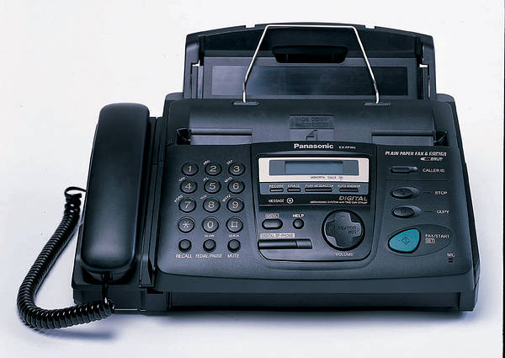
Classification of Electronic Products
1. Components and devices (semiconductors)
2. Electronic data processing
3. Office equipment
4. Consumer electronics
5. Telecommunication
6. Communication and radar
7. Control and instrumentation
8. Medical /industrial instrumentation
9. Automotive electronics

Slide 10
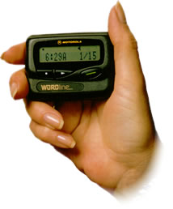
Classification of Electronic Products
1. Components and devices (semiconductors)
2. Electronic data processing
3. Office equipment
4. Consumer electronics
5. Telecommunication
6. Communication and radar
7. Control and instrumentation
8. Medical /industrial instrumentation
9. Automotive electronics

Slide 11
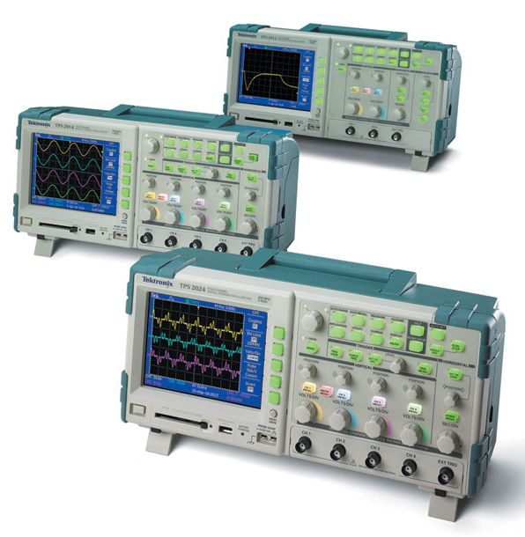
Classification of Electronic Products
1. Components and devices (semiconductors)
2. Electronic data processing
3. Office equipment
4. Consumer electronics
5. Telecommunication
6. Communication and radar
7. Control and instrumentation
8. Medical /industrial instrumentation
9. Automotive electronics

Slide 12
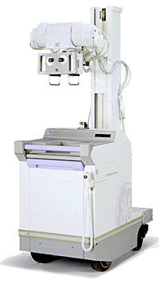
Classification of Electronic Products
1. Components and devices (semiconductors)
2. Electronic data processing
3. Office equipment
4. Consumer electronics
5. Telecommunication
6. Communication and radar
7. Control and instrumentation
8. Medical /industrial instrumentation
9. Automotive electronics

Slide 13
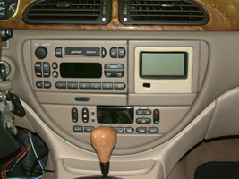
Classification of Electronic Products
1. Components and devices (semiconductors)
2. Electronic data processing
3. Office equipment
4. Consumer electronics
5. Telecommunication
6. Communication and radar
7. Control and instrumentation
8. Medical /industrial instrumentation
9. Automotive electronics

Slide 14
Why are we focusing on electronics?
There is no cohesive management system in place in the Federal government to improve the life cycle management practices of electronic equipment and enhance the growth of the infrastructure for the reuse and recycling of obsolete electronics

Slide 15
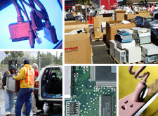
Four key facts about Federal
Government and Electronics

Slide 16
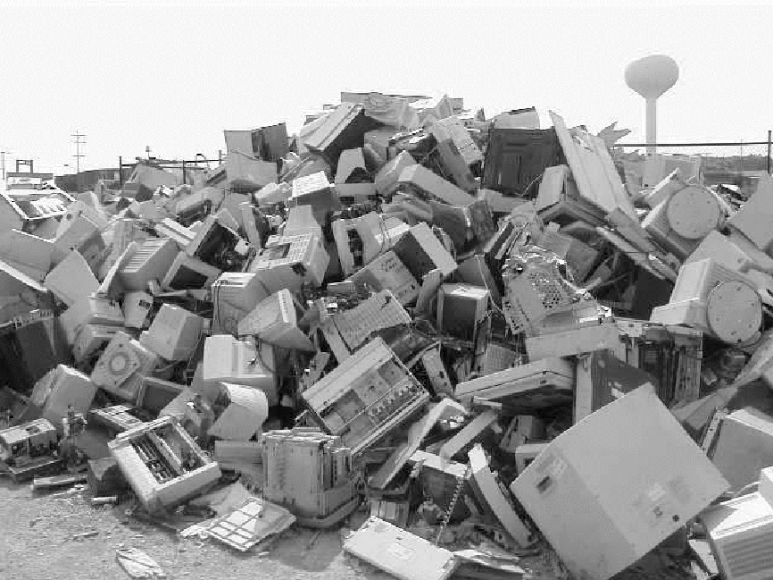
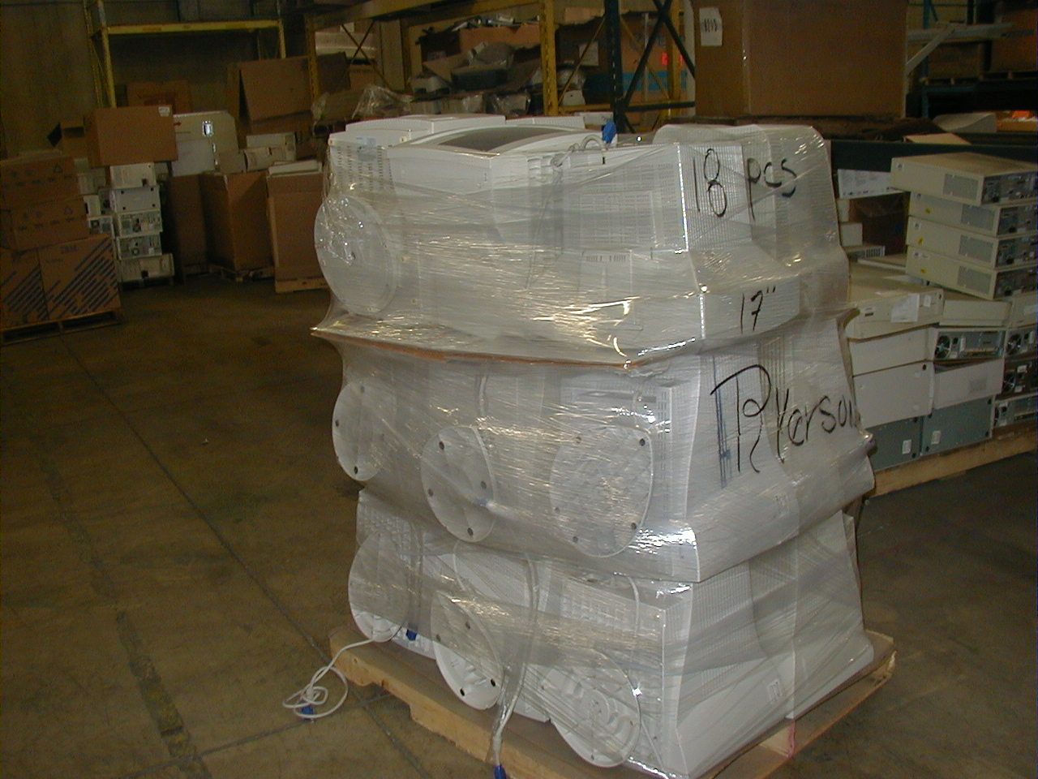
Fact #1
From This
Approximately 10,000 federally owned computers could be deemed excess or surplus each week
The Federal Government is setting Environmentally Sound Management guidelines for itself to ensure it is responsibly managing its electronic assets!
To This

Slide 17
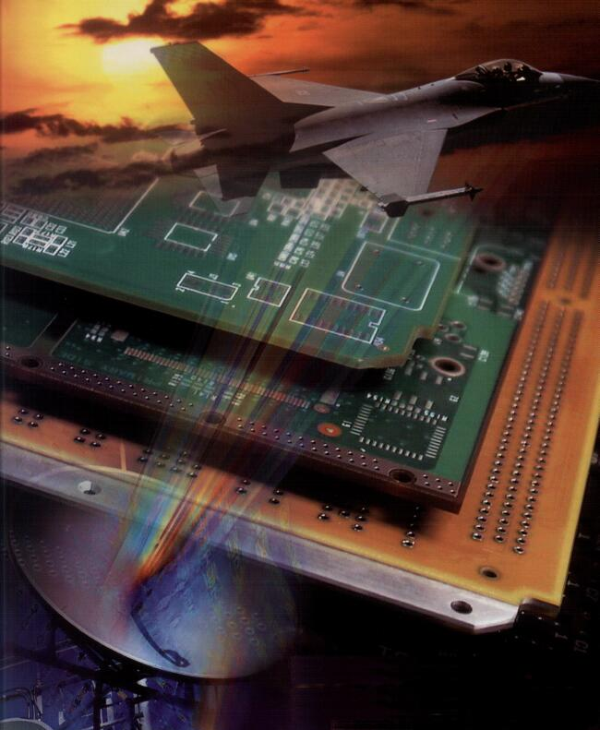
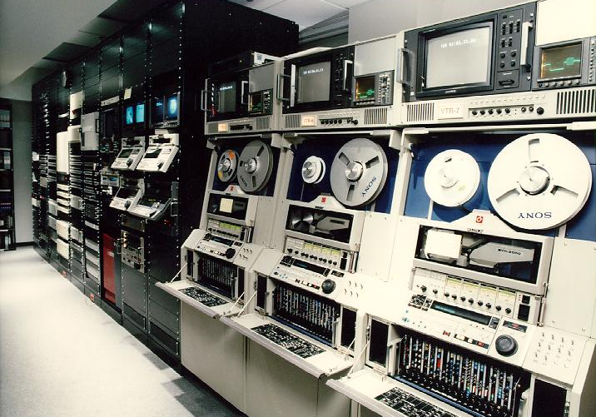
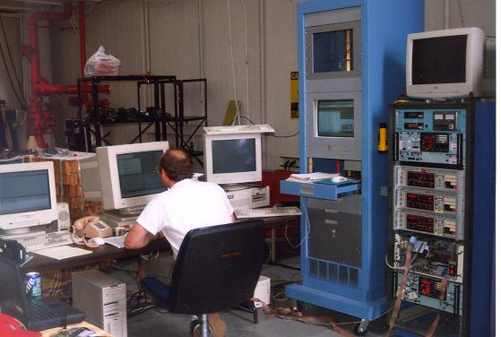
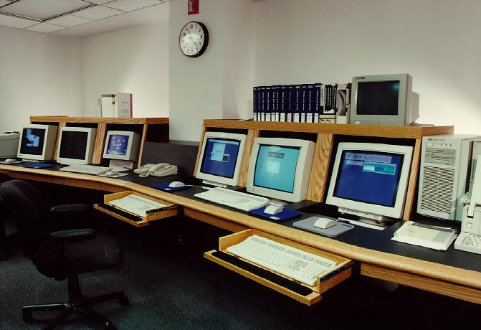
Fact #2 - The Federal government is a huge consumer electronics
With 1.8 million employees, the U.S. Federal sector represents a significant market share for electronics – About 7% of the total market
FY 2004 IT budget – $155 Billion (Hardware & Services)
FY 2005 IT budget - $60.8 Billion
Projected FY 2006 IT budget – approx. $65.1 Billion

Slide 18
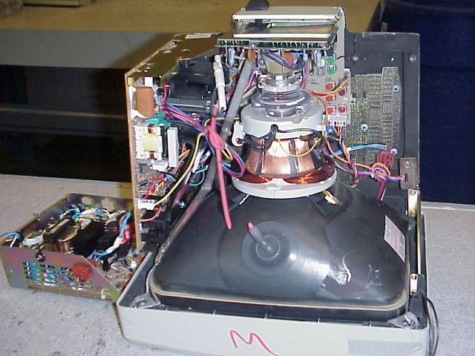
Fact #3 – Electronics represent serious environmental costs and opportunities
Electronic equipment contains hazardous substances such as lead, mercury, chromium, cadmium, and beryllium.
And valuable metals such as aluminum and copper and precious metals - gold, silver, platinum and palladium.
Components can be reused, recycled, or reclaimed in the current marketplace.
This is important to the Federal Government

Slide 19
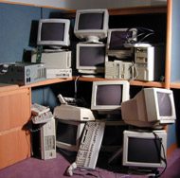
Fact #4 - The Federal government’s purchase and use of electronics are not sustainable
Average life cycle of Federally owned computers is 3 years
Significant quantities are ending up in storage closets, warehouses, or landfills
Liability Avoidance and Environmental Stewardship are important to the Federal Community

