Slide 1




Computer Networking
By
Brian Bogue

Slide 2
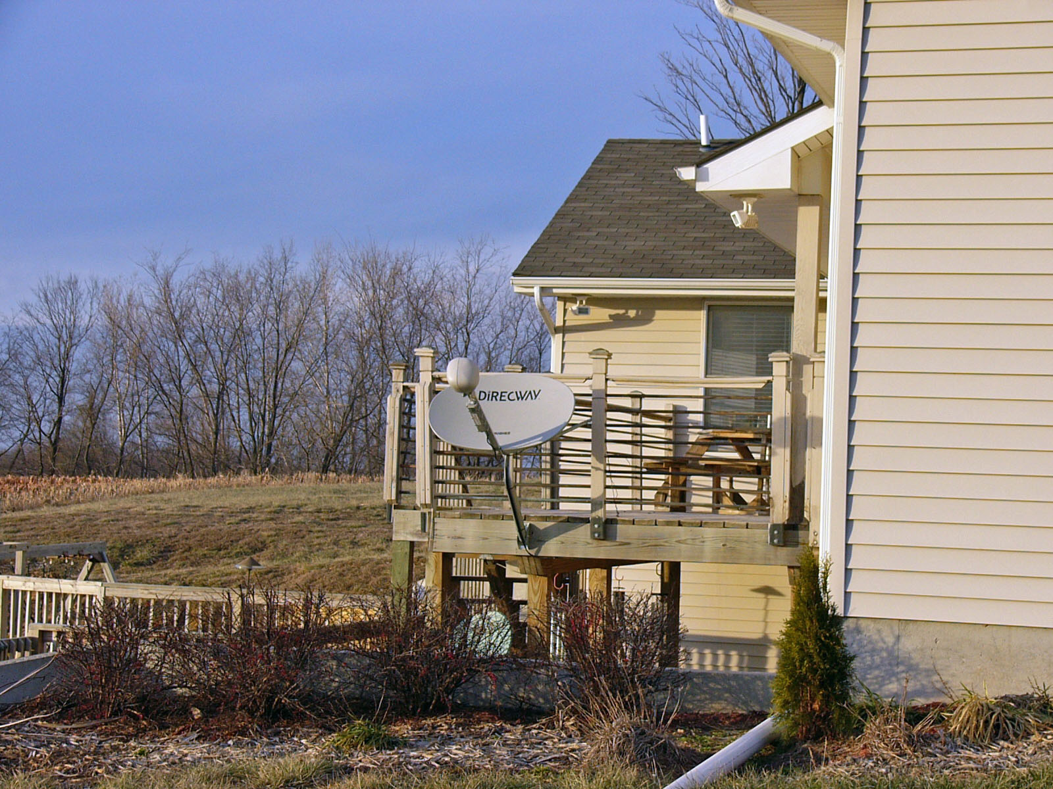
Internet Service Provider [ISP]
Satellite, Wireless, Cable and Dial-up
Direcway Satellite is our ISP with a connection speed of 850K down and 35K up.
We’ve had Direcway for almost a year and had no problems. Connection speed is excellent compared to dial-up

Slide 3
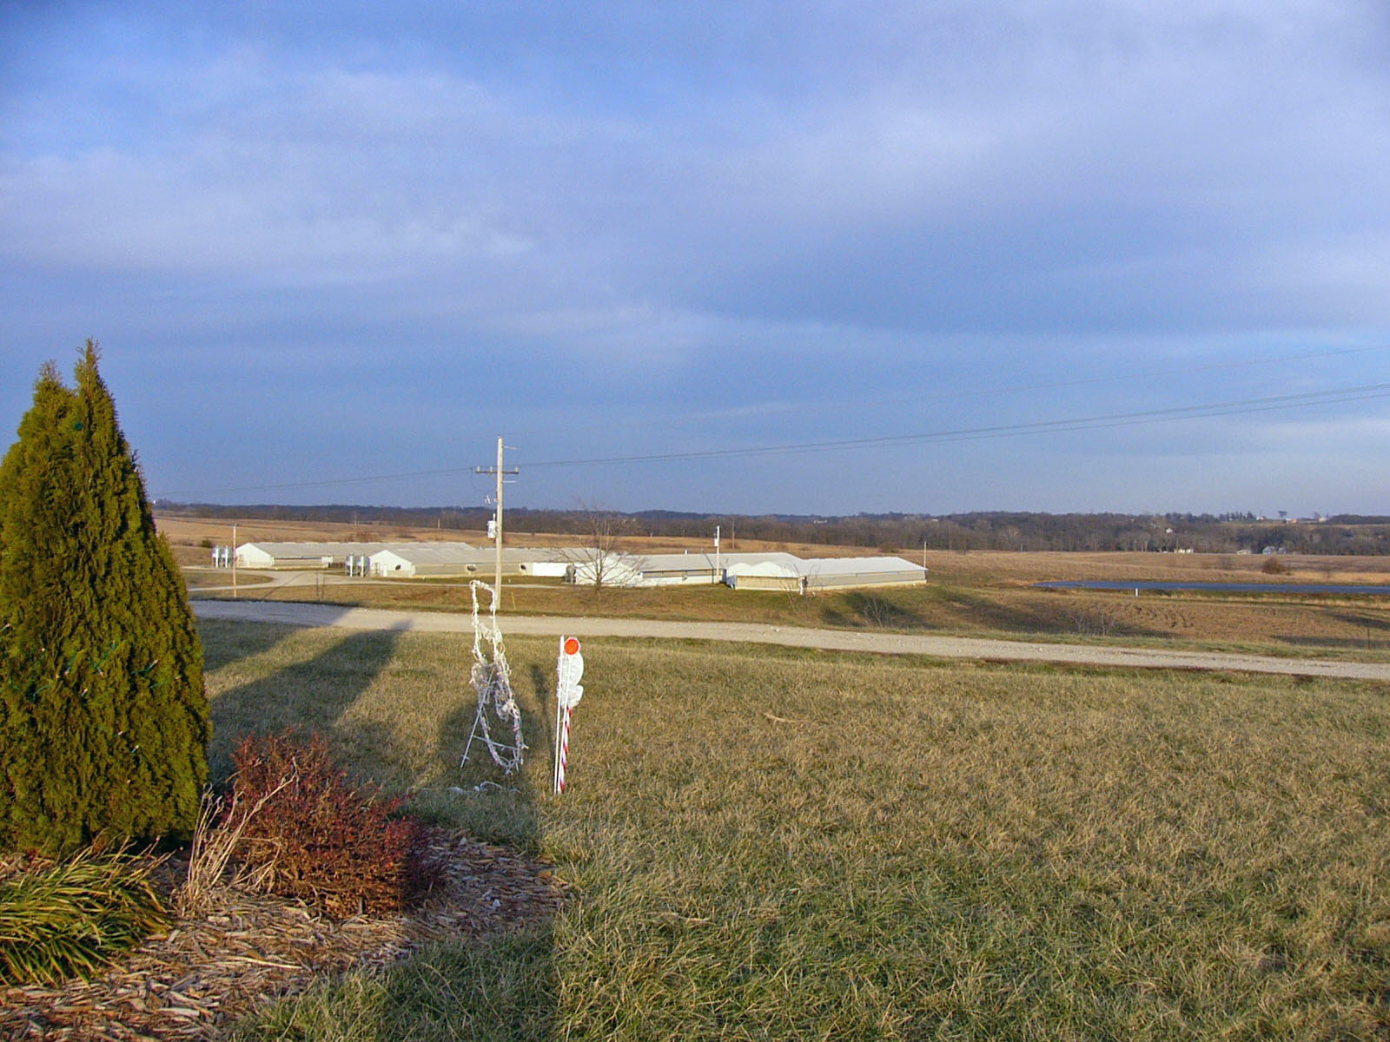

Wireless Network
Allows us to share our internet connection and files to multiple sites. Sending a signal just under ½ mile.

Slide 4
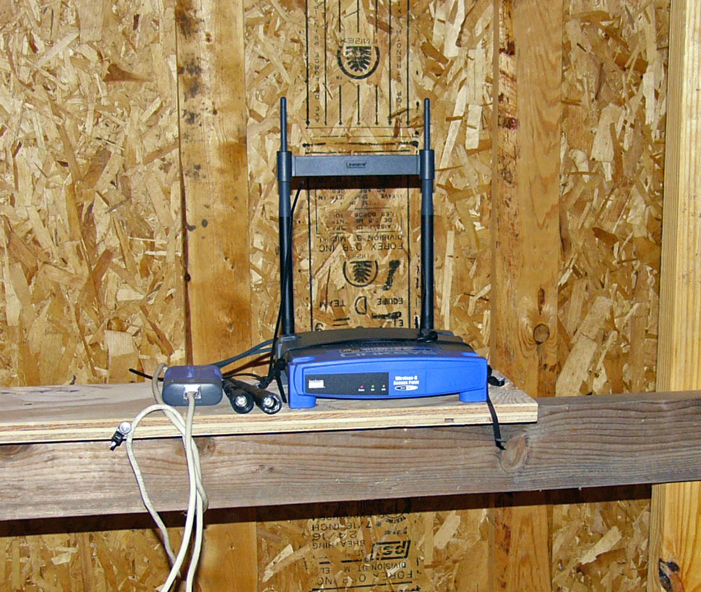
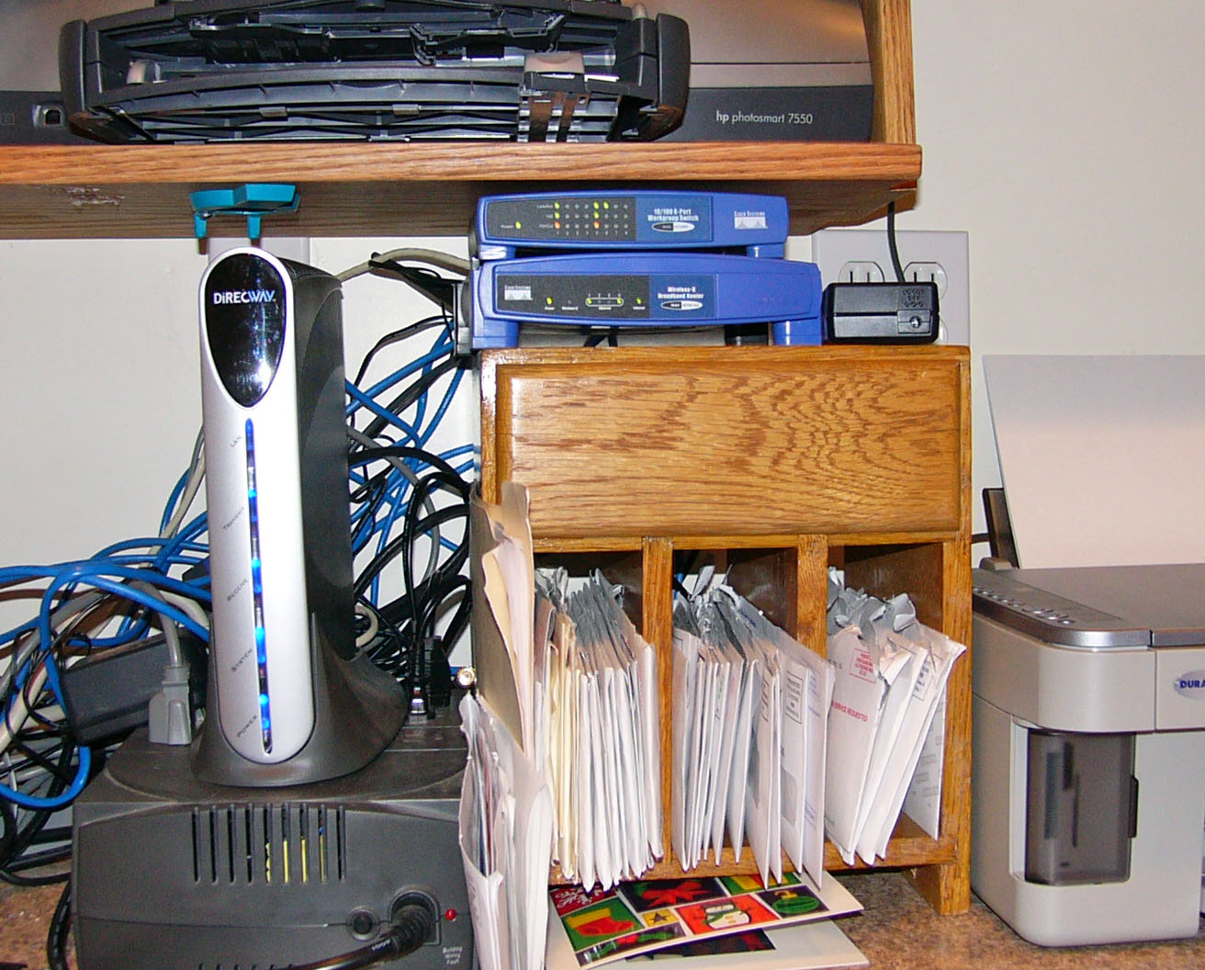
Hardware Required
Location, Location, Location
Height and a clear line of sight is most important for speed.
Switch with 4-8 ports [may need a router]
Outdoor CAT 5 cable, RJ45 connectors and crimper tool.
Access Point {use power-over-ethernet; from experience}
UPS [battery backup – keep out power problems]

Slide 5
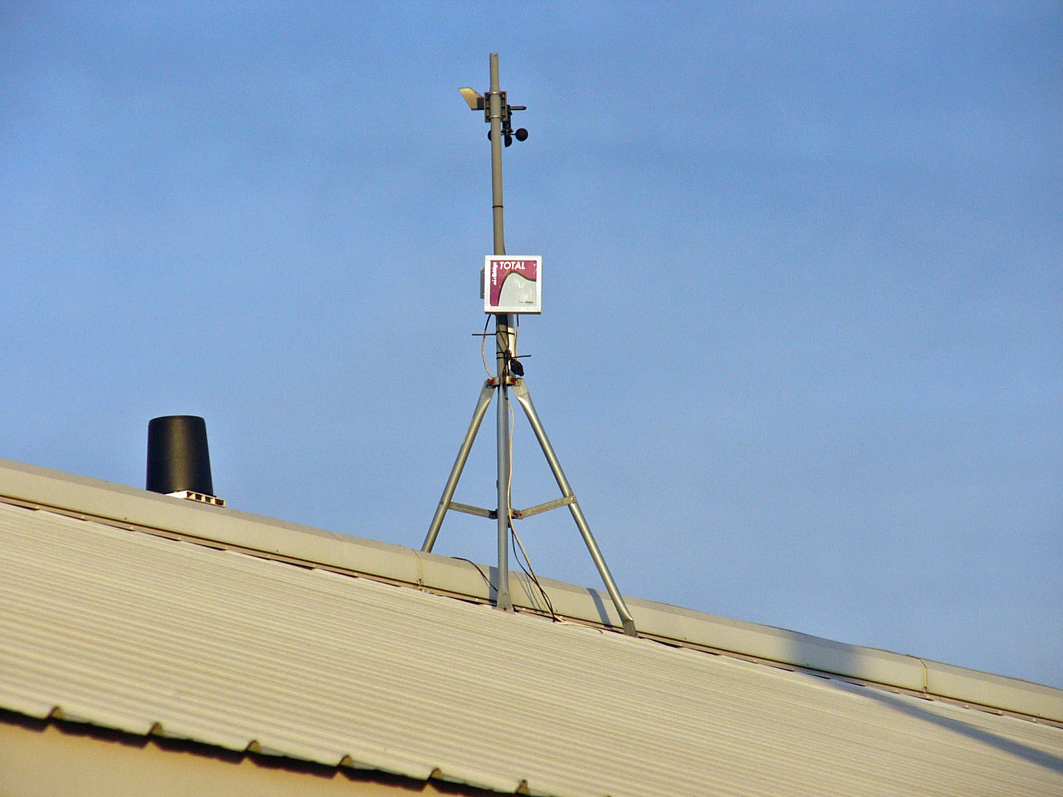
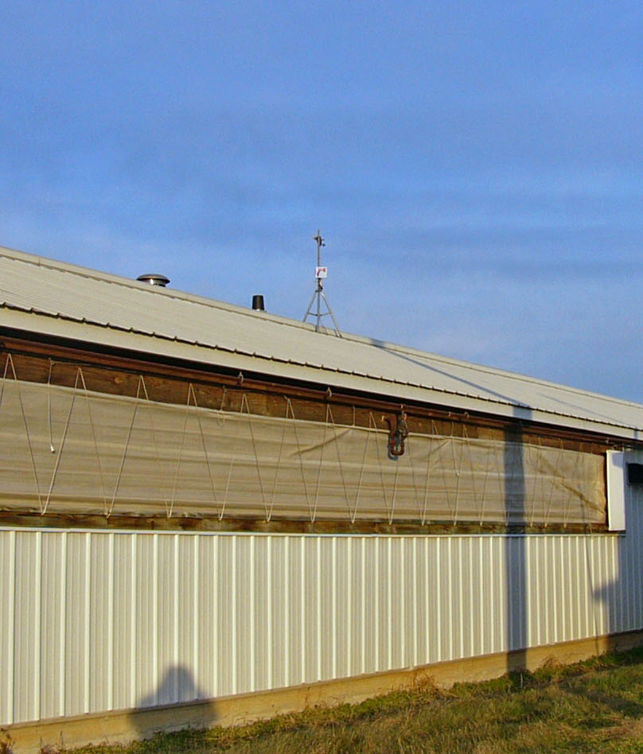
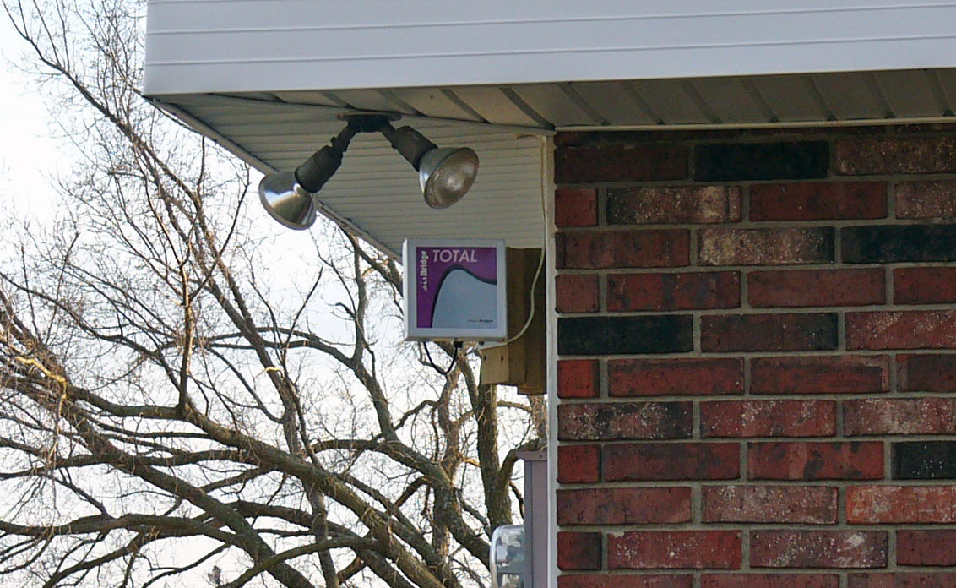
Hardware Required II
Location, Location, Location
Antennae at each location
Hardwire to remote location computer.

Slide 6
Be Patient and
Secure your Network!!
Keep on trying and asking questions.
Make sure you turn on the security for your wireless network.
A firewall must be on all computers running on the network.

