Slide 1
🎓 Startup 101 · MVP v3 · April 2026
Campus Connect
A peer-to-peer anonymous digital marketplace & AI-powered Lost & Found — built for university campuses.
🛒 Marketplace
🔍 AI Lost & Found
🛡️ Role-Based
💳 Stripe
👤 Anonymous

Slide 2
🔥 The Problem
Campus trading is broken
📱
WhatsApp Chaos
"When someone's hair is on fire, they'll take a brick if it helps." — Paul Graham, YC
Lost & sale messages buried within hours. No structure, no history.
🎭
No Privacy
Real identities exposed in every transaction — safety & trust concern.
💸
No Payment Safety
😰 'I lost my wallet before exams and can't reach anyone'
Cash or UPI only — no verification, high scam risk for students.
📦 'I'm leaving campus Friday — need to sell everything NOW'
🔎
Lost Objects Never Recovered
Manual notice boards are slow, unreliable, and not searchable.

Slide 3
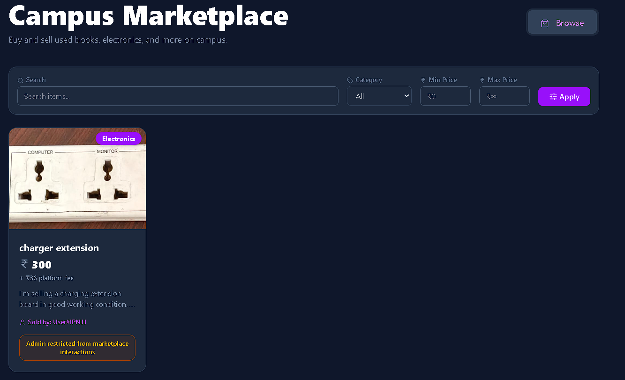
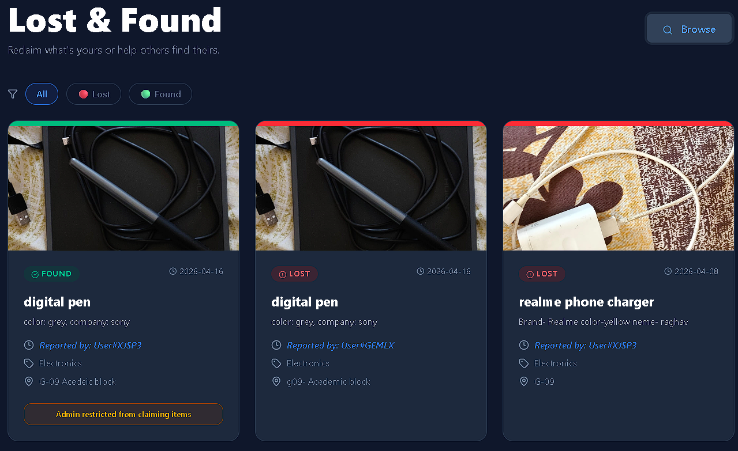
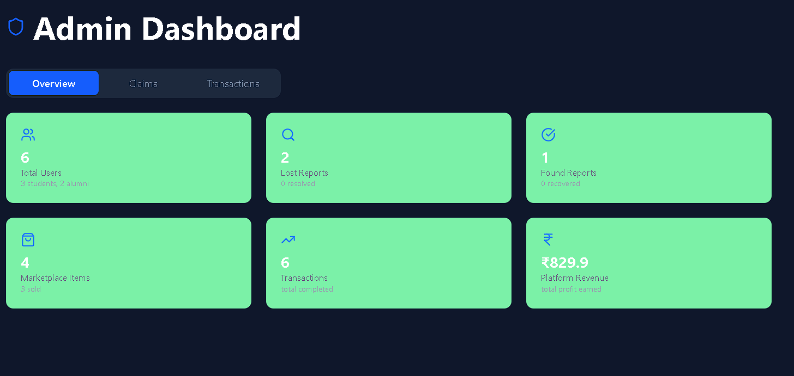
💡 Our Solution
One platform. Everything campus.
🛒
🔍
🛡️
Anonymous Marketplace
AI-Powered Lost & Found
Admin Dashboard
Buy & sell items with unique anonymous handles. Neither buyer nor seller knows each other's real identity.
TF-IDF text + OpenCV image matching auto-connects lost reports with found items in real-time
.
Real-time analytics, revenue tracking, dispute resolution — all isolated from marketplace activity.
"Unlike Rapido & Zomato — CampusConnect is two-way anonymous. The platform itself is the trusted third party."

Slide 4
🏗️ Architecture
Full-Stack Tech Stack
⚛️ Frontend — React.js + Vite + Tailwind CSS
Layer
Technology
↕ Axios REST API
Frontend
React, Vite, Tailwind CSS
Backend
Flask, JWT, Bcrypt
🐍 Backend — Flask + JWT Auth + Gunicorn
Database
MongoDB Atlas
↕ ↕
Auth
JWT + Google OAuth 2.0
🍃 MongoDB Atlas
Payments
Stripe Checkout API
AI Engine
TF-IDF + OpenCV
💳 Stripe API
Deploy
Gunicorn + Render

Slide 5
👥 User Roles
3 Distinct Roles
🎓
Student
🏫
Alumni
⚙️
Admin
✓
Login via Email or Google
✓
Same access as Student
✓
Full dashboard access
✓
List & Buy marketplace items
✓
Separate role badge
✓
Sees real names for disputes
✓
Report Lost & Claim Found
✓
Access via email/Google
✓
Revenue & analytics view
✓
Anonymous handle (User#ABC12)
✓
Anonymous identity enforced
✗
Cannot buy/sell/claim
✓
Secure Stripe checkout
✓
All marketplace features
✗
Platform neutrality enforced
"Admin isolation enforced on both frontend AND every backend route — double security layer."

Slide 6
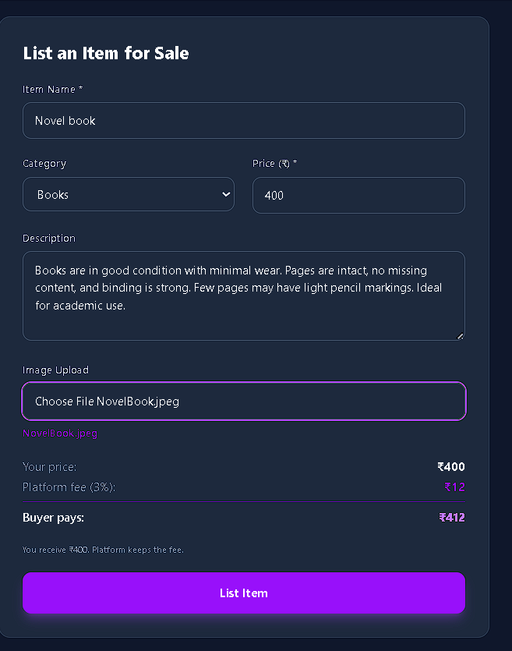
🛒 Marketplace
How the Marketplace Works
SELLER FLOW
BUYER FLOW
1. Browse, search, filter by price & category
2. Click 'Buy Now' → see fee breakdown
3. Redirect to Stripe Checkout
4. Item marked 'Sold' → Admin updated
💼
Seller
🛒
Buyer
🏛️
Platform
Gets full listed price
Gets verified item + safe tx
Earns % fee per sale

Slide 7
💰 Business Model
Tiered Fee Structure
CATEGORY-BASED (Priority)
📚 Books
3%
REVENUE EXAMPLE
💻 Electronics
12%
Book ₹300
+₹9
Laptop ₹25,000
+₹3,000
PRICE-BASED (Other Categories)
₹0 – ₹2,000
5%
Cycle ₹5,500
+₹550
₹2,001 – ₹5,000
8%
Table ₹1,800
+₹90
₹5,001+
10%
🔍 Lost & Found: FREE (0%)
Builds community trust first

Slide 8
🤖 AI Lost & Found
Smart Matching Engine
📝
COMBINED SCORE FORMULA
TF-IDF Text Similarity
With Images: Score = Text×0.40 + Image×0.35 + Bonus×0.25 Without Images: Score = Text×0.70 + Bonus×0.30 MATCH if Score > 0.25
Compares descriptions word-by-word using cosine similarity.
🖼️
OpenCV Image Hashing
Perceptual hash detects visually similar items, even edited ones.
🎯
Category & Name Bonus
CLAIM PROCESS
+15% for same category; +20% if item names are substrings.
1️⃣ Report lost → AI scans all 'Found' reports
2️⃣ Matched items shown ranked by score
3️⃣ Claimer submits proof of ownership
4️⃣ Admin verifies & approves claim

Slide 9
📊 Admin Dashboard
Platform Control Room
👥
💰
📦
🔎
Total Users
Platform Revenue
Items Sold
Lost Reports
All registered Students & Alumni
Net earnings from all marketplace fees
Complete transaction history log
Open & Resolved lost report counts
✅
🤝
📋
🛡️
Found Reports
Claims
Transactions
Role Isolated
All submitted found item reports
Pending / Approved / Rejected
Full buyer-seller payment ledger
Cannot buy, sell, or claim items

Slide 10
🔄 Build → Measure → Learn
MVP Iterations & Pivots
Ver
Hypothesis
Insight
Pivot
"If you're not embarrassed by the first version, you've launched too late." — Reid Hoffman
v1
Flat 5% fee on all items
Users didn't differentiate
Kept as baseline
v2
L&F claim fee (variable)
Users chose free WhatsApp instead
Fee was blocking adoption
v3
L&F = FREE (0%)
Community trust metric
→ Removed fee entirely ✓
v3
Category + Tiered pricing
Electronics = higher margin
→ Books 3%, Elec 12% ✓
YC PRINCIPLE APPLIED ✓
Like FR8 — we identified information asymmetry. WhatsApp = 30%+ lost deals. CampusConnect is the broker-free campus orchestration layer.

Slide 11
✅ Platform Status
MVP v3 is Production Ready
Email + Google OAuth Login
AI Smart Matching (Text + Image)
Anonymous Handle Assignment
Verified Claim Workflow
Marketplace (List / Browse / Buy)
Admin Dashboard (Live Analytics)
Stripe Payment Integration
Admin Role Isolation (Backend+UI)
Tiered + Category Fee Engine
Password Reset via Email
Lost & Found Reporting (FREE)
Gunicorn Production Deploy
UPCOMING ROADMAP
🔮 In-App Chat
⭐ Ratings
📱 Mobile App
🔔 Push Notifs
🏫 Partnerships

Slide 12
🎓 Thank You
CampusConnect
Built with the Y Combinator philosophy:
Launch fast. Iterate constantly. Listen to users.
🛒
🤖
💰
Peer-to-Peer Marketplace
AI Lost & Found
Smart Tiered Business Model
Built at IIIT Sri city · MVP v3 · Startup 101 · April 2026

Slide 13
Team Details
Team Name: Campus Connect
Member 1: Amit Kumar (S20220020253)
Member2: Sushant Bansode (S20220020314)
Member 3: Sandeep Nishad(S20220020309)

