Slide 1




Slide 2




Slide 3

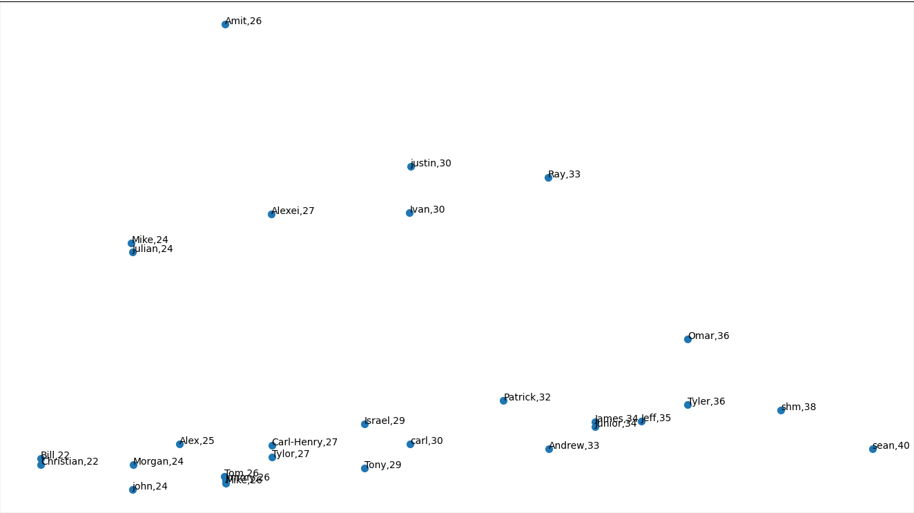

Check match by all properties
File: all.py

Slide 4
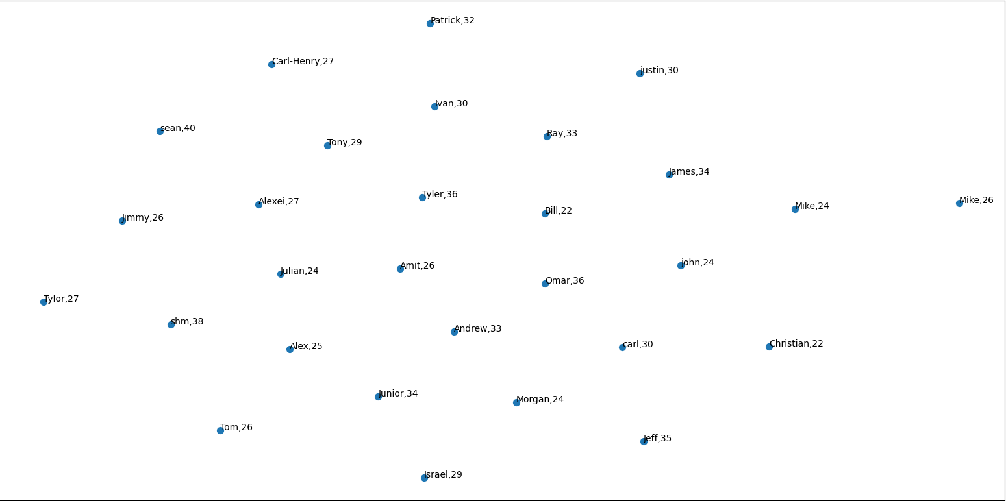
Check match by all properties by TSNE
File: TSNE.py

Slide 5
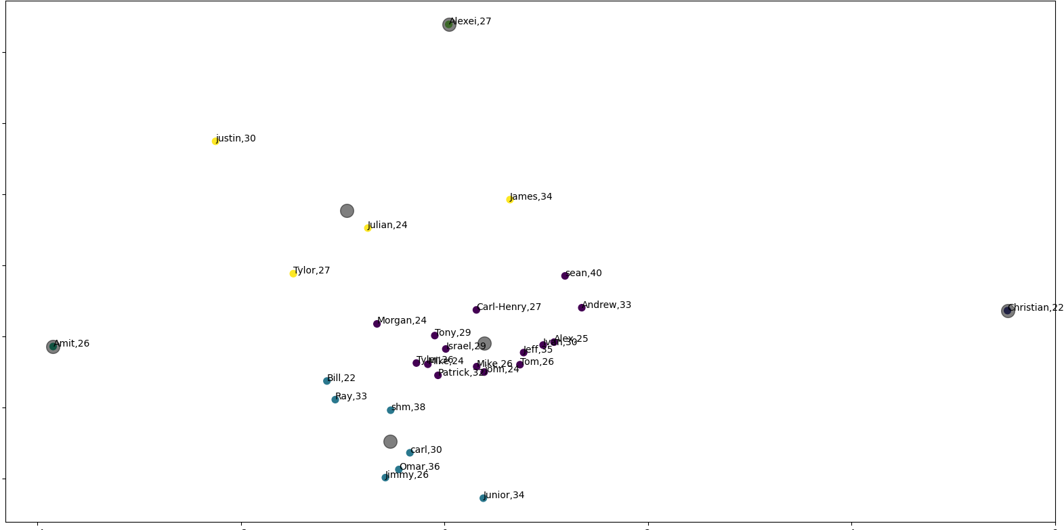
Check match by summary
File:summary.py

Slide 6
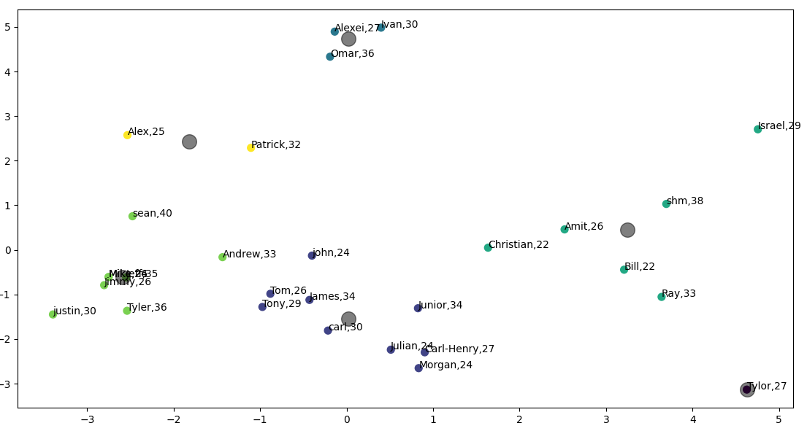
Check match by name
File:name.py

Slide 7
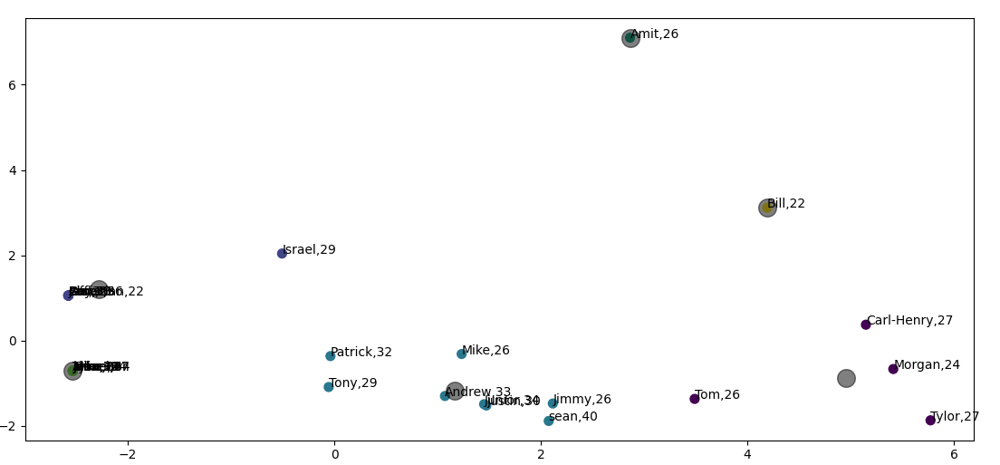
Check match by location
File:location.py

Slide 8





Slide 9






Slide 10


Map

Slide 11
