Slide 1



Personalized Recommendation System
Presented by Batch-III interns
Personalized Recommendation System
Presented by Batch-III interns

Slide 2






Transforming Citizen Service Delivery in BSK using AI/ML
Aritra Chatterjee
Soumyadeep Basak
Adarsh Rounak
Nilesh Ranjan Pal
Our team
This presentation outlines our innovative approach to enhancing citizen service delivery through the strategic application of Artificial Intelligence and Machine Learning.
Our team under the guidance of Dr. Saptarsi Goswami, Mr. Kausik Halder, Dr. Arindam Ray, and Mr. Manojit Baral, has developed a robust recommendation system designed to personalize and streamline public services.

Slide 3




Background and Problem Statement
About Bangla Sahayata Kendra
Background
Many citizens visiting BSK (Bangla Sahayata Kendras) are not fully informed about the range of services available to them.
For instance, a citizen who visits BSK for a property mutation service might not be aware that new electricity connection services are also available.
To address this gap, a personalized recommendation system is proposed to increase awareness and utilization of relevant services.
93K Services / Day
40 Departments
316 Services
Addressing the Core Problem
Analyze Citizen Behavior & Service Usage Patterns
Study historical service usage and demographic profiles of BSK visitors.
Identify frequently availed services and common combinations.
Design AI/ML-Based Recommendation System
Build models to suggest relevant additional services using demographic, geographic, and service usage data.
Apply filters for eligibility and recurrence to refine recommendations.
3561 BSKs
2 Operators/ BSK

Slide 4
Data Collection & Preparation
25L+
51L+
316
3
Citizens
Logs
Active Services
Months of Data
Extensive citizen profiles for comprehensive analysis.
Detailed service interaction logs to understand behavior.
Diverse range of government services for recommendation.
Duration of data
1 Jan’25 – 31 March’ 25
Our data was sourced from a PostgreSQL dump provided by BSK.
This raw data underwent meticulous preprocessing, including merging disparate datasets, cleaning inconsistencies, and standardizing formats to ensure high-quality input for our models.

Slide 5
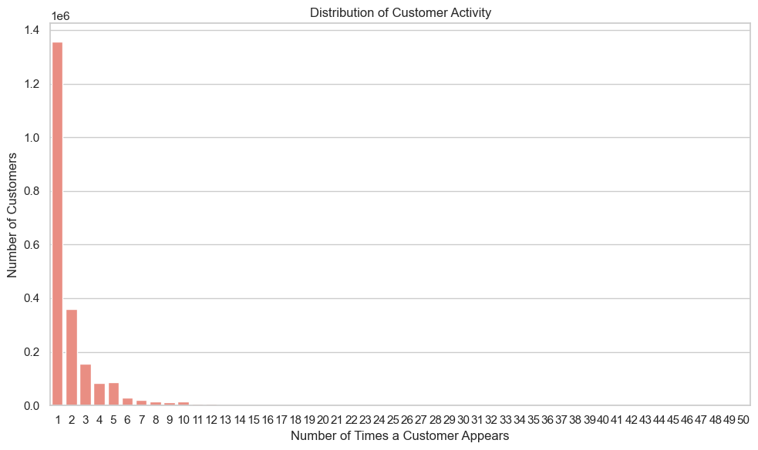
Data Quality

Slide 6
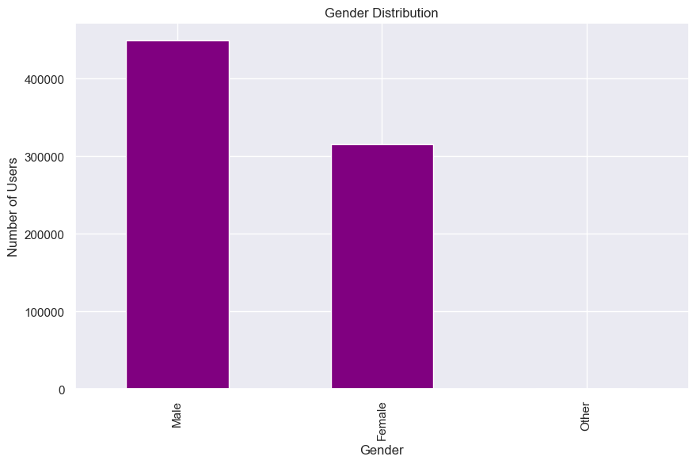
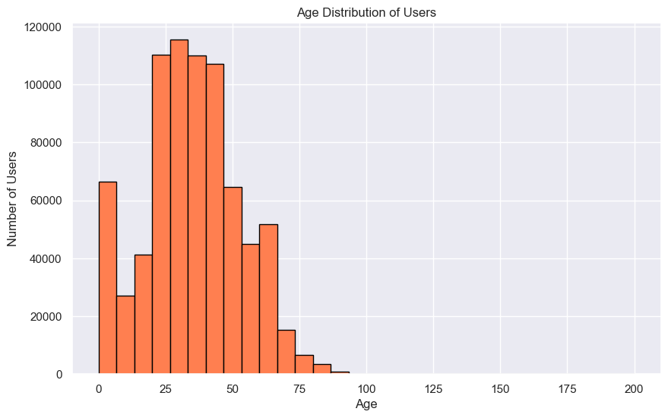
Data Quality

Slide 7
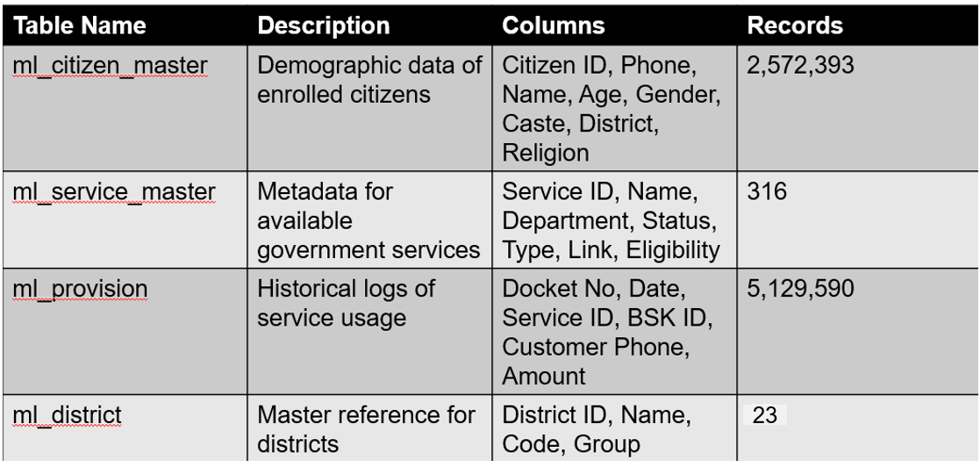
Data Description

Slide 8
Preprocessing
1. demo_helper.py – Demographic Clustering
- Merges citizen and provision data
- One-hot encodes service usage
- Adds age and religion group tags
- Clusters users by demographic profiles
Outputs:
grouped_df.csv – Cluster-wise service usage
cluster_service_map.pkl – Top services per cluster
service_id_with_name.csv – ID-to-name mapping
final_df.csv – Preprocessed user-service data for fast look-up (one hot encoding done for each user)
2. content_helper.py – Content-Based Recommendation
- Enhances service descriptions via prompting
- Generates embeddings using OpenAI
- Computes cosine similarity between services
Outputs:
service_master_enhanced.csv – Enriched service descriptions
openai_similarity_matrix.csv – Service similarity scores
3. district_helper.py – District Service Aggregation
- Analyzes service usage by district
- Ranks services by unique user count
Output:
district_top_services.csv – Top 20 services per district

Slide 9
Data Enhancement
"prompt_template = (
"You are a helpful assistant for BSK in West Bengal providing government services to common citizens, that enhances service descriptions.\n"
"Do not use any special characters or formatting.\n"
"Your task is to enhance the service description by making it more informative, concise, and structured.\n"
"Do not hallucinate or make up information.\n"
"Example:\n"
"Original: It is a conditional cash transfer scheme with the aim of improving the status and well-being of the girl child.\n"
"Enhanced: A flagship conditional cash transfer scholarship for unmarried girls aged 13–18 in West Bengal offering ₹750 annual and ₹25,000 one-time grant at 18, supporting education and delaying marriage."
" The online system uses Applicant ID/DOB/Captcha to track application status; funds are transferred via bank. Primary Domain: Education (80%), Cross-Domain: Social Welfare, Legal Services (age/marital proof), Finance, Public Services (wbkanyashree.gov.in, buddy4study.com)\n\n"
"Example:\n"
"Original: Income certificate is an essential legal document which serves as a proof of an individual annual income earned from all sources.\n"
"Enhanced: Digital portal to apply for and receive income certificates via bank statements or affidavits, crucial for subsidies, scholarships, fee waivers, housing and welfare eligibility. Works via upload, verification, and digital issuance."
" Primary Domain: Certificates (80%), Cross-Domain: Finance, Social Welfare, Legal Services\n\n"
"Original: {orig}\n"
"Enhanced:"
)

Slide 10
Technology Stack
Name | Reason why it is used
Python | Mature and comprehensive AIML ecosystem, open source, flexible
Streamlit | To display and interact with the system (Frontend Layer)
FastAPI | REST API for BSK data, service recommendations, analytics, High performance for AI service endpoints
PostgreSQL | Enterprise grade database, BSK uses this.
OpenAI | Generate embeddings for service descriptions

Slide 11
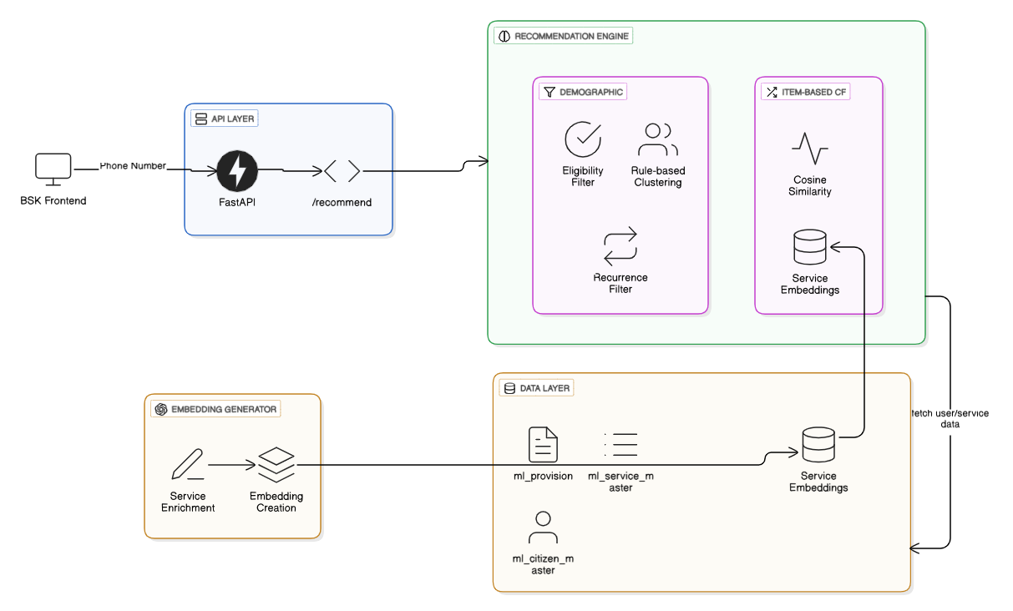
Proposed Recommendation Model
IComponents:
Backend: Powered by FastAPI for robust API handling, PostgreSQL for data storage, and Pandas for data manipulation.
Frontend: User-friendly interface developed with Streamlit for seamless interaction.

Slide 12
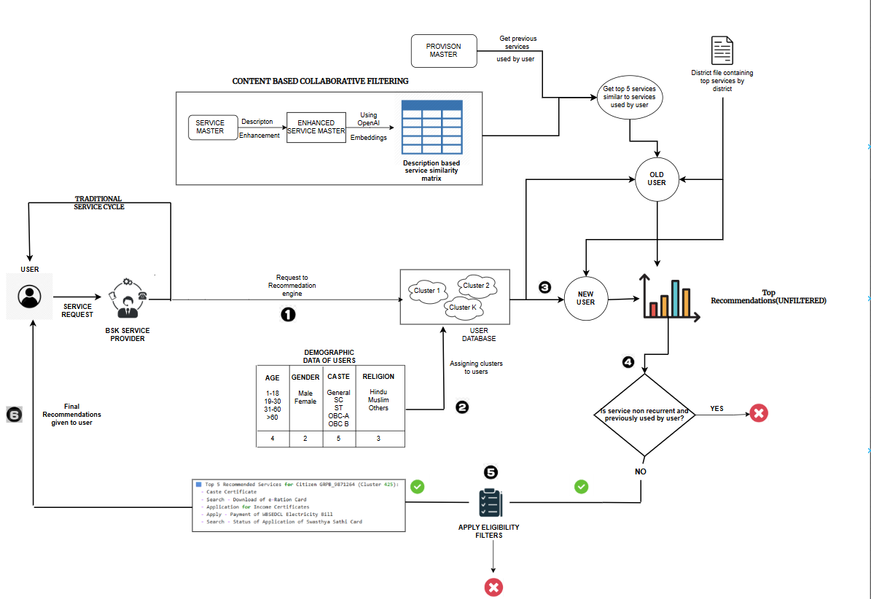
Proposed Recommendation Model
1
Data Ingestion
Raw data is fed into the system.
Preprocessing
Data is cleaned and transformed.
2
3
Recommendation Engine
Rule-based and ML models generate suggestions.
API Response
Recommendations are delivered via API.
4

Slide 13
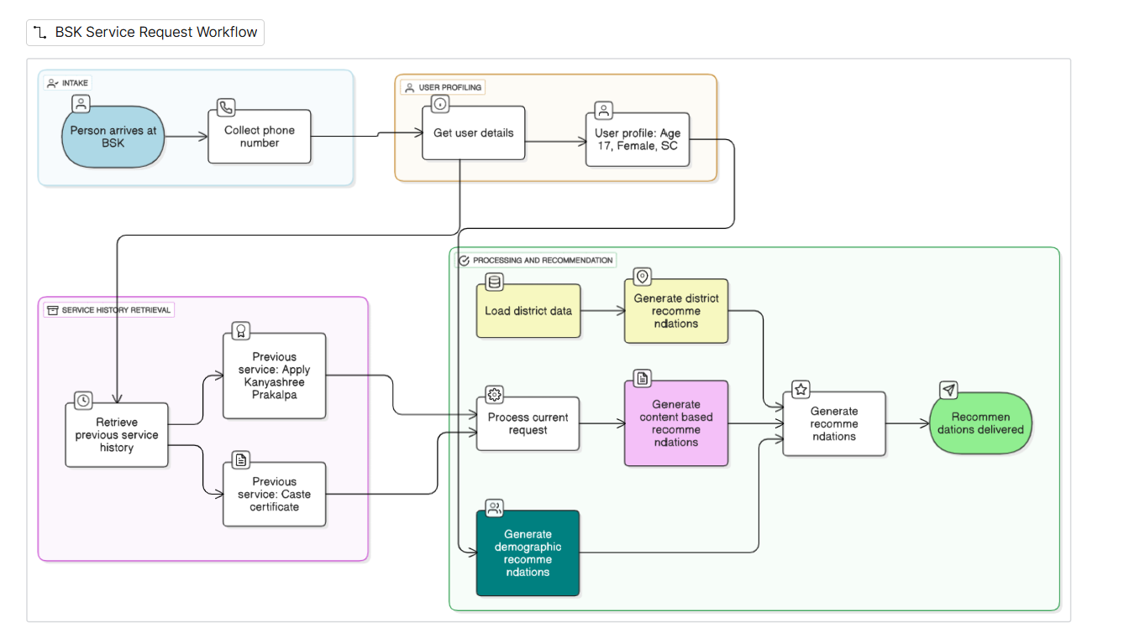
Example Walkthrough

Slide 14
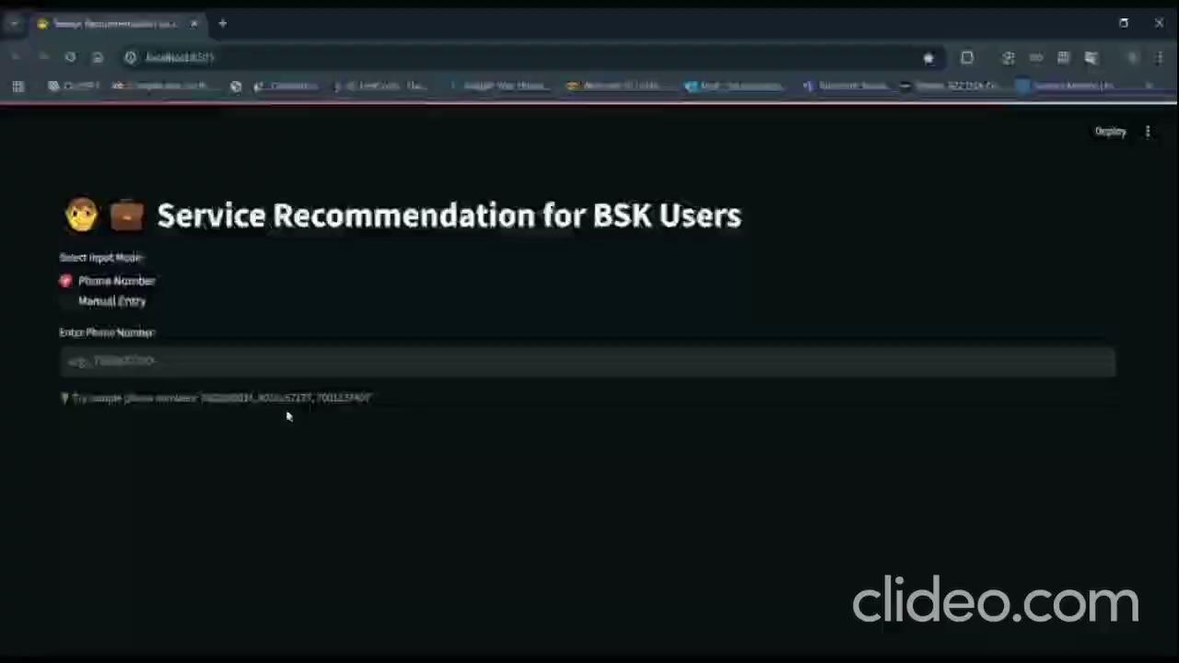

Slide 15
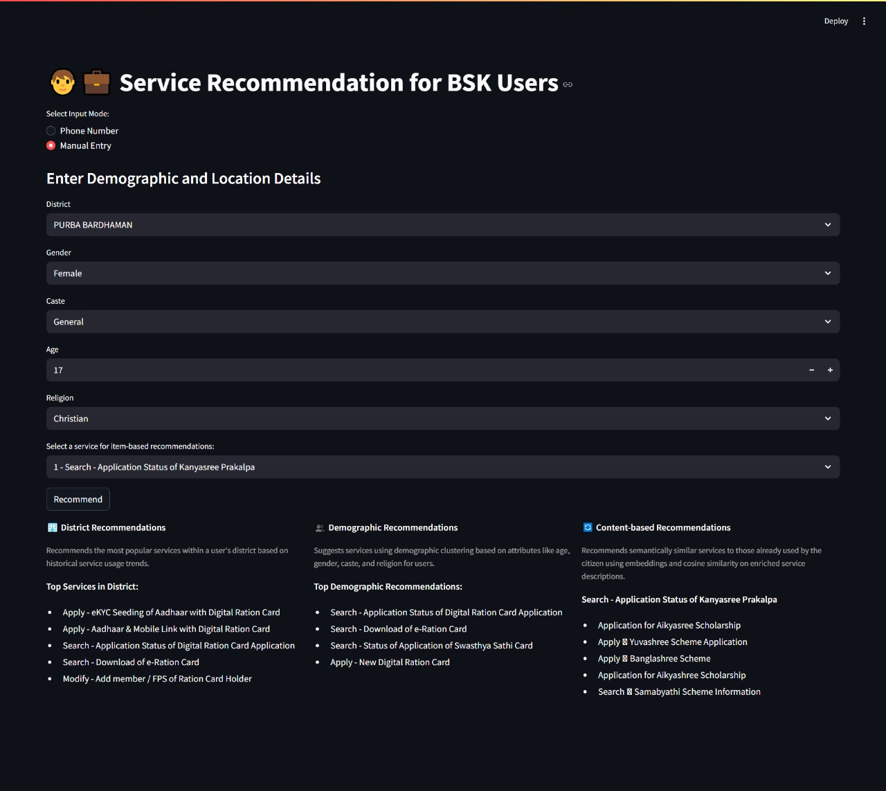
Sample Test Cases

Slide 16
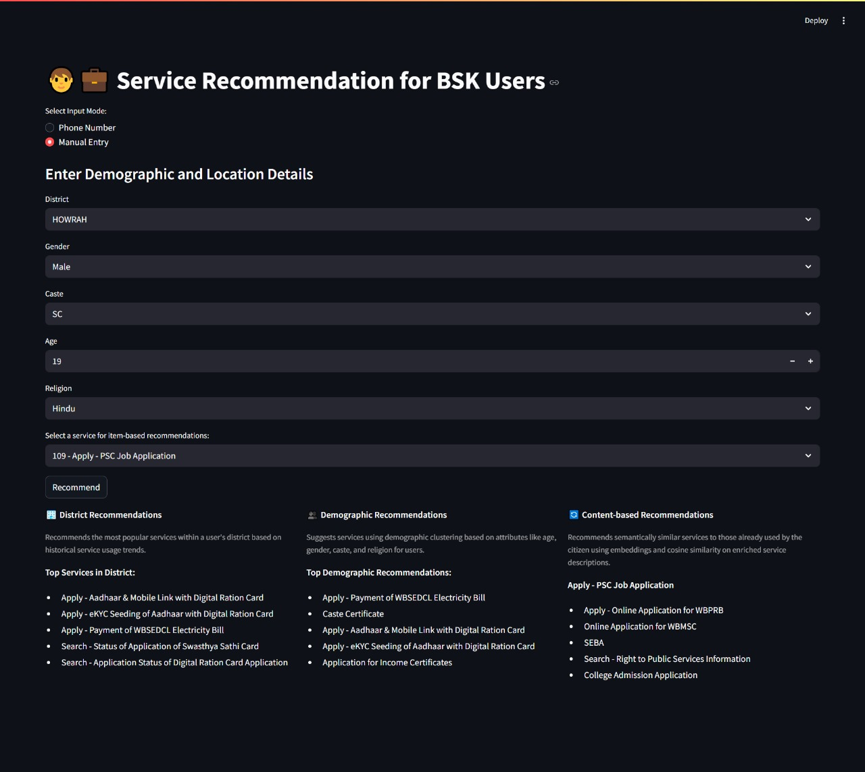

Slide 17
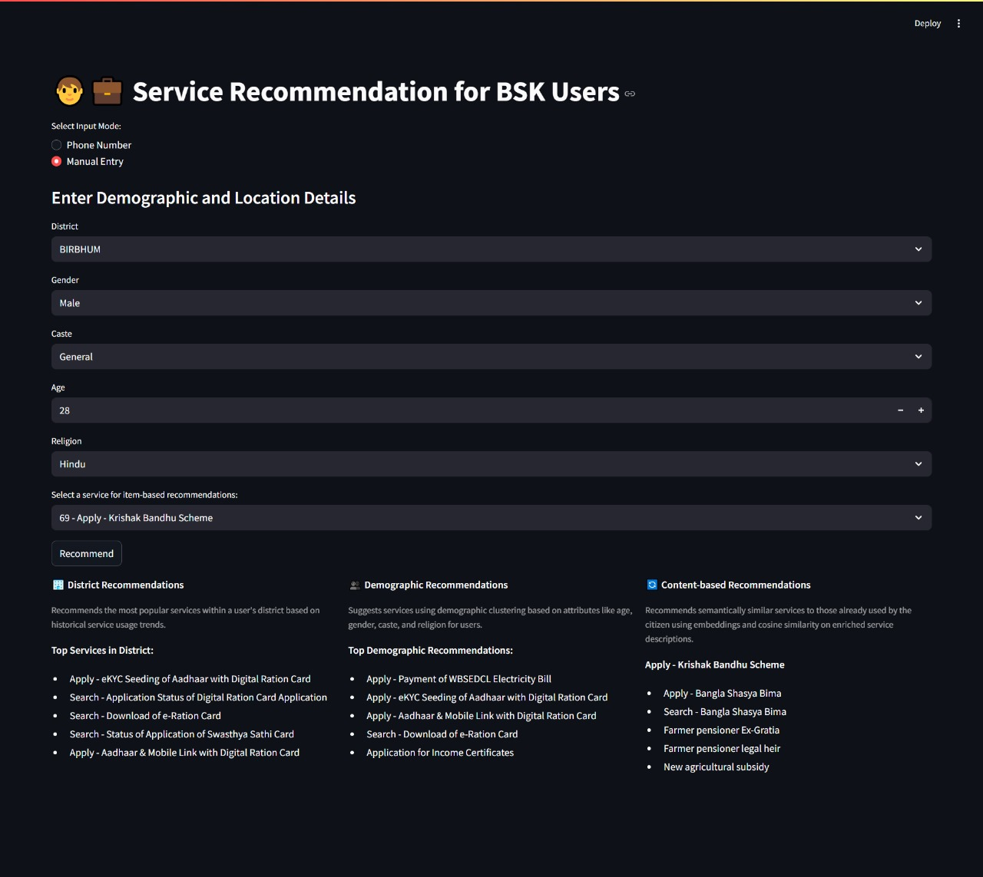

Slide 18
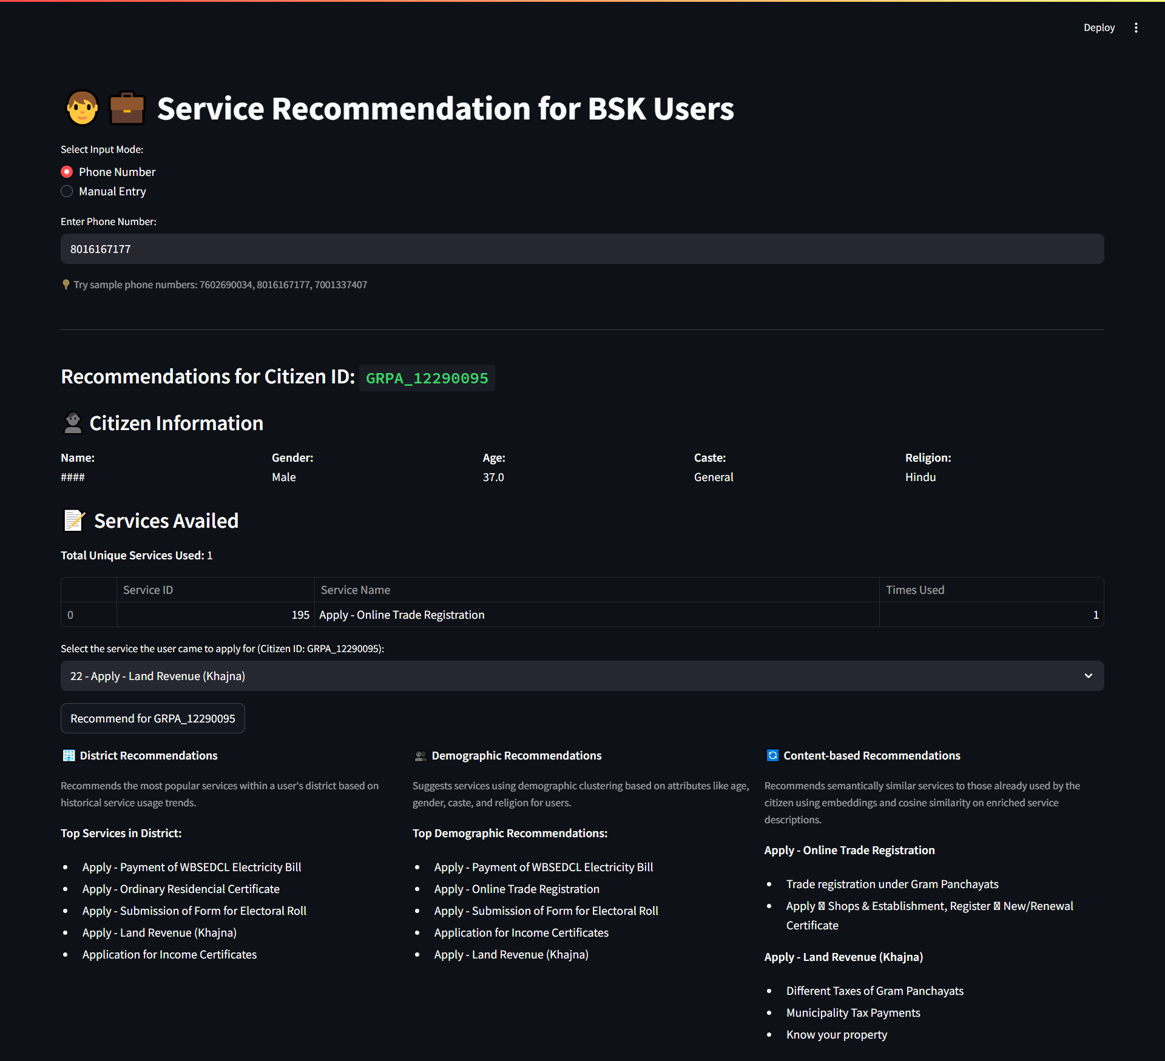

Slide 19
Regular Database Updation
1. POST/generate-district-csvs
Regenerates district-level top service usage statistics.
Calls the function `generate_district_csv_files()` in `district_helper.py`.
2. POST/generate-demo-csvs
Updates demographic clusters and service mappings.
Calls the function `generate_demo_csv_files()` in `demo_helper.py`.
3. POST/generate-content-csvs
Enhances service descriptions and computes semantic similarity.
Calls the function `generate_content_csv_files()` in `content_helper.py`.

Slide 20
Automation Enhancement – Cron Job Integration
Daily Demographic Refresh
• Schedule: Every day at 9:00 PM (21:00) - configured in `backend/main.py`
• Purpose: Refreshes demographic clusters and citizen service provisions
• Triggers: `scheduled_generate_demo_csvs()` function
• Updates: `grouped_df.csv`, `cluster_service_map.pkl`, `service_id_with_name.csv`, `services.csv`, `final_df.csv`
• Rationale: Keeps demographic recommendations current with new citizen registrations and service provisions
Monthly District Refresh
• Schedule: 1st of every month at 3:00 AM (03:00) - configured in `backend/main.py`
• Purpose: Updates popular services by district based on historical usage patterns
• Triggers: `scheduled_generate_district_csvs()` function
• Updates: `district_top_services.csv`
• Rationale: District service popularity changes more slowly, monthly updates are sufficient
Manual Content Refresh
• Schedule: On-demand (triggered manually by admin/developer)
• When to Trigger: When new services are added to the system or existing services are removed or deprecated
• How to Trigger: `POST /generate-content-csvs` endpoint
• Updates: `service_with_domains.csv`, `openai_similarity_matrix.csv`

Slide 21
Evaluation & Results
Coverage
Our system achieved a high coverage rate, indicating its ability to provide relevant recommendations across a broad spectrum of citizen inquiries, based on similarity-driven relevance.
Coverage=X/Y
X=Number of recommended services that match the previously used services​
Y=Total number of services previously used by the citizen
Uptake Rate(Future)
A manual operator-guided evaluation process will be implemented post-deployment to assess service uptake effectiveness.
Operators will select the most relevant recommendation from three models — demographic, district-based, and content-based — during live citizen interactions.
These selections will be logged and analyzed to determine which model performs best across varying citizen profiles.
Metric | Sample Size | Average Score
Coverage | 100 Citizens | 0.60(60%)
Interpretation: On average, 60% of the services previously used by a citizen were either exactly matched to those in the top-N list generated by the recommendation system.

Slide 22
Deployment Plan
1.Database Integration
Connect the bsk database by changing database config in .env
Intermediate outputs (e.g., clustered data, similarity results) should be stored in a database or object storage, or as temporary CSVs..
2.Backend Hosting
Host the FastAPI-based backend on BSK’s internal server (no GPU required; works on CPU).
Secure the backend using authentication if exposed publicly or over a network.
3.Frontend/Channel Integration
For internal use: Develop a frontend interface and connect to backend APIs.
For external communication (e.g., WhatsApp), extract and format API responses as user-facing messages.

Slide 23
Future Scope and Conclusion
Future Scope
Performance Monitoring: Track selected models and actual services availed to assess effectiveness.
Scalability: Make it more scalable by by using scalable cloud services and caching.
Conclusion
AI/ML-powered personalized recommendations enhance citizen awareness and service access at BSKs.
Improves welfare outreach, reduces repeat visits, and drives smarter public service delivery.
Provides a scalable, real-time solution for data-driven governance in West Bengal.

Slide 24


