Slide 1
Scala Programming
Au:- Amit S Khedkar

Slide 2
Agenda
Day 1 Scala Basics Control structures and Functions Arrays | Day 3
Day 2 | Day 4

Slide 3

Scala Basics

Slide 4
Topics Covered
Using Scala Interpreter
Defining variables with var and val
Numeric Types
Using operators and functions

Slide 5


The Scala Interpreter
On the scala shell type the following command and press Enter key
The answer is given the name res0. You can use that name in subsequent computations:
Notes:
The interpreter also displays the type of the result—in our examples, Int, Double, and java.lang.String. You can call methods.
Depending on how you launched the interpreter, you may be able to use tab completion for method names. Try typing res2.to
and then hit the Tab key. If the interpreter offers choices such as
toCharArray toLowerCase toString toUpperCase ……
this means tab completion works. Type a U and hit the Tab key again. You now get a single completion:
res2.toUpperCase
Also try hitting the ↑ and ↓ arrow keys. In most implementations, you will see the previously issued commands, and you can edit them.
Use the ←, →, and Del keys to change the last command to
res2.toLowerCase

Slide 6
The REPL
Scala interpreter reads an expression, evaluates it, prints it, and reads the next expression. This is called the read-eval-print loop, or REPL.
Notes:
Technically speaking, the scala program is not an interpreter. Behind the scenes, your input is quickly compiled into bytecode, and the bytecode is executed by the Java virtual machine. For that reason, most Scala programmers prefer to call it “the REPL”.
Advantage of REPL is that it provides Instant feedback, which encourages experimenting, and you will feel good whenever something works.
In the REPL, type :help to see a list of useful commands. All commands start with a colon. For example, the :javap command gives more detailed
information about the most recent compiler warning.

Slide 7


Declaring values and variables
You can define your own names:
You can use these names in subsequent expressions:
A value declared with val is actually a constant—you can’t change its contents
Notes:
A value declared with val is actually a constant—you can’t change its contents:
scala> answer = 0
<console>:6: error: reassignment to val

Slide 8

Declaring values and variables
To declare a variable whose contents can vary, use a var:
In Scala, you are encouraged to use a val unless you really need to change the contents.
Notes:
In Scala, you are encouraged to use a val unless you really need to change the contents. Perhaps surprisingly for Java or C++ programmers, most programs don’t need many var variables.
It is an error to declare a value or variable without initializing it.

Slide 9

Declaring values and variables
You need not specify the type of a value or variable. It is inferred from the type of the expression with which you initialize it.
However, you can specify the type if necessary. For example,
Notes:
In Scala, the type of a variable or function is always written after the name of the variable or function.

Slide 10
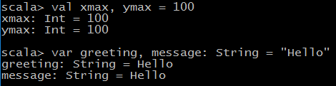
Declaring values and variables
In Scala, semicolons are only required if you have multiple statements on the same line.
You can declare multiple values or variables together:

Slide 11

Commonly Used Types
Like Java, Scala has seven numeric types: Byte, Char, Short, Int, Long, Float, Double, and a Boolean type
However, unlike Java, these types are classes. There is no distinction between primitive types and class types in Scala
You can invoke methods on numbers, for example:
Notes:
more interestingly,
1.to(10) // Yields Range(1, 2, 3, 4, 5, 6, 7, 8, 9, 10)
In Scala, there is no need for wrapper types. It is the job of the Scala compiler to convert between primitive types and wrappers. For example, if you make an array of Int, you get an int[] array in the virtual machine.

Slide 12

Commonly Used Types
Scala relies on the underlying java.lang.String class for strings. However, it augments that class with well over a hundred operations in the StringOps class.
For example, the intersect method yields the characters that are common to two strings:
Notes:
Similar to StringOps, there are classes RichInt, RichDouble, RichChar, and so on. Each of them has a small set of convenience methods for acting on Int, Double, or Char respectively.
to method that we have seen previously is actually a method of the RichInt class. In the expression 1.to(10).
the Int value 1 is first converted to a RichInt, and the to method is applied to that value.
There are classes BigInt and BigDecimal for computations with an arbitrary (but finite) number of digits. These are backed by the java.math.BigInteger and java.math.BigDecimal classes, but, they are much more convenient because you can use them with the usual mathematical operators.

Slide 13

Commonly Used Types
In Scala, you use methods, not casts, to convert between numeric types. For example:
Notes:
To convert a string containing a number into the number, use toInt or toDouble. For example, "99.44".toDouble is 99.44.

Slide 14

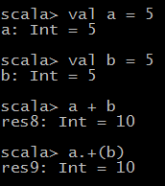
Arithmetic and Operator Overloading
Arithmetic operators in Scala work just as you would expect in Java or C++:
There is just one surprising aspect: These operators are actually methods. For example,
Notes:
a + b is a shorthand for a.+(b). Here, + is the name of the method.
Scala has no prejudice against non-alphanumeric characters in method names. You can define methods with just about any symbols for names.
For example, the BigInt class defines a method called /% that returns a pair containing the quotient and remainder of a division.
scala> val x = BigInt(5)
x: scala.math.BigInt = 5
scala> val y = BigInt(3)
y: scala.math.BigInt = 3
scala> x /% y
res14: (scala.math.BigInt, scala.math.BigInt) = (1,2)

Slide 15

Arithmetic and Operator Overloading
In general, you can write
a method b
as a shorthand for
a.method(b)
Here method is a method with two parameters (one implicit, one explicit). For example:
Notes:
There is one notable difference between Scala and Java or C++. Scala does not have ++ or -- operators. Instead, simply use +=1 or -=1:
counter+=1 // Increments counter—Scala has no ++
There is reason for Scala’s refusal to provide a ++ operator.
Note that you can’t simply implement a method called ++. Since the Int class is immutable, such a method cannot change an integer value.
The Scala designers decided it wasn’t worth having yet another special rule just to save one keystroke.

Slide 16

Arithmetic and Operator Overloading
You can use the usual mathematical operators with BigInt and BigDecimal objects:
Notes:
This’s much better than Java, where you would have had to call
x.multiply(x).multiply(x).
In Java, you cannot overload operators

Slide 17

Calling methods
If the method has no parameters, you don’t have to use parentheses. For example, the API of the StringOps class shows a method sorted, without (), which yields a new string with the letters in sorted order. Call it as
The rule of thumb is that a parameterless method that doesn’t modify the object has no parentheses.
Notes:
In Java, mathematical methods such as sqrt are defined as static methods of the Math class. In Scala, you define such methods in singleton objects
A package can have a package object. In that case, you can import the package and use the methods of the package object without any prefix:
import scala.math._ // In Scala, the _ character is a “wildcard,” like * in Java
sqrt(2) // Yields 1.4142135623730951
pow(2, 4) // Yields 16.0
min(3, Pi) // Yields 3.0
If you don’t import the scala.math package, add the package name:
scala.math.sqrt(2)
NOTE: If a package that starts with scala., you can omit the scala prefix. For example, import math._ is equivalent to import scala.math._, and math.sqrt(2)
is the same as scala.math.sqrt(2).

Slide 18
Calling methods
Often, a class has a companion object whose methods act just like static methods do in Java.
For example, the BigInt companion object to the scala.math.BigInt class has a method probablePrime that generates a random prime number with a given number of bits:
Notes:
Here, Random is a singleton random number generator object, defined in the scala.util package.

Slide 19
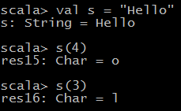
The apply method
In Scala, it is common to use a syntax that looks like a function call. For example, if s is a string, then s(i) is the i^{th} character of the string

Slide 20

The apply method
You can think of this as an overloaded form of the () operator. It is implemented as a method with the name apply
When you look at the documentation for the BigInt companion object, you will see apply methods that let you convert strings or numbers to BigInt objects. For example:
Notes:
For example, in the documentation of the StringOps class, you will find a method
def apply(n: Int): Char
That is, s(4) is a shortcut for s.apply(4)
Why not use the [] operator?
You can think of a sequence s of element type T as a function from { 0, 1, . . . , n – 1 } to T that maps i to s(i), the ith element of the
sequence.
This argument is even more convincing for maps. As you look up a map value for a given key as map(key). Conceptually, a map is a
function from keys to values, and it makes sense to use the function notation.
CAUTION: Occasionally, the () notation conflicts with another Scala feature: implicit parameters.
For example, the expression
“Martin".sorted(3)
yields an error because the sorted method can optionally be called with an ordering, but 3 is not a valid ordering.
You can use parentheses:
(“Martin".sorted)(3)
or call apply explicitly:
“Martin".sorted.apply(3)
BigInt.apply("1234567890") yields a new BigInt object, without having to use new.
Using the apply method of a companion object is a common Scala idiom for constructing
objects.
Array(1, 4, 9, 16) returns an array, because of the the apply method of the Array companion object.
NOTE: We have assumed that Scala code is executed on the Java virtual machine. That is in fact true for the standard Scala distribution.
However, the Scala.js project (www.scala-js.org) provides tools to translate Scala to JavaScript. If you take advantage of that project, you can
write both the client-side and the server-side code of web applications in Scala.

Slide 21
Demo: Demo of Scaladoc
Notes:
The entry page for Scaladoc
The search bar in Scaladoc
Class documentation in Scaladoc
Keep these tips in mind:
• Remember to look into RichInt, RichDouble, and so on, if you want to know how
to work with numeric types. Similarly, to work with strings, look into StringOps.
• The mathematical functions are in the package scala.math, not in any class.
• Sometimes, you’ll see functions with funny names. For example, BigInt has a
method unary_-., this is how you define the prefix negation operator -x.
• Methods can have functions as parameters. For example, the count method in
StringOps requires a function that returns true or false for a Char, specifying
which characters should be counted:
def count(p: (Char) => Boolean) : Int
You supply a function, often in a very compact notation, when you call the
method. As an example, the call s.count(_.isUpper) counts the number of uppercase
characters.
• You’ll occasionally run into classes such as Range or Seq[Char]. They mean what
your intuition tells you—a range of numbers, a sequence of characters. You
will learn all about these classes as you delve more deeply into Scala.
• In Scala, you use square brackets for type parameters. ASeq[Char] is a sequence
of elements of type Char, and Seq[A] is a sequence of elements of some type A.
• There are many slightly different types for sequences such as GenSeq, GenIterable,
GenTraversableOnce, and so on. The differences between them are rarely important.
When you see such a construct, just think “sequence.” For example, the
StringOps class defines a method
def containsSlice[B](that: GenSeq[B]): Boolean
This method tests whether the string contains with a given sequence. If you
like, you can pass a Range:
"Bierstube".containsSlice('r'.to('u'))
// Yields true since the string contains Range('r', 's', 't', 'u')
• Don’t get discouraged that there are so many methods. It’s the Scala way to
provide lots of methods for every conceivable use case. When you need
to solve a particular problem, just look for a method that is useful. More often
than not, there is one that addresses your task, which means you don’t have
to write so much code yourself.
• Some methods have an “implicit” parameter. For example, the sorted method
of StringOps is declared as
def sorted[B >: Char](implicit ord: math.Ordering[B]): String
That means that an ordering is supplied “implicitly,”
• Whenever you are confused what a method does, just try it out in the REPL:
"Scala".sorted // Yields "Saacl"
Now you can clearly see that the method returns a new string that consists
of the characters in sorted order.

Slide 22
Lab1: Scala Basics

Slide 23
Control Structures and Functions

Slide 24
Topics Covered
Conditional statements/Expressions
Loops
Story of semicolons
Functions
Default and Named arguments
Variable arguments
Procedures
Lazy Values
Exception

Slide 25

Conditional Expressions
Scala has an if/else construct with the same syntax as in Java or C++. However, in Scala, an if/else has a value, namely the value of the expression that follows the if or else. For example,
Notes:
Start from here

Slide 26

Conditional Expressions
In Scala, every expression has a type. For example, the expression if (x > 0) 1 else -1 has the type Int because both branches have the type Int.
Notes:
The type of a mixed-type expression, such as
if (x > 0) "positive" else -1
is the common supertype of both branches. In this example, one branch is a
java.lang.String, and the other an Int. Their common supertype is called Any.
If the else part is omitted, for example in
if (x > 0) 1
then it is possible that the if statement yields no value. However, in Scala, every
expression is supposed to have some value. This is finessed by introducing a class
Unit that has one value, written as (). The if statement without an else is
equivalent to
if (x > 0) 1 else ()
Think of () as a placeholder for “no useful value,” and of Unit as an analog of void
in Java or C++.
Note1:-
---------
The REPL is more nearsighted than the compiler—it only sees one line of code at a time. For example, when you type
if (x > 0) 1
else if (x == 0) 0 else -1
the REPL executes if (x > 0) 1 and shows the answer. Then it gets confused about the else keyword.
If you want to break the line before the else, use braces:
if (x > 0) { 1
} else if (x == 0) 0 else -1
This is only a concern in the REPL. In a compiled program, the parser will find the else on the next line.
Note2:
---------
If you want to paste a block of code into the REPL without worrying about its nearsightedness, use paste mode. Type
:paste
Then paste in the code block and type Ctrl+D. The REPL will then analyze the block in its entirety.

Slide 27
Statement termination
In Scala a semicolon is never required if it falls just before the end of the line
A semicolon is also optional before an }
An else, and similar locations where it is clear from context that the end of a statement has been reached

Slide 28
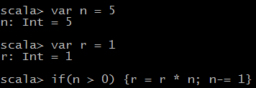
Statement termination
However, if you want to have more than one statement on a single line, you need to separate them with semicolons. For example,
Notes:
A semicolon is needed to separate r = r * n and n -= 1. Because of the }, no semicolon is needed after the second statement.
If you want to continue a long statement over two lines, make sure that the first line ends in a symbol that cannot be the end of a statement. An operator is often
a good choice:
s = s0 + (v - v0) * t + // The + tells the parser that this is not the end
0.5 * (a - a0) * t * t
In practice, long expressions usually involve function or method calls, and then you don’t need to worry much—after an opening (, the compiler won’t infer the
end of a statement until it has seen the matching ).
In the same spirit, Scala programmers favor the Kernighan & Ritchie brace style:
if (n > 0) {
r = r * n
n -= 1
}
The line ending with a { sends a clear signal that there is more to come.

Slide 29
Block Expressions and Assignments
In Scala, a { } block contains a sequence of expressions, and the result is also an expression.
The value of the block is the value of the last expression
This feature can be useful if the initialization of a val takes more than one step. For example,

Slide 30

Block Expressions and Assignments
In Scala, assignments have no value—or, strictly speaking, they have a value of type Unit. For example,
Notes:
A block that ends with an assignment, such as
{ r = r * n; n -= 1 }
has a Unit value.
Since assignments have Unit value, don’t chain them together.
x = y = 1 // No

Slide 31


Loops
Scala has the same while and do loops as Java and C++. For example,

Slide 32

Loops
you can use a for statement like this:
Notes:
Scala has no direct analog of the for (initialize; test; update) loop. If you need such
a loop, you have two choices. You can use a while loop. Or, a for statement as shown on the slide.
The construct for (i <- expr)
makes the variable i traverse all values of the expression to the right of the <-. Exactly how that traversal works depends on the type of the expression. For a
Scala collection, such as a Range, the loop makes i assume each value in turn. When traversing a string, you can loop over the index values:
val s = "Hello"
var sum = 0
for (i <- 0 to s.length - 1)
sum += s(i)
In this example, there is actually no need to use indexes. You can directly loop over the characters:
var sum = 0
for (ch <- "Hello") sum += ch
Note 1:-
----------
In Scala, loops are not used as often as in other languages. As you will see later, you can often process the values in a sequence by applying a function
to all of them, which can be done with a single method call.
Note 2:-
-----------
Scala has no break or continue statements to break out of a loop. What to do if you need a break? Here are a few options:
• Use a Boolean control variable.
• Use nested functions—you can return from the middle of a function.
• Use the break method in the Breaks object:
import scala.util.control.Breaks._
breakable {
for (...) {
if (...) break; // Exits the breakable block
...
}
}
Here, the control transfer is done by throwing and catching an exception, so you should avoid this mechanism when time is of essence.
NOTE:
In Java, you cannot have two local variables with the same name and overlapping scope. In Scala, there is no such prohibition, and the normal
shadowing rule applies. For example, the following is perfectly legal:
val n = ...
for (n <- 1 to 10) {
// Here n refers to the loop variable
}

Slide 33
Advanced for loop
You can have multiple generators of the form variable <- expression. Separate them by semicolons. For example,
Each generator can have a guard, a Boolean condition preceded by if:
Note that there is no semicolon before the if.
Notes:
for (i <- 1 to 3; j <- 1 to 3) print(f"${10 * i + j}%3d") please refer following URL for string interpolation starting with f
Ref:- http://docs.scala-lang.org/overviews/core/string-interpolation.html

Slide 34
Advanced for loop
You can have any number of definitions, introducing variables that can be used inside the loop:
When the body of the for loop starts with yield, the loop constructs a collection of values, one for each iteration:
This type of loop is called a for comprehension.
Notes:
The generated collection is compatible with the first generator.
Scala> for (c <- "Hello"; i <- 0 to 1) yield (c + i).toChar
Scala> res21: String = HIeflmlmop
Scala> for (i <- 0 to 1; c <- "Hello") yield (c + i).toChar
Scala> res22: scala.collection.immutable.IndexedSeq[Char] = Vector(H, e, l, l, o, I, f, m, m, p)
Scala> for (i <- 0 to 1; c <- "Hello") yield (c + i)
Scala> res23: scala.collection.immutable.IndexedSeq[Int] = Vector(72, 101, 108, 108, 111, 73, 102, 109, 109, 112)
NOTE:
If you prefer, you can enclose the generators, guards, and definitions of a for loop in braces, and you can use newlines instead of semicolons to
separate them:
for { i <- 1 to 3
from = 4 - i
j <- from to 3 }

Slide 35
Functions
Scala has functions in addition to methods. A method operates on an object, but a function doesn’t.
To define a function, specify the function’s name, parameters, and body like this:
Notes:
You must specify the types of all parameters. However, as long as the function is not recursive, you need not specify the return type. The Scala compiler determines
the return type from the type of the expression to the right of the = symbol.

Slide 36
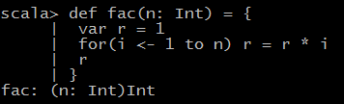
Functions
If the body of the function requires more than one expression, use a block.
The last expression of the block becomes the value that the function returns. For example, the following function returns the value of r after the for loop.
Notes:
There is no need for the return keyword in this example. It is possible to use return as in Java or C++, to exit a function immediately, but that is not commonly done
in Scala.
Note:
While there is nothing wrong with using return in a named function (except the waste of seven keystrokes), it is a good idea to get used to life without
return. Pretty soon, you will be using lots of anonymous functions, and there, return doesn’t return a value to the caller but breaks out to the enclosing
named function.

Slide 37
Functions
With a recursive function, you must specify the return type. For example,
Notes:
Without the return type, the Scala compiler couldn’t verify that the type of
n * fac(n - 1) is an Int.
Start from here

Slide 38
Default and Named Arguments
You can provide default arguments for functions that are used when you don’t specify explicit values. For example,
This function has two parameters, left and right, with default arguments “[“ and “]”
If you call decorate("Hello"), you get "[Hello]". If you don’t like the defaults, supply your own: decorate("Hello", "<<<", ">>>").
Notes:
If you supply fewer arguments than there are parameters, the defaults are applied from the end. For example, decorate("Hello", ">>>[") uses the default value of the
right parameter, yielding ">>>[Hello]".

Slide 39
Default and Named Arguments
You can also specify the parameter names when you supply the arguments. For example,
Note that the named arguments need not be in the same order as the parameters.
Notes:
Named arguments can make a function call more readable. They are also useful if a function has many default parameters.
You can mix unnamed and named arguments, provided the unnamed ones come first:
decorate("Hello", right = "]<<<") // Calls decorate("Hello", "[", "]<<<")

Slide 40
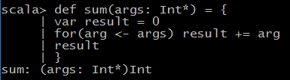

Variable Arguments
Sometimes, it is convenient to implement a function that can take a variable number of arguments. The following example shows the syntax:
You can call this function with as many arguments as you like.
Notes:
The function receives a single parameter of type Seq
If you already have a sequence of values, you cannot pass it directly to such a function. For example, the following is not correct:
val s = sum(1 to 5) // Error
If the sum function is called with one argument, that must be a single integer, not a range of integers. The remedy is to tell the compiler that you want the parameter
to be considered an argument sequence. Append : _*, like this:
val s = sum(1 to 5: _*) // Consider 1 to 5 as an argument sequence
This call syntax is needed in a recursive definition:
def recursiveSum(args: Int*) : Int = {
if (args.length == 0) 0
else args.head + recursiveSum(args.tail : _*)
}
Here, the head of a sequence is its initial element, and tail is a sequence of all other elements. That’s again a Seq, and we have to use : _* to convert it to an
argument sequence.

Slide 41

Procedures
If the function body is enclosed in braces without a preceding = symbol, then the return type is Unit. Such a function is called a procedure.
Notes:
A procedure returns no value, and you only call it for its side effect. For example, the following procedure prints a string inside
a box, like
-------
|Hello|
-------
Since the procedure doesn’t return any value, we omit the = symbol.
def box(s : String) { // Look carefully: no =
val border = "-" * (s.length + 2)
print(f"$border%n|$s|%n$border%n")
}
Some people (not me) dislike this concise syntax for procedures and suggest that you always use an explicit return type of Unit:
def box(s : String): Unit = {
...
}

Slide 42
Lazy Values
When a val is declared as lazy, its initialization is deferred until it is accessed for the first time. For example,
If the program never accesses words, the file is never opened.

Slide 43
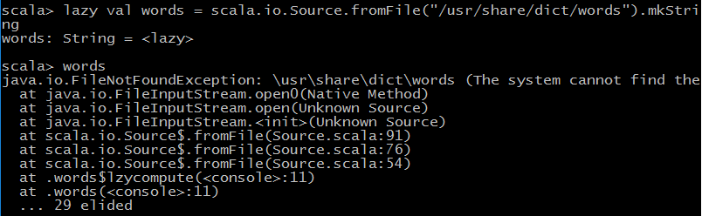
Lazy Values
There will be no error when the initialization statement is executed. However, if you access words, and file does not exist, you will get an error message that the file is not found.
Notes:
Lazy values are useful to delay costly initialization statements. They can also deal with other initialization issues, such as circular dependencies. Moreover,
they are essential for developing lazy data structures.
You can think of lazy values as halfway between val and def. Compare
val words = scala.io.Source.fromFile("/usr/share/dict/words").mkString
// Evaluated as soon as words is defined
lazy val words = scala.io.Source.fromFile("/usr/share/dict/words").mkString
// Evaluated the first time words is used
def words = scala.io.Source.fromFile("/usr/share/dict/words").mkString
// Evaluated every time words is used
NOTE:
Laziness is not cost-free. Every time a lazy value is accessed, a method is called that checks, in a threadsafe manner, whether the value has
already been initialized.

Slide 44
Exception
Scala exceptions work the same way as in Java or C++. When you throw an exception, for example
throw new IllegalArgumentException("x should not be negative")
the current computation is aborted, and the runtime system looks for an exception handler that can accept an IllegalArgumentException.
Notes:
As in Java, the objects that you throw need to belong to a subclass of java.lang.Throwable. However, unlike Java, Scala has no “checked” exceptions—you
never have to declare that a function or method might throw an exception.
A throw expression has the special type Nothing. That is useful in if/else expressions. If one branch has type Nothing, the type of the if/else expression is the type of the
other branch. For example, consider
if (x >= 0) { sqrt(x)
} else throw new IllegalArgumentException("x should not be negative")
The first branch has type Double, the second has type Nothing. Therefore, the if/else expression also has type Double.

Slide 45
Exception
The syntax for catching exceptions is modeled after the pattern matching syntax
val url = new URL("http://horstmann.com/fred-tiny.gif")
try {
process(url)
} catch {
case _: MalformedURLException => println(s"Bad URL: $url")
case ex: IOException => ex.printStackTrace()
}
Notes:
As in Java, the objects that you throw need to belong to a subclass of java.lang.Throwable. However, unlike Java, Scala has no “checked” exceptions—you
never have to declare that a function or method might throw an exception.
A throw expression has the special type Nothing. That is useful in if/else expressions. If one branch has type Nothing, the type of the if/else expression is the type of the
other branch. For example, consider
if (x >= 0) { sqrt(x)
} else throw new IllegalArgumentException("x should not be negative")
The first branch has type Double, the second has type Nothing. Therefore, the if/else expression also has type Double.
As in Java or C++, the more general exception types should come after the more specific ones.
Note that you can use _ for the variable name if you don’t need it.
The try/finally statement lets you dispose of a resource whether or not an exception has occurred. For example:
val in = new URL("http://horstmann.com/fred.gif").openStream()
try {
process(in)
} finally {
in.close()
}
Note that try/catch and try/finally have complementary goals. The try/catch statement handles exceptions, and the try/finally statement takes some action
(usually cleanup) when an exception is not handled. You can combine them into a single try/catch/finally statement:
try { ... } catch { ... } finally { ... }

Slide 46
Lab2: Control Structures and Functions

Slide 47
Arrays

Slide 48
Topics Covered
Array
ArrayBuffer
Traversing Array elements
Transforming to an array

Slide 49
Arrays
Array is a static data structure
In scala to use this data structure you need to use Array type for example
Notes:
Inside the JVM, a Scala Array is implemented as a Java array. The arrays in the preceding example have the type java.lang.String[] inside the JVM. An array of
Int, Double, or another equivalent of the Java primitive types is a primitive type array. For example, Array(2,3,5,7,11) is an int[] in the JVM.

Slide 50
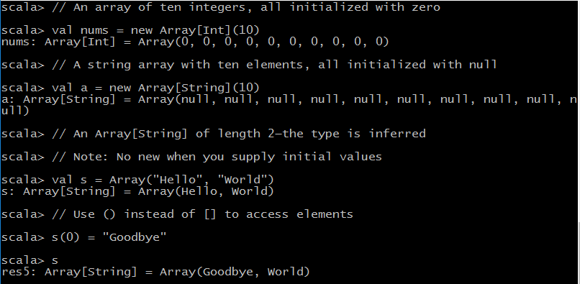
Arrays

Slide 51
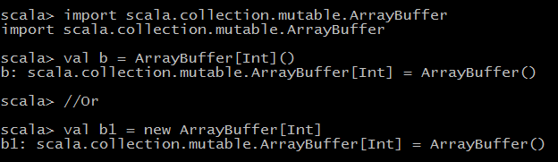
ArrayBuffer
ArrayBuffer is a dynamic data structure
Notes:
Java has ArrayList and C++ has vector for arrays that grow and shrink on demand. The equivalent in Scala is the ArrayBuffer.
// Add an element at the end with +=
b += 1
// ArrayBuffer(1)
// Add multiple elements at the end by enclosing them in parentheses
b += (1, 2, 3, 5)
// ArrayBuffer(1, 1, 2, 3, 5)
// You can append any collection with the ++= operator
b ++= Array(8, 13, 21)
// ArrayBuffer(1, 1, 2, 3, 5, 8, 13, 21)
// Removes the last five elements
b.trimEnd(5)
// ArrayBuffer(1, 1, 2)
Adding or removing elements at the end of an array buffer is an efficient operation.
You can also insert and remove elements at an arbitrary location, but those operations are not as efficient
For example:
// Insert before index 2
b.insert(2, 6)
// ArrayBuffer(1, 1, 6, 2)
// You can insert as many elements as you like
b.insert(2, 7, 8, 9)
// ArrayBuffer(1, 1, 7, 8, 9, 6, 2)
b.remove(2)
// ArrayBuffer(1, 1, 8, 9, 6, 2)
// The second parameter tells how many elements to remove
b.remove(2, 3)
// ArrayBuffer(1, 1, 2)

Slide 52
ArrayBuffer and Array
Sometimes, you want to build up an Array, but you don’t yet know how many elements you will need. In that case, first make an array buffer, then call toArray method on it:
b.toArray
Conversely, call toBuffer to convert the array a to an array buffer.
a.toBuffer

Slide 53
Traversing Array and ArrayBuffer
Here is how you traverse an array or array buffer with a for loop:
for (i <- 0 until a.length)
println(s"$i: ${a(i)}")
In general, the construct
for (i <- range)
makes the variable i traverse all values of the range.
Notes:
The until method is similar to the to method, except that it excludes the last value. Therefore, the variable i goes from 0 to a.length - 1.
To visit every second element, let i traverse
0 until a.length by 2
// Range(0, 2, 4, ...)
To visit the elements starting from the end of the array, traverse
0 until a.length by -1
// Range(..., 2, 1, 0)
Reference:-
Please see the API documentation of by method of scala.collection.immutable.Range
Please see the API documentation of until method of scala.runtime.RichInt

Slide 54
Traversing Array and ArrayBuffer
If you don’t need the array index in the loop body, visit the array elements directly:
for (elem <- a)
println(elem)
Notes:
This is similar to the “enhanced” for loop in Java or the “range-based” for loop in C++.

Slide 55

Transforming Array
It is easy to take an array (or array buffer) and transform it in some way. Such transformations don’t modify the original array but yield a new one. Use a for comprehension like this:
Notes:
The for/yield loop creates a new collection of the same type as the original collection. If you started with an array, you get another array. If you started with an
array buffer, that’s what you get from for/yield.
The result contains the expressions after the yield, one for each iteration of the loop.

Slide 56
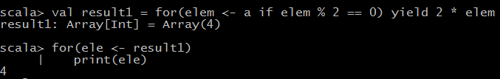
Transforming Array
Sometimes, when you traverse a collection, you only want to process the elements that match a particular condition. This is achieved with a guard: an if inside the for.
Here we double every even element, dropping the odd ones:
Notes:
NOTE:
Alternatively, you could write
a.filter(_ % 2 == 0).map(2 * _)
or even
a filter { _ % 2 == 0 } map { 2 * _ }
Some programmers with experience in functional programming prefer filter
and map to guards and yield. That’s just a matter of style—the for/yield loop
does exactly the same work. Use whichever you find easier.
Reference:-
Please see the API documentation of filter method of scala.Array
Please see the API documentation of map method of scala.Array
Suppose we want to remove all negative elements from an array buffer of integers. A traditional sequential solution might traverse the array buffer and remove
unwanted elements as they are encountered.
var n = a.length
var i = 0
while (i < n) {
if (a(i) >= 0) i += 1
else { a.remove(i); n -= 1 }
}
That’s a bit fussy—you have to remember not to increment i when you remove the element, and to decrement n instead. It is also not efficient to remove elements
from the middle of the array buffer. This loop unnecessarily moves elements that will later be removed.
In Scala, the obvious solution is to use a for/yield loop and keep all non-negative elements:
val result = for (elem <- a if elem >= 0) yield elem
The result is a new array buffer.
Suppose that we want to modify the original array buffer instead, removing the unwanted elements. Then we can collect their positions:
val positionsToRemove = for (i <- a.indices if a(i) < 0) yield i
Now remove the elements at those positions, starting from the back:
for (i <- positionsToRemove.reverse) a.remove(i)
Reference:-
Please see the API documentation of indices method of scala.Array

Slide 57
Some Common methods
Scala Doc | Description
def sum: A | Sums up the elements of this collection.
def max: A | Finds the largest element.
def sorted[B >: A](implicit ord: math.Ordering[B]): Array[T] | Sorts this mutable indexed sequence according to an Ordering
def sortWith(lt: (T, T) ⇒ Boolean): Array[T] | Sorts this mutable indexed sequence according to a comparison function
def mkString: String | Displays all elements of this mutable indexed sequence in a string.
def mkString(sep: String): String | Displays all elements of this mutable indexed sequence in a string using a separator string.
Notes:
Array(1, 7, 2, 9).sum
// 19
// Works for ArrayBuffer too
ArrayBuffer("Mary", "had", "a", "little", "lamb").max
// "little“
// Works for Array too
val b = ArrayBuffer(1, 7, 2, 9)
val bSorted = b.sorted
// b is unchanged; bSorted is ArrayBuffer(1, 2, 7, 9)
// Works for Array too
val bDescending = b.sortWith(_ > _) // ArrayBuffer(9, 7, 2, 1)
OR
val bDescending = b.sortWith((a, b) => a > b) // ArrayBuffer(9, 7, 2, 1)
// Works for Array too
//Each underscore denotes a separate parameter.
You can sort an array, but not an array buffer, in place:
val a = Array(1, 7, 2, 9)
scala.util.Sorting.quickSort(a)
// a is now Array(1, 2, 7, 9)
For the min, max, and quickSort methods, the element type must have a comparison operation. This is the case for numbers, strings, and other types with the Ordered
trait.
a.mkString(" and ")
// "1 and 2 and 7 and 9"
a.mkString("<", ",", ">")
// "<1,2,7,9>“
Contrast with toString:
a.toString
// "[I@b73e5"
// This is the useless toString method from Java
b.toString
// "ArrayBuffer(1, 7, 2, 9)"
// The toString method reports the type, which is useful for debugging
Some more methods to look for are
def count(p: (A) => Boolean): Int
def append(elems: A*): Unit
def appendAll(xs: TraversableOnce[A]): Unit
def containsSlice[B](that: GenSeq[B]): Boolean
def += (elem: A): ArrayBuffer.this.type
def copyToArray[B >: A] (xs: Array[B]): Unit
def sorted[B >: A] (implicit cmp: Ordering[B]): ArrayBuffer[A]
def ++:[B >: A, That](that: collection.Traversable[B])(implicit bf: CanBuildFrom[ArrayBuffer[A], B, That]): That

Slide 58
Multidimensional Array
A two-dimensional array of Double values has the type Array[Array[Double]].
To construct such an array, use the ofDim method:
val matrix = Array.ofDim[Double](3, 4) // Three rows, four columns
To access an element, use two pairs of parentheses:
matrix(row)(column) = 42
Notes:
You can make ragged arrays, with varying row lengths:
val triangle = new Array[Array[Int]](10)
for (i <- triangle.indices)
triangle(i) = new Array[Int](i + 1)
Interoperating with Java (Optional/SelfStudy)
-----------------------------
Since Scala arrays are implemented as Java arrays, you can pass them back and
forth between Java and Scala.
This works in almost all cases, except if the array element type isn’t an exact
match. In Java, an array of a given type is automatically converted to an array of
a supertype. For example, a Java String[] array can be passed to a method that
expects a Java Object[] array. Scala does not permit this automatic conversion
because it is unsafe.
Suppose you want to invoke a Java method with an Object[] parameter, such as
java.util.Arrays.binarySearch(Object[] a, Object key):
val a = Array("Mary", "a", "had", "lamb", "little")
java.util.Arrays.binarySearch(a, "beef") // Does not work
This does not work because Scala will not convert an Array[String] into an
Array[Object]. You can force the conversion like this:
java.util.Arrays.binarySearch(a.asInstanceOf[Array[Object]], "beef")
If you call a Java method that receives or returns a java.util.List, you could, of
course, use a Java ArrayList in your Scala code—but that is unattractive. Instead,
import the implicit conversion methods in scala.collection.JavaConversions. Then
you can use Scala buffers in your code, and they automatically get wrapped into
Java lists when calling a Java method.
For example, the java.lang.ProcessBuilder class has a constructor with a List<String>
parameter. Here is how you can call it from Scala:
import scala.collection.JavaConversions.bufferAsJavaList
import scala.collection.mutable.ArrayBuffer
val command = ArrayBuffer("ls", "-al", "/home/cay")
val pb = new ProcessBuilder(command) // Scala to Java
The Scala buffer is wrapped into an object of a Java class that implements the
java.util.List interface.
Conversely, when a Java method returns a java.util.List, you can have it
automatically converted into a Buffer:
import scala.collection.JavaConversions.asScalaBuffer
import scala.collection.mutable.Buffer
val cmd : Buffer[String] = pb.command() // Java to Scala
// You can’t use ArrayBuffer—the wrapped object is only guaranteed to be a Buffer
If the Java method returns a wrapped Scala buffer, then the implicit conversion
unwraps the original object. In our example, cmd == command.

Slide 59
Lab3: Arrays

Slide 60
Maps and Tuples

Slide 61
Topics Covered
Map
Traversing over Map
Sorted Maps
Tuples
Zipping

Slide 62
Constructing Map
You can construct a map as
If you want a mutable map, use
Notes:
If you want to start out with a blank map, you have to supply type parameters:
val scores = scala.collection.mutable.Map[String, Int]()
In Scala, a map is a collection of pairs. A pair is simply a grouping of two values,
not necessarily of the same type, such as ("Alice", 10).
The -> operator makes a pair. The value of
"Alice" -> 10
is
("Alice", 10)

Slide 63
Constructing Map
You could have equally well defined the map as
If you want to start out with a blank map, you have to supply type parameters:
Notes:
The -> operator is just a little easier on the eyes than the parentheses. It also supports the intuition that a map data structure is a kind of function that maps
keys to values. The difference is that a function computes values, and a map just looks them up.

Slide 64

Accessing Map Values
You use the () notation to look up key values
If the map doesn’t contain a value for the requested key, an exception is thrown

Slide 65

Accessing Map Values
To check whether there is a key with the given value, call the contains method:
This call combination is so common, there is a shortcut:
Notes:
If the map contains the key "Bob", return the value; otherwise, return 0.
Finally, the call map.get(key) returns an Option object that is either Some(value for key)
or None.
Given an immutable map, you can turn it into a map with a fixed default value for keys that are not present, or a function to compute such values.
val scores1 = scores.withDefaultValue(0)
val zeldasScore1 = scores1.get("Zelda")
// Yields 0 since "Zelda" is not present
val scores2 = scores.withDefault(_.length)
val zeldasScore2 = scores2.get("Zelda")
// Yields 5, applying the length function to the key that is not present

Slide 66
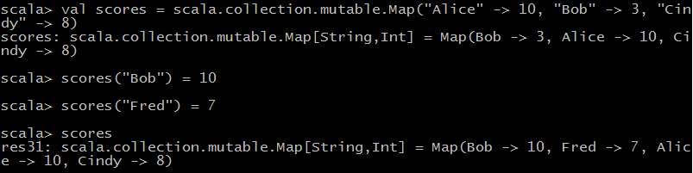
Updating Map Values
In a mutable map, you can update a map value, or add a new one, with a () to the left of an = sign:
Notes:
Alternatively, you can use the += operation to add multiple associations:
scores += ("Bob" -> 10, "Fred" -> 7)
You can’t update an immutable map, but you can do something that’s just as useful—obtain a new map that has the desired update:
val newScores = scores + ("Bob" -> 10, "Fred" -> 7) // New map with update
Instead of saving the result as a new value, you can update a var:
var scores = ...
scores = scores + ("Bob" -> 10, "Fred" -> 7)
You can even use the += operator:
scores += ("Bob" -> 10, "Fred" -> 7)

Slide 67
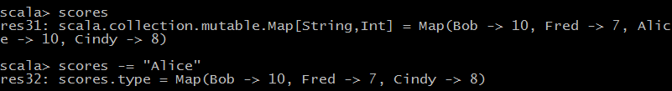
Updating Map Values
To remove a key and its associated value, use the -= operator:
Notes:
Similarly, to remove a key from an immutable map, use the - operator to obtain a new map without the key:
scores = scores - "Alice“
or
scores -= "Alice“

Slide 68
Iterating over Maps
The following simple loop iterates over all key/value pairs of a map:
for ((k, v) <- map) process k and v
The magic here is that you can use pattern matching in a Scala for loop. That way, you get the key and value of each pair in the map without tedious method calls.

Slide 69


Iterating over Maps
If you want to visit only the keys or values, use the keySet and values methods, as you would in Java.
The values method returns an Iterable that you can use in a for loop.
Notes:
To reverse a map—that is, switch keys and values—use
for ((k, v) <- map) yield (v, k)

Slide 70
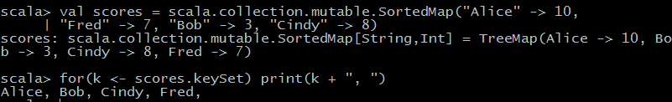
Sorted Maps
If you need to visit the keys in sorted order, use a SortedMap.
If you want to visit the keys in insertion order, use a LinkedHashMap.
Notes:
There are two common implementation strategies for maps: hash tables and balanced trees. Hash tables use the hash codes of the keys to scramble entries,
so iterating over the elements yields them in unpredictable order. By default, Scala gives you a map based on a hash table because it is usually more efficient.
If you want to visit the keys in insertion order, use a LinkedHashMap. For example:
val months = scala.collection.mutable.LinkedHashMap("January" -> 1, "February" -> 2, "March" -> 3, "April" -> 4, "May" -> 5, ...)
Interoperating with Java
---------------------------
If you get a Java map from calling a Java method, you may want to convert it to a Scala map so that you can use the pleasant Scala map API. This is also useful
if you want to work with a mutable tree map, which Scala doesn’t provide.
Simply add an import statement:
import scala.collection.JavaConversions.mapAsScalaMap
Then trigger the conversion by specifying the Scala map type:
val scores: scala.collection.mutable.Map[String, Int] = new java.util.TreeMap[String, Int]
In addition, you can get a conversion from java.util.Properties to a Map[String, String]:
import scala.collection.JavaConversions.propertiesAsScalaMap
val props: scala.collection.Map[String, String] = System.getProperties()
Conversely, to pass a Scala map to a method that expects a Java map, provide the opposite implicit conversion. For example:
import scala.collection.JavaConversions.mapAsJavaMap
import java.awt.font.TextAttribute._ // Import keys for map below
val attrs = Map(FAMILY -> "Serif", SIZE -> 12) // A Scala map
val font = new java.awt.Font(attrs) // Expects a Java map

Slide 71

Tuples
A tuple value is formed by enclosing individual values in parentheses. For example,
Notes:
Maps are collections of key/value pairs. Pairs are the simplest case of tuples— aggregates of values of different types.
(1, 3.14, "Fred") is a tuple of type
Tuple3[Int, Double, java.lang.String]
which is also written as
(Int, Double, java.lang.String)

Slide 72


Tuples
If you have a tuple, say,
then you can access its components with the methods _1,
_2, _3, for example:
Notes:
Unlike array or string positions, the component positions of a tuple start with 1, not 0.
NOTE: You can write t._2 as t _2 (with a space instead of a period), but not t_2.

Slide 73
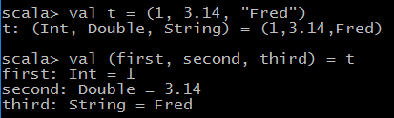
Tuples
Usually, it is better to use pattern matching to get at the components of a tuple, for example

Slide 74
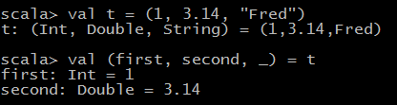
Tuples
You can use a _ if you don’t need all components:
Notes:
Tuples are useful for functions that return more than one value. For example, the partition method of the StringOps class returns a pair of strings, containing the
characters that fulfill a condition and those that don’t:
"New York".partition(_.isUpper) // Yields the pair ("NY", "ew ork")

Slide 75
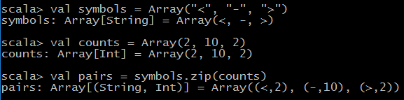
Zipping
One reason for using tuples is to bundle together values so that they can be processed together. This is commonly done with the zip method. For example, the following code yields an array of pair

Slide 76

Zipping
The pairs can then be processed together:
Notes:
Note : The toMap method turns a collection of pairs into a map. If you have a collection of keys and a parallel collection of values, zip them
up and turn them into a map like this:
keys.zip(values).toMap

Slide 77
Lab4: Maps and Tuples

Slide 78
Classes

Slide 79
Topics Covered
Simple classes and parameter less methods
Properties
Object private fields
Constructors
Nested classes

Slide 80

Simple Classes and Parameter less Methods

Slide 81
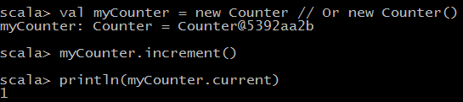
Simple Classes and Parameter less Methods
In Scala, a class is not declared as public. A Scala source file can contain multiple classes, and all of them have public visibility.
To use this class, you construct objects and invoke methods in the usual way:
Notes:
Which form should you use? It is considered good style to use () for a mutator method (a method that changes the object state), and to drop the () for an
accessor method (a method that does not change the object state). That’s what we did in our example:
myCounter.increment() // Use () with mutator
println(myCounter.current) // Don’t use () with accessor
You can enforce this style by declaring current without ():
class Counter {
...
def current = value // No () in definition
}
Now class users must use myCounter.current, without parentheses.

Slide 82

Simple Classes and Parameter less Methods
You can call a parameter less method (such as current) with or without parentheses:

Slide 83

Properties with Getters and Setters
Scala provides getter and setter methods for every field. Here, we define a public field:

Slide 84
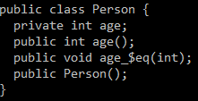
Properties with Getters and Setters
Scala generates a class for the JVM with a private age field and getter and setter methods. These methods are public because we did not declare age as private. (For a private field, the getter and setter methods are private.)
Notes:
In Scala, the getter and setter methods are called age and age_=.
In Scala, the getters and setters are not named getXxx and setXxx, but they fulfill the same purpose.
Note:- As you can see, the compiler created methods age and age_$eq. (The = symbol is translated to $eq because the JVM does not allow an = in a method name.)
At any time, you can redefine the getter and setter methods yourself. For example,
class Person {
private var privateAge = 0 // Make private and rename
def age = privateAge
def age_=(newValue: Int) {
if (newValue > privateAge) privateAge = newValue; // Can’t get younger
}
}
The user of your class still accesses fred.age, but now Fred can’t get younger:
val fred = new Person
fred.age = 30
fred.age = 21
println(fred.age) // 30
NOTE: Bertrand Meyer, the inventor of the influential Eiffel language,
formulated the Uniform Access Principle that states: “All services offered by
a module should be available through a uniform notation, which does not
betray whether they are implemented through storage or through computation.”
In Scala, the caller of fred.age doesn’t know whether age is implemented
through a field or a method. (Of course, in the JVM, the service is always
implemented through a method, either synthesized or programmer-supplied.)
Note: It may sound scary that Scala generates getter and setter methods for
every field. But you have some control over this process.
• If the field is private, the getter and setter are private.
• If the field is a val, only a getter is generated.
• If you don’t want any getter or setter, declare the field as private[this]

Slide 85
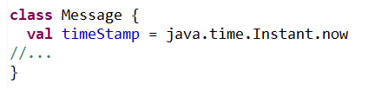
Properties with Only Getters
Sometimes you want a read-only property with a getter but no setter. If the value of the property never changes after the object has been constructed, use a val field:
Notes:
The Scala compiler produces a Java class with a private final field and a public getter method, but no setter.

Slide 86
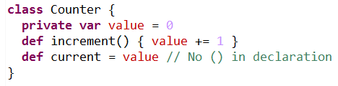
Properties with Only Getters
Provide a private field and a property getter if you don’t want a client to set it at will, but that is mutated in some other way
Notes:
To summarize, you have four choices for implementing properties:
1. var foo: Scala synthesizes a getter and a setter.
2. val foo: Scala synthesizes a getter.
3. You define methods foo and foo_=.
4. You define a method foo.
NOTE: In Scala, you cannot have a write-only property (that is, a property
with a setter and no getter).
Note:When you see a field in a Scala class, remember that it is not the same
as a field in Java or C++. It is a private field together with a getter (for a val
field) or a getter and a setter (for a var field).

Slide 87
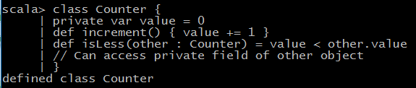
Object-Private Fields
In Scala (as well as in Java or C++), a method can access the private fields of all objects of its class. For example,
Accessing other.value is legal because other is also a Counter object.

Slide 88
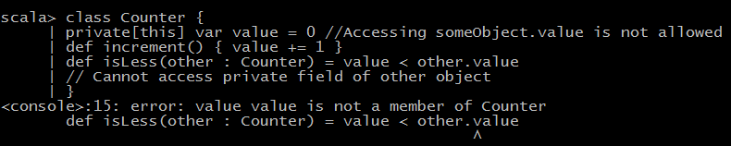
Object-Private Fields
Scala allows an even more severe access restriction with the private[this] qualifier:
Notes:
Now, the methods of the Counter class can only access the value field of the current object, not of other objects of type Counter.
This access is sometimes called object-private, and it is common in some OO languages such as SmallTalk.
With a class-private field, Scala generates private getter and setter methods. However, for an object-private field, no getters and setters are generated at all.
Scala allows you to grant access rights to specific classes. The private[ClassName] qualifier states that only methods of the given class can
access the given field. Here, the ClassName must be the name of the class being defined or an enclosing class.
class Counter1 {
class Counter2 {
var value = 0
def isLess(other : Counter1) = value < other.value
// Cannot access private field of other object
}
private[Counter1] var value = 0 //Accessing someObject.value is not allowed
def increment() { value += 1 }
}

Slide 89
Bean Properties
Scala provides getter and setter methods for the fields that you define. However, the names of these methods are not what Java tools expect.
The JavaBeans specification defines a Java property as a pair of getFoo/setFoo methods
Many Java tools rely on this naming convention.

Slide 90
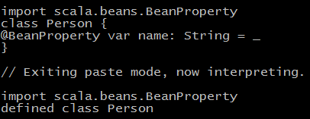
Bean Properties
When you annotate a Scala field with @BeanProperty, then such methods are automatically generated. For example,
Notes:
generates four methods are:
1. name: String
2. name_=(newValue: String): Unit
3. getName(): String
4. setName(newValue: String): Unit
Note:
Here var name: String = _ does initialization to default value
scala> var name: String = _
name: String = null

Slide 91
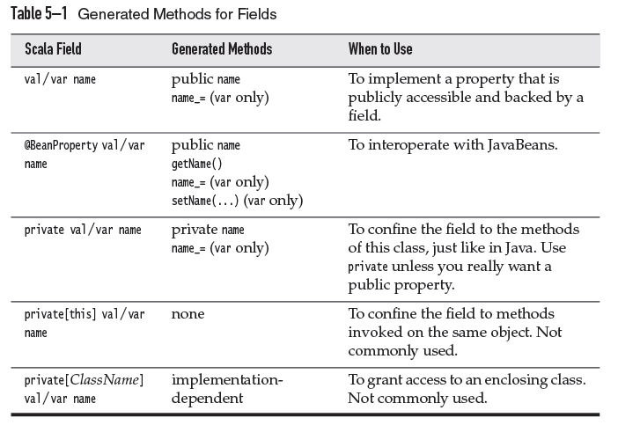
Summary of scala properties
Notes:
Courtesy – Scala for the impatient

Slide 92
Auxiliary Constructors
Auxiliary constructors are similar to constructors in Java or C++, with just two differences.
1. The auxiliary constructors are called this. (In Java or C++, constructors have the same name as the class—which is not so convenient if you rename the class.)
2. Each auxiliary constructor must start with a call to a previously defined auxiliary constructor or the primary constructor.

Slide 93
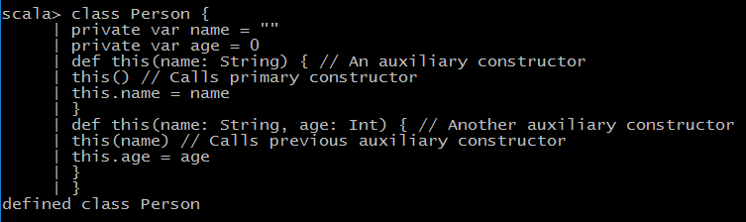
Auxiliary Constructors
Here is a class with two auxiliary constructors:
Notes:
Note:-
a class for which you don’t define a primary constructor has a primary constructor with no arguments.

Slide 94
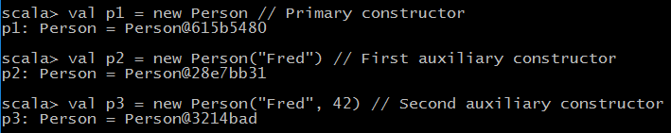
Auxiliary Constructors
You can construct objects of this class in three ways:
Notes:
Note:-
a class for which you don’t define a primary constructor has a primary constructor with no arguments.

Slide 95
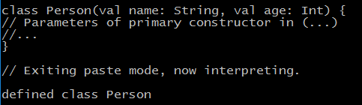
The Primary Constructor
In Scala, every class has a primary constructor. It is interwoven with the class definition
The parameters of the primary constructor are placed immediately after the class name.
Notes:
Parameters of the primary constructor turn into fields that are initialized with the construction parameters.
In our example, name and age become fields of the Person class. A constructor call such as new Person("Fred", 42) sets the name and age fields.

Slide 96
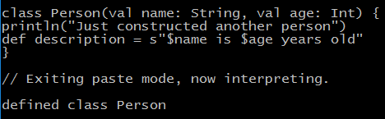

The Primary Constructor
The primary constructor executes all statements in the class definition. For example, in the following class
Notes:
NOTE 1:
If there are no parameters after the class name, then the class has a primary constructor with no parameters. That constructor simply executes all
statements in the body of the class.
NOTE 2: You can often eliminate auxiliary constructors by using default arguments in the primary constructor. For example:
class Person(val name: String = "", val age: Int = 0)

Slide 97
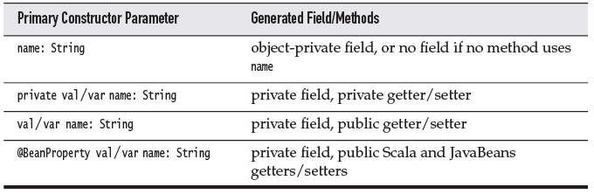
The Primary Constructor
Following table summarizes the fields and methods that are generated for different kinds of primary constructor parameters
Notes:
NOTE 1:
When you think of the primary constructor’s parameters as class parameters, parameters without val or var become easier to understand.The
scope of such a parameter is the entire class. Therefore, you can use the parameter in methods. If you do, it is the compiler’s job to save it in a field.
NOTE 2:
To make the primary constructor private, place the keyword private like this:
class Person private(val id: Int) { ... }
A class user must then use an auxiliary constructor to construct a Person object.

Slide 98
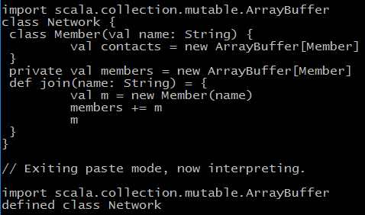
Nested Classes

Slide 99

Nested Classes
Consider two networks:
In Scala, each instance has its own class Member, just like each instance has its own field members. That is, chatter.Member and myFace.Member are different classes.
Notes:
NOTE:
This is different from Java, where an inner class belongs to the outer class.
The Scala approach is more regular. For example, to make a new inner object, you simply use new with the type name: new chatter.Member. In Java, you need
to use a special syntax, chatter.new Member().
In our network example, you can add a member within its own network, but not across networks.
val fred = chatter.join("Fred") //of type chatter.Member
val wilma = chatter.join("Wilma") //of type chatter.Member
fred.contacts += wilma // OK
val barney = myFace.join("Barney") // Has type myFace.Member
fred.contacts += barney
// No—can’t add a myFace.Member to a buffer of chatter.Member elements
If you don’t want it, there are two solutions.
you can move the Member type somewhere else. A good place would be the Network companion object.
object Network {
class Member(val name: String) {
val contacts = new ArrayBuffer[Member]
}
}
class Network {
private val members = new ArrayBuffer[Network.Member]
...
}
2) you can use a type projection Network#Member, which means “a Member of any Network.” For example,
class Network {
class Member(val name: String) {
val contacts = new ArrayBuffer[Network#Member]
}
...
}
NOTE:
In a nested class, you can access the this reference of the enclosing class as EnclosingClass.this, like in Java.
If you like, you can establish an alias for that reference with the following syntax:
class Network(val name: String) { outer =>
class Member(val name: String) {
...
def description = s"$name inside ${outer.name}"
}
}
The class Network { outer => syntax makes the variable outer refer to Network.this.You can choose any name for this variable. The name self is
common, but perhaps confusing when used with nested classes.

Slide 100
Lab5: Classes

Slide 101
Objects

Slide 102
Topics Covered
objects for singletons and utility methods
class and a companion object with the same name
Objects can extend classes or traits
apply method of an object for constructing new instances of the companion class
object that extends the App trait
Enumeration object

Slide 103
Singletons
Scala has no static methods or fields. Instead, you use the object construct.
An object defines a single instance of a class with the features that you want

Slide 104
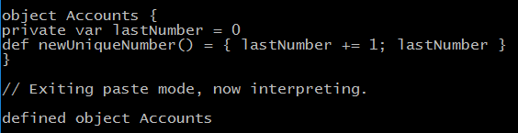
Singletons

Slide 105

Singletons
When you need a new unique account number in your application, call
The constructor of an object is executed when the object is first used.
In our example, the Accounts constructor is executed with the first call to Accounts.newUniqueNumber().
If an object is never used, its constructor is not executed.

Slide 106
Singletons
An object can have essentially all the features of a class—it can even extend other classes or traits.
There is just one exception: You cannot provide constructor parameters.
Notes:
Use an object in Scala whenever you would have used a singleton object in Java
or C++:
• As a home for utility functions or constants
• When a single immutable instance can be shared efficiently
• When a single instance is required to coordinate some service (the singleton
design pattern)

Slide 107
Companion Objects
In Java or C++, you often have a class with both instance methods and static methods.
In Scala, you can achieve this by having a class and a “companion” object of the same name. For example

Slide 108
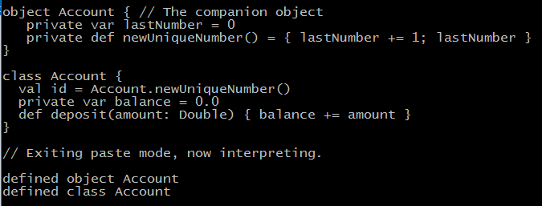
Companion Objects

Slide 109
Companion Objects
The class and its companion object can access each other’s private features.
They must be located in the same source file.
Notes:
Note that the companion object’s features are not in the scope of the class. For example, the Account class has to use Account.newUniqueNumber() and not just
newUniqueNumber() to invoke the method of the companion object.

Slide 110
Objects Extending a Class or Trait
An object can extend a class and/or one or more traits.
The result is an object of a class that extends the given class and/or traits, and in addition has all of the features specified in the object definition.
One useful application is to specify default objects that can be shared. For example

Slide 111
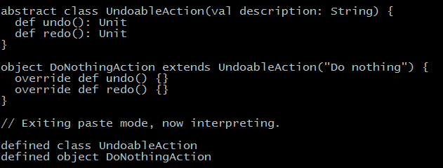
Objects Extending a Class or Trait

Slide 112
Objects Extending a Class or Trait
The DoNothingAction object can be shared across all places that need this default

Slide 113
The apply()
It is common to have objects with an apply method.
The apply method is called for expressions of the form
Object(arg1, ..., argN)
Typically, such an apply method returns an object of the companion class.

Slide 114
The apply()
For example, the Array object defines apply methods that allow array creation with expressions such as
Array("Mary", "had", "a", "little", "lamb")
Notes:
Why doesn’t one just use a constructor? Not having the new keyword is handy for nested expressions, such as
Array(Array(1, 7), Array(2, 9))
Note:
-------
It is easy to confuse Array(100) and new Array(100). The first expression calls apply(100), yielding an Array[Int] with a single element, the
integer 100. The second expression invokes the constructor this(100). The result is an Array[Nothing] with 100 null elements.

Slide 115
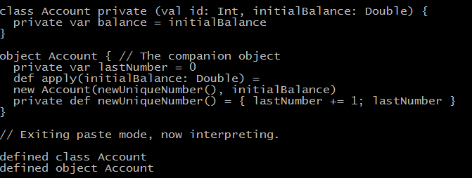
The apply()
Here is an example of defining an apply method:

Slide 116

The apply()
Now you can construct an account as

Slide 117
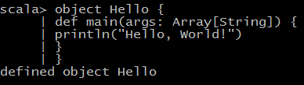
Application Objects
Each Scala program must start with an object’s main method of type Array[String] => Unit

Slide 118

Application Objects
Instead of providing a main method for your application, you can extend the App trait and place the program code into the constructor body:

Slide 119
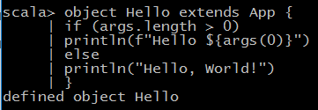
Application Objects
If you need the command-line arguments, you can get them from the args property:
Notes:
If you invoke the application with the scala.time option set, then the elapsed time is displayed when the program exits.
$ scalac Hello.scala
$ scala -Dscala.time Hello Fred
Hello, Fred
[total 4ms]
The App trait extends another trait, DelayedInit, that gets special handling from the compiler. All initialization code of a class with
that trait is moved into a delayedInit method. The main of the App trait method captures the command-line arguments, calls the delayedInit method, and optionally
prints the elapsed time.

Slide 120
Enumerations
Unlike Java or C++, Scala does not have enumerated types.
However, the standard library provides an Enumeration helper class that you can use to produce enumerations.

Slide 121

Enumerations
Define an object that extends the Enumeration class and initialize each value in your enumeration with a call to the Value method. For example,
Notes:
Here we define three fields, Red, Yellow, and Green, and initialize each of them with
a call to Value.
This is a shortcut for
val Red = Value
val Yellow = Value
val Green = Value
Each call to the Value method returns a new instance of an inner class, also called Value.
Alternatively, you can pass IDs, names, or both to the Value method:
val Red = Value(0, "Stop")
val Yellow = Value(10) // Name "Yellow"
val Green = Value("Go") // ID 11
If not specified, the ID is one more than the previously assigned one, starting with zero. The default name is the field name.
You can now refer to the enumeration values as TrafficLightColor.Red, TrafficLightColor.Yellow, and so on. If that gets too tedious, use
import TrafficLightColor._
Remember that the type of the enumeration is TrafficLightColor.Value and not TrafficLightColor—that’s the type of the object holding the values. Some people
recommend that you add a type alias
object TrafficLightColor extends Enumeration {
type TrafficLightColor = Value
val Red, Yellow, Green = Value
}
Now the type of the enumeration is TrafficLightColor.TrafficLightColor, which is
only an improvement if you use an import statement. For example,
import TrafficLightColor._
def doWhat(color: TrafficLightColor) = {
if (color == Red) "stop"
else if (color == Yellow) "hurry up"
else "go"
}
The ID of an enumeration value is returned by the id method, and its name by the
toString method.
The call TrafficLightColor.values yields a set of all values:
for (c <- TrafficLightColor.values) println(s"${c.id}: $c")
Finally, you can look up an enumeration value by its ID or name. Both of the
following yield the object TrafficLightColor.Red:
TrafficLightColor(0) // Calls Enumeration.apply
TrafficLightColor.withName("Red")

Slide 122
Lab6: Objects

Slide 123
Packages and Imports

Slide 124
Topics Covered
Packages nest just like inner classes
A package object can hold functions and variables
Import statements can import packages, classes, and objects
Import statements can rename and hide members

Slide 125
Packages
Packages in Scala fulfill the same purpose as packages in Java or namespaces in C++: to manage names in a large program.
To add items to a package, you can include them in package statements, such as:
Notes:
For example, the name Map can occur in the packages scala.collection.immutable and scala.collection.mutable without conflict.
To access either name, you can use the fully qualified scala.collection.immutable.Map or scala.collection.mutable.Map.
Alternatively, use an import statement to provide a shorter alias

Slide 126
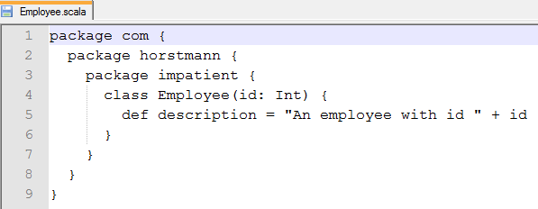
Packages
Then the class name Employee can be accessed anywhere as com.horstmann.impatient.Employee

Slide 127
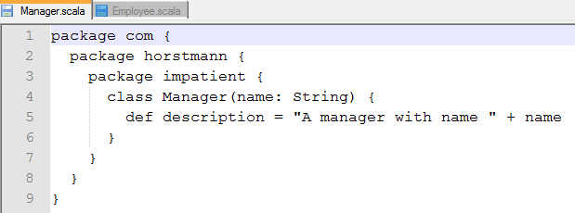
Packages
Unlike an object or a class, a package can be defined in multiple files.
The preceding code might be in a file Employee.scala, and a file Manager.scala might contain
Notes:
NOTE: There is no enforced relationship between the directory of the source
file and the package.You don’t have to put Employee.scala and Manager.scala
into a com/horstmann/impatient directory.

Slide 128
Packages
Conversely, you can contribute to more than one package in a single file.
The file Employee.scala may contain

Slide 129
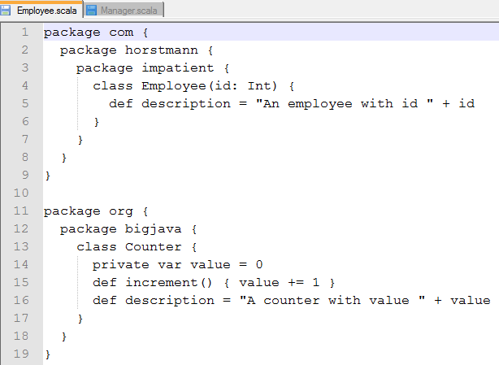
Packages

Slide 130
Demo 1: Packages
Notes:
Demo 1
$ cd demos/PackagesAndImports/sec01/src
$ scalac -d ../bin *.scala
$ scala –classpath ../bin Main

Slide 131
Scope Rules
Scala packages nest just like all other scopes.
You can access names from the enclosing scope. For example
Notes:
Demo steps

Slide 132
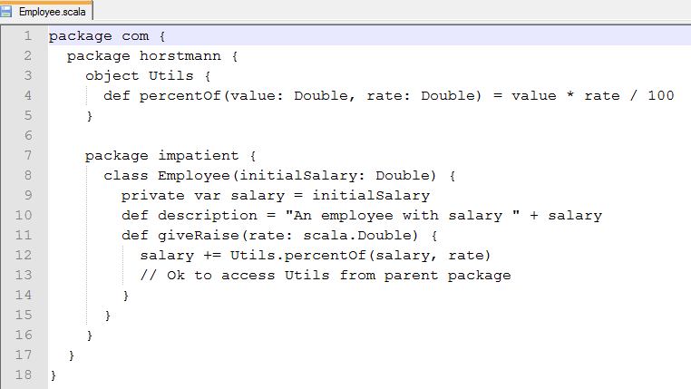
Scope Rules
Notes:
Demo steps

Slide 133
Scope Rules
Note the Utils.percentOf qualifier.
The Utils class was defined in the parent package.
Everything in the parent package is in scope, and it is not necessary to use com.horstmann.Utils.percentOf (You could, though, if you prefer—after all, com is also in scope.)
Notes:
There is a fly in the ointment, however. Consider
package com {
package horstmann {
package impatient {
class Manager {
val subordinates = new collection.mutable.ArrayBuffer[Employee]
...
}
}
}
}
This code takes advantage of the fact that the scala package is always imported. Therefore, the collection package is actually scala.collection.
And now suppose someone introduces the following package, perhaps in a different file:
package com {
package horstmann {
package collection {
...
}
}
}
Now the Manager class no longer compiles. It looks for a mutable member inside the com.horstmann.collection package and doesn’t find it.
The intent in the Manager class was the collection package in the top-level scala package, not whatever collection subpackage happened to
be in some accessible scope.
In Java, this problem can’t occur because package names are always absolute, starting at the root of the package hierarchy. But in Scala,
package names are relative.
One solution is to use absolute package names, starting with _root_, for example:
val subordinates = new _root_.scala.collection.mutable.ArrayBuffer[Employee]
Another approach is to use “chained” package clauses.

Slide 134
Demo 2: Scope Rules
Notes:
Demo 2
$ cd demos/PackagesAndImports/sec02/src
$ scalac -d ../bin *.scala
$ scala –classpath ../bin Main

Slide 135
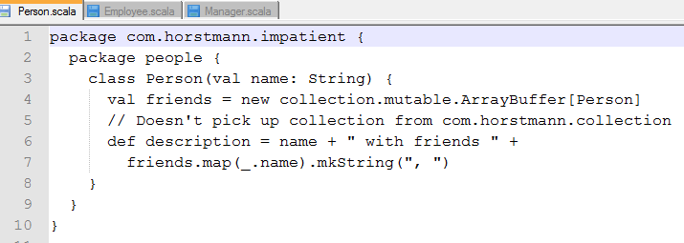
Chained Package Clauses
A package clause can contain a “chain,” or path segment, for example:

Slide 136
Chained Package Clauses
Such a clause limits the visible members.
Now a com.horstmann.collection package would no longer be accessible as collection:

Slide 137
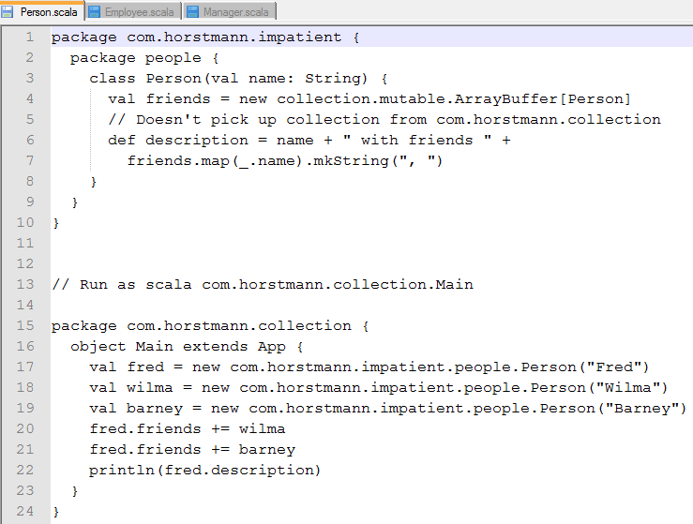
Chained Package Clauses

Slide 138
Demo 3: chained package clause
Notes:
Demo 2
$ cd demos/PackagesAndImports/sec03/src
$ scalac -d ../bin *.scala
$ scala –classpath ../bin com.horstmann.collection.Main

Slide 139
Top-of-File Notation
Instead of the nested notation that we have used up to now, you can have package clauses at the top of the file, without braces. For example:

Slide 140
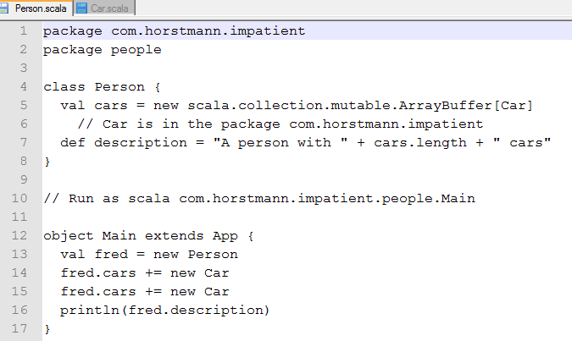
Top-of-File Notation

Slide 141
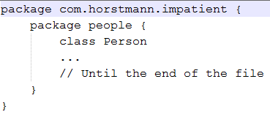
Top-of-File Notation
This is equivalent to

Slide 142
Top-of-File Notation
This is the preferred notation if all the code in the file belongs to the same package (which is the usual case).
Note that in the example above, everything in the file belongs to the package com.horstmann.impatient.people, but the package com.horstmann.impatient has also been opened up so you can refer to its contents

Slide 143
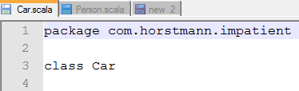
Top-of-File Notation

Slide 144
Demo 4: Top-of-file notation
Notes:
Demo 2
$ cd demos/PackagesAndImports/sec04/src
$ scalac -d ../bin *.scala
$ scala –classpath ../bin com.horstmann.impatient.people.Main

Slide 145
Package Objects
A package can contain classes, objects, and traits, but not the definitions of functions or variables
It would make more sense to add utility functions or constants to a package
Every package can have one package object. You define it in the parent package, and it has the same name as the child package. For example
Notes:
A package can contain classes, objects, and traits, but not the definitions of functions or variables. That’s an unfortunate limitation of the Java virtual machine.

Slide 146
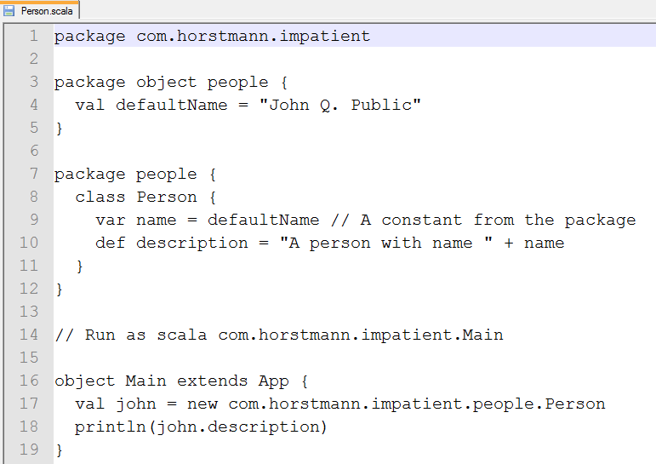
Package Objects
Notes:
A package can contain classes, objects, and traits, but not the definitions of functions or variables. That’s an unfortunate limitation of the Java virtual machine.

Slide 147
Package Objects
Note that the defaultName value didn’t need to be qualified because it was in the same package
Elsewhere, it is accessible as com.horstmann.impatient.people.defaultName
Notes:
A package can contain classes, objects, and traits, but not the definitions of functions or variables. That’s an unfortunate limitation of the Java virtual machine.
It is a good idea to use the same naming scheme for source files. Put the package object into a file com/horstmann/impatient/people/package.scala.
That way, anyone who wants to add functions or variables to a package can find the package object easily.

Slide 148
Demo 5: Package Objects
Notes:
Demo
$ cd demos/PackagesAndImports/sec05/src
$ scalac -d ../bin com/horstmann/impatient/people/*.scala
$ scala –classpath ../bin com.horstmann.impatient.Main

Slide 149
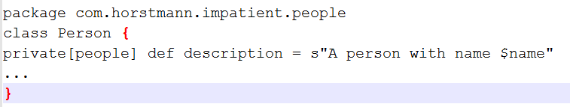
Package Visibility
In Java, a class member that isn’t declared as public, private, or protected is visible in the package containing the class.
In Scala, you can achieve the same effect with qualifiers.
The following method is visible in its own package:

Slide 150
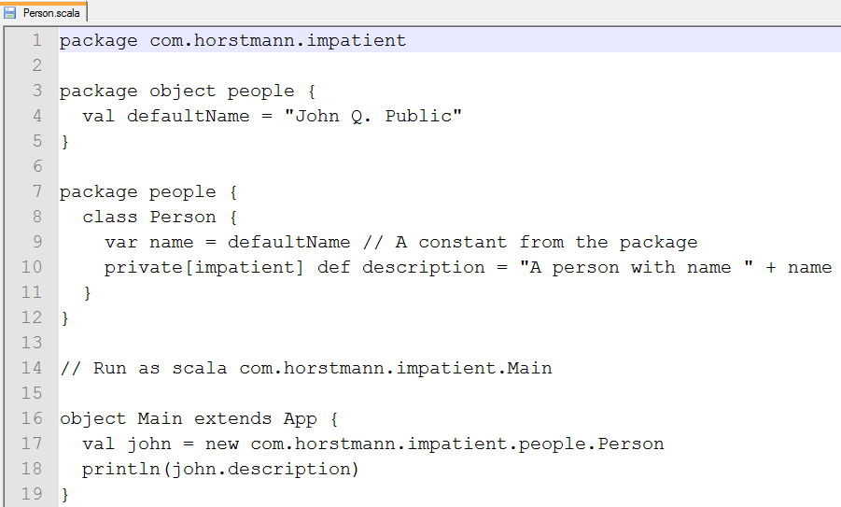
Package Visibility
You can extend the visibility to an enclosing package:

Slide 151
Demo 6: Package Objects
Notes:
Demo
$ cd demos/PackagesAndImports/sec06/src
$ scalac -d ../bin *.scala
$ scala –classpath ../bin com.horstmann.impatient.Main

Slide 152


Imports
Imports let you use short names instead of long ones. With the clause
you can write Color in your code instead of java.awt.Color.
That is the sole purpose of imports. If you don’t mind long names, you’ll never need them.

Slide 153


Imports
You can import all members of a package as
This is the same as the * wildcard in Java.
You can also import all members of a class or object.
Notes:
This is like import static in Java. Java programmers seem to live in fear of this variant, but in Scala it is commonly used.

Slide 154
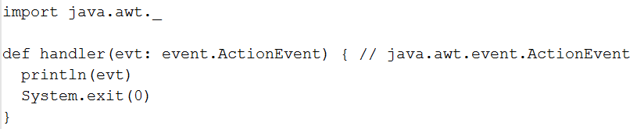
Imports
Once you import a package, you can access its subpackages with shorter names. For example:
The event package is a member of java.awt, and the import brings it into scope
Notes:
Demo
1) $ cd demos/PackagesAndImports/sec07

Slide 155
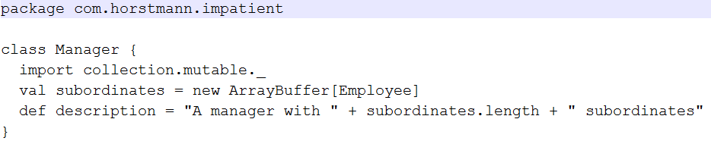
Imports Can Be Anywhere
In Scala, an import statement can be anywhere, not just at the top of a file.
The scope of the import statement extends until the end of the enclosing block. For example
Notes:
By putting the imports where they are needed, you can greatly reduce the potential for conflicts.

Slide 156
Demo 7: Imports Can Be Anywhere
Notes:
Demo
$ cd demos/PackagesAndImports/sec08/src
$ scalac -d ../bin *.scala
$ scala –classpath ../bin com.horstmann.impatient.Main

Slide 157


Renaming and Hiding Members
If you want to import more than one member from a package, use a selector like this:
The selector syntax lets you rename members:
Notes:
Now JavaHashMap is a java.util.HashMap and plain HashMap is a scala.collection.mutable.HashMap.

Slide 158

Renaming and Hiding Members
The selector HashMap => _ hides a member instead of renaming it. This is only useful if you import others:
Now HashMap unambiguously refers to scala.collection.mutable.HashMap since java.util.HashMap is hidden.

Slide 159
Demo 8: Renaming and Hiding Members

Slide 160

Implicit Imports
Every Scala program implicitly starts with
Finally, the Predef object is imported. It contains commonly used types, implicit conversions, and utility methods.
Notes:
As with Java programs, java.lang is always imported. Next, the scala package is imported, but in a special way. Unlike all other imports, this one is allowed
to override the preceding import. For example, scala.StringBuilder overrides java.lang.StringBuilder instead of conflicting with it.
The methods could equally well have been placed into the scala package object, but Predef was introduced before Scala had package objects.

Slide 161
Implicit Imports
Since the scala package is imported by default, you never need to write package names that start with scala. For example,
collection.mutable.HashMap is just as good as scala.collection.mutable.HashMap

Slide 162
Demo 9: Implicit Imports

Slide 163
Inheritance

Slide 164
Topics Covered
The extends and final keywords
override keyword
Constructor chaining
Overriding fields

