Slide 1
Nest-n-Cabins
A Home away from Home
Made By:-
Amit Khowal
Hemant

Slide 2
Week 1:-
Problem Statement.
Problem Formulation.
Requirements.
Feasibility
Technical implementation

Slide 3
Week 2:-
Topic Finalization
Project Proposal
Gathering the Resources

Slide 4
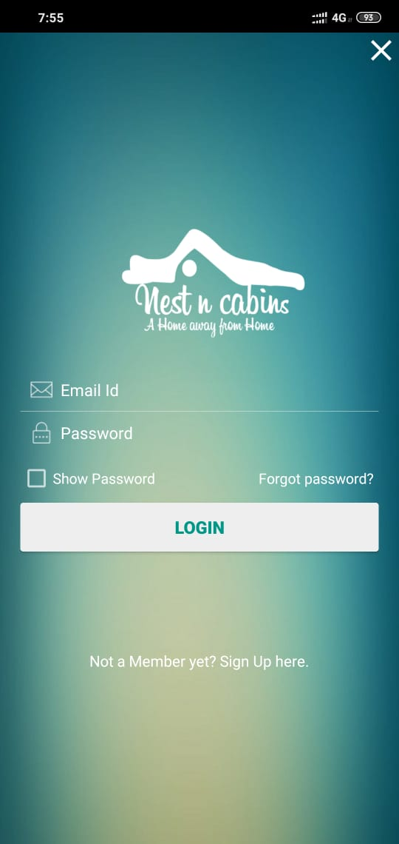
Week 3:-
Started coding
Implementing Login page
Adding attributes
Username and Password

Slide 5
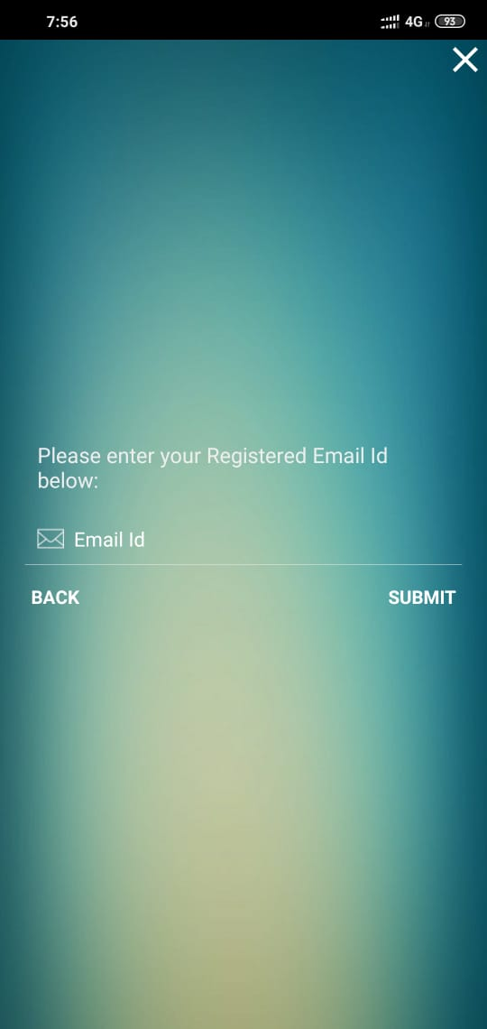
Week 4:-
Login Page Attributes like forgot password
Signup page---->

Slide 6
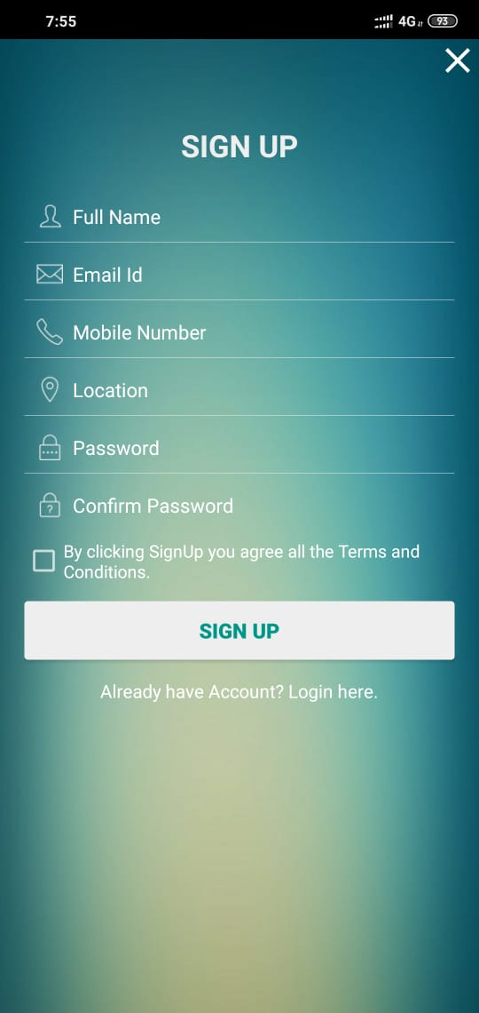
Week 4:-
Forgot Password Page

Slide 7
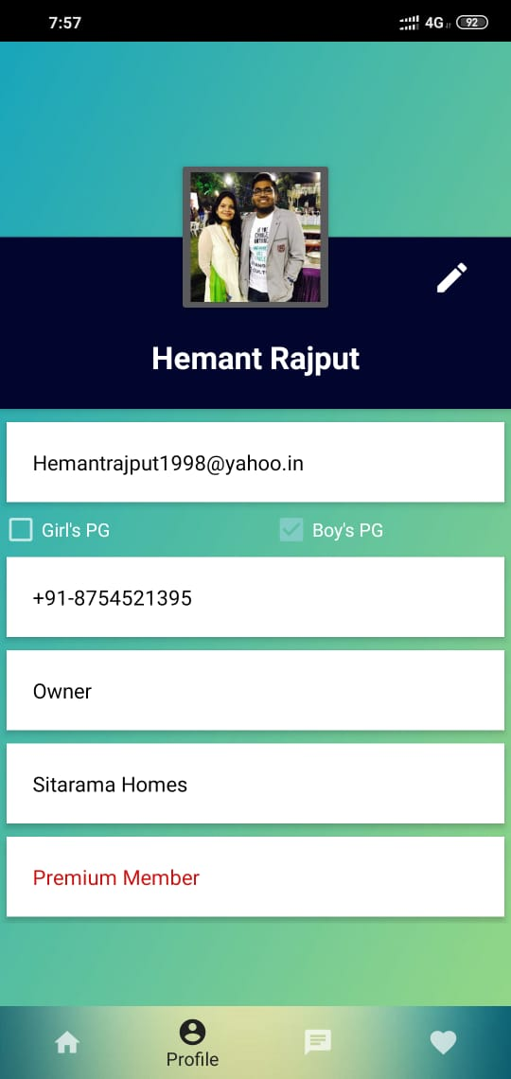
Week 5:-
Profile Page Making

Slide 8
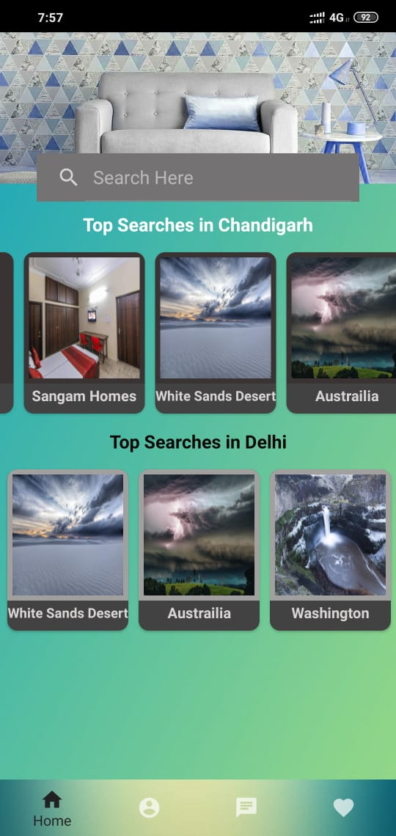
Week 6:-
Searching area
Top Searches in Cities

