Slide 1
Data Science Master-Class

Slide 2
MDLC – Model development lifecycle CRISP - DM
Req gathering
Data gathering -- DE
Model Selection
Development + Training – coding –java R python
Testing accuracy
Release – Production deploy – DevOps
Production support teams
FULL STACK developer

Slide 3
Data Engineer + Data Scientist + DevOps
Java software development kit – swift ios
Models--- mdk software--- pandas/numpy/stasmodel/sklearn
CART – CARET – DTREE -- RPART
ABC – DTREE RPART_ng - ABCDTREE---DS – DTREE--ABCDTREE
MDK

Slide 4
BREAK till 6:20 PM
Machine Learning
Supervised ML
UnSupervised ML
Regression
Linear Regression
OLS
WLS
GLS
Ridge Regression
Lasso Regression
ElasticNet
Classification
Logistic Regression –LOGIT Function - y=mx+c
KNN
Naïve Bayes– Bayes Theorem- Conditional probability
10 SVM -- ensemble- NOT RF
6 KNN + 4 SVM --ensemble
10 DTREE – ensemble + RF
Decision Trees
Ensemble models:
Bagging --- RF
Boosting -- XGBoost/GBM
Clustering Models
Mixture Models
Association Rule mining
Market Basket Analysis
UP-SELL
Recommendation engine
Dimensionality Reduction

Slide 5
Supervised ML
Regression
Linear Regression
OLS
WLS
GLS
Ridge Regression
Lasso Regression
KNN
DTrees
Ensemble models:
Bagging
Boosting

Slide 6
Linear Regression

Slide 7
KNN K Nearest Neighbor Model K=3/5/7/9
Distance Metric
Manhattan
Euclidean
Minkowski
Mahalonobis

Slide 8
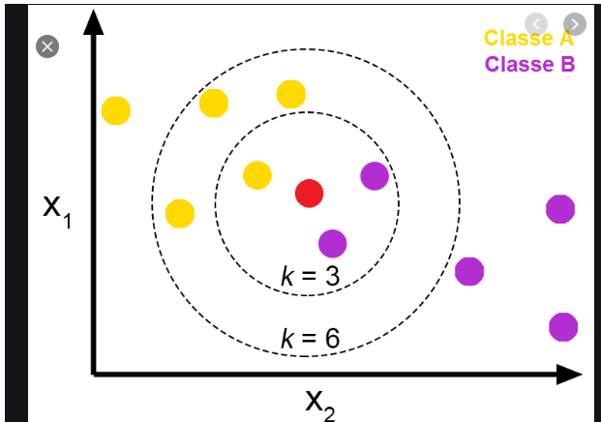
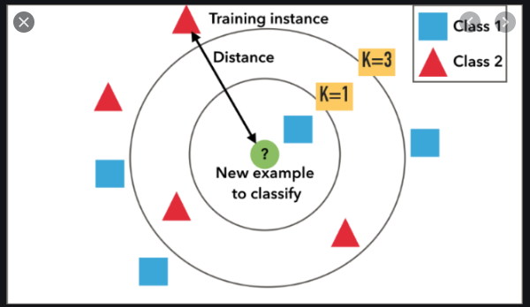

Slide 9
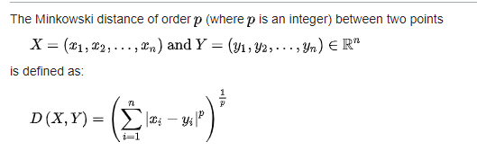
Minkoswki -- general – p variable
p = 1, Manhattan Distance
p = 2, Euclidean Distance
p = ∞, Chebychev Distance
Notes:
References:
https://en.wikipedia.org/wiki/Minkowski_distance
https://www.google.com/search?q=euclidean+distance+formula&sxsrf=ALeKk034gv_J8YTFM_jN39ltfugmhqiIFQ:1592652614839&source=lnms&tbm=isch&sa=X&ved=2ahUKEwjbm-6qpZDqAhUROisKHc-3CV4Q_AUoAXoECBEQAw&biw=1366&bih=625

Slide 10
Supervised ML
Classification
Logistic Regression
KNN
Naïve Bayes
SVM
Decision Trees
Ensemble models:
Bagging
Boosting

Slide 11
UnSupervised ML
Clustering
Mixture Models
Market Basket Analysis
AR mining
Dimensionality Reduction

