Slide 1

Combating Pilot Contamination
EE632: Advance Topics in Communication
UNDER THE SUPERVISION
PRESENTED BY
1. Simran Raj (234102014)
2. Amit Kumar Yadav (234102005)
Dr. Manoj BR
Assistant Professor
EEE Department

Slide 2
Research Papers
Combating Inter-Operator Pilot Contamination in Reconfigurable Intelligent Surfaces Assisted Multi-Operator Networks ( Base paper)
Mitigating Pilot Contamination by Pilot Reuse and Power Control Schemes for Massive MIMO Systems
Rayleigh Fading Modeling and Channel Hardening for Reconfigurable Intelligent Surfaces

Slide 3

Layouts :-
Introduction
System Model
Channel Analysis
Pilot Contamination Avoiding
Rayleigh Fading Modeling
Channel Hardening
Conclusion

Slide 4
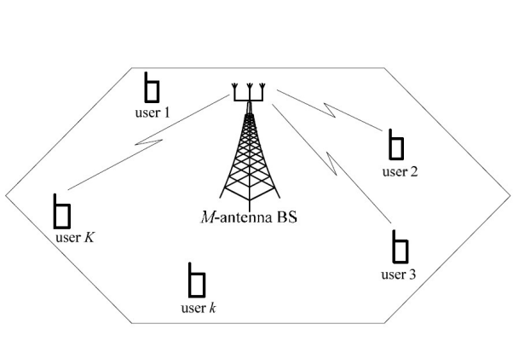
Introduction
Combating Inter-Operator Pilot Contamination in Reconfigurable Intelligent Surfaces (RIS)
Mitigating Pilot Contamination by Pilot Reuse and Power Control Schemes
Rayleigh Fading Modeling and Channel Hardening for Reconfigurable Intelligent Surfaces

Slide 5
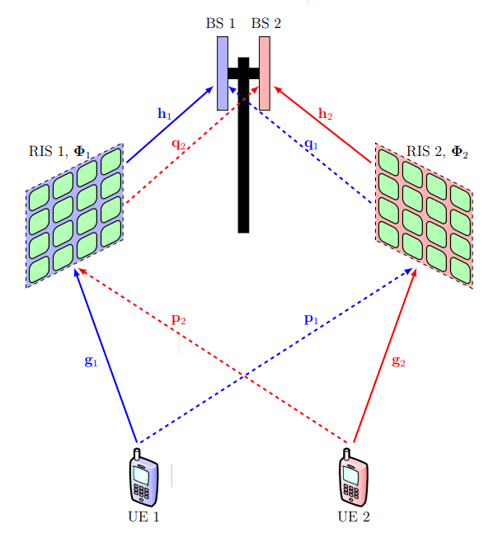
System Model
Pilot Contamination caused by presence of Reflecting configurable surfaces
Fig1 : The considered setup with two UEs, two RISs, and two co-located single-antenna BSs

Slide 6
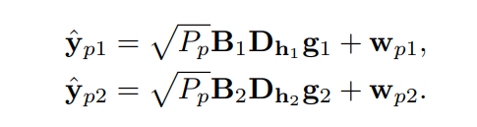
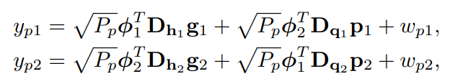
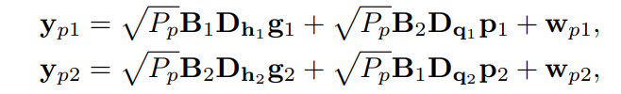
Pilot Contamination caused by presence of Reflecting configurable surfaces
1. Received signal model at the base station
……(1)
……(2)
……(3)
Fig1 : The considered setup with two UEs, two RISs, and two co-located single-antenna BSs

Slide 7
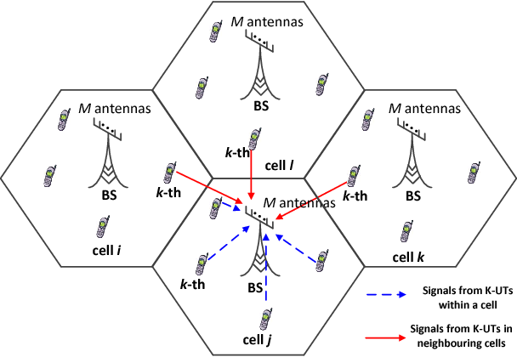
Mitigating Pilot Contamination by Pilot Reuse in Massive MIMO system
System Model
Fig2 : Massive MIMO system

Slide 8

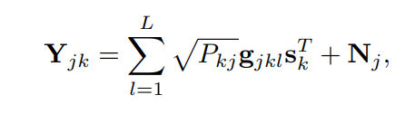
Mitigating Pilot Contamination by Pilot Reuse in Massive MIMO system
A. Pilot Signal Model and Channel Estimation
1. Pilot sequences
……(4)
2. Received signal matrix at the jth BS due to kth pilot sequence
……(5)
Fig2 : Massive MIMO system

Slide 9
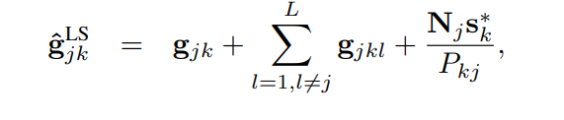


Mitigating Pilot Contamination by Pilot Reuse in Massive MIMO system
3. Uplink channel vector estimated by least square and MMSE
……(6)
……(7)
Fig2 : Massive MIMO system

Slide 10
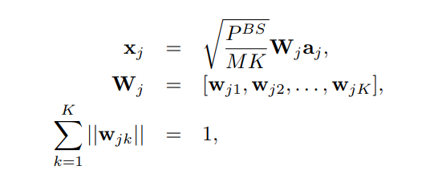


Mitigating Pilot Contamination by Pilot Reuse in Massive MIMO system
B. Downlink Signal Model
1. Downlink signal model at jth cell
……(8)
2. User specified weight vector
Fig2 : Massive MIMO system
……(9)

Slide 11
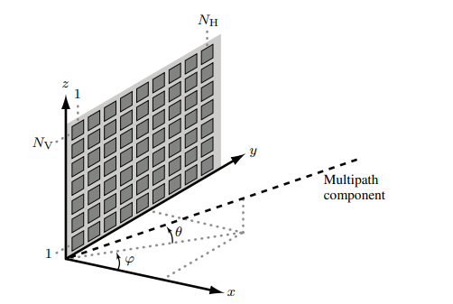
Rayleigh Fading Modeling in Reconfigurable Intelligent Surfaces
System Model
Fig3 : The 3D geometry of an RIS consisting of NH elements per row and NV elements per column.

Slide 12




Rayleigh Fading Modeling in Reconfigurable Intelligent Surfaces
1. Received signal
……(10)
2. Probability density function
……(11)
3. Location of nth element from origin
Fig3 : The 3D geometry of an RIS consisting of NH elements per row and NV elements per column.

Slide 13
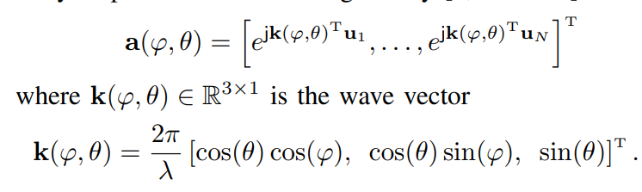
Rayleigh Fading Modeling in Reconfigurable Intelligent Surfaces
4. Array response vector
……(12)

Slide 14
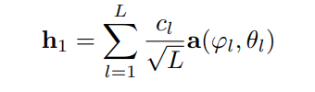



Rayleigh Fading modeling
Here, we will derive the fading distribution for the channels h1, h2 and characterize their spatial channel correlation
Channels are independently distributed.
There are infinitely many multipath components in an isotropic scattering environment
Signal attenuation constant
……(13)

Slide 15
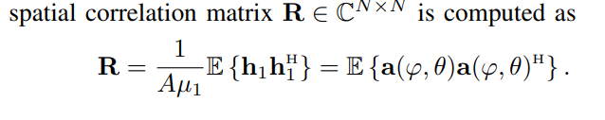
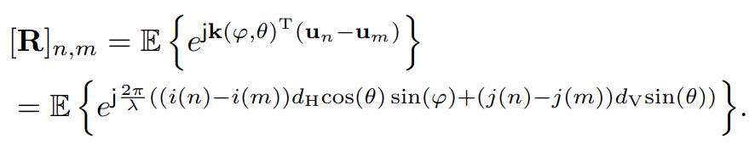
Rayleigh Fading modeling
……(14)
For (n,m) element of Correlation matrix
……(15)

Slide 16

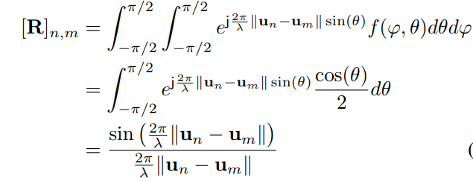
Rayleigh Fading modeling
With isotropic scattering in the half-space in front of the RIS, the spatial correlation matrix R
……(16)

Slide 17


Rayleigh Fading modeling
2. In an isotropic scattering environment, h1, h2 are independent and distributed as
3. The average received signal power at the RIS if R is an identity matrix
……(17)
since tr (R) = N and it is proportional to the total RIS area NA.

Slide 18
Channel Analysis

Slide 19
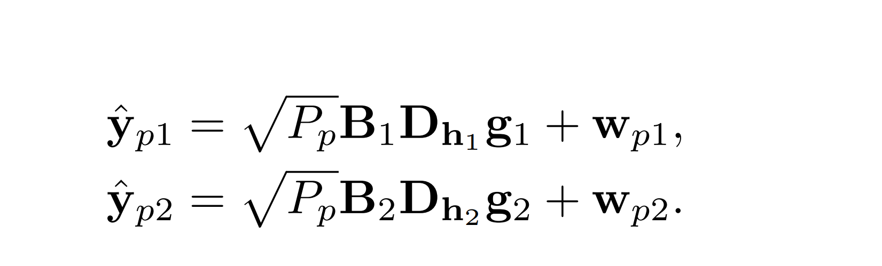
Maximum Likelihood Estimation of Deterministic Channels
Channel estimation for deterministic channels.
Received signal models assumed by the BSs as.
(1a)
(1b)
Assumptions=?

Slide 20
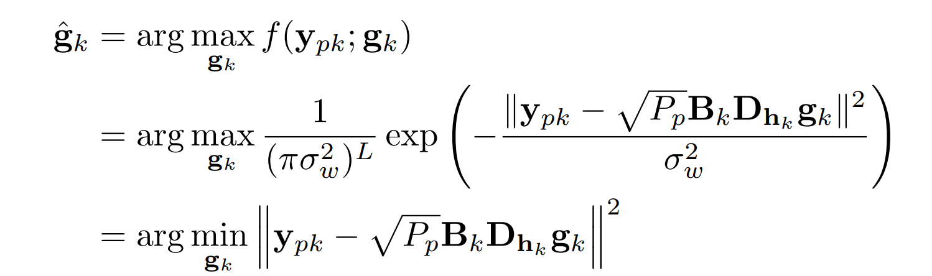
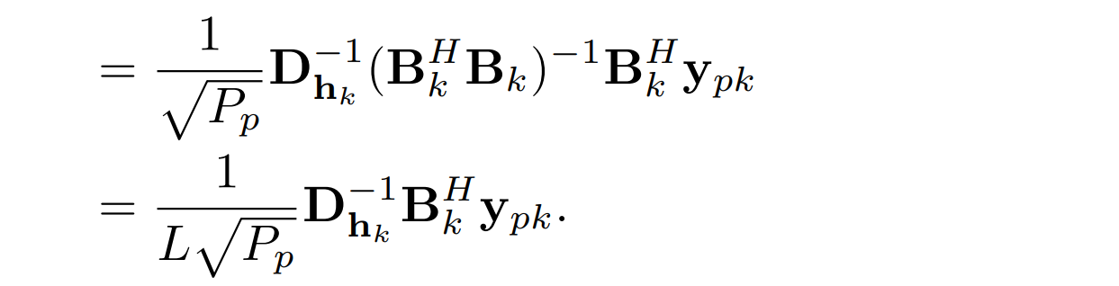
MML estimator
(2)
Now we discuss the behaviour of this estimator for two different choices of Bk matrices.

Slide 21

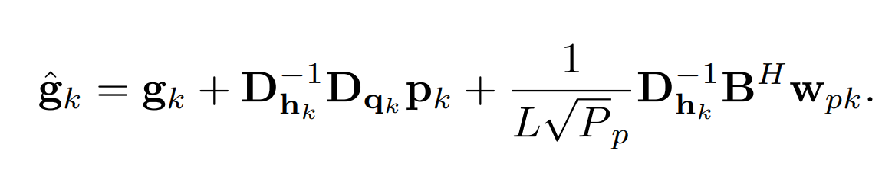
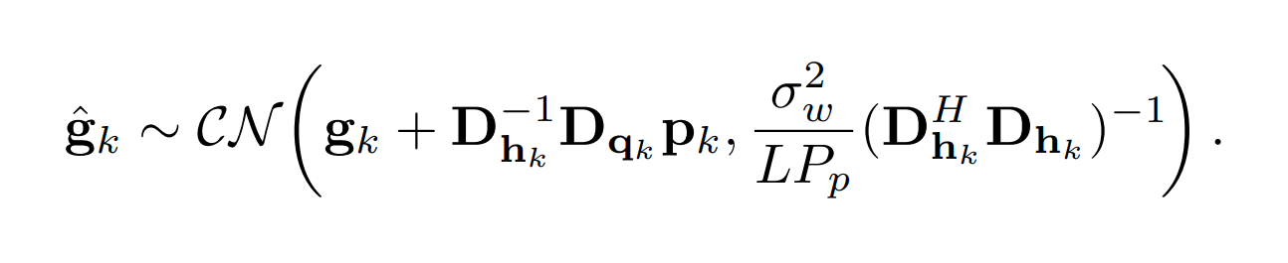

Case 1: The RISs Adopt the Same Configuration Sequence i.e

Slide 22
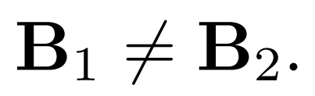
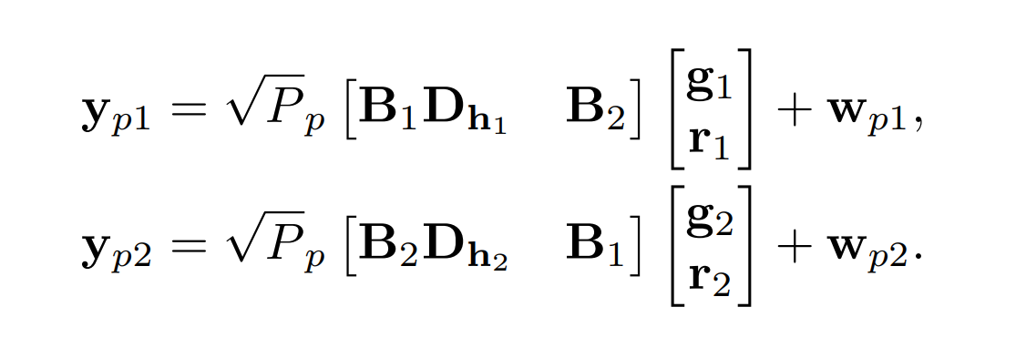
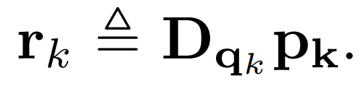
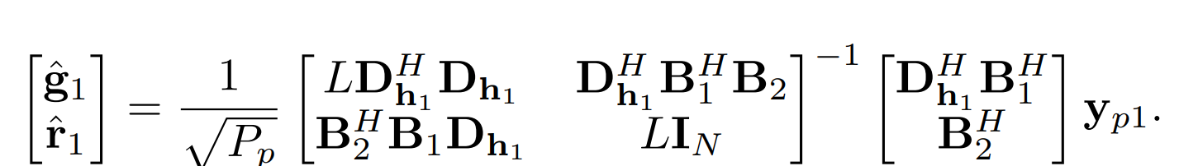
Case 2: The RISs Adopt Different Configuration Sequences i.e
(3a)
(3b)
(4)

Slide 23

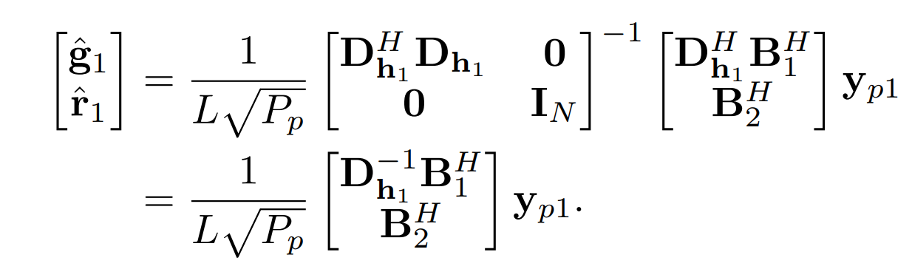
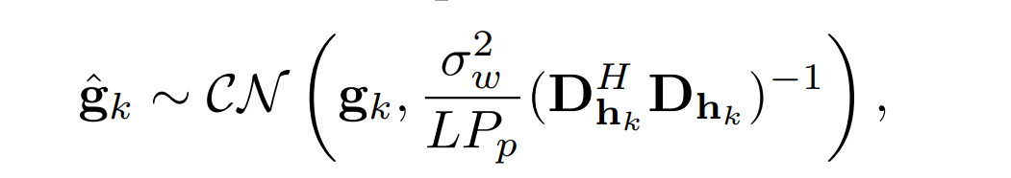
(3)
What it concludes=?

Slide 24
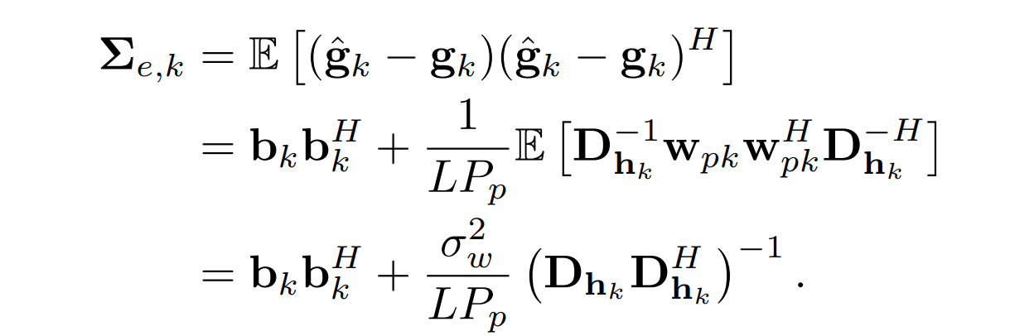
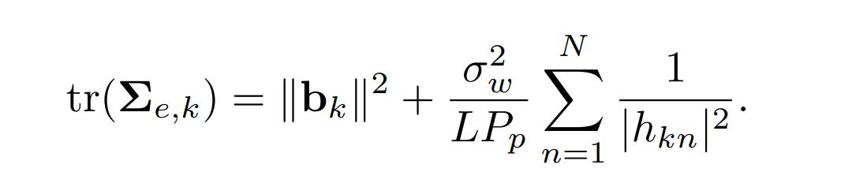
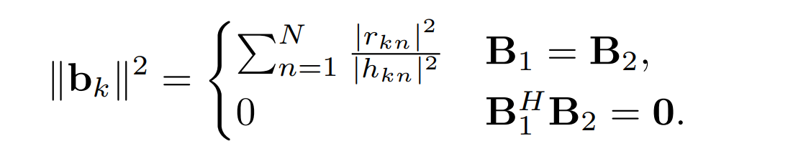
C. MSE During Channel Estimation
What it shows=?

Slide 25



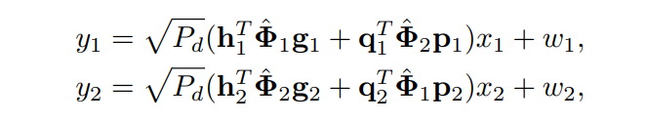
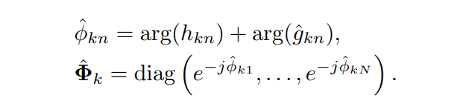
IV. Data Signal Estimation with Deterministic Channels
The data signal transmitted by the kth UE is
We can express the received data as
(5a)
(5b)

Slide 26
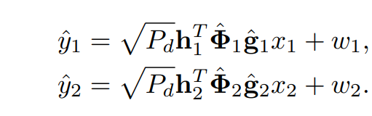


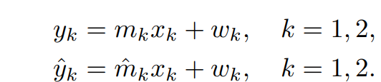
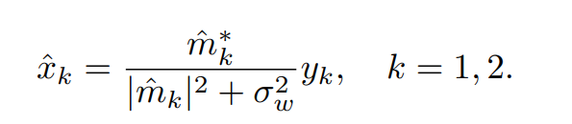
What happens at base station ?
(6a)
(6b)
(5)
(6)

Slide 27
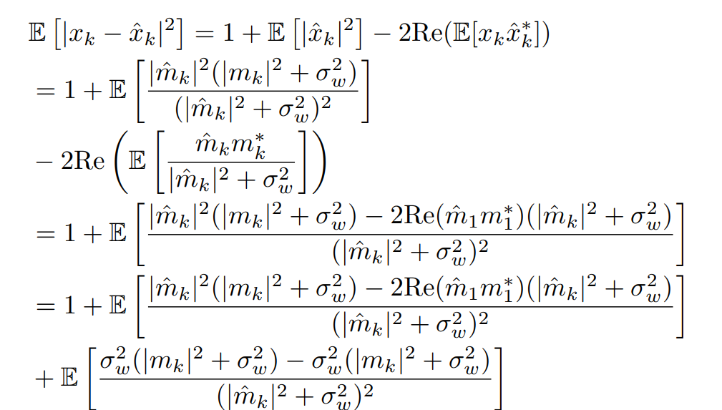
Data estimation MSE for UE k

Slide 28
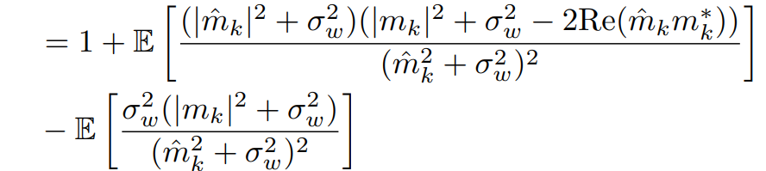
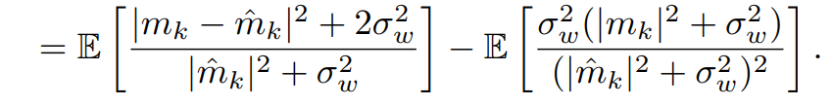

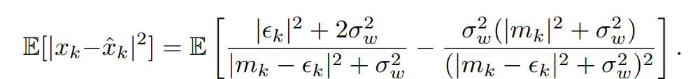

Slide 29

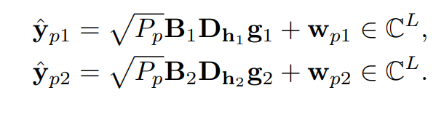
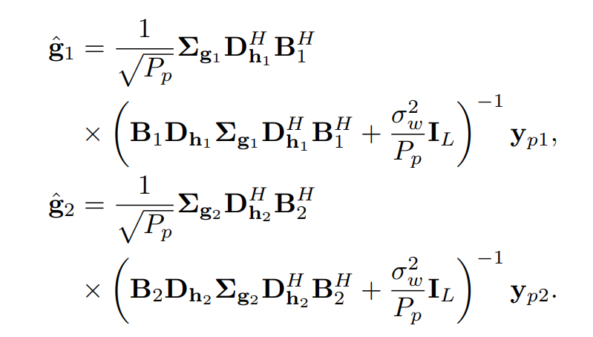

Channel Estimation Based on Correlated Rayleigh Fading Priors

Slide 30



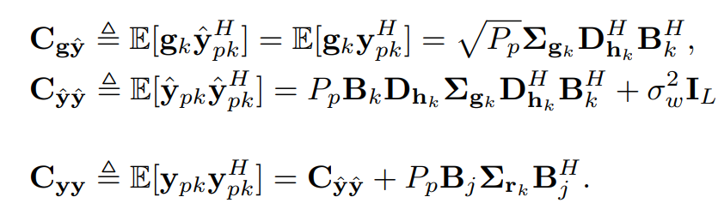
To simplify the notation of channel estimation error covariance matrix , we introduce the following notations

Slide 31
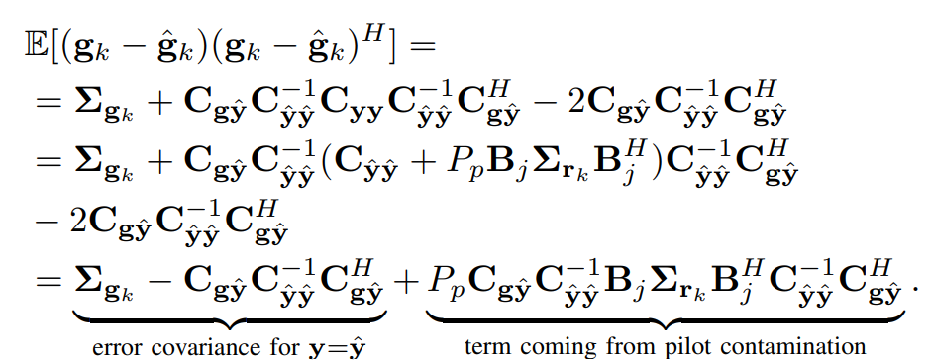
With this notation error covariance matrix can be represented as

Slide 32
PILOT CONTAMINATION AVOIDING AND MITIGATION SCHEMES
Pilot Power Control
Corrdinated Pilot Allocation

Slide 33
A. Pilot Power control

Slide 34
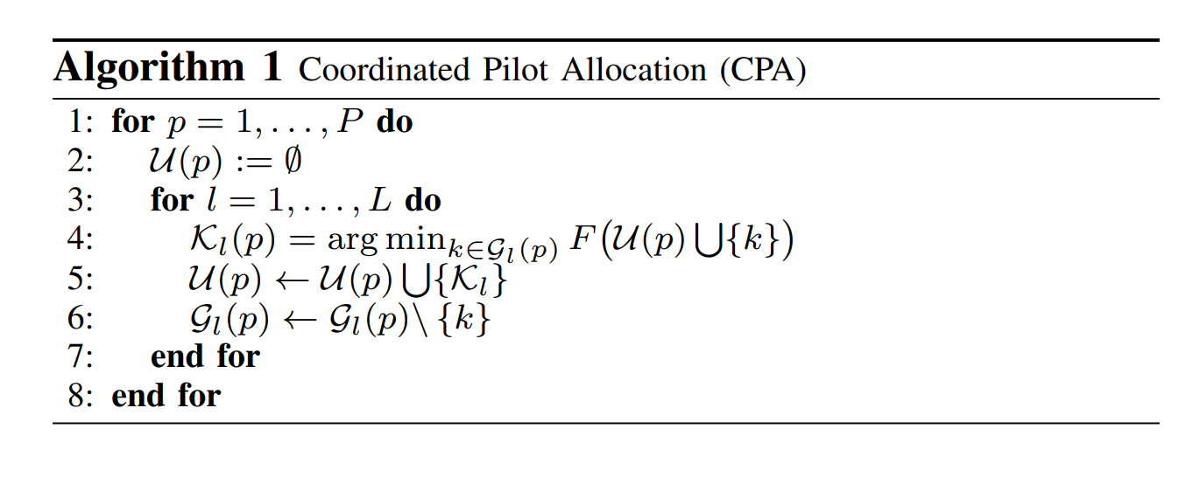
B. Corrdinated pilot allocation

Slide 35
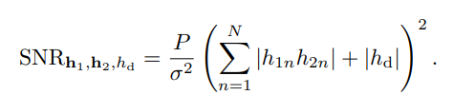
Channel Hardening

Slide 36
Conclusion :-
performance analysis based on eigenvalues provides valuable insights into the spatial characteristics and capacity limitations of RIS-assisted communication systems. By leveraging eigenvalue information, one can design efficient communication strategies, optimize system parameters, and improve overall system performance. Conclusion , aims to enhance effiencieny and overall performance of MIMO bu decreasing athe adverse effect of pilot contamination

