Slide 1
ASP.NET Core*
A Quick Overview of ASP.NET Core
Shahed Chowdhuri
Sr. Technical Evangelist @ Microsoft
@shahedC
WakeUpAndCode.com
* aka ASP.NET 5 before RC1

Slide 2
Evolution of ASP and ASP .NET
Active Server Pages
(Classic ASP)
Active Server Pages
(Classic ASP)
ASP.NET
MVC
1/2/3/4/5
ASP.NET
MVC
1/2/3/4/5
ASP.NET
MVC 6
Unified MVC, Web API and Web Pages
ASP.NET
(Web Forms)
ASP.NET
MVC 6
Core MVC
Unified MVC, Web API and Web Pages
ASP.NET
(Web Forms)
ASP.NET
Web Pages
ASP.NET
Web Pages
ASP.NET
Web API
ASP.NET
Web API

Slide 3
Names & Version Numbers
ASP.NET
MVC 6
C# 6.0
ASP.NET
MVC 6
Core MVC
C# 6.0
ASP.NET 5
(runs on .NET Core 5 or .NET Framework 4.5.2+)
ASP.NET 5 Core 1.0
(runs on .NET Core 5 1.0
or .NET Framework 4.5.2+)
SignalR 3
SignalR 3
.NET Framework 4.6
.NET Core 5
.NET Core 1.0
.NET Framework 4.6
.NET Core 5

Slide 4
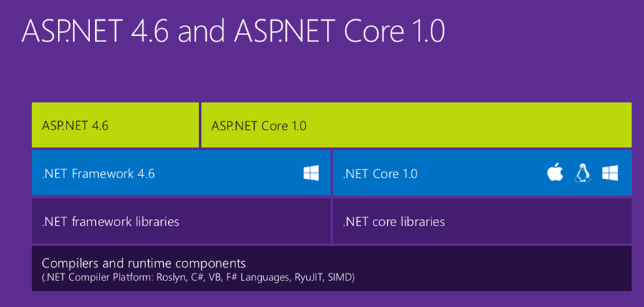
ASP.NET Core High-Level Overview

Slide 5
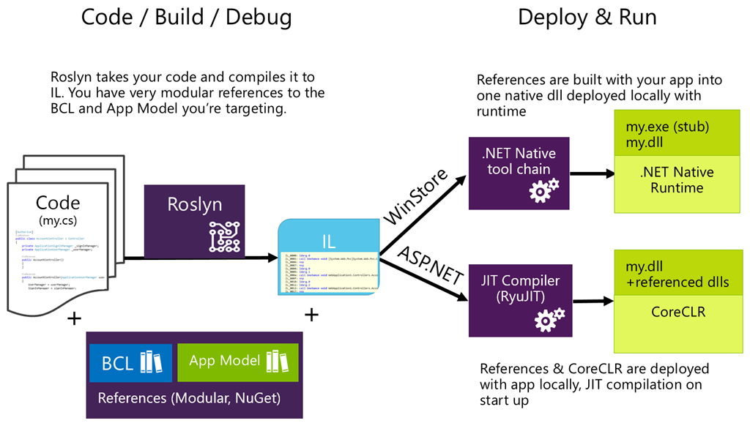
Compilation Process

Slide 6
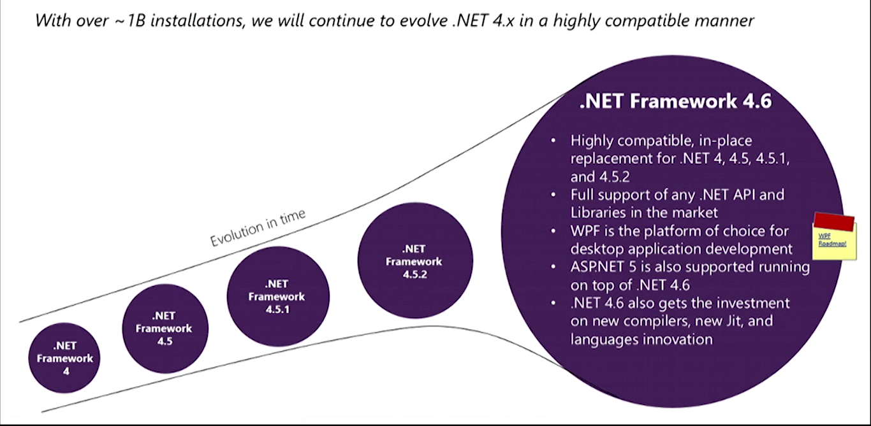

What About .NET Framework 4.6?

Slide 7
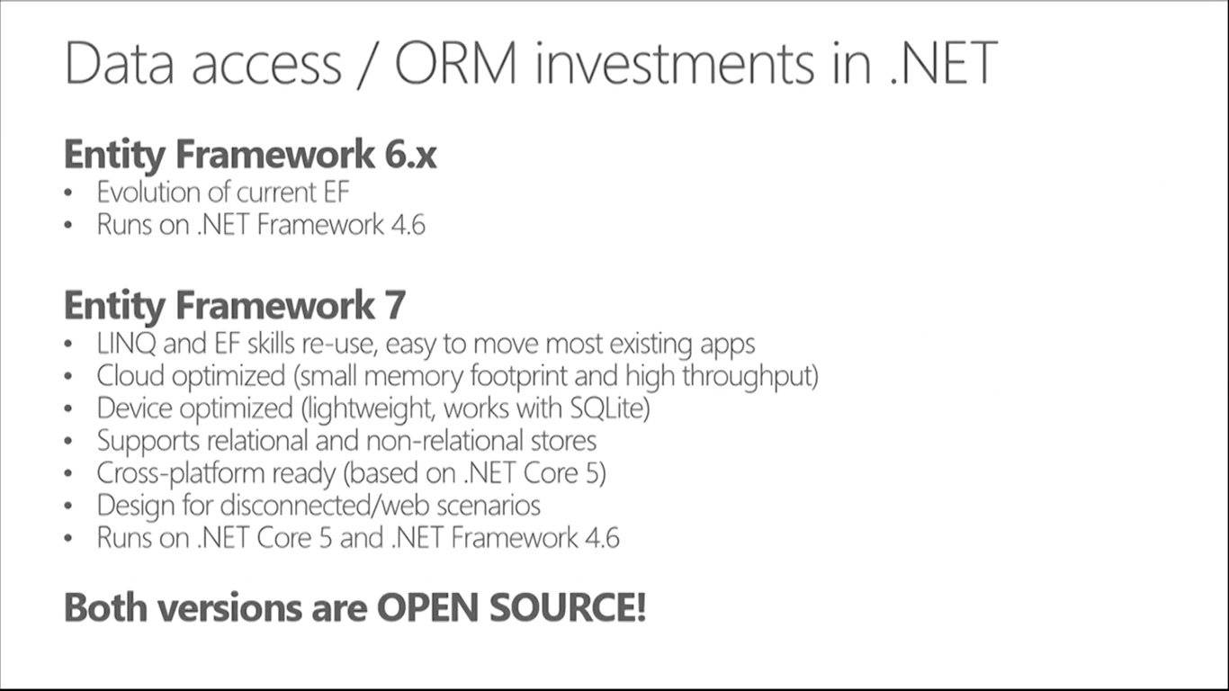
How about Entity Framework?
Entities in Code
ORM
DB

Slide 8
Entity Framework Core*
The Future of EF for ASP.NET Core
Shahed Chowdhuri
Sr. Technical Evangelist @ Microsoft
@shahedC
WakeUpAndCode.com
* aka EF7 before RC1

Slide 9
EF Core Agenda
Overview
Models and Fields
Connection Strings
Add Initial Migration
Additional Migrations
Controllers and Views
Migration History and Snapshots
Notes:
Shahed Chowdhuri
Web Application Security
Overview
SQL Injection
Cross-Site Scripting (XSS)
Data Exposure
In the Real World
Next Steps
Q&A

Slide 10
DB-Driven Web Applications
Web App
Internet
ORM
Database
Users

Slide 11
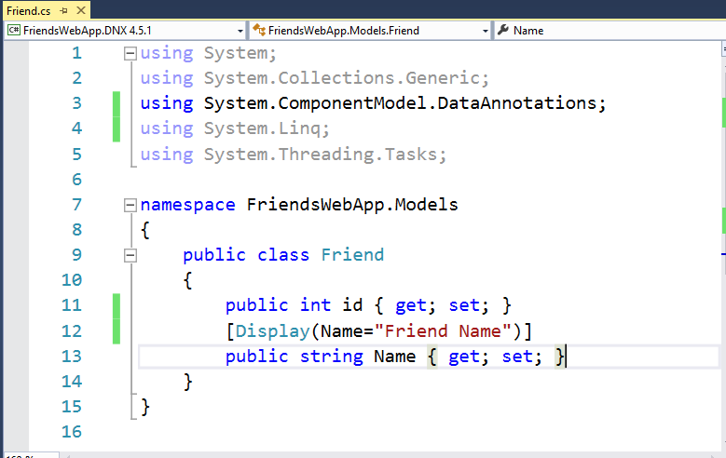
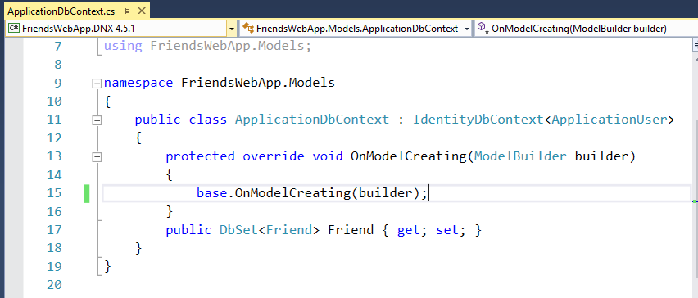

Models and Fields
C# classes with data types, annotated with attributes

Slide 12
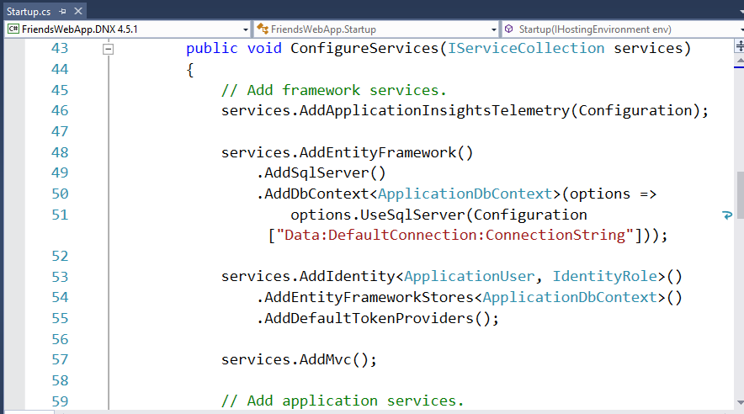
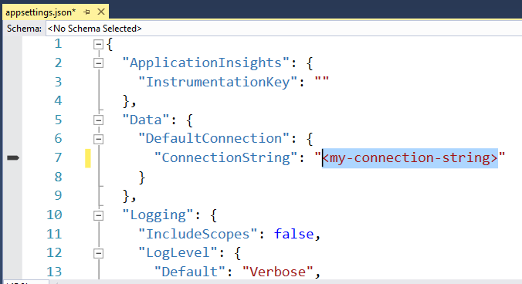
Connection Strings
Added with DB Context Options in Startup.ConfigureServices()

Slide 13
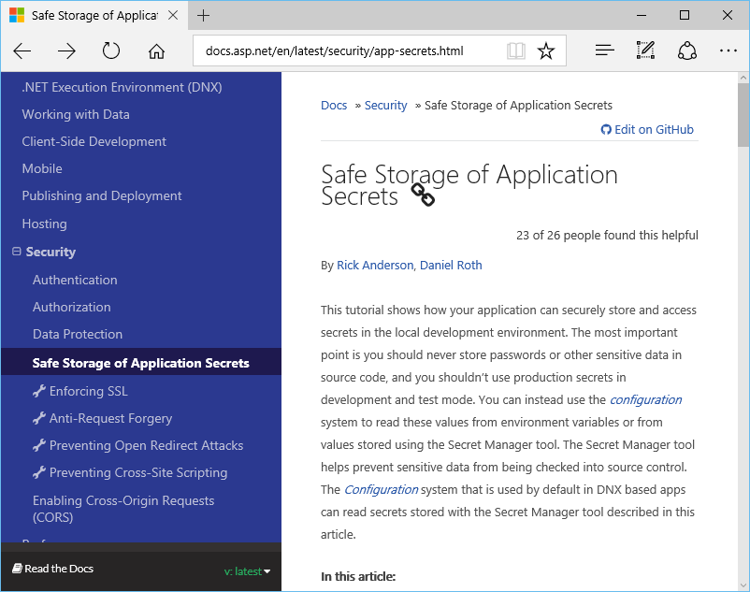
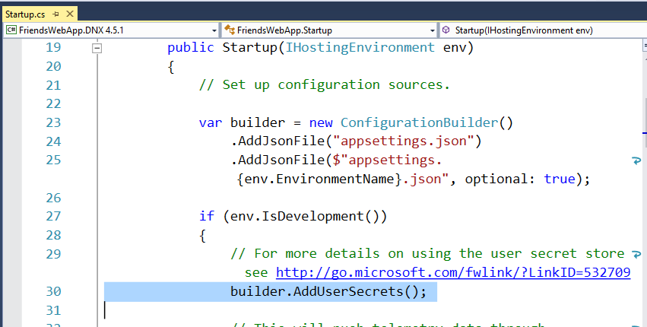
Connection Strings in Development
More info: http://docs.asp.net/en/latest/security/app-secrets.html

Slide 14
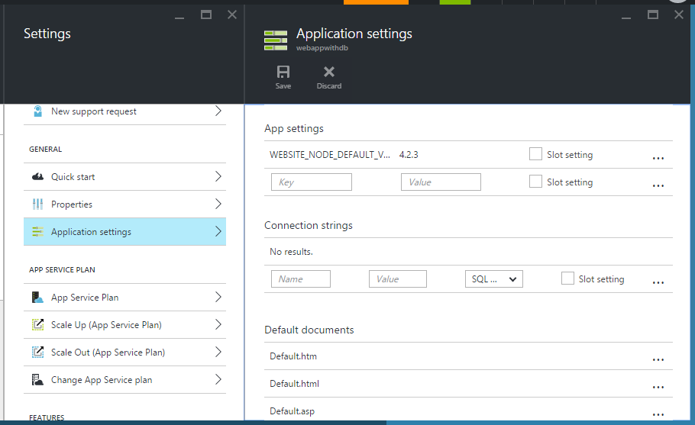
Connection Strings in Azure
More info: https://azure.microsoft.com/en-us/documentation/articles/web-sites-configure

Slide 15
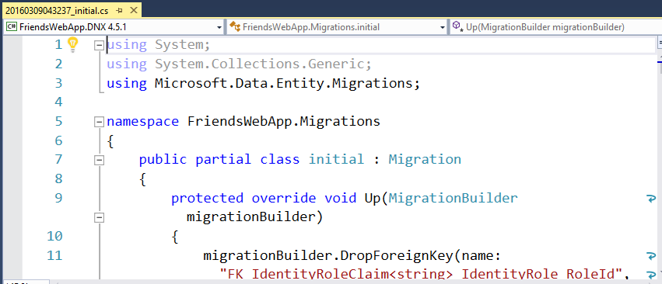
Add Initial Migration *
>dnvm use 1.0.0-rc1-update1
>dnx ef migrations add initial
>dnx ef database update
* Subject to change after RC2, see official documentation: https://docs.efproject.net/en/latest/platforms/aspnetcore/new-db.html

Slide 16
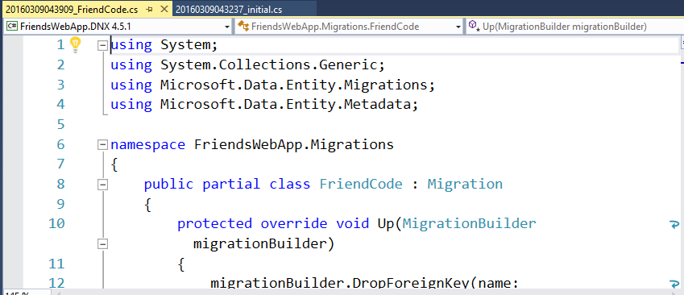
Add Additional Migrations *
>dnvm use 1.0.0-rc1-update1
>dnx ef migrations add FriendCode
>dnx ef database update
* Subject to change after RC2, see official documentation: https://docs.efproject.net/en/latest/platforms/aspnetcore/new-db.html

Slide 17
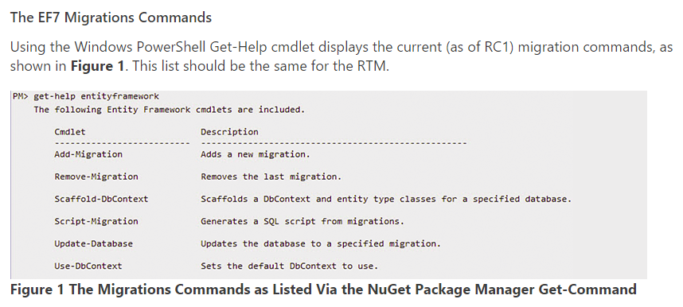

EF Migration Commands
More info: https://msdn.microsoft.com/en-us/magazine/mt614250.aspx

Slide 18
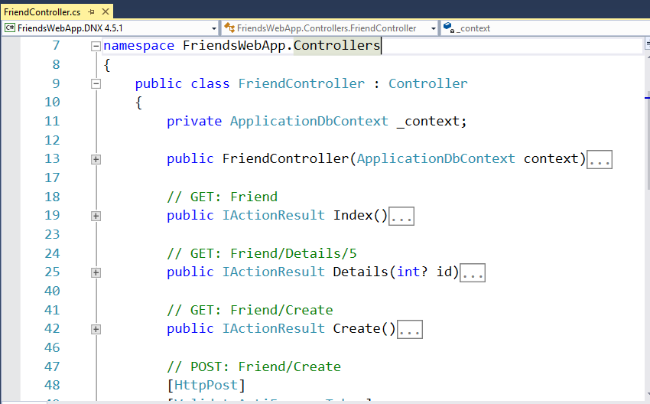
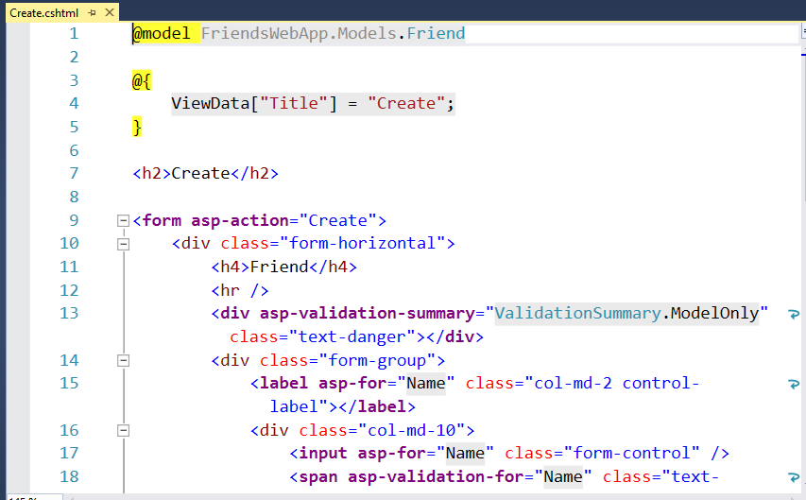
Controllers and Views

Slide 19
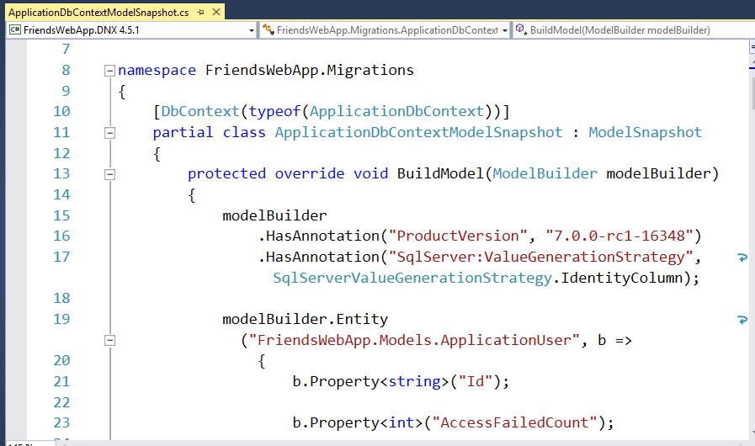
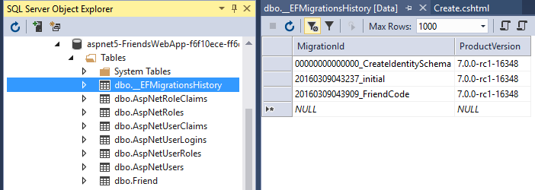
Migration History and Snapshots

Slide 20
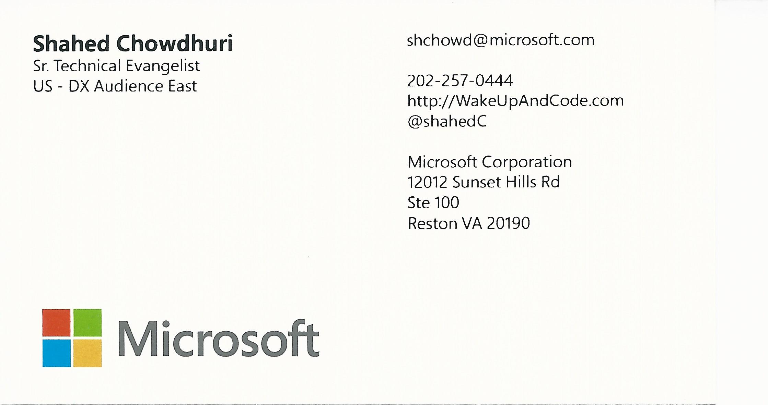
Email: shchowd@microsoft.com  Twitter: @shahedC
Notes:
Contact
Microsoft email: shchowd@microsoft.com
Personal Twitter: @shahedC
Dev Blog: WakeUpAndCode.com

