Slide 1

Introduction to Angular
For Angular Online Training : +91-999 123 502
Shailendra Chauhan
Microsoft MVP, Technical Consultant and Corporate Trainer

Slide 2

Introduction to Angular
For Angular Online Training : +91-999 123 502
A framework for building application using web technologies like html, css and js
Empowers developers to build applications for browsers, mobiles, or desktop

Slide 3
Angular History
For Angular Online Training : +91-999 123 502
Developed in 2009 by Misko Hevery and Adam Abrons at Brat Tech
Misko Hevery started to work for Google in 2009
Angular version 1.0 (AngularJS) was released in 2012 by Google
Angular version 2.0 was released in September 2016
Angular 4.0 was released in March 2017
Angular 5.0 was released in Nov 2017
Angular 6.0 was released in May 2018
Angular 7.0 was released in Oct 2018
Angular 8.0 was released in May 2019
Angular 9.0 was released in Feb 2020

Slide 4
Angular CLI
For Angular Online Training : +91-999 123 502
A powerful to create, build, compile and serve Angular2 App
Used to generate new components, routes, services and pipes
Installing Angular CLI
npm install -g @angular/cli
Generating and serving Angular app
ng new proj_name --skip-install
cd proj_name
npm install
ng serve

Slide 5
Angular CLI Options
For Angular Online Training : +91-999 123 502
Options | Usage
Help | ng --help
Build | ng build --env
Build and Run | ng serve
Testing | ng test
End-End Testing | ng e2e

Slide 6
Angular CLI Commands
For Angular Online Training : +91-999 123 502
Scaffold | Usage | In Short
Module | ng generate module my-module | ng g m my-module
Component | ng generate component my-component | ng g c my-component
Directive | ng generate directive my-directive | ng g d my-directive
Pipe | ng generate pipe my-pipe | ng g p my-pipe
Service | ng generate service my-service | ng g s my-service
Guard | ng generate guard my-guard | ng g g my-guard
Class | ng generate class my-class | ng g cl my-class
Interface | ng generate interface my-interface | ng g i my-interface
Enum | ng generate enum my-enum | ng g e my-enum

Slide 7
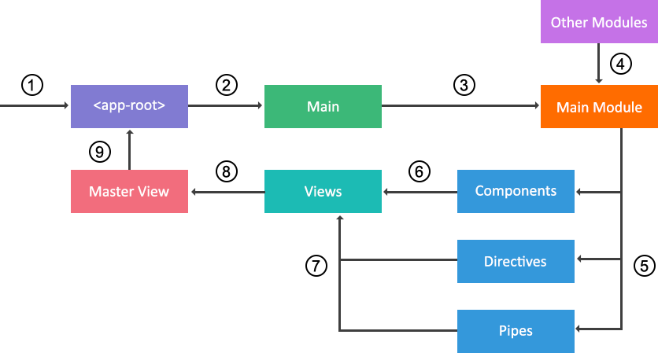
Angular Initialization Process
For Angular Online Training : +91-999 123 502

Slide 8
Angular Building Blocks
For Angular Online Training : +91-999 123 502
Modules
Components
Templates
Metadata
Data binding
Directives
Pipes
Routing
Forms
Services
Dependency injection

Slide 9
Modules
For Angular Online Training : +91-999 123 502
A module organize an application into unified blocks of functionality
An Angular module is a class with an @NgModule
decorator
Accepts a single metadata object whose properties describe the module
Each Angular app must have at least one module, known as root module

Slide 10
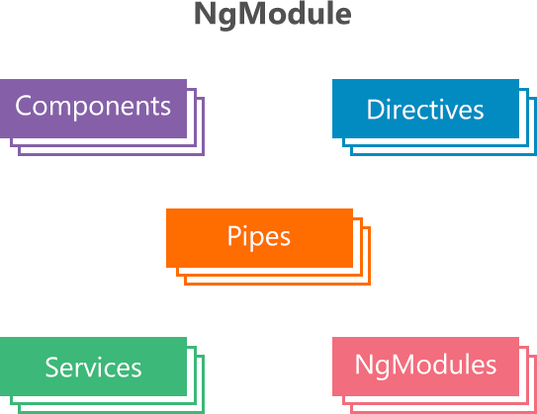
Modules
For Angular Online Training : +91-999 123 502

Slide 11
NgModule Metadata Main Properties
For Angular Online Training : +91-999 123 502
imports – Specify other dependent modules whose classes are required by the component templates declared in the module
declarations – Specify the components, directives, and pipes that belong to the module
bootstrap – Specify the main app view i.e root component. Only the root module can have this bootstrap property
exports – A subset of declarations that will be visible and usable in the other modules. A root module doesn’t have export option.
providers – Specify the services, accessible across the app

Slide 12
Built-In Modules
For Angular Online Training : +91-999 123 502
Angular has built-In library modules starting with the @angular as prefix
Built-In library & third part modules can be installed using npm manager
Built-In modules, components, services, directives etc. can be imported by using built-In library modules

Slide 13
Component
For Angular Online Training : +91-999 123 502
A type of directives with template, styles and logic for user interaction
Exported as a custom HTML tag like as:
<my-component></my-component>
Initialized by Angular Dependency Injection engine

Slide 14
Angular Components Page View
For Angular Online Training : +91-999 123 502
ROOT COMPONENT
HEADER COMPONENT
ARTICLE COMPONENT
CATEGORIES COMPONENT
COMMENTS
COMPONENT
NEWS FEEDS COMPONENT
FOOTER COMPONENT

Slide 15
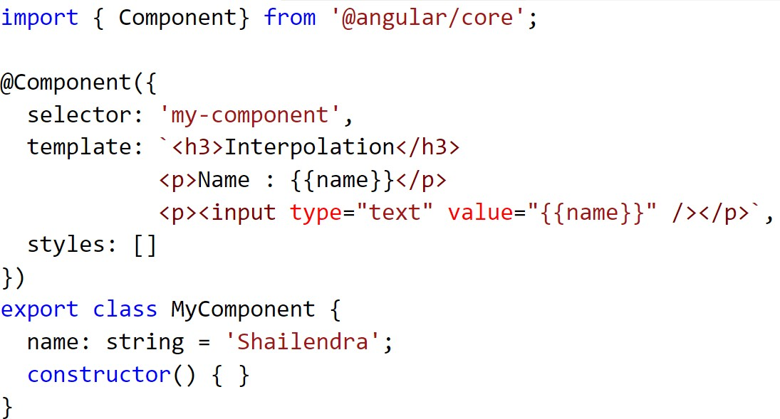
Component Example
For Angular Online Training : +91-999 123 502

Slide 16
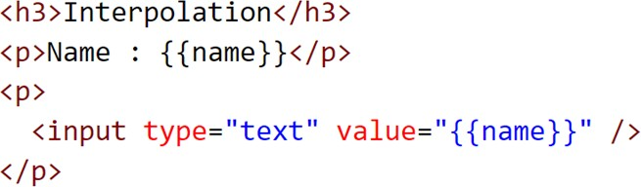
Template
For Angular Online Training : +91-999 123 502
Define the view of a component
Contains Html markup and angular directives, attributes etc.
Describe how a component is rendered on the page

Slide 17
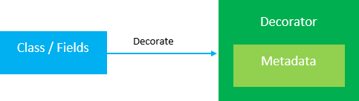
Decorators
For Angular Online Training : +91-999 123 502
A function that adds metadata to a class, class members
These are prefix with @ symbol
Angular has built-In decorators like - @Component, @NgModule, @Directive, @Pipe etc.

Slide 18
Types of Decorators
For Angular Online Training : +91-999 123 502
Class decorators
@NgModule – Used for defining a module
@Component – Used for defining a component
@Directive – Used for defining a directive
@Injectable – Used for injecting dependencies
@Pipe – Used for defining a pipe
Class field decorators
@Input – Used for receiving data (input) component
@Output – Used for passing data (events) component
from parent to child
from child to parent

Slide 19
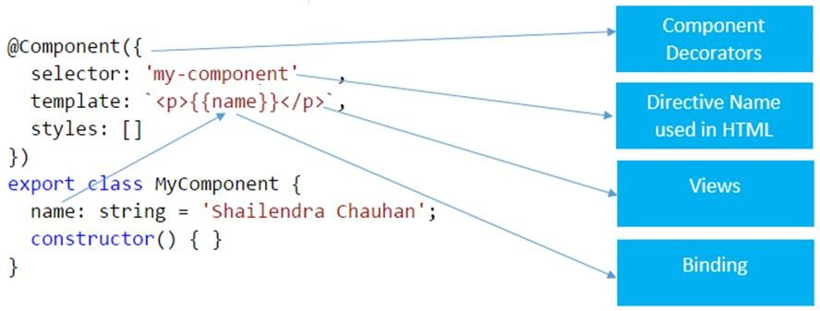
Metadata
For Angular Online Training : +91-999 123 502
Tells Angular how to process a class
Decorators are used to attach metadata to a class

Slide 20
Angular Forms
For Angular Online Training : +91-999 123 502
HTML forms are an essential part of a web application
Angular provides two ways to create form – Template Driven and Model Driven
Forms
Template Driven
Model Driven

Slide 21
Angular Form Building Blocks
For Angular Online Training : +91-999 123 502
Building Blocks
FormGroup
FormControl
FormArray
Validations

Slide 22
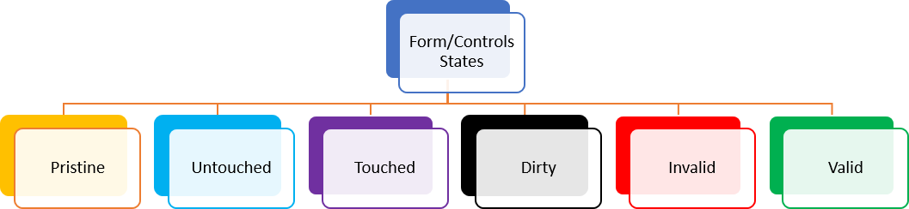
Angular Form and Form Controls States
For Angular Online Training : +91-999 123 502

