Slide 1



Linux and Operating System
Presenter
Arun Kumar
Senior Project Engineer
Software Technology & Cyber Security Group
Notes:
1.7.2013
‹#›

Slide 2



Course Outline
1
Introduction of Linux
2
Shell Scripting
3
Processes & Scheduling
4
Memory Management
5
File Systems
6
Package Managers
Notes:
1.7.2013
‹#›

Slide 3

Introduction to Unix
UNIX is a powerful and widely used operating system that originated in the 1960s at AT&T’s Bell Labs by Ken Thompson, Dennis Ritchie, and others. Designed as a multi-user and multitasking system, UNIX offers stability, security, and flexibility, making it a preferred choice for developers and enterprises. Its structured file system hierarchy ensures efficient data management, while the command-line interface provides users with a robust environment for executing various commands. Over time, UNIX has inspired several operating systems, including Linux, macOS, and BSD, each incorporating its core principles. Its portability allows it to run on different hardware platforms with minimal modifications, contributing to its widespread adoption. Whether in networking, programming, or system administration, UNIX continues to play a vital role in shaping modern computing. Would you like to explore specific aspects of UNIX, such as its commands or architecture?

Slide 4
Introduction to the Linux Operating System
Linux is a versatile, open-source operating system that has revolutionized modern computing, offering exceptional security, flexibility, and scalability. Developed through a community-driven approach, Linux powers everything from personal computers and mobile devices to supercomputers, cloud servers, and embedded systems. Its influence extends to major tech giants like Google, Facebook, and Amazon, all relying on Linux for stable and efficient infrastructure. Additionally, Android, the world's most popular mobile OS, is built on the Linux kernel, highlighting its widespread adoption. Whether driving innovation in artificial intelligence, scientific research, or powering everyday smart devices, Linux remains the backbone of the digital world, constantly evolving to meet the needs of technology and innovation.

Slide 5

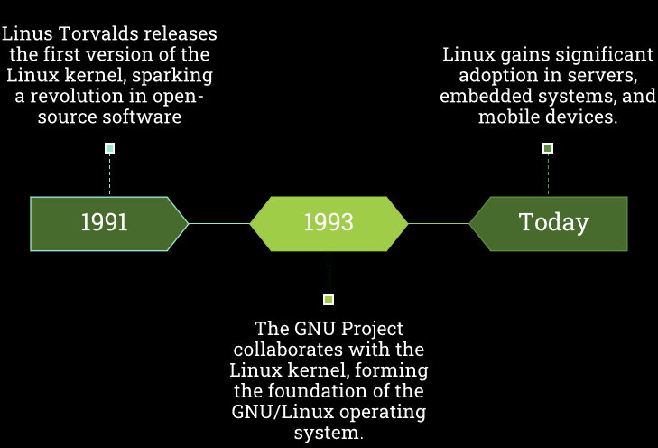

History of Linux

Slide 6
Linux vs. Unix
Licensing and Availability
Linux: Open-source and free to use, with multiple distributions (Ubuntu, Fedora, Debian, Red Hat, etc.) maintained by communities and organizations.
UNIX: Proprietary and commercial versions exist, often licensed by companies such as IBM (AIX), HP (HP-UX), and Oracle (Solaris)
Kernel Type
Linux: Uses a monolithic kernel, meaning all essential services run in the kernel space, improving performance.
UNIX: Can use monolithic, microkernel, or hybrid kernels, depending on the variant.
File System Support
Linux: Supports Ext2, Ext3, Ext4, XFS, Btrfs, ReiserFS, FAT, NTFS, and more.
UNIX: Supports JFS, GPFS, HFS, HFS+, UFS, XFS, ZFS, among others.
GUI (Graphical User Interface)
Linux: Offers multiple desktop environments like GNOME, KDE, Xfce, LXDE, Unity.
UNIX: Originally command-line based, but later versions introduced GUI support like Common Desktop Environment (CDE).

Slide 7
CentOS8-Stream Installation
A brief introduction about CentOS
CentOS is a Community-based Enterprise Operating System, with a free support platform which uses the source code of Red Hat Enterprises Linux (RHEL) distribution. The advantage of using CentOS is that it is completely free to install on any 64-bit x86 system. Most of the Web Hosting companies are using this free community enterprise edition on their servers. Each version of CentOS comes with a 10-year supported life cycle, more than any other OS in the market.
Step-1: Download the latest CentOS-8
Download CentOS 8 ISO file https://www.centos.org/download/
Step-2: Bootable USB
To install OS on standard servers, we need either a bootable USB. You can use the Rufus Software to create bootable USB, To install the OS in a virtual environment, then use the .iso file.

Slide 8
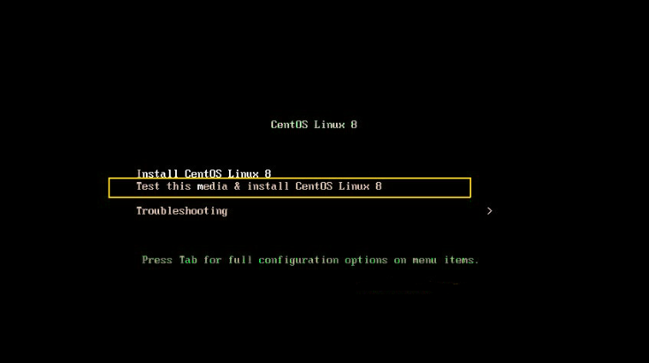
CentOS8-Stream Installation
Step-3: Let's start the CentOS-8 Installation
The following screen will appear when you boot the system with either ".iso or bootable media" kit for CentOS 8 for the first time. Choose either "Install CentOS Linux 8" OR "Test this media & Install CentOS Linux 8 "and hit the enter key to proceed.

Slide 9
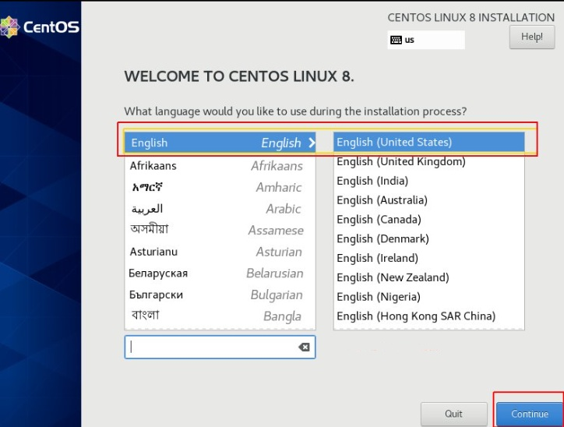
CentOS8-Stream Installation
Step-4: Language selection screen
On this screen you can choose your preferred language, in our case we will go with English United States and click on Continue.

Slide 10
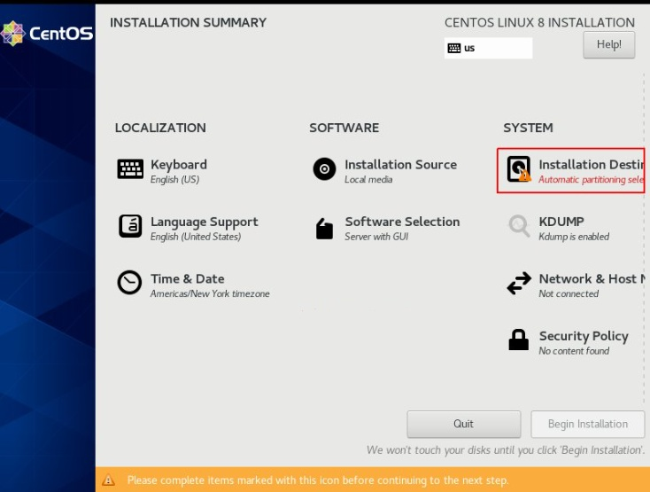
CentOS8-Stream Installation
Step-5: Configure Installation summary
We need to configure the respective options to customize the installation based on our requirements on the following screen:

Slide 11

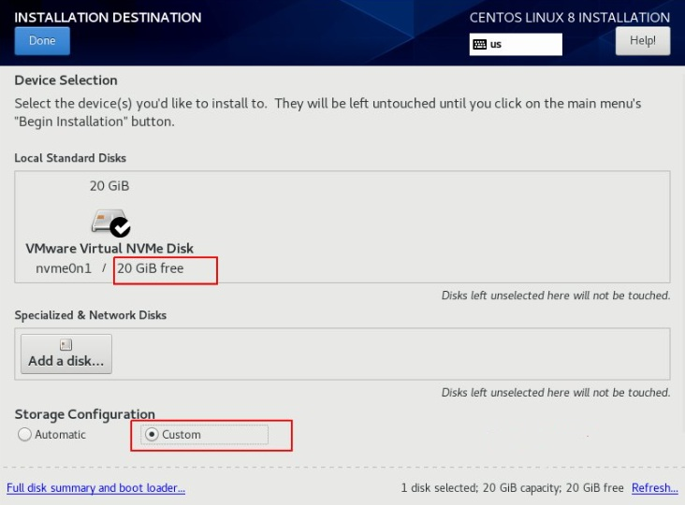
CentOS8-Stream Installation
Step-6: System (Installation Destination)
You can see a 20GB virtual disk is available to install CentOS 8. Here, we have two options (Automatic and Custom) to configure the disk partition. The Automatic option will create all the partitions by the system itself. To configure the partition manually, we need to select the "custom option". In our case, I will go with the custom partition based on my requirements. Click on Done to proceed.

Slide 12
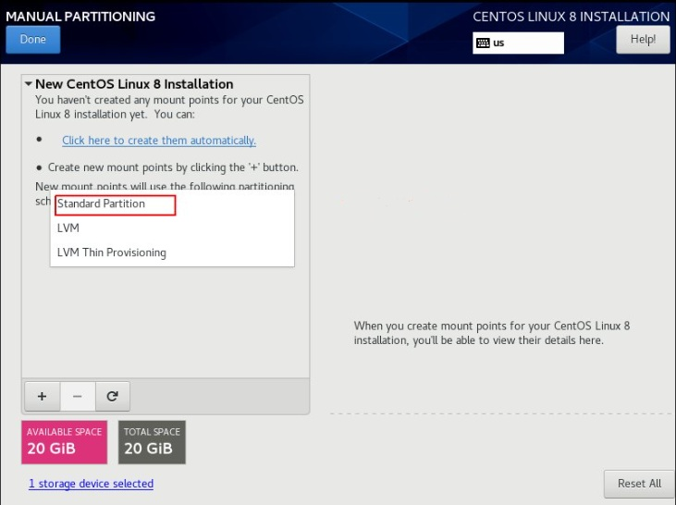
CentOS8-Stream Installation
Step-6.1: Manual Partitioning
We have the choice of selecting three different mount partition schemes, which are Standard, LVM, and LVM Thin Provisioning. By default, LVM is selected, to change the scheme, click the drop-down list then select the option based on your requirement. Here, I choose the standard partition option.

Slide 13
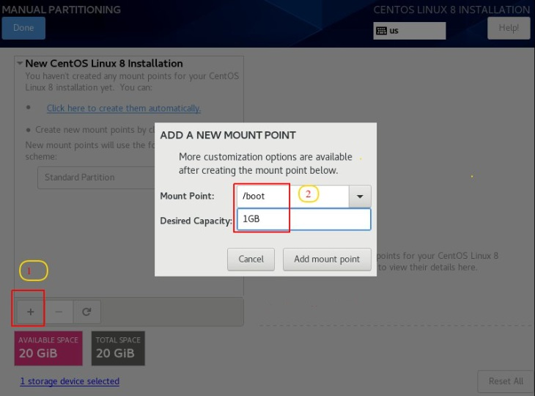
CentOS8-Stream Installation
Step-6.2: Manual Partitioning
Here, I go with 1GB size of (boot) partition. You can enter the desired size based on your requirement, mostly 1 or 2 GB is fair enough for the boot partition. Then click "Add mount points" to continue.

Slide 14
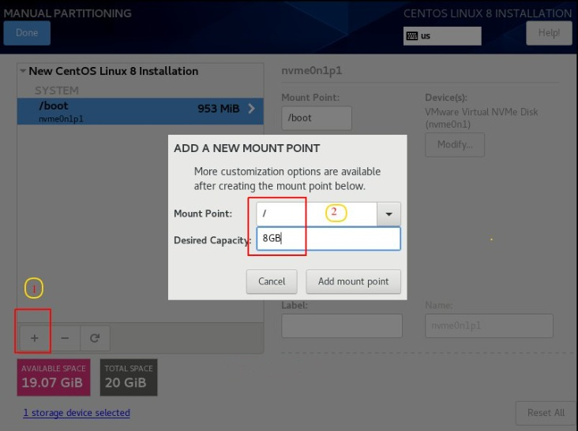
CentOS8-Stream Installation
Step-6.3: Manual Partitioning
Next, create the "/ " (parent) partition which is called "root" partition. Here, I am going to use an 8GB size for this partition. Then click "Add mount points" to continue.

Slide 15
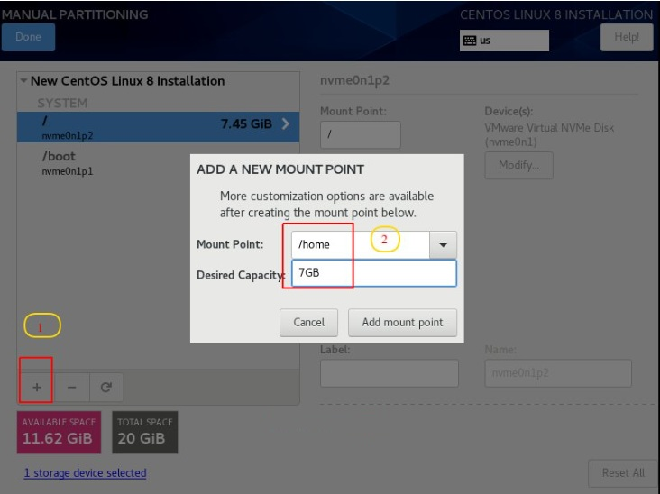
CentOS8-Stream Installation
Step-6.4: Manual Partitioning
Similarly, we can use the same method to create remaining partitions (/home, /var, and Swap).

Slide 16
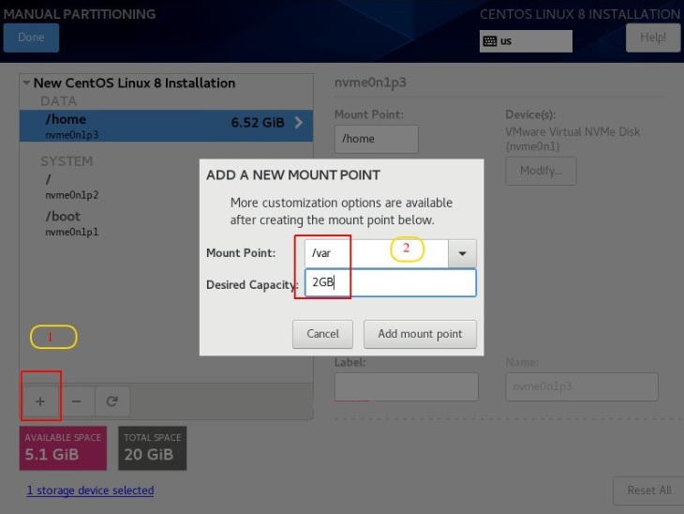
CentOS8-Stream Installation
Step-6.4: Manual Partitioning
Similarly, we can use the same method to create remaining partitions (/home, /var, and Swap).

Slide 17
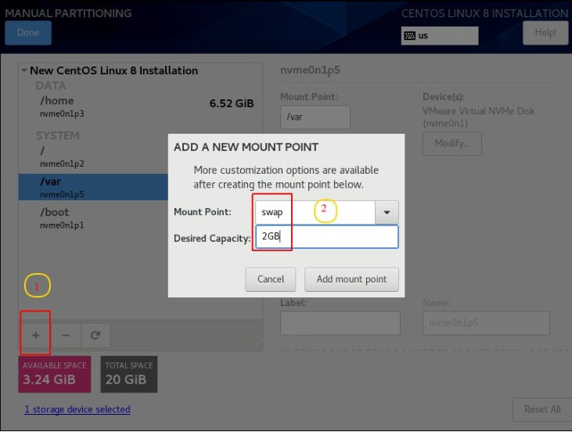
CentOS8-Stream Installation
Step-6.4: Manual Partitioning
Similarly, we can use the same method to create remaining partitions (/home, /var, and Swap).

Slide 18
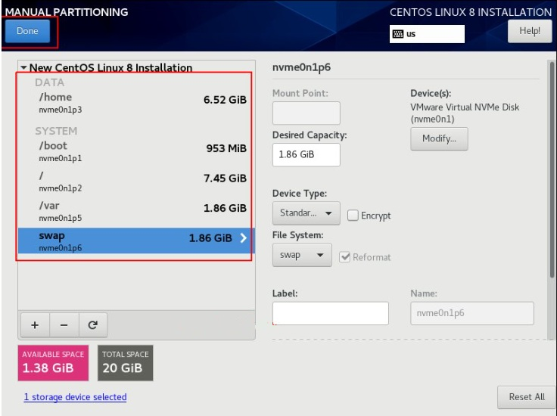
CentOS8-Stream Installation
Step-6.4: Manual Partitioning
Once you have completed the disk partition, click "Done" to proceed, as shown below:

Slide 19
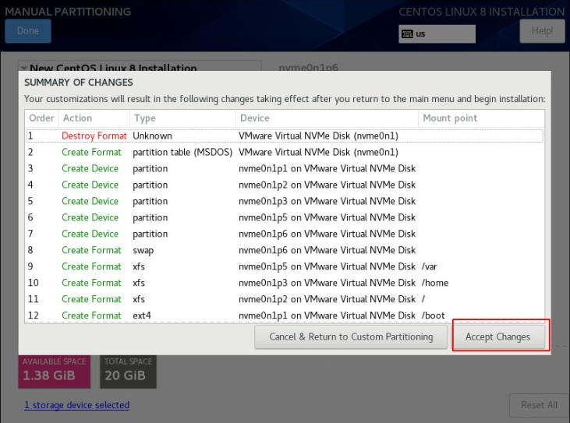
CentOS8-Stream Installation
Step-6.4: Manual Partitioning
We are going to click on “Accept Changes“ to fulfill the summary changes that the changes made in the disk, it will write all the partitions.

Slide 20
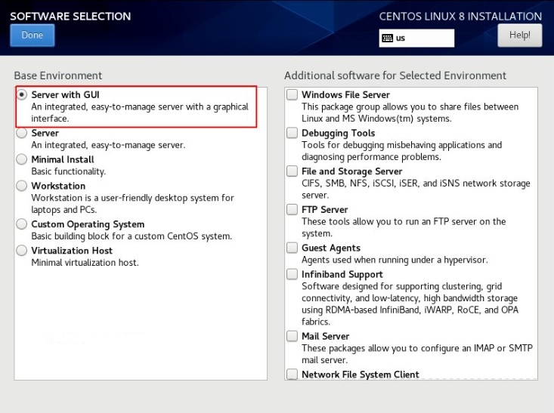
CentOS8-Stream Installation
Step-7: Software Selection
Next, click “Software Selection“. Here you have a choice of 6 different options to install your server. In our case, I am going with the “Server with GUI” option and if you need only the minimal installation, then select “Minimal Install“. Once you have selected it, click "Done" to move to the next step.

Slide 21
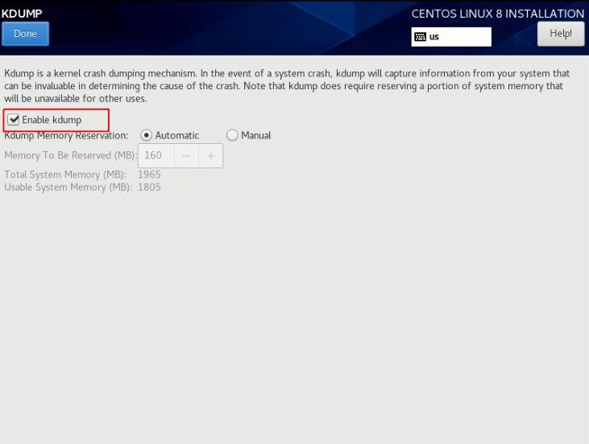
CentOS8-Stream Installation
Step-8: Kdump
The next Kdump option is enabled by default if you want to disable it, just click the option and remove the tick mark, but it is recommended to always enable it, as it will help to debug in case of any crashes at the kernel level.

Slide 22
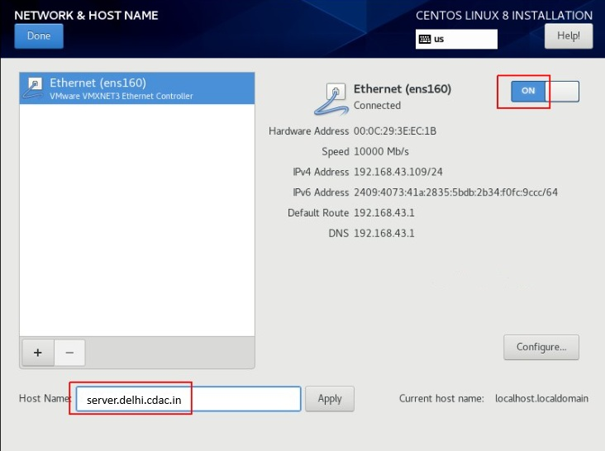
CentOS8-Stream Installation
Step-9: Network & Host Name
To configure “Network & Host Name” during the installation time, just click the respective option and enable the Ethernet connection "On" and it will assign the IP address automatically (DHCP) and you add the hostname as well. Click "Done" to proceed as shown below:

Slide 23
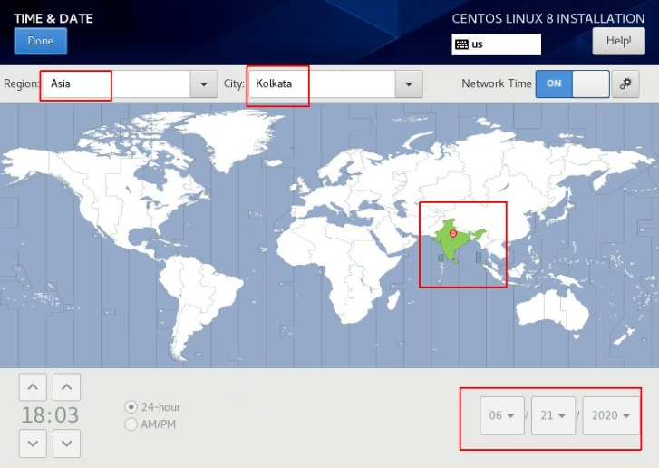
CentOS8-Stream Installation
Step-10: Time & Date
Change the Date and Time settings based on your zone, click the respective icon and just select the region and city from the map as shown below:

Slide 24
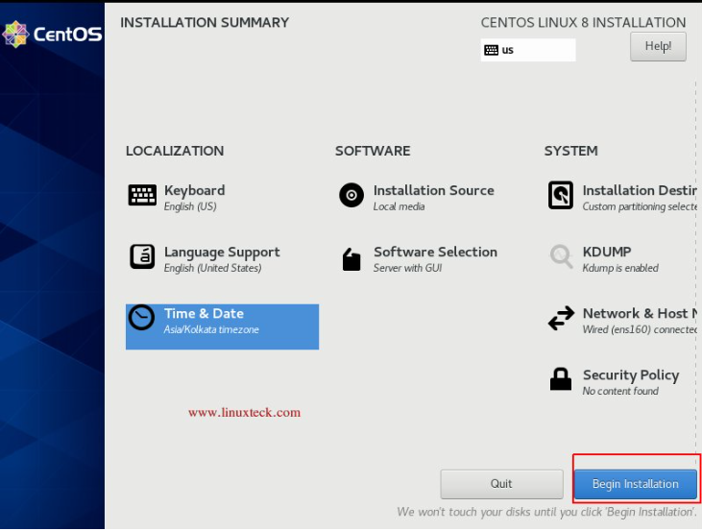
CentOS8-Stream Installation
Step-11: Click "Begin Installation"
Once, we have customized all the respective options based on our requirement, then hit the “Begin Installation” tab from the Installation Summary screen to start the installation process as shown below:

Slide 25
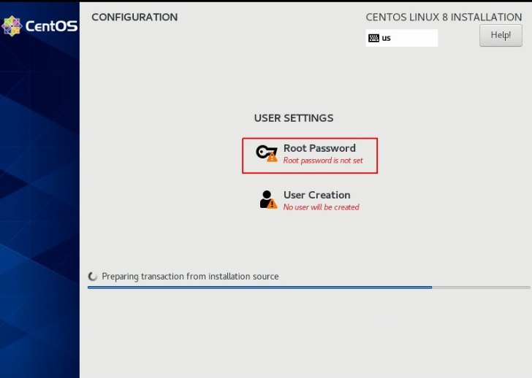
CentOS8-Stream Installation
Step-12: Root Password & User Creation
During the installation process, it will ask you to set the root password and the option to create a normal user.

Slide 26
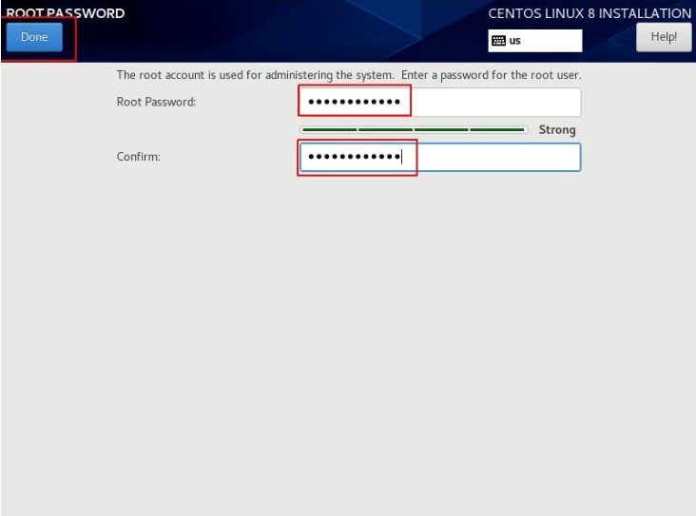
CentOS8-Stream Installation
Step-12.1: Set Root Password
First set the root password as shown below

Slide 27
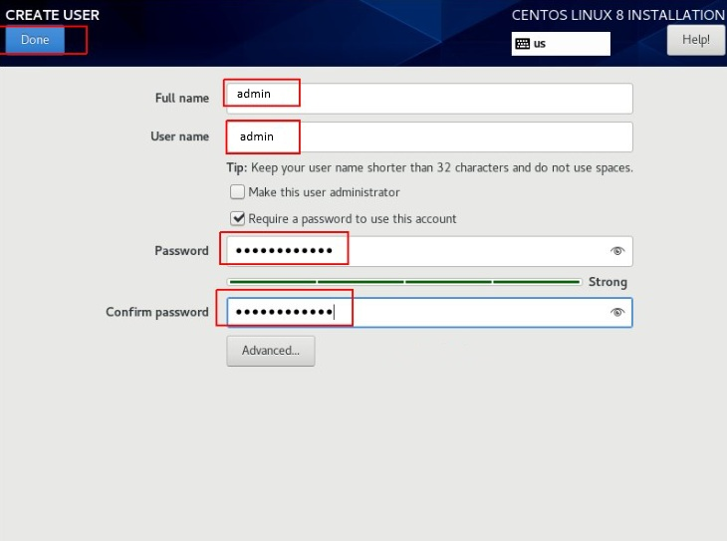
CentOS8-Stream Installation
Step-12.2: Create User
Second, create a local user as shown below

Slide 28
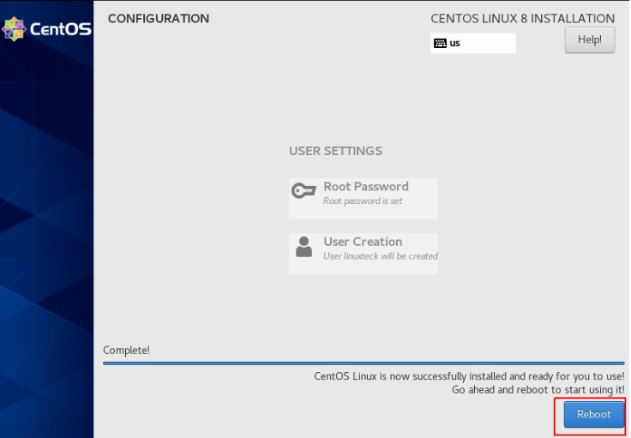
CentOS8-Stream Installation
Step-13: System Reboot
Once the installation is finished, it will prompt you to reboot the system. Click on Reboot.

Slide 29


Basic Commands
The Linux Command-Line Interface (CLI)
The Linux Command-Line Interface (CLI) is a text-based interface that allows users to interact with the operating system by entering commands. Unlike graphical user interfaces (GUIs), the CLI provides direct control over system functions, making it powerful for automation, scripting, and system administration.
Key Features of Linux CLI
Text-Based Interface – Linux CLI operates entirely through text commands, making it lightweight and efficient compared to graphical user interfaces (GUIs)
Command History – Allows users to recall and reuse previous commands.
Scripting Capabilities – Enables automation of repetitive tasks using shell scripts.
Piping and Redirection – Facilitates data transfer between commands for efficient processing.

Slide 30

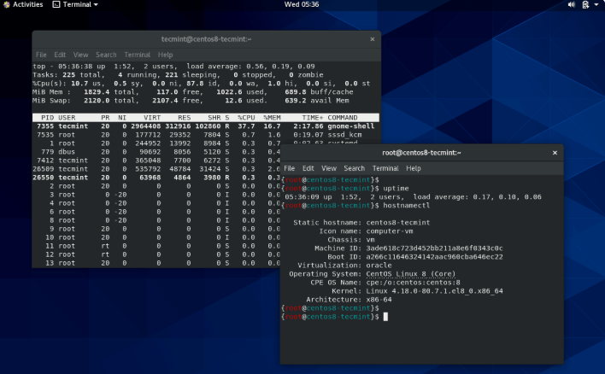
Start with Command Line
Terminal Emulator
To access the Terminal Emulator in Linux, you can use several methods. The quickest way is to press Ctrl + Alt + T, If this shortcut doesn’t work, you can manually search for "Terminal" in the application menu and open it from there.

Slide 31

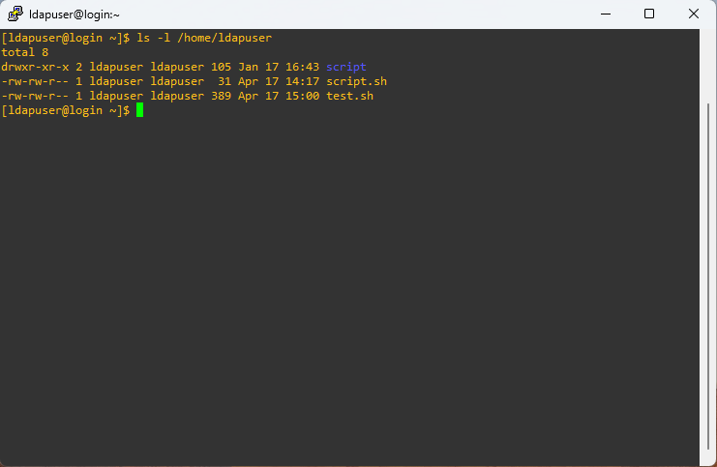
Understanding the Command
Command Line Input Structure
General Format:
Command [Options] [Arguments]
Components of a Command:
  Command – The name of the program or script being executed (e.g., ls, mkdir, grep)
  Options – Modify the behavior of the command (e.g., -l, --help)
  Arguments – Additional inputs required by the command (e.g., a filename or directory path).
Example Command:
ls -l /home/user
Command: ls → Lists directory contents
Option: -l → Long format display
Argument: /home/user → Directory to list
Result:

Slide 32
Basic Commands
1. File and Directory Management
ls – Lists files and directories in the current location.
pwd – Displays the current working directory.
mkdir – Creates a new directory.
cd – Changes the current directory.
rm – Deletes files or directories.
cp – Copies files or directories.
mv – Moves or renames files
2. File Viewing and Editing
cat – Displays the contents of a fie.
nano / vim – Opens a file for editing.
less – Views file contents page by page.
head – Shows the first few lines of a file.
tail – Shows the last few lines of a file

Slide 33
Basic Commands
3. System Information
uname -a – Displays system information.
df -h – Shows disk space usage.
free -m – Displays memory usage.
top – Shows running processes and system performance.
uptime – Shows system uptime.
vmstat – Displays system performance statistics.
iostat – Provides CPU and disk I/O statistics.
4. User Management
whoami – Displays the current user.
who – Lists logged-in user.
passwd – Changes the user password.
adduser – Adds a new user.
5. Networking
ping <hostname/IP address> – Checks network connectivity.
ifconfig – Displays network configuration.
wget <URL> – Downloads files from the internet

Slide 34
Basic Commands
6. File Permissions and Ownership
chmod – Changes file permissions (e.g., chmod 755 filename).
chown – Changes file ownership (e.g., chown user:group filename).
ls -l – Displays detailed file permissions and ownership
7. Archiving and Compression
tar -cvf archive.tar directory/ – Creates a tar archive.
tar -xvf archive.tar – Extracts a tar archive.
gzip filename – Compresses a file using gzip.
gunzip filename.gz – Decompresses a gzip file
8. Searching and Filtering
grep "text" filename – Searches for specific text in a file.
find /path -name filename – Finds files by name.
locate filename – Quickly finds files using a database

Slide 35
Practice Lab
CentOS8-Stream Installation
Linux Basic Commands

