Slide 1



Linux and Operating System
Presenter
Arun Kumar
Senior Project Engineer
Software Technology & Cyber Security Group
Notes:
1.7.2013
‹#›

Slide 2



Course Outline
1
Introduction of Linux
2
Shell Scripting
3
Processes & Scheduling
4
Memory Management
5
File Systems
6
Package Managers
Notes:
1.7.2013
‹#›

Slide 3

Shell Scripting
1
Introduction to Shell and Shell Scripting
2
Basic Shell Commands
3
Writing Shell Scripts
4
Conditional statements
5
Loops: for, while, until
Notes:
1.7.2013
‹#›

Slide 4

What is Shell Scripting ?
Shell scripting is a method of automating tasks in Unix-like operating systems by writing a series of commands that the shell interpreter executes sequentially. It is widely used for system administration, file manipulation, text processing, and application automation, making workflows more efficient and reducing manual effort. A typical shell script begins with a shebang (#!) to specify the interpreter, followed by commands that perform various operations, such as defining variables, executing loops, handling conditionals, and processing user input. Shell scripting also enables piping and redirection, error handling, scheduled execution using cron jobs, and modular coding through functions, enhancing its flexibility and usability. Different shells interpreter, such as Bash, Bourne Shell, C Shell, and Korn Shell, provide distinct scripting features, making it adaptable to diverse computing environments. Its simplicity, portability, and efficiency make it an essential tool for developers, system administrators, and DevOps engineers, significantly streamlining automation and improving system performance

Slide 5
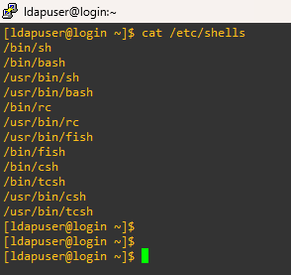
What is Shell Interpreter ?
A shell is a command-line interface that enables users to interact with the operating system by executing commands, managing files, and controlling processes. It acts as an intermediary between the user and the system’s kernel, interpreting commands and executing them accordingly.
Shell Choices
Linux provides a wide choice of shells; exactly what is available on the system is listed in /etc/shells.

Slide 6

Shell Interpreters
1. Bourne Shell (sh)
One of the earliest Unix shells, known for its simplicity and efficiency.
Lacks advanced interactive features but is widely used in scripting.
2. Bourne Again Shell (Bash)
Bash (Bourne-Again SHell) is one of the most commonly used Unix/Linux shells and is the default shell in many Linux distributions
Supports command history, auto-completion, and improved debugging tools.
3. C Shell (csh)
Provides C-like syntax, making it easier for programmers familiar with C.
Includes features like aliasing, job control, and command history.
4. RC Shell (rc)
Rc shell eliminates unnecessary quoting, making scripting more intuitive and reducing errors.
All variables are treated as lists of strings, simplifying data manipulation and eliminating complex parsing.

Slide 7
Types of Shells
5. Fish Shell (fish)
Commands are color-coded to indicate errors or valid syntax.
Fish suggests commands based on history as you type.
6. TENEX C Shell (tcsh)
An enhanced version of C Shell with improved command-line editing.
Provides better scripting capabilities and interactive features.
7. Z Shell (zsh)
An extended shell with advanced customization options.
Offers powerful auto-completion, spelling correction, and improved scripting features.
8. Korn Shell (ksh)
Combines features of Bourne and C shells, offering better scripting capabilities.
Supports associative arrays, floating-point arithmetic, and improved performance.

Slide 8
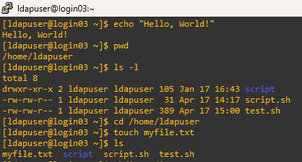
Basic Shell Commands
1. echo – Prints text to the terminal
Example : echo "Hello, World!"
2. pwd – Displays the current working directory
Example : pwd
  3. ls – Lists files in a directory
  Example : ls -l
  4. cd – Changes the current directory
  Example : cd /path/to/directory
  5. touch – Creates an empty fil
  Example : touch myfile.txt

Slide 9
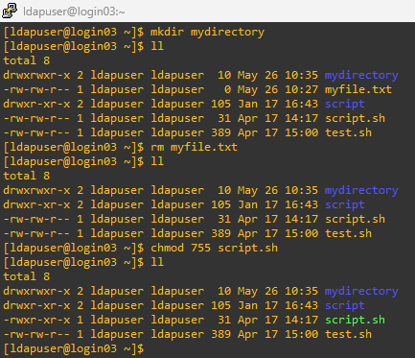
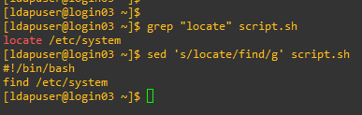
Basic Shell Commands
6. mkdir – Creates a new directory
Example : mkdir mydirectory
7. rm – Removes file
Example : rm myfile.txt
  8. chmod – Changes file permission
  Example : chmod 755 script.sh
  9. grep – Searches for patterns in a fil
  Example : grep "error" logfile.txt
  10. sed – Stream editor for modifying text
  Example : sed 's/oldtext/newtext/g' file.txt
Notes:
sed 's/oldtext/newtext/g' file.txt
s → Substitute command
oldtext → The string to search for
newtext → The string to replace it with
g → Global flag (replace all occurrences in each line)
file.txt → The file to process
📌 This command replaces every occurrence of oldtext with newtext in file.txt.

Slide 10
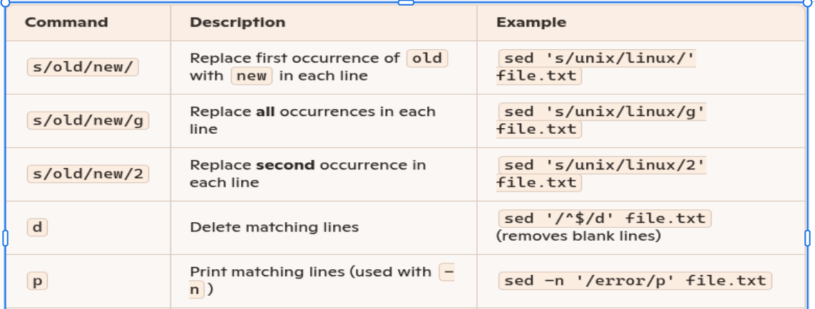
sed commands

Slide 11
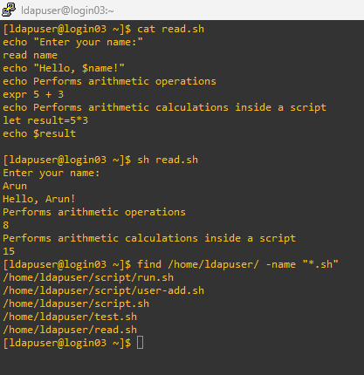
Basic Shell Commands
11. read – Takes user input
Example : echo "Enter your name:"
    read name
    echo "Hello, $name!"
12. expr – Performs arithmetic operations
Example : expr 5 + 3
  13. let – Performs arithmetic calculations inside
  a script
  Example : let result=5*3
  echo $result
  14. find – Searches for file
  Example : find /home -name "*.txt"

Slide 12
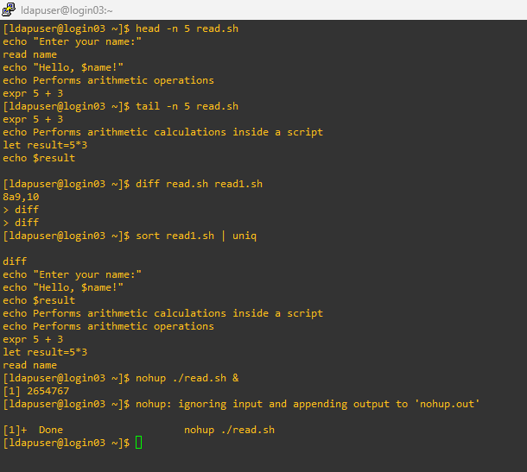
Basic Shell Commands
15. head / tail – Shows the first or last lines of a file
Example : head -n 5 file.txt
    tail -n 5 file.txt
16. diff – Compares two file
Example : diff file1.txt file2.txt
  17. uniq – Removes duplicate lines from a file
  Example : sort file.txt | uniq
  18. nohup – Runs a command even after logging out
  Example : nohup ./script.sh &
  19. bg / fg – Moves jobs to the background or foreground
  Example : bg %1, fg %1

Slide 13
Writing Shell Scripts
Script naming conventions
By naming convention, bash scripts end with .sh. However, bash scripts can run perfectly fine without the .sh extension.
Adding the Shebang
Bash scripts start with a shebang. Shebang is a combination of bash # and bang ! followed by the bash shell path. This is the first line of the script. Shebang tells the shell to execute it via bash shell. Shebang is simply an absolute path to the bash interpreter.
Example : #!/bin/bash
Creating our first bash script
Create a file named run_all.sh using the vi command vi run_all.sh
To be continued...

Slide 14
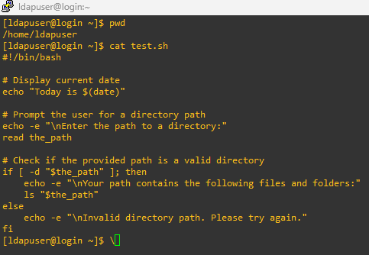
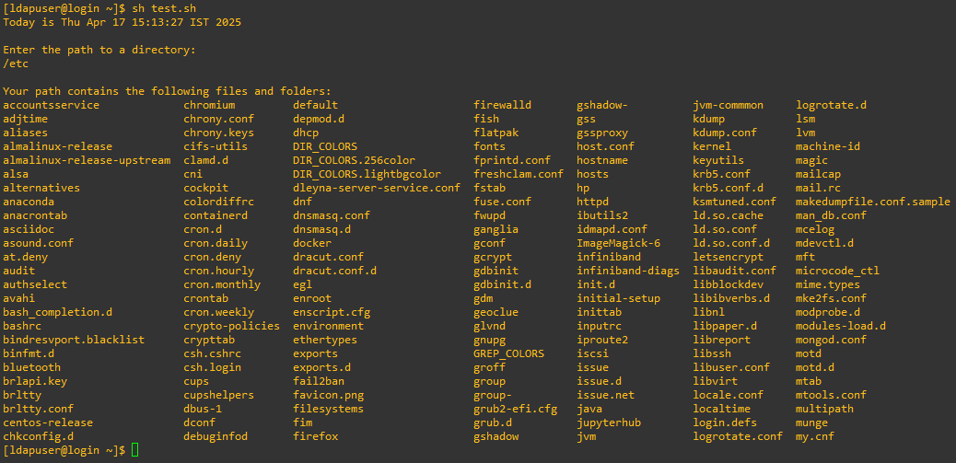
Add the following commands in your file and save it:
#!/bin/bash
# Display current date
echo "Today is $(date)"
# Prompt the user for a directory path
echo -e "\nEnter the path to a directory:"
read the_path
# Check if the provided path is a valid directory
if [ -d "$the_path" ]; then
echo -e "\nYour path contains the following files and folders:"
ls "$the_path"
else
echo -e "\nInvalid directory path. Please try again."
fi
Executing the bash script
To make the script executable, assign execution rights to your user using this command: chmod u+x run_all.sh
Execute the script : sh run_all.sh

Slide 15
Conditional Statements
Conditional programming plays a crucial role in shell scripting, allowing the execution of commands based on specific conditions rather than running all instructions sequentially. The if-else statement in shell scripts enables decision-making by evaluating conditions and executing different blocks of code accordingly. When using if-else, a condition is checked, and based on whether it evaluates to true or false, the corresponding set of statements is executed. This control structure helps in automating tasks that require logic-based execution, making scripts more dynamic and responsive to user input or system status. Additionally, elif statements allow multiple conditions to be checked sequentially, ensuring efficient processing without unnecessary repetitions. Logical operators such as && (AND) and || (OR) extend the flexibility of conditional statements by combining multiple conditions. An alternative approach to conditional execution is the case statement, which simplifies multiple-choice decision-making and is particularly useful for handling user input. By using conditional statements, shell scripts can intelligently process data, handle errors, and optimize automation, making them an essential component of programming for system administration and task automation.

Slide 16
Conditional statements (if/else)
Expressions that produce a boolean result, either true or false, are called conditions. There are several ways to evaluate conditions, including if, if-else, if-elif-else conditionals.
Syntax:
    if [[ condition ]];
    then
    statement
    elif [[ condition ]]; then
    statement
    else
    do this by default
    fi

Slide 17
Conditional statements (nested)
A nested statement refers to a conditional or control statement placed inside another statement. This allows for more complex decision-making where one condition depends on another. In shell scripting, nested statements are commonly used when multiple conditions must be evaluated sequentially.
Syntax:
    if [ condition1 ]; then
    if [ condition2 ]; then
    # Commands if both condition1 and condition2 are true
    else
    # Commands if condition1 is true but condition2 is false
    fi
    else
    # Commands if condition1 is false
    fi

Slide 18
Conditional statements (Logical operators)
Logical operators && (AND) and || (OR) are used in shell scripting to combine multiple conditions within an if statement. They help determine whether certain conditions should be evaluated together or separately.
Syntax:
    if [ condition1 ] && [ condition2 ]; then
    # Commands if both condition1 and condition2 are true
    elif [ condition1 ] || [ condition2 ]; then
    # Commands if at least one condition is true
    else
    # Commands if neither condition is true
    fi

Slide 19
Conditional statements (case)
The case statement is an alternative to if-elif-else in shell scripting, used for handling multiple choices efficiently. It is particularly useful when checking a single variable against multiple possible values.
Syntax:
    case variable in
    option1)
# Commands for option1
;;
option2)
# Commands for option2
;;
*)
    # Commands for all other cases
    ;;
    esac

Slide 20
This shell script demonstrates different types of conditional statements (if-else, logical operators, and case) to evaluate user input.
Sample Program :
#!/bin/bash
echo "Enter a number:"
read num
# Using if, else, if-else statements
if [ $num -gt 0 ]; then
echo "$num is positive."
elif [ $num -lt 0 ]; then
echo "$num is negative."
else
echo "$num is zero."
fi
Explanation:
1. Reading User Input
The script starts by asking the user to enter a number using read num, storing the value in the variable num.
2. Checking If a Number is Positive, Negative, or Zero (if-elif-else)
if [ $num -gt 0 ]; then → If num is greater than 0, it's positive.
elif [ $num -lt 0 ]; then → If num is less than 0, it's negative.
else → If neither condition matches, the number is zero.

Slide 21
Sample Program :
# Using logical operators (&&, ||)
if [ $((num % 2)) -eq 0 ] && [ $num -ne 0 ]; then
echo "$num is an even number."
elif [ $num -ne 0 ]; then
echo "$num is an odd number."
fi
Explanation:
3. Checking Even or Odd Using Logical Operators (&& and ||)
if [ $((num % 2)) -eq 0 ] && [ $num -ne 0 ]; then → Checks if num is divisible by 2 (even) and not zero.
elif [ $num -ne 0 ]; then → If num is not zero, it's odd.

Slide 22
Sample Program :
# Using case statement
echo "Choose a category: (1) Fruit (2) Animal (3) Color"
read choice
case $choice in
1) echo "You chose Fruit." ;;
2) echo "You chose Animal." ;;
3) echo "You chose Color." ;;
*) echo "Invalid choice." ;;
esac
Explanation:
4. Using case Statement for Multiple Choices
The script prompts the user to select a category (Fruit, Animal, or Color).
It reads the user's choice and evaluates it using case:
If the user selects 1, it prints "You chose Fruit."
If the user selects 2, it prints "You chose Animal."
If the user selects 3, it prints "You chose Color."
Any other input results in "Invalid choice."

Slide 23
Loops: for, while, until
Loops in shell scripting are powerful constructs used to automate repetitive tasks, process data efficiently, and manage system operations. They allow a block of code to be executed multiple times based on certain conditions. There are three main types of loops in shell scripting: for, while, and until.
The for loop is ideal for iterating over a predefined list or a range of values. It cycles through each item in a sequence, executing the enclosed commands for every iteration. For example, a for loop can process each file in a directory or iterate through numeric ranges systematically. The while loop runs as long as a given condition remains true, making it suitable for situations where the number of iterations isn’t known beforehand. It is frequently used for checking system resources, monitoring file existence, or handling continuous user input until a stopping condition is met. On the other hand, the until loop executes repeatedly until a specific condition becomes true. It is essentially the opposite of a while loop, running as long as the condition remains false. This loop structure is useful in cases where you need to wait for a state to change before proceeding.
Loops are enhanced by control statements such as break (to exit a loop prematurely) and continue (to skip an iteration and proceed to the next). Additionally, loops can be combined with conditional statements like if-else to perform dynamic operations based on different conditions. Nested loops, where one loop exists within another, provide additional flexibility and are commonly used in complex automation scripts.

Slide 24
Loops in shell scripting play a crucial role in automating tasks and improving efficiency by executing a block of commands multiple times. They help reduce manual effort, making scripts more dynamic and adaptable to different situations.
Types of Loops in Shell Scripting
1. for Loop – Iterates over a list or range
The for loop is useful when the number of iterations is known in advance. It allows the execution of commands for each element in a list or numeric sequence.
Example: Iterating over a list of number
for i in {1..5}; do
echo "Iteration $i"
done
2. while Loop – Executes as long as a condition is true
The while loop runs indefinitely until the specified condition becomes false, making it ideal for scenarios where iterations depend on dynamic changes.

Slide 25
Example: Counting from 1 to 5
count=1
while [ $count -le 5 ]; do
echo "Count: $count"
((count++))
done
3. until Loop – Executes until a condition is true
Unlike while, the until loop runs as long as the condition is false and stops once the condition evaluates to true.
num=1
until [ $num -gt 5 ]; do
echo "Number: $num"
((num++))
done

Slide 26
Loop Control Statements
These statements modify loop behavior by controlling execution flow:
break – Terminates the loop prematurely.
continue – Skips the current iteration and moves to the next one.
Example: Using break to exit a loop Example: Using continue to skip an iteration
for i in {1..10}; do for i in {1..5}; do
if [ $i -eq 5 ]; then if [ $i -eq 3 ]; then
break continue
fi fi
echo "Iteration $i" echo "Iteration $i"
done done

Slide 27
Nested Loops
Loops can be placed inside other loops to perform complex operations.
Example: Nested for loop
for i in {1..3}; do
for j in {1..2}; do
echo "Outer loop $i, Inner loop $j"
done
done

Slide 28
This shell script that demonstrates various types of loops, including for, while, until, loop control statements (break, continue), and nested loops.
#!/bin/bash
# FOR Loop: Iterates over numbers 1 to 5
echo "For Loop Example:"
for i in {1..5}; do
echo "Iteration $i"
done
echo ""
# WHILE Loop: Runs as long as count is <= 5
echo "While Loop Example:"
count=1
while [ $count -le 5 ]; do
echo "Count: $count"
((count++)) # Increment count
done
Explanation
1. for Loop:
Iterates over a sequence {1..5}, printing each number.
Used for structured, predefined iterations.
2. while Loop:
Runs as long as count is less than or equal to 5.
Useful when the number of iterations isn't known beforehand.

Slide 29
echo ""
# UNTIL Loop: Executes until num > 5
echo "Until Loop Example:"
num=1
until [ $num -gt 5 ]; do
echo "Number: $num"
((num++))
done
echo ""
# LOOP CONTROL STATEMENTS: Using Break and Continue
echo "Loop Control Statements (Break & Continue):"
for i in {1..10}; do
if [ $i -eq 5 ]; then
echo "Breaking the loop at $i"
3. until Loop:
Runs until num is greater than 5.
Opposite of while, continues until the condition becomes true.
4. Loop Control Statements (break, continue):
break: Exits the loop entirely when i reaches 5.
continue: Skips printing when i is 3, moving to the next iteration.

Slide 30
break # Exit loop when i equals 5
fi
if [ $i -eq 3 ]; then
echo "Skipping iteration $i"
continue # Skip iteration when i equals 3
fi
echo "Iteration $i"
done
echo ""
# NESTED LOOPS: Outer loop iterates 3 times, Inner loop iterates 2 times
echo "Nested Loop Example:"
for outer in {1..3}; do
for inner in {1..2}; do
echo "Outer Loop: $outer, Inner Loop:
4. Nested Loops:
The outer loop runs 3 times.
The inner loop runs 2 times for each outer iteration, generating a grid-like pattern of execution.

Slide 31
  $inner"
done
done
echo "Script Execution Complete!"

Slide 32

Practice Lab
• Create a basic shell script.
• Basic Shell Commands
• Write scripts using if, if-else, and if-elif-else.
• Loops

