Slide 1



Linux and Operating System
Presenter
Arun Kumar
Senior Project Engineer
Software Technology & Cyber Security Group
Notes:
1.7.2013
‹#›

Slide 2



Course Outline
1
Introduction of Linux
2
Shell Scripting
3
Processes & Scheduling
4
Memory Management
5
File Systems
6
Package Managers
Notes:
1.7.2013
‹#›

Slide 3
Processes & Scheduling
Process
CPU Scheduling
Types of Processes
Scheduling Algorithms
Process States
Synchronization Basics
Process Control Block (PCB)
Synchronization Techniques
Context Switching
Lab
Notes:
1.7.2013
‹#›

Slide 4

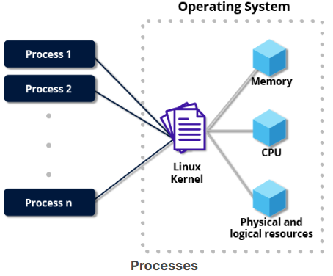
Process
In computing, a process is an instance of a running program. It's essentially the execution of a program’s instructions by the computer’s processor. Each process has its own allocated system resources, like memory and CPU time, and operates independently or alongside other processes.
A process typically goes through different states:
New: The process is being created.
Ready: The process is waiting to be assigned CPU time.
Running: The process is actively executing instructions.
Waiting: The process is paused, waiting for an event or resource.
Terminated: The process has completed or been stopped.
Multiple processes can run at the same time, and modern operating systems use process scheduling to manage them efficiently. Some processes are system-level (like background services), while others are user-initiated (like opening an application).

Slide 5
Types of Processes
Processes in a computer system can be categorized based on their functionality and interaction with the system. Here are the key types:
1. User Processes vs. System Processes
User Processes: Initiated by users (e.g., opening a web browser, running a text editor).
System Processes: Managed by the operating system (e.g., background services, kernel tasks).
2. Foreground vs. Background Processes
Foreground Process: Requires direct user interaction (e.g., playing a video).
Background Process (Daemon/Service): Runs without user input (e.g., antivirus scanning).
3. Independent vs. Cooperating Processes
Independent Process: Doesn't rely on other processes; executes its own tasks.
Cooperating Process: Shares data or resources with other processes.

Slide 6
4. Batch, Interactive, and Real-time Processes
Batch Process: Executes tasks sequentially with little or no user input (e.g., large-scale data processing).
Interactive Process: Responds to user commands (e.g., editing a document).
Real-time Process: Requires immediate execution; used in critical systems (e.g., air traffic control, medical devices).
5. Inter-process Communication (IPC) Processes
Parent Process: Initiates child processes.
Child Process: Spawned by a parent process; can operate independently or under supervision.
Zombie Process: Completed execution but still occupies system resources.
Orphan Process: Parent process terminates, leaving it running.
6. Multi-threaded vs. Single-threaded Processes
Single-threaded Process: Contains only one thread of execution, handling tasks sequentially.
Multi-threaded Process: Has multiple threads running concurrently, improving efficiency.

Slide 7
7. Long-lived vs. Short-lived Processes
Long-lived Process: Runs continuously, often system-related (e.g., OS services, network daemons).
Short-lived Process: Executes briefly and then terminates (e.g., small computation tasks).
8. Kernel Processes vs. User-space Processes
Kernel Processes: Operate within the OS kernel, managing system operations (e.g., memory management).
User-space Processes: Run applications outside the kernel, interacting with the system through APIs.

Slide 8
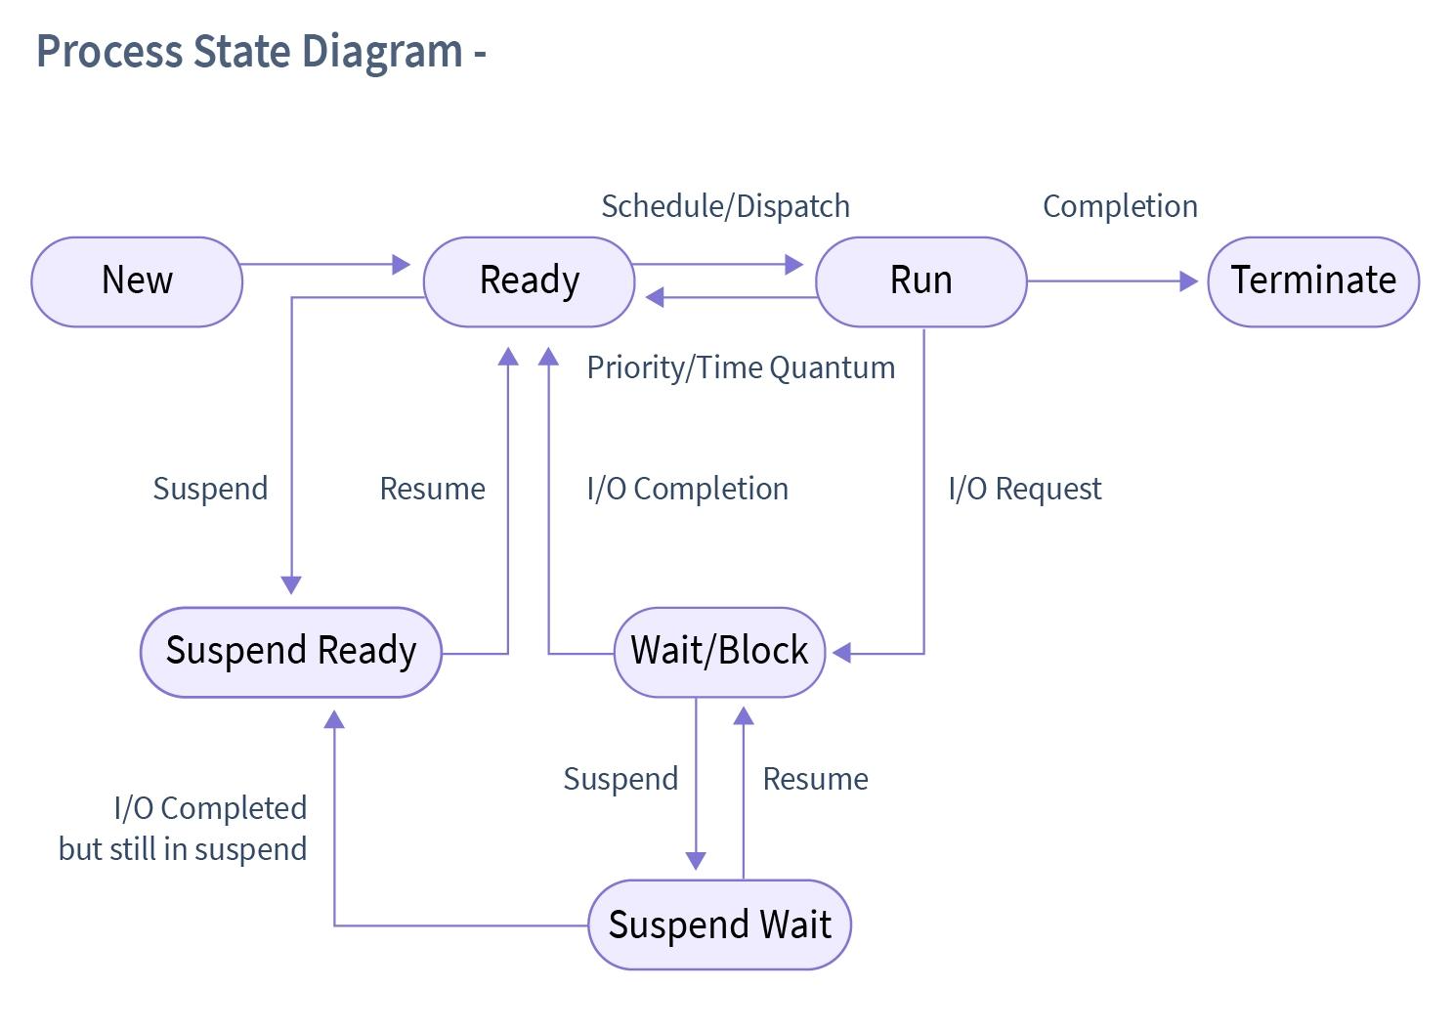
Process States
A process state refers to the current condition of a process as it executes within the operating system. A process moves through various states during its lifecycle. Here are the key process states:
1. New
The process is being created.
It has been initialized but has not yet started execution.
2. Ready
The process is waiting for CPU time.
It is prepared to run but is waiting for scheduling by the OS.

Slide 9
Process States
3. Running
The process is actively being executed by the CPU.
At any time, only one process per processor can be in this state.
4. Waiting (Blocked)
The process is paused, waiting for an event (e.g., I/O operation, user input).
It cannot proceed until the required event occurs.
5. Terminated (Exit)
The process has completed execution or has been forcefully stopped.
Resources allocated to the process are released.
6. Suspended States (Optional)
Some operating systems introduce suspended states:
Suspended-Ready: The process is in secondary memory, waiting to be moved back to the ready queue.
Suspended-Blocked: The process is paused and placed in secondary memory, waiting for an event.

Slide 10

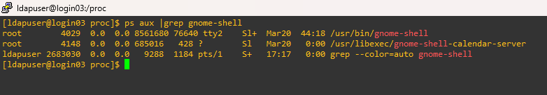
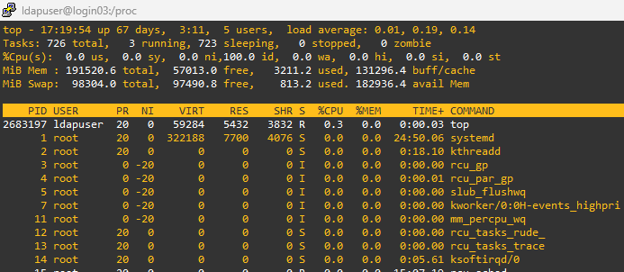
You can verify the state of a process in Linux using various commands. Here are some common methods:
1. Using the ps Command
The ps command displays information about active processes.
To check the state of a process:
$ps aux | grep <process_name>
2. Using the top Command
$top

Slide 11

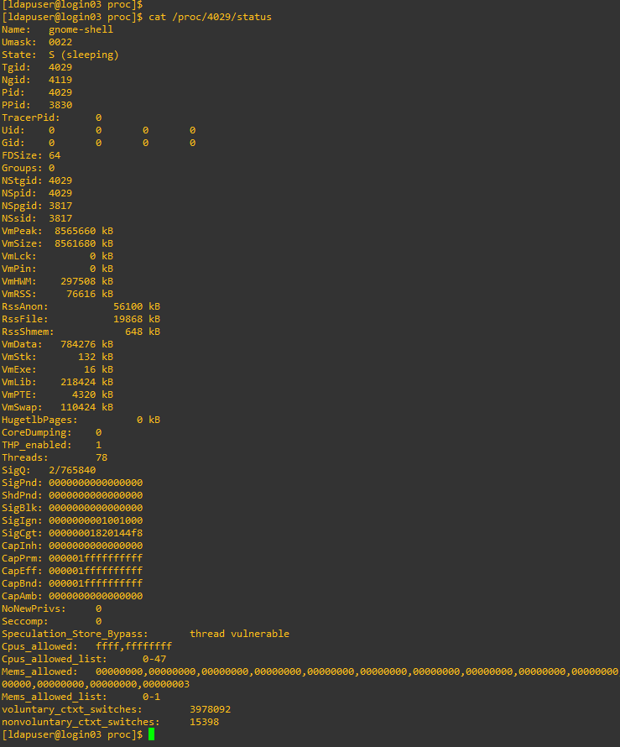
3. Checking /proc Filesystem
Each process has a directory under /proc with its PID. You can check its status:
$cat /proc/<PID>/status | grep State
4. Terminate the process
The process can be terminated by using the kill command.
$kill -9 <PID>

Slide 12
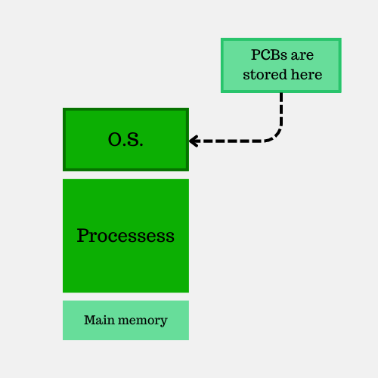
Process Control Block (PCB)
A Process Control Block (PCB) is a data structure that is used by an Operating System to manage and regulate how processes are carried out. In operating systems, managing the process and scheduling them properly play the most significant role in the efficient usage of memory and other system resources. In the process control block, all the details regarding the process corresponding to it like its current status, its program counter, its memory use, its open files, and details about CPU scheduling are stored. With the creation of a aim of helping the OS to manage the enormous amounts of tasks that are being
process, a PCB is created which controls how that process is being carried out. The PCB is created with thecarried out in the system. PCB is helpful in doing that as it helps the OS to actively monitor the process and redirect system resources to each process to accordingly. The OS creates a PCB for every process which is created, and it contains all the important information about the process. All this information is afterward used by the OS to manage processes and run them efficiently.

Slide 13
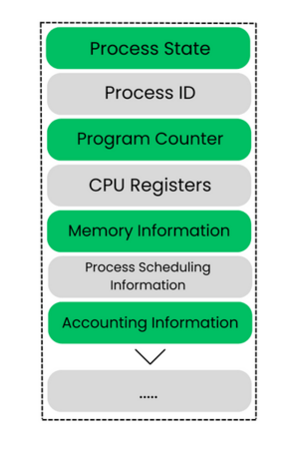
Process Control Block Terminologies :
Process State: Indicates the current state of the process (e.g., new, ready, running, waiting, or terminated).
Process ID: A unique identifier assigned to each process to distinguish it from others.
Program Counter: Stores the address of the next instruction to be executed.
CPU Registers: Holds the values of registers used by the process, including accumulators, index registers, and stack pointers.
Memory Management Information: Includes details like base address, limit registers, and memory allocation tables.
Process Scheduling Information: Contains priority levels, scheduling queues, and other parameters used for scheduling decisions.
Accounting Information: Tracks CPU usage, memory consumption, execution time, and other performance metrics.

Slide 14
Process Control Block Operations:
1. Process Scheduling
The PCB stores information like process priority, state, and resources used, which helps the OS schedule processes efficiently.
It assists in context switching, allowing the OS to save and restore process states when switching between tasks.
2. Memory Management
The PCB contains memory allocation details, including base address and limit registers.
It helps the OS track memory usage and allocate resources dynamically.
3. Process Synchronization & Communication
The PCB maintains process dependencies, ensuring smooth execution of interdependent processes.
It facilitates Inter-Process Communication (IPC) by storing information about shared resources.
4. Resource Allocation & Accounting
The PCB tracks CPU usage, execution time, and I/O operations to optimize resource distribution.
It helps in monitoring system performance and enforcing security policies.

Slide 15
5. Error Handling & Termination
The PCB stores error codes and process exit status, allowing the OS to handle failures gracefully.
It ensures proper cleanup of resources when a process terminates.

Slide 16
Context Switching
Context switching is a crucial mechanism in operating systems that allows the CPU to switch between multiple processes efficiently. Context switching refers to the process of saving the state of a currently running process and loading the state of another process. This enables multitasking and ensures that different processes get a fair share of CPU time.
Context switching occurrence:
Multitasking: The OS switches between processes to allow multiple applications to run simultaneously.
Interrupt Handling: When an interrupt occurs (e.g., I/O request or hardware event), the OS switches to handle it.
User & Kernel Mode Switching: When a process transitions between user mode and kernel mode, a context switch may be required.

Slide 17
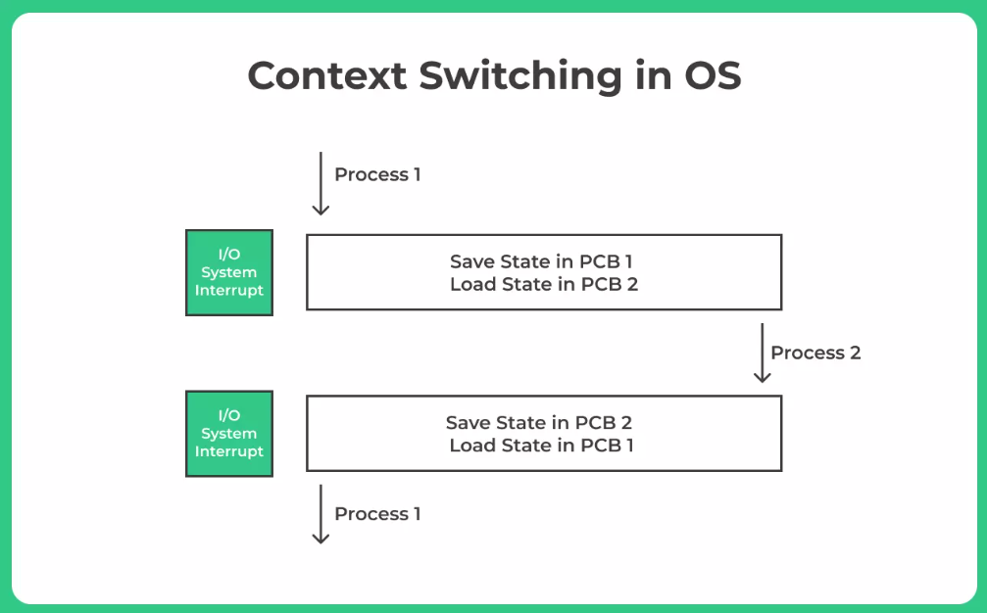
Steps in Context Switching
Save the current process state (registers, program counter, memory allocation).
Update the PCB (Process Control Block) of the current process.
Move the process to the appropriate queue (ready queue, I/O queue, etc.).
Select a new process for execution based on scheduling policies.
Load the new process state from its PCB.
Resume execution of the new process.
Context Switching Overhead
Context switching introduces overhead, as the CPU spends time saving and restoring process states instead of executing instructions. The efficiency of context switching depends on factors like:
Hardware support: Some processors have multiple register sets, reducing the time needed for switching.
Operating system design: More complex OS designs require additional work during a context switch.
Memory speed: Faster memory access reduces the delay in saving and restoring process states.

Slide 18
Process Control Blocks (PCBs) are essential for managing processes in operating systems, and they play a crucial role in various real-world applications. Here are some examples of PCB usage:
1. Operating Systems in Computers
Every modern operating system, including Windows, Linux, and macOS, uses PCBs to manage multiple processes efficiently.
They help in context switching, ensuring smooth multitasking.
2. Embedded Systems
Devices like smartphones, routers, and IoT devices use PCBs to manage background processes.
They ensure efficient resource allocation and process scheduling.
3. Banking Systems
ATMs and online banking platforms rely on PCBs to handle multiple transactions securely.
They help in process synchronization to prevent conflicts in financial operations.
4. Industrial Automation
Factories use robotic systems and automated machinery that depend on PCBs for process control.

Slide 19
They ensure real-time execution of tasks like assembly line operations.
5. Healthcare Systems
Medical devices such as MRI machines, patient monitoring systems, and diagnostic tools use PCBs to manage multiple processes.
They help in data processing and real-time monitoring.
6. Telecommunications
Mobile networks and internet services rely on PCBs to handle data transmission and call processing.
They ensure efficient communication between multiple users.
7. Aerospace & Defense
Flight control systems in aircraft and satellites use PCBs to manage navigation and communication.
They help in real-time decision-making and system monitoring.

Slide 20
CPU Scheduling
CPU scheduling is a process that allows one process to use the CPU while the execution of another process is on hold(in waiting state) due to unavailability of any resource like I/O etc, thereby making full use of CPU. The aim of CPU scheduling is to make the system efficient, fast, and fair.
Whenever the CPU becomes idle, the operating system must select one of the processes in the ready queue to be executed. The selection process is carried out by the short-term scheduler (or CPU scheduler). The scheduler selects from among the processes in memory that are ready to execute and allocates the CPU to one of them.
In Multiprogramming, if the long-term scheduler selects multiple I/O binding processes then most of the time, the CPU remains idle. How does the CPU decide which process should be executed next from the ready queue for maximum utilization of the CPU? This procedure of "scheduling" the processes, is called CPU scheduling.

Slide 21
CPU Scheduling Time Terminologies:
Arrival Time: The time at which the process arrives in the ready queue.
Completion Time: The time at which the process completes its execution.
Burst Time: Time required by a process for CPU execution.
Turn Around Time: Time Difference between completion time and arrival time.
            Turn Around Time = Completion Time – Arrival Time
Waiting Time(W.T): Time Difference between turn around time and burst time.
            Waiting Time = Turn Around Time – Burst Time

Slide 22
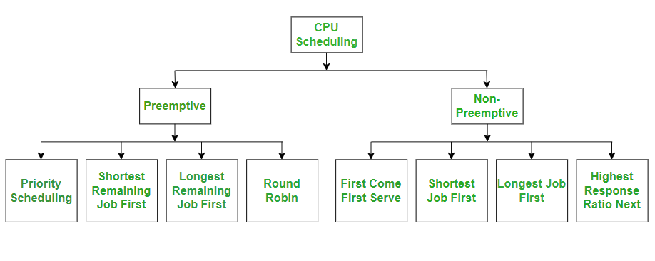
Types of CPU Scheduling Algorithms:
Preemptive Scheduling: Preemptive scheduling is used when a process switches from running state to ready state or from the waiting state to the ready state.
Non-Preemptive Scheduling: Non-Preemptive scheduling is used when a process terminates , or when a process switches from running state to waiting state.
Scheduling Algorithms

Slide 23
Preemptive Scheduling Algorithms:
Preemptive scheduling allows the operating system to interrupt a running process and allocate CPU time to another process based on priority or execution time. Here are some common preemptive scheduling algorithms:
1. Priority Scheduling (Preemptive)
Each process is assigned a priority.
The CPU is allocated to the highest-priority process.
If a new process arrives with a higher priority, it preempts the current process.
Advantage: Ensures important tasks are executed first.
Disadvantage: Lower-priority processes may suffer starvation.
2. Shortest Remaining Job First (SRTF)
The process with the shortest remaining execution time is selected.
If a new process arrives with a shorter remaining time, it preempts the current process.
Advantage: Minimizes average waiting time.
Disadvantage: Requires accurate burst time prediction.

Slide 24
3. Longest Remaining Job First (LRJF)
The process with the longest remaining execution time is selected.
If a new process arrives with a longer remaining time, it preempts the current process.
Advantage: Can be useful in specific scenarios where long processes need priority.
Disadvantage: Shorter tasks may experience delays.
4. Round Robin (RR)
Each process gets a fixed time slice (quantum).
After the time slice expires, the process is preempted and moved to the back of the queue.
Advantage: Ensures fairness among processes.
Disadvantage: Frequent context switching can reduce efficiency.

Slide 25
Non-Preemptive Scheduling Algorithms:
Non-preemptive scheduling ensures that once a process starts execution, it cannot be interrupted until it either completes or voluntarily enters a waiting state. Here are some common non-preemptive scheduling algorithms:
1. First Come First Serve (FCFS)
Processes execute in the order they arrive.
Implemented using a FIFO (First-In-First-Out) queue.
Advantage: Simple and easy to implement.
Disadvantage: Can lead to convoy effect, where long processes delay shorter ones.
2. Shortest Job First (SJF)
The process with the shortest burst time is executed first.
Advantage: Minimizes average waiting time.
Disadvantage: Can cause starvation for longer processes.

Slide 26
3. Longest Job First (LJF)
The process with the longest burst time is executed first.
Advantage: Ensures longer tasks get priority.
Disadvantage: Shorter tasks may experience delays.
4. Highest Response Ratio Next (HRRN)
Prioritizes processes based on response ratio:
  [ \text{Response Ratio} = \frac{\text{Waiting Time} + \text{Burst Time}}{\text{Burst Time}} ]
Advantage: Balances fairness and efficiency.
Disadvantage: Requires complex calculations for response ratio.

Slide 27
Synchronization Basics
Process Synchronization is used in a computer system to ensure that multiple processes or threads can run concurrently without interfering with each other.
The main objective of process synchronization is to ensure that multiple processes access shared resources without interfering with each other and to prevent the possibility of inconsistent data due to concurrent access. To achieve this, various synchronization techniques such as semaphores, monitors, and critical sections are used.
In a multi-process system, synchronization is necessary to ensure data consistency and integrity, and to avoid the risk of deadlocks and other synchronization problems. Process synchronization is an important aspect of modern operating systems, and it plays a crucial role in ensuring the correct and efficient functioning of multi-process systems.
On the basis of synchronization, processes are categorized as one of the following two types:
Independent Process: The execution of one process does not affect the execution of other processes.
Cooperative Process: A process that can affect or be affected by other processes executing in the system.

Slide 28
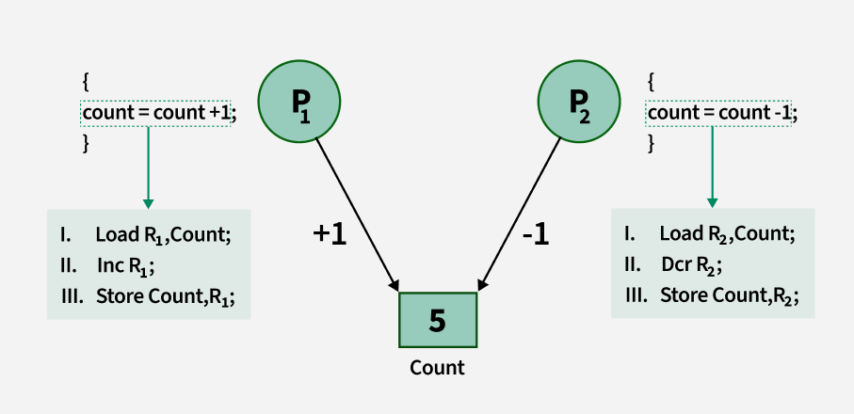
Process Synchronization
Process Synchronization is the coordination of execution of multiple processes in a multi-process system to ensure that they access shared resources in a controlled and predictable manner. It aims to resolve the problem of race conditions and other synchronization issues in a concurrent system.
1. Lack of Synchronization in Inter Process Communication Environment leads to following problems:
Inconsistency: When two or more processes access shared data at the same time without proper synchronization. This can lead to conflicting changes, where one process’s update is overwritten by another, causing the data to become unreliable and incorrect.

Slide 29
2. Loss of Data: Loss of data occurs when multiple processes try to write or modify the same shared resource without coordination. If one process overwrites the data before another process finishes, important information can be lost, leading to incomplete or corrupted data.
3 Deadlock: Lack of Synchronization leads to Deadlock which means that two or more processes get stuck, each waiting for the other to release a resource. Because none of the processes can continue, the system becomes unresponsive and none of the processes can complete their tasks.
Types of Process Synchronization
The two primary type of process Synchronization in an Operating System are:
Competitive: Two or more processes are said to be in Competitive Synchronization if and only if they compete for the accessibility of a shared resource.
Cooperative: Two or more processes are said to be in Cooperative Synchronization if and only if they get affected by each other i.e. execution of one process affects the other process.

Slide 30
Scheduling Techniques
Synchronization techniques refer to methods used in computing to coordinate multiple processes or threads so they can work together efficiently without conflicts. These techniques ensure that shared resources are accessed in a controlled manner, preventing issues like race conditions, deadlocks, and data inconsistencies.
1. Mutual Exclusion (Mutex)
Mutual exclusion ensures that only one process accesses a shared resource at a time. This prevents multiple processes from modifying the same data simultaneously.
Methods of Mutual Exclusion:
Mutex Locks: Ensures that only one process/thread enters the critical section at a time.
Spinlocks: Continuously checks if the lock is available (used in busy waiting).
Test-and-Set Lock: Atomic operation to check and set the lock in one step.

Slide 31
2. Semaphores
Semaphores are integer variables used for process synchronization. They help manage resource allocation in a controlled manner.
Types of Semaphores:
Binary Semaphore: Works like a simple lock (values: 0 or 1).
Counting Semaphore: Manages access for multiple processes to a resource (useful for limiting access).
Operations:
wait() (P): Decreases the semaphore value; if it reaches zero, the process waits.
signal() (V): Increases the semaphore value, allowing another process to enter.
3. Monitors
Monitors are high-level synchronization constructs that encapsulate shared resources, allowing safe access through predefined procedures.
Components of Monitors:
Condition Variables: Used to block a process until a certain condition is met.
Entry & Exit Procedures: Ensures controlled access to shared data.

Slide 32
4. Message Passing
In distributed systems, synchronization is achieved using message passing instead of shared memory.
Types of Message Passing:
Direct Communication: Processes send messages directly to each other.
Indirect Communication: Messages are exchanged through a shared mailbox.
5. Critical Section Handling
A critical section is a portion of code that modifies shared resources. The OS ensures only one process executes the critical section at a time.
Solutions for Critical Section Problems:
Peterson’s Algorithm: Software-based mutual exclusion method.
Bakery Algorithm: Assigns ticket numbers to processes for ordering execution.
Test-and-Set & Compare-and-Swap: Atomic operations used in synchronization.

Slide 33
6. Barrier Synchronization
In parallel computing, barrier synchronization ensures that all processes reach a certain point before proceeding.
Example Usage:
In multi-threaded applications, all threads must complete a task before moving to the next step.
7. Readers-Writers Problem
Handles synchronization when multiple processes need to read/write shared data.
Rules:
Readers can access the data simultaneously.
Writers must have exclusive access to prevent inconsistencies.

Slide 34
Practice Lab
• Write a C program to create child processes using fork()
• Simulate context switching with multiple processes by alternating I/O and CPU operations manually using sleep or scheduling.
• Simulate scheduling algorithms (FCFS, SJF, Round Robin, Priority) using C or Python.
• Implement mutual exclusion using semaphores (P()/V() operations in C)

