Slide 1

Linux and Operating System
Presenter
Arun Kumar
Senior Project Engineer
Software Technology & Cyber Security Group
Notes:
1.7.2013
‹#›

Slide 2
Course Outline
01
Introduction of Linux
04
Memory Management
02
Shell Scripting
05
File Systems
03
Processes & Scheduling
06
Package Managers
Notes:
1.7.2013
‹#›

Slide 3
Memory Management
01
Memory Allocation Techniques
02
Segmentation
03
Paging
04
Virtual Memory
Notes:
1.7.2013
‹#›

Slide 4
Memory Management
The term memory can be defined as a collection of data in a specific format. It is used to store instructions and process data. The memory comprises a large array or group of words or bytes, each with its own location. The primary purpose of a computer system is to execute programs. These programs, along with the information they access, should be in the main memory during execution. The CPU fetches instructions from memory according to the value of the program counter. To achieve a degree of multiprogramming and proper utilization of memory, memory management is important.
Memory management mostly involves management of main memory. In a multiprogramming computer, the Operating System resides in a part of the main memory, and the rest is used by multiple processes. The task of subdividing the memory among different processes is called Memory Management. Memory management is a method in the operating system to manage operations between main memory and disk during process execution. The main aim of memory management is to achieve efficient utilization of memory.

Slide 5

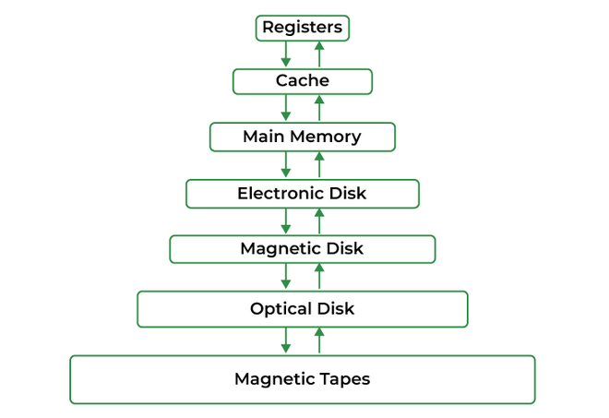
Main Memory:
The main memory is central to the operation of a Modern Computer. Main Memory is a large array of words or bytes, ranging in size from hundreds of thousands to billions. Main memory is a repository of rapidly available information shared by the CPU and I/O devices. Main memory is the place where programs and information are kept when the processor is effectively utilizing them. Main memory is associated with the processor, so moving instructions and information into and out of the processor is extremely fast. Main memory is also known as RAM (Random Access Memory). This memory is volatile. RAM loses its data when a power interruption occurs.

Slide 6
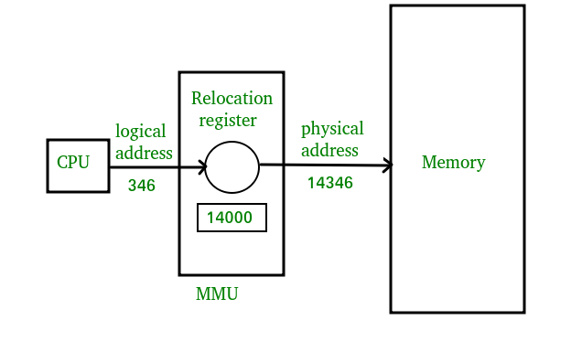
Logical and Physical Address Space:
Logical Address Space: An address generated by the CPU is known as a “Logical Address”. It is also known as a Virtual address. Logical address space can be defined as the size of the process. A logical address can be changed.
Physical Address Space: An address seen by the memory unit (i.e. the one loaded into the memory address register of the memory) is commonly known as a “Physical Address”. A Physical address is also known as a Real address. The set of all physical addresses corresponding to these logical addresses is known as Physical address space. A physical address is computed by MMU. The run-time mapping from virtual to physical addresses is done by a hardware device Memory Management Unit(MMU). The physical address always remains constant.

Slide 7
Static and Dynamic Loading:
Loading a process into the main memory is done by a loader. There are two different types of loading :
Static Loading: Static Loading is basically loading the entire program into a fixed address. It requires more memory space.
Dynamic Loading: The entire program and all data of a process must be in physical memory for the process to execute. So, the size of a process is limited to the size of physical memory. To gain proper memory utilization, dynamic loading is used. In dynamic loading, a routine is not loaded until it is called. All routines are residing on disk in a relocatable load format. One of the advantages of dynamic loading is that the unused routine is never loaded. This loading is useful when a large amount of code is needed to handle it efficiently.

Slide 8
Static and Dynamic Linking:
To perform a linking task a linker is used. A linker is a program that takes one or more object files generated by a compiler and combines them into a single executable file.
Static Linking: In static linking, the linker combines all necessary program modules into a single executable program. So there is no runtime dependency. Some operating systems support only static linking, in which system language libraries are treated like any other object module.
Dynamic Linking: The basic concept of dynamic linking is similar to dynamic loading. In dynamic linking, "Stub" is included for each appropriate library routine reference. A stub is a small piece of code. When the stub is executed, it checks whether the needed routine is already in memory or not. If not available then the program loads the routine into memory.

Slide 9
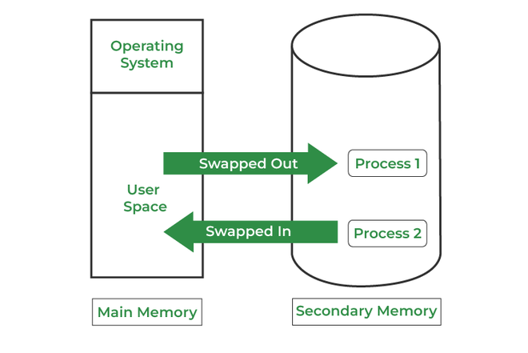
Swapping:
When a process is executed it must have resided in memory. Swapping is a process of swapping a process temporarily into a secondary memory from the main memory, which is fast compared to secondary memory. A swapping allows more processes to be run and can be fit into memory at one time. The main part of swapping is transferred time and the total time is directly proportional to the amount of memory swapped. Swapping is also known as roll-out, or roll because if a higher priority process arrives and wants service, the memory manager can swap out the lower priority process and then load and execute the higher priority process. After finishing higher priority work, the lower priority process swapped back in memory and continued to the execution process.

Slide 10
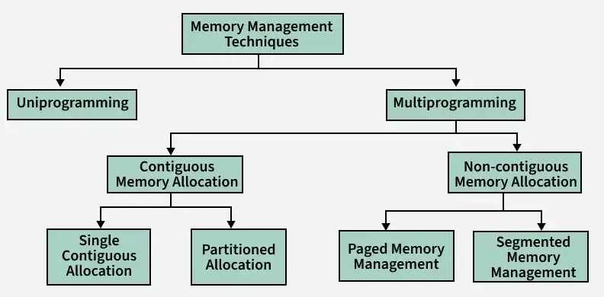
Memory Management Techniques:
Memory management techniques are methods used by an operating system to efficiently allocate, utilize, and manage memory resources for processes. These techniques ensure smooth execution of programs and optimal use of system memory
Different Memory Management techniques are:

Slide 11

Uniprogramming and multiprogramming are two different approaches to process execution in an operating system. Multiprogramming significantly improves CPU utilization and system efficiency compared to uniprogramming.
Uniprogramming
Only one program runs at a time.
The CPU remains idle when the program waits for input/output operations.
Simple memory management, as only one process occupies memory.
Used in older systems and embedded devices where multitasking isn't required.
Multiprogramming
Multiple programs are loaded into memory and executed concurrently.
The CPU switches between processes, utilizing idle time efficiently.
Requires complex memory management and scheduling algorithms.
Found in modern operating systems like Windows, Linux, and macOS.

Slide 12
Memory Allocation Techniques
To store the data and to manage the processes, we need a large-sized memory and, at the same time, we need to access the data as fast as possible. But if we increase the size of memory, the access time will also increase and, as we know, the CPU always generates addresses for secondary memory, i.e. logical addresses. But we want to access the main memory, so we need Address translation of logical address into physical address.
The main memory interacts with both the user processes and the operating system. So we need to efficiently use the main memory. Main memory is divided into non-overlapping memory regions called partitions.
The main memory can be broadly allocated in two ways:
Contiguous memory allocation
Non-Contiguous memory allocation

Slide 13
Contiguous Memory Allocation:
Contiguous memory allocation is a memory management method where each process is given a single, continuous block of memory. This means all the data for a process is stored in adjacent memory locations. Contiguous Memory Management has two types:
Fixed (or Static) Partition Allocation
Variable (or Dynamic) Partitioning Allocation

Slide 14
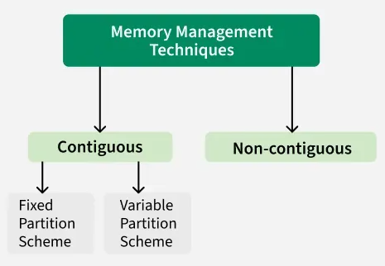
Partition Allocation Methods:
To gain proper memory utilization, memory allocation must be allocated efficient manner. One of the simplest methods for allocating memory is to divide memory into several fixed-sized partitions and each partition contains exactly one process. Thus, the degree of multiprogramming is obtained by the number of partitions.
Fixed (or Static) Partition Allocation: Memory is divided into fixed-sized partitions during system initialization. Each partition can hold only one process.
Variable (or Dynamic) Partitioning Allocation:
In this allocation strategy, Memory is divided into variable-sized partitions based on the size of the processes.

Slide 15
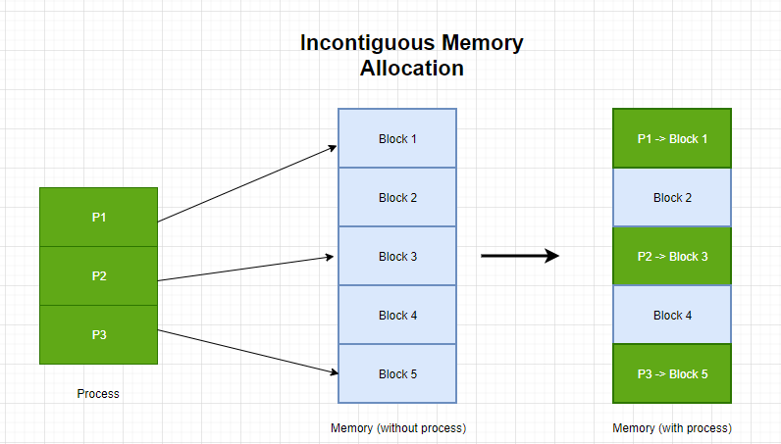
Non-Contiguous memory allocation:
Non-contiguous allocation, also known as dynamic or linked allocation, is a memory allocation technique used in operating systems to allocate memory to processes that do not require a contiguous block of memory. In this technique, each process is allocated a series of non-contiguous blocks of memory that can be located anywhere in the physical memory.
Non-contiguous allocation involves the use of pointers to link the non-contiguous memory blocks allocated to a process. These pointers are used by the operating system to keep track of the memory blocks allocated to the process and to locate them during the execution of the process.

Slide 16
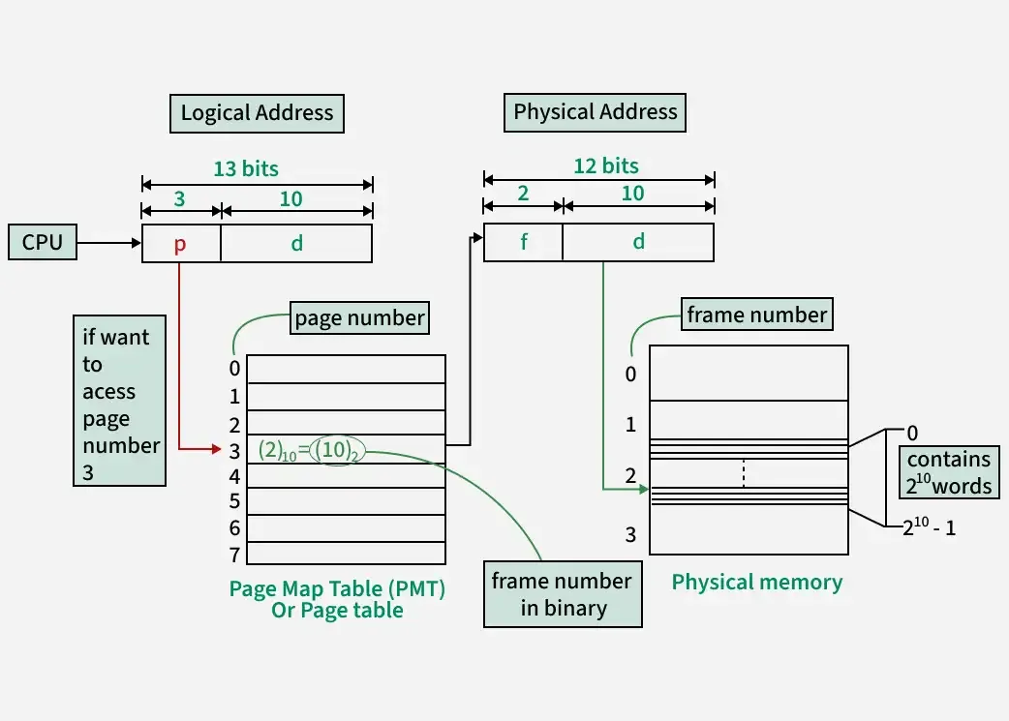
Primary approaches to implementing non-contiguous memory allocation:
Paging and Segmentation are the two ways that allow a process’s physical address space to be non-contiguous. It has the advantage of reducing memory wastage but it increases the overheads due to address translation. It slows the execution of the memory because time is consumed in address translation.
Paging: Paging is the process of moving parts of a program, called pages, from secondary storage (like a hard drive) into the main memory (RAM). The main idea behind paging is to break a program into smaller fixed-size blocks called pages. To keep track of where each page is stored in memory, the operating system uses a page table. This table shows the connection between the logical page numbers (used by the program) and the physical page frames (actual locations in RAM). The memory management unit uses the page table to convert logical addresses into physical addresses, so the program can access the correct data in memory.

Slide 17
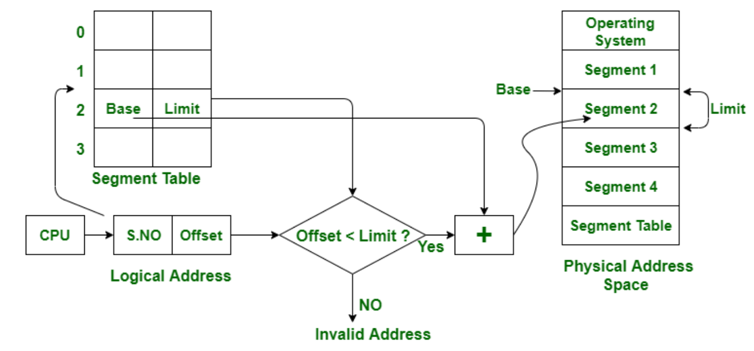
Segmentation: Segmentation is a memory management technique that divides a process into logical segments based on its structure, such as functions, arrays, or data structures. Unlike paging, which uses fixed-size blocks, segmentation allows for variable-sized partitions, making it more intuitive for programmers. Each segment has a base address and a limit, stored in a segment table, which helps the operating system manage memory efficiently. When a process requests memory, the OS assigns segments based on its needs, translating logical addresses into physical addresses using the segment table. Segmentation enhances memory protection by preventing unauthorized access to
different segments and allows for memory sharing between processes. However, it can lead to external fragmentation, where free memory is scattered across different locations. To mitigate this, segmentation is often combined with paging, creating a hybrid approach that optimizes memory usage while maintaining flexibility.

Slide 18
Virtual memory is a memory management technique used by operating systems to give the appearance of a large, continuous block of memory to applications, even if the physical memory (RAM) is limited. It creates the illusion of a larger memory space, enabling programs to run even when RAM is insufficient.
When a system runs out of RAM, it moves less frequently used data to a paging file on the hard drive or SSD, freeing up space for active processes. This helps prevent slowdowns and crashes, especially when multitasking.
The main objective of virtual memory is to support multiprogramming, The main advantage that virtual memory provides is, a running process does not need to be entirely in memory.
Programs can be larger than the available physical memory. Virtual Memory provides an abstraction of main memory, eliminating concerns about storage limitations.
A memory hierarchy, consisting of a computer system's memory and a disk, enables a process to operate with only some portions of its address space in RAM to allow more processes to be in memory.

Slide 19
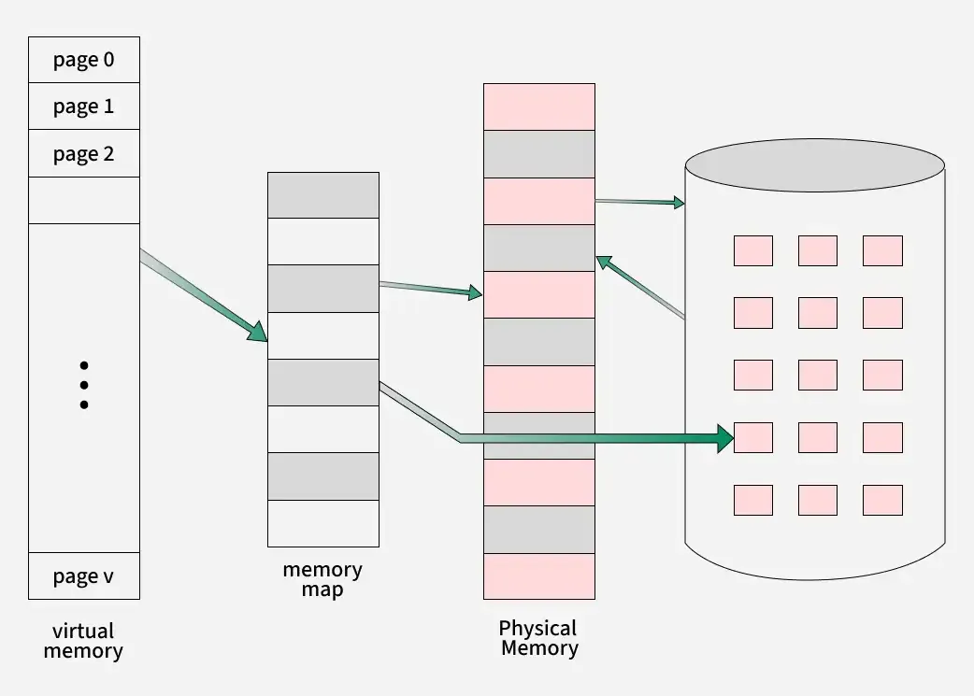
How Virtual Memory Works
The operating system divides memory into pages and stores them in page frames in RAM.
When RAM is full, less frequently used pages are moved to a paging file on the hard drive or SSD.
When needed again, the system retrieves these pages, causing a page fault.
This process ensures efficient multitasking and prevents system crashes due to memory shortages.

Slide 20
Practice Lab
Create page tables and perform address translation.
Convert logical addresses to physical using base and limit values for segments.
Simulate demand paging with page fault handling.

