Slide 1

Linux and Operating System
Presenter
Arun Kumar
Senior Project Engineer
Software Technology & Cyber Security Group
Notes:
1.7.2013
‹#›

Slide 2
Course Outline
01
02
03
04
05
06
Introduction of Linux
Shell Scripting
Processes & Scheduling
Memory Management
File Systems
Package Managers
Notes:
1.7.2013
‹#›

Slide 3
FILE SYSTEM
01
02
03
04
File System Type
Limux File System
FIle and Directory Permissions
Lab
Notes:
1.7.2013
‹#›

Slide 4
File System
File system in an operating system is a crucial component that dictates how data is stored, organized, and managed on storage devices such as hard drives, SSDs, and USB drives. It provides a structured way for users and applications to create, read, update, and delete files efficiently. The file system is responsible for maintaining directories, managing permissions, and ensuring data integrity. Different operating systems use various file systems, each with unique features and advantages. For example, FAT (File Allocation Table) is an older file system used in external storage devices, while NTFS (New Technology File System) is widely used in Windows due to its support for encryption and permissions. Linux-based systems commonly use ext (Extended File System), and macOS relies on APFS (Apple File System) for optimized performance. A file system also handles space allocation, preventing fragmentation and ensuring efficient storage utilization. Additionally, it maintains metadata such as file names, sizes, types, creation dates, and access permissions. Without a file system, an operating system would struggle to locate and retrieve stored data, making it an essential component for seamless computing.

Slide 5
Linux File Systems:
A Linux file system is a set of processes that controls how, where, and when data is stored or retrieved from storage devices. It manages data systematically on disk drives or partitions, and each partition in Linux has its own file system because Linux treats everything as a file, including devices and applications.. Like Windows uses C: and D: drives, Linux uses mount points, but everything appears under the root / directory. In Linux, everything is treated as a file, including devices and applications.
Key Terms of Linux File Systems:
Journaing : A journaling file system in Linux is designed to protect the integrity of your data by keeping a log—or journal—of changes before they’re actually written to the main file system. Think of it like a flight recorder for your data: if something goes wrong (like a power failure or system crash), the system can use the journal to recover and avoid corruption.

Slide 6
There are two main types of journaling:
Metadata journaling, which logs only changes to file system structure (like file names or permissions).
Full data journaling, which logs both the data and the metadata—this is safer but slower.
Versioning : Versioning in file systems refers to the ability to keep multiple historical versions of files, allowing users to access or restore previous states. Unlike journaling—which protects against corruption—versioning is about preserving history.
Inode : An inode is just a fixed-size record in a special on-disk inode table. Each record gets a unique integer—its inode number—and stores every scrap of metadata the kernel needs to reach a file’s data blocks except the file’s name or its path. Those two pieces live in directory entries that simply map the filename you type to the inode number the kernel cares about.

Slide 7
Linux File System Types:
EXT2 : Second Extended File System, is like the minimalist grandparent of modern Linux file systems—no journaling, no frills, just raw performance and simplicity. It was introduced in 1993 and became the default for many early Linux distributions. Ext2 support up to 32 TiB (block-size dependent) volumes and 2 TiB files (with 4 KiB blocks).
EXT3 : The Third Extended File System, was Linux’s first mainstream journaling file system—essentially ext2 with a safety net. Introduced in 2001, it brought reliability to the table without changing the on-disk layout, which meant you could upgrade from ext2 without reformatting. Ext3 support up to 16–32 TiB (block-size dependent) volumes and 2 TiB files (with 4 KiB blocks).
EXT4 : Short for Fourth Extended File System, is the default file system for many Linux distributions—and for good reason. It builds on ext3’s stability while adding performance, scalability, and reliability improvements. Instead of tracking every single block, ext4 uses extents—contiguous ranges of blocks. This reduces fragmentation and

Slide 8
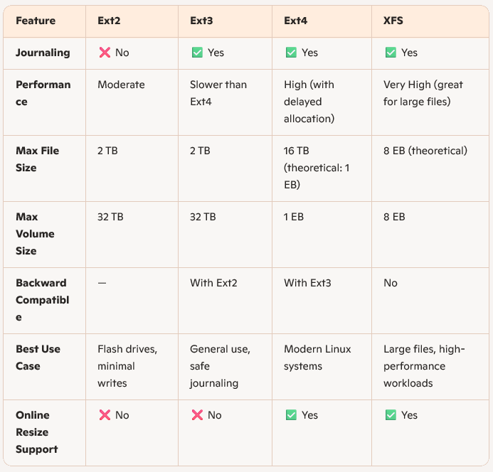
speeds up large file operations. Adds integrity to the journal itself, reducing the chance of corruption during recovery. Ext4 support up to 1 exbibyte (EiB) volumes and 16 tebibyte (TiB) files (with 4 KiB blocks). You can mount ext4 as ext3 or ext2 (with journaling disabled), and even convert ext3 to ext4 without reformatting.

Slide 9
XFS : XFS is a robust, high-performance journaling file system that excels in handling large files and parallel I/O operations, making it a favorite in enterprise and high-throughput environments. Developed originally by SGI, it’s designed with scalability in mind, supporting massive file and volume sizes up to exabytes. What sets XFS apart is its use of extent-based allocation and advanced metadata structures like B-trees, which enhance file access speed and efficient space management. It also employs journaling to protect against data loss during system crashes, and features like delayed allocation help reduce fragmentation and boost performance. XFS supports online resizing, meaning you can expand a mounted file system without downtime, though shrinking isn't supported.
It’s particularly well-suited to systems with multi-threaded workloads, high concurrency, or large storage arrays—think media servers, scientific computing, or database backends. With robust toolsets like xfs_repair, xfs_growfs, and quota journaling capabilities, XFS balances power and resilience, making it ideal when performance and reliability are top priorities.

Slide 10
File and Directory Permissions:
In Linux, file and directory permissions are a foundational part of the system’s security model. They determine who can access a file or directory and what they can do with it. Every file and directory has three types of permissions—read (r), write (w), and execute (x)—assigned to three categories of users: the owner, the group, and others.
Read (r): Lets you view the contents of a file or list the contents of a directory.
Write (w): Allows you to modify a file or add/delete files in a directory.
Execute (x): Lets you run a file as a program or enter a directory.
Numeric values : Read (r) - 4 , Write (w) -2 , Execute (x) -1
For example, a permission string like -rwxr-xr-- means:
The owner can read, write, and execute.
The group can read and execute.
Others can only read.

Slide 11
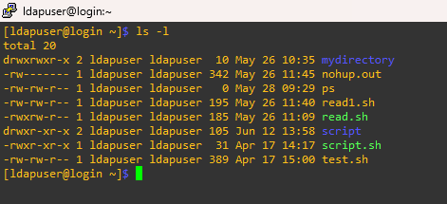
You can view permissions using ls -l and modify them with chmod, chown, and chgrp. These tools let you fine-tune access, whether you're locking down sensitive configs or opening up shared folders for collaboration.

Slide 12
OwnershipOwner :hip
There are three types of ownership in Linux:
User: The individual who created the file. This user has the ability to change the file's ownership.
Group: A collection of users. Users can belong to multiple groups, which simplifies permission management.
Other: This category includes all users on the system who are neither the owner nor part of the group associated with the file.

Slide 13
Modifying Permissions and Ownership :
To manage file permissions and ownership, Linux provides several commands:
Changing Ownership:
chown [user]:[group] filename : Changes the owner and/or group of a file.
Changing Permissions:
chmod [options] [mode] filename : Modifies the permissions of a file.
Symbolic Mode: For example, chmod u+x filename adds execute permission for the user owner.
Numeric Mode: For example, chmod 755 filename sets specific read, write, and execute permissions using octal values.

Slide 14
Practice Lab
• Explore and list the file systems used in your system.
• Format a partition using Ext4 and mount it on a directory.
• Change file permissions using chmod.

