Slide 1

Linux and Operating System
Presenter
Arun Kumar
Senior Project Engineer
Software Technology & Cyber Security Group
Notes:
1.7.2013
‹#›

Slide 2
Course Outline
01
02
03
04
05
06
Introduction of Linux
Shell Scripting
Processes & Scheduling
Memory Management
File Systems
Package Managers
Notes:
1.7.2013
‹#›

Slide 3
PACKAGE MANAGERS
01
02
03
04
Types of Package Managers
RPM (Red Hat-based systems)
APT(Debian-based systems)
Differences between RPM
and APT, YUM, DNF basics
Notes:
1.7.2013
‹#›

Slide 4


Package Managers in Linux

Slide 5





Objective of This Session
Understand what package managers are and how they function.
Learn the differences between APT, RPM, YUM, and DNF.
Perform hands-on tasks including installing and removing software via CLI.
Write a basic automation script for package installation.
Get comfortable with managing packages on Debian- and Red Hat-based systems.

Slide 6

What is a Package:
A package is a compressed file that includes:
Executable binaries (the program itself)
Configuration files
Metadata (such as version, author, license)
Dependency information (what other software is needed to run it)
Scripts (to install or uninstall properly)

Slide 7
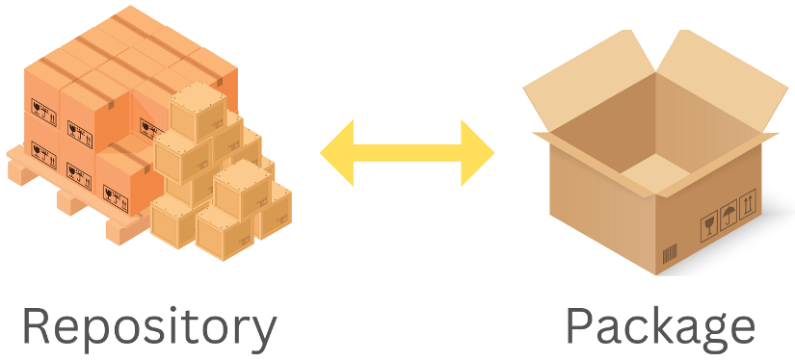
What are the Repositories:
While a user can obtain package files through any method of file transfer, it is typical to use software repositories (also called repos) to obtain packages. Repositories are simply the location where the packages are stored, commonly accessible via the internet. A repository can contain a single package or thousands of packages. Most Linux distributions have their own unique repositories, sometimes separating out their core's packages into one while additional features are in others.

Slide 8
What is a Package Manager
A package manager is a command-line or graphical tool used to automate the process of:
Installing,
Updating and,
Removing software packages on a Linux system.
Package managers keep track of the packages, making it easier to manage software on a Linux system. In Linux, package managers install packages from repositories.

Slide 9
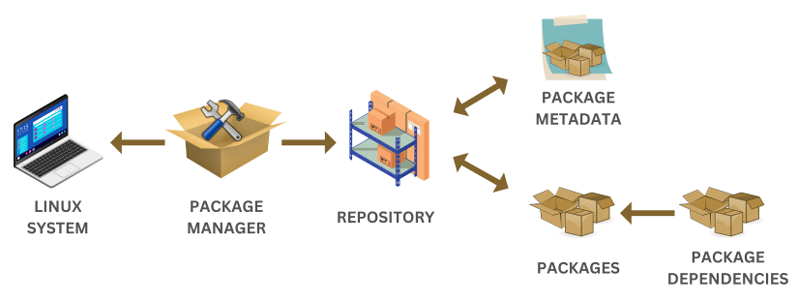
What is a Package Manager
The package manager is not exclusive to Linux; it is almost available in all operating systems. Developers construct and develop software applications and packages on the foundation of the Linux operating system.
The package manager requests a list of software packages that can be installed on the system by connecting to the repositories. It evaluates every package metadata to ensure that its dependencies are satisfied.

Slide 10
Functionalities of Package Manager in Linux
Installation: Package managers facilitate the installation of software packages from repositories or local files. They automatically handle dependencies, ensuring that all required components are installed.
Dependency Resolution: Linux software often relies on other packages. Package managers detect these dependencies and fetch and install them automatically.
Upgrading: Package managers allow users to update installed software to the latest versions. This helps in keeping the system secure and up-to-date.
Removal: Uninstalling software is straightforward with package managers. They ensure that all related files and dependencies are removed, preventing conflicts.
Querying: Users can query the package manager to get information about installed packages, available updates, and package details.

Slide 11
Types of Package Managers
Linux distributions use different package managers depending on the system architecture and philosophy. The main types are:
DEB-based (Debian Family)
Package Format: .deb
Popular Managers:
  APT (Advanced Package Tool)
  dpkg
Used in: Ubuntu, Debian, Linux Mint
2. RPM-based (Red Hat Family)
Package Format: .rpm
Popular Managers:
  YUM (Yellowdog Updater Modified) – older systems
  DNF (Dandified YUM) – newer Fedora, RHEL, CentOS
  RPM – low-level tool
Used in: Fedora, RHEL, CentOS, AlmaLinux, Rocky Linux

Slide 12
Types of Package Managers
Linux distributions use different package managers depending on the system architecture and philosophy. The main types are:
3. Source-based
Package Format: Source code (compiled locally)
Popular Managers:
  Portage (Gentoo)
  pkgsrc (NetBSD, also used on other Unix-like OSes)
4. Universal Package Managers
Designed to work across multiple distros
Examples:
  Snap (by Canonical)
  Flatpak
  AppImage (no package manager required -portable apps)

Slide 13
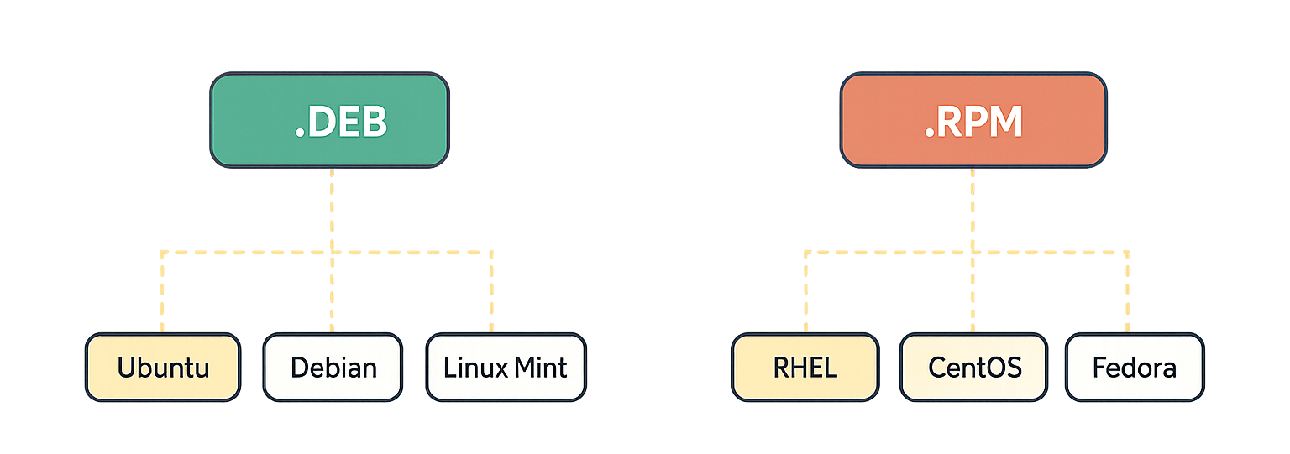
Categorization of Linux Distributions Based on Package Manager
Distributions such as RHEL, Fedora, and CentOS are based on the RPM package format. Hence, they are known as RPM-based distributions. The Debian family, including Ubuntu, Debian, Linux Mint, and others, makes use of Debian-based package managers such as APT (Advanced Package Tool).

Slide 14

Most Widely used Package Manager in Linux
1. APT (Advanced Package Tool):
APT (Advanced Package Tool) is a powerful and widely used package manager in the Linux world. It's the default package manager for Debian-based distributions, including Debian itself, Ubuntu, and Linux Mint. APT simplifies software management, ensuring that users can easily install, update, and remove packages while taking care of dependencies. Let's explore APT in more detail, including its commands and real-world examples.

Slide 15
Key Features of APT:
Dependency Resolution: APT is known for its robust dependency resolution capabilities. It automatically detects and installs any necessary libraries or packages required by the software you want to install. This ensures that the software functions correctly without manual intervention.
Repository Management: APT connects to online repositories where software packages are hosted. Users can configure which repositories to use, allowing them to install software from official sources and trusted third-party repositories.
Package Management: It allows users to manage packages on the system, including installation, upgrading, downgrading, and removal. Additionally, APT can lock packages to specific versions, ensuring system stability.
Cache Management: APT maintains a local cache of package information. This cache helps in faster package searches and updates. Users can update this cache using the apt-get update command.

Slide 16
Basic commands in APT:
1. Installing a package:
sudo apt-get install package-name
2. Updating the package list:
sudo apt-get update
3. Upgrading packages:
sudo apt-get upgrade
4. Removing a package:
sudo apt-get remove package-name
5. Searching for packages:
apt-cache search package-name

Slide 17
2. RPM (Red Hat Package Manager)
RPM (Red Hat Package Manager) is a powerful package management tool used on Linux systems, particularly in Red Hat-based distributions such as RHEL, Fedora, and CentOS. It enables users and system administrators to install, update, verify, and remove software packages efficiently. The rpm command provides direct control over individual package files, allowing for precise management of software on the system. RPM is essential for maintaining system stability and managing software dependencies in environments that rely on RPM-based package formats.
Basic Syntax of RPM
The basic syntax of the rpm command is as follows:
rpm [options] [package_name]
Here,
[options] represent various command-line options that control the behavior of the rpm command.
[package_name] refers to the name of the RPM package you want to work with.

Slide 18
Basic commands in RPM:
1. Installing a package:
rpm -i example
2. Upgrading a package using RPM:
rpm -U example
3. Checking if a package is installed:
rpm -q example
4. Verifying package integrity:
rpm -V example
5. Uninstalling a package:
rpm -e example

Slide 19
3. YUM (Yellowdog Updater, Modified):
YUM (Yellowdog Updater, Modified) is a package manager primarily used in Red Hat-based Linux distributions such as CentOS, Fedora, and RHEL (Red Hat Enterprise Linux). YUM has played a significant role in simplifying package management on these systems, although it's important to note that in recent years, dnf (Dandified YUM) has become the modern and recommended replacement for YUM. Here, we will discuss YUM, its commands, and provide examples of its usage.
Key Features of YUM:
Dependency Resolution: YUM, like APT, is adept at handling complex dependency resolution. It automatically identifies and installs any necessary dependencies for the packages you want to install, ensuring that your software functions correctly.
Repository Management: YUM interacts with software repositories to fetch and install packages. Users can configure these repositories to obtain software from both official sources and trusted third-party repositories.
Package Management: YUM provides a set of commands to manage packages on the system. This includes installing, updating, downgrading, and removing packages, as well as listing installed packages and their information.
Cache Management: YUM maintains a local cache of metadata from the repositories. This cache improves package search and installation speed. You can update this cache using the yum makecache command.

Slide 20
Basic commands in YUM:
1. Installing a package:
sudo yum install package-name
2. Updating the package list:
sudo yum makecache
3. Upgrading packages:
sudo yum update
4. Removing a package:
sudo yum remove package-name

Slide 21
4. dnf Package Manager
dnf is the successor to YUM and is now the recommended package manager for Fedora-based distributions. It provides a more modern and user-friendly experience. The syntax and commands for dnf are similar to yum.
Some dnf examples are:
1. Installing a package:
2. Updating packages:
sudo dnf install package-name
sudo dnf upgrade

Slide 22
Difference b/w RPM, APT, YUM and DNF
Feature | RPM | APT | YUM | DNF
Type | Low-level package format/manager | High-level package manager | High-level package manager | High-level package manager (YUM's successor)
Primary Role | Install/manage individual packages | Automate software management with dependencies | Automate software management with dependencies | Automate software management with improved performance
Package Format | .rpm | .deb | .rpm | .rpm
Dependency Mgmt. | Manual (tells you what's missing) | Automatic | Automatic | Automatic (and improved)
Used In | Red Hat-based distributions | Debian-based distributions | Older Red Hat-based distributions | Modern Red Hat-based distributions
Speed/Perf. | N/A (low-level) | Fast | Slower than DNF | Faster than YUM

Slide 23
LABS:
Install and remove a package using both RPM and APT.
Install a .rpm file manually and verify the installation.
Create a shell script to automate the installation of a software suite using a package manager.

