Slide 1



OPENMP PROGRAMMING
National
Supercomputing
Mission
Centre for HPC Upskilling & Knowledge-sharing
Centre for Development of Advanced Computing
September 22 to 25, 2026, OpenMP Programming, C-HUK-ACC
Ankit Mishra
ankitkumarbm@cdac.in
C-DAC, Bengaluru

Slide 2

CONTENT
Introduction to OpenMP
OpenMP Programming Model
OpenMP Programs
OpenMP Use Cases
Conclusion
References
September 22 to 25, 2026, OpenMP Programming, C-HUK-ACC
C-HUK HPC Advanced Certification Course

Slide 3
INTRODUCTION TO OPENMP
OpenMP is an Application Program Interface (API).
The API supports C, C++ and FORTRAN.
OpenMP is designed for multi-processor/shared memory machines.
September 22 to 25, 2026, OpenMP Programming, C-HUK-ACC
C-HUK HPC Advanced Certification Course

Slide 4
INTRODUCTION TO OPENMP : PROCESS AND THREAD CONCEPTS
Process:
“The Program in execution is called Process.”
Thread:
“The smallest unit of execution within a process is called Thread.”
Each thread has its own stack, register set, program counter.
September 22 to 25, 2026, OpenMP Programming, C-HUK-ACC
C-HUK HPC Advanced Certification Course

Slide 5
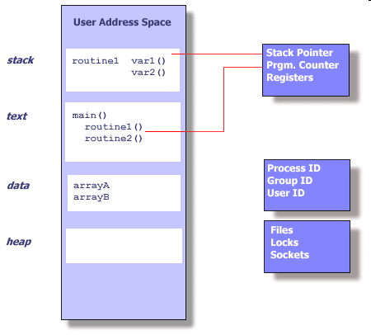
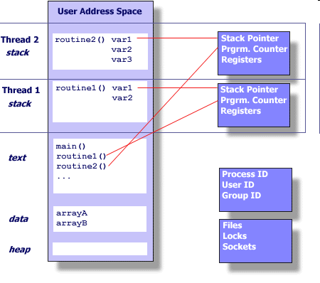
INTRODUCTION TO OPENMP : PROCESS AND THREAD CONCEPTS
September 22 to 25, 2026, OpenMP Programming, C-HUK-ACC
C-HUK HPC Advanced Certification Course

Slide 6
INTRODUCTION TO OPENMP : PROCESS AND THREAD CONCEPTS
Multi-threading:
“The execution of multiple threads concurrently within a single process is called Multi-threading.”
The Threads created are called team of threads.
The creation of multiple thread is called thread spawning.
September 22 to 25, 2026, OpenMP Programming, C-HUK-ACC
C-HUK HPC Advanced Certification Course

Slide 7
INTRODUCTION TO OPENMP : PROCESS AND THREAD CONCEPTS
Master Thread:
“Each process contains at least one thread is called Master Thread.”
Worker Thread:
“The thread spawned out of Master thread in multi-threading is called Worker thread.”
September 22 to 25, 2026, OpenMP Programming, C-HUK-ACC
C-HUK HPC Advanced Certification Course

Slide 8
INTRODUCTION TO OPENMP : PROCESS AND THREAD CONCEPTS
NOTE:
Master Thread is primary thread in a multithreaded program responsible for spawning and coordinating Worker Threads.
OpenMP provides Shared Memory based thread-based parallelism.
September 22 to 25, 2026, OpenMP Programming, C-HUK-ACC
C-HUK HPC Advanced Certification Course

Slide 9
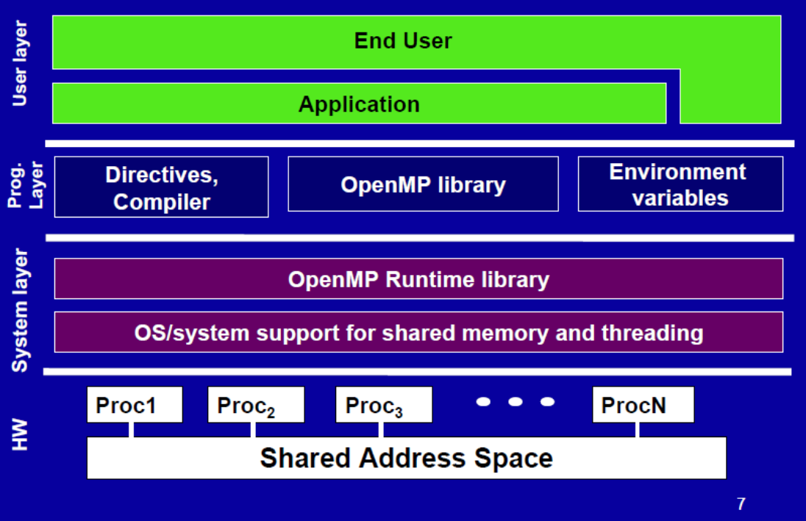
INTRODUCTION TO OPENMP :
OPENMP STACK
September 22 to 25, 2026, OpenMP Programming, C-HUK-ACC
[4]
Image: OpenMP Stack
C-HUK HPC Advanced Certification Course

Slide 10
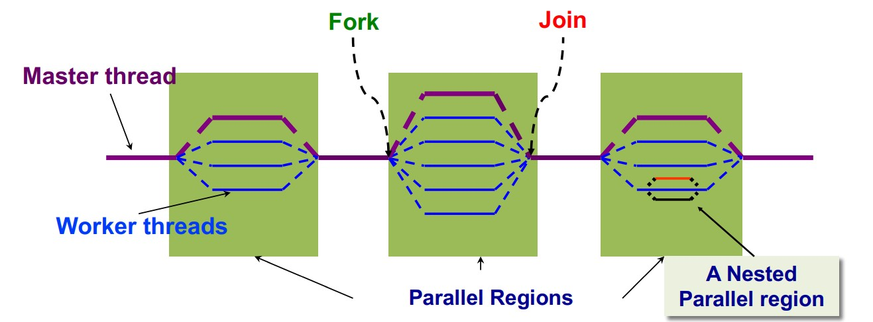
OPENMP PROGRAMMING MODEL : FORK – JOIN PARALLELISM
OpenMP uses Fork – Join Model for Parallelization.
September 22 to 25, 2026, OpenMP Programming, C-HUK-ACC
Image: OpenMP Fork – Join Programming Model
C-HUK HPC Advanced Certification Course

Slide 11
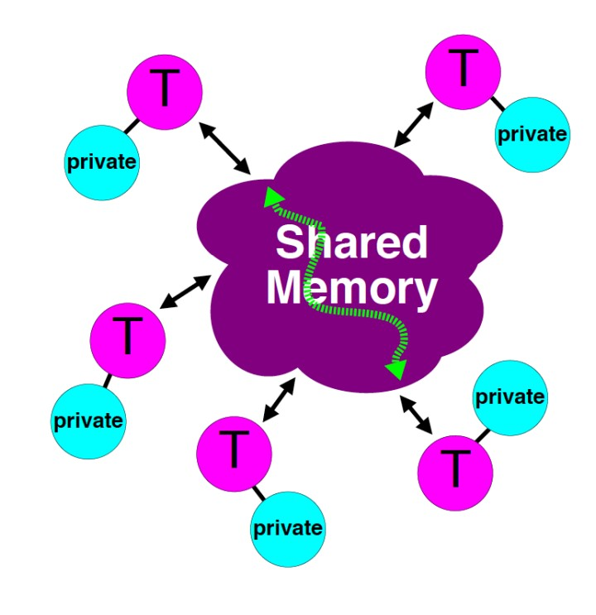
OPENMP PROGRAMMING MODEL : OPENMP MEMORY MODEL
Threads can communicate by reading/writing variables in the common address space.
Data is private or shared.
Private accessed only by owned threads.
Shared data accessible by all threads.
September 22 to 25, 2026, OpenMP Programming, C-HUK-ACC
Image: Memory Model
C-HUK HPC Advanced Certification Course

Slide 12

OPENMP PROGRAMMING MODEL : SERIAL PROGRAM
#include <iostream>
int main()
{
int ID ;
std::cout << "Hello my ID is : " << ID << std::endl;
return(0);
}
September 22 to 25, 2026, OpenMP Programming, C-HUK-ACC
C-HUK HPC Advanced Certification Course

Slide 13
OPENMP PROGRAMMING MODEL : OPENMP PROGRAM SKELETON
FORMAT:
Sentinel | directive-name | [clause ...] | newline
Required for all OpenMP C/C++ Directives #pragma omp | A valid OpenMP directive. Must appear after the pragma and before any clauses. | Optional. Clauses can be in any order, and repeated as necessary unless otherwise restricted. | Required. Proceeds the structured block which is enclosed by this directive.
September 22 to 25, 2026, OpenMP Programming, C-HUK-ACC
C-HUK HPC Advanced Certification Course

Slide 14
OPENMP PROGRAMMING MODEL : OPENMP PROGRAM SKELETON
C/C++ Compiler Directive Format
sentinel directive-name clause‫‏‬
Example
#pragma omp parallel for‫‏‬
September 22 to 25, 2026, OpenMP Programming, C-HUK-ACC
C-HUK HPC Advanced Certification Course

Slide 15
OPENMP PROGRAMMING MODEL : OPENMP PROGRAM SKELETON
#include <iostream>
#include <omp.h>
int main() {
omp_set_num_threads (4);
//continue to next slide…
September 22 to 25, 2026, OpenMP Programming, C-HUK-ACC
C-HUK HPC Advanced Certification Course

Slide 16
OPENMP PROGRAMMING MODEL : OPENMP PROGRAM SKELETON
#pragma omp parallel
{
int ID = omp_get_thread_num();
std::cout << "Hello my ID is : " << ID << std::endl;
}
return (0);
}
September 22 to 25, 2026, OpenMP Programming, C-HUK-ACC
C-HUK HPC Advanced Certification Course

Slide 17
COMPILATION AND EXECUTION OF OPENMP PROGRAM
GNU compiler command to compile openmp program
cmd> g++ –fopenmp demo.c –o demo.out
Linux command to execute openmp program
cmd>./demo.out
September 22 to 25, 2026, OpenMP Programming, C-HUK-ACC
C-HUK HPC Advanced Certification Course

Slide 18
‘P A R A L L E L’ CONSTRUCT
The number of threads in a parallel region is determined by the following factors, precedence in ascending order:
Implementation default - usually the number of CPUs on a node, though it could be dynamic.
Setting of the OMP_NUM_THREADS environment variable
September 22 to 25, 2026, OpenMP Programming, C-HUK-ACC
C-HUK HPC Advanced Certification Course

Slide 19
‘P A R A L L E L’ CONSTRUCT
3) Use of the omp_set_num_threads() library function
4) Setting of the NUM_THREADS clause
5) Evaluation of the IF clause
NOTE:
Threads are numbered from 0 (master thread) to N-1
September 22 to 25, 2026, OpenMP Programming, C-HUK-ACC
C-HUK HPC Advanced Certification Course

Slide 20
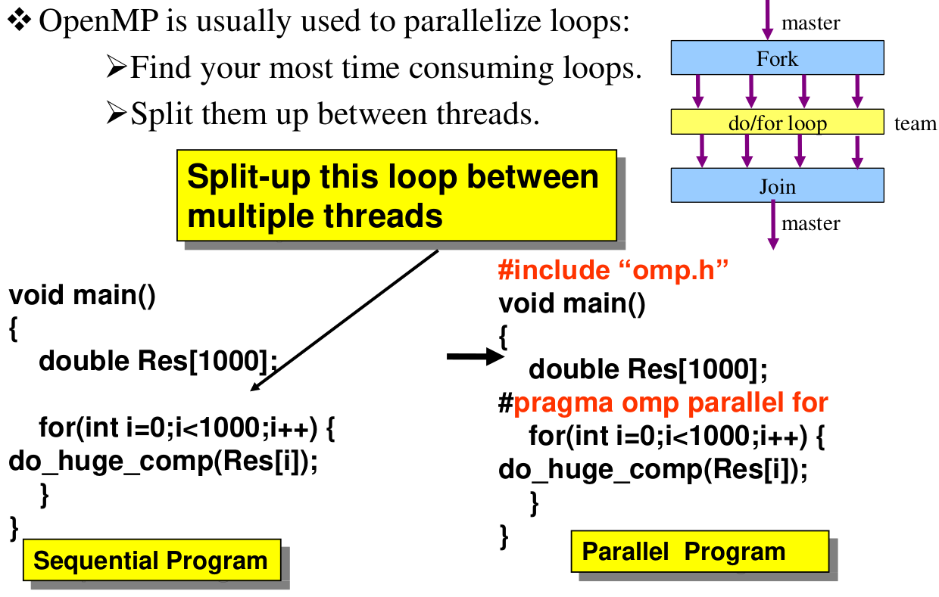
WORK SHARING CONSTRUCT : ‘for’
<CONTENT>
September 22 to 25, 2026, OpenMP Programming, C-HUK-ACC
Image: ‘fork’ construct
C-HUK HPC Advanced Certification Course

Slide 21
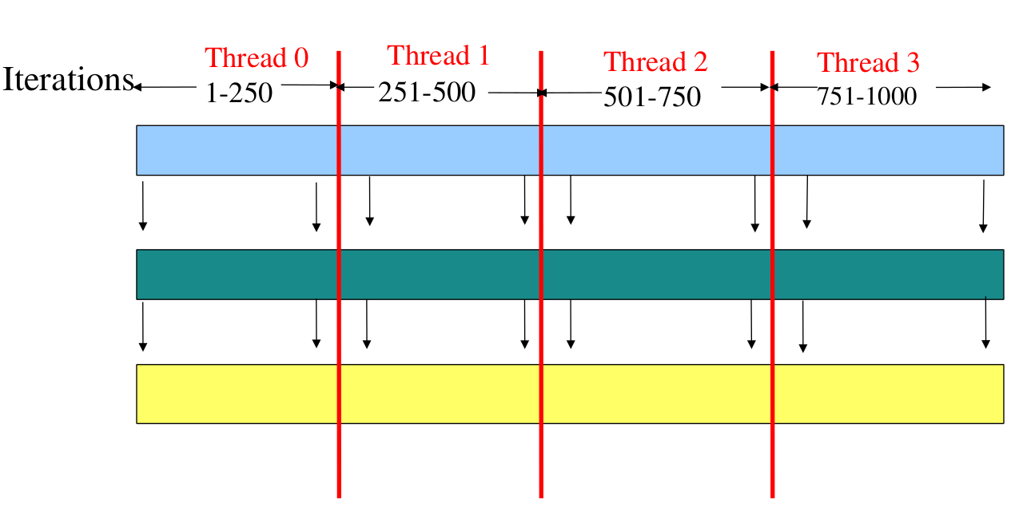
WORK SHARING CONSTRUCT : ‘for’
<CONTENT>
September 22 to 25, 2026, OpenMP Programming, C-HUK-ACC
Image: ‘for’ work sharing
C-HUK HPC Advanced Certification Course

Slide 22
WORK SHARING CONSTRUCT ‘for’
for directive identifies the iterative work-sharing construct.
#pragma omp for [clause[[,]clause]…] new-line
for-loop
September 22 to 25, 2026, OpenMP Programming, C-HUK-ACC
C-HUK HPC Advanced Certification Course

Slide 23
WORK SHARING CONSTRUCT : ‘for’
for (index = start ; index < end ; increment_expr)
it must be possible to determine the number of loop iterations before execution
no while loops
September 22 to 25, 2026, OpenMP Programming, C-HUK-ACC
C-HUK HPC Advanced Certification Course

Slide 24
WORK SHARING CONSTRUCT :
‘for’
3) increment must be the same each iteration
4) all loop iterations must be done
5) It is illegal to branch (goto) out of a loop associated with a for directive
September 22 to 25, 2026, OpenMP Programming, C-HUK-ACC
C-HUK HPC Advanced Certification Course

Slide 25
USE CASE: MATRIX MULTIPLICATION
Input: Given two matrices A (m x n) and B (n x p) to be multiplied.
Output: Compute the matrix product C (m x p) where C = A * B
September 22 to 25, 2026, OpenMP Programming, C-HUK-ACC
C-HUK HPC Advanced Certification Course

Slide 26
USE CASE: MATRIX MULTIPLICATION
Computation:
each loop preceded by OpenMP construct
Outer loop (i): Iterate over the rows of matrix A (m rows).
Middle loop (j): Iterate over the columns of matrix B (p columns).
Inner loop (k): Iterate over the common dimension (n) shared by matrices A and B.
Set C[i][j] = sum of (A[i][k] * B[k][j]) for k = 0 to n-1
September 22 to 25, 2026, OpenMP Programming, C-HUK-ACC
C-HUK HPC Advanced Certification Course

Slide 27
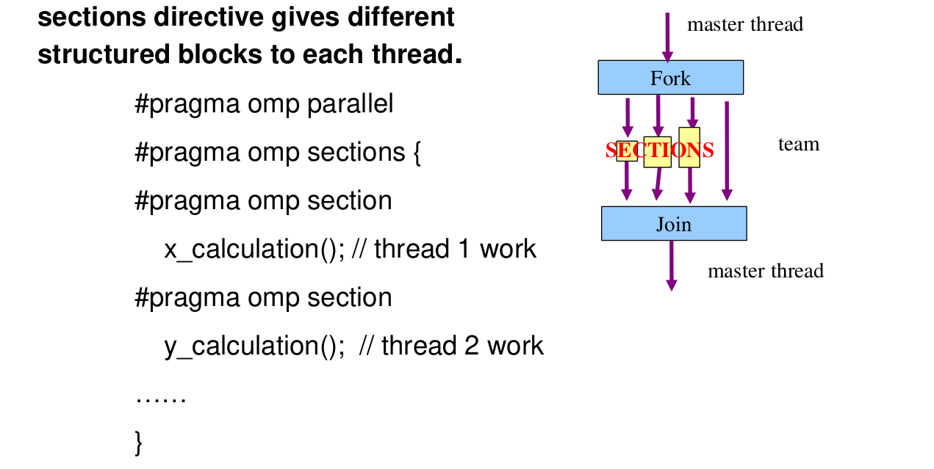
WORK SHARING CONSTRUCT : ‘section’
<CONTENT>
September 22 to 25, 2026, OpenMP Programming, C-HUK-ACC
Image: ‘section’ construct

Slide 28
WORK SHARING CONSTRUCT : ‘section’
Clauses
NOWAIT: implied barrier exists at the end of a SECTIONS directive, unless this clause is used.
Restriction
It is illegal to branch into or out of section blocks.
SECTION directives must occur within the lexical extent of an enclosing SECTIONS directive
September 22 to 25, 2026, OpenMP Programming, C-HUK-ACC

Slide 29
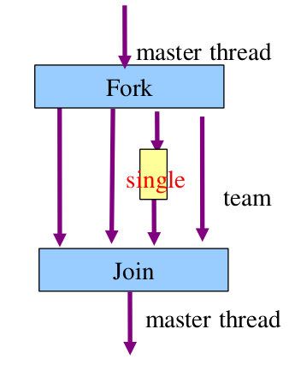
WORK SHARING CONSTRUCT : ‘single’
The associated structured block is to be executed by only one thread.
It can be any thread including master thread.
September 22 to 25, 2026, OpenMP Programming, C-HUK-ACC
Image: ‘single’ scheduling

Slide 30
WORK SHARING CONSTRUCT : ‘single’
May be useful when dealing with sections of code that are not thread safe (such as I/O)
#pragma omp single [clause[[,] clause] ...] new-line
September 22 to 25, 2026, OpenMP Programming, C-HUK-ACC

Slide 31
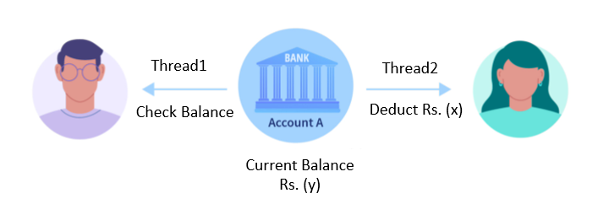
SYNCHRONIZATION CONSTRUCT
Synchronization is the task of ensuring that the multiple threads can safely share the resources .
It is used to avoid the race condition.
September 22 to 25, 2026, OpenMP Programming, C-HUK-ACC
Image: synchronization

Slide 32
SYNCHRONIZATION CONSTRUCT
High level synchronization:
Critical
Atomic
Barrier
September 22 to 25, 2026, OpenMP Programming, C-HUK-ACC

Slide 33
SYNCHRONIZATION CONSTRUCT : ‘critical’
Critical section prevents multiple threads from accessing a section of code at the same time.
Only one active thread can update the code inside critical region.
Syntax:
#pragma omp critical
{ //code_block
}
September 22 to 25, 2026, OpenMP Programming, C-HUK-ACC

Slide 34
SYNCHRONIZATION CONSTRUCT : ‘atomic’
The atomic directive of openmp ensure that the specific memory location is accessed atomically.
It used to prevents the race condition.
It works on single expression statement.
Used with atomic operations such as increment, decrement.
September 22 to 25, 2026, OpenMP Programming, C-HUK-ACC

Slide 35
SYNCHRONIZATION CONSTRUCT : ‘atomic’
Syntax :
#pragma omp atomic
//expression statement;
September 22 to 25, 2026, OpenMP Programming, C-HUK-ACC

Slide 36
SYNCHRONIZATION CONSTRUCT :
‘barrier’
When a BARRIER directive is reached, a thread will wait at that point until all other threads have reached that barrier.
All threads then resume executing in parallel the code that follows the barrier.
Syntax :
#pragma omp barrier
{ //code_block
}
September 22 to 25, 2026, OpenMP Programming, C-HUK-ACC

Slide 37
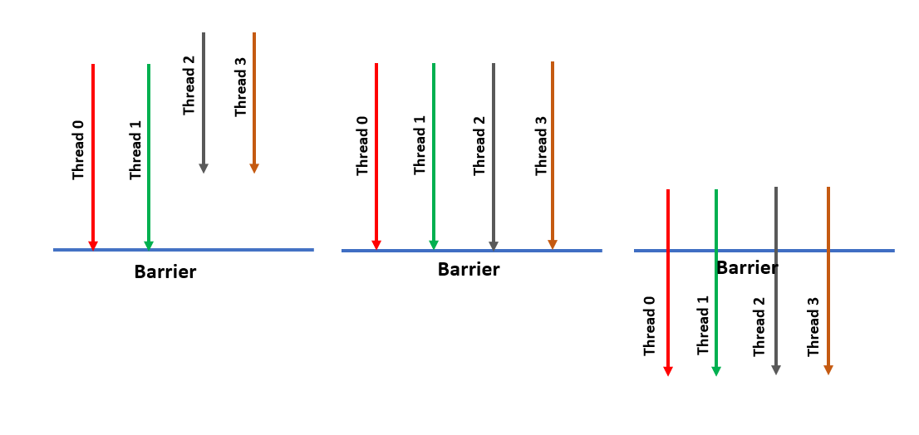
SYNCHRONIZATION CONSTRUCT : ‘barrier’
September 22 to 25, 2026, OpenMP Programming, C-HUK-ACC
Image: ‘barrier’ construct

Slide 38
DATA ENVIRONMENT
The OpenMP Data Scope Attribute Clauses are used to explicitly define how variables should be scoped.
September 22 to 25, 2026, OpenMP Programming, C-HUK-ACC

Slide 39
DATA ENVIRONMENT : ‘shared’
There exists one instance of this variable which is shared among all the threads.
Syntax : shared(list)

Slide 40
DATA ENVIRONMENT : ‘private’
Each thread in a team of threads has its own local copy of the private variable.
Syntax: private(list)
September 22 to 25, 2026, OpenMP Programming, C-HUK-ACC

Slide 41
DATA ENVIRONMENT : ‘firstprivate’
FirstPrivate will copy the variable’s original value in each thread’s private variable.
Syntax: firstprivate(var1 , var2,…)
var1 , var2 have instances in each thread
Used with parallel for , parallel , single directives
September 22 to 25, 2026, OpenMP Programming, C-HUK-ACC

Slide 42
DATA ENVIRONMENT : ‘lastprivate’
Value from the last loop iteration upon exit from the parallel block is assigned to the original variable.
Syntax: lastprivate(var1 , var2,…)
var1 , var2 have instances in each thread
Used with parallel for
September 22 to 25, 2026, OpenMP Programming, C-HUK-ACC

Slide 43
DATA ENVIRONMENT : ‘threadprivate’
It makes the variables allocated to the threads persistent across the parallel regions.
It also retains the computed values.
It preserves the local copy for each thread.
Syntax: threadprivate(var1 , var2,…)
var1 , var2 have instances in each thread and must be global variable.
September 22 to 25, 2026, OpenMP Programming, C-HUK-ACC

Slide 44
DATA ENVIRONMENT : ‘copyin’
It copies the values from the master thread to all other threads.
It only applicable for threadprivate variables.
Syntax: copyin(var1 , var2,…)
var1 , var2 have instances in each thread
Applicable to parallel directive
September 22 to 25, 2026, OpenMP Programming, C-HUK-ACC

Slide 45
DATA ENVIRONMENT : ‘copyprivate’
The copyprivate clause can be used to broadcast values acquired by a single thread directly to all instances of the private variables in the other threads.
Associated with the SINGLE directive.
Syntax: copyprivate(var1 , var2,…)
var1 , var2 have instances in each thread.
September 22 to 25, 2026, OpenMP Programming, C-HUK-ACC

Slide 46
DATA ENVIRONMENT : ‘reduction’
Reduction is the accumulation of partial results from each threads into a single final result.
A private copy for each list variable is created for each thread.
Syntax: reduction (operator: list)
September 22 to 25, 2026, OpenMP Programming, C-HUK-ACC

Slide 47
DATA ENVIRONMENT : ‘reduction’
Symbol | Meaning
+ | Summation
- | Subtraction
* | Product
& | Bitwise AND
| | Bitwise OR
^ | Shift
&& | Logical AND
|| | Logical OR
September 22 to 25, 2026, OpenMP Programming, C-HUK-ACC

Slide 48
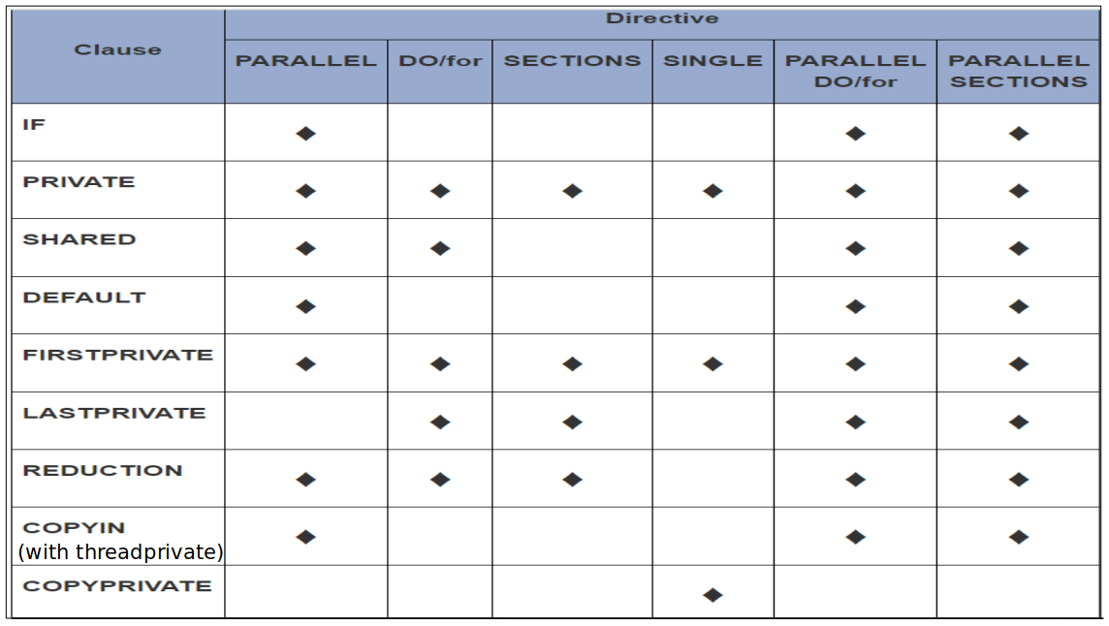
DATA ENVIRONMENT : ‘reduction’
September 22 to 25, 2026, OpenMP Programming, C-HUK-ACC

Slide 49
CONCLUSION
Parallelization using OpenMP is explained.
Various OpenMP Constructs are discussed with examples.
September 22 to 25, 2026, OpenMP Programming, C-HUK-ACC
C-HUK HPC Advanced Certification Course

Slide 50
REFERENCES
[1]. Parallel Programming in C using OpenMp and MPI- Micheal J Quinn
[2]. HyPack workshop, C-DAC - http://www.cdac.in/index.aspx?id=ev_hpc_hypack13_m1_mcore_openmp
[3].Lawrence Livermore National laboratory – Training Material https://computing.llnl.gov/?set=training&page=index#training_materials
[4]. OpenMP by Tim Mattson, http://openmp.org/mp-documents/Intro_To_OpenMP_Mattson.pdf
[5]. http://openmp.org/mp-documents/omp-hands-on-SC08.pdf
[6]. OpenMp by Example - http://people.math.umass.edu/~johnston/PHI_WG_2014/OpenMPSlides_tamu_sc.pdf
[7]. OpenMP Application Program Interface -http://www.openmp.org/mp-documents/OpenMP3.1.pdf
[8]. OpenMP Application Program Interface - http://www.openmp.org/mp-documents/OpenMP4.0.0.pdf
[9]. https://www.nersc.gov/assets/Uploads/XE62011OpenMP.pdf
[10]. www.clear.rice.edu/comp422/lecture-notes/comp422-2015-Lecture7-OpenMP.pdf
September 22 to 25, 2026, OpenMP Programming, C-HUK-ACC
C-HUK HPC Advanced Certification Course

Slide 51
THANK YOU
ANY QUESTION?
September 22 to 25, 2026, OpenMP Programming, C-HUK-ACC
C-HUK HPC Advanced Certification Course

