Slide 1
FOOD DELIVERY
ORDER MANAGEMENT SYSTEM
🍔
🍕
🍜
Data Structures PBL
Array • Linked List • Queue • Stack
One customer → One Order ID → Multiple Items → One complete order
1

Slide 2
Problem & Objective
The Problem
✓
The Objective
A simple digital model for handling food delivery orders.
!
• Orders contain multiple food items.
• Pending orders need FIFO processing.
• Delivered orders need history.
• Customers may cancel or edit a pending order.
• Manual handling makes order tracking messy.
• Store the menu using an array.
• Keep one complete customer order in one node.
• Use a queue for pending orders.
• Use a stack for order history.
• Keep the program simple and easy to demonstrate.
2

Slide 3
Data Structures Used
Each structure has one clear job.
A
Array
L
Linked List
Q
Queue
S
Stack
Food menu
ID
Name
Price
Fast menu lookup
Stores complete orders
Order ID
Customer
Items
Total
Next
Pending orders
FIFO
First order placed
→ first order processed
Order history
LIFO
Latest processed
→ appears first
Array → Linked List → Queue → Stack
Menu → Order → Pending → History
3

Slide 4
System Workflow
From menu selection to delivery and history.
1.ADD MENU
Array
EDIT ORDER
2.PLACE ORDER
Select items +Quantity
3.PENDING ORDERS
Queue .FIFO
CANCEL ORDER
4.PROCESS ORDER
Complete order
5.ORDER HISTORY
Stack.LIFO
4

Slide 5

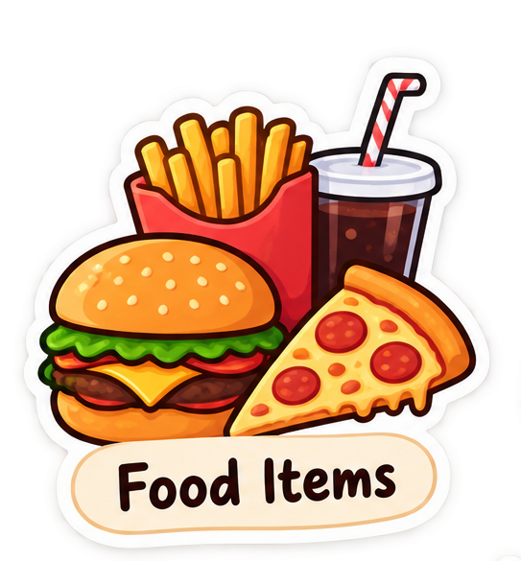
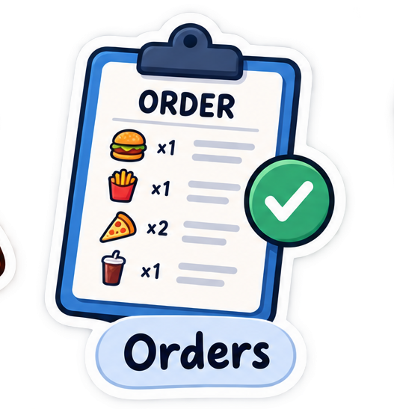
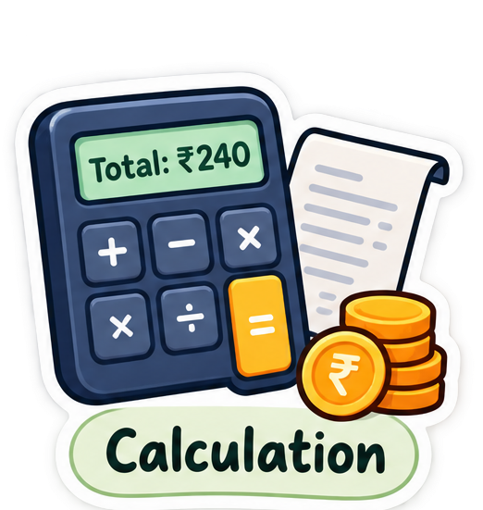
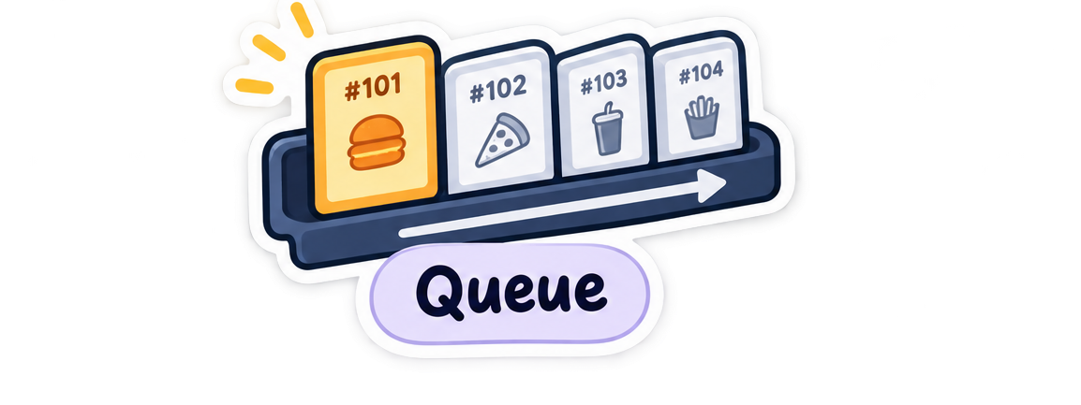
How One Order Works
Multiple items stay inside one customer order.
1
Customer
2
Items
3
Order
4
Total
5
Queue
Enter name
Choose how many
Add food + quantity
Calculate amount
Store pending order
Example: Sam → Order 101 → Burger ×2 + Pizza ×1 + Momos ×2 → Total
5

Slide 6
Core Features
Seven simple operations for the PBL demo.
01
View Menu
02
Place Order
Show food ID, name and price.
Choose number of items and quantities.
03
Pending Orders
04
Process Order
Show only ID, customer and total.
Remove from queue and push to history.
05
Order History
06
Cancel Order
Show all items, quantities, prices and total.
Remove a selected pending order.
07
Edit Order
Modify items/quantities and recalculate total.
6

Slide 7
Expected Result
A smart and simple food delivery order management system.
MENU
Array
ORDER
Linked List
PENDING
Queue
HISTORY
Stack
Key Idea
A Complete Order Travels Through the System as One Unit.
7

Slide 8
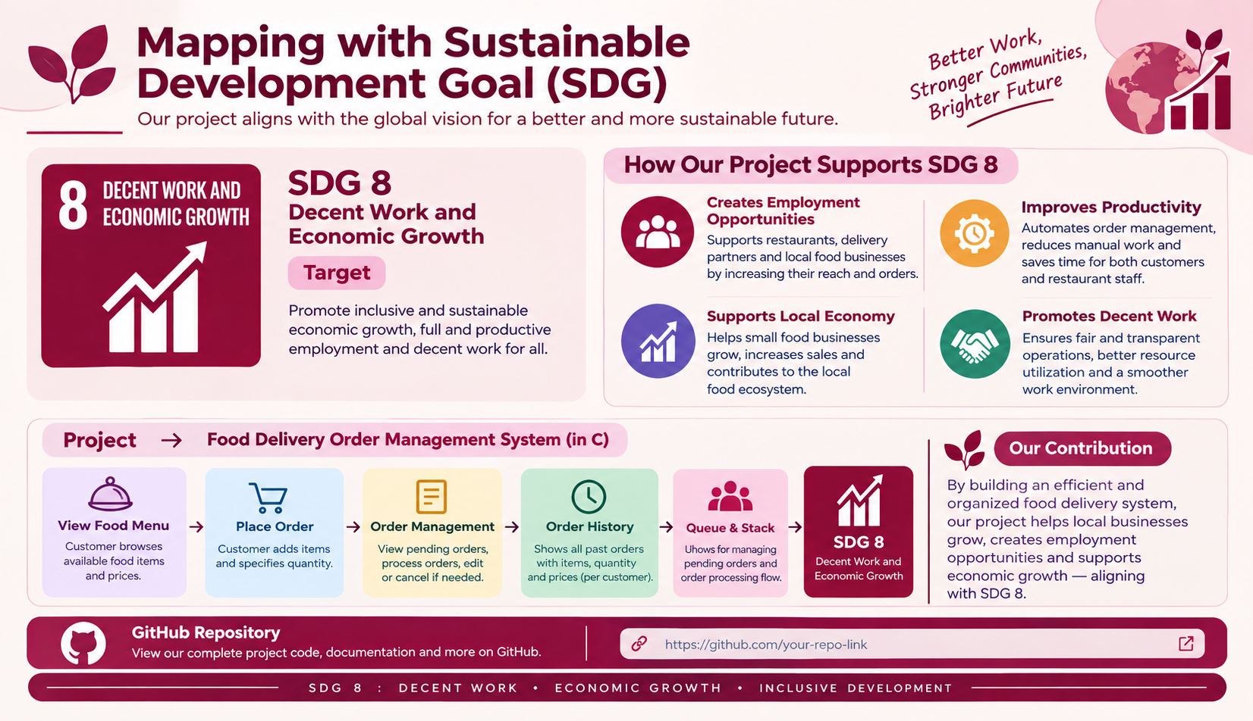
https://github.com/amitkrofficial2005-ac/Food-delivery-order-management-system

