Slide 1
Ratings Prediction
Classification

Slide 2
Problem Statement
Build an application which can predict the rating by seeing the review.

Slide 3
Requirements
Analyse the text in the data
Provide insights for every class
Predict the star rating of each review.

Slide 4
Preprocessing and cleaning
Symbols and whitespaces were cleaned
Irrelevant columns dropped.
Sliced rating strings to just the first character.

Slide 5
Visualizations
Countplots used to check occurrence of each class and sentiments
Wordclouds are used to get an idea of loud words

Slide 6
Data Pre-processing
The reviews were cleaned of the newlines first.
The unnecessary whitespaces and symbols were cleaned post that
The ratings were sliced to show only first character.
Stop words cleaning cannot be employed here as words like not, don’t will be removed which will be an important part of negative reviews

Slide 7
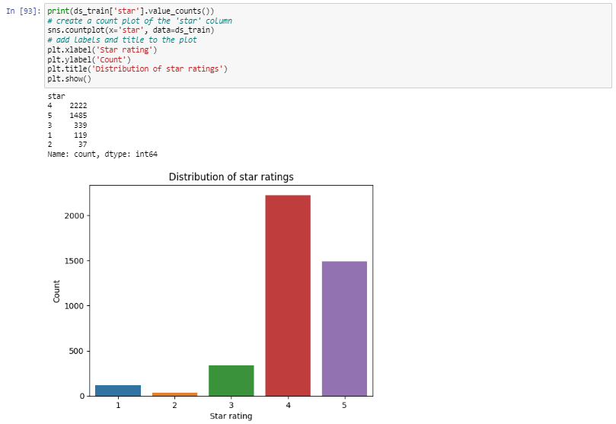
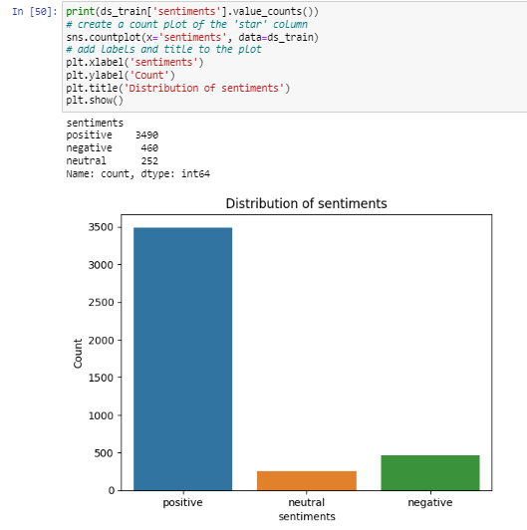
Counts of star column
Counts of each sentiments

Slide 8
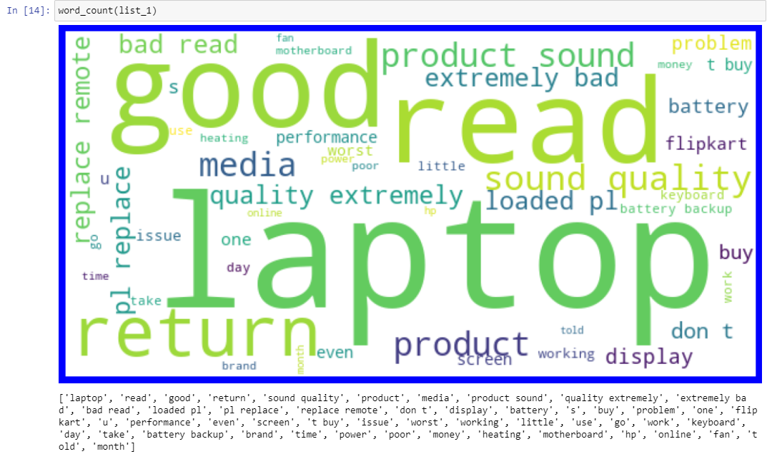
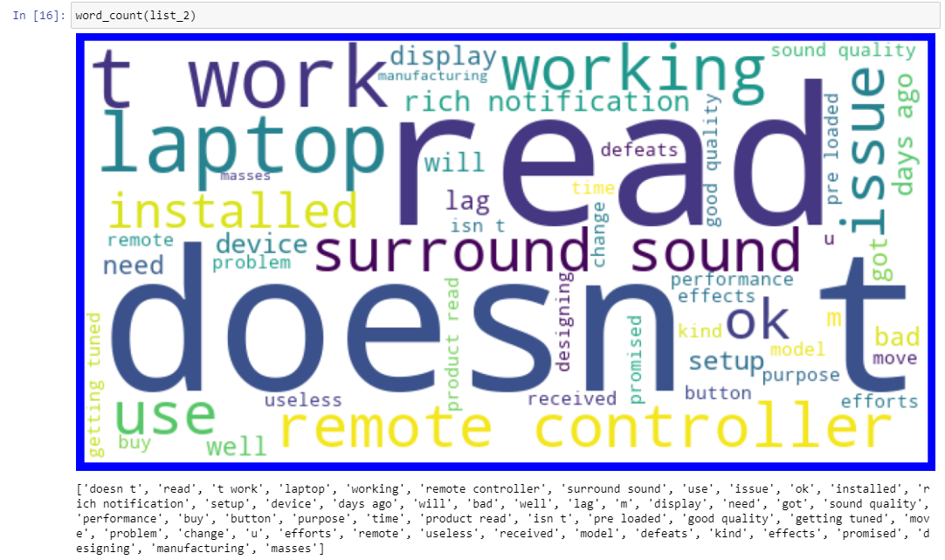
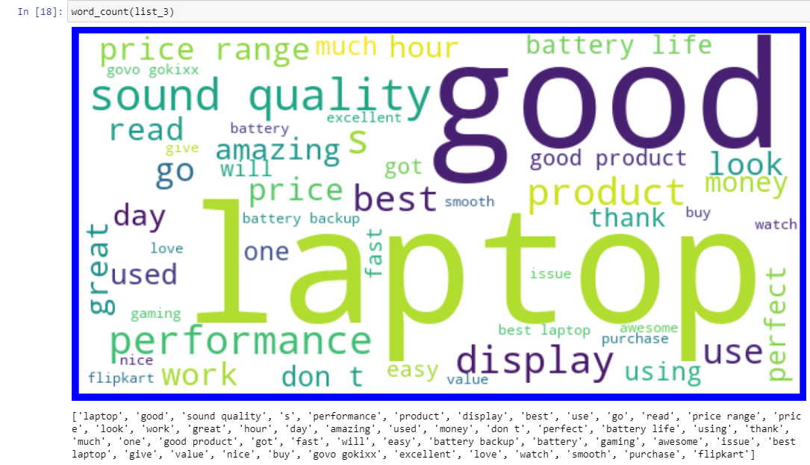
Loud words of rating 1
Loud words of rating 2
Loud words of rating 3

Slide 9
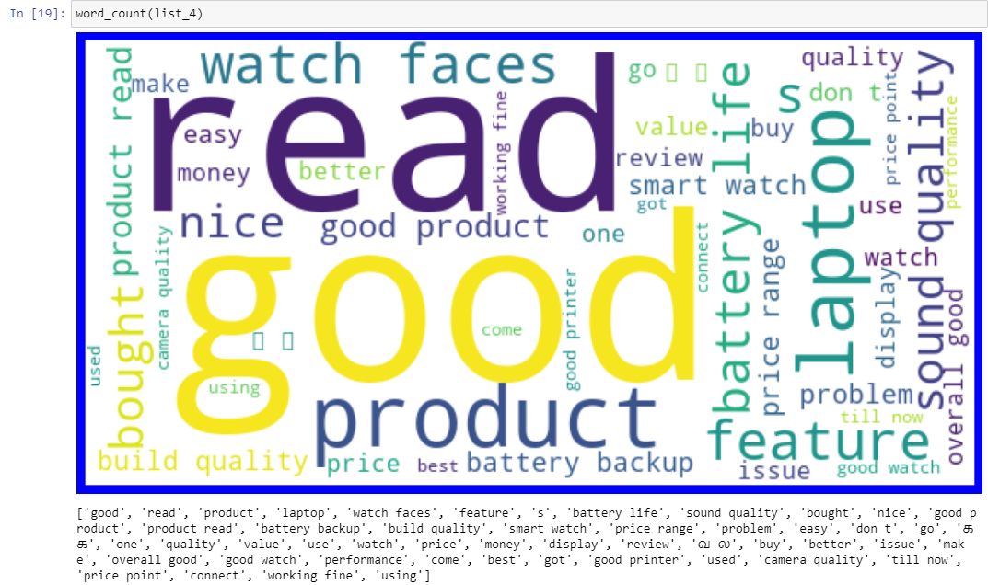
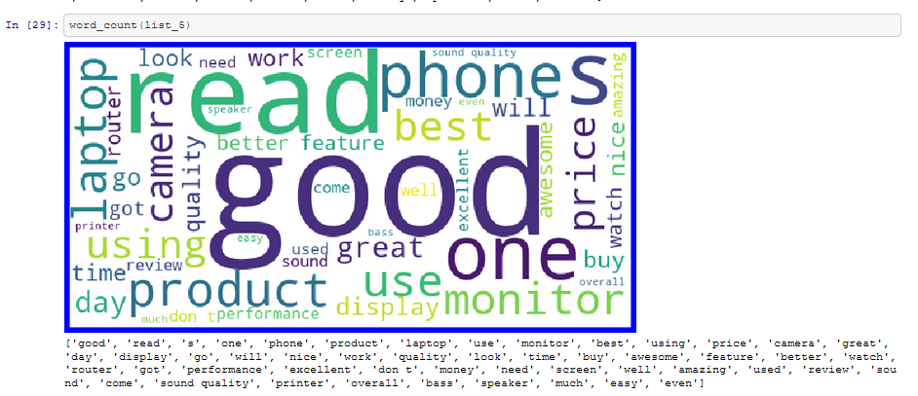
Loud words of rating 4
Loud words of rating 5

Slide 10
Algorithms tested
Decision tree classifier
Random forest classifier
Switched vector classifier
A DL model with with ReLU for input layer and softmax for next layers

Slide 11
Results
 | Accuracy | Precision | Recall | F1-score
DTC | 0.8886774500475737 | 1: 0.72 2: 0.67 3: 0.95 4: 0.91 5: 0.86 | 1: 0.78 2: 0.36 3: 0.91 4: 0.92 5: 0.86 | 1: 0.75 2: 0.47 3: 0.93 4: 0.91 5: 0.86
RFC | 0.9067554709800191 | 1: 0.94 2: 1.00 3: 1.00 4: 0.98 5: 0.80 | 1: 0.63 2: 0.36 3: 0.91 4: 0.89 5: 0.97 | 1: 0.76 2: 0.53 3: 0.95 4: 0.93 5: 0.88
SVC | 0.9067554709800191 | 1: 0.83 2: 1.00 3: 0.99 4: 0.98 5: 0.81 | 1: 0.56 2: 0.36 3: 0.90 4: 0.90 5: 0.97 | 1: 0.67 2: 0.53 3: 0.94 4: 0.94 5: 0.88

Slide 12
observations from scores
RFC performs best on the reviews data
SVC and RFC have better abilities to predict less abundant values.
considering higher accuracy and minor differences in prediction capabilities RFC can be finalized.
hyper parameter tuning does not result into good results considering text data

Slide 13
conclusion
Sentiment analysis proves to be a better approach when dealing with multiple classes in text
Comparison of predicted and actual results help greatly to get an idea of model performance
Visualization of the frequently occurring words in text data greatly helps to get an idea of how a particular class might look and helps the model to better recognize the provided data.
Data cleaning helps reduce the processing time in case of text data.
Visualization of results must be done to get an idea of model performance.

