Slide 1
Health Management System
Team Name: WatsonX Warriors
Team Members:
amitkumar_ghatwal@persistent.com , valen_mascarenhas@persistent.com , anup_kodlekere@persistent.com , pawan_kalligudda@persistent.com siddesh_sangodkar@persistent.co.in
bharat_tatti@persistent.com
WatsonX Challenge
05th December 2023

Slide 2


Problem Statement:
“ Streamlining Healthcare Communication: A User-Friendly Solution for Simplifying Medical Reports and Call Transcripts.”
Difficulty in understanding medical reports.
Transcript decoding between doctor and patient
Categorizing disease
“
2
Confidential © 2023 Persistent Systems

Slide 3
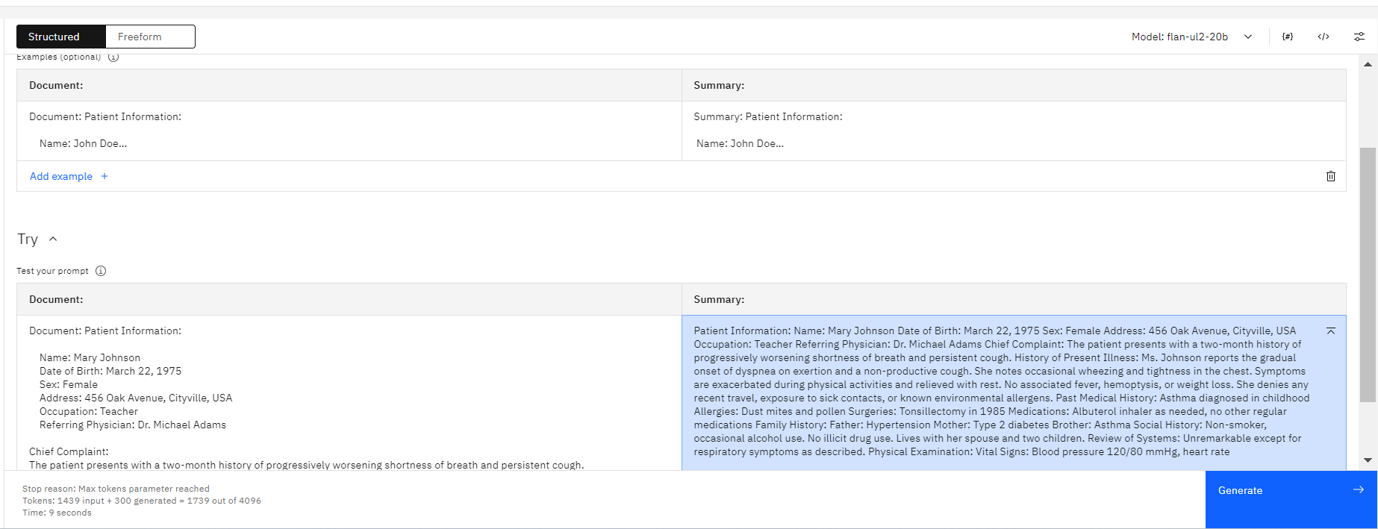
Our solution using watsonX.ai:
“ Difficulty in understanding medical reports."
“
3
Confidential © 2023 Persistent Systems

Slide 4
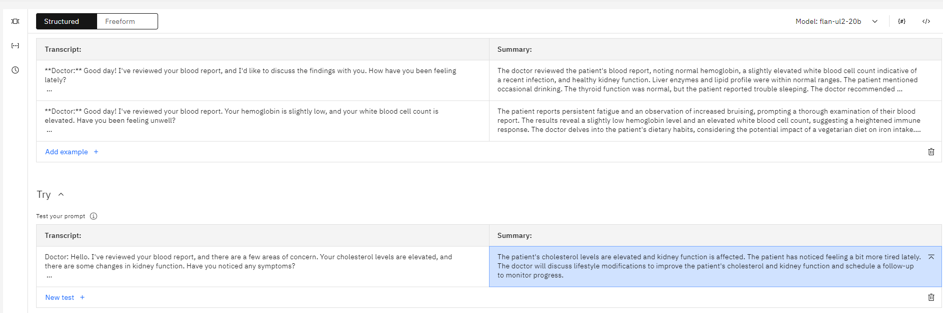
Our solution using watsonX.ai :
“ Transcript decoding between doctor and patient"
“
4
Confidential © 2023 Persistent Systems

Slide 5
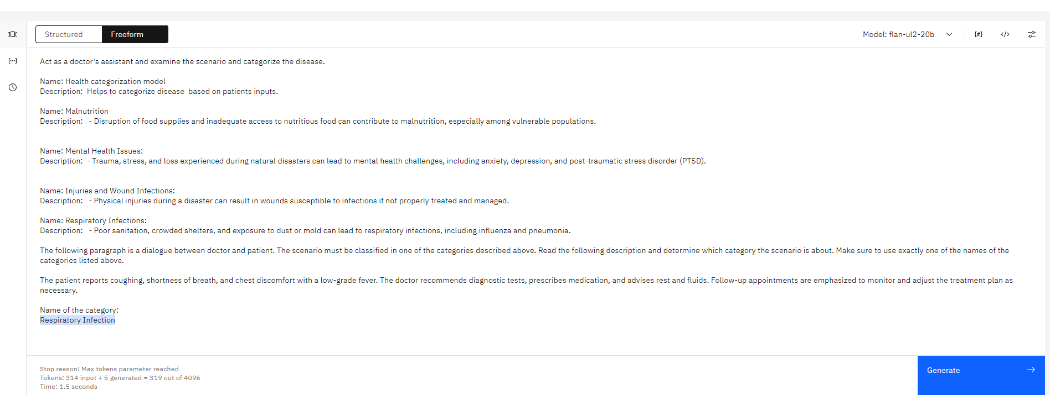
Our solution using watsonX.ai :
“ Categorizing Disease"
“
5
Confidential © 2023 Persistent Systems

Slide 6


Architecture
database
API s
Health Manage Service
Prompts
Output
Transcripts
Reports
WatsonX APIs
Classification
Fact Extraction
Text Analysis

Slide 7



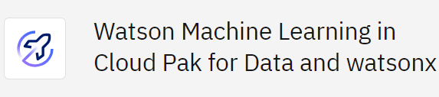
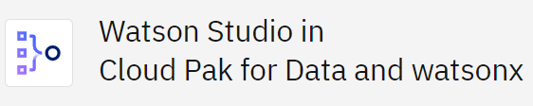


Technology Stack
Cloud Resources
Web/ UI
Services
Cloud

Slide 8
Future scope
Adding more complex/terminal diseases
Adding image processing models for identifying disease.
Improve medical logistics and distribution.
Notes:
. E.g. youtube channel.

Slide 9
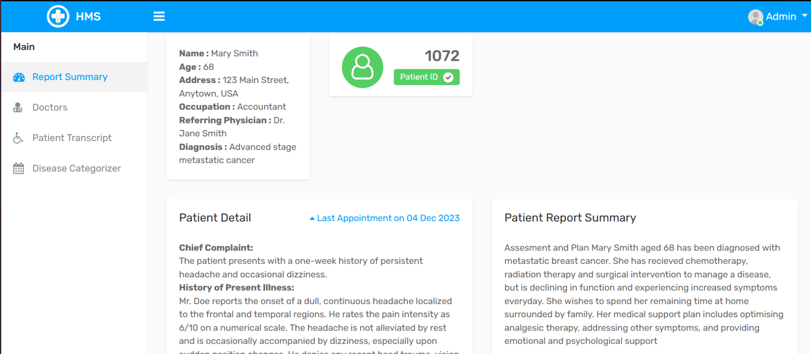
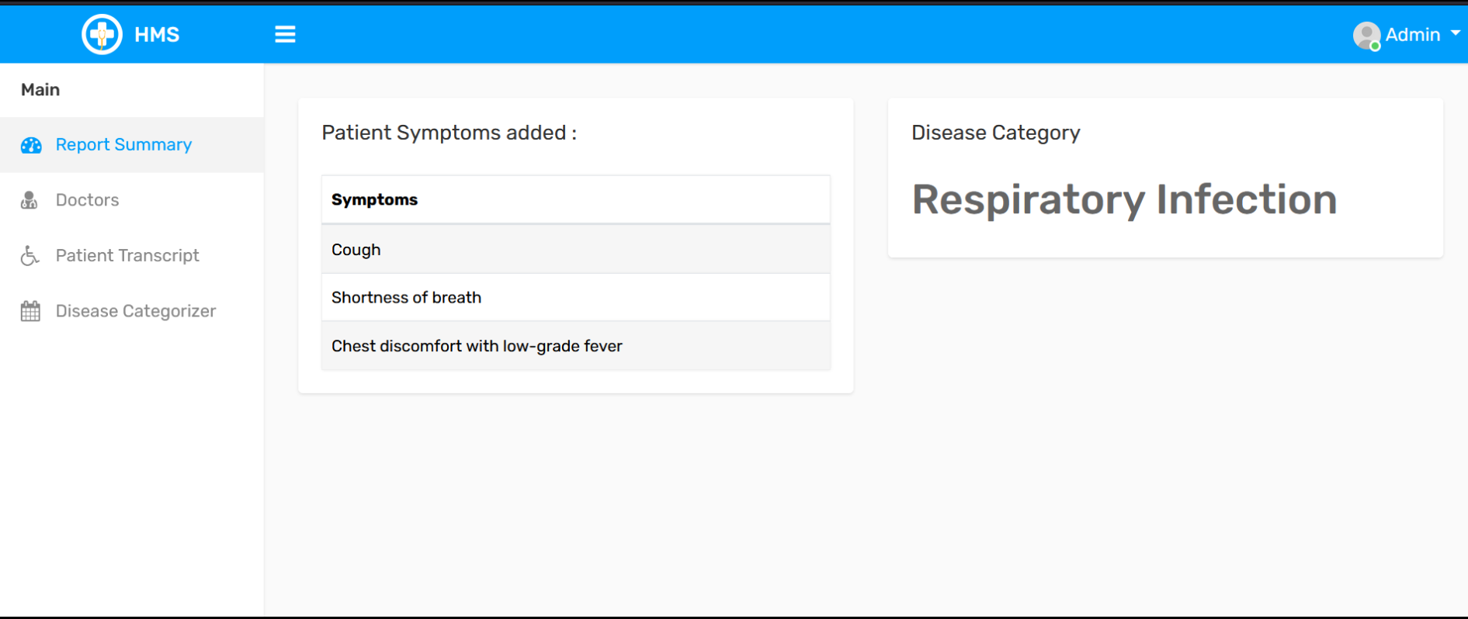
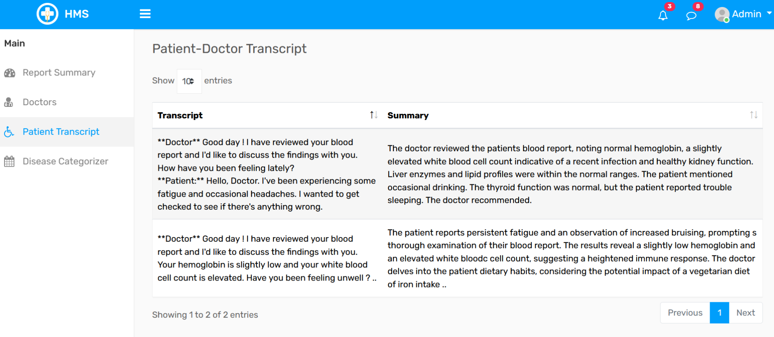
Screenshots of HMS app Source code -https://github.com/amitkumar-ghatwal/watsonX-warriors/blob/main/HMS-Demo.zip
Notes:
. E.g. youtube channel.

Slide 10
Thank you
WatsonX Warriors

