Slide 1
Zurich-Cloud-Hackathon 2023
Barcelona, Spain

Slide 2
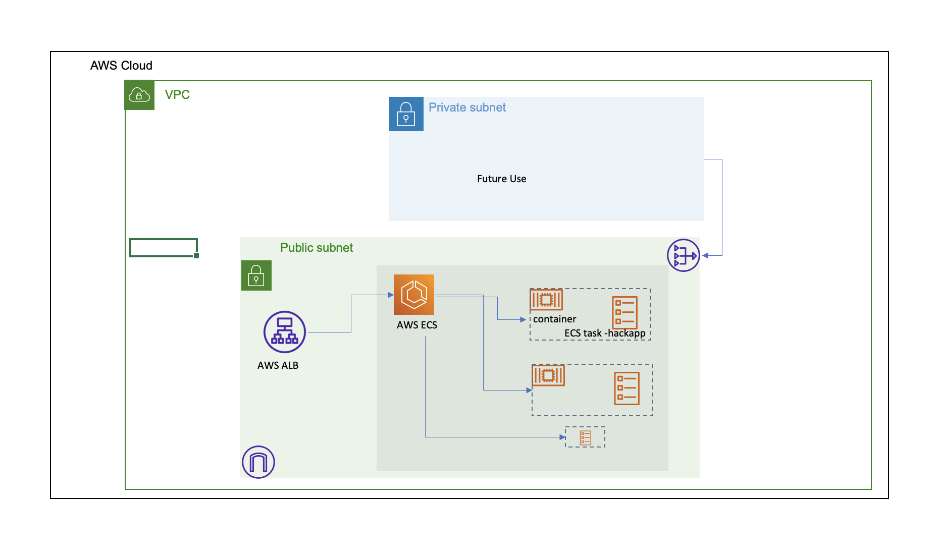
Diagram

Slide 3
FAQ

Slide 4
What service you choose the deploying the containerized application
We choose to go with ECS service as in FARGET mode. As it is the best alternative to Kubernetes and can scale based on the request(Precisely based on Memory and CPU consumption.). We also have put a threshold of memory 80% and CPU 60% to add more no of task to serve the request while on the initial go, we are going with minimum 2 containers. It works the same way like Kubernetes HPA(Horizontal Pod Scaler) works.
What if the sudden raise of traffic, Will this able to handle the request in that case?
Well, Definitely Yes, This one is tried and tested and we are using in our current organisation as we are moving out from Kubernetes(EKS). We haven't seen any issue.
Is there any another way we can build this scalable infrastructure?
Yes, There are couple of ways we can design this infrastructure, we can go with Elastic Beanstalk service which actually abstract all the settings like ASG, LB rather than going with tradition approach.
We can also go with Lambda with reserved concurrency if our code is static and doesn't need a start-up time like Java Spring boot and connecting to RDS services. For the current case, I believe the Lambda is perfect fit.

Slide 5
How does it optimizes cost?
When you are using ECS in Farget mode, this is little expensive considering regular mode, However the cost is justified if the service is critical and customer facing. I have selected FARGET considering that its an critical application and we cant afford the downtime of the application.
Did you used local stack to deploy the services?
I have executed this terraform code on actual aws environment. Also i need to check weather the same resources are available on local stack or not accordingly we can modify the provider configuration to use localstack.
Is your application is running?
I have build the docker images and docker file doesn't container the container port. Im not sure what is the container port. The wrong container port causing the task to restart in loop like happens in kubernates.

Slide 6
Thanks You

