Slide 1

Wikidata
Open Structured Data by Wikimedia for Everyone
Amit Kumar Jaiswal
@AMIT_GKP
WikiTolearn India Conference’17

Slide 2
Who of you has edited Wikipedia before?

Slide 3
Was it easy?

Slide 4
Imagine a world in which every single human being can freely share in the sum of all knowledge.

Slide 5


Slide 6

articles: 23 000 000+
edits: 1 400 000 000+
languages: 286

Slide 7

images: 14 300 000+
videos: 18 000+
audio: 165 000+

Slide 8
But...

Slide 9
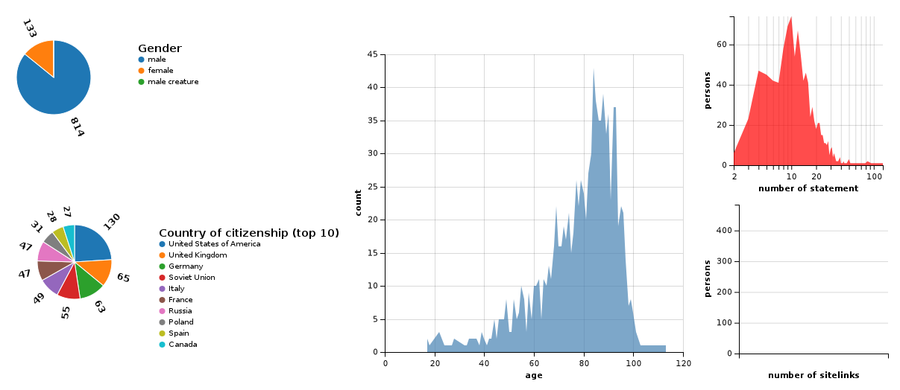
People who died recently by place of death(Country)

Slide 10
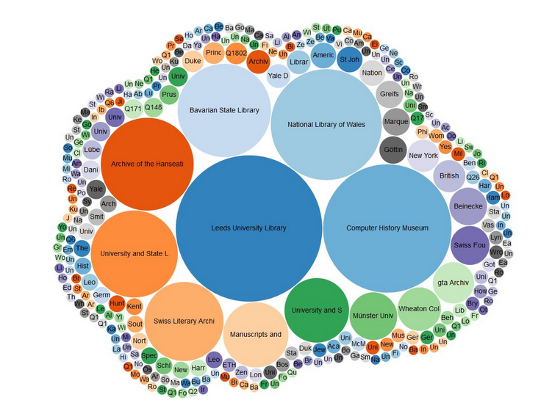
ORAL HISTORY AT THE COMPUTER HISTORY MUSEUM

Slide 11
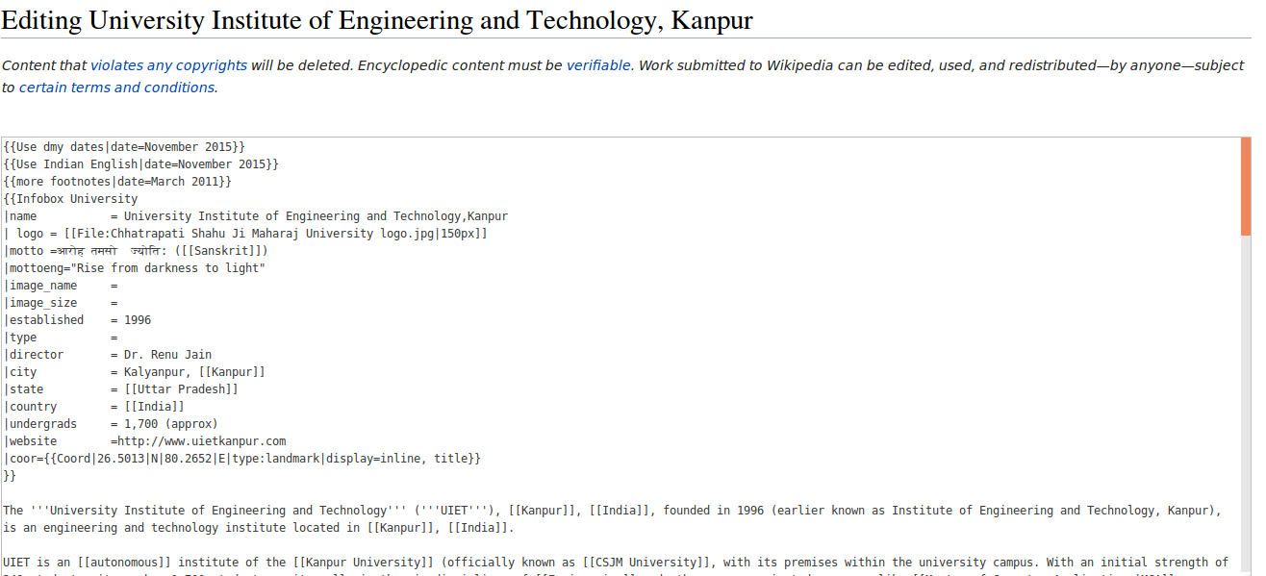
editor recruiting and retention

Slide 12
coverage and reach

Slide 13
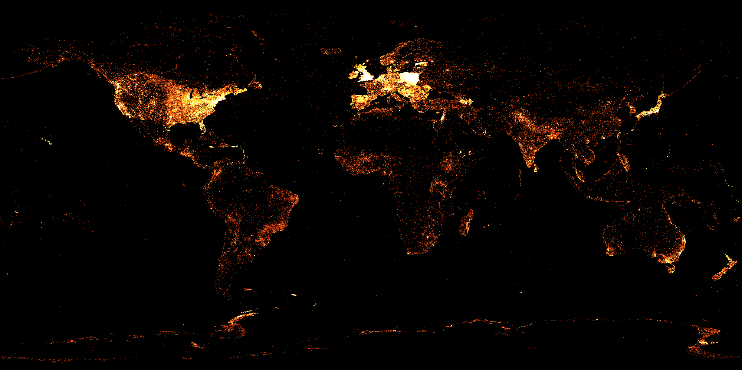
English
Notes:
geo-tagged articles

Slide 14
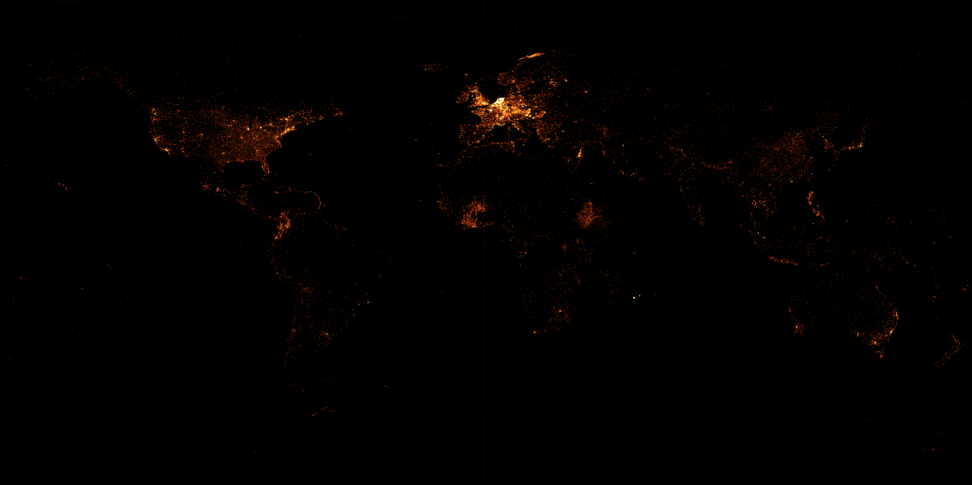
French

Slide 15
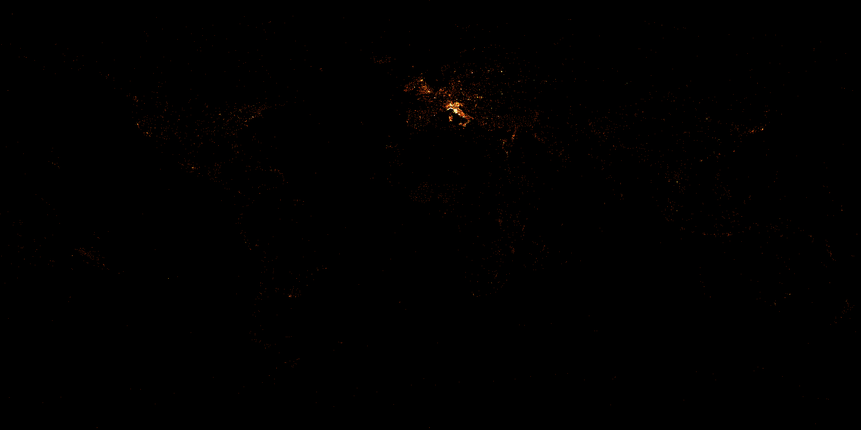
Italian

Slide 16

Greek

Slide 17

Turkish

Slide 18
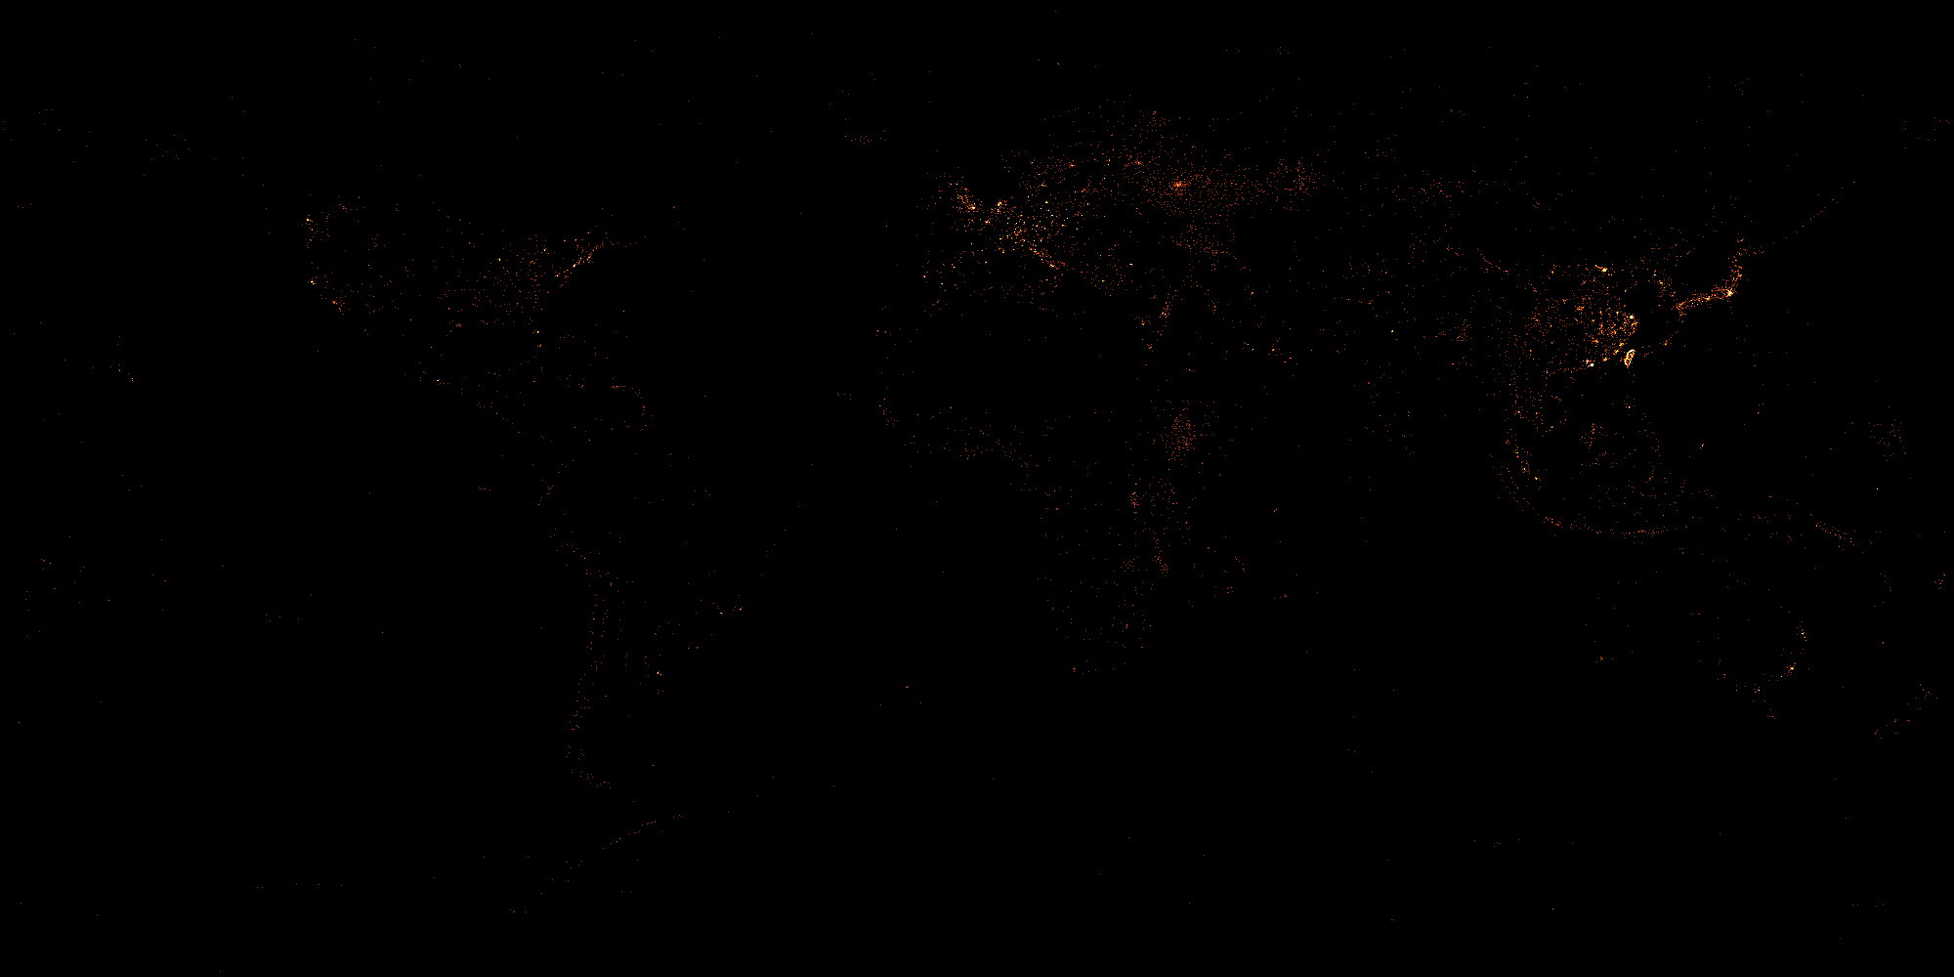
Chinese

Slide 19
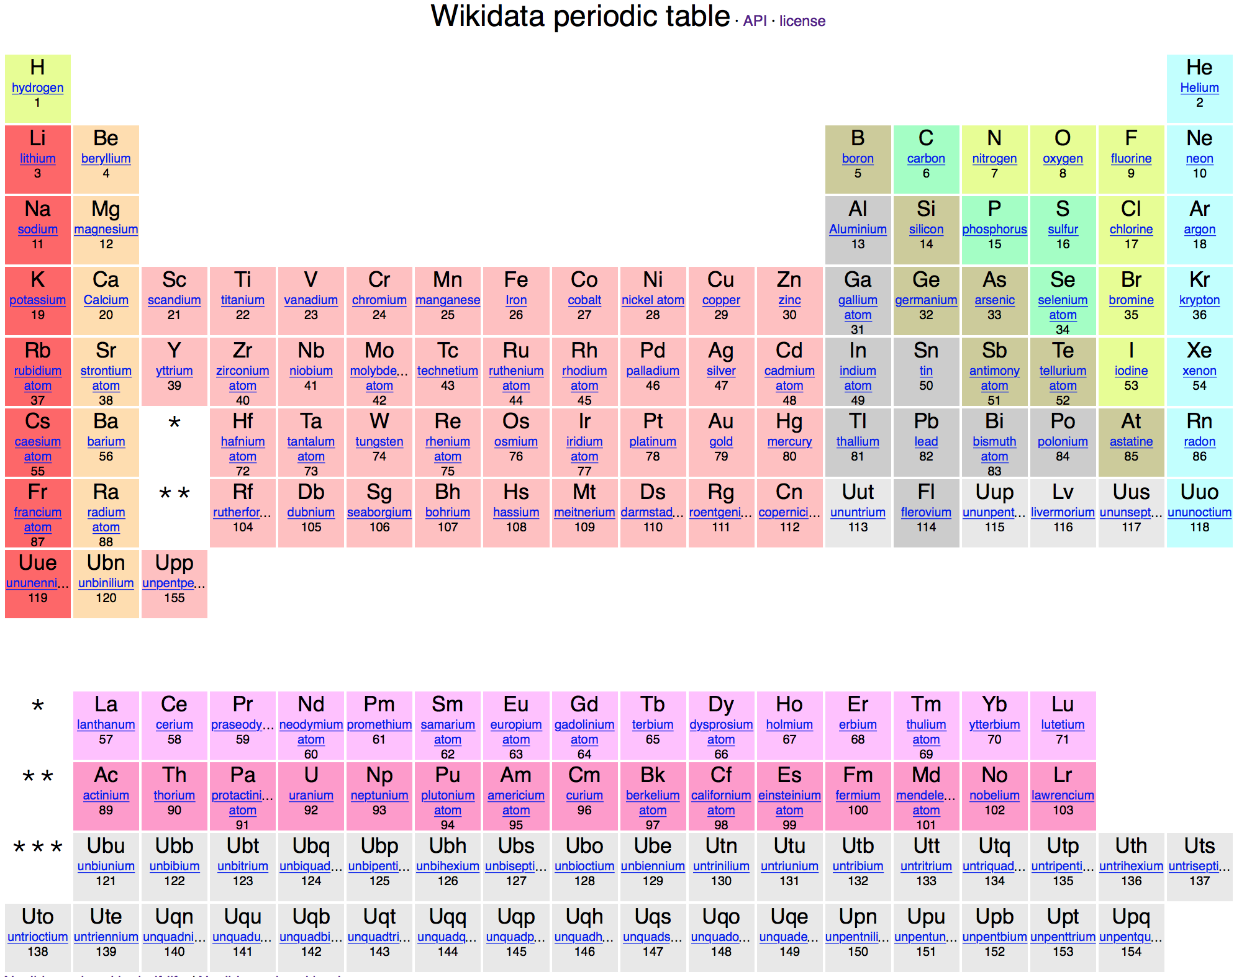
Notes:
Each element has a wikidata item identifier - a PID!

Slide 20

Wikidata to the elusion!

Slide 21


Slide 23
But what is Wikidata actually?
repository of the world's knowledge
database anyone can read and edit
multi-lingual
Free Software
But let me show you!

Slide 24
Demo wikidata.org

Slide 25
How is Wikidata helping?
allow a lot of easy micro-contributions
support smaller languages
allow easy data entry and editing
automate some stuff currently done by hand

Slide 26
What does this mean for the world outside Wikimedia?
large multi-lingual knowledge base with references
huge amount of data under an open license
for free!
accessible via an API
edited and maintained by a large community
you can run your own instance

Slide 27
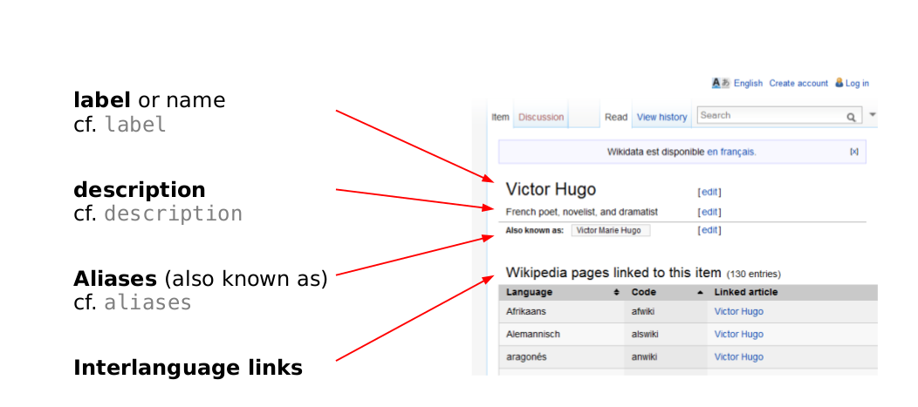
Wikidata Data Model

Slide 28
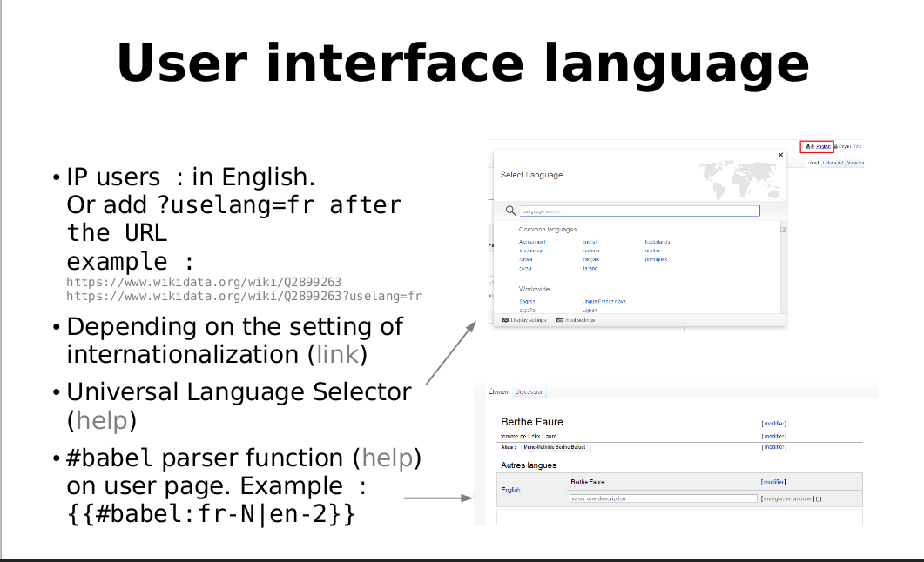

Slide 29
Demo geocoordinates

Slide 30
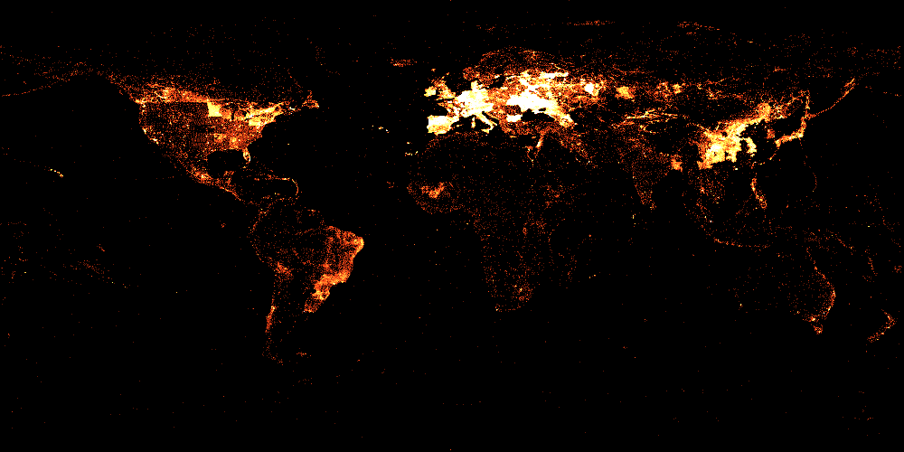

Slide 31
wikidata.org
@wikidata
#wikimedia-wikidata
wikidata-l@lists.wikimedia.org
amitkumarj441@gmail.com

Slide 32
Appendix: Pages used for demo
http://www.wikidata.org/wiki/Q1867
http://www.wikidata.org/wiki/Q83101
http://www.wikidata.org/wiki/Q159
https://commons.wikimedia.org/wiki/User:Denny/Wikidata_growth
http://simia.net/treeoflife/
toolserver.org/~magnus/ts2/php/wd_query.php
toolserver.org/~magnus/ts2/geneawiki/
http://fissl.indus.uberspace.de/#1867
tools.wmflabs.org/reasonator/?q=Q42
http://toolserver.org/~magnus/thetalkpage/

